Slide 1
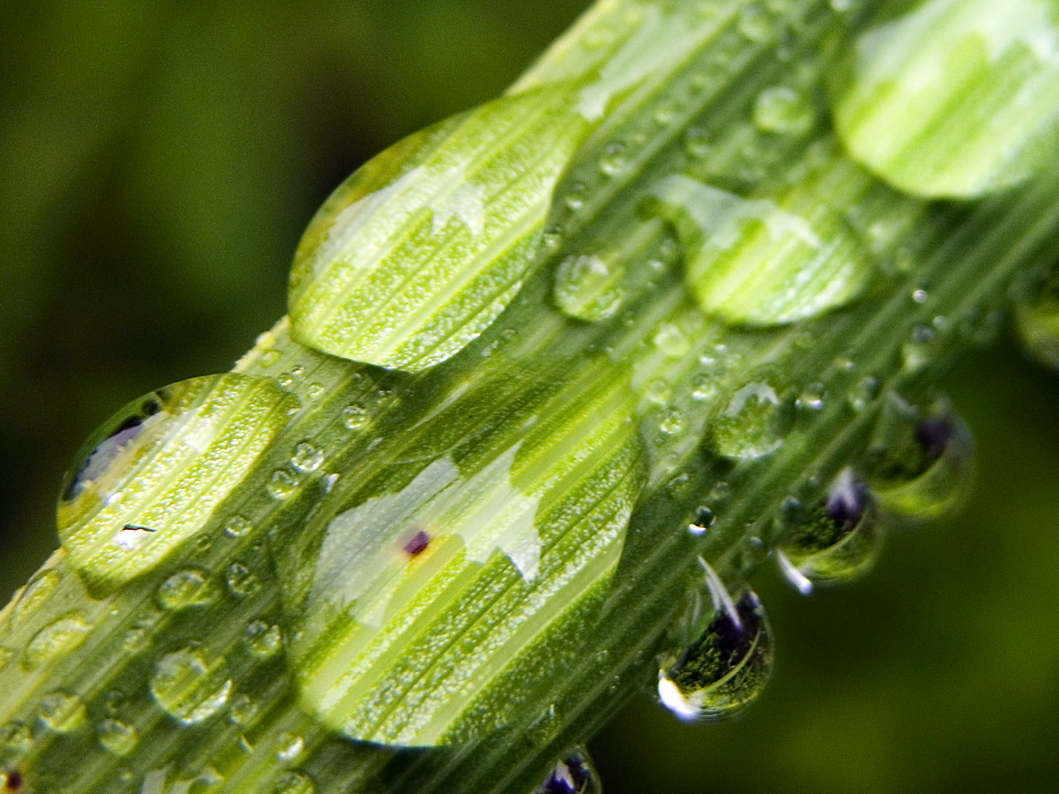
Plant Anatomy
(Ch. 35)

Slide 2
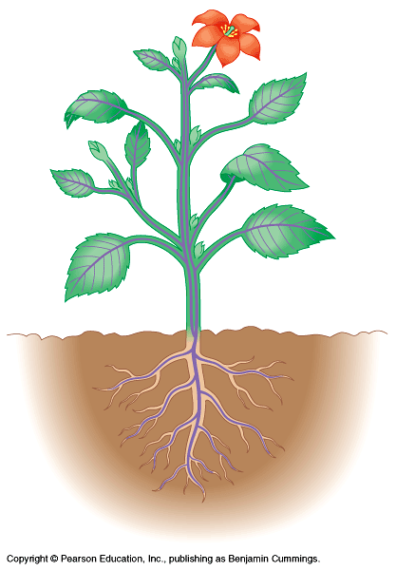
Basic plant anatomy 1
root
root tip
root hairs

Slide 3
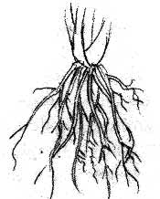
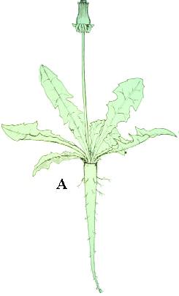
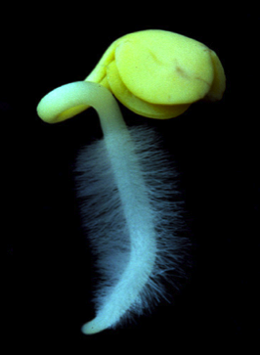
Roots
1
Roots anchor plant in soil, absorb minerals & water, & store food
fibrous roots (1)
mat of thin roots that spread out
monocots
tap roots (2)
1 large vertical root
also produces many small lateral, or branch roots
dicots
root hairs (3)
increase absorptive surface area
2
3

Slide 4
Basic plant anatomy 2
root
root tip
root hairs
shoot (stem)
nodes
internodes
buds
terminal or apical buds
axillary buds
flower buds & flowers

Slide 5
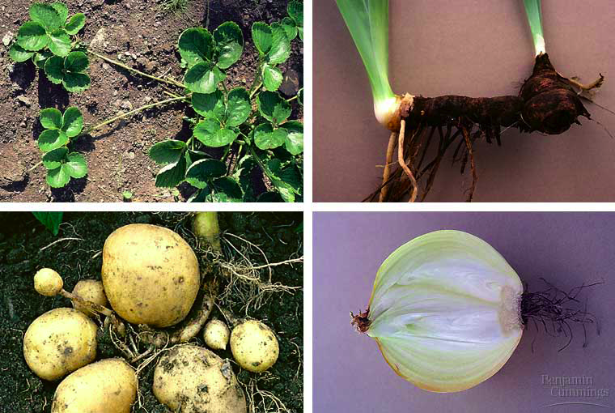
Modified shoots
stolons (strawberries)
rhizome (ginger)
tuber (potato)
bulb (onion)

Slide 6
Basic plant anatomy 3
root
root tip
root hairs
shoot (stem)
nodes
internodes
buds
terminal or apical buds
axillary buds
flower buds & flowers
leaves
mesophyll tissue
veins (vascular bundles)

Slide 7
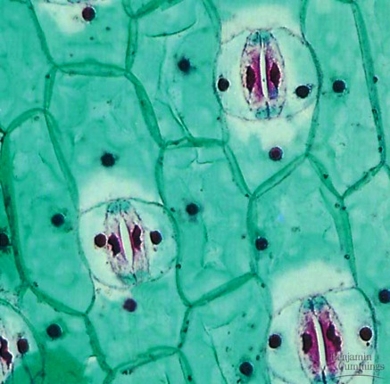
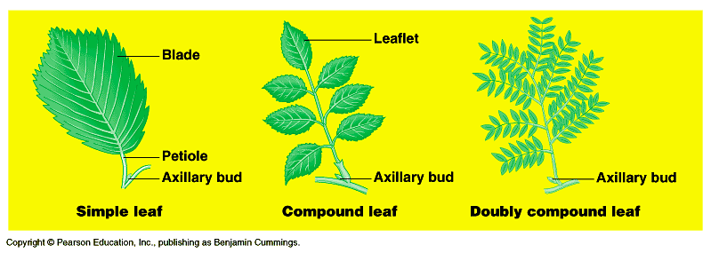
Leaves
Function of leaves
photosynthesis
energy production
CHO production
gas exchange
transpiration
simple vs. compound

Slide 8
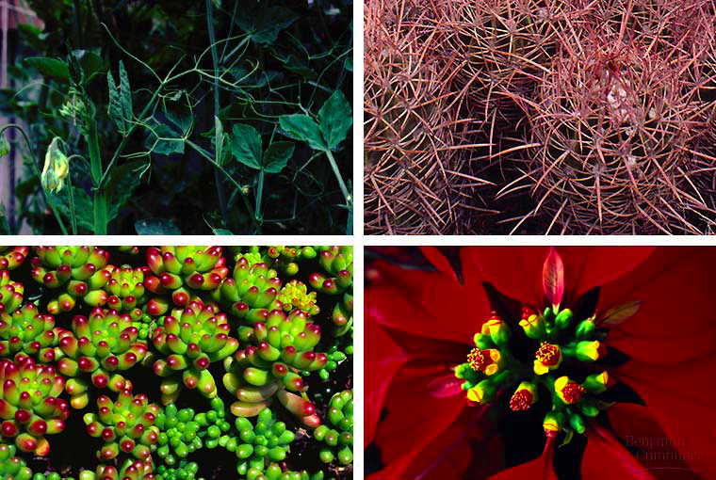
Modified leaves
tendrils (peas)
spines (cacti)
succulent leaves
colored leaves (poinsetta)

Slide 9
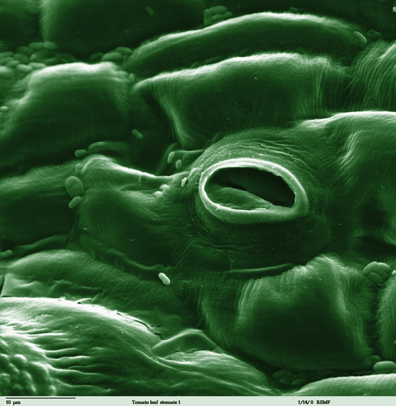
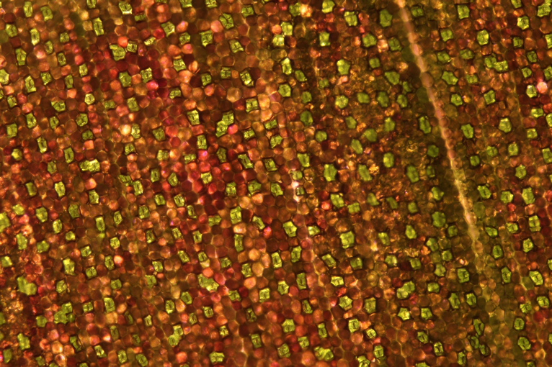
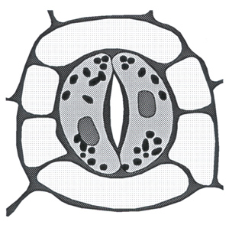
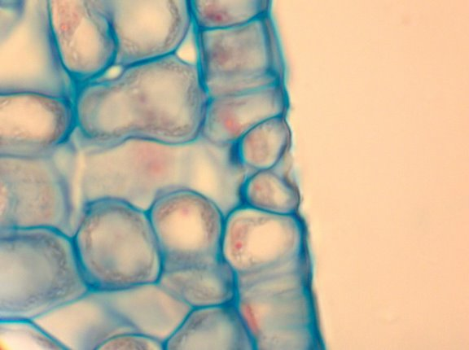
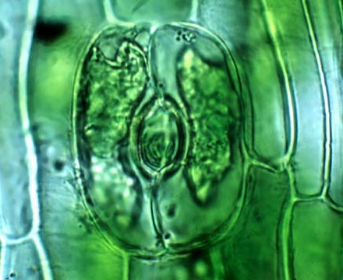

Slide 10
Interdependent systems
Both systems depend on the other
roots depend on sugars produced by photosynthetic leaves
shoots depend on water & minerals absorbed from the soil by roots
sugars
water & minerals

Slide 11
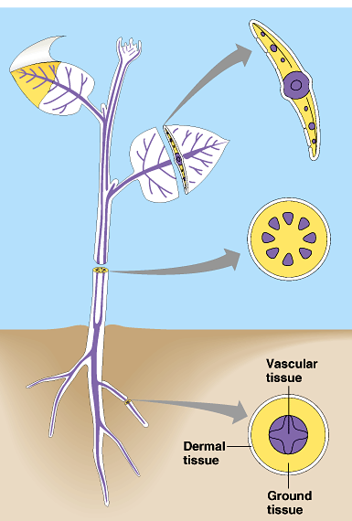
Plant TISSUES
Dermal
epidermis (“skin” of plant)
single layer of tightly packed cells that covers & protects plant
Ground
bulk of plant tissue
photosynthetic mesophyll, storage
Vascular
transport system in shoots & roots
xylem & phloem

