Slide 1
Plant CELL types in plant tissues
Parenchyma
  “typical” plant cells = least specialized
  photosynthetic cells, storage cells
  tissue of leaves, stem, fruit, storage roots
Collenchyma
  unevenly thickened primary walls
  support
Sclerenchyma
  very thick, “woody” secondary walls
  support
  rigid cells that can’t elongate
  dead at functional maturity
If I’d only
had triplets!

Slide 2
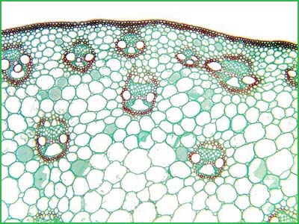
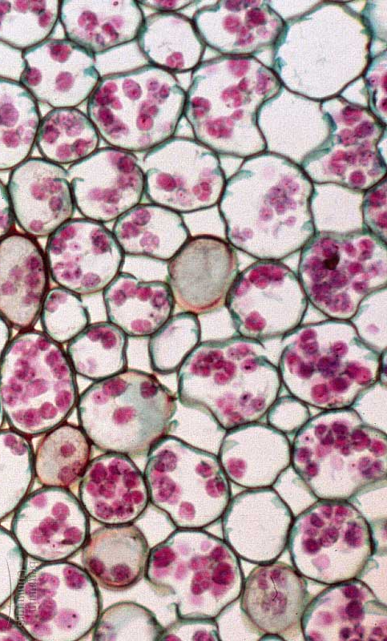
Parenchyma
Parenchyma cells are unspecialized, thin, flexible & carry out many metabolic functions
  all other cell types in plants develop from parenchyma

Slide 3
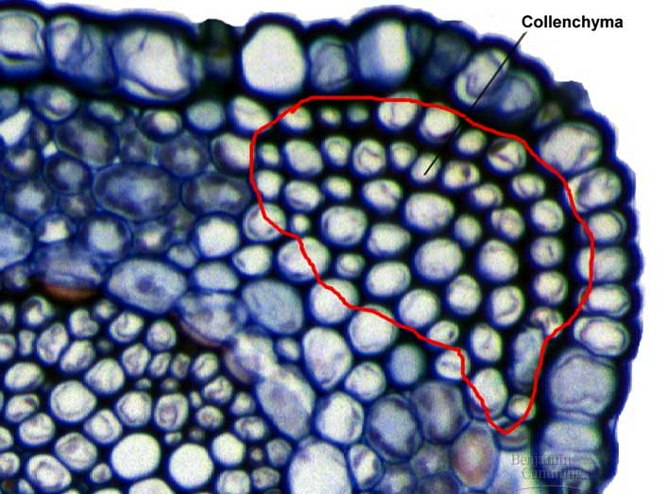
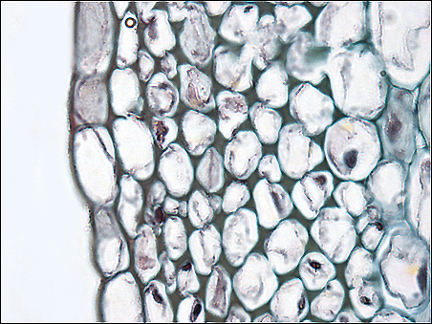
Collenchyma
Collenchyma cells have thicker primary walls & provide support
  help support without restraining growth
  remain alive in maturity
the strings in celery stalks
are collenchyma

Slide 4
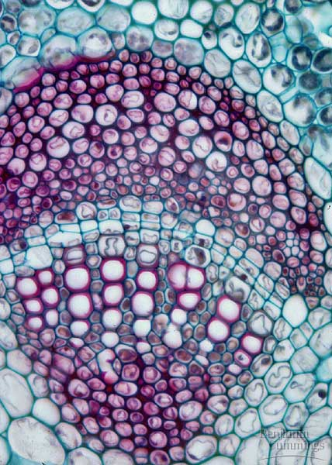
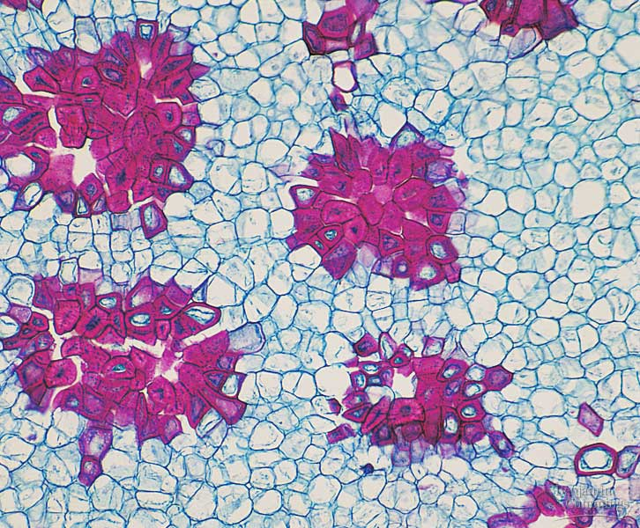
Sclerenchyma
Thick, rigid cell wall
  lignin (wood)
  cannot elongate
  mostly dead at maturity
Cells for support
  xylem vessels
  xylem tracheids
  fibers
    rope fibers
  sclereids
    nutshells
    seed coats
    grittiness in pears

Slide 5
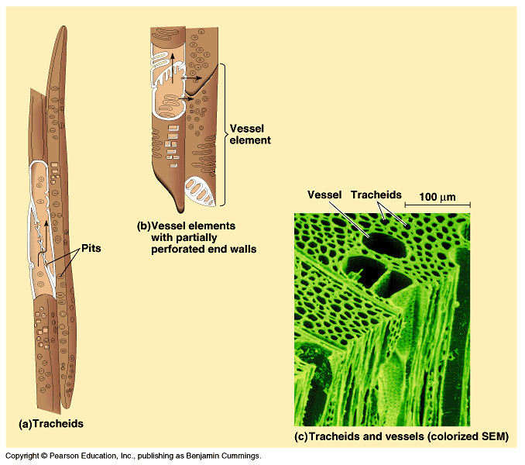
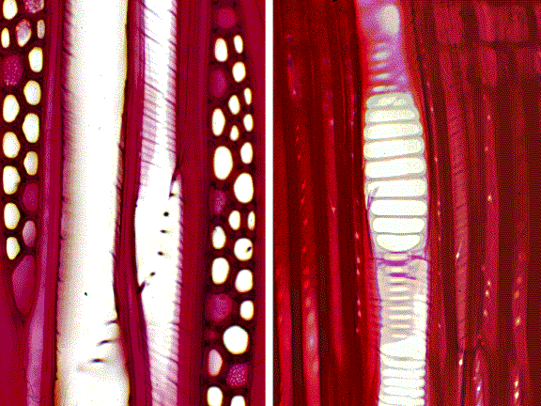
Vascular tissue
vessel elements
Xylem
  move water & minerals up from roots
  dead cells at functional maturity
    only cell walls remain
    need empty pipes to efficiently move H₂O
    transpirational pull
vessel
element
dead cells
Aaaah…
Structure–Function
again!
tracheids

Slide 6
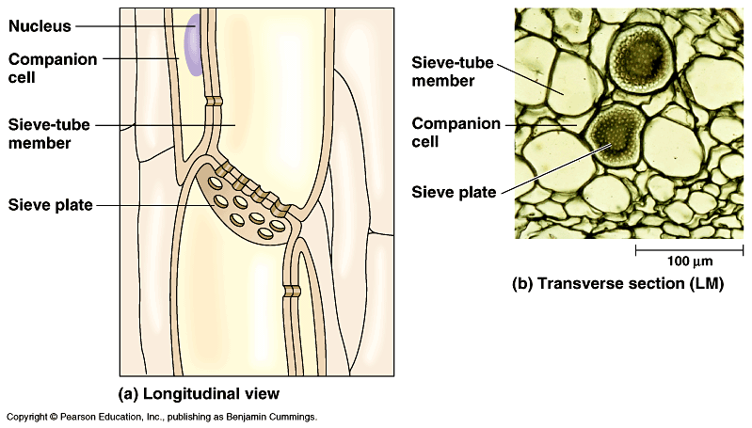
Phloem: food-conducting cells
carry sugars & nutrients throughout plant
sieve tube
companion cell
sieve plate
plasmodesmata
living cells

Slide 7
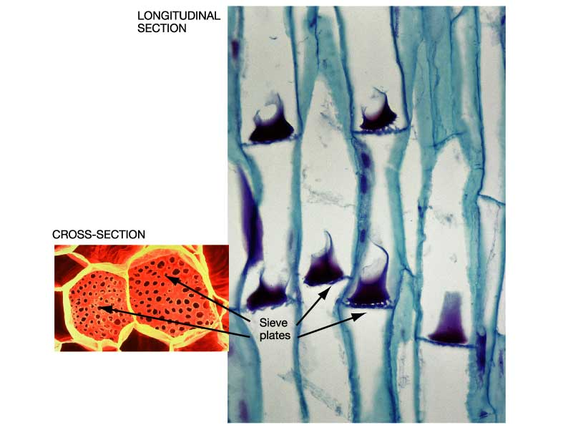
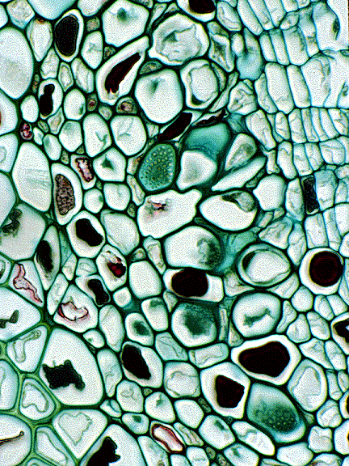
Phloem: food-conducting cells
sieve tube elements & companion cells

Slide 8
Phloem
Aaaah…
Structure–Function
again!
Living cells at functional maturity
  cell membrane, cytoplasm
    control of diffusion
  lose their nucleus, ribosomes & vacuole
    more room for specialized transport of
    liquid food (sucrose)
Cells
  sieve tubes
    sieve plates — end walls — have pores to facilitate flow of fluid between cells
  companion cells
    nucleated cells connected to the sieve-tube
    help sieve tubes

Slide 9
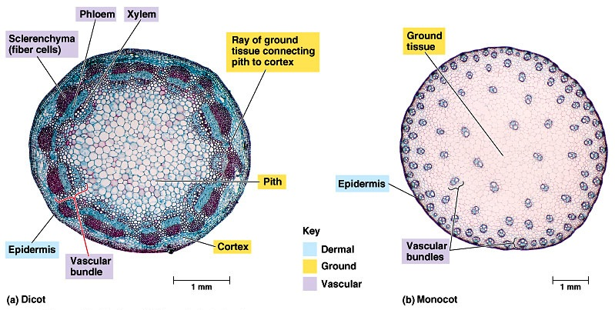
Vascular tissue in stems
dicot
trees & shrubs
monocot
grasses & lilies
collect annual rings

Slide 10
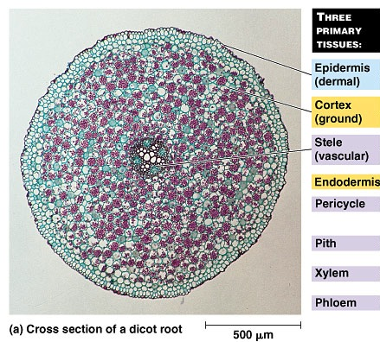
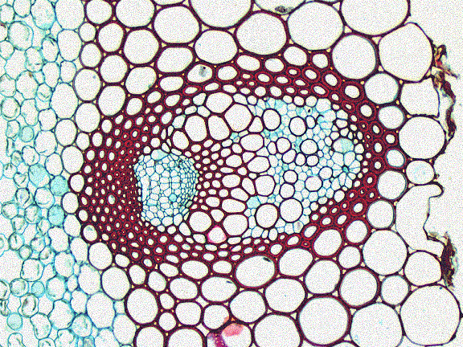
Vascular tissue in roots: dicot
phloem
xylem

Slide 11
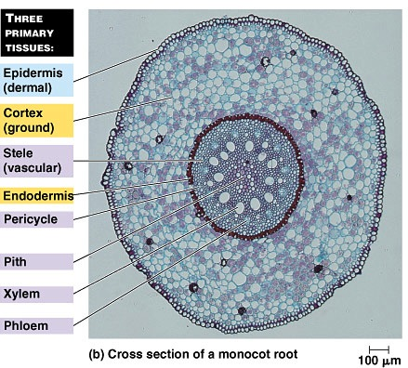
Vascular tissue in roots: monocot
xylem
phloem

