Slide 1
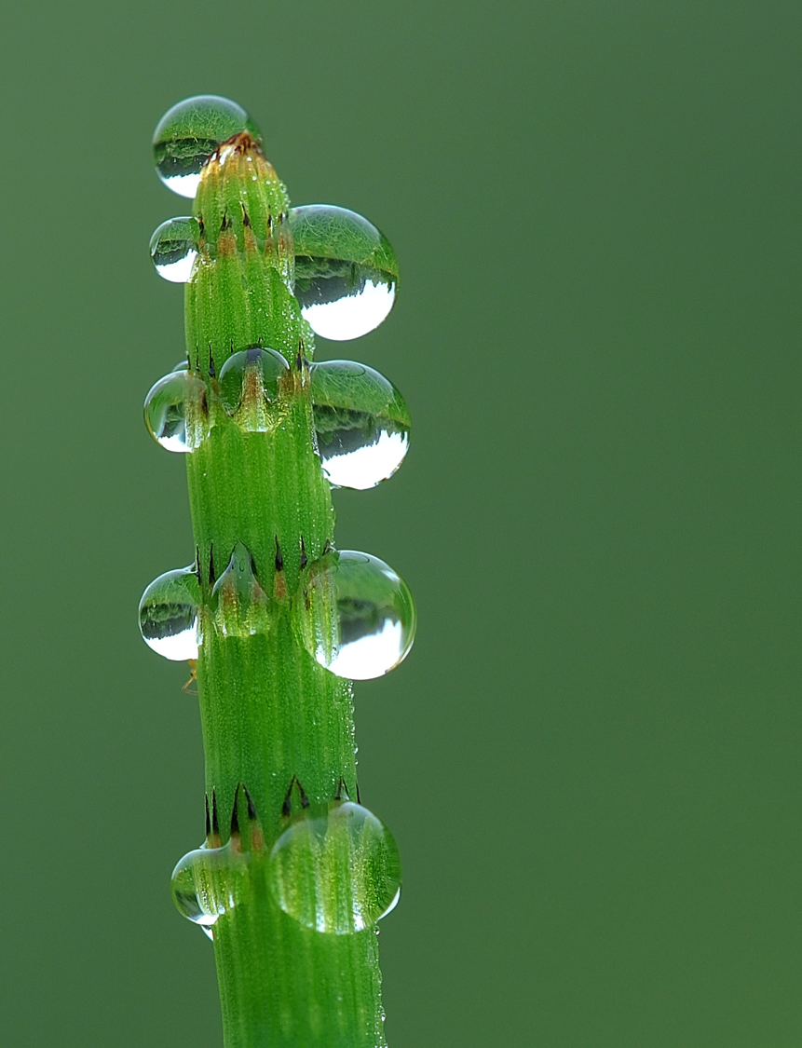

Transport in Plants
(Ch. 36)

Slide 2
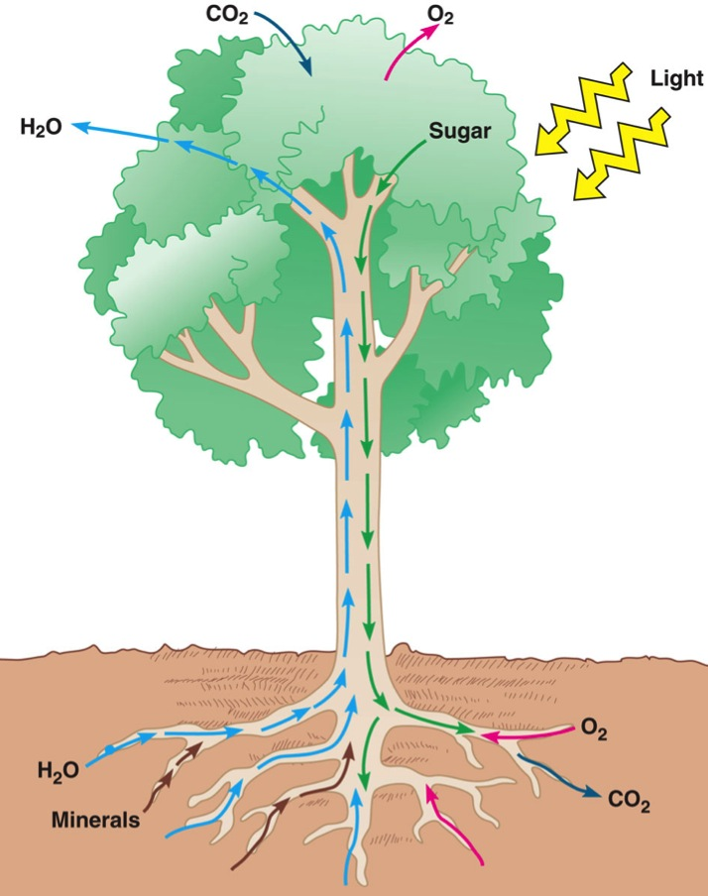
Transport in plants
H₂O & minerals
  transport in xylem
  Transpiration
    Adhesion, cohesion & Evaporation
Sugars
  transport in phloem
  bulk flow
Gas exchange
  photosynthesis
    CO₂ in; O₂ out
    stomates
  respiration
    O₂ in; CO₂ out
    roots exchange gases within air spaces in soil
Why does
over-watering
kill a plant?

Slide 3
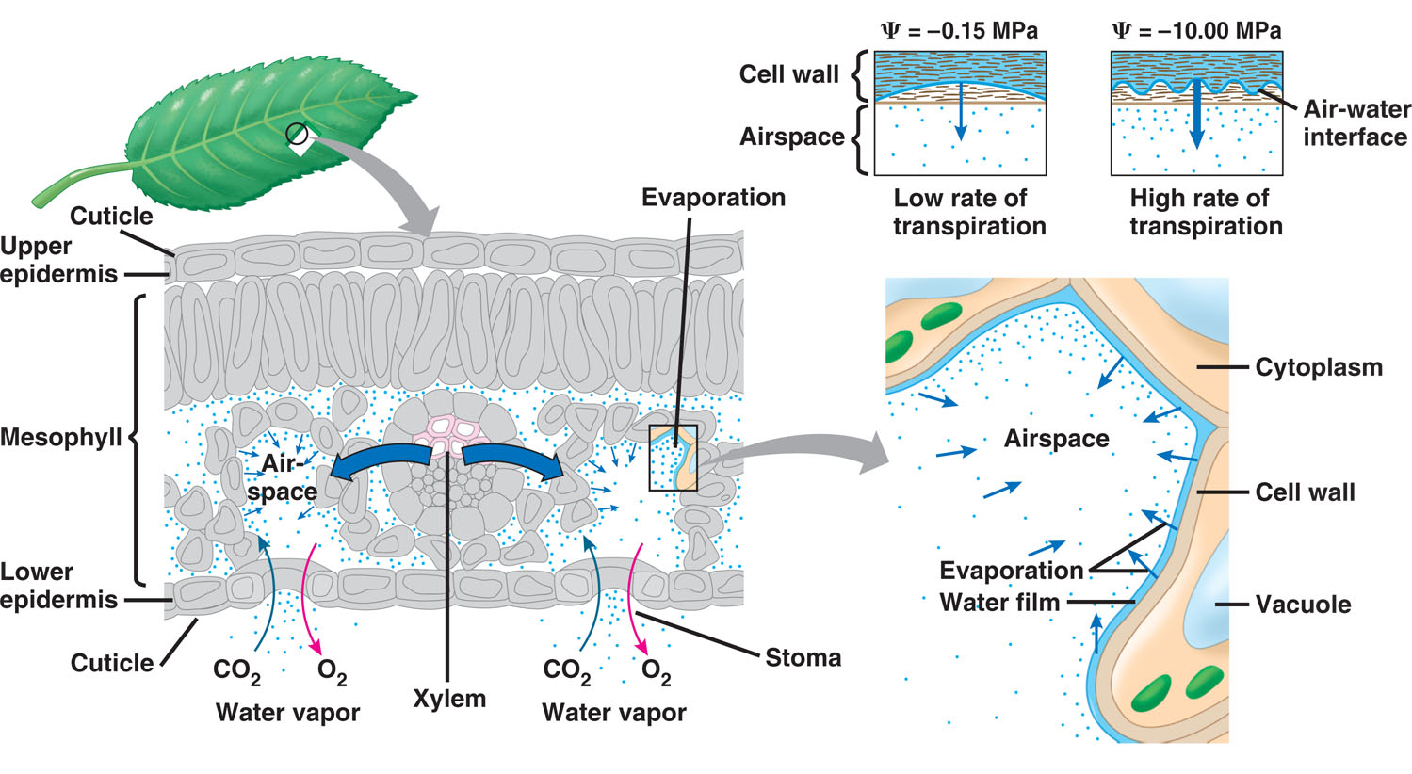
Ascent of xylem fluid
Transpiration pull generated by leaf

Slide 4
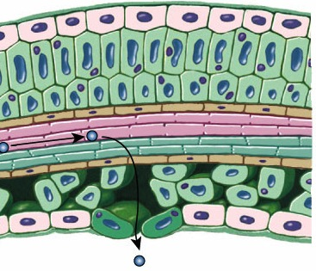
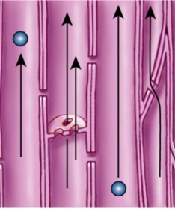
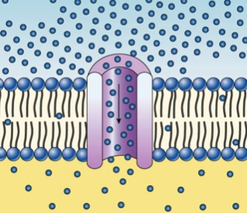
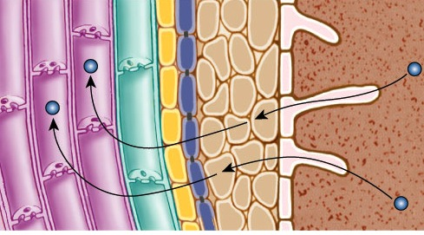
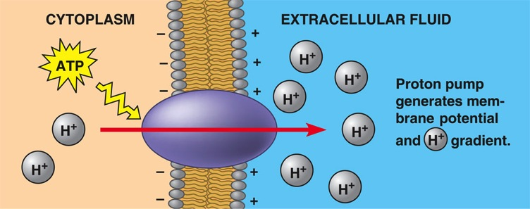
Water & mineral absorption
Water absorption from soil
  osmosis
  aquaporins
Mineral absorption
  active transport
  proton pumps
    active transport of H⁺
aquaporin
root hair
proton pumps
H₂O

Slide 5
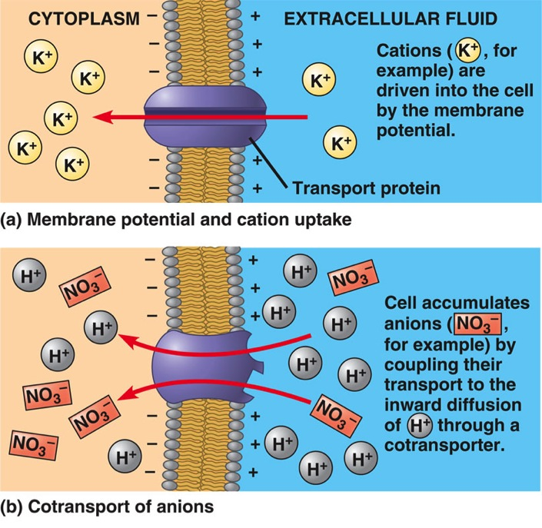
Mineral absorption
Proton pumps
  active transport of H⁺ ions out of cell
    chemiosmosis
    H⁺ gradient
  creates membrane
  potential
    difference in charge
    drives cation uptake
  creates gradient
    cotransport of other
    solutes against their
    gradient
Notes:
The most important active transport protein in the plasma membranes of plant cells is the proton pump , which uses energy from ATP to pump hydrogen ions (H+) out of the cell. This results in a proton gradient with a higher H+ concentration outside the cell than inside. Proton pumps provide energy for solute transport. By pumping H+ out of the cell, proton pumps produce an H+ gradient and a charge separation called a membrane potential. These two forms of potential energy can be used to drive the transport of solutes.
Plant cells use energy stored in the proton gradient and membrane potential to drive the transport of many different solutes. For example, the membrane potential generated by proton pumps contributes to the uptake of K+ by root cells.
In the mechanism called cotransport, a transport protein couples the downhill passage of one solute (H+) to the uphill passage of another (ex. NO3−). The “coattail” effect of cotransport is also responsible for the uptake of the sugar sucrose by plant cells. A membrane protein cotransports sucrose with the H+ that is moving down its gradient through the protein.
The role of proton pumps in transport is an application of chemiosmosis.

Slide 6
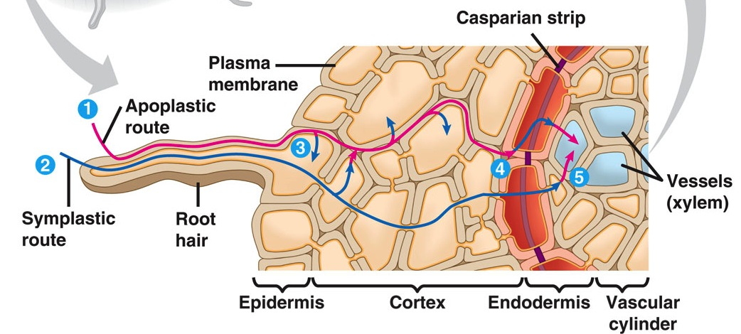
Water flow through root
Porous cell wall
  water can flow through cell wall route (apoplastic) & not enter cells (symplastic)
  plant needs to force water into cells
Casparian strip
Notes:
The endodermis, with its Casparian strip, ensures that no minerals can reach the vascular tissue of the root without crossing a selectively permeable plasma membrane. If minerals do not enter the symplast of cells in the epidermis or cortex, they must enter endodermal cells or be excluded from the vascular tissue. The endodermis also prevents solutes that have been accumulated in the xylem sap from leaking back into the soil solution. The structure of the endodermis and its strategic location in the root fit its function as sentry of the border between the cortex and the vascular cylinder, a function that contributes to the ability of roots to transport certain minerals preferentially from the soil into the xylem.

Slide 7
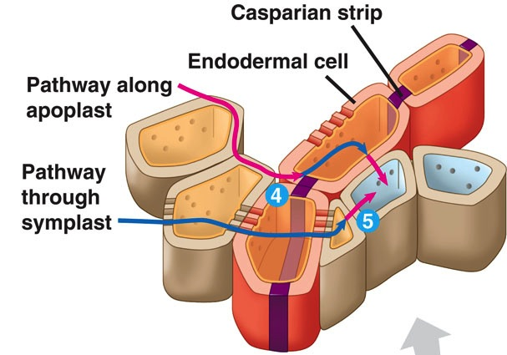
Controlling the route of water in root
Endodermis
  cell layer surrounding vascular cylinder of root
  lined with impermeable Casparian strip
  forces fluid through selective cell membrane
    filtered & forced into xylem cells
Aaaah…
Structure–Function
yet again!

Slide 8
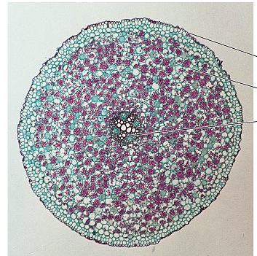
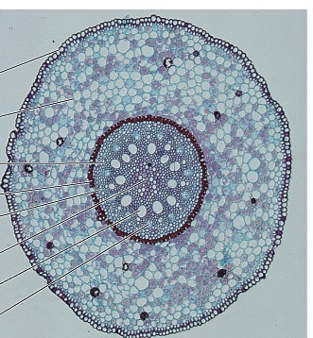
Root anatomy
dicot
monocot

Slide 9
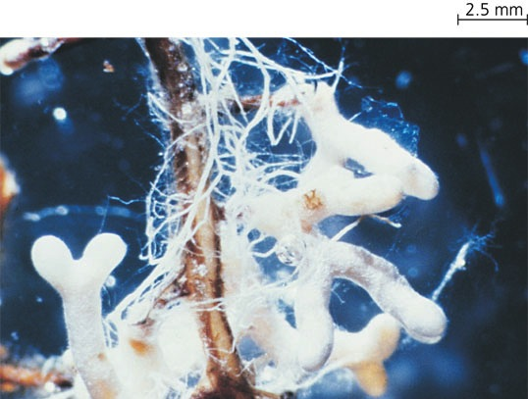
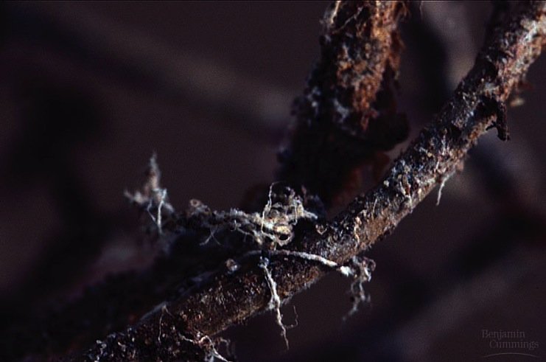
Mycorrhizae increase absorption
Symbiotic relationship between fungi & plant
  symbiotic fungi greatly increases surface area for absorption of water & minerals
  increases volume of soil reached by plant
  increases transport to host plant

Slide 10
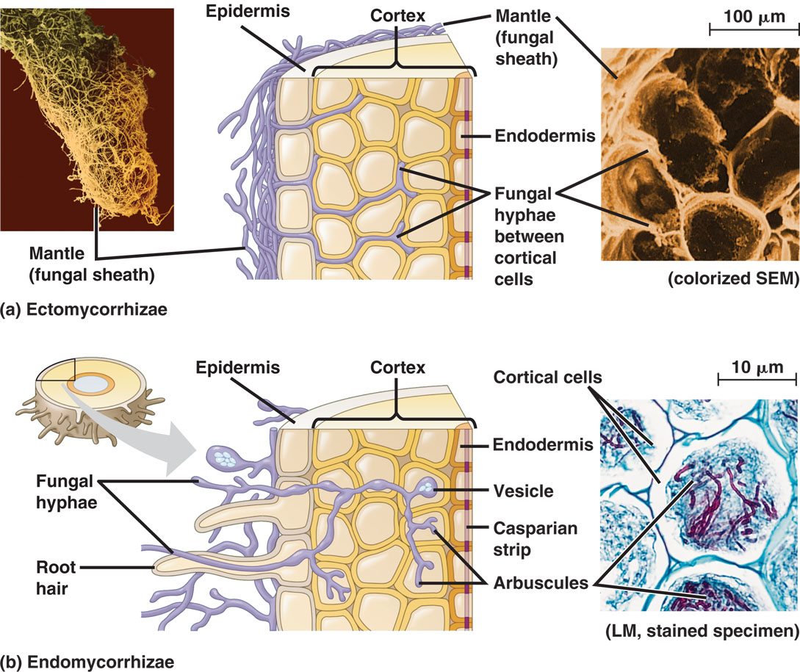
Mycorrhizae
Notes:
The hyphae of mycorrhizal fungi extend into soil, where their large surface area and efficient absorption enable them to obtain mineral nutrients, even if these are in short supply or are relatively immobile. Mycorrhizal fungi seem to be particularly important for absorption of phosphorus, a poorly mobile element, and a proportion of the phosphate that they absorb has been shown to be passed to the plant.

Slide 11
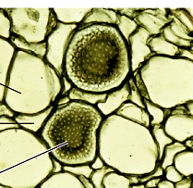
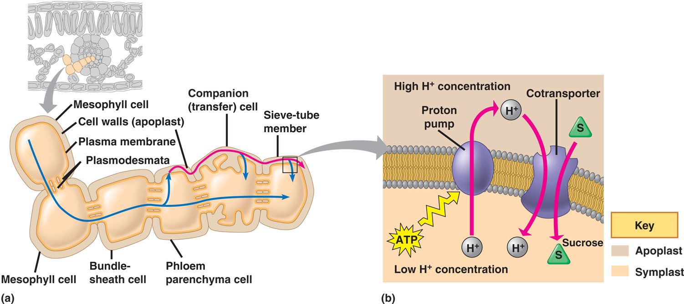
Transport of sugars in phloem
Loading of sucrose into phloem
  flow through cells via plasmodesmata
  proton pumps
    cotransport of sucrose into cells down proton gradient

Slide 12
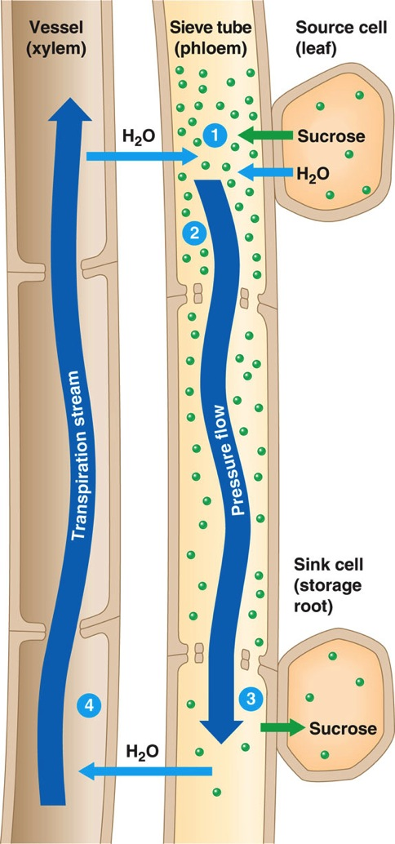
Pressure flow in phloem
Mass flow hypothesis
  “source to sink” flow
    direction of transport in phloem is dependent on plant’s needs
  phloem loading
    active transport of sucrose
    into phloem
    increased sucrose concentration decreases H₂O potential
  water flows in from xylem cells
    increase in pressure due to increase in H₂O causes flow
can flow 1m/hr
On a plant…
What’s a source…What’s a sink?
Notes:
In contrast to the unidirectional transport of xylem sap from roots to leaves, the direction that phloem sap travels is variable. However, sieve tubes always carry sugars from a sugar source to a sugar sink. A sugar source is a plant organ that is a net producer of sugar, by photosynthesis or by breakdown of starch. Mature leaves are the primary sugar sources. A sugar sink is an organ that is a net consumer or storer of sugar. Growing roots, buds, stems, and fruits are sugar sinks. A storage organ, such as a tuber or a bulb, may be a source or a sink, depending on the season. When stockpiling carbohydrates in the summer, it is a sugar sink. After breaking dormancy in the spring, it is a source as its starch is broken down to sugar, which is carried to the growing tips of the plant.
A sugar sink usually receives sugar from the nearest sources. Upper leaves on a branch may send sugar to the growing shoot tip, whereas lower leaves export sugar to roots. A growing fruit may monopolize sugar sources around it. For each sieve tube, the direction of transport depends on the locations of the source and sink connected by that tube. Therefore, neighboring tubes may carry sap in opposite directions. Direction of flow may also vary by season or developmental stage of the plant.

Slide 13
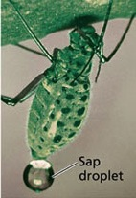


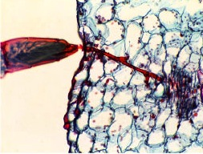
Experimentation
Testing pressure flow hypothesis
  using aphids to measure sap flow & sugar concentration along plant stem
Notes:
Pressure Flow: The Mechanism of Translocation in Angiosperms
Phloem sap flows from source to sink at rates as great as 1 m/hr, much too fast to be accounted for by either diffusion or cytoplasmic streaming. In studying angiosperms, researchers have concluded that sap moves through a sieve tube by bulk flow driven by positive pressure (thus the synonym pressure flow.
The building of pressure at the source end and reduction of that pressure at the sink end cause water to flow from source to sink, carrying the sugar along. Xylem recycles the water from sink to source.
The pressure flow hypothesis explains why phloem sap always flows from source to sink.

Slide 14
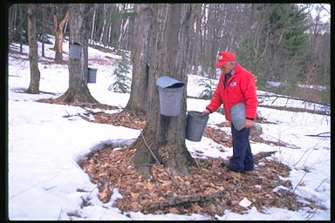
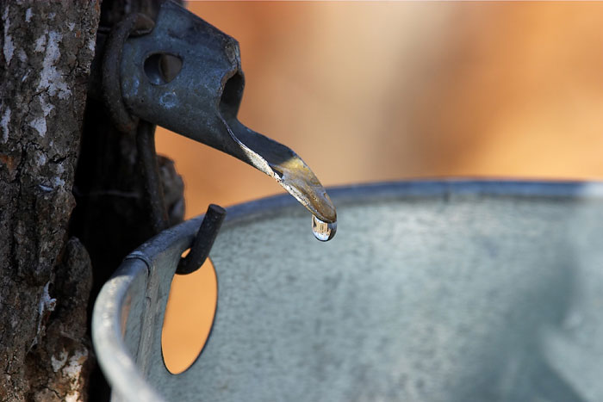
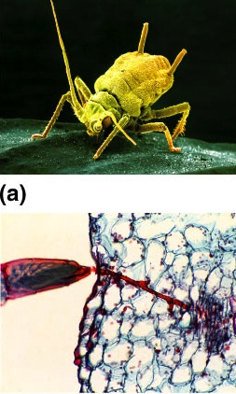
Maple sugaring

Slide 15
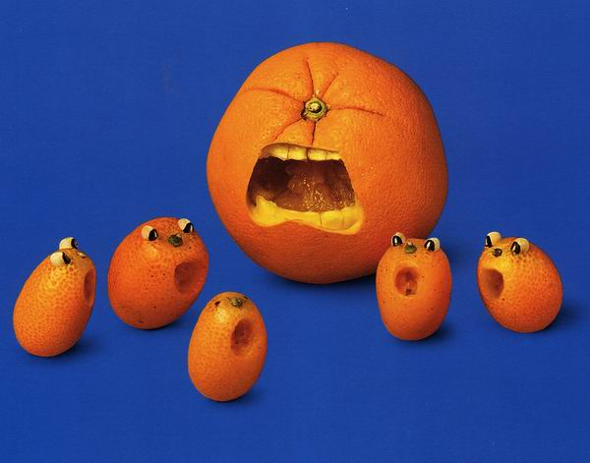
Don’t get mad…
Get answers!!
Ask Questions!

Slide 16
Review Questions
0

Slide 17
1. What mechanism explains the movement of sucrose from source to sink?
  evaporation of water and active transport of sucrose from the sink
  osmotic movement of water into the sucrose-loaded sieve-tube members creating a higher hydrostatic pressure in the source than in the sink
  tension created by the differences in hydrostatic pressure in the source and sink
  active transport of sucrose through the sieve-tube cells driven by proton pumps
  the hydrolysis of starch to sucrose in the mesophyll cells that raises their water potential and drives the bulk flow of sap to the sink
Notes:
Answer: b
Source: Taylor - Student Study Guide for Biology, Sixth Edition, Test Your Knowledge Question #18 .

Slide 18
2. A water molecule could move all the way through a plant from soil to root to leaf to air and pass through a living cell only once. This living cell would be a part of which structure?
  the Casparian strip
  a guard cell
  the root epidermis
  the endodermis
  the root cortex
Notes:
Answer: d
Source: Barstow - Test Bank for Biology, Sixth Edition, Question #24.

Slide 19
3. Which of the following experimental procedures would most likely reduce transpiration while allowing the normal growth of a plant? *
  subjecting the leaves of the plant to a partial vacuum
  increasing the level of carbon dioxide around the plant
  putting the plant in drier soil
  decreasing the relative humidity around the plant
  injecting potassium ions into the guard cells of the plant
Notes:
Answer: b
Source: Barstow - Test Bank for Biology, Sixth Edition, Question #48.
Discussion Notes for the Instructor
This question integrates some components of plant physiology.
It could be used as an introduction to the material on transpiration or after completing it.
Questions to help stimulate student thinking during this question might include:
• What determines the rate of transpiration?
• What is needed to have transpiration occur?
• What is exchanged through the stomata?

Slide 20
4. In the pressure-flow hypothesis of translocation, what causes the pressure?
  root pressure
  the osmotic uptake of water by sieve tubes at the source
  the accumulation of minerals and water by the stele in the root
  the osmotic uptake of water by the sieve tubes of the sink
  hydrostatic pressure in xylem vessels
Notes:
Answer: b
Source: Barstow - Test Bank for Biology, Sixth Edition, Question #61.

