Slide 1
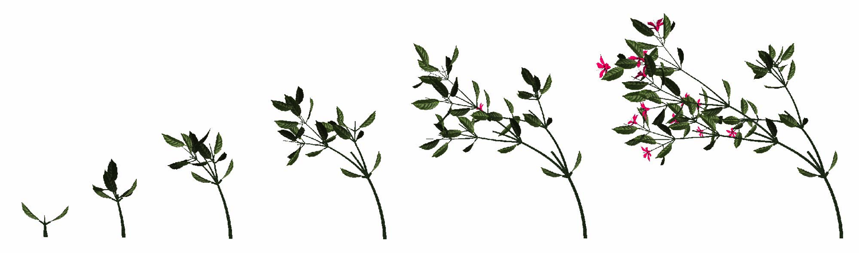
Plant Growth
(Ch. 35, 39)

Slide 2
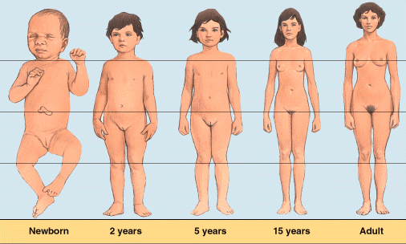
Growth in Animals
Animals grow throughout the whole organism
  many regions & tissues at different rates

Slide 3
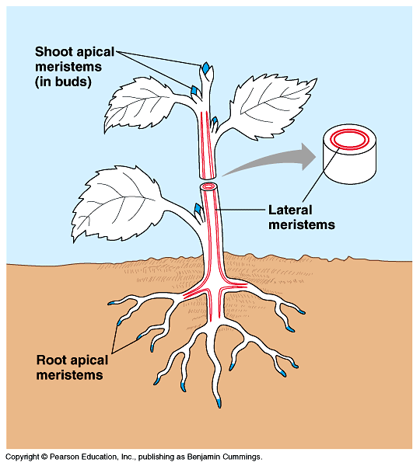
Growth in Plants
Specific regions of growth: meristems
  stem cells: perpetually embryonic tissue
  regenerate new cells
    apical shoot meristem
      growth in length
      primary growth
    apical root meristem
      growth in length
      primary growth
    lateral meristem
      growth in girth
      secondary growth

Slide 4
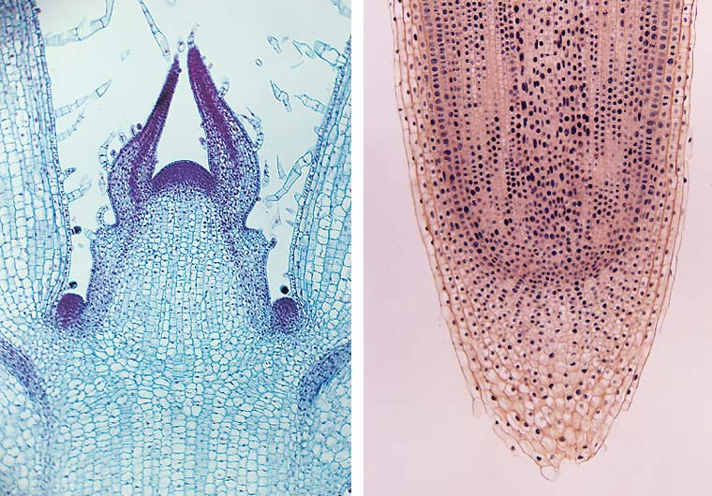
Apical meristems
shoot
root

Slide 5
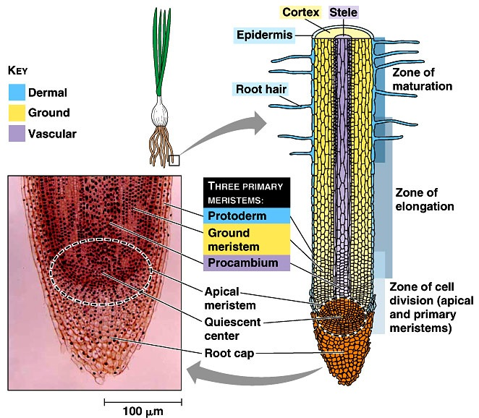
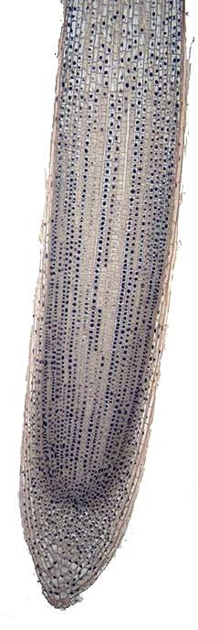
Root structure & growth
protecting the meristem

Slide 6
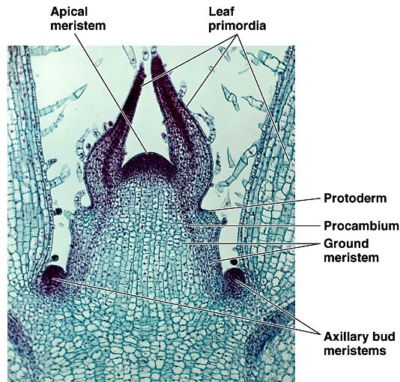
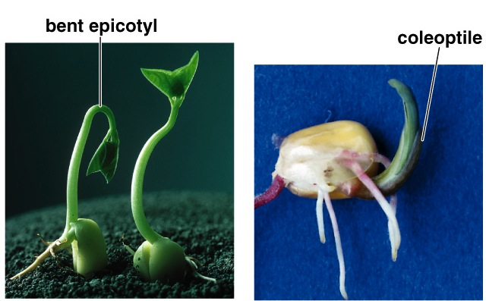
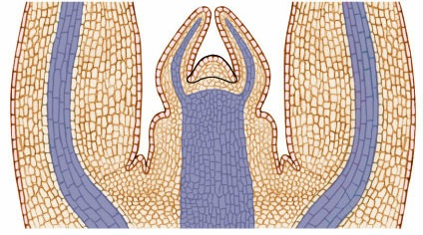
Shoot growth
Apical bud & primary growth of shoot
  region of stem growth
  axillary buds
    “waiting in the wings”
protecting the meristem
Young leaf
primordium
Apical meristem
Older leaf
primordium
Lateral bud
primordium
Vascular tissue

Slide 7
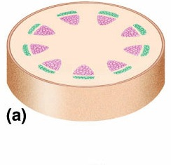
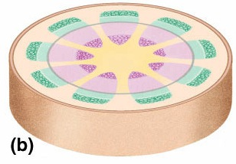
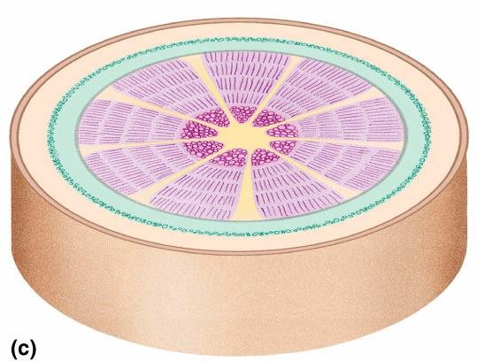
Growth in woody plants
Primary
xylem
Woody plants grow in height from tip
  primary growth
  apical meristem
Woody plants grow in diameter from sides
  secondary growth
  lateral meristems
    vascular cambium
      makes 2° phloem & 2° xylem
    cork cambium
      makes bark
Primary
phloem
Epidermis
Lateral
meristems
Secondary
xylem
Primary
phloem
Primary
xylem
Secondary
phloem
Annual
growth
layers
Bark

Slide 8
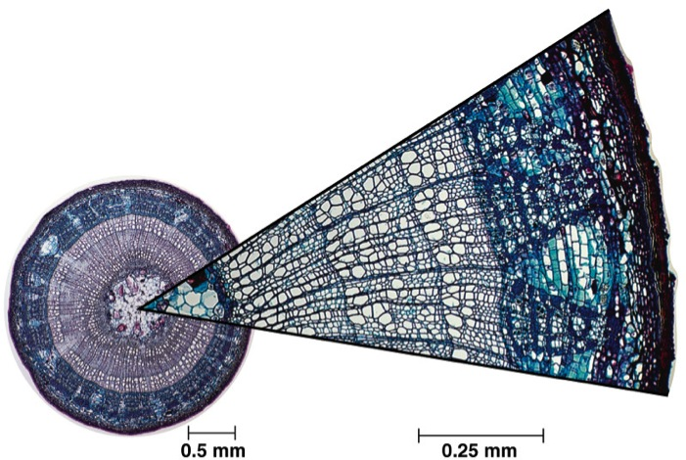
Secondary growth
Secondary growth
  growth in diameter
    thickens & strengthens older part of tree
  cork cambium makes bark
    growing ring around tree
  vascular cambium makes xylem & phloem
    growing ring around tree

Slide 9
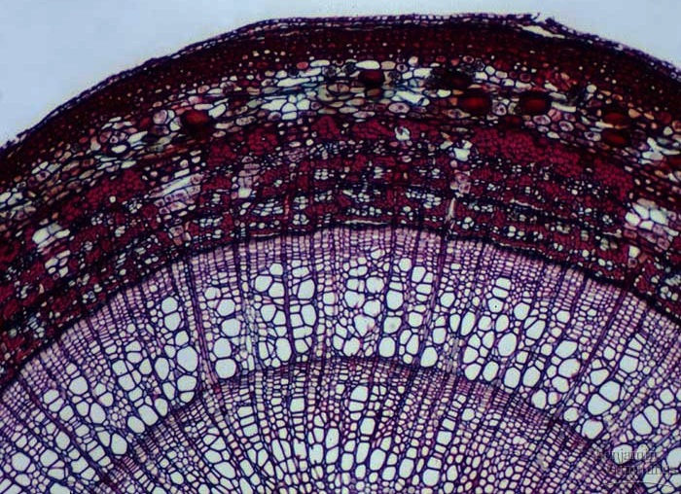
Vascular cambium
Why are early
& late growth
different?
Phloem produced to the outside
Xylem produced to the inside
bark
cork
cambium
phloem
xylem
late
vascular
cambium
early
last year’s xylem

Slide 10

Woody stem
cork cambium
How old is
this tree?
vascular cambium
late
early
3
2
1
xylem
phloem
bark

Slide 11
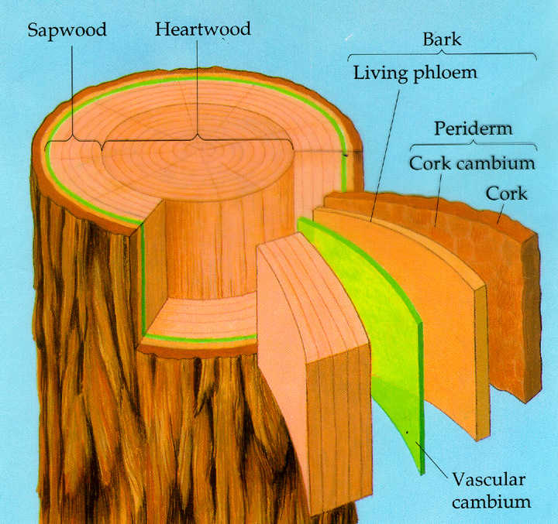
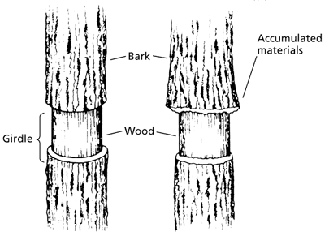
Tree trunk anatomy
Aaaargh!
Murderer!
Arborcide!
tree girdling
What does girdling do to a tree?

Slide 12
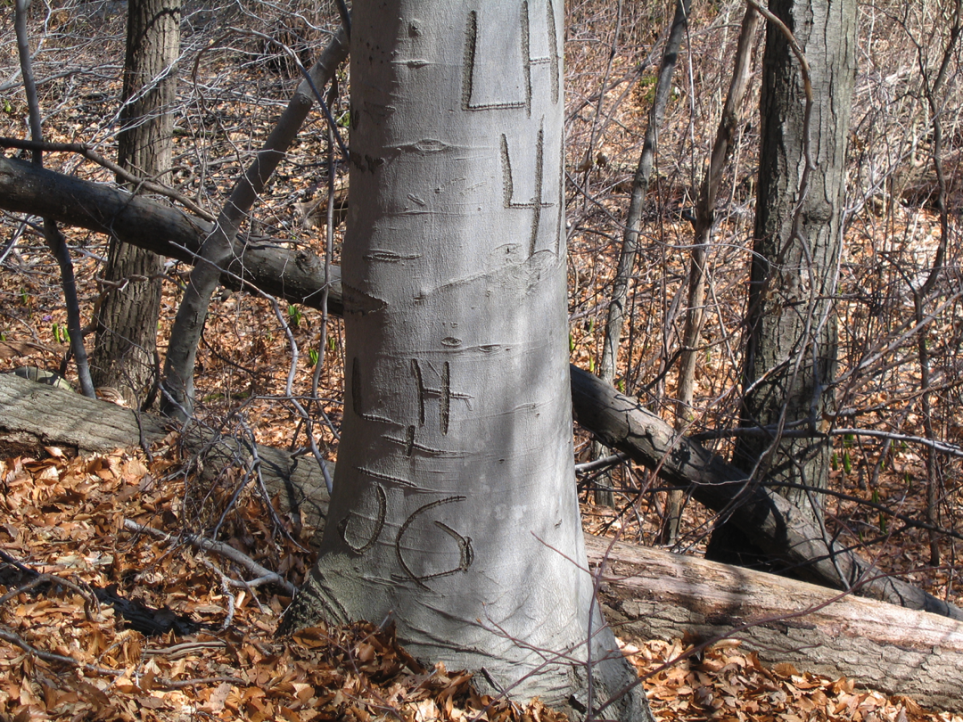
Where will the carving be in 50 years?

Slide 13
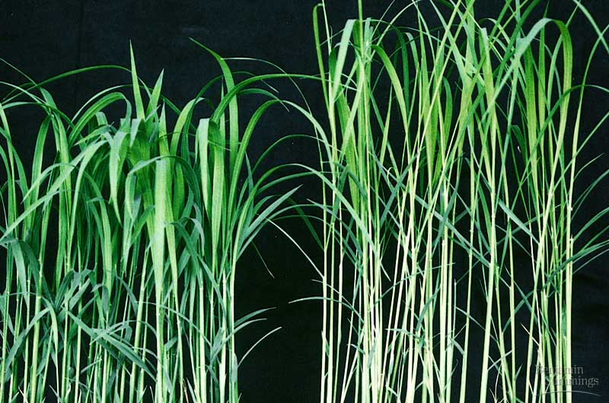
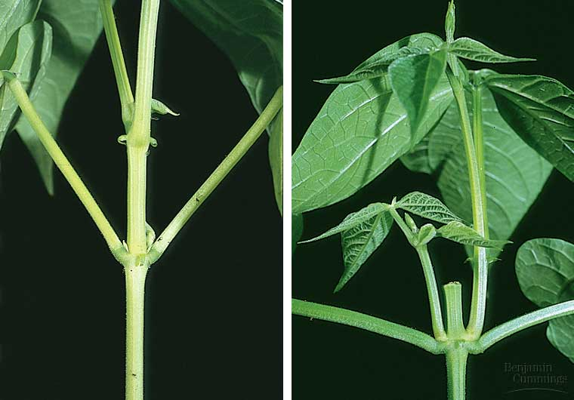
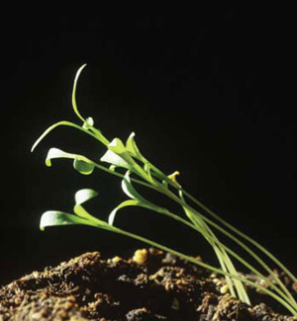
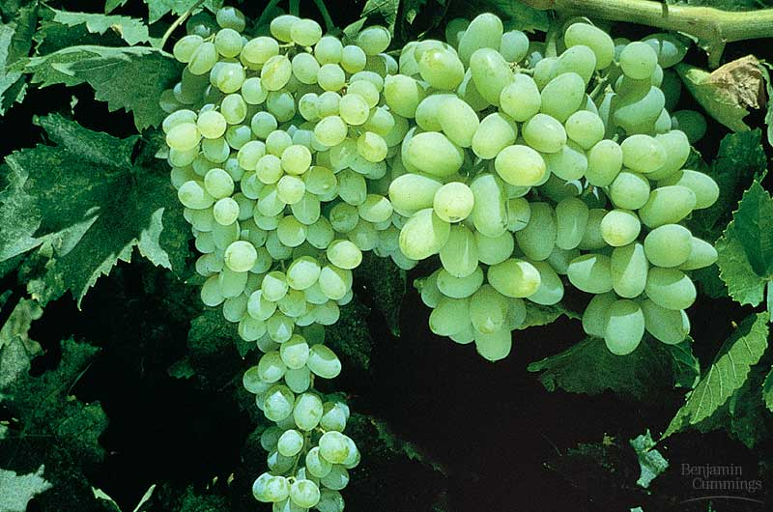
Plant hormones
auxin
gibberellins
abscisic acid
ethylene
and more…

Slide 14
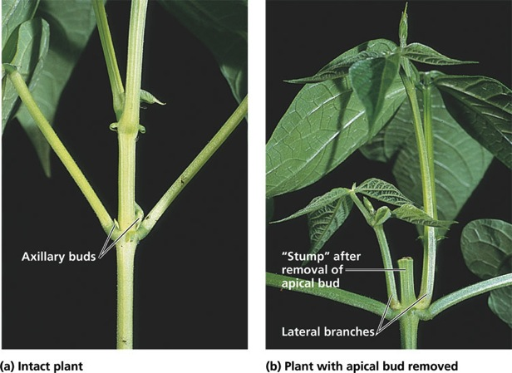
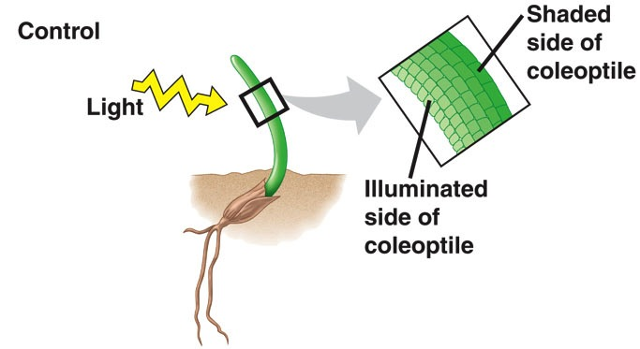
Auxin (IAA)
Effects
  controls cell division
  & differentiation
  phototropism
    growth towards light
    asymmetrical distribution of auxin
    cells on darker side elongate faster
    than cells on brighter side
  apical dominance

Slide 15
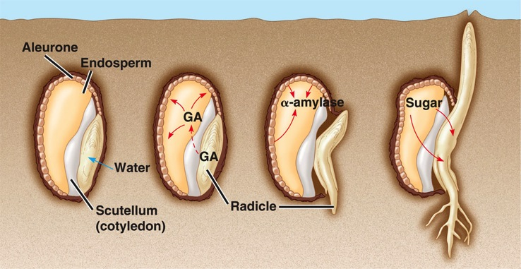
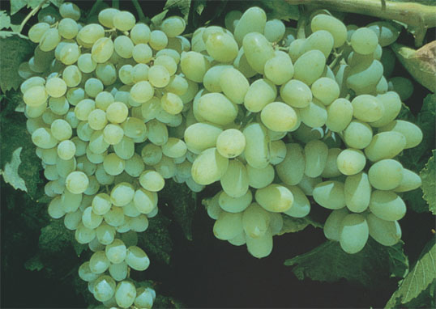
Gibberellins
Family of hormones
  over 100 different gibberellins identified
Effects
  stem elongation
  fruit growth
  seed germination
plump grapes in grocery stores have been treated with gibberellin hormones while on the vine

Slide 16
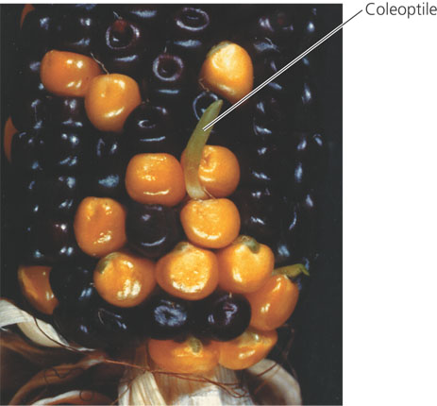
Abscisic acid (ABA)
Effects
  slows growth
  seed dormancy
    high concentrations of abscisic acid
      germination only after ABA is inactivated or leeched out
    survival value:
    seed will germinate only
    under optimal conditions
      light, temperature, moisture

Slide 17
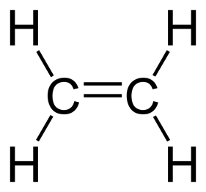



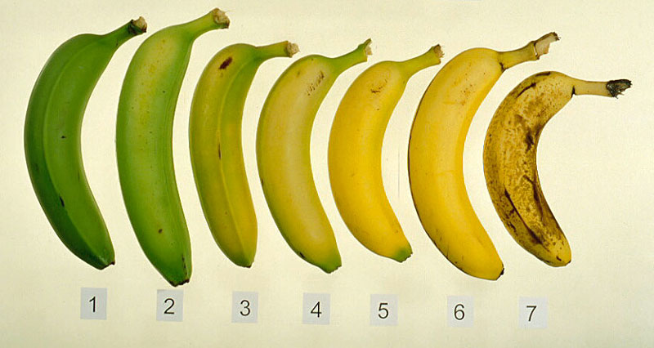

Ethylene
Hormone gas released by plant cells
Effects
  fruit ripening
  leaf drop
    like in Autumn
    apoptosis
One bad apple
spoils the
whole bunch…

Slide 18
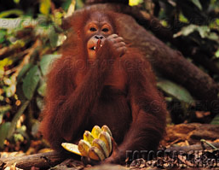
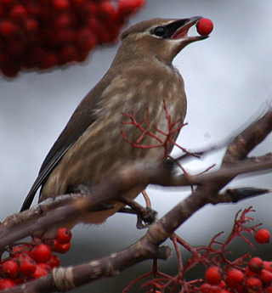
Fruit ripening
Adaptation
  hard, tart fruit protects
  developing seed from herbivores
  ripe, sweet, soft fruit attracts
  animals to disperse seed
Mechanism
  triggers ripening process
    breakdown of cell wall
      softening
    conversion of starch to sugar
      sweetening
  positive feedback system
    ethylene triggers ripening
    ripening stimulates more ethylene production

Slide 19
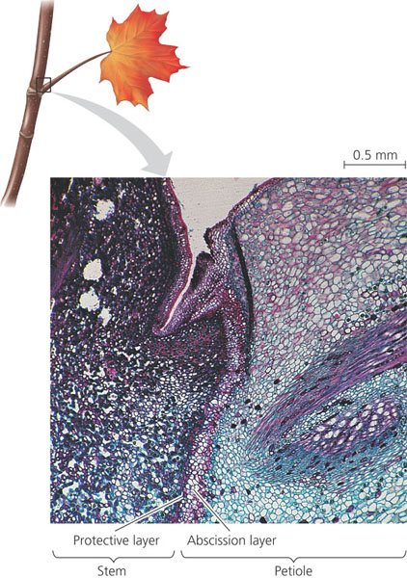
Apoptosis in plants
Many events in plants involve apoptosis
  response to hormones
    ethylene
    auxin
  death of annual plant after flowering
    senescence
  differentiation of xylem vessels
    loss of cytoplasm
  shedding of autumn leaves
What is the evolutionary advantage of loss of leaves in autumn?
Notes:
The loss of leaves each autumn is an adaptation that keeps deciduous trees from desiccating during winter when the roots cannot absorb water from the frozen ground. Before leaves abscise, many essential elements are salvaged from the dying leaves and are stored in stem parenchyma cells. These nutrients are recycled back to developing leaves the following spring. Fall color is a combination of new red pigments made during autumn and yellow and orange carotenoids that were already present in the leaf but are rendered visible by the breakdown of the dark green chlorophyll in autumn.
Photo: Abscission of a maple leaf.
Abscission is controlled by a change in the balance of ethylene and auxin. The abscission layer can be seen here as a vertical band at the base of the petiole. After the leaf falls, a protective layer of cork becomes the leaf scar that helps prevent pathogens from invading the plant (LM).

Slide 20
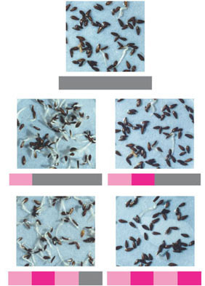
How does the order of red and far-red illumination affect seed germination?
During the 1930s, USDA scientists briefly exposed batches of lettuce seeds to red light or far-red light to test the effects on germination. After the light exposure, the seeds were placed in the dark, and the results were compared with control seeds that were not exposed to light.
EXPERIMENT
The bar below each photo indicates the sequence of red-light exposure, far-red light exposure, and darkness. The germination rate increased greatly in groups of seeds that were last exposed
to red light (left). Germination was inhibited in groups of seeds that were last exposed to far-red light (right).
RESULTS
Dark (control)
Red
Dark
Red
Far-red
Dark
Red
Far-red
Red
Dark
Red
Far-red
Red
Far-red
Red light stimulated germination, and far-red light inhibited germination.
The final exposure was the determining factor. The effects of red and far-red light were reversible.
CONCLUSION

Slide 21
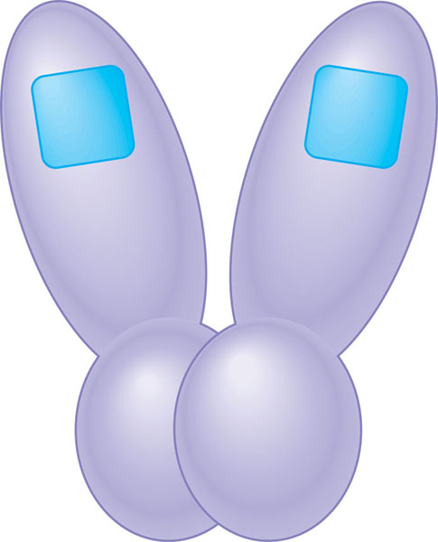
Structure of a phytochrome
A phytochrome consists of two identical proteins joined to form
one functional molecule. Each of these proteins has two domains.
Chromophore
Photoreceptor activity. One domain,
which functions as the photoreceptor,
is covalently bonded to a nonprotein
pigment, or chromophore.
Kinase activity. The other domain
has protein kinase activity. The
photoreceptor domains interact with the kinase domains to link light reception to cellular responses triggered by the kinase.

Slide 22
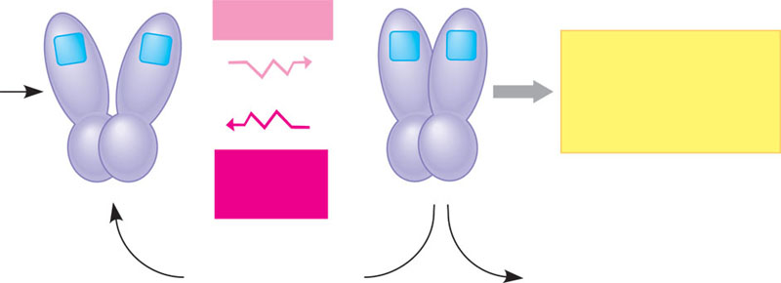
Phytochrome: a molecular switching mechanism
P_{r}
P_{fr}
Red light
Responses:
seed germination,
control of
flowering, etc.
Synthesis
Far-red
light
Slow conversion
in darkness
(some plants)
Enzymatic
destruction

Slide 23
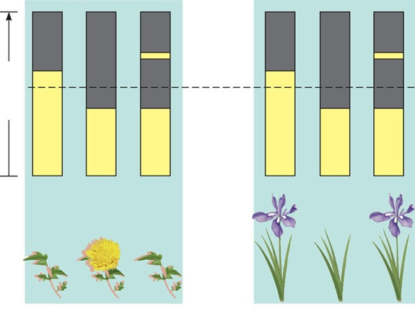
How does interrupting the dark period with a brief exposure to light affect flowering?
During the 1940s, researchers conducted experiments in which periods of darkness were interrupted with brief exposure to light to test how the light and dark portions
of a photoperiod affected flowering in “short-day” and “long-day” plants.
EXPERIMENT
RESULTS
Darkness
Flash of
light
24 hours
Critical
dark
period
Light
(a) “Short-day” plants
flowered only if a period of
continuous darkness was
longer than a critical dark
period for that particular
species (13 hours in this
example). A period of
darkness can be ended by a
brief exposure to light.
(b) “Long-day” plants
flowered only if a
period of continuous
darkness was shorter
than a critical dark
period for that
particular species (13
hours in this example).
The experiments indicated that flowering of each species was determined
by a critical period of darkness (“critical night length”) for that species, not by a specific period
of light. Therefore, “short-day” plants are more properly called “long-night” plants, and “long-day”
plants are really “short-night” plants.
CONCLUSION

Slide 24
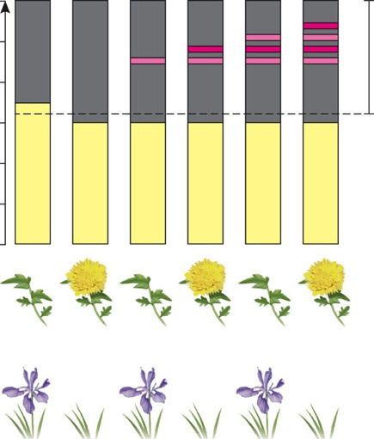
Is phytochrome the pigment that measures the interruption of dark periods in photoperiodic response?
A unique characteristic of phytochrome is reversibility in response to red and far-red light. To test whether phytochrome is the pigment measuring interruption of dark periods, researchers observed how flashes of red light and far-red light affected flowering in “short-day” and “long-day” plants.
EXPERIMENT
RESULTS
24
20
R
FR
FR
FR
R
FR
R
R
Critical dark period
16
R
R
Hours
12
8
4
0
Short-day (long-night) plant
Long-day (short-night) plant
A flash of red light shortened the dark period. A subsequent flash of far-red light
canceled the red light’s effect. If a red flash followed a far-red flash, the effect of the far-red light was
canceled. This reversibility indicated that it is phytochrome that measures the interruption of dark periods.
CONCLUSION

Slide 25
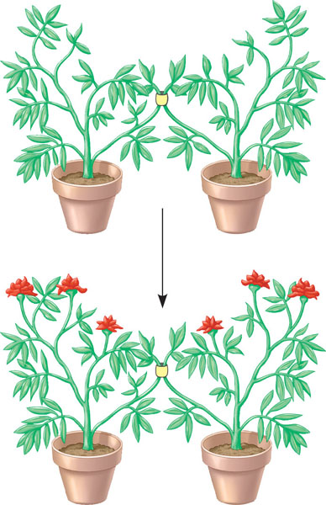
Is there a flowering hormone?
To test whether there is a flowering hormone, researchers conducted an experiment in which a plant that had been induced to flower by photoperiod was grafted to
a plant that had not been induced.
EXPERIMENT
RESULTS
Plant subjected to photoperiod
that induces flowering
Plant subjected to photoperiod
that does not induce flowering
Graft
Time
(several
weeks)
Both plants flowered, indicating the transmission of a flower-inducing
substance. In some cases, the transmission worked even if one was a short-day plant
and the other was a long-day plant.
CONCLUSION

Slide 26
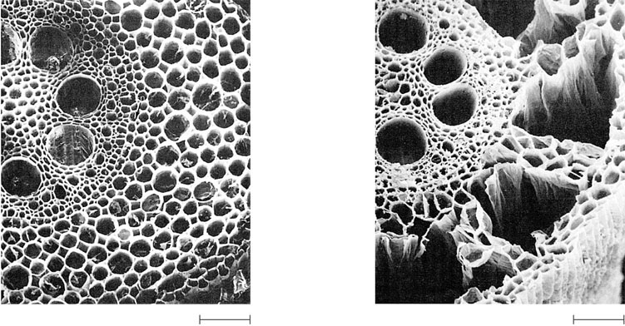
A developmental response of maize roots to flooding and oxygen deprivation
Vascular
cylinder
Air tubes
Epidermis
100 μm
100 μm
(a) Control root (aerated)
(b) Experimental root (nonaerated)

Slide 27
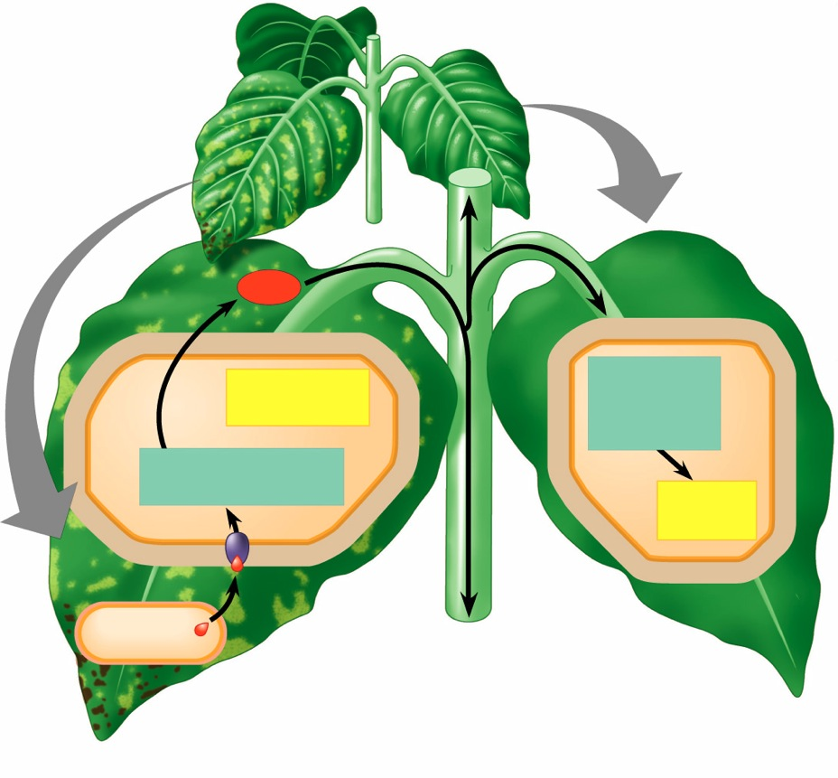
Defense responses against an avirulent pathogen
4 Before they die,
infected cells
release a chemical
signal, probably
salicylic acid.
3 In a hypersensitive
response (HR), plant
cells produce anti-
microbial molecules,
seal off infected
areas by modifying
their walls, and
then destroy
themselves. This
localized response
produces lesions
and protects other
parts of an infected
leaf.
Signal
5 The signal is
distributed to the
rest of the plant.
4
5
Hypersensitive
response
Signal
transduction
pathway
6
3
6 In cells remote from
the infection site,
the chemical
initiates a signal
transduction
pathway.
Signal transduction
pathway
2
Acquired
resistance
7
2 This identification
step triggers a
signal transduction
pathway.
1
7 Systemic acquired
resistance is
activated: the
production of
molecules that help
protect the cell
against a diversity
of pathogens for
several days.
Avirulent
pathogen
1 Specific resistance is
based on the
binding of ligands
from the pathogen
to receptors in plant
cells.
R-Avr recognition and
hypersensitive response
Systemic acquired
resistance

Slide 28
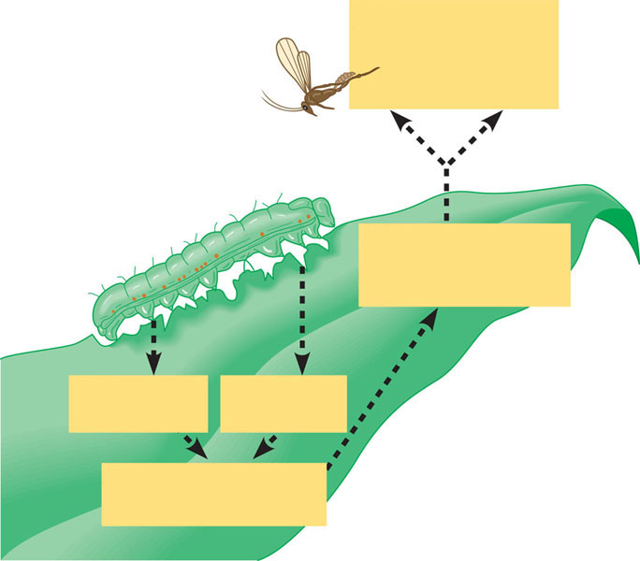
A maize leaf “recruits” a parasitoid wasp as a defensive response to an herbivore, an army-worm caterpillar
4
Recruitment of
parasitoid wasps
that lay their eggs
within caterpillars
3
Synthesis and
release of
volatile attractants
1
Wounding
1
Chemical
in saliva
2
Signal transduction
pathway

Slide 29
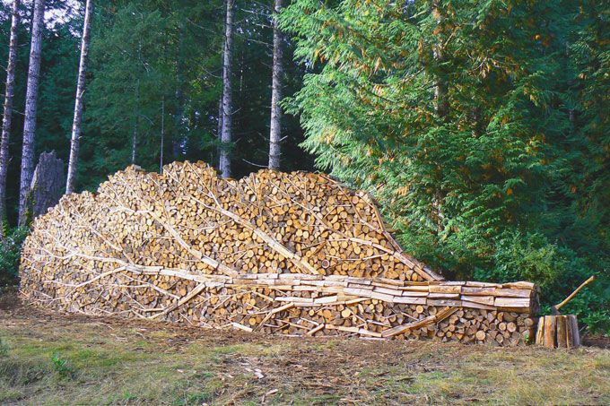
Don’t take this lying down…
Ask Questions!!

Slide 30
Review Questions
0

Slide 31
1. What is one result of an organism having meristems?
  a rapid change from juvenile to adult state
  a seasonal change in leaf morphology
  a rapid change from a vegetative state to a reproductive state
  indeterminate, life-long growth
  production of a fixed number of segments during growth
Notes:
Answer: d
Source: Barstow - Test Bank for Biology, Sixth Edition, Question 20 .

Slide 32
Pick one of the following choices for each of the following questions:
A. Auxin
B. Gibberellin
C. Ethylene
D. Abscisic Acid
E. Phytochrome
Controls the phototropic response in plants
Contributes to fruit development
Contributes to fruit ripening
Contributes to seed dormancy
Contributes to flowering
Notes:
2 Auxin
3 Gibberellin
4. Ethylene
5 Abscisic Acid
6 Phytochrome

