Slide 1
Angiosperm Reproduction (Ch.38)
(Ch. 38)

Slide 2
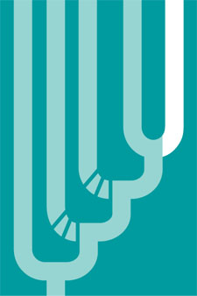
Charophyceans
Gymnosperms
Angiosperms
Seedless vascular plants
Bryophytes (nonvascular plants)

Slide 3
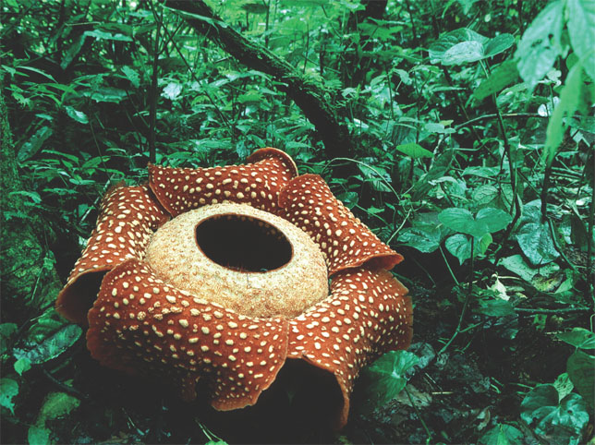
Rafflesia arnoldii, “monster flower” of Indonesia

Slide 4
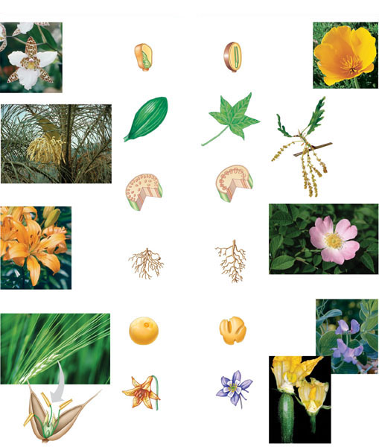
MONOCOTS
EUDICOTS
Orchid
(Lemboglossum
rossii)
Monocot
Characteristics
Eudicot
Characteristics
California
poppy
(Eschscholzia
californica)
Embryos
One cotyledon
Two cotyledons
Leaf
venation
Pyrenean oak
(Quercus
pyrenaica)
Veins usually
parallel
Veins usually
netlike
Pygmy date palm
(Phoenix roebelenii)
Stems
Lily (Lilium
“Enchant-
ment”)
Vascular tissue
usually arranged
in ring
Vascular tissue
scattered
Root
Root system
Usually fibrous
(no main root)
Taproot (main root)
usually present
Dog rose (Rosa canina), a wild rose
Barley (Hordeum vulgare),
a grass
Pea (Lathyrus nervosus,
Lord Anson’s blue pea),
a legume
Pollen
Pollen grain with
one opening
Pollen grain with
three openings
Flowers
Anther
Floral organs
usually in
multiples of three
Floral organs usually
in multiples of
four or five
Zucchini (Cucurbita
Pepo), female
(left) and male flowers
Stigma
Filament
Ovary

Slide 5
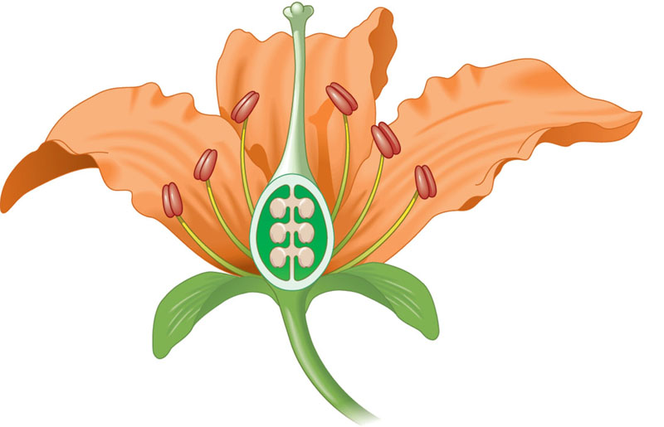
The structure of an idealized flower
Carpel
Stigma
Stamen
Anther
Style
Filament
Ovary
Petal
Sepal
Receptacle
Ovule

Slide 6
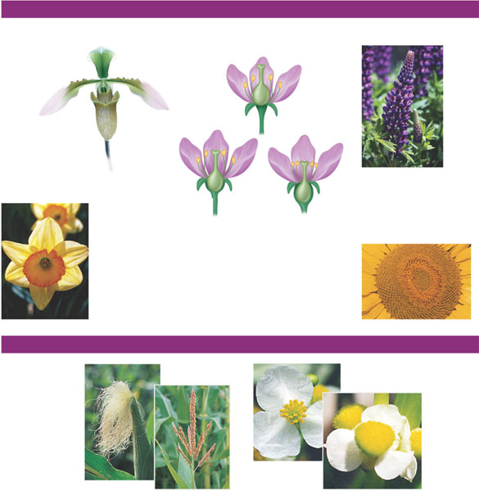
Floral Variations
SYMMETRY
OVARY LOCATION
FLORAL DISTRIBUTION
Lupine inflorescence
Bilateral symmetry
(orchid)
Superior
ovary
Sunflower inflorescence. A
Sunflower’s central disk actually consists of hundreds of tiny
incomplete flowers. What look like petals are actually sterile flowers.
Sepal
Semi-inferior ovary
Inferior ovary
Radial symmetry
(daffodil)
Fused petals
REPRODUCTIVE VARIATIONS
Maize, a monoecious species. A maize “ear” (left) consists
of kernels (one-seeded fruits) that develop from an
inflorescence of fertilized carpellate flowers. Each kernel is derived
from a single flower. Each “silk” strand consists of a stigma
and long style. The tassels (right) are staminate inflorescences.
Dioecious Sagittaria latifolia (common
arrowhead). The staminate flower (left) lacks
carpels, and the carpellate flower (right) lacks
stamens. Having these two types of flowers on
separate plants reduces inbreeding.

Slide 7
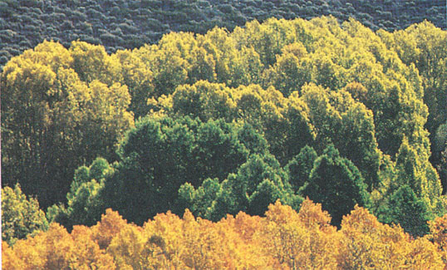
Asexual reproduction in aspen trees

Slide 8
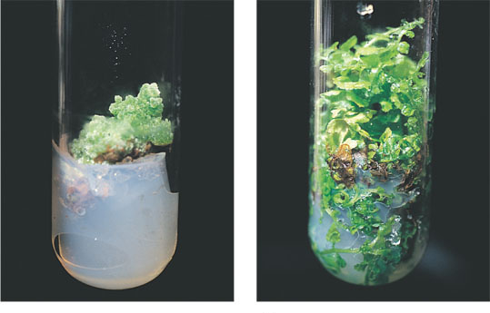
Test-tube cloning of carrots
(a)
Just a few parenchyma cells from a
carrot gave rise to this callus, a mass
of undifferentiated cells.
(b)
The callus differentiates into an entire
plant, with leaves, stems, and roots.

Slide 9
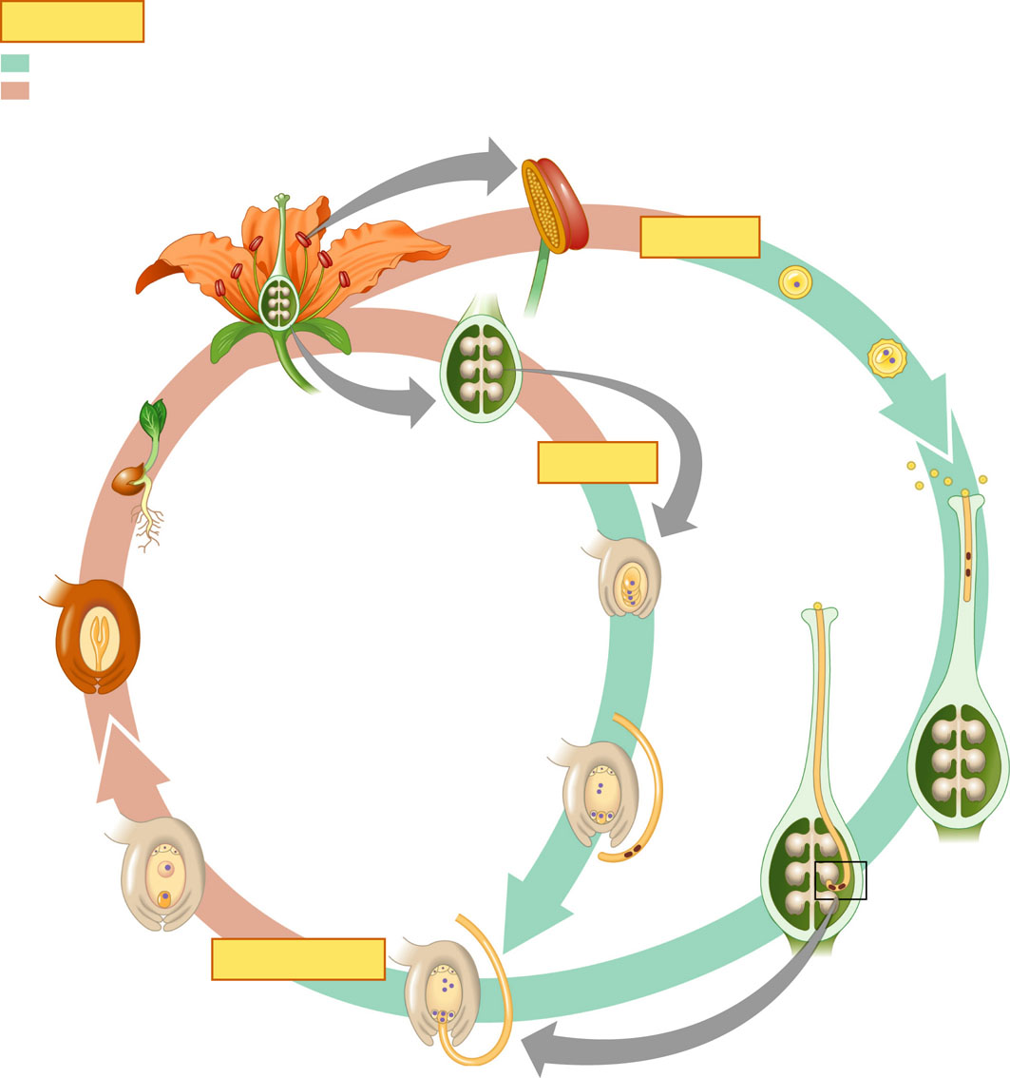
The life cycle of an angiosperm
Key
Haploid (n)
Diploid (2n)
Anther
Microsporangium
Microsporocytes (2n)
Mature flower on
sporophyte plant
(2n)
MEIOSIS
Microspore (n)
Generative cell
Ovule with
megasporangium (2n)
Male gametophyte
(in pollen grain)
Tube cell
Ovary
Pollen
grains
Germinating
seed
MEIOSIS
Stigma
Megasporangium
(n)
Pollen
tube
Embryo (2n)
Sperm
Endosperm
(food
supply) (3n)
Pollen
tube
Seed
Surviving
megaspore
(n)
Seed coat (2n)
Style
Female gametophyte
(embryo sac)
Antipodal cells
Polar nuclei
Synergids
Egg (n)
Pollen
tube
Zygote (2n)
Egg
nucleus (n)
Nucleus of
developing
endosperm
(3n)
Sperm
(n)
FERTILIZATION
Discharged
sperm nuclei (n)

Slide 10
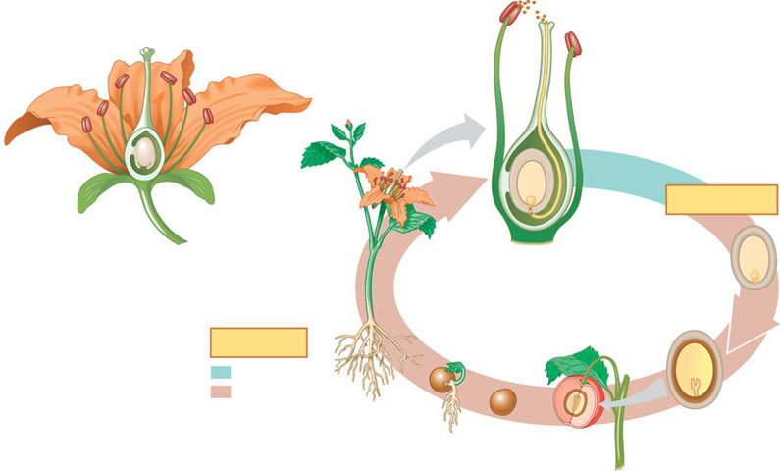
An overview of angiosperm reproduction
Germinated pollen grain
(n) (male gametophyte)
on stigma of carpel
Stigma
Anther at
tip of stamen
Stamen
Anther
Carpel
Style
Filament
Ovary
Ovary (base of carpel)
Pollen tube
Ovule
Embryo sac (n)
(female gametophyte)
Sepal
Egg (n)
FERTILIZATION
Petal
Receptacle
Sperm (n)
Zygote
(2n)
(a) An idealized flower.
Mature sporophyte
plant (2n) with
flowers
Seed
(develops
from ovule)
Key
Seed
Haploid (n)
Diploid (2n)
(a) Simplified angiosperm life cycle. See Figure 30.10 for a more detailed version of the life cycle, including meiosis.
Germinating
seed
Embryo (2n)
(sporophyte)
Simple fruit
(develops from ovary)

Slide 11
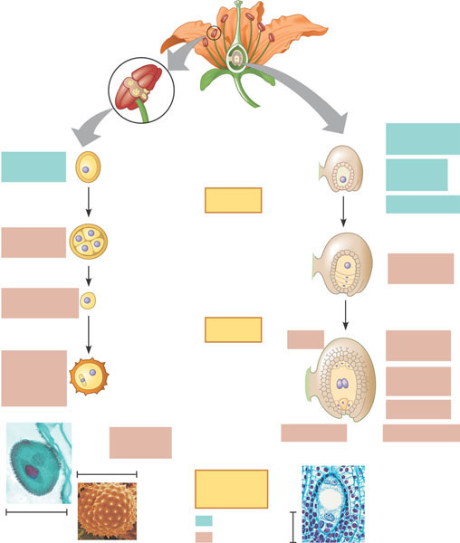
The development of angiosperm gametophytes (pollen grains and embryo sacs)
(a)
Development of a male gametophyte
(pollen grain). Pollen grains develop
within the microsporangia (pollen
sacs) of anthers at the tips of the
stamens.
(b)
Development of a female gametophyte
(embryo sac). The embryo sac develops
within an ovule, itself enclosed by the
ovary at the base of a carpel.
Pollen sac
(microsporangium)
1
Each one of the
microsporangia
contains diploid
microsporocytes
(microspore
mother cells).
Mega-
sporangium
1
Within the ovule’s
megasporangium
is a large diploid
cell called the
megasporocyte
(megaspore
mother cell).
Micro-
sporocyte
Ovule
Mega-
sporocyte
MEIOSIS
Integuments
2
Each microsporo-
cyte divides by
meiosis to produce
four haploid
microspores,
each of which
develops into
a pollen grain.
Micro-
Spores (4)
Micropyle
The megasporo-
cyte divides by
meiosis and gives
rise to four haploid
cells, but in most
species only one
of these survives
as the megaspore.
2
Surviving
megaspore
Each of 4
microspores
Female gametophyte
(embryo sac)
MITOSIS
Ovule
Antipodel
Cells (3)
Generative
cell (well
form 2
sperm)
Male
Gametophyte
(pollen grain)
3
A pollen grain becomes a
mature male gametophyte
when its generative nucleus
divides and forms two sperm.
This usually occurs after a
pollen grain lands on the stigma
of a carpel and the pollen
tube begins to grow. (See
Figure 38.2b.)
Polar
Nuclei (2)
3
Three mitotic divisions
of the megaspore form
the embryo sac, a
multicellular female
gametophyte. The
ovule now consists of
the embryo sac along
with the surrounding
integuments (protective
tissue).
Egg (1)
Nucleus
of tube cell
Integuments
Synergids (2)
20 μm
Key
To labels
Ragweed
Pollen
grain
Embryo
sac
75 μm
Haploid (2n)
100μ m
100 μm
Diploid (2n)
Diploid (2n)

Slide 12
Growth of the pollen tube and double fertilization
Pollen grain
Stigma
If a pollen grain
germinates, a pollen tube
grows down the style
toward the ovary.
Pollen tube
1
2 sperm
Style
Polar
nuclei
Ovary
Ovule (containing
female
Gametophyte, or
Embryo sac)
Egg
Micropyle
The pollen tube
discharges two sperm into
the female gametophyte
(embryo sac) within an ovule.
2
Ovule
Polar nuclei
Egg
Two sperm
about to be
discharged
One sperm fertilizes
the egg, forming the zygote.
The other sperm combines with
the two polar nuclei of the embryo
sac’s large central cell, forming
a triploid cell that develops into
the nutritive tissue called
endosperm.
3
Endosperm nucleus (3n)
(2 polar nuclei plus sperm)
Zygote (2n)
(egg plus sperm)

Slide 13
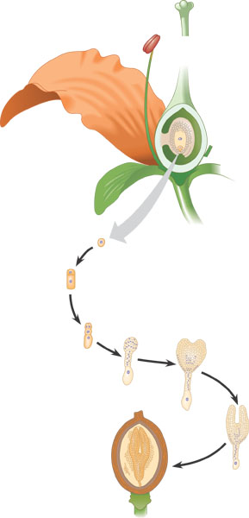
The development of a eudicot plant embryo
Ovule
Endosperm
nucleus
Integuments
Zygote
Zygote
Terminal cell
Basal cell
Proembryo
Suspensor
Basal cell
Cotyledons
Shoot
apex
Root
apex
Seed coat
Suspensor
Endosperm
Suspensor

Slide 14
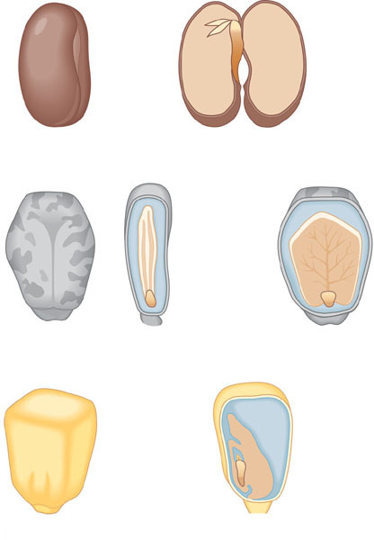
Seed structure
Seed coat
Epicotyl
Hypocotyl
Radicle
Cotyledons
(a) Common garden bean, a eudicot with thick cotyledons. The
fleshy cotyledons store food absorbed from the endosperm before
the seed germinates.
Seed coat
Endosperm
Cotyledons
Epicotyl
Hypocotyl
Radicle
(b) Castor bean, a eudicot with thin cotyledons. The narrow,
membranous cotyledons (shown in edge and flat views) absorb
food from the endosperm when the seed germinates.
Pericarp fused
with seed coat
Scutellum
(cotyledon)
Endosperm
Coleoptile
Epicotyl
Coleorhiza
Hypocotyl
Radicle
(c) Maize, a monocot. Like all monocots, maize has only one
cotyledon. Maize and other grasses have a large cotyledon called a
scutellum. The rudimentary shoot is sheathed in a structure called
the coleoptile, and the coleorhiza covers the young root.

Slide 15
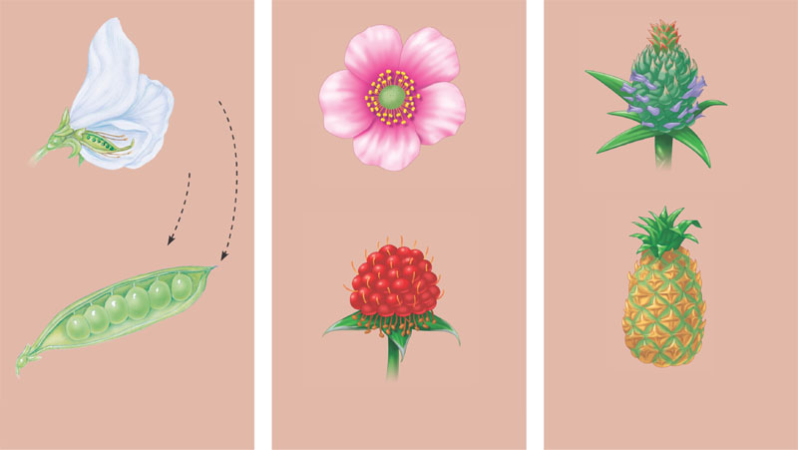
Developmental origin of fruits
Carpels
Flower
Stamen
Ovary
Stigma
Stamen
Ovule
Pea flower
Raspberry flower
Pineapple inflorescence
Carpel
(fruitlet)
Each
segment
develops
from the
carpel of
one flower
Stigma
Seed
Ovary
Stamen
Pea fruit
Raspberry fruit
Pineapple fruit
(a)
Simple fruit. A simple fruit
develops from a single carpel (or
several fused carpels) of one flower
(examples: pea, lemon, peanut).
(b)
Aggregate fruit. An aggregate fruit
develops from many separate
carpels of one flower (examples:
raspberry, blackberry, strawberry).
(c)
Multiple fruit. A multiple fruit
develops from many carpels
of many flowers (examples:
pineapple, fig).

Slide 16
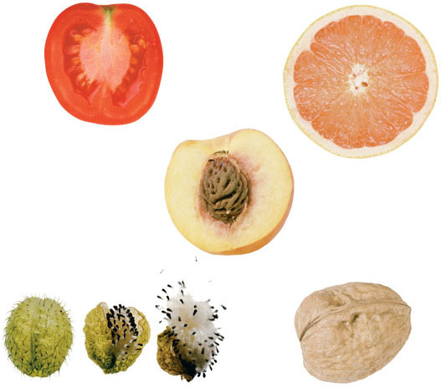
Some variations in fruit structure
(a)
Tomato, a fleshy fruit with
soft outer and inner layers
of pericarp
(b)
Ruby grapefruit, a fleshy fruit
with a hard outer layer and
soft inner layer of pericarp
(c)
Nectarine, a fleshy
fruit with a soft outer
layer and hard inner
layer (pit) of pericarp
(d)
Milkweed, a dry fruit that
splits open at maturity
(e)
Walnut, a dry fruit that
remains closed at maturity

Slide 17
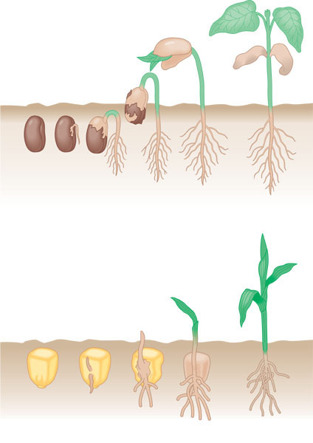
Two common types of seed germination
Foliage leaves
Cotyledon
Hypocotyl
Epicotyl
Cotyledon
Cotyledon
Hypocotyl
Hypocotyl
Radicle
Seed coat
(a)
Common garden bean. In common garden
beans, straightening of a hook in the
hypocotyl pulls the cotyledons from the soil.
Foliage leaves
Coleoptile
Coleoptile
Radicle
(b)
Maize. In maize and other grasses, the shoot grows
straight Up through the tube of the coleoptile.

Slide 18
Flower-pollinator relationships
(a)
A flower pollinated by honeybees.
This honeybee is harvesting pollen
and Nectar (a sugary solution secreted
by flower glands) from a Scottish
broom flower. The flower has a tripping
Mechanism that arches the stamens
over the bee and dusts it with pollen,
some of which will rub off onto the
stigma of the next flower the bee visits.
(b)
A flower pollinated by hummingbirds.
The long, thin beak and tongue of this
rufous hummingbird enable the animal
to probe flowers that secrete nectar
deep within floral tubes. Before the
hummer leaves, anthers will dust its
beak and head feathers with pollen.
Many flowers that are pollinated by
birds are red or pink, colors to which
bird eyes are especially sensitive.
(c)
A flower pollinated by nocturnal animals.
Some angiosperms, such as this cactus,
depend mainly on nocturnal pollinators,
including bats. Common adaptations
of such plants include large, light-colored,
highly fragrant flowers that nighttime
pollinators can locate.

Slide 19
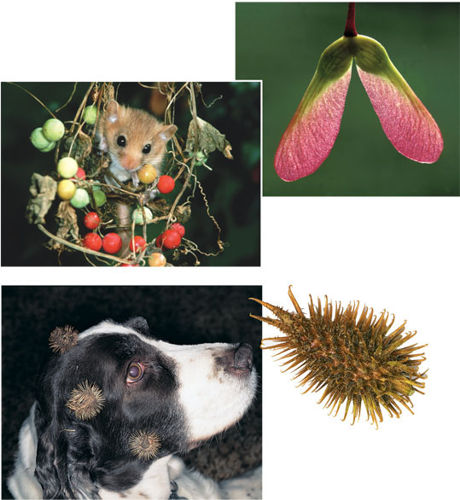
Fruit adaptations that enhance seed dispersal
(a)
Wings enable maple fruits
to be easily carried by the wind.
(b)
Seeds within berries and other
edible fruits are often dispersed
in animal feces.
(c)
The barbs of cockleburs
facilitate seed dispersal by
allowing the fruits to
“hitchhike” on animals.

Slide 20
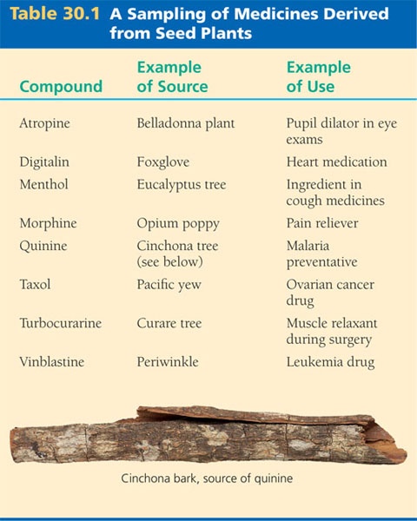
A Sampling of Medicines Derived from Seed Plants

Slide 21
Review Questions
0

Slide 22
1. What is the relationship between pollination and fertilization in flowering plants? *
Fertilization precedes pollination.
Pollination easily occurs between plants of different species.
Pollen is formed within megasporangia so that male and female gametes are near each other.
Pollination brings gametophytes together so that fertilization can occur.
If fertilization occurs, pollination is unnecessary.
Notes:
Answer: d
Source: Barstow - Test Bank for Biology, Sixth Edition, Question #34.
Discussion Notes for the Instructor
This question focuses on the conceptual difference between pollination and fertilization.
The follow-up questions might include
• What is the difference between pollination and fertilization?
• Where does pollination take place?
• Where does fertilization take place?

Slide 23
2. Assume that a botanist was visiting a tropical region for the purpose of discovering plants with medicinal properties. All of the following might be ways of identifying potentially useful plants except
observing which plants sick animals seek out.
observing which plants are the most used food plants.
observing which plants animals do not eat.
collecting plants and subjecting them to chemical analysis.
asking local people which plants they use as medicine.
Notes:
Answer: b
Source: Barstow - Test Bank for Biology, Sixth Edition, Question #52.

Slide 24
The following questions relate to the following parts of a flower:
Petals
Sepals
Stamen
Stigma
Ovary
Site of pollen development
Site of fertilization
Used to attract pollinators
Recieves pollen
Notes:
Answer: b
Source: Barstow - Test Bank for Biology, Sixth Edition, Question #52.

