Slide 1
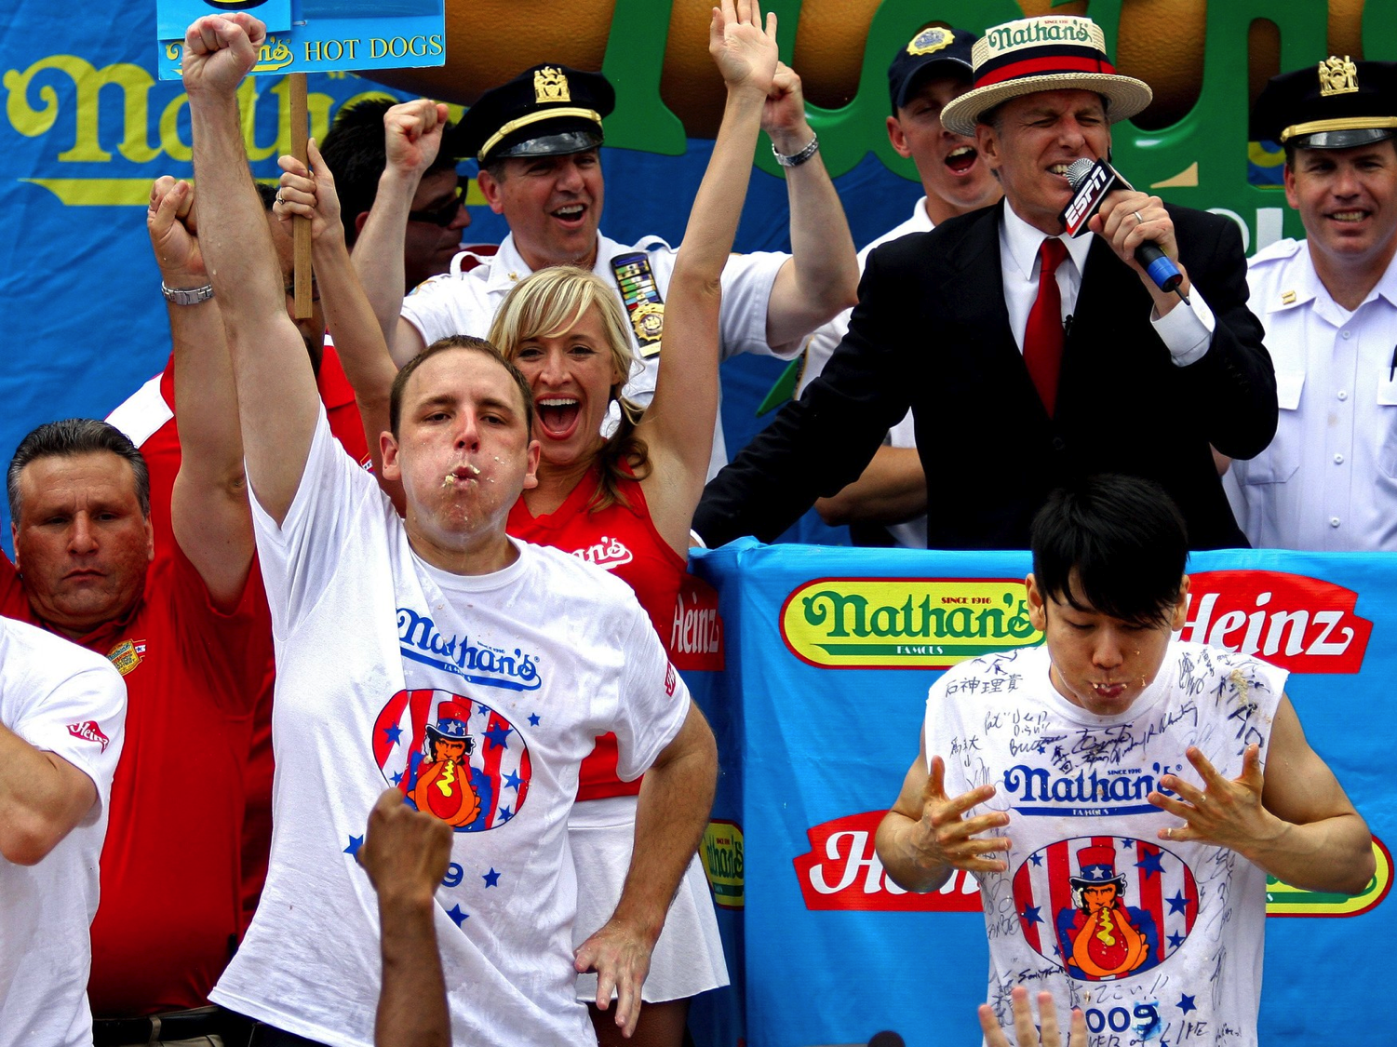
Animal Nutrition
Animal Nutrition
(Ch. 41)

Slide 2
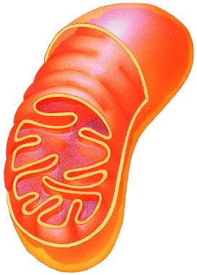
What do animals need to live?
Animals make energy
using:
  food
  oxygen
Animals build bodies
using:
  food for raw materials
    amino acids, sugars,
    fats, nucleotides
  ATP energy for synthesis
food
ATP
O₂

Slide 3
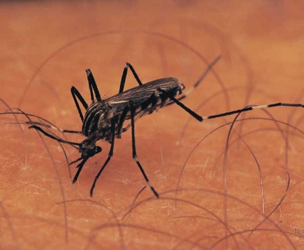
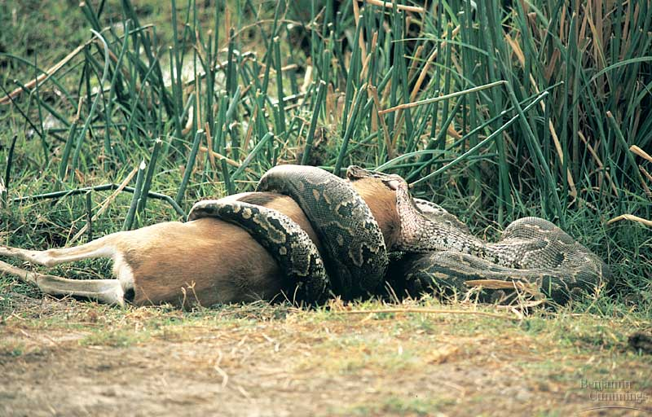
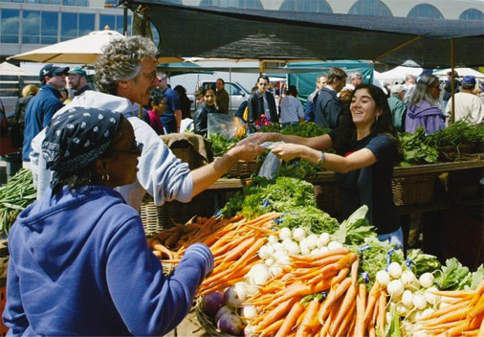
Nutritional requirements
Animals are heterotrophs
  need to take in food
  Why? fulfills 3 needs…
    fuel = chemical energy for production of ATP
    raw materials = carbon source for synthesis
    essential nutrients = animals cannot make
      elements (N, P, K, Fe, Na, K, Ca...), NAD, FAD, etc.

Slide 4
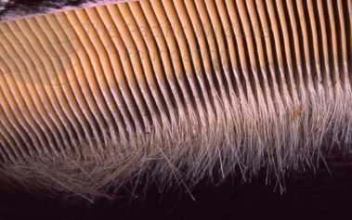
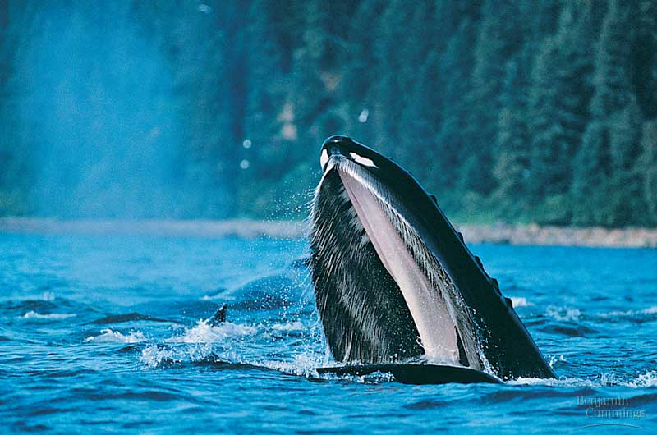
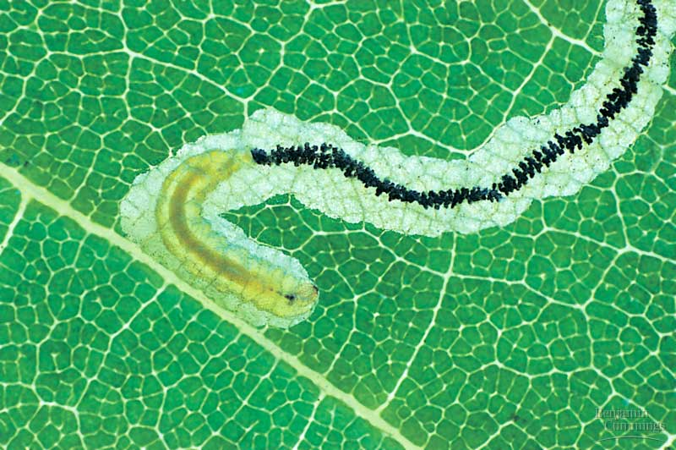
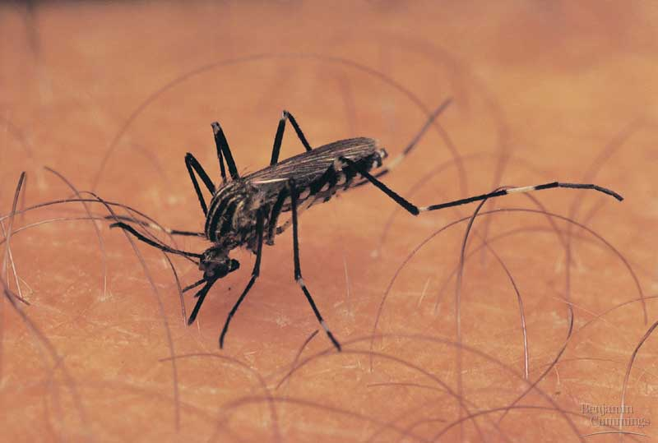
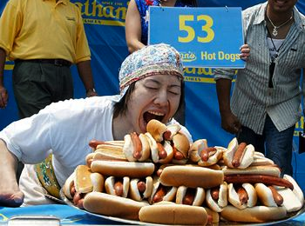
How do animals get their food?
filter (suspension) feeding
substrate feeding
fluid feeding
bulk feeding

Slide 6

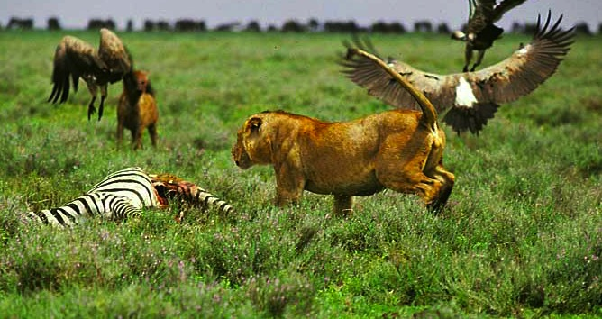
Different diets; different lives
All animals eat other organisms
  Herbivores
    eat mainly plants
      gorillas, cows,
      rabbits, snails
  Carnivores
    eat other animals
      sharks, hawks, spiders, snakes
  Omnivores
    eat animals & plants
      cockroaches, bears, raccoons, humans
      humans evolved as hunters, scavengers & gatherers

Slide 7
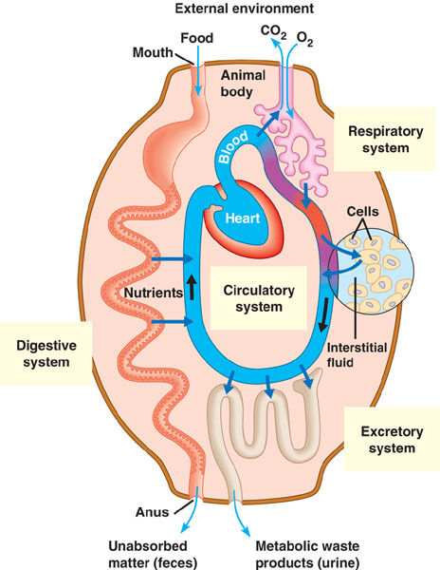
Generalized Animal Body Plan

Slide 8
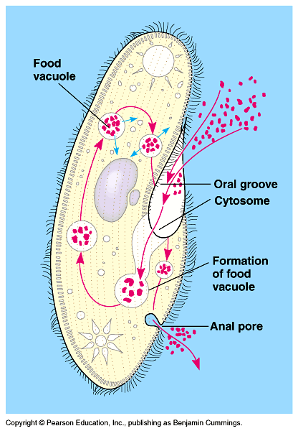
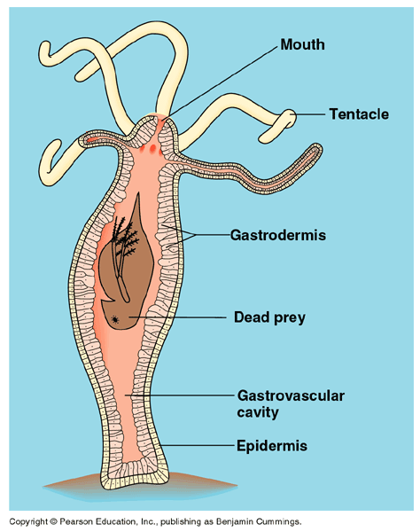
Getting & Using Food
Ingest
  taking in food
Digest
  mechanical digestion
    Breaking food into smaller pieces
  chemical digestion
    breaking down food into small molecules to be absorbed into cells
Absorb
  absorb across cell membrane
    Diffusion, active transport
Eliminate
  undigested extracellular material passes out of digestive system
intracellular
digestion
extracellular
digestion

Slide 9
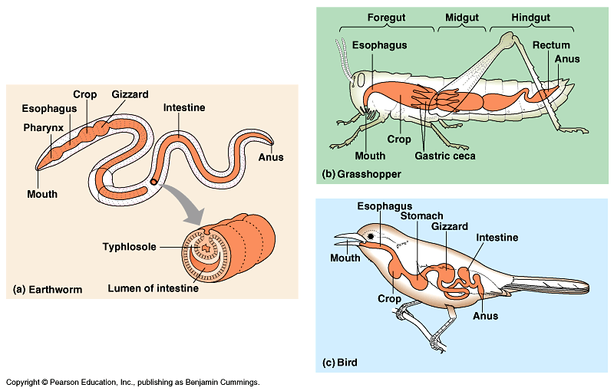
Digestive systems
Everybody’s got one!

Slide 10
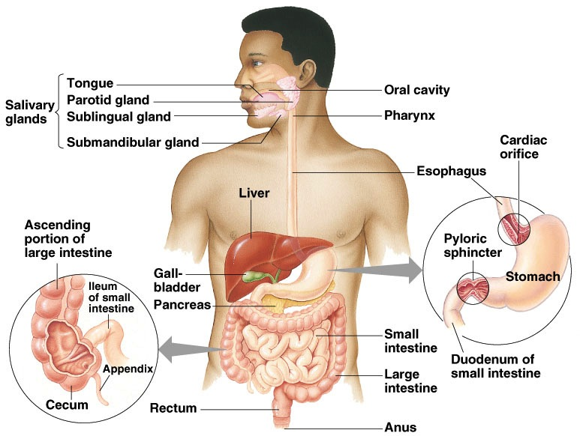
Human digestive system
Alimentary Canal
Notes:
After chewing and swallowing, it takes 5 to 10 seconds for food to pass down the esophagus to the stomach, where it spends 2 to 6 hours being partially digested.
Final digestion and nutrient absorption occur in the small intestine over a period of 5 to 6 hours.
In 12 to 24 hours, any undigested material passes through the large intestine, and feces are expelled through the anus.

Slide 11
Common processes & structures
Movement & Control
  peristalsis
    push food along by rhythmic waves of smooth muscle contraction in walls of digestive system
  sphincters
    muscular ring-like valves, regulate the passage of material between sections of digestive system
Accessory glands
  salivary glands, pancreas, liver & gall bladder
    secrete digestive juices (enzymes & fluid)

Slide 12
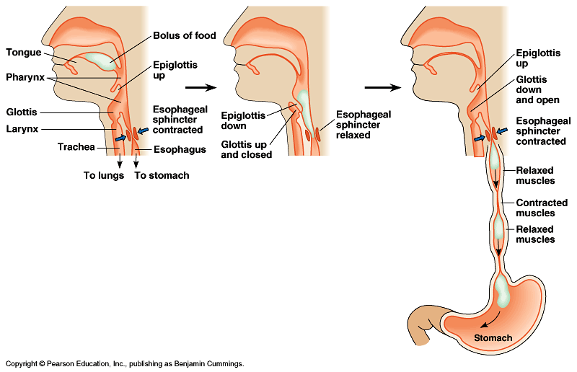
Swallowing (& not choking)
Epiglottis
  problem: breathe & swallow through same orifice
  flap of cartilage closes trachea (windpipe) when swallowing
  food travels down esophagus
Esophagus
  move food along to stomach by peristalsis

Slide 13
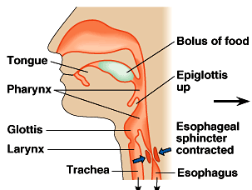
Ingestion
Mouth
  mechanical digestion
    Teeth: breaking up food
  chemical digestion
    saliva
      Amylase: enzyme digests starch
      Mucin: slippery protein (mucus). Protects lining of digestive system, lubricates food.
      Buffers: neutralize acid to prevent tooth decay
      anti-bacterial chemicals: lysozyme.

Slide 14
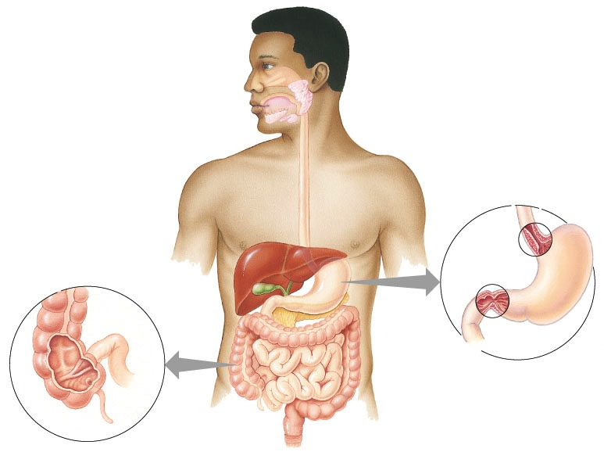
mouth
▪break up food
▪moisten food
▪digest starch
▪kill germs

Slide 15
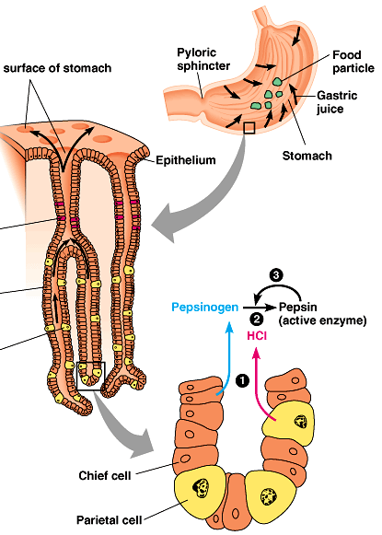
Stomach
Ooooooh!
Zymogen!
Functions
  food storage: can stretch to fit ~2L food
  disinfect food
    HCl = pH 2
      kills bacteria, breaks apart cells
  chemical digestion
    Pepsin: enzyme breaks down proteins
      secreted as pepsinogen
        activated by HCl
But the stomach is made out of protein!
What stops the stomach from digesting itself?
mucus secreted by stomach cells protects stomach lining
Notes:
Still, the epithelium is continually eroded, and the epithelium is completely replaced by mitosis every three days.
Gastric ulcers, lesions in the stomach lining, are caused by the acid-tolerant bacterium Heliobacter pylori.
Ulcers are often treated with antibiotics.
Pepsin is secreted in an inactive form, called pepsinogen by specialized chief cells in gastric pits.
Parietal cells, also in the pits, secrete hydrochloric acid which converts pepsinogen to the active pepsin only when both reach the lumen of the stomach, minimizing self-digestion.
Also, in a positive-feedback system, activated pepsin can activate more pepsinogen molecules.

Slide 16
mouth
▪break up food
▪moisten food
▪digest starch
▪kill germs
stomach
▪kills germs
▪store food
▪break up food
▪digest proteins
cardiac
sphincter
pyloric
sphincter

Slide 17
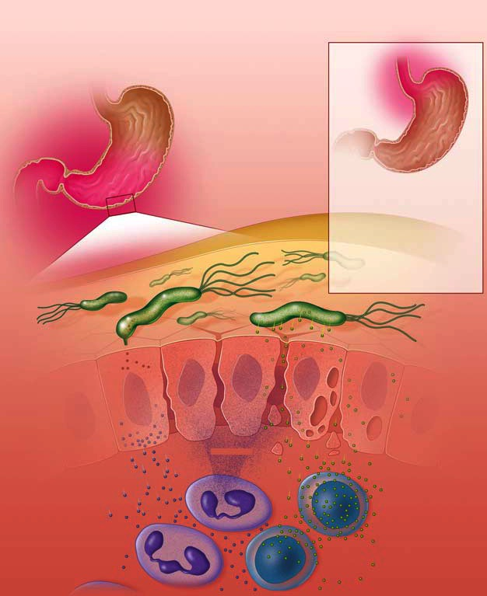
Ulcers
Coevolution of parasite & host
Used to think ulcers were caused by stress
  tried to control with antacids
Now know ulcers caused by bacterial infection of stomach
  Helicobacter pylori
  now cure with antibiotics
Colonized by
H. pylori
Free of
H. pylori
inflammation of stomach
inflammation of esophagus
H. pylori
inflammatory proteins
(CagA)
cell damaging proteins
(VacA)
cytokines
helper T cells
neutrophil cells
white blood cells

Slide 18

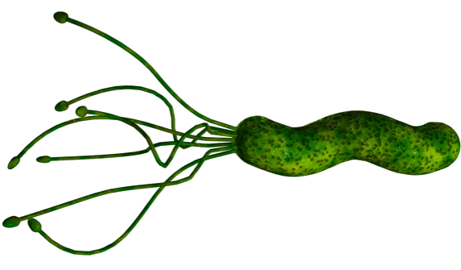
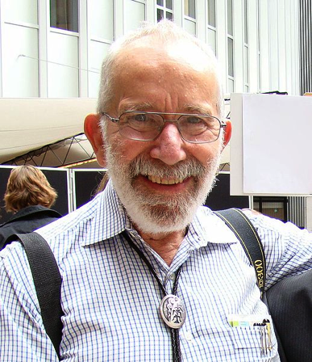
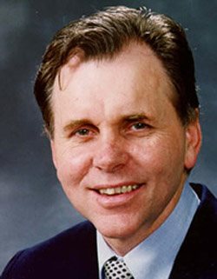
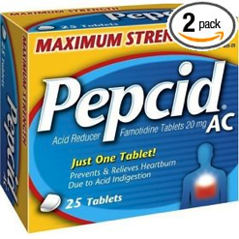
Revolutionizing healthcare
1982 | 2005
"for their discovery of the bacterium Helicobacter pylori and its role in gastritis and peptic ulcer disease"
Helicobacter pylori
J. Robin Warren
Barry Marshall

Slide 19

Small intestine
Function
  major organ of digestion & absorption
  chemical digestion: digestive enzymes
  absorption through lining: over 6 meters!
    small intestine has huge surface area = 300m² (~size of tennis court)
Structure
  3 sections
    duodenum = most digestion
    jejunum = absorption of nutrients & water
    ileum = absorption of nutrients & water
Notes:
About every 20 seconds, the stomach contents are mixed by the churning action of smooth muscles.
As a result of mixing and enzyme action, what begins in the stomach as a recently swallowed meal becomes a nutrient-rich broth known as acid chyme.
At the opening from the stomach to the small intestine is the pyloric sphincter, which helps regulate the passage of chyme into the intestine.
A squirt at a time, it takes about 2 to 6 hours after a meal for the stomach to empty.

Slide 20
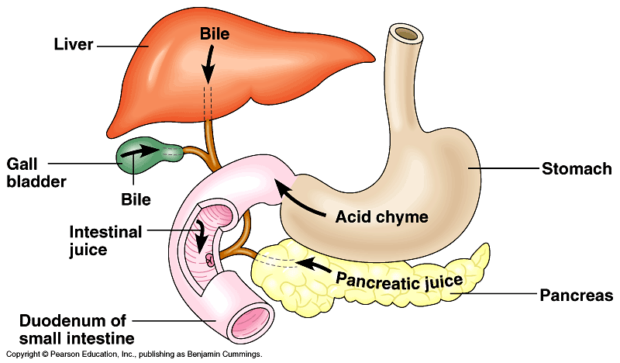
Duodenum
1st section of small intestines
  acid food from stomach mixes with digestive juices from accessory glands:
pancreas
liver
gall bladder

Slide 21
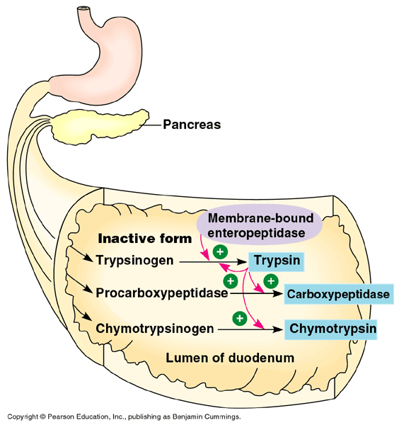
Pancreas
What stops
pancreas
from digesting
itself
Ooooooh!
Zymogen!
Digestive enzymes
  peptidases
    trypsin
      trypsinogen
    chymotrypsin
      chimotrypsinogen
    carboxypeptidase
      procarboxypeptidase
  pancreatic amylase
Buffers
  reduces acidity
    alkaline solution rich in bicarbonate (HCO₃-)
    buffers acidity of material from stomach
small intestines
Explain how this is a molecular example of structure-function theme.

Slide 22
mouth
▪break up food
▪moisten food
▪digest starch
▪kill germs
stomach
▪kills germs
▪break up food
▪digest proteins
▪store food
pancreas
▪produces enzymes to
digest proteins & starch

Slide 23
Liver
Digestive System Functions
  produces bile
    stored in gallbladder until needed
    breaks up fats
      act like detergents to breakup fats
Circulatory System Connection
bile contains colors from old red blood cells collected in liver =
iron in RBC rusts & makes feces brown

Slide 24
mouth
▪break up food
▪moisten food
▪digest starch
▪kill germs
stomach
▪kills germs
▪break up food
▪digest proteins
▪store food
liver
▪produces bile
- stored in gall bladder
▪break up fats
pancreas
▪produces enzymes to
digest proteins & starch

Slide 25
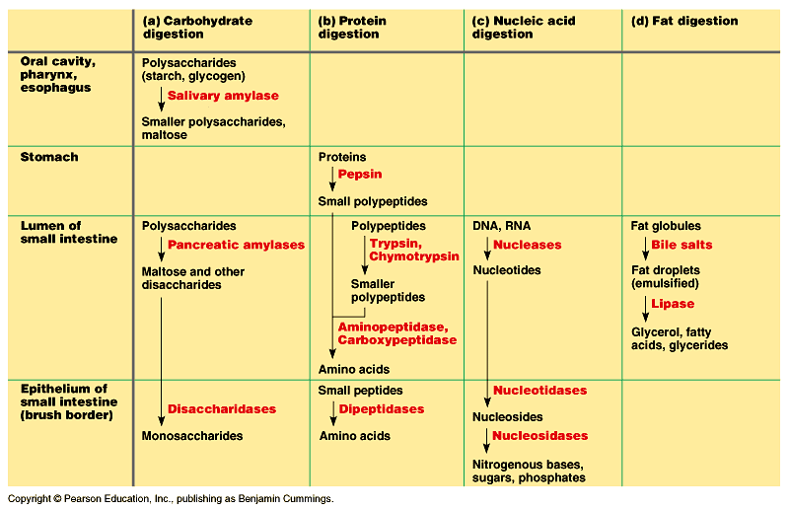
Digestive enzymes

Slide 26
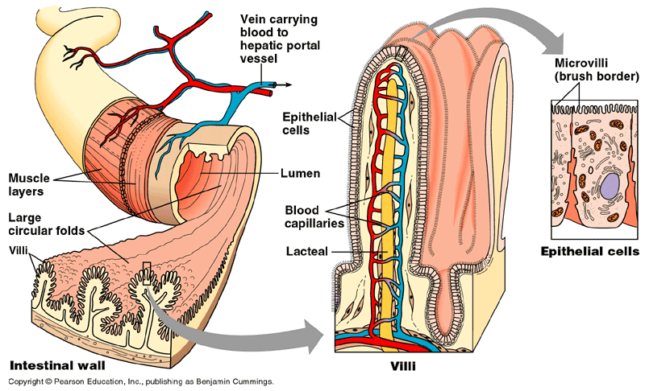
Absorption by Small Intestines
Absorption through villi & microvilli
  finger-like projections
    increase surface area for absorption
Ooooh…
Structure-Function
theme!

Slide 27
Absorption of Nutrients
Passive transport
  fructose
Active (protein pumps) transport
  pump amino acids, vitamins & glucose
    against concentration gradients across intestinal cell membranes
    allows intestine to absorb much higher proportion of nutrients in the intestine than would be possible with passive diffusion
      worth the cost of ATP!
nutrients are valuable…
grab all you can get!

Slide 28
mouth
▪break up food
▪moisten food
▪digest starch
▪kill germs
stomach
▪kills germs
▪break up food
▪digest proteins
▪store food
liver
▪produces bile
- stored in gall bladder
▪break up fats
small intestines
▪breakdown all foods
- proteins
- starch
- fats
- nucleic acids
▪absorb nutrients
pancreas
▪produces enzymes to
digest proteins & starch

Slide 29
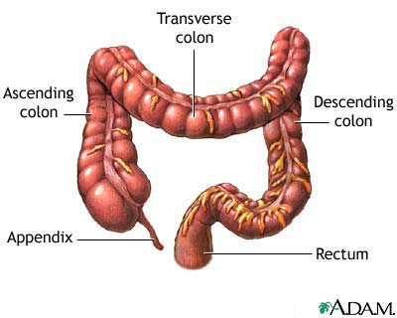
Large intestines (colon)
Function
  re-absorb water
    use ~9 liters of water every
    day in digestive juices
    > 90% of water reabsorbed
      not enough water absorbed
      back to body
        diarrhea
      too much water absorbed back to body
        constipation

Slide 30

Flora of large intestines
You’ve got
company!
Living in the large intestine is a rich
flora of harmless, helpful bacteria
  Escherichia coli (E. coli)
    a favorite research organism
  bacteria produce vitamins
    vitamin K; biotin, folic acid & other B vitamins
  generate gases
    by-product of bacterial
    metabolism
    methane, hydrogen sulfide
Notes:
Folic acid: coenzyme needed for DNA & RNA synthesis and proper neural tube growth, may have role in cancer prevention
Biotin: coenzyme needed for Krebs cycle, fatty acid synthesis & gluconeogenesis

Slide 31


Rectum
Last section of colon (large intestines)
  eliminate feces
    undigested materials
      extracellular waste
        mainly cellulose from plants
        roughage or fiber
    salts
    masses of
    bacteria
Notes:
The study of the rabbit is fascinating, and from periods of quiet observation we learn some of the peculiarities of its life and habits. One of the most interesting of these is coprophagy. The word comes from the Greek kopros (dung) and phago (eating). This dung eating is not quite so revolting as it sounds at first, for the rabbit makes a special form of pellet which it takes directly from its anus. Coprophagy plays an important part in the digestive/nutritional process.
This practice involves ingestion of special soft fecal pellets which are excreted in the early morning hours. This is a significant practice in that the bacterial synthesis of certain B vitamins in the cecum are excreted at this time and if rabbits are prevented from this practice they will die from vitamin B deficiency within a rather short period of time.
The special soft pellets are produced at night or during periods of rest and are often called "nocturnal pellets" to distinguish them from the fecal pellets excreted at other times. The process has a distinct analogy with the chewing of the cud by ruminants.
Like the cow, rabbits are herbivorous and their diet contains a high proportion of crude fiber. The cellulose of the fiber has to be broken down before complete digestion and absorption can take place. The rabbit has a comparatively large caecum and colon to facilitate this. In order to obtain the maximum nutriment from its food the rabbit has developed the habit of coprophagy, passing certain of its intestinal contents through the system twice.
In addition to the improved nutrition, it is possible that the soft pellets fulfill a need to give greater bulk to the stomach contents. The rabbit's stomach and intestines are geared to bulk supplies and under some conditions the diet may lack bulk. The stomach has a comparatively poor muscular action and relies to a great extent on the pressure of successive meals to push the mass of food along the digestive tract.
The composition of the two types of pellets is interesting, the soft pellets having much more protein and less crude fiber. The process is controlled by adrenal glands.

Slide 32
mouth
▪break up food
▪moisten food
▪digest starch
▪kill germs
stomach
▪kills germs
▪break up food
▪digest proteins
▪store food
liver
▪produces bile
- stored in gall bladder
▪break up fats
small intestines
▪breakdown food
- proteins
- starch
- fats
▪absorb nutrients
pancreas
▪produces enzymes to
digest proteins & carbs
large intestines
absorb water

Slide 33
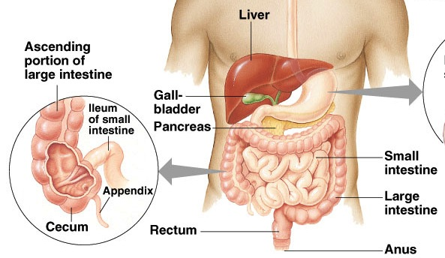
Appendix
Vestigial organ

Slide 34
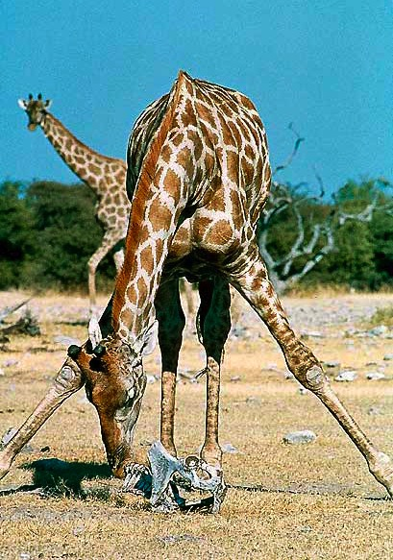
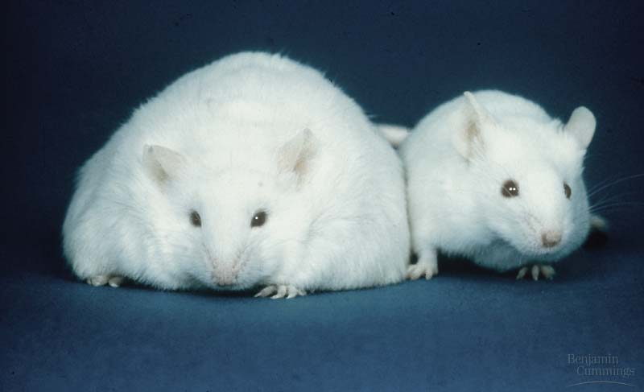
Animal Nutrition
Variations, Adaptations & Regulation
This obese mouse (L) has defect in gene which normally produces leptin, an appetite-regulating protein.
Many herbivores have diets deficient in mineral salts. Must find other sources = salt licks, chewing on bones

Slide 35
Energy budget
{
basal (resting)
metabolism
temperature
regulation
activity
food
intake
ATP
production
{
repair
growth
reproduction
synthesis
{
glycogen
fat
storage

Slide 36
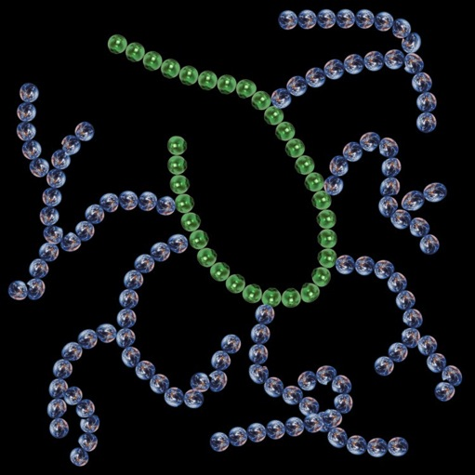

Energy storage
In humans
  glycogen storage
    glucose polymer
  in liver & muscle cells
If glycogen stores are full
& caloric intake still exceeds caloric expenditure
  excess stored as fat
  synthesis pathway
  from acetyl coA
Why is
glycogen highly
branched?

Slide 37



Balancing calorie needs with intake
When fewer calories are taken in than are expended, fuel is taken out of storage deposits & oxidized (digested)
  breakdown (digest) glycogen
  from liver & muscle cells
  metabolize (digest) fat
Just do it!

Slide 38
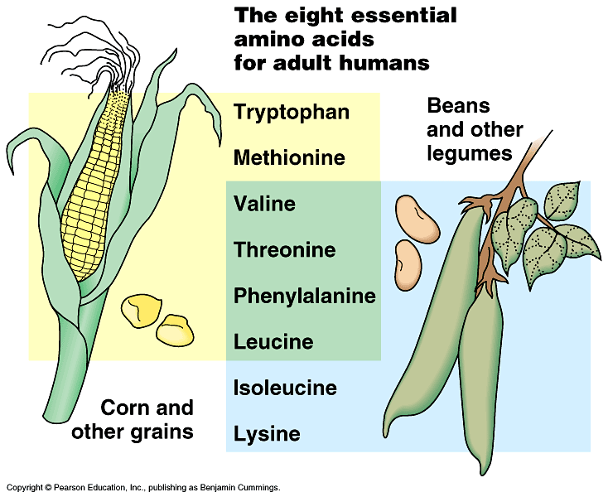
Vegetarian diets
Need to make sure you get enough protein
  20 amino acids to make protein
    humans can synthesize 12 of the amino acids
    8 have to be eaten = “essential amino acids”
  Grains (like corn) have 6 (missing 2)
  Beans (like soybean & red beans) have 6 (missing different 2)
    mix beans & grains
    for complete group of
    amino acids
      rice & beans
      taco/tortilla & beans
      tofu & rice
      peanut butter & bread
What no fish!

Slide 39

Eating a balanced diet
What happens if an animal’s diet is missing an essential nutrient?
  deficiency diseases
    scurvy — vitamin C (collagen production)
    rickets — vitamin D (calcium absorption)
    blindness — vitamin A (retinol production)
    anemia — vitamin B₁₂ (energy production)
    kwashiorkor — protein

Slide 40
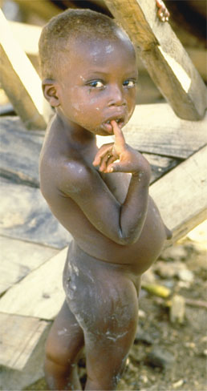
Kwashiorkor (a protein deficiency) in a Haitian boy

Slide 41
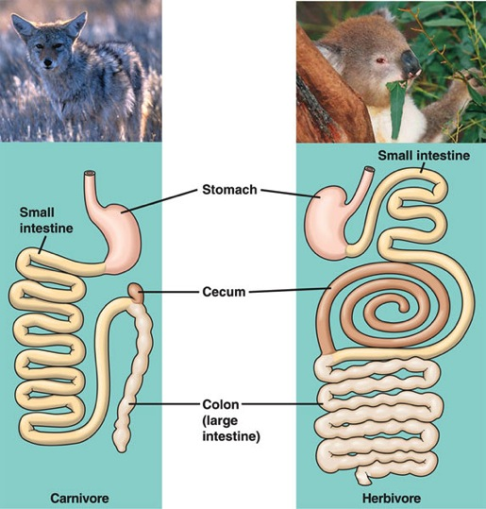
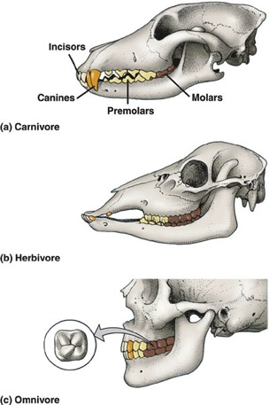
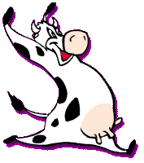
Different diets; different bodies
Adaptations of herbivore vs. carnivore
  specialization in teeth
  length of digestive system
  number & size of stomachs

Slide 42
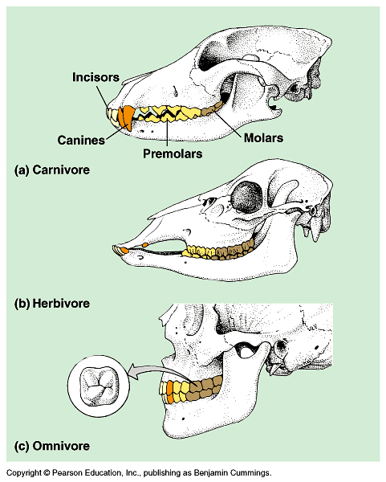
Teeth
Carnivore
  sharp ripping teeth
  “canines”
Herbivore
  wide grinding teeth
  molars
Omnivore
  both kinds of teeth

Slide 43
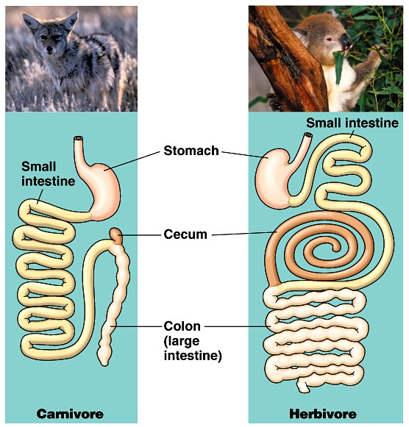
Length of digestive system
Remember
the rabbits,
George!
Carnivores
  short digestive system
    protein easier to digest than cellulose
Herbivores & omnivores
  long digestive system
    more time to digest cellulose
    symbiotic bacteria in gut

Slide 44
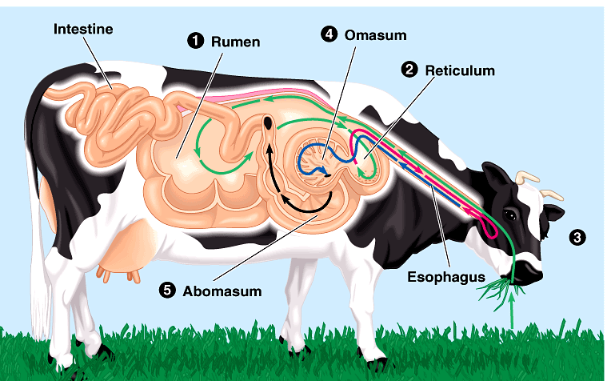
Symbiotic organisms
How can cows digest cellulose efficiently?
  symbiotic bacteria in stomachs help digest cellulose-rich meals
  rabbit vs. cow adaptation: eat feces vs. chew cud
caprohagy
ruminant
Ruminants
additional mechanical digestion by chewing food multiple times after mixing it with enzymes

Slide 45
Managing glucose levels
Mammals regulate use & storage of glucose
  insulin reduces blood glucose levels
    glucose levels rise above set point,
    pancreas secretes insulin
    promotes transport of glucose into cells &
    storage of glucose (as glycogen) in liver & muscle cells
    drops blood glucose levels
  glucagon increases blood glucose levels
    when glucose levels drop below set point,
    pancreas secretes glucagon
    promotes breakdown of glycogen &
    release of glucose into the blood
    raises blood glucose levels
Whoa!
Didn’t realize
I was so busy!

Slide 46

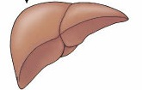
Feedback: Maintaining Homeostasis
insulin
body
cells take
up glucose
from blood
liver stores
glucose as
glycogen
reduces
appetite
pancreas
high
liver
blood glucose level
(90 mg/100 mL blood)
low
liver
releases
glucose
triggers
hunger
pancreas
liver
glucagon

Slide 47
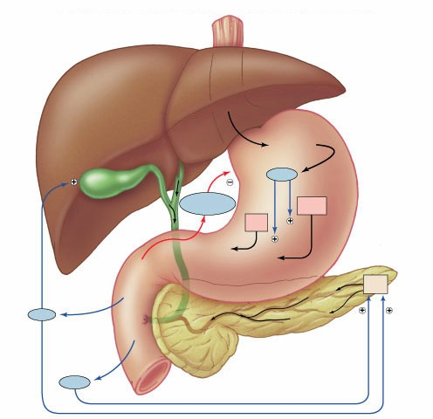
Regulation of Digestion
Coordination of nervous system & endocrine system
Liver
Stomach
Proteins
–
Gastrin
Gallbladder
Gastric
inhibitory
peptide
Bile
+
Parietal
cells
Chief
cells
–
+
+
Pepsin
HCl
Pancreas
Duodenum
Acinar
cells
Fats
Enzymes
+
CCK
–
Bicarbonate
+
+
Secretin
–

Slide 48
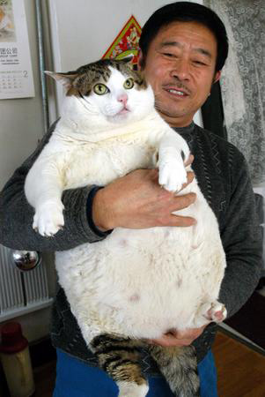
Hungry for Information?
Ask Questions!

Slide 49
Make sure you can do the following:
Label/Identify all organs that play major roles in the digestive system.
Provide at least three examples of physical and chemical digestion and their locations.
Explain the causes of digestive system disruptions and how disruptions of the digestive system can lead to disruptions of homeostasis.

