Slide 1
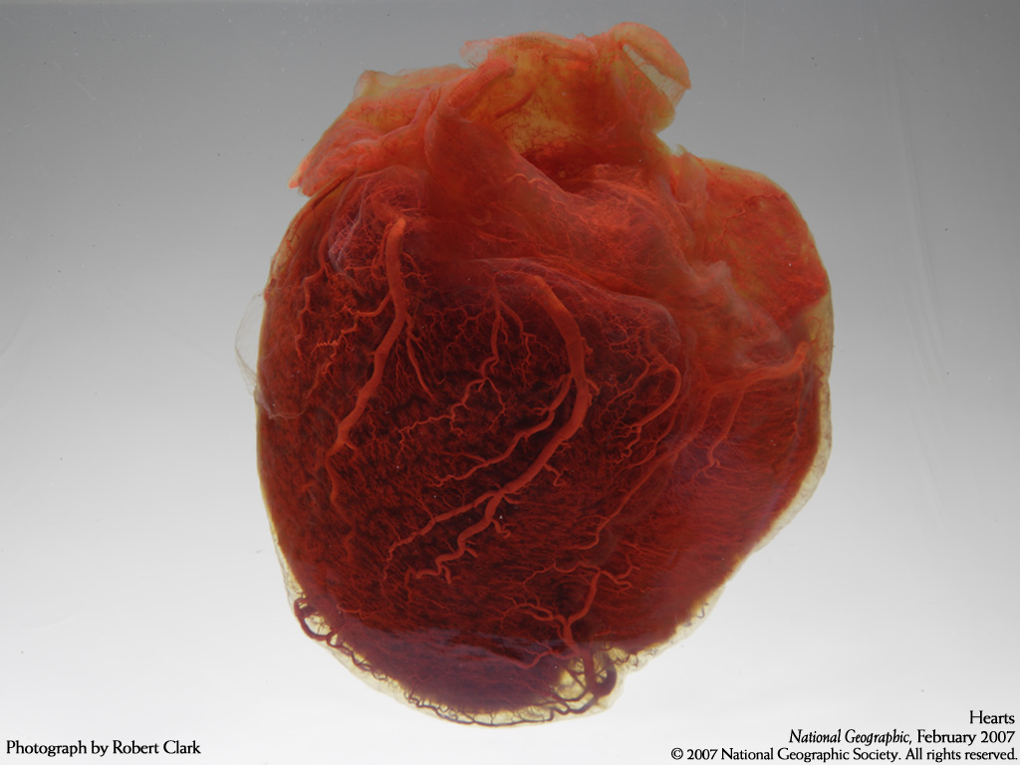
Circulatory Systems
(Ch. 42)
Notes:
Take a look at a skeleton and see how well a heart is protected — open heart surgery takes breaking a body to get to the heart.

Slide 2
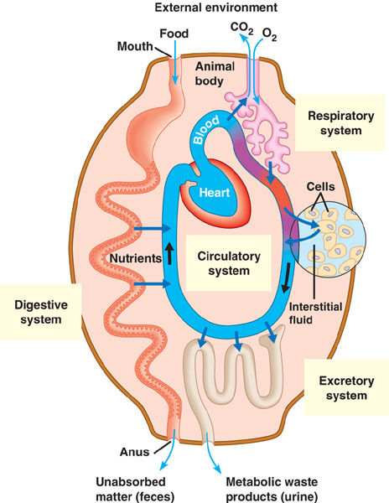

Slide 3
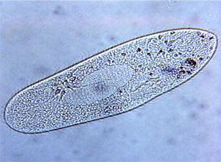
Exchange of materials
Animal cells exchange material across their cell membrane
  fuels for energy
  nutrients
  oxygen
  waste (urea, CO₂)
If you are a 1-cell organism that’s easy!
  diffusion
If you are many-celled that’s harder

Slide 4
Overcoming limitations of diffusion
Diffusion is not adequate for moving material across more than 1-cell barrier
CO₂
CO₂
NH₃
O₂
aa
NH₃
aa
CO₂
NH₃
CH
O₂
CO₂
CO₂
CO₂
CHO
NH₃
aa
O₂
NH₃
NH₃
CO₂
CO₂
CHO
CO₂
aa
NH₃
CH
NH₃
NH₃
CHO
CO₂
CO₂
O₂
aa
CH
aa

Slide 5
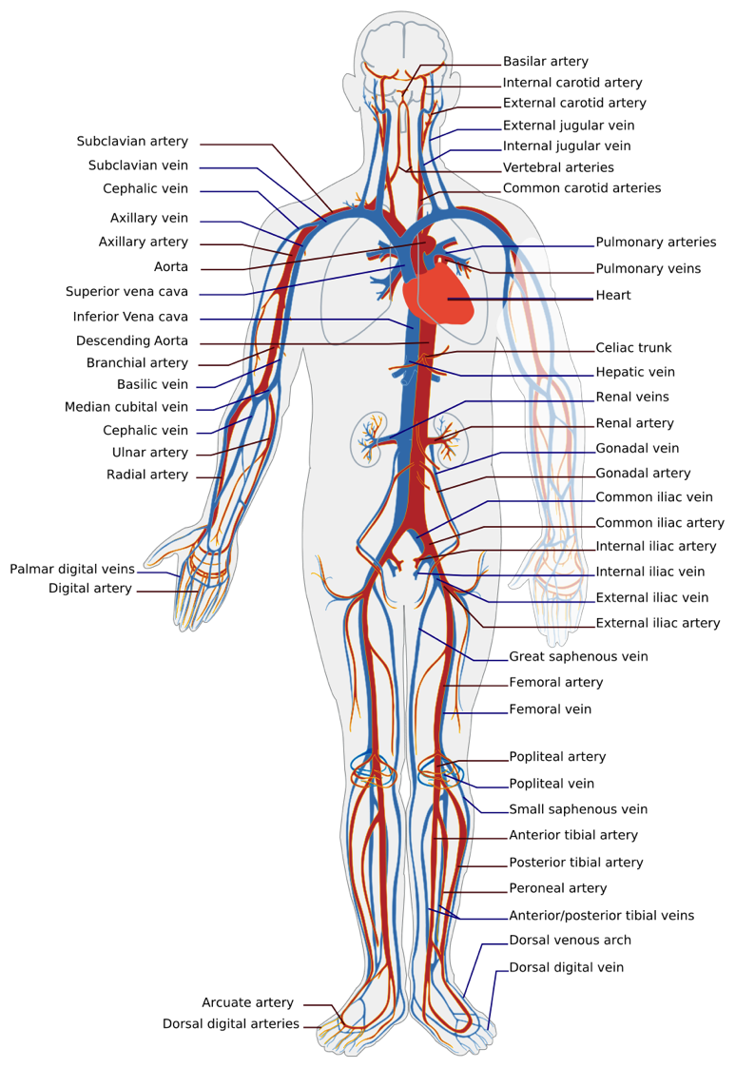
In circulation…
What needs to be transported
  nutrients & fuels
    from digestive system
  respiratory gases
    O₂ & CO₂ from & to gas exchange systems
  intracellular waste
    waste products from cells: water, salts, nitrogenous wastes
  protective agents
    immune defenses
  regulatory molecules
    hormones

Slide 6
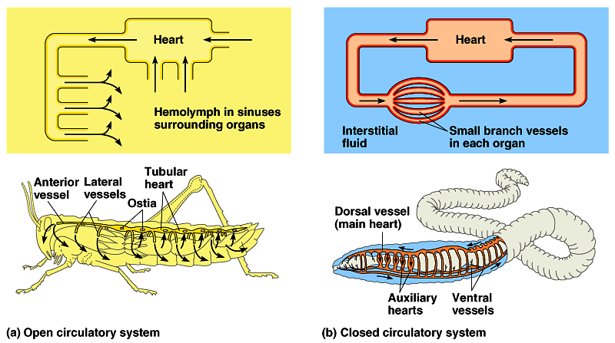
Circulatory systems
All animals have:
  circulatory fluid = “blood”
  tubes = blood vessels
  muscular pump = heart
open
closed
hemolymph
blood

Slide 7
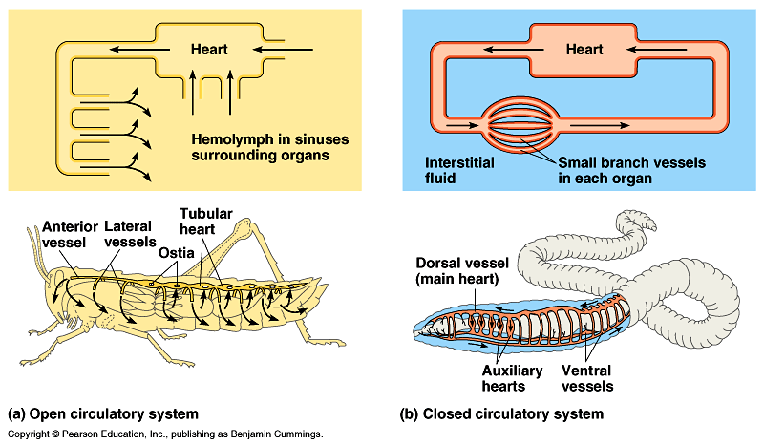
Open circulatory system
Taxonomy
  invertebrates
    insects, arthropods, mollusks
Structure
  no separation
  between blood &
  interstitial fluid
    hemolymph
Notes:
The fact that open and closed circulatory systems are each widespread among animals suggests that both offer advantages. For example, the lower hydrostatic pressures associated with open circulatory systems make them less costly than closed systems in terms of energy expenditure. Furthermore, because they lack an extensive system of blood vessels, open systems require less energy to build and maintain. And in some invertebrates, open circulatory systems serve a variety of other functions. For example, in molluscs and freshly molted aquatic arthropods, the open circulatory system functions as a hydrostatic skeleton in supporting the body.

Slide 8
Closed circulatory system
Taxonomy
  invertebrates
    earthworms, squid, octopuses
  vertebrates
Structure
  blood confined to vessels & separate from interstitial fluid
    1 or more hearts
    large vessels to smaller vessels
    material diffuses between blood vessels & interstitial fluid
closed system = higher pressures
Notes:
What advantages might be associated with closed circulatory systems? Closed systems, with their higher blood pressure, are more effective at transporting circulatory fluids to meet the high metabolic demands of the tissues and cells of larger and more active animals. For instance, among the molluscs, only the large and active squids and octopuses have closed circulatory systems. And although all arthropods have open circulatory systems, the larger crustaceans, such as the lobsters and crabs, have a more developed system of arteries and veins as well as an accessory pumping organ that helps maintain blood pressure. Closed circulatory systems are most highly developed in the vertebrates.

Slide 9
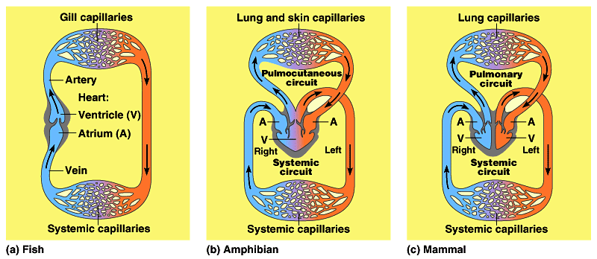
Vertebrate circulatory system
Adaptations in closed system
  number of heart chambers differs
2
3
4
high pressure
& high O₂
to body
low pressure
to body
low O₂
to body
What’s the adaptive value of a 4 chamber heart?
4 chamber heart is double pump = separates oxygen-rich & oxygen-poor blood; maintains high pressure

Slide 10
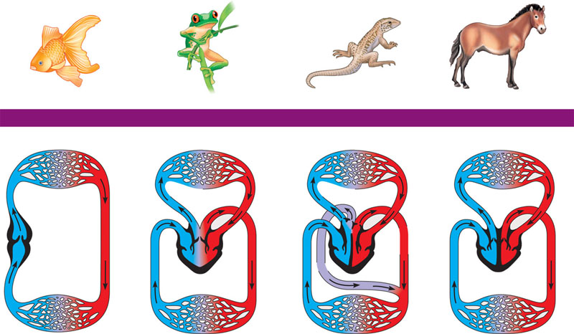
Evolution of vertebrate circulatory system
FISHES
AMPHIBIANS
REPTILES (EXCEPT BIRDS)
MAMMALS AND BIRDS
Gill capillaries
Lung and skin capillaries
Lung capillaries
Lung capillaries
Artery
Pulmocutaneous
circuit
Right
systemic
aorta
Pulmonary
circuit
Pulmonary
circuit
Gill
circulation
Heart:
ventricle (V)
Birds AND
mammals!
Wassssup?!
Left
Systemic
aorta
A
A
A
A
A
A
Atrium (A)
V
V
V
V
V
Right
Left
Right
Left
Right
Left
Systemic
circulation
Systemic
circuit
Systemic
circuit
Vein
Systemic capillaries
Systemic capillaries
Systemic capillaries
Systemic capillaries
Notes:
A powerful four–chambered heart was an essential adaptation in support of the endothermic way of life characteristic of mammals and birds. Endotherms use about ten times as much energy as equal–sized ectotherms; therefore, their circulatory systems need to deliver about ten times as much fuel and O2 to their tissues (and remove ten times as much CO2 and other wastes). This large traffic of substances is made possible by separate and independent systemic and pulmonary circulations and by large, powerful hearts that pump the necessary volume of blood. Mammals and birds descended from different reptilian ancestors, and their four–chambered hearts evolved independently—an example of convergent evolution.

Slide 11
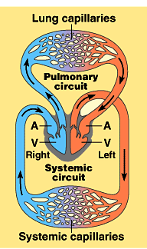
Evolution of 4-chambered heart
Selective forces
  increase body size
    protection from predation
    bigger body = bigger stomach
  endothermy
    can colonize more habitats
  flight
    decrease predation & increase hunting
Effect of higher metabolic rate
  greater need for energy, fuels, O₂, waste removal
    endothermic animals need 10x energy
    need to deliver 10x fuel & O₂ to cells
convergent
evolution
Notes:
Why is it an advantage to get big?
Herbivore: can eat more with bigger gut.
lowers predation
(but will push predators to get bigger as well, although no one east elephant s.)

Slide 12
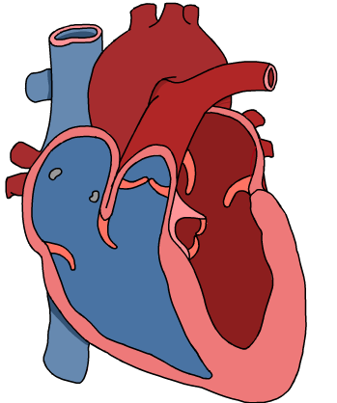
Vertebrate cardiovascular system
Chambered heart
  atrium = receive blood
  ventricle = pump blood out
Blood vessels
  arteries = carry blood away from heart
    arterioles
  veins = return blood to heart
    venules
  capillaries = thin wall, exchange / diffusion
    capillary beds = networks of capillaries
Notes:
Arteries, veins, and capillaries are the three main kinds of blood vessels, which in the human body have a total length of about 100,000 km.
Notice that arteries and veins are distinguished by the direction in which they carry blood, not by the characteristics of the blood they contain. All arteries carry blood from the heart toward capillaries, and veins return blood to the heart from capillaries. A significant exception is the hepatic portal vein that carries blood from capillary beds in the digestive system to capillary beds in the liver. Blood flowing from the liver passes into the hepatic vein, which conducts blood to the heart.

Slide 13
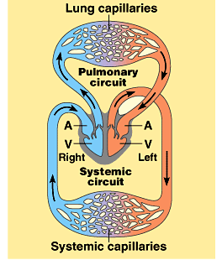
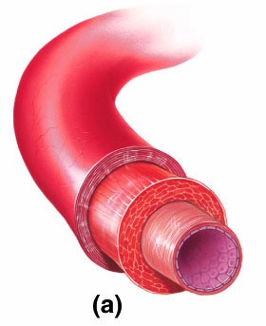
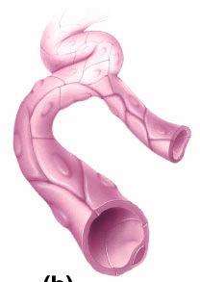
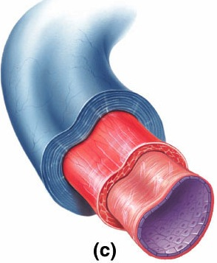
Blood vessels
arteries
veins
artery
arterioles
venules
arterioles
capillaries
venules
veins

Slide 14

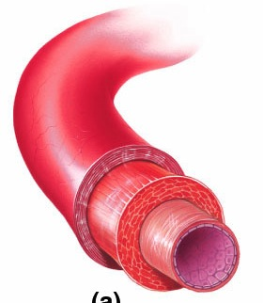
Arteries: Built for high pressure pump
Arteries
  thicker walls
    provide strength for high pressure pumping of blood
  narrower diameter
  elasticity
    elastic recoil helps
    maintain blood
    pressure even
    when heart relaxes

Slide 15
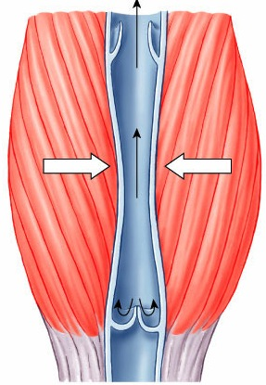
Veins: Built for low pressure flow
Veins
  thinner-walled
  wider diameter
    blood travels back to heart
    at low velocity & pressure
    lower pressure
      distant from heart
      blood must flow by skeletal muscle contractions when we move
        squeeze blood through veins
  valves
    in larger veins one-way valves
    allow blood to flow only toward heart
Blood flows
toward heart
Open valve
Closed valve

Slide 16
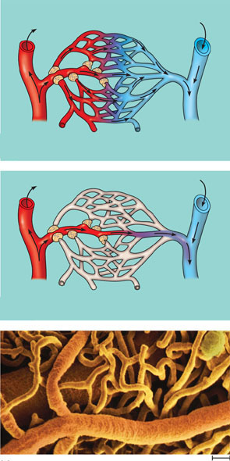
Capillaries: Built for exchange
Capillaries
  very thin walls
    lack 2 outer wall layers
    only endothelium
      enhances exchange across capillary
  diffusion
    exchange between blood & cells
Precapillary sphincters
Thoroughfare
channel
Capillaries
Arteriole
Venule
(a) Sphincters relaxed
Arteriole
Venule
(b) Sphincters contracted
(c) Capillaries and larger vessels (SEM)
20 μm

Slide 17
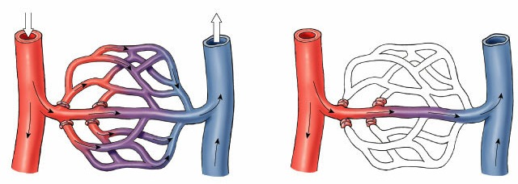
Controlling blood flow to tissues
Blood flow in capillaries controlled by
pre-capillary sphincters
    supply varies as blood is needed
    after a meal, blood supply to digestive tract increases
    during strenuous exercise, blood is diverted from digestive tract to skeletal muscles
  capillaries in brain, heart, kidneys & liver usually filled to capacity
Why?
sphincters open
sphincters closed

Slide 18
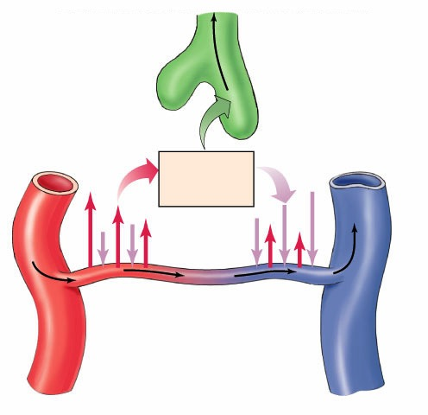

Exchange across capillary walls
Lymphatic
capillary
Fluid & solutes flows out of capillaries to tissues due to blood pressure
“bulk flow”
Interstitial fluid flows back into capillaries due to osmosis
plasma proteins ↑ osmotic
pressure in capillary
BP > OP
BP < OP
Interstitial
fluid
What about
edema?
Blood
flow
85% fluid returns to capillaries
Capillary
15% fluid returns via lymph
Arteriole
Venule
Notes:
About 85% of the fluid that leaves the blood at the arterial end of a capillary bed reenters from the interstitial fluid at the venous end, and the remaining 15% is eventually returned to the blood by the vessels of the lymphatic system.

Slide 19
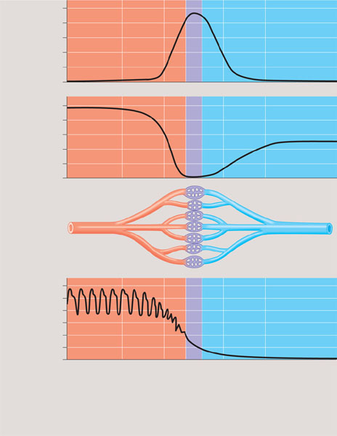
The interrelationship of blood flow velocity, cross-sectional area of blood vessels, and blood pressure
5,000
4,000
3,000
2,000
1,000
0
Area (cm²)
50
40
30
20
10
0
Velocity (cm/sec)
120
100
80
60
40
20
0
Systolic
pressure
Pressure (mm Hg)
Diastolic
pressure
Aorta
Arteries
Arterioles
Venules
Veins
Capillaries
Venae cavae

Slide 20
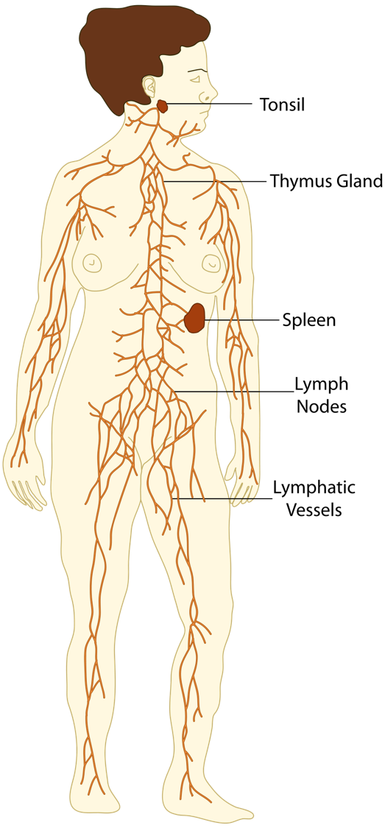
Lymphatic system
Parallel circulatory system
  transports white blood cells
    defending against infection
  collects interstitial fluid & returns to blood
    maintains volume & protein concentration of blood
    drains into circulatory system near junction of vena cava & right atrium

Slide 21
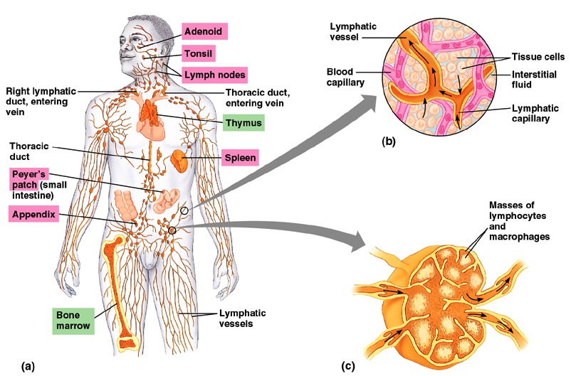
Lymph system
Production & transport of WBCs
Traps foreign invaders
lymph vessels
(intertwined amongst blood vessels)
lymph node

Slide 22
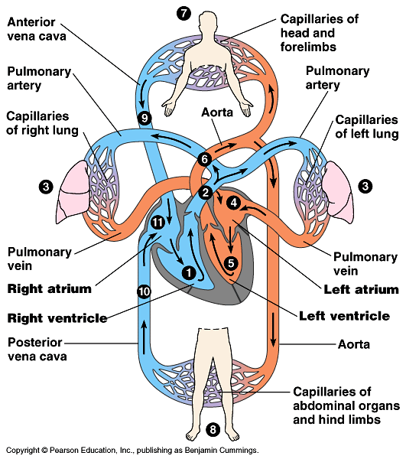
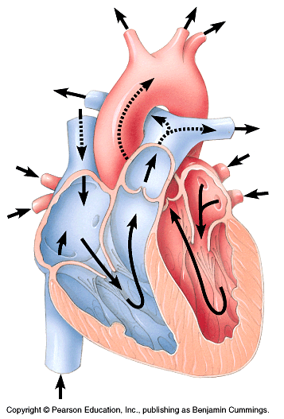
Mammalian circulation
systemic
pulmonary
systemic
What do blue vs. red areas represent?

Slide 23
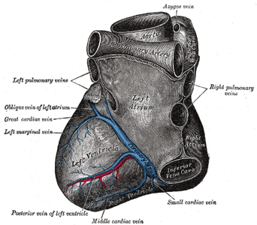
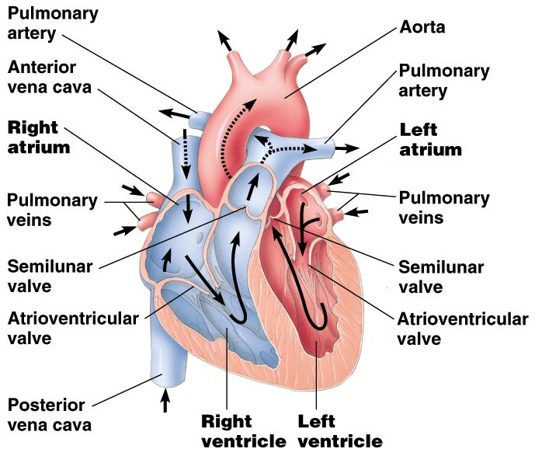
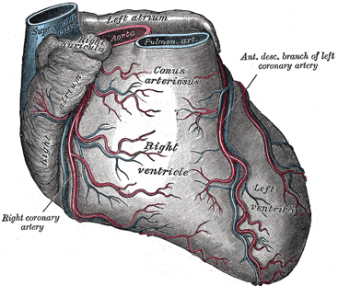
Mammalian heart
to neck & head
& arms
Coronary arteries

Slide 24
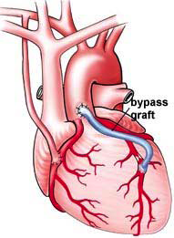
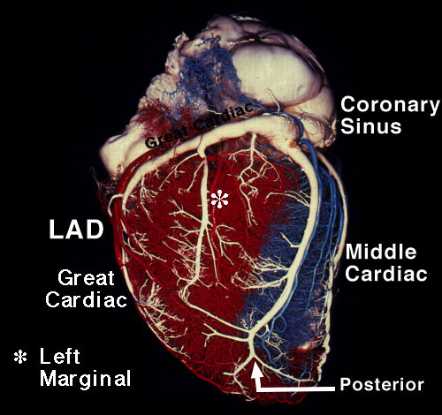
Coronary arteries
bypass surgery

Slide 25
Heart valves
4 valves in the heart
  flaps of connective tissue
  prevent backflow
Atrioventricular (AV) valve
  between atrium & ventricle
  keeps blood from flowing back
  into atria when ventricles contract
    “lub”
Semilunar valves
  between ventricle & arteries
  prevent backflow from arteries into ventricles while they are relaxing
    “dub”
SL
AV
AV
Notes:
The heart sounds heard with a stethoscope are caused by the closing of the valves. (Even without a stethoscope, you can hear these sounds by pressing your ear tightly against the chest of a friend—a close friend.) The sound pattern is “lub–dup, lub–dup, lub–dup.” The first heart sound (“lub”) is created by the recoil of blood against the closed AV valves. The second sound (“dup”) is the recoil of blood against the semilunar valves.

Slide 26
Lub-dub, lub-dub
Heart sounds
  closing of valves
  “Lub”
    recoil of blood against
    closed AV valves
  “Dub”
    recoil of blood against
    semilunar valves
Heart murmur
  defect in valves causes hissing sound when stream of blood squirts backward through valve
SL
AV
AV

Slide 27
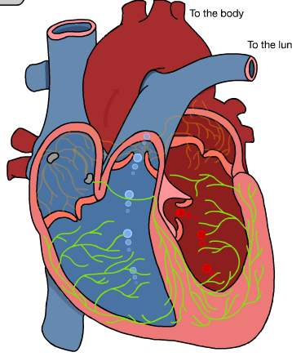
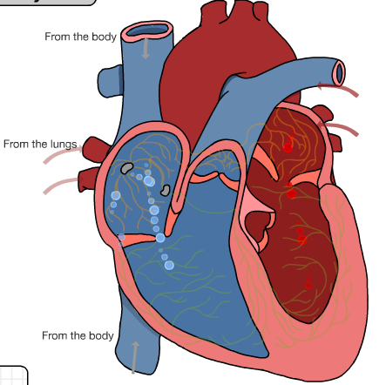
Cardiac cycle
1 complete sequence of pumping
  heart contracts & pumps
  heart relaxes & chambers fill
  contraction phase
    systole
    ventricles pumps blood out
  relaxation phase
    diastole
    atria refill with blood
110
____
70
systolic
________
diastolic
pump (peak pressure)
_________________
fill (minimum pressure)

Slide 28
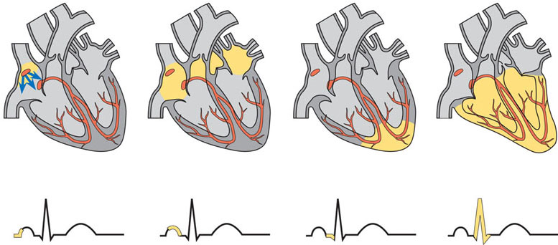
The control of heart rhythm
1
Pacemaker generates
wave of signals
to contract.
2
Signals are delayed
at AV node.
3
Signals pass
to heart apex.
4
Signals spread
throughout
ventricles.
AV node
Bundle
branches
SA node
(pacemaker)
Heart
apex
Purkinje
fibers
ECG

Slide 29
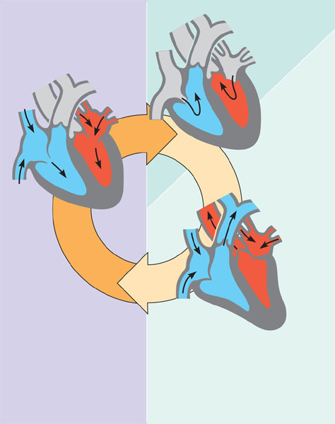
The cardiac cycle
Semilunar
valves
closed
2
Atrial systole;
ventricular
diastole
0.1 sec
Semilunar
valves
open
0.3 sec
0.4 sec
AV valve
open
AV valve
closed
1
Atrial and
ventricular
diastole
3
Ventricular systole;
atrial diastole

Slide 30
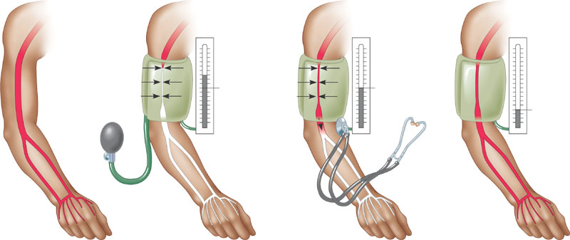
Measurement of blood pressure
Blood pressure
Reading: 120/170
Pressure
in cuff
above120
Pressure
in cuff
below 120
Pressure
in cuff
below 70
Rubber cuff
inflated
with air
120
120
70
Sounds
stop
Sounds
audible in
stethoscope
Artery
Artery
closed
High Blood Pressure (hypertension)
  if top number (systolic pumping) > 150
  if bottom number (diastolic filling) > 90

Slide 31
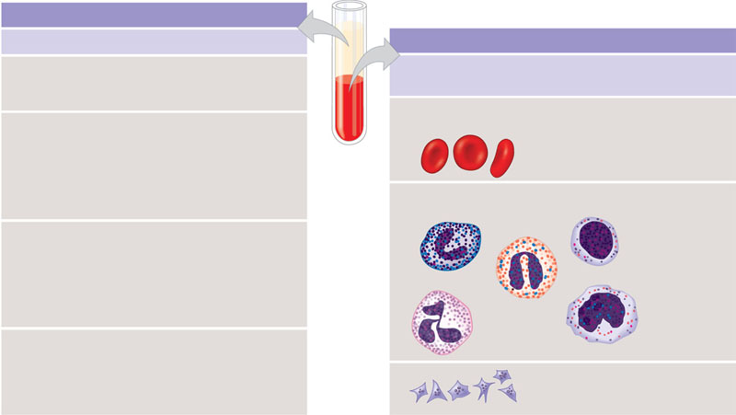
The composition of mammalian blood
Plasma 55%
Constituent
Major functions
Cellular elements 45%
Water
Solvent for
carrying other
substances
Cell type
Number
per μL (mm³) of blood
Functions
Erythrocytes
(red blood cells)
Icons (blood electrolytes
5–6 million
Transport oxygen
and help transport
carbon dioxide
Sodium
Potassium
Calcium
Magnesium
Chloride
Bicarbonate
Osmotic balance
pH buffering, and
regulation of
membrane
permeability
Separated
blood
elements
Leukocytes
(white blood cells)
5,000–10,000
Defense and
immunity
Plasma proteins
Osmotic balance,
pH buffering
Clotting
Defense
Albumin
Fibringen
Immunoglobulins
(antibodies)
Basophil
Lymphocyte
Eosinophil
Substances transported by blood
Nutrients (such as glucose, fatty acids, vitamins)
Waste products of metabolism
Respiratory gases (O₂ and CO₂)
Hormones
Neutrophil
Monocyte
Platelets
250,000−
400,000
Blood clotting

Slide 32
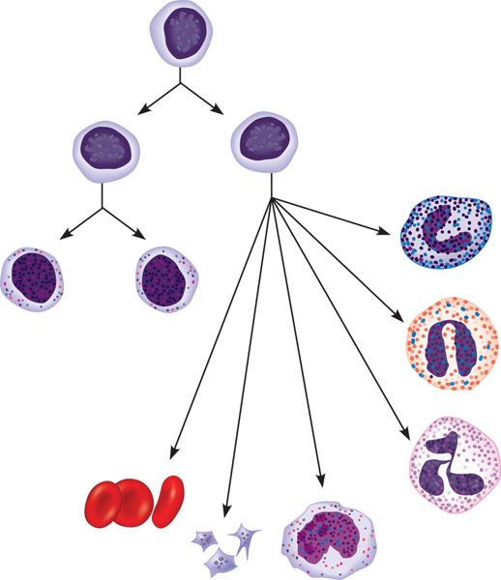
Differentiation of blood cells
Pluripotent stem cells
(in bone marrow)
Lymphoid
stem cells
Myeloid
stem cells
Basophils
B cells
T cells
Lymphocytes
Eosinophils
Neutrophils
Erythrocytes
Platelets
Monocytes

Slide 33
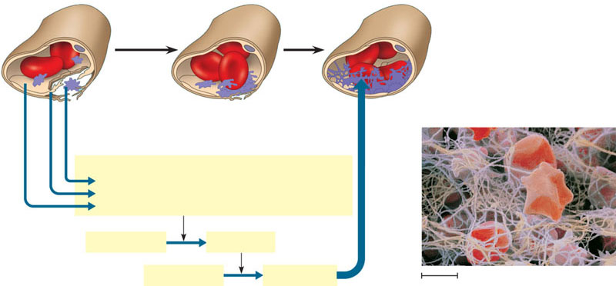
Blood clotting
1
The clotting process begins
when the endothelium of a
vessel is damaged, exposing
connective tissue in the
vessel wall to blood. Platelets
adhere to collagen fibers in
the connective tissue and
release a substance that
makes nearby platelets sticky.
2
The platelets form a
plug that provides
emergency protection
against blood loss.
3
This seal is reinforced by a clot of fibrin when
vessel damage is severe. Fibrin is formed via a
multistep process: Clotting factors released from
the clumped platelets or damaged cells mix with
clotting factors in the plasma, forming an
activation cascade that converts a plasma protein
called prothrombin to its active form, thrombin.
Thrombin itself is an enzyme that catalyzes the
final step of the clotting process, the conversion of
fibrinogen to fibrin. The threads of fibrin become
interwoven into a patch (see colorized SEM).
Collagen fibers
Platelet
plug
Fibrin clot
Red blood cell
Platelet releases chemicals
that make nearby platelets sticky
Clotting factors from:
Platelets
Damaged cells
Plasma (factors include calcium, vitamin K)
Prothrombin
Thrombin
Fibrinogen
Fibrin
5 µm

Slide 34
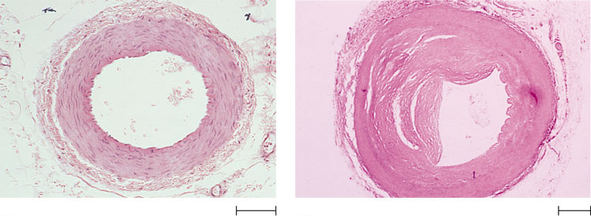
Atherosclerosis
Connective
tissue
Smooth muscle
Plaque
Endothelium
(a) Normal artery
(b) Partly clogged artery
50 µm
250 µm

Slide 35
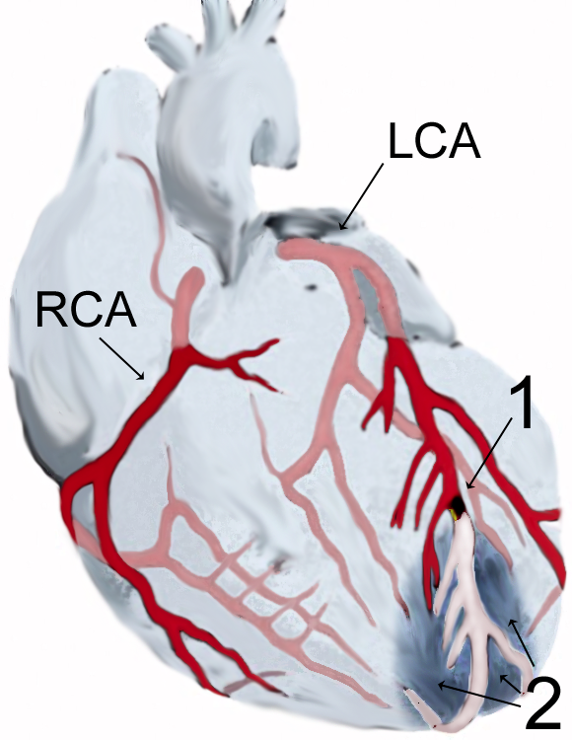
Coronary Embolism

Slide 36
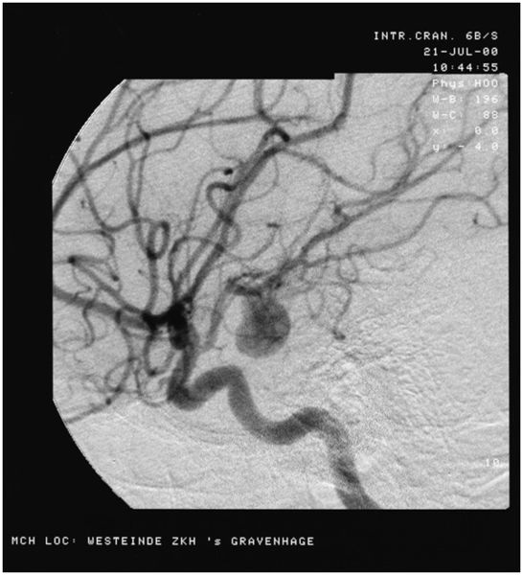
Cerebral Aneurysm

Slide 37
Bloody well ask
some questions, already!

Slide 38
Make sure you can do the following:
Label all parts of the mammalian heart and diagram blood flow through it.
Explain the causes of circulatory system disruptions and how disruptions of the circulatory system can lead to disruptions of homeostasis.

