Slide 1
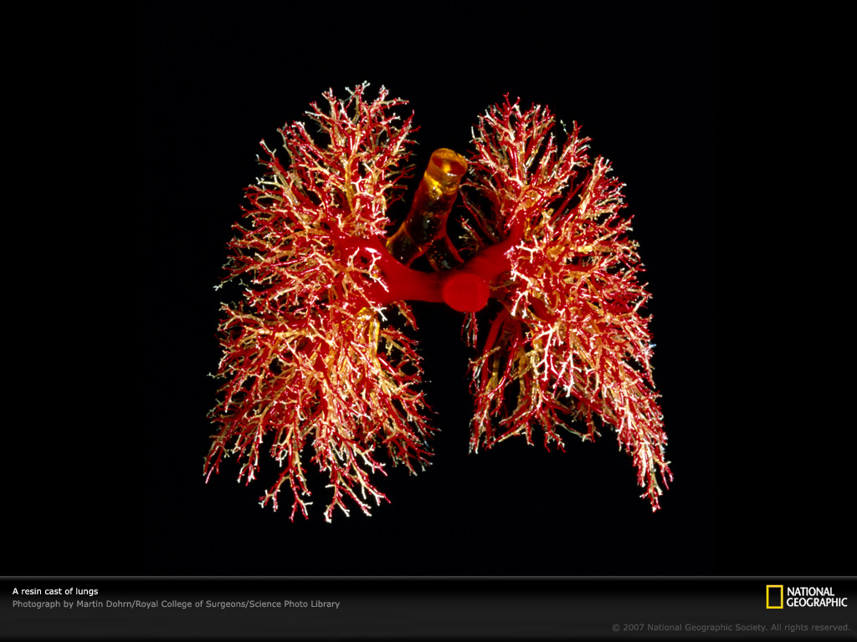
Gas Exchange
Respiratory Systems
(Ch. 42)

Slide 2
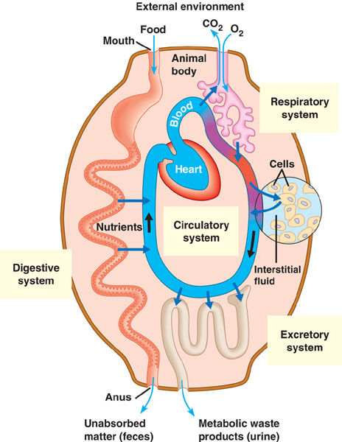

Slide 3
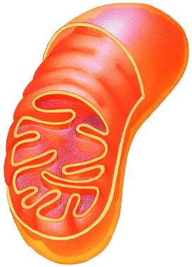
Why do we need a respiratory system?
respiration for
respiration
Need O₂ in
  for aerobic cellular respiration
  make ATP
Need CO₂ out
  waste product from
  Krebs cycle
food
O₂
ATP
CO₂

Slide 4
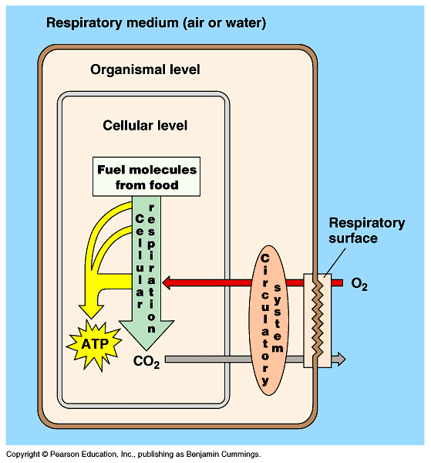
Gas exchange
O₂ & CO₂ exchange between
environment & cells
  need moist membrane
  need high surface area

Slide 5
Optimizing gas exchange
Why high surface area?
  maximizing rate of gas exchange
  CO₂ & O₂ move across cell membrane by diffusion
    rate of diffusion proportional to surface area
Why moist membranes?
  moisture maintains cell membrane structure
  gases diffuse only dissolved in water
High surface area?
High surface area!
Where have we heard that before?
Notes:
small intestines
large intestines
capillaries
mitochondria

Slide 6
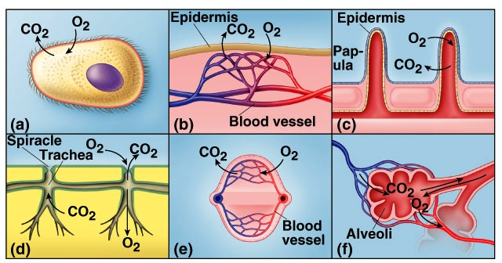
Gas exchange in many forms…
one-celled
amphibians
echinoderms
cilia
insects
fish
mammals
size
•
water vs. land
•
endotherm vs. ectotherm

Slide 7
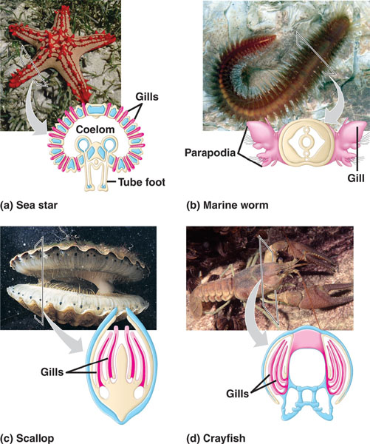
Evolution of gas exchange structures
Aquatic organisms
external systems with lots of surface area exposed to aquatic environment
Terrestrial
moist internal respiratory tissues with lots of surface area
Notes:
Constantly passing water across gills
Crayfish & lobsters
paddle-like appendages that drive a current of water over their gills
Fish
creates current by taking water in through mouth, passes it through slits in pharynx, flows over the gills & exits the body

Slide 8
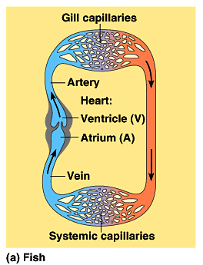
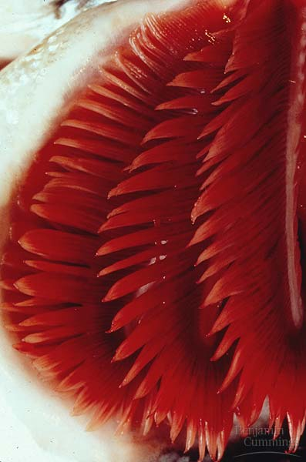
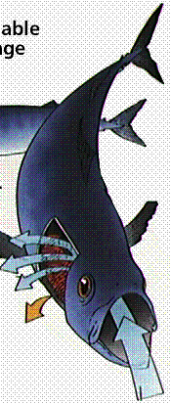
Gas Exchange in Water: Gills
Notes:
In fish, blood must pass through two capillary beds, the gill capillaries & systemic capillaries.
When blood flows through a capillary bed, blood pressure — the motive force for circulation — drops substantially.
Therefore, oxygen-rich blood leaving the gills flows to the systemic circulation quite slowly (although the process is aided by body movements during swimming).
This constrains the delivery of oxygen to body tissues, and hence the maximum aerobic metabolic rate of fishes.

Slide 9
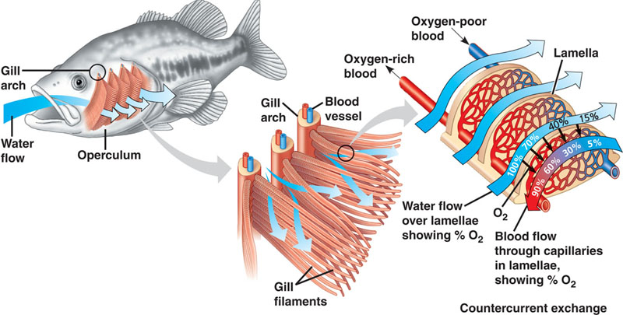
Counter current exchange system
Water carrying gas flows in one direction,
blood flows in opposite direction
Why does it work
counter current?
Adaptation!
just keep
swimming….
Notes:
Living in water has both advantages & disadvantages as respiratory medium
keep surface moist
O₂ concentrations in water are low, especially in warmer & saltier environments
gills have to be very efficient
ventilation
counter current exchange

Slide 10
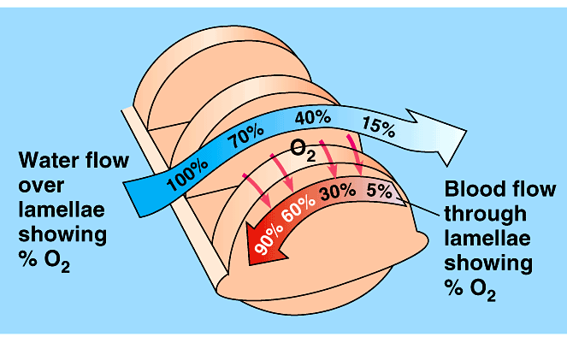
How counter current exchange works
70%
40%
front
back
100%
15%
water
60%
30%
90%
counter-current
5%
blood
50%
70%
100%
50%
30%
water
concurrent
5%
blood
Blood & water flow in opposite directions
  maintains diffusion gradient over whole length of gill capillary
  maximizing O₂ transfer from water to blood

Slide 11
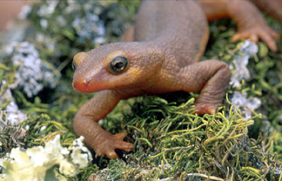
Gas Exchange on Land
Advantages of terrestrial life
  air has many advantages over water
    higher concentration of O₂
    O₂ & CO₂ diffuse much faster through air
      respiratory surfaces exposed to air do not have to be ventilated as thoroughly as gills
    air is much lighter than water & therefore much easier to pump
      expend less energy moving air in & out
Disadvantages
  keeping large respiratory surface moist
  causes high water loss
    reduce water loss by keeping lungs internal
Why don’t
land animals
use gills?

Slide 12
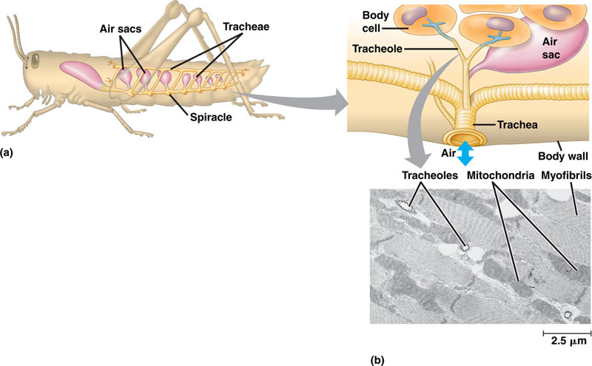
Terrestrial adaptations
Tracheae
air tubes branching throughout body
gas exchanged by diffusion across moist cells lining terminal ends, not through open circulatory system
Notes:
How is this adaptive?
No longer tied to living in or near water.
Can support the metabolic demand of flight
Can grow to larger sizes.

Slide 13
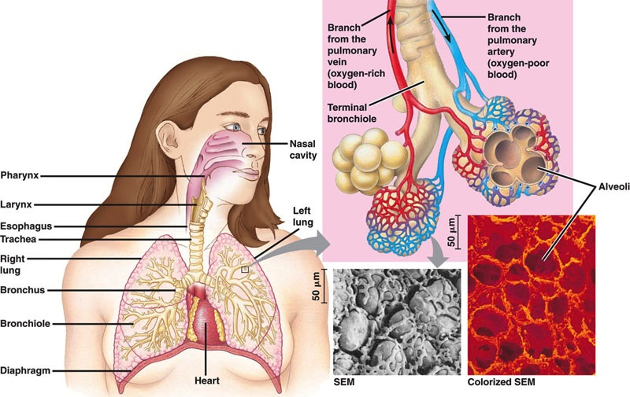
Lungs
Exchange tissue:
spongy texture, honeycombed with moist epithelium
Why is this exchange
with the environment
RISKY?
Notes:
Lungs, like digestive system, are an entry point into the body
lungs are not in direct contact with other parts of the body
circulatory system transports gases
between lungs & rest of body

Slide 14
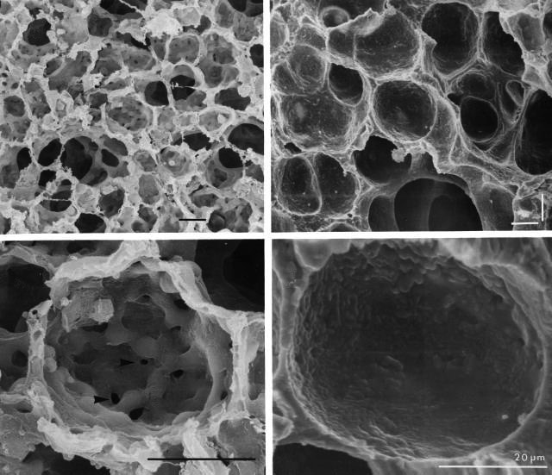
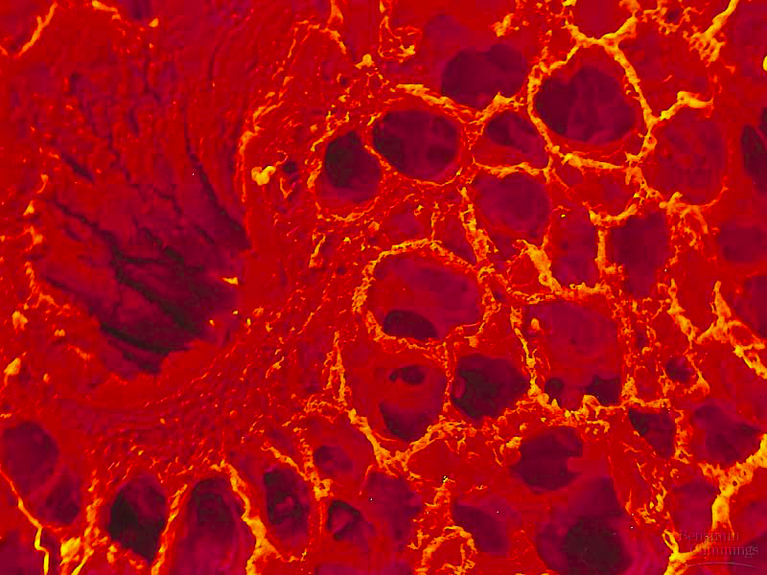
Alveoli
Gas exchange across thin epithelium of millions of alveoli
  total surface area in humans ~100 m²

Slide 15
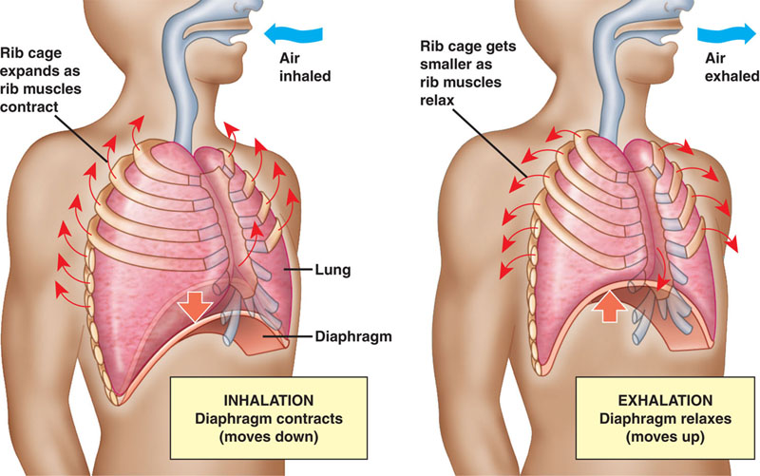
Negative pressure breathing
Breathing due to changing pressures in lungs
  air flows from higher pressure to lower pressure
  pulling air instead of pushing it

Slide 16
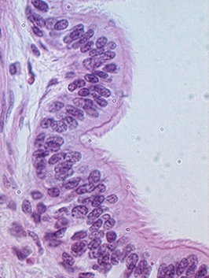
Mechanics of breathing
Air enters nostrils
  filtered by hairs, warmed & humidified
  sampled for odors
Pharynx → glottis → larynx (vocal cords) → trachea (windpipe) → bronchi → bronchioles → air sacs (alveoli)
Epithelial lining covered by
cilia & thin film of mucus
  mucus traps dust, pollen,
  particulates
  beating cilia move mucus upward
  to pharynx, where it is swallowed

Slide 17
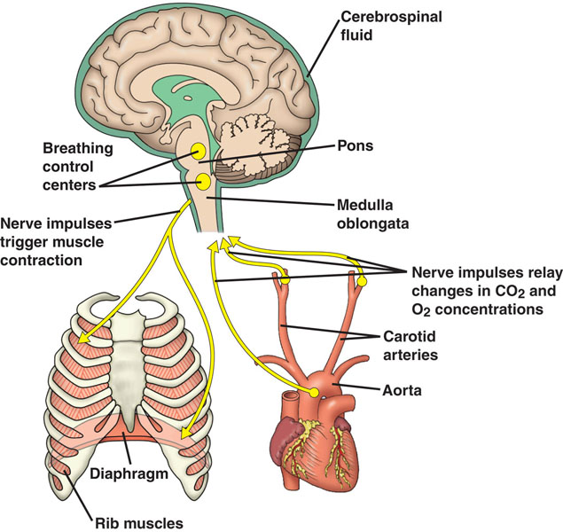
Autonomic breathing control
don’t want
to have to think
to breathe!
Medulla sets rhythm & pons moderates it
  coordinate
  respiratory,
  cardiovascular
  systems &
  metabolic
  demands
Nerve sensors in
walls of aorta &
carotid arteries in
neck detect
O₂ & CO₂ in blood

Slide 18
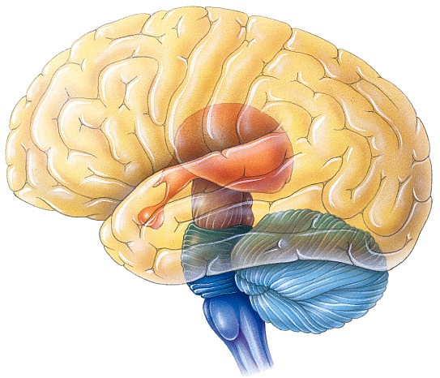
Medulla monitors blood
Monitors CO₂ level of blood
  measures pH of blood & cerebrospinal fluid bathing brain
    CO₂ + H₂O → H₂CO₃ (carbonic acid)
    if pH decreases then
    increase depth & rate
    of breathing & excess
    CO₂ is eliminated in
    exhaled air

Slide 19
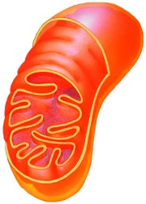
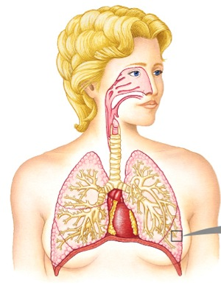
Breathing and Homeostasis
Homeostasis
  keeping the internal environment of the
  body balanced
  need to balance O₂ in and CO₂ out
  need to balance energy (ATP) production
Exercise
  breathe faster
    need more ATP
    bring in more O₂ & remove more CO₂
Disease
  poor lung or heart function = breathe faster
    need to work harder to bring in O₂ & remove CO₂
ATP
O₂
CO₂

Slide 20
Diffusion of gases
Concentration gradient & pressure drives movement of gases into & out of blood at both lungs & body tissue
capillaries in lungs
capillaries in muscle
O₂
O₂
O₂
O₂
CO₂
CO₂
CO₂
CO₂
blood
lungs
blood
body

Slide 21
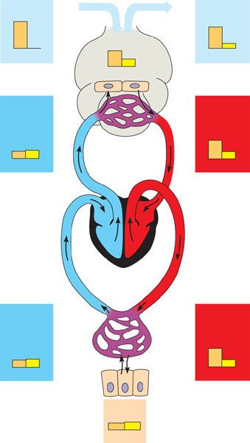
Loading and unloading of respiratory gases
Inhaled air
Exhaled air
160
0.2
Alveolar spaces
120 27
Alveolar
epithelial
cells
O₂
CO₂
104 40
O₂
CO₂
O₂
CO₂
Blood
entering
alveolar
capillaries
1
CO₂
O₂
2
Blood
leaving
alveolar
capillaries
CO₂
O₂
40 45
Alveolar
capillaries
of lung
104 40
O₂
CO₂
O₂
CO₂
Pulmonary
arteries
Pulmonary
veins
Systemic
arteries
Systemic
veins
Heart
Tissue
capillaries
O₂
4
CO₂
3
Blood
leaving
tissue
capillaries
Blood
entering
tissue
capillaries
40 45
CO₂
O₂
100 40
O₂
CO₂
O₂
CO₂
Tissue
cells
<40 >45
O₂
CO₂

Slide 22
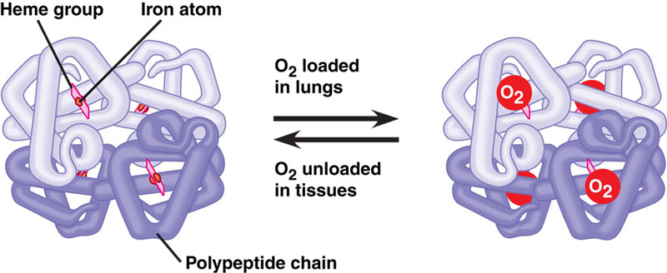
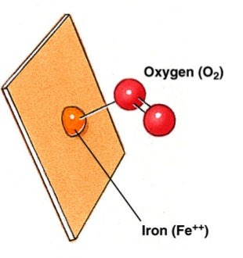
Hemoglobin
Why use a carrier molecule?
  O₂ not soluble enough in H₂O for animal needs
    blood alone could not provide enough O₂ to animal cells
    hemocyanin in insects = copper (bluish/greenish)
    hemoglobin in vertebrates = iron (reddish)
Reversibly binds O₂
  loading O₂ at lungs or gills & unloading at cells
heme group
cooperativity
Notes:
The low solubility of oxygen in water is a fundamental problem for animals that rely on the circulatory systems for oxygen delivery.
For example, a person exercising consumes almost 2 L of O₂ per minute, but at normal body temperature and air pressure, only 4.5 mL of O₂ can dissolve in a liter of blood in the lungs.
If 80% of the dissolved O₂ were delivered to the tissues (an unrealistically high percentage), the heart would need to pump 500 L of blood per minute — a ton every 2 minutes.

Slide 23
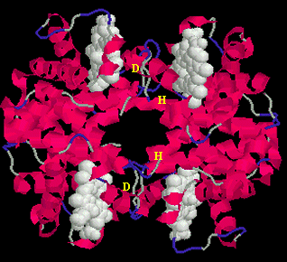
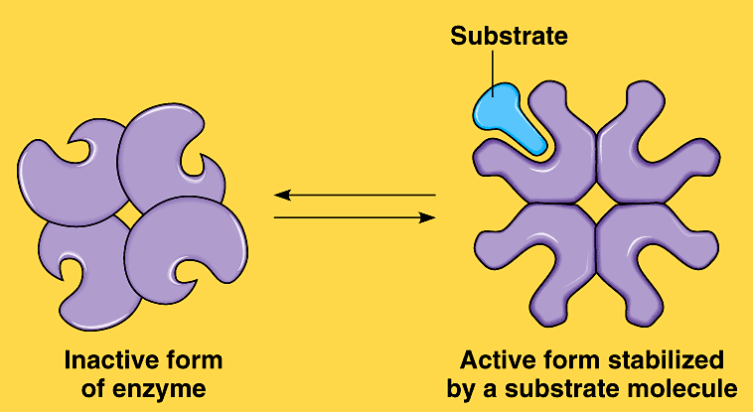
Cooperativity in Hemoglobin
Binding O₂
  binding of O₂ to 1st subunit causes shape change to other subunits
    conformational change
  increasing attraction to O₂
Releasing O₂
  when 1st subunit releases O₂,
  causes shape change to
  other subunits
    conformational change
  lowers attraction to O₂

Slide 24
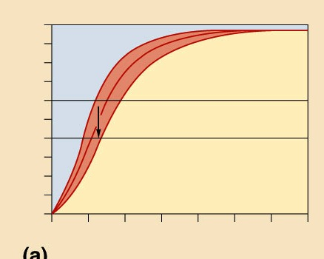
O₂ dissociation curve for hemoglobin
Effect of pH (CO₂ concentration)
Bohr Shift
  drop in pH lowers affinity of Hb for O₂
  active tissue (producing CO₂) lowers blood pH
  & induces Hb to release more O₂
100
90
pH 7.60
80
pH 7.40
pH 7.20
70
60
50
% oxyhemoglobin saturation
40
30
More O₂ delivered to tissues
20
10
0
0
20
40
60
80
100
120
140
P_{O2} (mm Hg)

Slide 25
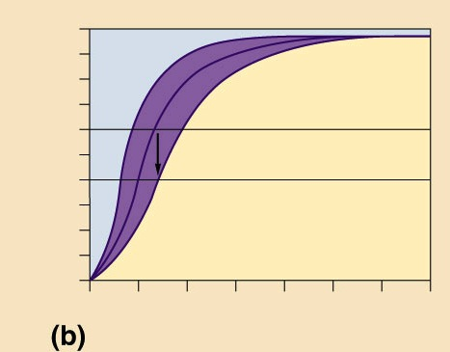
O₂ dissociation curve for hemoglobin
Effect of Temperature
Bohr Shift
  increase in temperature lowers affinity of Hb for O₂
  active muscle produces heat
100
90
20°C
37°C
43°C
80
70
60
50
% oxyhemoglobin saturation
40
30
More O₂ delivered to tissues
20
10
0
0
20
40
60
80
100
120
140
P_{O2} (mm Hg)

Slide 26
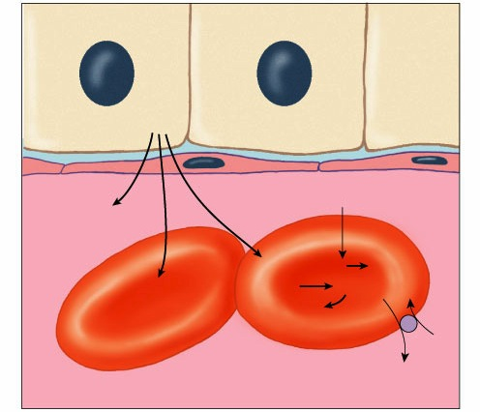
Transporting CO₂ in blood
Dissolved in blood plasma as bicarbonate ion
Tissue cells
carbonic acid
CO₂ + H₂O → H₂CO₃
bicarbonate
H₂CO₃ → H⁺ ₊ HCO₃–
CO₂
carbonic anhydrase
Carbonic
anhydrase
CO₂ dissolves
in plasma
CO₂ + H₂O
H₂CO₃
CO₂ combines
with Hb
H₂CO₃
H+ + HCO₃–
Cl–
HCO₃–
Plasma

Slide 27
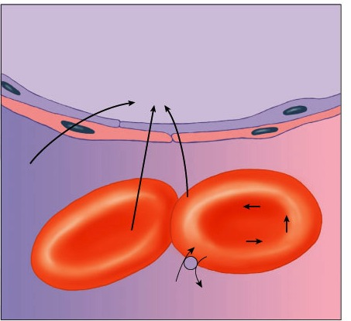
Releasing CO₂ from blood at lungs
Lower CO₂ pressure at lungs allows CO₂ to diffuse out of blood into lungs
Lungs: Alveoli
CO₂
CO₂ dissolved
in plasma
CO₂ + H₂O
H₂CO₃
Hemoglobin + CO₂
HCO₃ – + H⁺
H₂CO₃
HCO₃–Cl–
Plasma

Slide 28
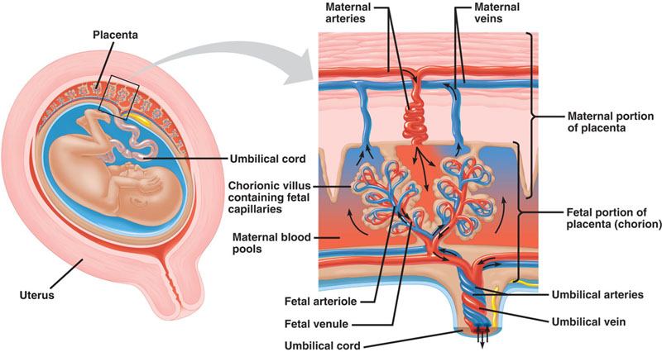
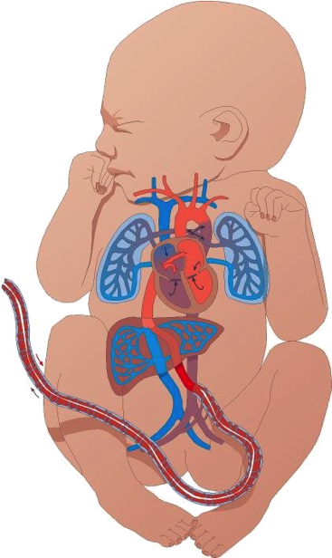
Adaptations for pregnancy
Mother & fetus exchange O₂ & CO₂ across placental tissue
Why would
mother’s Hb give up
its O₂ to baby’s Hb?

Slide 29
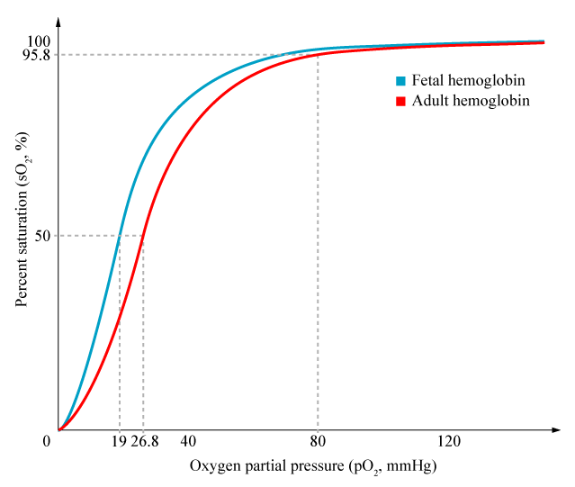
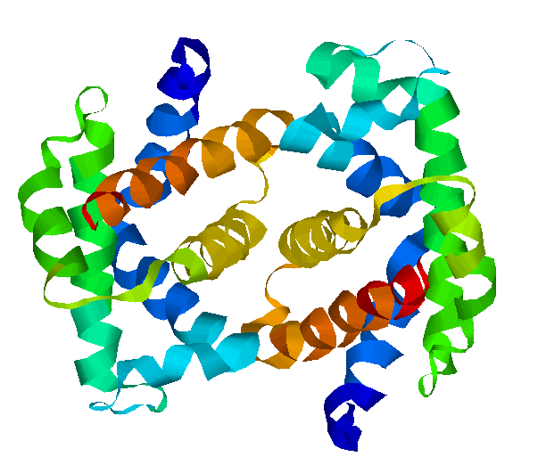
Fetal hemoglobin (HbF)
HbF has greater attraction to O₂ than Hb
  low % O₂ by time blood reaches placenta
  fetal Hb must be able to bind O₂ with greater attraction than maternal Hb
What is the adaptive advantage?
2 alpha & 2 gamma units
Notes:
Both mother and fetus share a common blood supply. In particular, the fetus's blood supply is delivered via the umbilical vein from the placenta, which is anchored to the wall of the mother's uterus. As blood courses through the mother, oxygen is delivered to capillary beds for gas exchange, and by the time blood reaches the capillaries of the placenta, its oxygen saturation has decreased considerably. In order to recover enough oxygen to sustain itself, the fetus must be able to bind oxygen with a greater affinity than the mother.
Fetal hemoglobin's affinity for oxygen is substantially greater than that of adult hemoglobin. Notably, the P50 value for fetal hemoglobin (i.e., the partial pressure of oxygen at which the protein is 50% saturated; lower values indicate greater affinity) is roughly 19 mmHg, whereas adult hemoglobin has a value of approximately 26.8 mmHg. As a result, the so-called "oxygen saturation curve", which plots percent saturation vs. pO2, is left-shifted for fetal hemoglobin in comparison to the same curve in adult hemoglobin.
Hydroxyurea, used also as an anti-cancer drug, is a viable treatment for sickle cell anemia, as it promotes the production of fetal hemoglobin while inhibiting sickling.

Slide 30
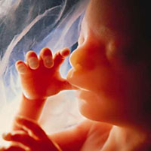
Don’t be such a baby…
Ask Questions!!

Slide 31
Make sure you can do the following:
Label all parts of the mammalian respiratory system and explain their functions.
Understand how respiratory gasses are transported between the lungs and body tissues.
Explain the causes of respiratory system disruptions and how disruptions of the respiratory system can lead to disruptions of homeostasis.

