Slide 1
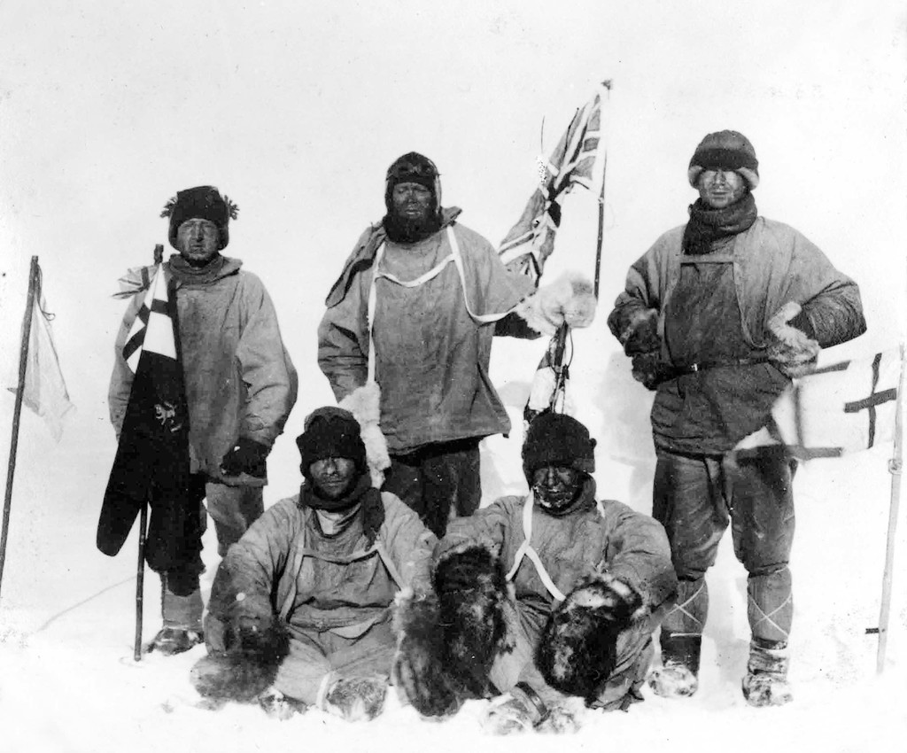
Regulating the Internal Environment
(Ch. 40, 44)
Notes:
Women use the bathroom more often than men for a variety of reasons — smaller bladder & more fluid consumption.
Mayor Bloomberg passed a potty parity bill that guarantees twice as many stalls in any new construction in NYC. in a lifetime which would fill a small swimming pool.

Slide 2
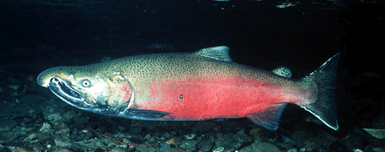
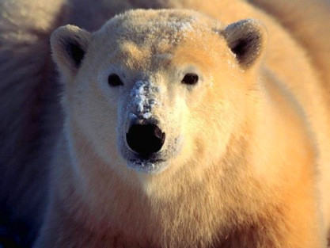
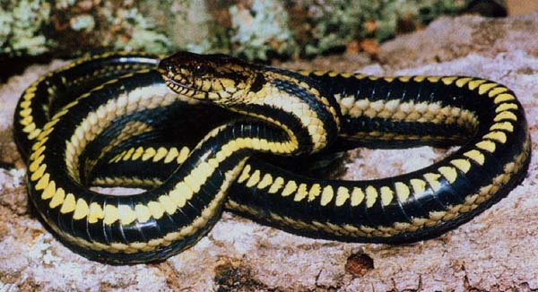
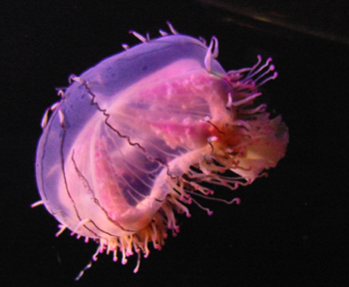
Conformers vs. Regulators
Two evolutionary paths for organisms
  regulate internal environment
    maintain relatively constant internal conditions
  conform to external environment
    allow internal conditions to fluctuate along with external changes
thermoregulation
osmoregulation
regulator
regulator
conformer
conformer

Slide 3
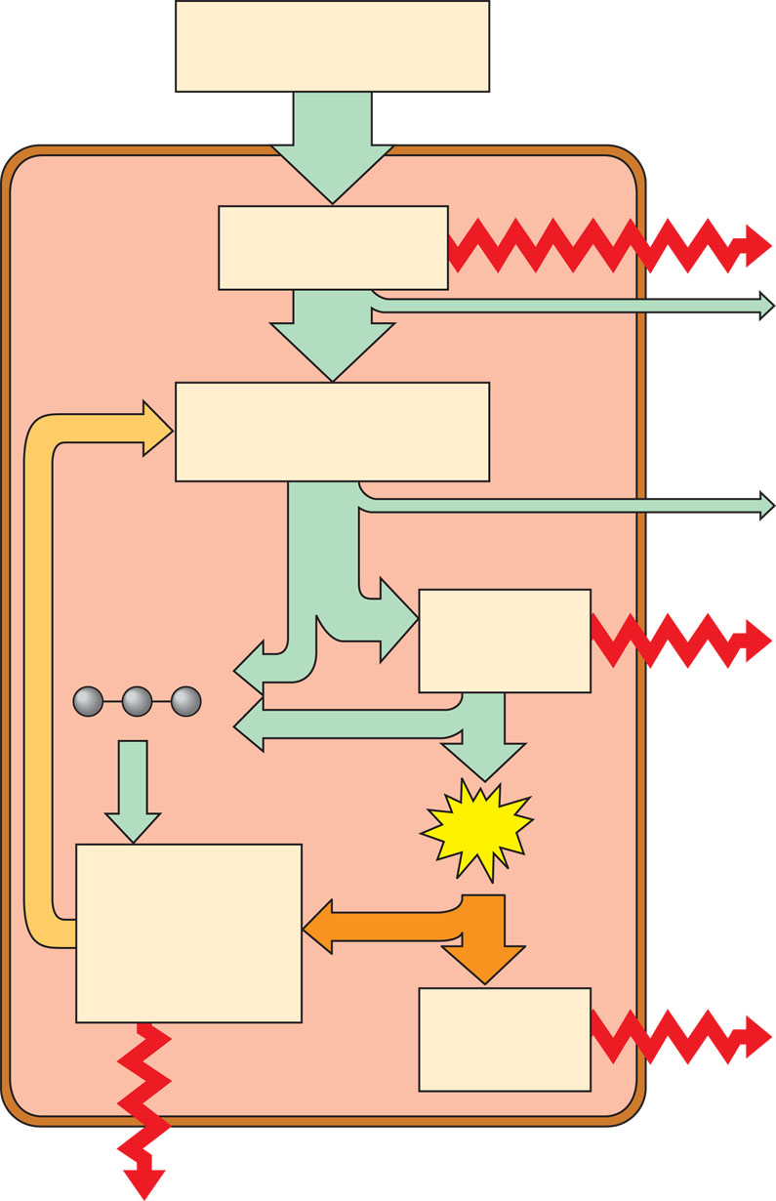
Bioenergetics of an animal: an overview
Organic molecules
in food
External
environment
Animal
body
Digestion and
absorption
Heat
Energy
lost in
feces
Nutrient molecules
in body cells
Energy
lost in
urine
Carbon
skeletons
Cellular
respiration
Heat
ATP
Biosynthesis:
growth,
storage, and
reproduction
Cellular
work
Heat
Heat

Slide 4
Homeostasis
Keeping the balance
  animal body needs to coordinate
  many systems all at once
    temperature
    blood sugar levels
    energy production
    water balance & intracellular waste disposal
    nutrients
    ion balance
    cell growth
  maintaining a “steady state” condition

Slide 5
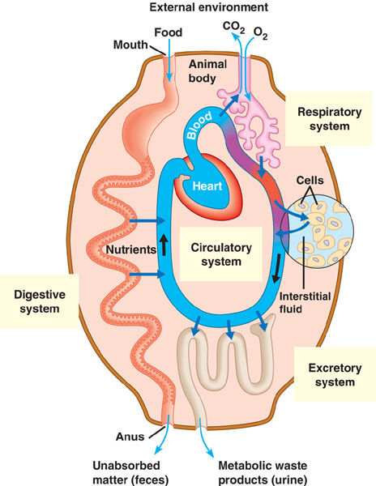
Animal systems evolved to support multicellular life
aa
CH
O₂
CO₂
CHO
aa
NH₃
CHO
O₂
O₂
CH
aa
CO₂
intracellular waste
CO₂
O₂
aa
NH₃
NH₃
CO₂
NH₃
CO₂
CO₂
O₂
NH₃
NH₃
CO₂
CO₂
CO₂
aa
NH₃
NH₃
NH₃
CO₂
CO₂
CHO
CH
aa
extracellular waste
Diffusion too slow!

Slide 6
Overcoming limitations of diffusion
Evolution of exchange systems for
  distributing nutrients
    circulatory system
  removing wastes
    excretory system
CO₂
CO₂
aa
NH₃
O₂
NH₃
CO₂
NH₃
CO₂
CO₂
NH₃
NH₃
O₂
CO₂
CO₂
CO₂
aa
NH₃
NH₃
NH₃
systems to support
multicellular organisms
CHO
CO₂
CO₂
CH
aa
Notes:
Transport epithelia in excretory organs often have the dual functions of maintaining water balance and disposing of metabolic wastes.
Transport epithelia in the gills of freshwater fishes actively pump salts from the dilute water passing by the gill filaments.

Slide 7
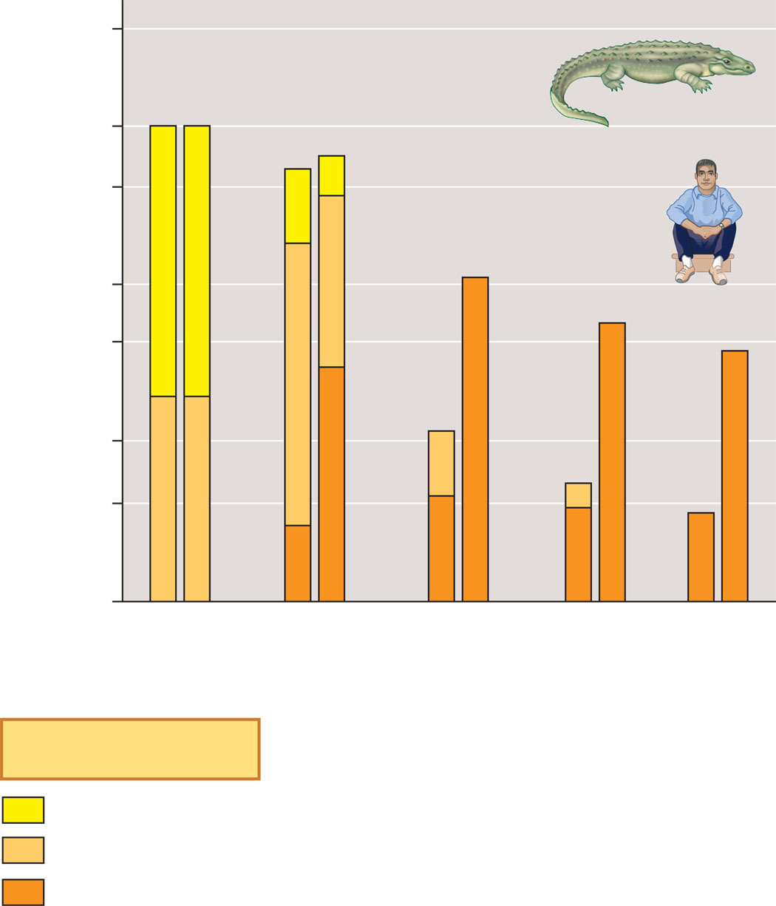
Maximum metabolic rates over different time spans
500
A = 60-kg alligator
100
A
H
A
H
50
H = 60-kg human
Maximum metabolic rate
(kcal/min; log scale)
H
10
H
5
H
A
1
A
0.5
A
0.1
1
second
1
minute
1
hour
1
day
1
week
Time interval
Key
Existing intracellular ATP
ATP from glycolysis
ATP from aerobic respiration

Slide 8
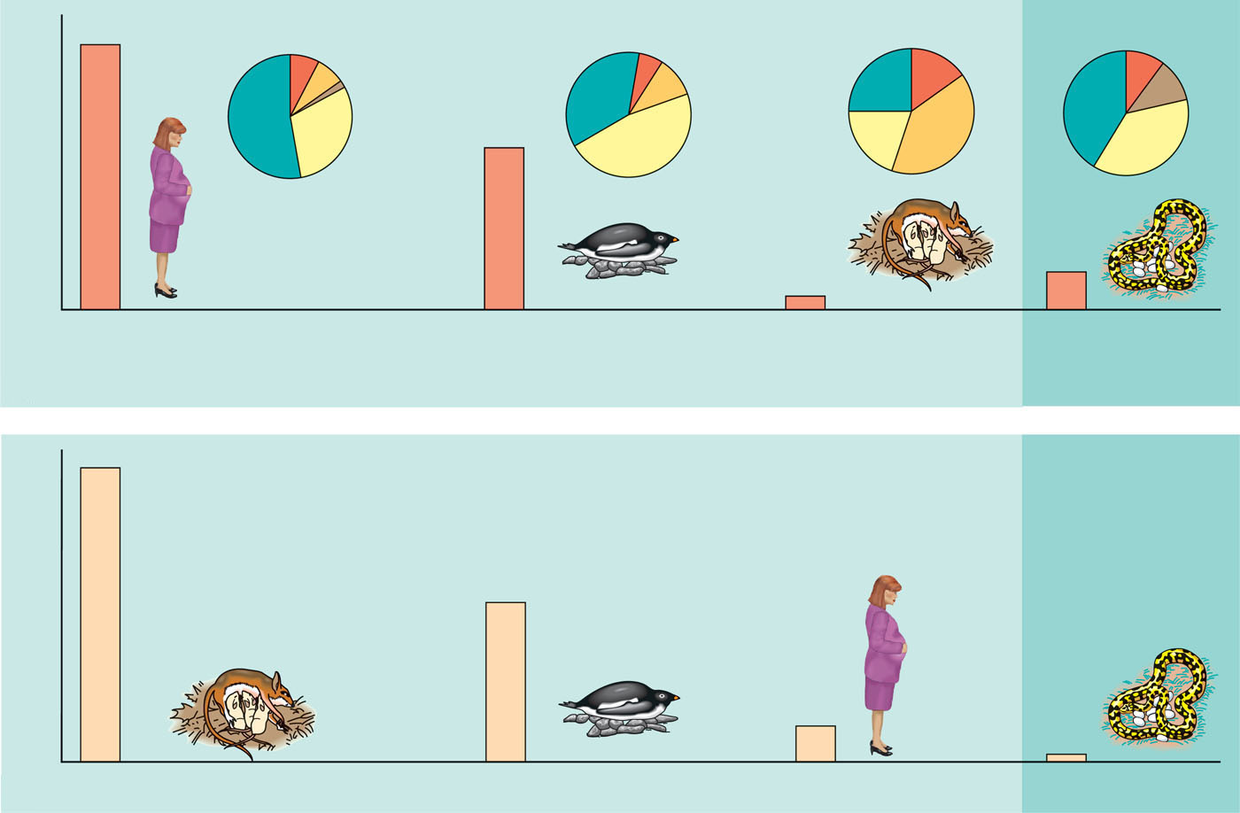
Energy budgets for four animals
Endotherms
Ectotherm
800,000
Basal
metabolic
rate
Reproduction
Temperature
regulation costs
Growth
Activity
costs
340,000
Annual energy expenditure (kcal/yr)
8,000
4,000
60-kg female human
from temperate climate
4-kg male Adélie penguin
from Antarctica (brooding)
0.025-kg female deer mouse
from temperate
North America
4-kg female python
from Australia
(a)
Total annual energy expenditures
438
Human
Energy expenditure per unit mass
(kcal/kg•day)
233
Python
Deer mouse
Adélie penguin
36.5
5.5
(b)
Energy expenditures per unit mass (kcal/kg•day)

Slide 9
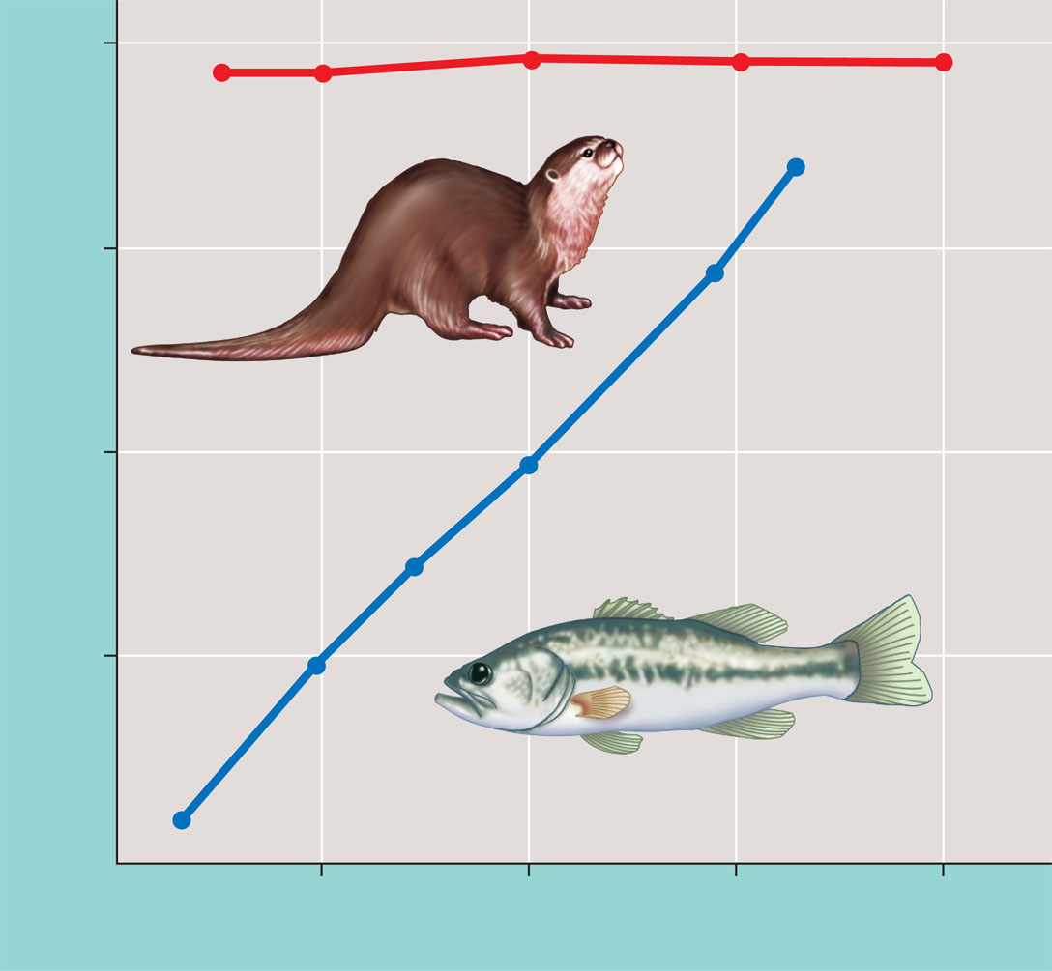
The relationship between body temperature and environmental temperature in an aquatic endotherm and ectotherm
40
River otter (endotherm)
30
Body temperature (°C)
20
Largemouth bass (ectotherm)
10
0
10
20
30
40
Ambient (environmental) temperature (°C)

Slide 10
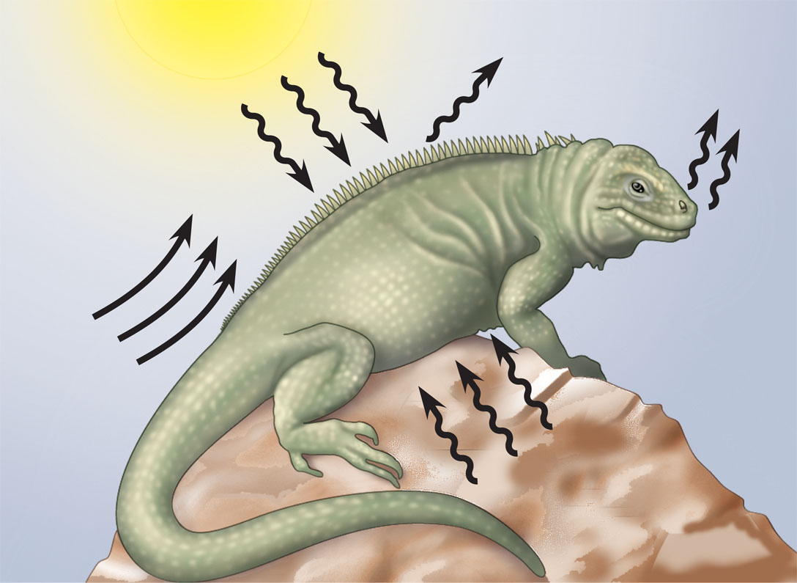
Heat exchange between an organism and its environment
Radiation is the emission of electromagnetic
waves by all objects warmer than absolute
zero. Radiation can transfer heat between
objects that are not in direct contact, as when
a lizard absorbs heat radiating from the sun.
Evaporation is the removal of heat from the surface of a
liquid that is losing some of its molecules as gas.
Evaporation of water from a lizard’s moist surfaces that
are exposed to the environment has a strong cooling effect.
Convection is the transfer of heat by the
movement of air or liquid past a surface,
as when a breeze contributes to heat loss
from a lizard’s dry skin, or blood moves
heat from the body core to the extremities.
Conduction is the direct transfer of thermal motion (heat)
between molecules of objects in direct contact with each
other, as when a lizard sits on a hot rock.

Slide 11
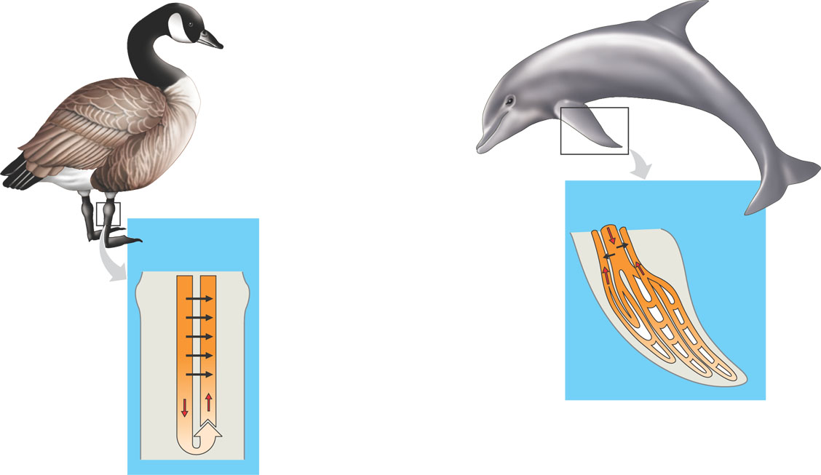
Countercurrent heat exchangers
1
Arteries carrying warm blood down the
legs of a goose or the flippers of a dolphin
are in close contact with veins conveying
cool blood in the opposite direction, back
toward the trunk of the body. This
arrangement facilitates heat transfer
from arteries to veins (black
arrows) along the entire length
of the blood vessels.
Pacific
bottlenose
dolphin
Canada
goose
2
Near the end of the leg or flipper, where
arterial blood has been cooled to far below
the animal’s core temperature, the artery
can still transfer heat to the even colder
blood of an adjacent vein. The venous blood
continues to absorb heat as it passes warmer
and warmer arterial blood traveling in the
opposite direction.
Blood flow
1
Artery
Vein
Vein
1
3
Artery
35°C
33°
3
3
30º
27º
20º
18º
2
10º
9º
As the venous blood approaches the
center of the body, it is almost as warm
as the body core, minimizing the heat lost
as a result of supplying blood to body parts
immersed in cold water.
3
In the flippers of a dolphin, each artery is
surrounded by several veins in a
countercurrent arrangement, allowing
efficient heat exchange between arterial
and venous blood.
2

Slide 12
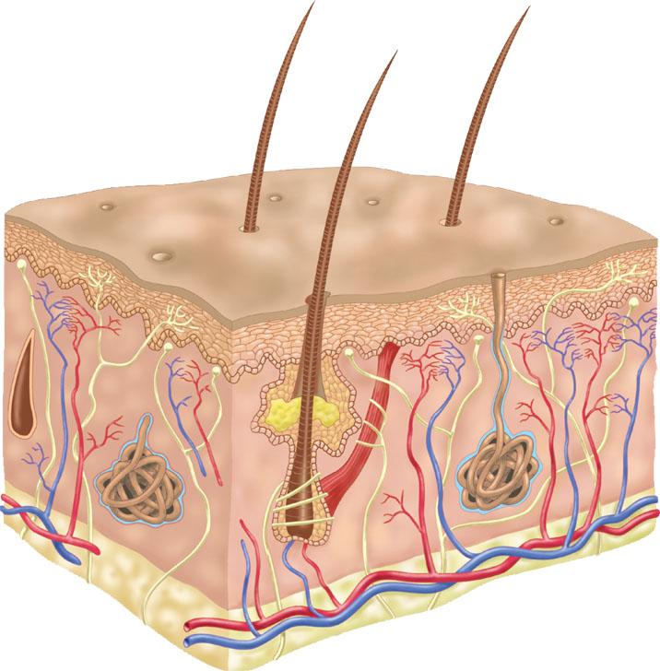
Mammalian integumentary system
Hair
Epidermis
Sweat
pore
Muscle
Dermis
Nerve
Sweat
gland
Hypodermis
Adipose tissue
Blood vessels
Oil gland
Hair follicle

Slide 13
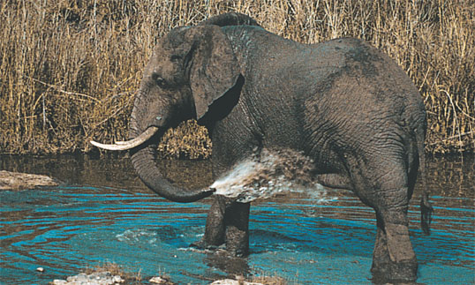
A terrestrial mammal bathing, an adaptation that enhances evaporative cooling

Slide 14
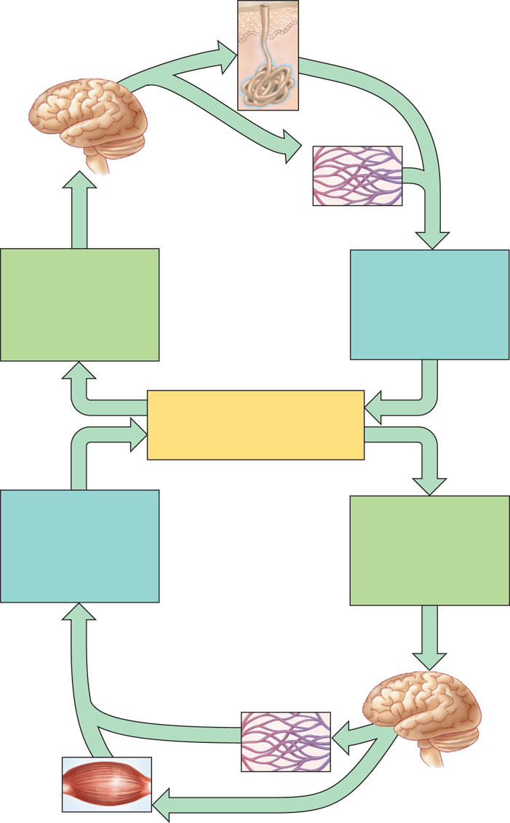
The thermostat function of the hypothalamus in human thermoregulation
Thermostat in
hypothalamus
activates cooling
mechanisms.
Sweat glands secrete
sweat that evaporates,
cooling the body.
Blood vessels
in skin dilate:
capillaries fill
with warm blood;
heat radiates from
skin surface.
Increased body
temperature (such
as when exercising
or in hot
surroundings)
Body temperature
decreases;
thermostat
shuts off cooling
mechanisms.
Homeostasis:
Internal body temperature
of approximately 36–38°C
Body temperature
increases;
thermostat
shuts off warming
mechanisms.
Decreased body
temperature
(such as when
in cold
surroundings)
Blood vessels in skin
constrict, diverting blood
from skin to deeper tissues
and reducing heat loss
from skin surface.
Thermostat in
hypothalamus
activates
warming
mechanisms.
Skeletal muscles rapidly
contract, causing shivering,
which generates heat.

Slide 15
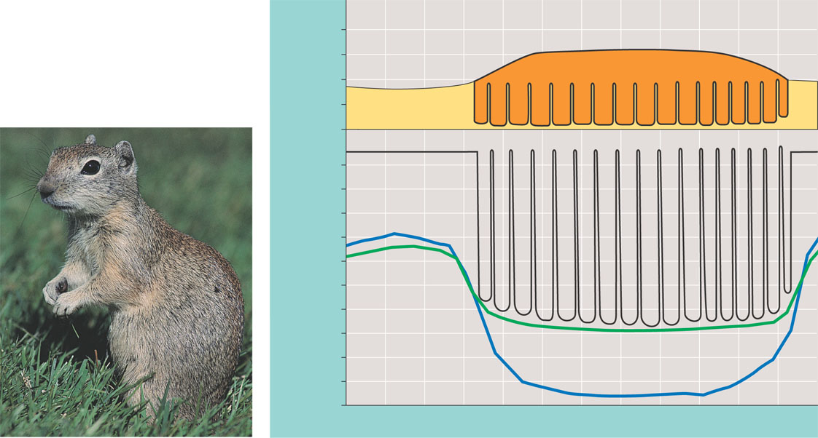
Body temperature and metabolism during hibernation in Belding’s ground squirrels
Additional metabolism that would be
necessary to stay active in winter
200
Actual
metabolism
100
Metabolic rate
(kcal per day)
0
Arousals
35
Body
temperature
30
25
20
Temperature (°C)
15
10
5
0
Outside
temperature
-5
Burrow
temperature
-10
-15
June
August
October
December
February
April

Slide 16
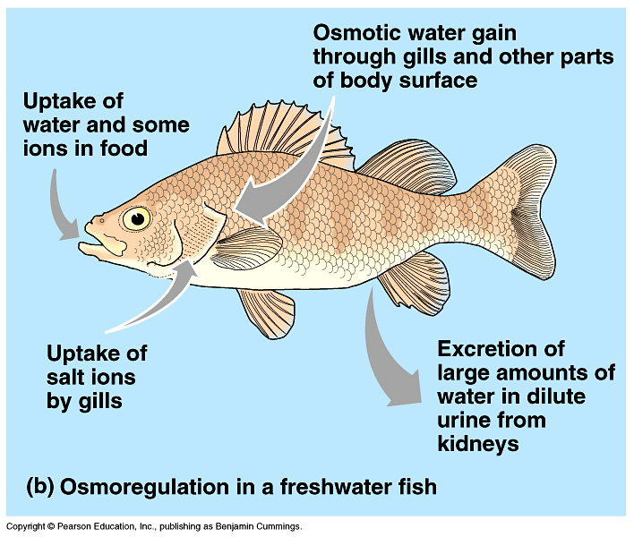
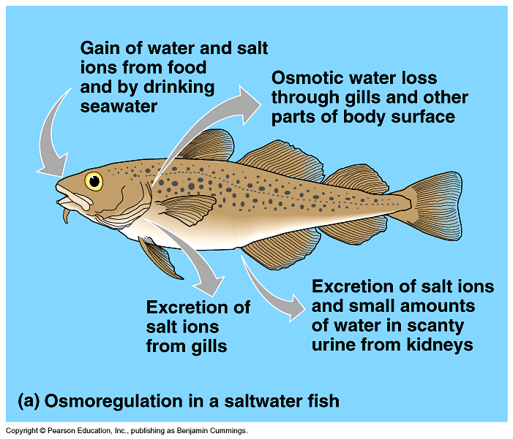
Osmoregulation
hypotonic
Water balance
  freshwater
    hypotonic
    water flow into cells & salt loss
  saltwater
    hypertonic
    water loss from cells
  land
    dry environment
    need to conserve water
    may also need to conserve salt
hypertonic
Why do all land animals have to conserve water?
always lose water (breathing & waste)
may lose life while searching for water
Notes:
The threat of desiccation (drying out) is perhaps the largest regulatory problem confronting terrestrial plants and animals.
Humans die if they lose about 12% of their body water.
Adaptations that reduce water loss are key to survival on land. Most terrestrial animals have body coverings that help prevent dehydration. These include waxy layers in insect exoskeletons, the shells of land snails, and the multiple layers of dead, keratinized skin cells.
Being nocturnal also reduces evaporative water loss.
Despite these adaptations, most terrestrial animals lose considerable water from moist surfaces in their gas exchange organs, in urine and feces, and across the skin.
Land animals balance their water budgets by drinking and eating moist foods and by using metabolic water from aerobic respiration.
And don’t forget plants, they have to deal with this too!

Slide 17
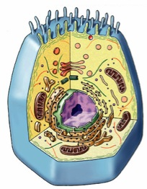
Intracellular Waste
Animals
poison themselves
from the inside
by digesting
proteins!
What waste products?
  what do we digest our food into…
    carbohydrates = CHO
    lipids = CHO
    proteins = CHON
    nucleic acids = CHOPN
→ CO₂ + H₂O
lots!
→ CO₂ + H₂O
very
little
→ CO₂ + H₂O + N
→ CO₂ + H₂O + P + N
cellular digestion…
cellular waste
H
O
H
|
|
|
CO₂ ₊ H₂O
N
–C–
C–OH
NH₂ =
ammonia
H
|
R
Notes:
Can you store sugars? YES
Can you store lipids? YES
Can you store proteins? NO
Animals do not have a protein storage system

Slide 18
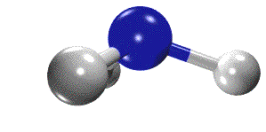

Nitrogenous waste disposal
Ammonia (NH₃)
  very toxic
    carcinogenic
  very soluble
    easily crosses membranes
  must dilute it & get rid of it… fast!
How you get rid of nitrogenous wastes depends on
  who you are (evolutionary relationship)
  where you live (habitat)
aquatic
terrestrial
terrestrial egg layer

Slide 19
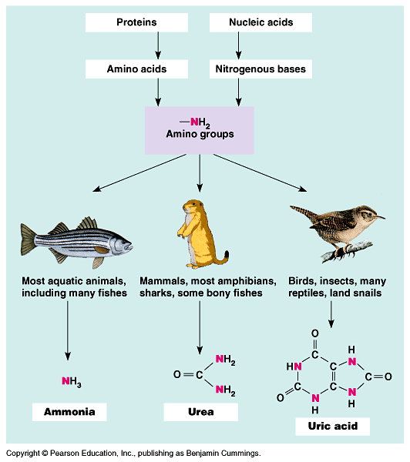
Nitrogen waste
Aquatic organisms
  can afford to lose water
  Ammonia: most toxic
Terrestrial
  need to conserve
  water
  Urea: less toxic
Terrestrial egg
layers
  need to conserve water
  need to protect
  embryo in egg
  uric acid: least toxic
Notes:
Mode of reproduction appears to have been important in choosing between these alternatives.
Soluble wastes can diffuse out of a shell-less amphibian egg (ammonia) or be carried away by the mother’s blood in a mammalian embryo (urea).
However, the shelled eggs of birds and reptiles are not permeable to liquids, which means that soluble nitrogenous wastes trapped within the egg could accumulate to dangerous levels (even urea is toxic at very high concentrations).
In these animals, uric acid precipitates out of solution and can be stored within the egg as a harmless solid left behind when the animal hatches.

Slide 20
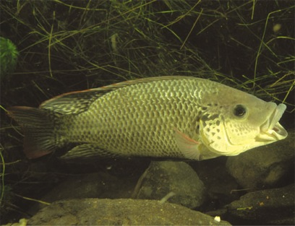
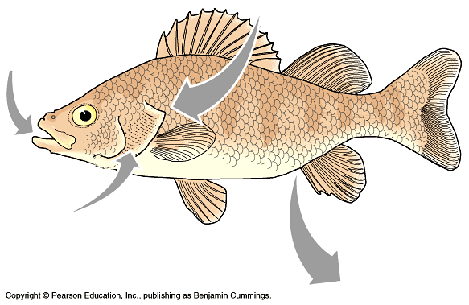
Freshwater animals
Water removal & nitrogen waste disposal
  remove surplus water
    use surplus water to dilute ammonia & excrete it
      need to excrete a lot of water so dilute ammonia &
      excrete it as very dilute urine
    also diffuse ammonia continuously through gills or
    through any moist membrane
  overcome loss of salts
    reabsorb in kidneys or active transport across gills
Notes:
If you have a lot of water you can urinate out a lot of dilute urine.
Predators track fish by sensing ammonia gradients in water.
Transport epithelia in the gills of freshwater fishes actively pump salts from the dilute water passing by the gill filaments.

Slide 21
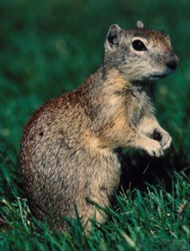
Land animals
H
N
Nitrogen waste disposal on land
  need to conserve water
  must process ammonia so less toxic
    urea = larger molecule = less soluble = less toxic
      2NH₂ + CO₂ = urea
      produced in liver
  kidney
    filter solutes out of blood
    reabsorb H₂O (+ any useful solutes)
    excrete waste
      urine = urea, salts, excess sugar & H₂O
        urine is very concentrated
        concentrated NH₃ would be too toxic
H
C
O
H
N
H
Urea
costs energy
to synthesize,
but it’s worth it!
mammals
Notes:
The main advantage of urea is its low toxicity, about 100,000 times less than that of ammonia.
Urea can be transported and stored safely at high concentrations.
This reduces the amount of water needed for nitrogen excretion when releasing a concentrated solution of urea rather than a dilute solution of ammonia.
The main disadvantage of urea is that animals must expend energy to produce it from ammonia.
In weighing the relative advantages of urea versus ammonia as the form of nitrogenous waste, it makes sense that many amphibians excrete mainly ammonia when they are aquatic tadpoles.
They switch largely to urea when they are land-dwelling adults.

Slide 22
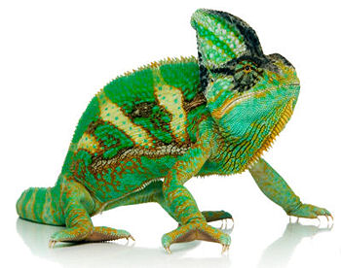
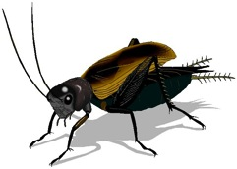
Egg-laying land animals
Nitrogen waste disposal in egg
  no place to get rid of waste in egg
  need even less soluble molecule
    uric acid = BIGGER = less soluble = less toxic
  birds, reptiles, insects
itty bitty
living space!
Notes:
But unlike either ammonia or urea, uric acid is largely insoluble in water and can be excreted as a semisolid paste with very small water loss.
While saving even more water than urea, it is even more energetically expensive to produce.
Uric acid and urea represent different adaptations for excreting nitrogenous wastes with minimal water loss.
The type of nitrogenous waste also depends on habitat.
For example, terrestrial turtles (which often live in dry areas) excrete mainly uric acid, while aquatic turtles excrete both urea and ammonia.
In some species, individuals can change their nitrogenous wastes when environmental conditions change.
For example, certain tortoises that usually produce urea shift to uric acid when temperature increases and water becomes less available.
The salt secreting glands of some marine birds, such as an albatross, secrete an excretory fluid that is much more salty than the ocean.
The salt-excreting glands of the albatross remove excess sodium chloride from the blood, so they can drink sea water during their months at sea.
The counter-current system in these glands removes salt from the blood, allowing these organisms to drink sea water during their months at sea.

Slide 23
Uric acid
And that folks,
is why most
male birds don’t
have a penis!
Polymerized urea
  large molecule
  precipitates out of solution
    doesn’t harm embryo in egg
      white dust in egg
    adults still excrete N waste as white paste
      no liquid waste
      uric acid = white bird “poop”!
O
H
H
N
N
O
O
N
N
H
H
Notes:
Birds don’t “pee”, like mammals, and therefore most male birds do not have a penis
So how do they mate?
In the males of species without a phallus**, sperm is stored within the “proctodeum“ compartment within the cloaca prior to copulation. During copulation, the female moves her tail to the side and the male either mounts the female from behind or moves very close to her. He moves the opening of his cloaca, close to hers, so that the sperm can enter the female's cloaca, in what is referred to as a “cloacal kiss”. This can happen very fast, sometimes in less than one second.
The sperm is stored in the female's cloaca for anywhere from a week to a year, depending on the species of bird. Then, one by one, eggs will descend from the female's ovaries and become fertilized by the male's sperm, before being subsequently laid by the female. The eggs will then continue their development in the nest.
(BTW, cloaca is Greek for sewer)
** Many waterfowl and some other birds, such as the ostrich and turkey, do possess a phallus. Except during copulation, it is hidden within the proctodeum compartment just inside the cloaca. The avian phallus differs from the mammalian penis in several ways, most importantly in that it is purely a copulatory organ and is not used for dispelling urine.

Slide 24
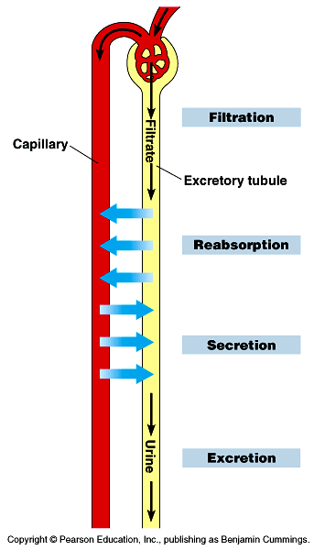
Mammalian System
Filter solutes out of blood & reabsorb H₂O + desirable solutes
Key functions
  Filtration: fluids (water & solutes) filtered out of blood
  Reabsorption: selectively reabsorb (diffusion) needed water + solutes back to blood
  Secretion: pump out any other unwanted solutes to urine
  Excretion: expel concentrated urine (N waste + solutes + toxins) from body
blood
filtrate
concentrated
urine
Notes:
What’s in blood?
Cells
Plasma
H₂O = want to keep
proteins = want to keep
glucose = want to keep
salts / ions = want to keep
urea = want to excrete

Slide 25
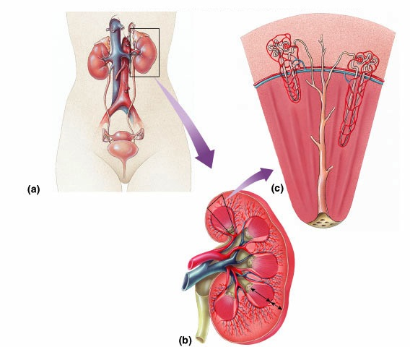
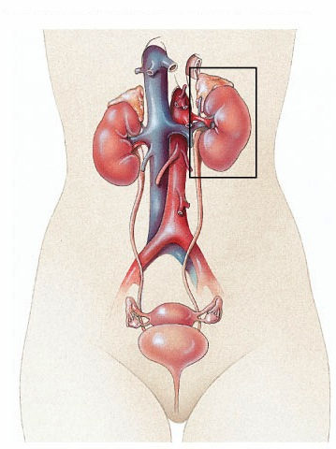
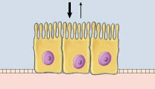
Mammalian Kidney
inferior
vena cava
aorta
adrenal gland
kidney
nephron
ureter
renal vein
& artery
epithelial
cells
bladder
urethra
Notes:
From Bowman’s capsule, the filtrate passes through three regions of the nephron: the proximal tubule; the loop of Henle, a hairpin turn with a descending limb and an ascending limb; and the distal tubule.
The distal tubule empties into a collecting duct, which receives processed filtrate from many nephrons.
The many collecting ducts empty into the renal pelvis, which is drained by the ureter.

Slide 26
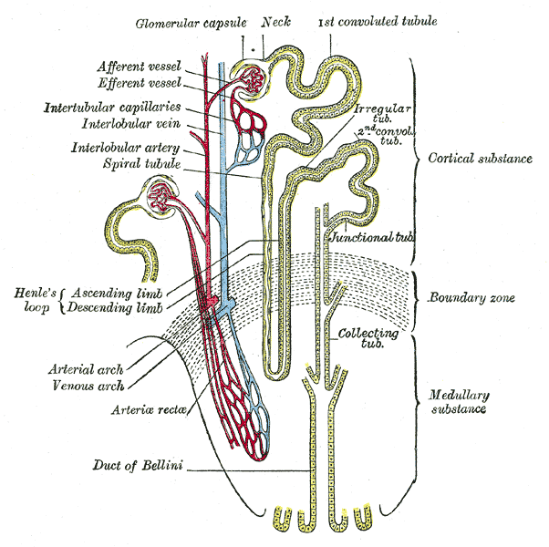
Nephron
Functional units of kidney
  1 million nephrons
  per kidney
Function
  filter out urea & other
  solutes (salt, sugar…)
  blood plasma filtered
  into nephron
    high pressure flow
  selective reabsorption of
  valuable solutes & H₂O
  back into bloodstream
    greater flexibility & control
why
selective reabsorption
& not selective
filtration?
“counter current
exchange system”
Notes:
Each nephron consists of a single long tubule and a ball of capillaries, called the glomerulus.
The blind end of the tubule forms a cup-shaped swelling, called Bowman’s capsule, that surrounds the glomerulus.
Each human kidney packs about a million nephrons.

Slide 27
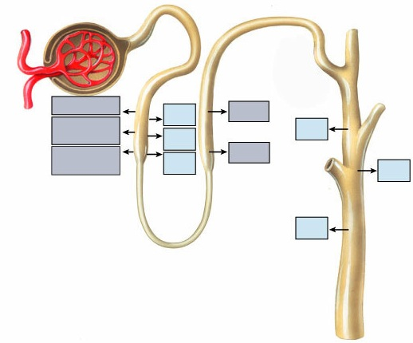
Mammalian kidney
How can
different sections
allow the diffusion
of different
molecules?
Interaction of circulatory & excretory systems
Circulatory system
  glomerulus =
  ball of capillaries
Excretory system
  nephron
  Bowman’s capsule
  loop of Henle
    proximal tubule
    descending limb
    ascending limb
    distal tubule
  collecting duct
Bowman’s capsule
Proximal
tubule
Distal tubule
Glomerulus
Glucose
H₂O
Na⁺ Cl⁻
Amino
acids
H₂O
H₂O
Mg⁺⁺ Ca⁺⁺
H₂O
Na⁺ Cl⁻
H₂O
H₂O
Collecting
duct
Loop of Henle

Slide 28
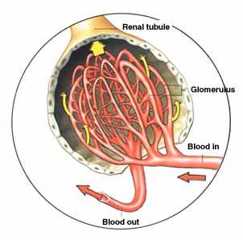
Nephron: Filtration
At glomerulus
  filtered out of blood
    H₂O
    glucose
    salts / ions
    urea
  not filtered out
    cells
    proteins
high blood pressure in kidneys
force to push (filter) H₂O & solutes out of blood vessel
BIG problems when you start out with high blood pressure in system
hypertension = kidney damage
Notes:
Filtrate from Bowman’s capsule flows through the nephron and collecting ducts as it becomes urine.
Filtration occurs as blood pressure forces fluid from the blood in the glomerulus into the lumen of Bowman’s capsule.
The porous capillaries, along with specialized capsule cells called podocytes, are permeable to water and small solutes but not to blood cells or large molecules such as plasma proteins.
The filtrate in Bowman’s capsule contains salt, glucose, vitamins, nitrogenous wastes, and other small molecules.

Slide 29
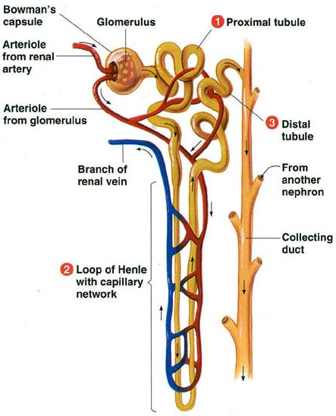
Nephron: Re-absorption
Proximal tubule
  reabsorbed back into blood
    NaCl
      active transport
      of Na⁺
      Cl– follows
      by diffusion
    H₂O
    glucose
    HCO₃⁻
      bicarbonate
      buffer for
      blood pH
Notes:
One of the most important functions of the proximal tubule is reabsorption of most of the NaCl and water from the initial filtrate volume.
The epithelial cells actively transport Na⁺ into the interstitial fluid.
This transfer of positive charge is balanced by the passive transport of Cl⁻ out of the tubule. As salt moves from the filtrate to the interstitial fluid, water follows by osmosis.
For example, the cells of the transport epithelium help maintain a constant pH in body fluids by controlled secretions of hydrogen ions or ammonia.
The proximal tubules reabsorb about 90% of the important buffer bicarbonate (HCO₃⁻).

Slide 30
Nephron: Re-absorption
Loop of Henle
  descending limb
    high permeability to H₂O
      many aquaporins in cell membranes
    low permeability to salt
      few Na⁺ or Cl– channels
  reabsorbed
    H₂O
structure fits
function!
Notes:
Proximal tubule.
Secretion and reabsorption in the proximal tubule substantially alter the volume and composition of filtrate.
For example, the cells of the transport epithelium help maintain a constant pH in body fluids by controlled secretions of hydrogen ions or ammonia.
The proximal tubules reabsorb about 90% of the important buffer bicarbonate (HCO₃⁻).
Descending limb of the loop of Henle. Reabsorption of water continues as the filtrate moves into the descending limb of the loop of Henle.
This transport epithelium is freely permeable to water but not very permeable to salt and other small solutes.

Slide 31
Nephron: Re-absorption
Loop of Henle
  ascending limb
    low permeability
    to H₂O
    Cl⁻ pump
    Na⁺ follows by diffusion
      different membrane proteins
  reabsorbed
    salts
      maintains osmotic gradient
structure fits
function!
Notes:
Ascending limb of the loop of Henle.
In contrast to the descending limb, the transport epithelium of the ascending limb is permeable to salt, not water.
As filtrate ascends the thin segment of the ascending limb, NaCl diffuses out of the permeable tubule into the interstitial fluid, increasing the osmolarity of the medulla.
The active transport of salt from the filtrate into the interstitial fluid continues in the thick segment of the ascending limb.
By losing salt without giving up water, the filtrate becomes progressively more dilute as it moves up to the cortex in the ascending limb of the loop.

Slide 32
Nephron: Re-absorption
Distal tubule
  reabsorbed
    salts
    H₂O
    HCO₃⁻
      bicarbonate
Notes:
Distal tubule. The distal tubule plays a key role in regulating the K⁺ and NaCl concentrations in body fluids by varying the amount of K⁺ that is secreted into the filtrate and the amount of NaCl reabsorbed from the filtrate.
Like the proximal tubule, the distal tubule also contributes to pH regulation by controlled secretion of H⁺ and the reabsorption of bicarbonate (HCO₃⁻).

Slide 33
Nephron: Reabsorption & Excretion
Collecting duct
  reabsorbed
    H₂O
  excretion
    concentrated urine passed
    to bladder
      impermeable lining
Notes:
Collecting duct. By actively reabsorbing NaCl, the transport epithelium of the collecting duct plays a large role in determining how much salt is actually excreted in the urine.
The epithelium is permeable to water but not to salt or (in the renal cortex) to urea.
As the collecting duct traverses the gradient of osmolarity in the kidney, the filtrate becomes increasingly concentrated as it loses more and more water by osmosis to the hyperosmotic interstitial fluid.
In the inner medulla, the duct becomes permeable to urea, contributing to hyperosmotic interstitial fluid and enabling the kidney to conserve water by excreting a hyperosmotic urine.

Slide 34
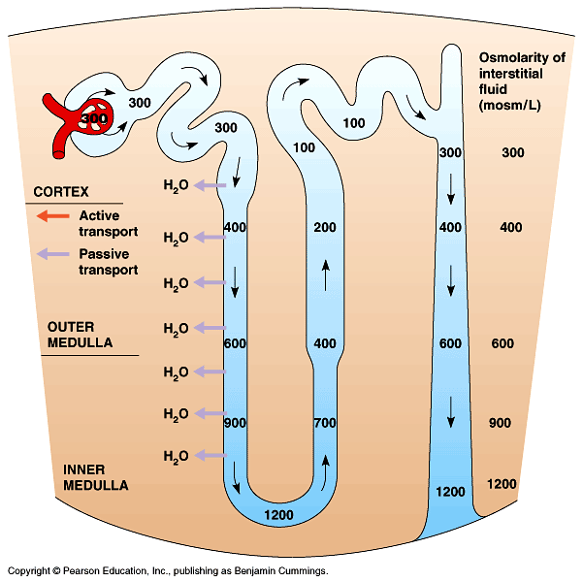
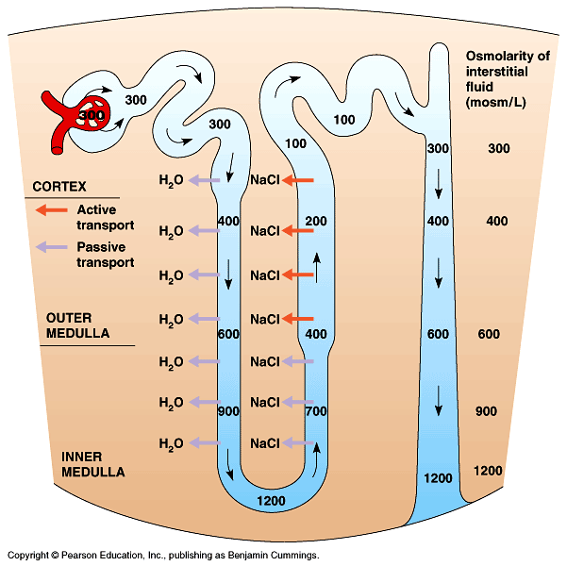
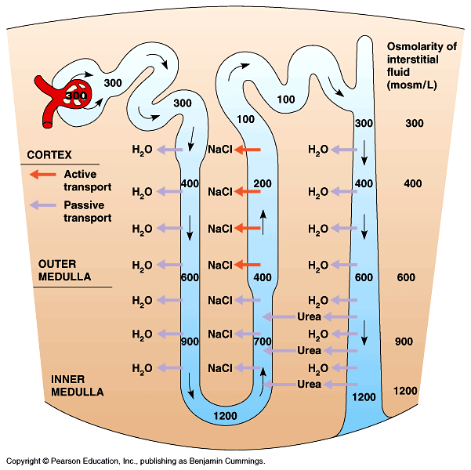
Osmotic control in nephron
How is all this re-absorption achieved?
  tight osmotic
  control to reduce
  the energy cost
  of excretion
  use diffusion
  instead of
  active transport
  wherever possible
the value of a
counter current
exchange system
Notes:
Descending limb of the loop of Henle.
Reabsorption of water continues as the filtrate moves into the descending limb of the loop of Henle.
This transport epithelium is freely permeable to water but not very permeable to salt and other small solutes. For water to move out of the tubule by osmosis, the interstitial fluid bathing the tubule must be hyperosmotic to the filtrate.
Because the osmolarity of the interstitial fluid does become progressively greater from the outer cortex to the inner medulla, the filtrate moving within the descending loop of Henle continues to loose water.
Ascending limb of the loop of Henle.
In contrast to the descending limb, the transport epithelium of the ascending limb is permeable to salt, not water.
As filtrate ascends the thin segment of the ascending limb, NaCl diffuses out of the permeable tubule into the interstitial fluid, increasing the osmolarity of the medulla.
The active transport of salt from the filtrate into the interstitial fluid continues in the thick segment of the ascending limb. By losing salt without giving up water, the filtrate becomes progressively more dilute as it moves up to the cortex in the ascending limb of the loop.

Slide 35
Summary
why
selective reabsorption
& not selective
filtration?
Not filtered out
  Cells, proteins
  remain in blood (too big)
Reabsorbed: active transport
  Na⁺ Cl⁻, amino acids, glucose
Reabsorbed: diffusion
  Na⁺, Cl–, H₂O
Excreted
  Urea, excess H₂O , excess solutes (glucose, salts), toxins, drugs, “unknowns”

Slide 36
Negative Feedback Loop
hormone or nerve signal
lowers
body condition
(return to set point)
gland or nervous system
high
sensor
specific body condition
sensor
low
raises
body condition
(return to set point)
gland or nervous system
hormone or nerve signal

Slide 37
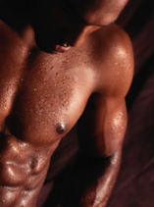

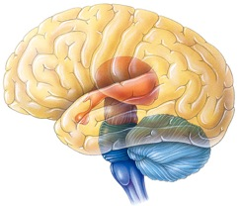


Controlling Body Temperature
Nervous System Control
nerve signals
brain
sweat
dilates surface
blood vessels
high
body temperature
low
constricts surface
blood vessels
shiver
brain
nerve signals

Slide 38
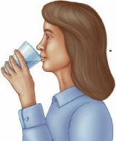
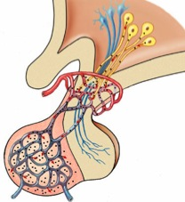
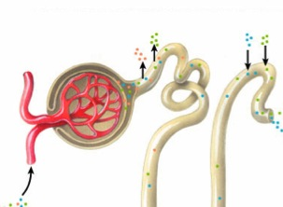
Blood Osmolarity
Endocrine System Control
ADH
pituitary
increased
water
reabsorption
increase
thirst
high
nephron
blood osmolarity
blood pressure
low
ADH =
AntiDiuretic Hormone

Slide 39
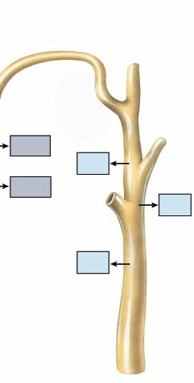
Maintaining Water Balance
High blood osmolarity level
  too many solutes in blood
    dehydration, high salt diet
  stimulates thirst = drink more
  release ADH from pituitary gland
    antidiuretic hormone
  increases permeability of collecting duct
  & reabsorption of water in kidneys
    increase water absorption back into blood
    decrease urination
Get more
water into
blood fast
H₂O
H₂O
Alcohol
suppresses ADH…
makes you
urinate a lot!
H₂O

Slide 40
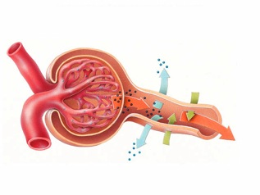
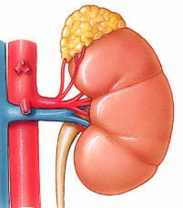
Blood Osmolarity
Endocrine System Control
Oooooh,
zymogen!
JGA =
JuxtaGlomerular
Apparatus
high
blood osmolarity
blood pressure
low
JGA
increased
water & salt
reabsorption
in kidney
adrenal
gland
nephron
renin
aldosterone
angiotensinogen
angiotensin

Slide 41
Maintaining Water Balance
Get more
water & salt into
blood fast!
Low blood osmolarity level
or low blood pressure
  JGA releases renin in kidney
  renin converts angiotensinogen to angiotensin
  angiotensin causes arterioles to constrict
    increase blood pressure
  angiotensin triggers release of aldosterone from adrenal gland
  increases reabsorption of NaCl & H₂O in kidneys
    puts more water & salts back in blood
adrenal
gland
Why such a
rapid response
system?
Spring a leak?

Slide 42
Blood Osmolarity
Endocrine System Control
ADH
pituitary
increased
water
reabsorption
increase
thirst
high
nephron
blood osmolarity
blood pressure
JuxtaGlomerular
Apparatus
low
increased
water & salt
reabsorption
adrenal
gland
nephron
renin
aldosterone
angiotensinogen
angiotensin

Slide 43
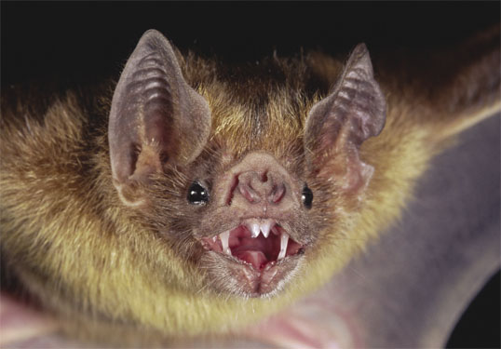
Don’t get batty…
Ask Questions!!

Slide 44
Make sure you can do the following:
Label/Identify all organs that play major roles in the Excretory system.
Diagram all important parts of a nephron and explain their functions.
Diagram the feedback loops that function in regulating blood osmolarity.
Compare and contrast the thermoregulatory strategies of endoderms and ectoderms
Explain the causes of excretory system disruptions and how disruptions of the excretory system can lead to disruptions of homeostasis.

