Slide 1
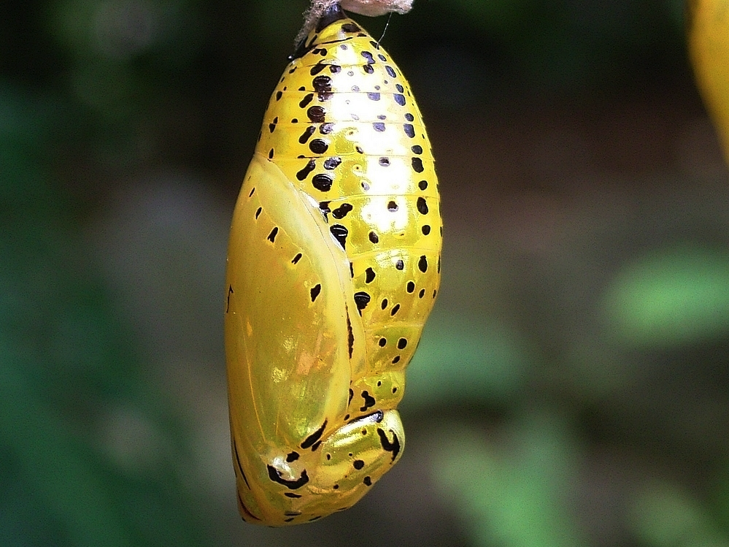
Endocrine System
Hormones
(Ch. 45)

Slide 2
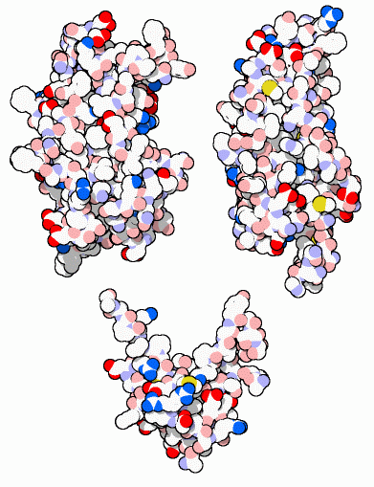
Regulation
Why are hormones needed?
  chemical messages from one body part to another
  communication needed to coordinate whole body
  daily homeostasis & regulation of large scale changes
    solute levels in blood
      glucose, Ca⁺⁺, salts, etc.
    metabolism
    growth
    development
    maturation
    reproduction
growth hormones

Slide 3
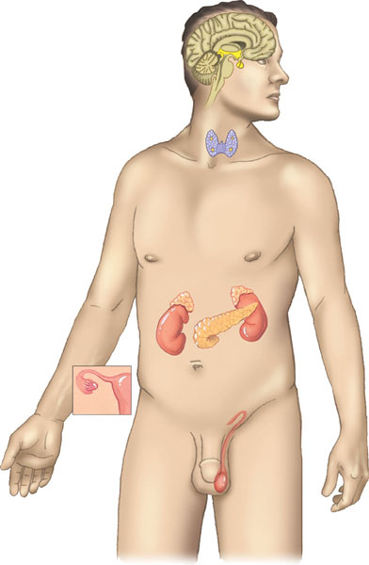
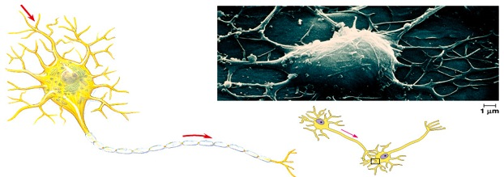
Regulation & Communication
Animals rely on 2 systems for regulation
  endocrine system
    system of ductless glands
      secrete chemical signals directly into blood
      chemical travels to target tissue
      target cells have receptor proteins
      slow, long-lasting response
  nervous system
    system of neurons
      transmits “electrical” signal &
      release neurotransmitters to
      target tissue
      fast, short-lasting response
Notes:
Hormones coordinate slower but longer–acting responses to stimuli such as stress, dehydration, and low blood glucose levels. Hormones also regulate long–term developmental processes by informing different parts of the body how fast to grow or when to develop the characteristics that distinguish male from female or juvenile from adult. Hormone–secreting organs, called endocrine glands, are referred to as ductless glands because they secrete their chemical messengers directly into extracellular fluid. From there, the chemicals diffuse into the circulation.

Slide 4
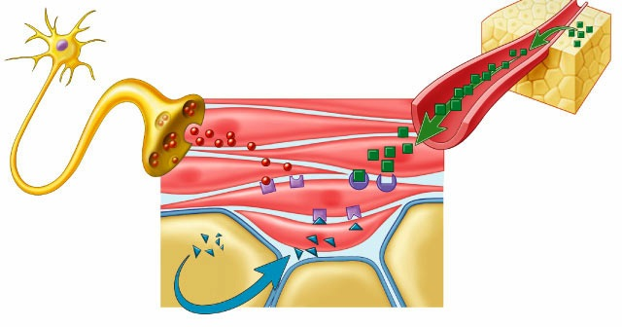
Regulation by chemical messengers
Neurotransmitters released by neurons
Hormones release by endocrine glands
endocrine gland
neurotransmitter
axon
hormone carried by blood
receptor proteins
receptor proteins
Lock & Key
system
target cell

Slide 5
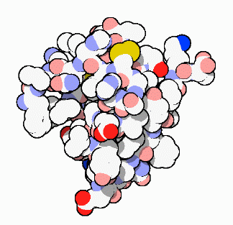
Classes of Hormones
Protein-based hormones
  polypeptides
    small proteins: insulin, ADH
  glycoproteins
    large proteins + carbohydrate: FSH, LH
  amines
    modified amino acids: epinephrine, melatonin
Lipid-based hormones
  steroids
    modified cholesterol: sex hormones, aldosterone
insulin

Slide 6
How do hormones act on target cells
Lipid-based hormones
  hydrophobic & lipid-soluble
    diffuse across cell membrane & enter cells
    bind to receptor proteins in cytoplasm & nucleus
    bind to DNA as transcription factors
      turn on genes
Protein-based hormones
  hydrophilic & not lipid soluble
    can’t diffuse across cell membrane
    bind to receptor proteins in cell membrane
    trigger secondary messenger pathway
    activate internal cellular response
      enzyme action, uptake or secretion of molecules…

Slide 7
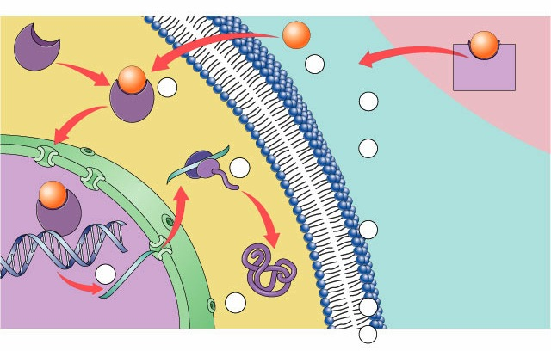
Action of lipid (steroid) hormones
target cell
steroid hormone
blood
S
1
S
cross cell membrane
protein
carrier
S
2
cytoplasm
binds to receptor protein
becomes
transcription factor
5
mRNA read by ribosome
3
S
plasma membrane
DNA
4
mRNA
nucleus
6
7
protein
protein secreted
ex: secreted protein = growth factor (hair, bone, muscle, gametes)

Slide 8
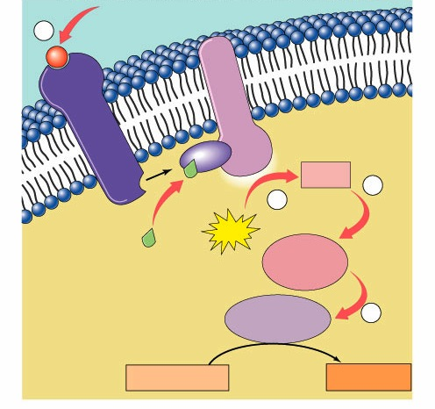
Action of protein hormones
signal-transduction pathway
1
signal
protein
hormone
P
plasma membrane
binds to receptor protein
activates
G-protein
activates enzyme
cAMP
acts as 2° messenger
receptor protein
ATP
transduction
activates
cytoplasmic
signal
GTP
ATP
activates
enzyme
2
secondary
messenger
system
cytoplasm
activates
enzyme
target cell
produces an action
3
response
Notes:
transduction: the action or process of converting something and especially energy or a message into another form

Slide 9
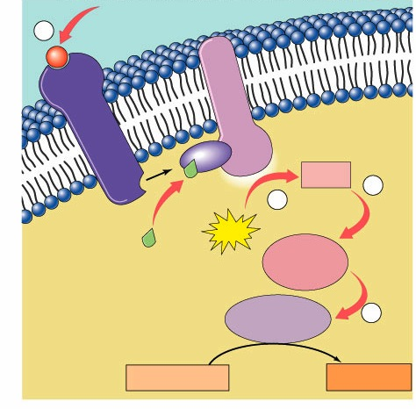
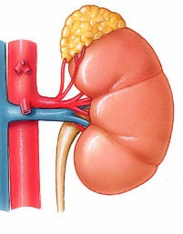
Ex: Action of epinephrine (adrenaline)
signal
adrenal gland
1
epinephrine
activates
G protein
3
receptor
protein
in cell
membrane
activates
adenylyl cyclase
GDP
cAMP
4
transduction
ATP
GTP
2
activates
protein kinase-A
5
activates GTP
activates
phosphorylase kinase
cytoplasm
activates
glycogen phosphorylase
released
to blood
7
liver cell
glycogen
6
glucose
response

Slide 10
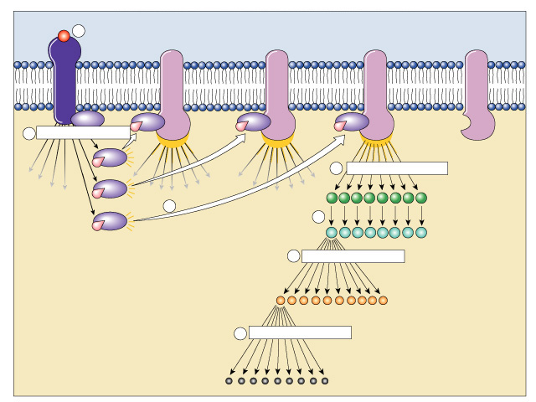
Benefits of a 2° messenger system
signal
1
receptor protein
Activated adenylyl cyclase
2
amplification
Not yet
activated
4
amplification
3
cAMP
amplification
5
GTP
G protein
protein kinase
6
amplification
Amplification!
enzyme
Cascade multiplier!
7
amplification
FAST response!
product

Slide 11
Maintaining homeostasis
hormone 1
gland
lowers
body condition
high
specific body condition
low
raises
body condition
gland
Negative Feedback
Model
hormone 2

Slide 12


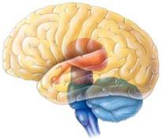
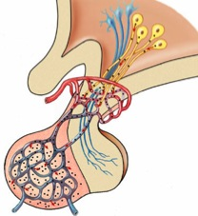


Controlling Body Temperature
Nervous System Control
Feedback
nerve signals
hypothalamus
sweat
dilates surface
blood vessels
high
body temperature
(37°C)
low
hypothalamus
constricts surface
blood vessels
shiver
nerve signals

Slide 13
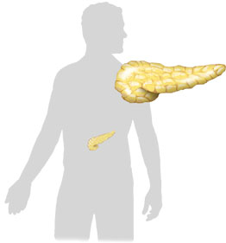

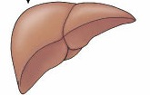
Regulation of Blood Sugar
Endocrine System Control
Feedback
insulin
islets of Langerhans
beta islet cells
body
cells take
up sugar
from blood
liver stores
glycogen
reduces
appetite
pancreas
high
liver
blood sugar level
(90mg/100ml)
low
liver
releases
glucose
triggers
hunger
pancreas
liver
glucagon
islets of Langerhans
alpha islet cells

Slide 14
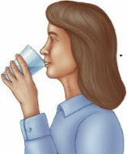
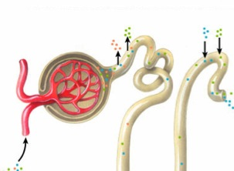
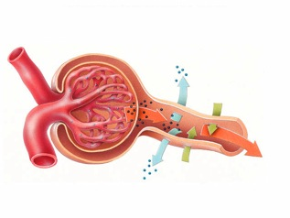
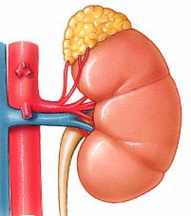
Blood Osmolarity
Endocrine System Control
Feedback
osmoreceptors in
hypothalamus
ADH
increased
water
reabsorption
increase
thirst
pituitary
high
nephron
blood osmolarity
blood pressure
JuxtaGlomerular
Apparatus
nephron
low
increased
water & salt
reabsorption
nephron
(JGA)
adrenal
gland
renin
aldosterone
angiotensinogen
angiotensin

Slide 15
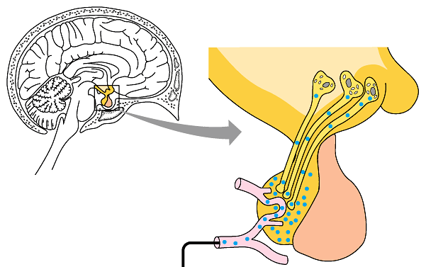
Nervous & Endocrine systems linked
Hypothalamus = “master nerve control center”
  nervous system
  receives information from nerves around body about internal conditions
  releasing hormones: regulates release of hormones from pituitary
Pituitary gland = “master gland”
  endocrine system
  secretes broad range
  of “tropic” hormones
  regulating other
  glands in body
hypothalamus
posterior
pituitary
anterior

Slide 16
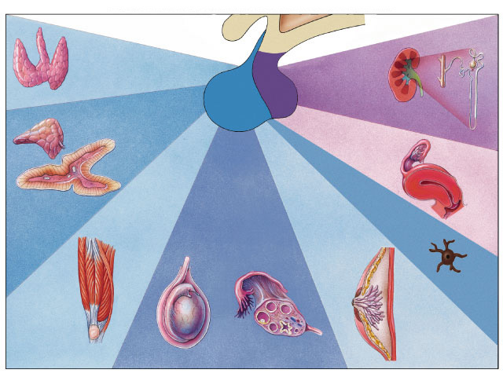
tropic hormones = target endocrine glands
hypothalamus
thyroid-stimulating
hormone
(TSH)
posterior
pituitary
antidiuretic
hormone
(ADH)
Thyroid gland
anterior
pituitary
adrenocorticotropic
hormone (ACTH)
Kidney
tubules
oxytocin
Muscles
of uterus
growth hormone (GH)
gonadotropic
hormones:
follicle-
stimulating
hormone (FSH)
& luteinizing
hormone (LH)
melanocyte-stimulating hormone
(MSH)
prolactin (PRL)
Adrenal
cortex
Melanocyte
in amphibian
Bone
and muscle
Mammary
glands
in mammals
Testes
Ovaries
Notes:
tropins (tropic hormones) stimulate growth in target organs/cells (tropic means nourishment) When the target organ is another gland, tropic hormones cause them to produce & release their own hormones.

Slide 17
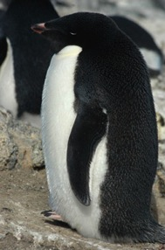
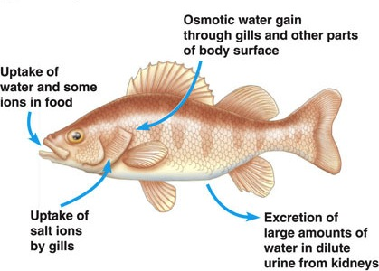
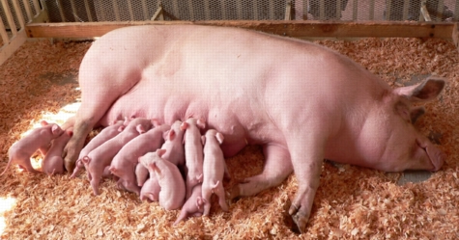
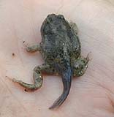
Homology in hormones
What does this tell you about these hormones?
How could these hormones have different effects?
prolactin
same gene family
growth
hormone
gene duplication?
mammals
birds
fish
amphibians
milk
production
fat
metabolism
salt &
water
balance
metamorphosis
& maturation
growth
& development
Notes:
The most remarkable characteristic of prolactin (PRL) is the great diversity of effects it produces in different vertebrate species. For example, prolactin stimulates mammary gland growth and milk synthesis in mammals; regulates fat metabolism and reproduction in birds; delays metamorphosis in amphibians, where it may also function as a larval growth hormone; and regulates salt and water balance in freshwater fishes. This list suggests that prolactin is an ancient hormone whose functions have diversified during the evolution of the various vertebrate groups.
Growth hormone (GH) is so similar structurally to prolactin that scientists hypothesize that the genes directing their production evolved from the same ancestral gene. Gene duplication!

Slide 18
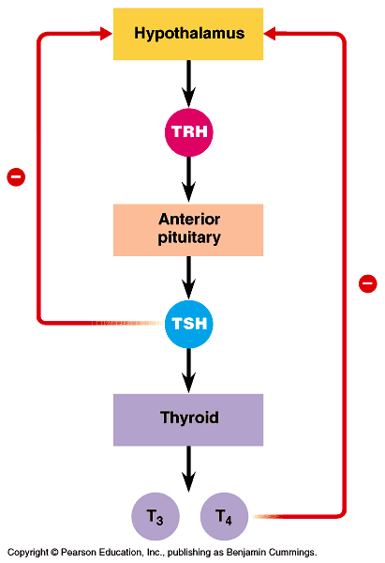
Regulating metabolism
Hypothalamus
  TRH = TSH-releasing hormone
Anterior Pituitary
  TSH = thyroid stimulating hormone
Thyroid
  produces thyroxine hormones
  metabolism & development
    bone growth
    mental development
    metabolic use of energy
    blood pressure & heart rate
    muscle tone
    digestion
    reproduction
tyrosine
+
iodine
thyroxines
Notes:
The thyroid gland produces two very similar hormones derived from the amino acid tyrosine: triiodothyronine (T3), which contains three iodine atoms, and tetraiodothyronine, or thyroxine (T4), which contains four iodine atoms. In mammals, the thyroid secretes mainly T4, but target cells convert most of it to T3 by removing one iodine atom. Although both hormones are bound by the same receptor protein located in the cell nucleus, the receptor has greater affinity for T3 than for T4. Thus, it is mostly T3 that brings about responses in target cells.

Slide 19
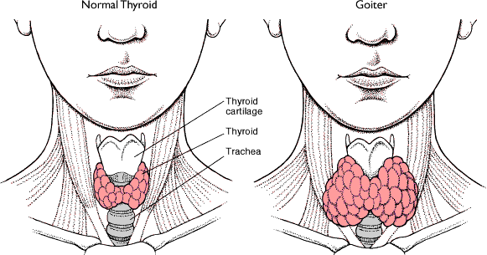
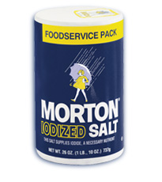

Goiter
Iodine deficiency causes thyroid to enlarge as it tries to produce thyroxine
+
tyrosine
+
iodine
✗
✗
thyroxines

Slide 20
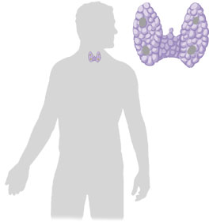

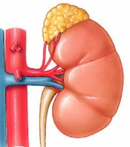


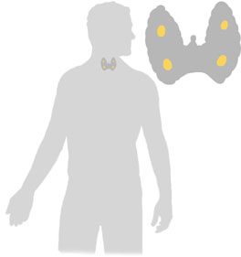

Regulation of Blood Calcium
Endocrine System Control
Feedback
calcitonin
thyroid
↓ kidney
reabsorption
of Ca⁺⁺
Ca⁺⁺ deposited
in bones
high
blood calcium level
(10 mg/100mL)
↑ Ca⁺⁺ uptake
in intestines
low
activated Vitamin D
↑ kidney
reabsorption
of Ca⁺⁺
parathyroid
bones
release Ca⁺⁺
parathyroid hormone (PTH)

Slide 21





Female reproductive cycle
Feedback
egg
matures &
is released
(ovulation)
builds up
uterus lining
estrogen
corpus
luteum
ovary
progesterone
FSH & LH
fertilized egg
(zygote)
maintains
uterus lining
pituitary
gland
hCG
yes
corpus
luteum
pregnancy
GnRH
no
progesterone
hypothalamus
corpus luteum breaks down
progesterone drops
menstruation
maintains
uterus lining
Notes:
Gonadotropin-releasing hormone
Gonadotropin-releasing hormone 1 (GNRH1) is a peptide hormone responsible for the release of FSH and LH from the anterior pituitary. GNRH1 is synthesized and released by the hypothalamus. GNRH1 is considered a neurohormone, a hormone produced in a specific neural cell and released at its neural terminal. At the pituitary, GNRH1 stimulates the synthesis and secretion of the gonadotropins follicle-stimulating hormone (FSH) and luteinizing hormone (LH). These processes are controlled by the size and frequency of GNRH1 pulses, as well as by feedback from androgens and estrogens. Low frequency GNRH1 pulses lead to FSH release, whereas high frequency GNRH1 pulses stimulate LH release. There are differences in GNRH1 secretion between females and males. In males, GNRH1 is secreted in pulses at a constant frequency, but in females the frequency of the pulses varies during the menstrual cycle and there is a large surge of GNRH1 just before ovulation. GNRH1 secretion is pulsatile in all vertebrates, and is necessary for correct reproductive function. Thus, a single hormone, GNRH1, controls a complex process of follicular growth, ovulation, and corpus luteum maintenance in the female, and spermatogenesis in the male.
Human chorionic gonadotropin
Human chorionic gonadotropin (hCG) is a peptide hormone produced in pregnancy that is made by the embryo soon after conception and later by the syncytiotrophoblast (part of the placenta). Its role is to prevent the disintegration of the corpus luteum of the ovary and thereby maintain progesterone production that is critical for a pregnancy in humans. hCG may have additional functions; for instance, it is thought that hCG affects the immune tolerance of the pregnancy.

Slide 22
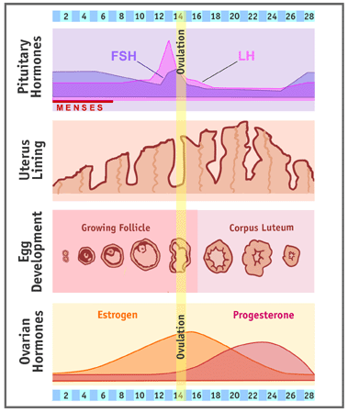

Slide 23
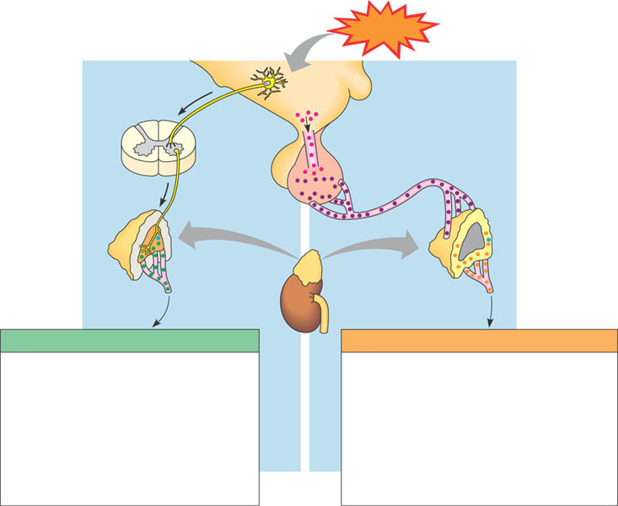
Effects of stress on a body
Stress
Spinal cord
(cross section)
Nerve
signals
Hypothalamus
Releasing
hormone
Nerve
cell
Anterior pituitary
adrenal medulla
secretes epinephrine
& norepinephrine
Blood vessel
Nerve cell
Adrenal cortex
secretes
mineralocorticoids
& glucocorticoids
ACTH
Adrenal
gland
Kidney
MEDULLA
CORTEX
(A) SHORT-TERM STRESS RESPONSE
(B) LONG-TERM STRESS RESPONSE
Effects of epinephrine and norepinephrine:
1. Glycogen broken down to glucose; increased blood glucose
2. Increased blood pressure
3. Increased breathing rate
4. Increased metabolic rate
5. Change in blood flow patterns, leading to increased alertness & decreased digestive & kidney activity
Effects of
mineralocorticoids:
1. Retention of sodium ions & water by kidneys
2. Increased blood volume & blood pressure
Effects of
glucocorticoids:
1. Proteins & fats broken down & converted to glucose, leading to increased blood glucose
2. Immune system suppressed

Slide 24
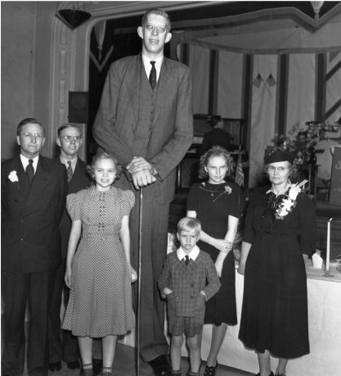
Any Questions??
Robert Wadlow
1918-1940
8' 11"
Notes:
The rabbit test was an early pregnancy test developed in 1927 by Bernhard Zondek and Selmar Aschheim. The original test actually used mice. The test consisted of injecting the tested woman's urine into a female rabbit, then examining the rabbit's ovaries a few days later, which would change in response to a hormone only secreted by pregnant women. The hormone, human chorionic gonadotropin (hCG), is produced during pregnancy and indicates the presence of a fertilized egg; it can be found in a pregnant woman's urine and blood. The rabbit test became a widely used bioassay (animal-based test) to test for pregnancy. The term "rabbit test" was first recorded in 1949 but became a common phrase in the English language. Xenopus frogs were also used in a similar "frog test".
Modern pregnancy tests still operate on the basis of testing for the presence of the hormone hCG. Due to medical advances, use of a live animal is no longer required.
It is a common misconception that the injected rabbit would die only if the woman was pregnant. This led to the phrase "the rabbit died" being used as a euphemism for a positive pregnancy test. In fact, all rabbits used for the test died, because they had to be surgically opened in order to examine the ovaries. While it was possible to do this without killing the rabbit, it was generally deemed not worth the trouble and expense.

Slide 25
Make sure you can do the following:
Compare and contrast the regulatory structures and functions of the nervous and endocrine systems
Diagram the processes by which signal transduction occurs in multicellular animals, including steroid and lipid hormone signaling pathways
Diagram the endocrine feedback loops that contribute to regulation of multicellular animals including pituitary, thyroid, pancreatic, and gonadal hormones.
Explain the causes of enodcrine system disruptions and how disruptions of the endocrine system can lead to disruptions of homeostasis.

