Slide 1
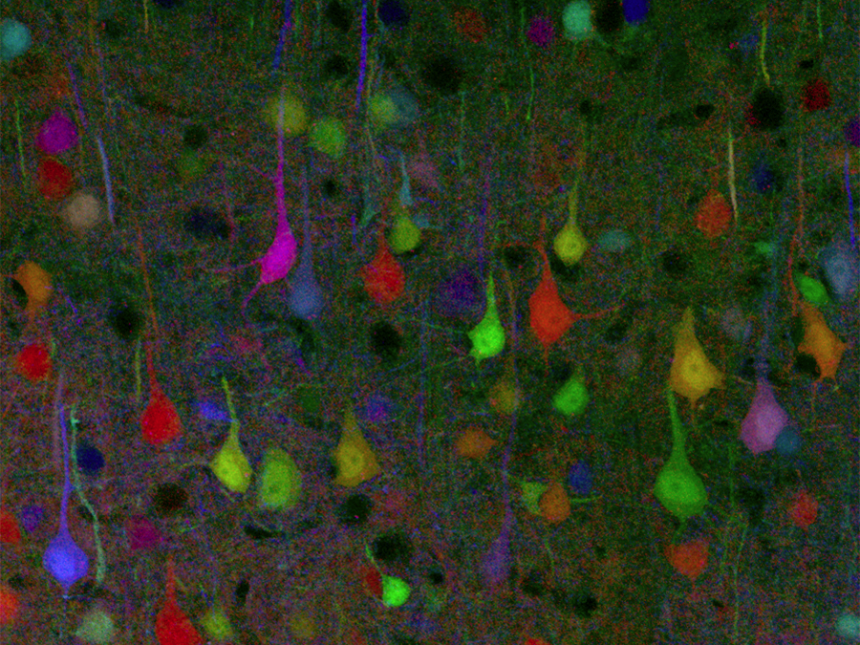

Nervous System
(Ch. 48)
Notes:
Every time you move a muscle & every time you think a thought, your nerve cells are hard at work. They are processing information: receiving signals, deciding what to do with them, & dispatching new messages off to their neighbors. Some nerve cells communicate directly with muscle cells, sending them the signal to contract. Other nerve cells are involved solely in the bureaucracy of information, spending their lives communicating only with other nerve cells. But unlike our human bureaucracies, this processing of information must be fast in order to keep up with the ever-changing demands of life.

Slide 2
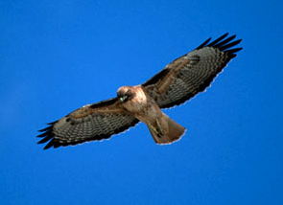
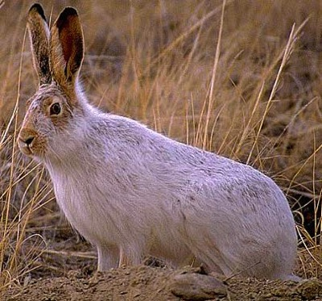

Why do animals need a nervous system?
What characteristics do animals need in
a nervous system?
  fast
  accurate
  reset quickly
Remember…
think about
the bunny…
Poor bunny!

Slide 3
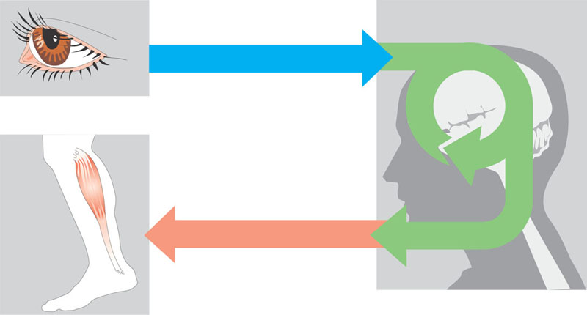
Overview of information processing by nervous systems
Sensory input
Integration
Sensor
Motor output
Effector
Peripheral nervous
system (PNS)
Central nervous
system (CNS)

Slide 4
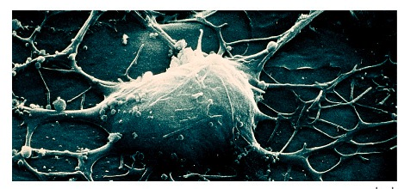
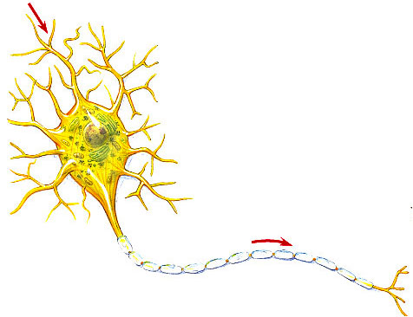
Nervous system cells
Neuron
  a nerve cell
signal
direction
dendrites
cell body
Structure fits function
  many entry points for signal
  one path out
  transmits signal
axon
signal direction
myelin sheath
synaptic terminal
dendrite → cell body → axon
synapse

Slide 5
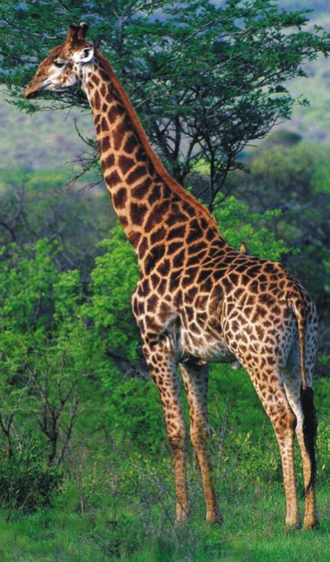

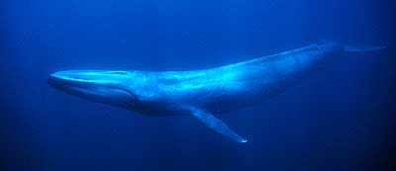
Fun facts about neurons
Most specialized cell in
animals
Longest cell
  blue whale neuron
    10-30 meters
  giraffe axon
    5 meters
  human neuron
    1-2 meters
Nervous system allows for
1 millisecond response time

Slide 6
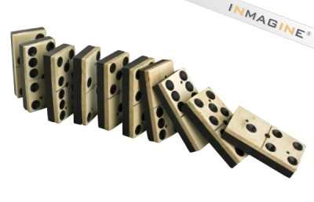
Transmission of a signal
Think dominoes!
  start the signal
    knock down line of dominoes by tipping 1st one
    → trigger the signal
  propagate the signal
    do dominoes move down the line?
    → no, just a wave through them!
  re-set the system
    before you can do it again,
    have to set up dominoes again
    → reset the axon

Slide 7
Transmission of a nerve signal
Neuron has similar system
  protein channels are set up
  once first one is opened, the rest open in succession
    all or nothing response
  a “wave” action travels along neuron
  have to re-set channels so neuron can react again

Slide 8
Cells: surrounded by charged ions
Cells live in a sea of charged ions
  anions (negative)
    more concentrated within the cell
    Cl⁻, charged amino acids (aa⁻)
  cations (positive)
    more concentrated in the extracellular fluid
    Na⁺
channel
leaks K⁺
K⁺
Na⁺
Na⁺
K⁺
Na⁺
Na⁺
+
Na⁺
Na⁺
Na⁺
Na⁺
Na⁺
Na⁺
Na⁺
K⁺
aa⁻
Cl⁻
Cl⁻
Cl⁻
–
aa⁻
K⁺
aa⁻
K⁺
aa⁻
Cl⁻
K⁺
aa⁻
Cl⁻
aa⁻
Cl⁻

Slide 9
Cells have voltage!
Opposite charges on opposite sides of cell membrane
  membrane is polarized
    negative inside; positive outside
    charge gradient
    stored energy (like a battery)
+
+
+
+
+
+
+
+
+
+
+
+
+
+
+
–
–
–
–
–
–
–
–
–
–
–
–
–
–
–
–
–
–
–
–
–
–
–
–
–
–
–
–
+
+
+
+
+
+
+
+
+
+
+
+
+
+
+
Notes:
This is an imbalanced condition.
The positively + charged ions repel each other as do the negatively - charged ions. They “want” to flow down their electrical gradient and mix together evenly.
This means that there is energy stored here, like a dammed up river.
Voltage is a measurement of stored electrical energy. Like “Danger High Voltage” = lots of energy (lethal).

Slide 10
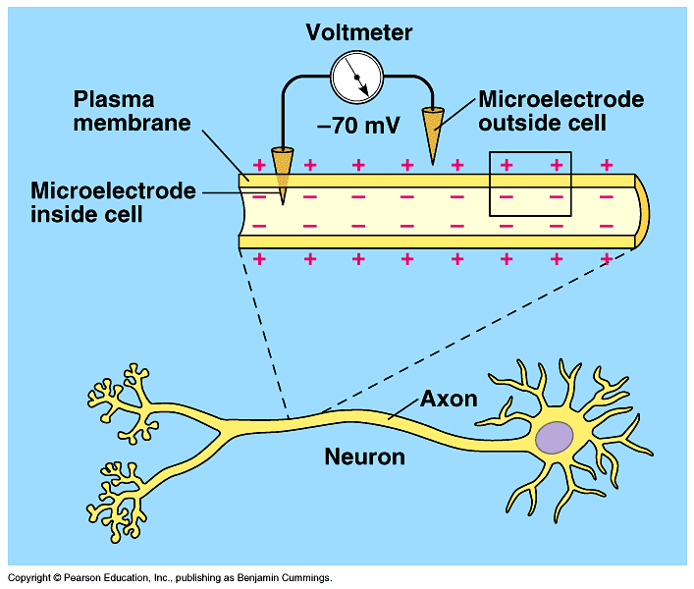
Measuring cell voltage
unstimulated neuron = resting potential of -70mV
Notes:
Voltage = measures the difference in concentration of charges.
The positives are the “hole” you leave behind when you move an electron.
Original experiments on giant squid neurons!

Slide 11
How does a nerve impulse travel?
Stimulus: nerve is stimulated
  reaches threshold potential
    open Na⁺ channels in cell membrane
    Na⁺ ions diffuse into cell
  charges reverse at that point on neuron
    positive inside; negative outside
    cell becomes depolarized
The 1st
domino
goes
down!
–
+
+
+
+
+
+
+
+
+
+
+
+
+
+
+
–
–
–
–
–
–
–
–
–
–
–
–
–
–
Na⁺
+
–
–
–
–
–
–
–
–
–
–
–
–
–
–
–
+
+
+
+
+
+
+
+
+
+
+
+
+
+

Slide 12
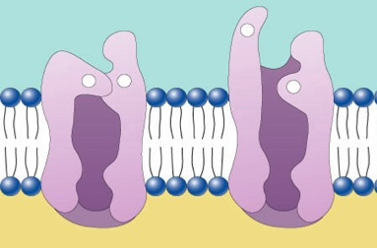
How does a nerve impulse travel?
Wave: nerve impulse travels down neuron
  change in charge opens
  next Na⁺ gates down the line
    “voltage-gated” channels
  Na⁺ ions continue to diffuse into cell
  “wave” moves down neuron = action potential
Gate
+
+
–
+
channel closed
channel open
The rest
of the
dominoes
fall!
–
–
–
+
+
+
+
+
+
+
+
+
+
+
+
+
+
+
–
–
–
–
–
–
–
–
–
–
–
–
Na⁺
+
+
+
–
–
–
–
–
–
–
–
–
–
–
–
–
–
–
+
+
+
+
+
+
+
+
+
+
+
+
wave →

Slide 13
How does a nerve impulse travel?
Re-set: 2nd wave travels down neuron
  K⁺ channels open
    K⁺ channels open up more slowly than Na⁺ channels
  K⁺ ions diffuse out of cell
  charges reverse back at that point
    negative inside; positive outside
Set
dominoes
back up
quickly!
K⁺
+
–
–
–
–
+
+
+
+
+
+
+
+
+
+
–
+
+
+
+
–
–
–
–
–
–
–
–
–
–
Na⁺
–
+
+
+
+
–
–
–
–
–
–
–
–
–
–
+
–
–
–
–
+
+
+
+
+
+
+
+
+
+
wave →
Notes:
Opening gates in succession =
- same strength
- same speed
- same duration

Slide 14
How does a nerve impulse travel?
Combined waves travel down neuron
  wave of opening ion channels moves down neuron
  signal moves in one direction → → → → →
    flow of K⁺ out of cell stops activation of Na⁺ channels in wrong direction
Ready
for
next time!
K⁺
+
+
+
–
–
–
–
+
+
+
+
+
+
+
+
–
–
–
+
+
+
+
–
–
–
–
–
–
–
–
Na⁺
–
–
–
+
+
+
+
–
–
–
–
–
–
–
–
+
+
+
–
–
–
–
+
+
+
+
+
+
+
+
wave →

Slide 15
How does a nerve impulse travel?
Action potential propagates
  wave = nerve impulse, or action potential
  brain → finger tips in milliseconds!
In the
blink of
an eye!
K⁺
+
+
+
+
+
+
+
–
–
–
–
+
+
+
+
–
–
–
–
–
–
–
+
+
+
+
–
–
–
–
Na⁺
–
–
–
–
–
–
–
+
+
+
+
–
–
–
–
+
+
+
+
+
+
+
–
–
–
–
+
+
+
+
wave →
Notes:
K+ gates open more slowly than Na+ gates

Slide 16
Voltage-gated channels
Ion channels open & close in response to changes in charge across membrane
  Na⁺ channels open quickly in response to depolarization & close slowly
  K⁺ channels open slowly in response to depolarization & close slowly
Structure
& function!
K⁺
+
+
+
+
+
+
+
+
+
–
–
–
+
+
+
–
–
–
–
–
–
–
–
–
+
+
+
–
–
–
Na⁺
–
–
–
–
–
–
–
–
–
+
+
+
–
–
–
+
+
+
+
+
+
+
+
+
–
–
–
+
+
+
wave →
Notes:
Na+ channel closed when nerve isn’t doing anything.

Slide 17
How does the nerve re-set itself?
After firing a neuron has to re-set itself
  Na⁺ needs to move back out
  K⁺ needs to move back in
  both are moving against concentration gradients
    need a pump!!
A lot of
work to
do here!
Na⁺
Na⁺
Na⁺
Na⁺
Na⁺
K⁺
Na⁺
K⁺
K⁺
Na⁺
Na⁺
K⁺
Na⁺
Na⁺
+
+
K⁺
+
+
+
+
+
+
+
+
–
–
–
–
+
Na⁺
–
–
–
–
–
–
–
–
–
–
+
+
+
+
–
Na⁺
K⁺
Na⁺
K⁺
Na⁺
K⁺
K⁺
Na⁺
K⁺
Na⁺
Na⁺
K⁺
Na⁺
K⁺
K⁺
–
–
–
–
–
–
–
–
–
–
+
+
+
+
–
+
+
+
+
+
+
+
+
+
+
–
–
–
–
+
wave →

Slide 18
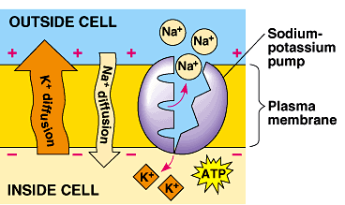
How does the nerve re-set itself?
Sodium-Potassium pump
  active transport protein in membrane
    requires ATP
  3 Na⁺ pumped out
  2 K⁺ pumped in
  re-sets charge
  across
  membrane
ATP
That’s a lot
of ATP !
Feed me some
sugar quick!
Notes:
Dominoes set back up again.
Na/K pumps are one of the main drains on ATP production in your body. Your brain is a very expensive organ to run!

Slide 19
Neuron is ready to fire again
Na⁺
Na⁺
Na⁺
Na⁺
Na⁺
Na⁺
Na⁺
Na⁺
Na⁺
Na⁺
Na⁺
Na⁺
Na⁺
K⁺
aa⁻
K⁺
K⁺
aa⁻
K⁺
aa⁻
K⁺
aa⁻
K⁺
K⁺
aa⁻
K⁺
aa⁻
K⁺
Na⁺
Na⁺
Na⁺
Na⁺
Na⁺
Na⁺
Na⁺
Na⁺
Na⁺
Na⁺
Na⁺
Na⁺
Na⁺
resting potential
+
+
+
+
+
+
+
+
+
+
+
+
+
+
+
–
–
–
–
–
–
–
–
–
–
–
–
–
–
–
–
–
–
–
–
–
–
–
–
–
–
–
–
–
–
+
+
+
+
+
+
+
+
+
+
+
+
+
+
+

Slide 20
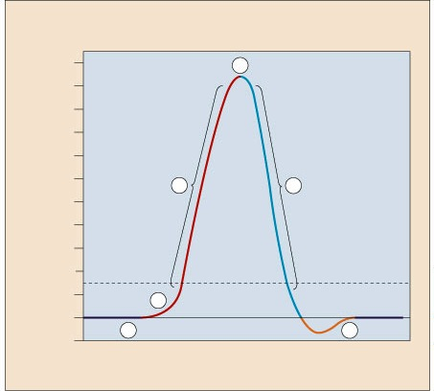
Action potential graph
Resting potential
Stimulus reaches threshold potential
Depolarization
Na⁺ channels open;
K⁺ channels closed
Na⁺ channels close;
K⁺ channels open
Repolarization
reset charge gradient
Undershoot
K⁺ channels close slowly
40 mV
4
30 mV
20 mV
Depolarization
Na⁺ flows in
Repolarization
K⁺ flows out
10 mV
0 mV
–10 mV
3
5
Membrane potential
–20 mV
–30 mV
–40 mV
Hyperpolarization
(undershoot)
–50 mV
Threshold
–60 mV
2
–70 mV
1
Resting potential
6
Resting
–80 mV

Slide 21
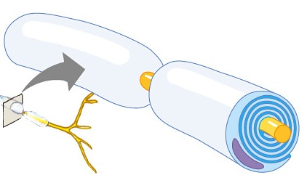
Myelin sheath
Axon coated with Schwann cells
  insulates axon
  speeds signal
    signal hops from node to node
    saltatory conduction
  150 m/sec vs. 5 m/sec
  (330 mph vs. 11 mph)
signal
direction
myelin sheath

Slide 22

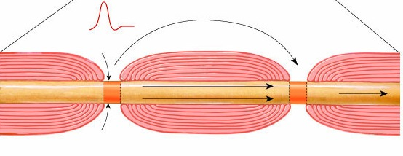
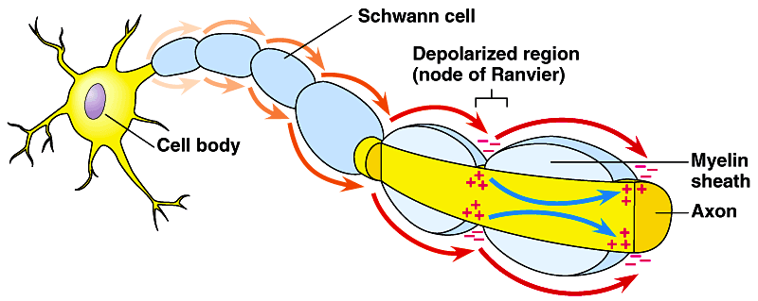
action potential
saltatory
conduction
Na⁺
myelin
axon
+
+
+
+
–
+
–
Na⁺
Multiple Sclerosis
  immune system (T cells) attack myelin sheath
  loss of signal

Slide 23
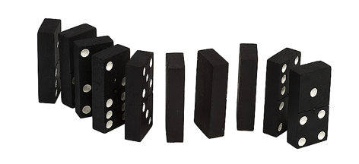
Synapse
What happens at the end of the axon?
Impulse has to jump the synapse!
  junction between neurons
  has to jump quickly from one cell to next
How does
the wave
jump the gap?

Slide 24
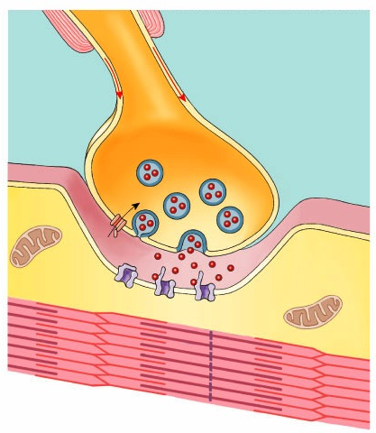
Chemical synapse
Events at synapse
  action potential depolarizes membrane
  opens Ca⁺⁺ channels
  neurotransmitter vesicles fuse with membrane
  release neurotransmitter to synapse → diffusion
  neurotransmitter binds with protein receptor
    ion-gated channels open
  neurotransmitter degraded or reabsorbed
axon terminal
action potential
synaptic vesicles
synapse
Ca⁺⁺
neurotransmitter
acetylcholine (ACh)
receptor protein
muscle cell (fiber)
We switched…
from an electrical signal
to a chemical signal
Notes:
Calcium is a very important ion throughout your body. It will come up again and again involved in many processes.

Slide 25
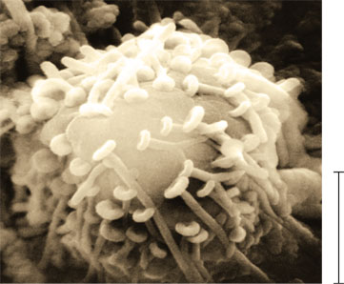
Synaptic terminals on the cell body of a postsynaptic neuron (colorized SEM)
Postsynaptic
neuron
Synaptic
terminal
of presynaptic
neurons
5 µm

Slide 26
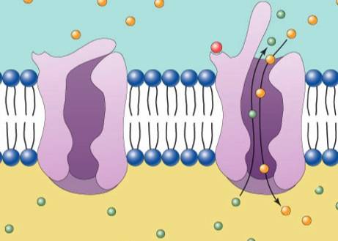
Nerve impulse in next neuron
Post-synaptic neuron
  triggers nerve impulse in next nerve cell
    chemical signal opens ion-gated channels
    Na⁺ diffuses into cell
    K⁺ diffuses out of cell
      switch back to
      voltage-gated channel
K⁺
Na⁺
Na⁺
binding site
ACh
Here we
go again!
ion channel
K⁺
K⁺
Na⁺
–
+
+
+
+
+
+
+
+
+
+
+
+
+
+
+
–
–
–
–
–
–
–
–
–
–
–
–
–
–
Na⁺
+
–
–
–
–
–
–
–
–
–
–
–
–
–
–
–
+
+
+
+
+
+
+
+
+
+
+
+
+
+

Slide 27
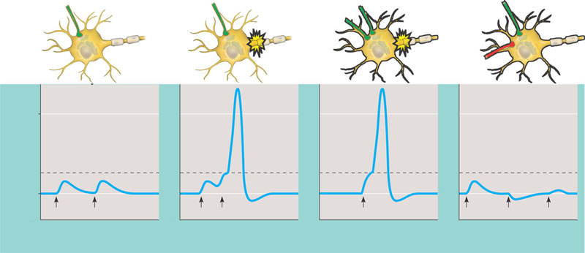
Summation of postsynaptic potentials
Terminal branch of
presynaptic neuron
Postsynaptic
neuron
E₁
E₁
E₁
E₁
E₂
Axon
hillock
I
Threshold of axon of
postsynaptic neuron
0
Action
potential
Resting
potential
Action
potential
Membrane potential (mV)
–70
E₁
E₁
E₁
E₁
E₁ + E₂
E₁
I
E₁ + I
(a) Subthreshold, no
summation
(b) Temporal summation
(c) Spatial summation
(d) Spatial summation
of EPSP and IPSP

Slide 28
Neurotransmitters
Acetylcholine
  transmit signal to skeletal muscle
Epinephrine (adrenaline) & norepinephrine
  fight-or-flight response
Dopamine
  widespread in brain
  affects sleep, mood, attention & learning
  lack of dopamine in brain associated with Parkinson’s disease
  excessive dopamine linked to schizophrenia
Serotonin
  widespread in brain
  affects sleep, mood, attention & learning
Notes:
Nerves communicate with one another and with muscle cells by using neurotransmitters. These are small molecules that are released from the nerve cell and rapidly diffuse to neighboring cells, stimulating a response once they arrive. Many different neurotransmitters are used for different jobs:
glutamate excites nerves into action;
GABA inhibits the passing of information;
dopamine and serotonin are involved in the subtle messages of thought and cognition.
The main job of the neurotransmitter acetylcholine is to carry the signal from nerve cells to muscle cells. When a motor nerve cell gets the proper signal from the nervous system, it releases acetylcholine into its synapses with muscle cells. There, acetylcholine opens receptors on the muscle cells, triggering the process of contraction. Of course, once the message is passed, the neurotransmitter must be destroyed, otherwise later signals would get mixed up in a jumble of obsolete neurotransmitter molecules. The cleanup of old acetylcholine is the job of the enzyme acetylcholinesterase.

Slide 29
Neurotransmitters
Weak point of nervous system
  any substance that affects neurotransmitters or mimics them affects nerve function
    gases: nitrous oxide, carbon monoxide
    mood altering drugs:
      stimulants
        amphetamines, caffeine, nicotine
      depressants
        quaaludes, barbiturates
    hallucinogenic drugs: LSD, peyote
    SSRIs: Prozac, Zoloft, Paxil
    poisons
Pity the
Test Mice
Notes:
Selective serotonin reuptake inhibitor

Slide 30
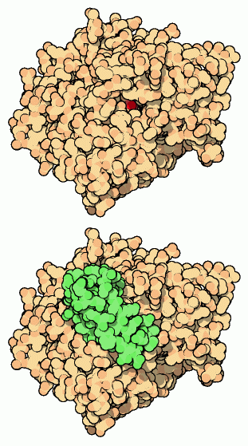
Acetylcholinesterase
Enzyme which breaks down
acetylcholine neurotransmitter
  acetylcholinesterase inhibitors = neurotoxins
    snake venom, sarin, insecticides
neurotoxin
in green
active site
in red
snake toxin blocking
acetylcholinesterase active site
acetylcholinesterase
Notes:
Since acetylcholinesterase has an essential function, it is a potential weak point in our nervous system. Poisons and toxins that attack the enzyme cause acetylcholine to accumulate in the nerve synapse, paralyzing the muscle. Over the years, acetylcholinesterase has been attacked in many ways by natural enemies. For instance, some snake toxins attack acetylcholinesterase.
Acetylcholinesterase is found in the synapse between nerve cells and muscle cells. It waits patiently and springs into action soon after a signal is passed, breaking down the acetylcholine into its two component parts, acetic acid and choline. This effectively stops the signal, allowing the pieces to be recycled and rebuilt into new neurotransmitters for the next message. Acetylcholinesterase has one of the fastest reaction rates of any of our enzymes, breaking up each molecule in about 80 microseconds.
Is the acetylcholinesterase toxin a competitive or non-competitive inhibitor?

Slide 31

Questions to ponder…
Why are axons so long?
Why have synapses at all?
How do “mind altering drugs” work?
  caffeine, alcohol, nicotine, marijuana…
Do plants have a nervous system?
  Do they need one?
Notes:
Why are axons so long?
Transmit signal quickly. The synapse is the choke point. Reduce the number of synapses & reduce the time for transmission
Why have synapses at all?
Decision points (intersections of multiple neurons) & control points
How do mind altering drugs work?
Affect neurotransmitter release, uptake & breakdown. React with or block receptors & also serve as neurotransmitter mimics
Do plants have — or need — nervous systems?
They react to stimuli — is that a nervous system?
Depends on how you define nervous system.
But if you can’t move quickly, there is very little adaptive advantage of a nervous system running at the speed of electrical transmission.

Slide 32
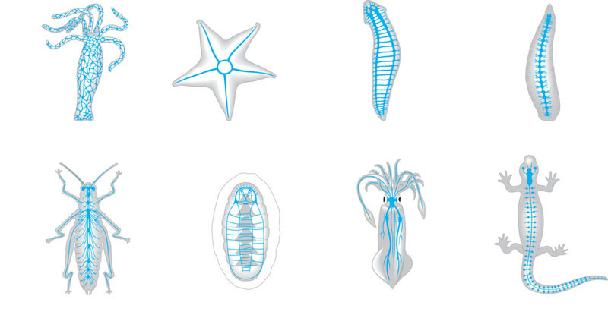
Organization of some nervous systems
Eyespot
Brain
Brain
Radial
nerve
Nerve
cord
Ventral
nerve
cord
Nerve
ring
Transverse
nerve
Nerve net
Segmental
ganglion
(a) Hydra (cnidarian)
(b) Sea star (echinoderm)
(c) Planarian (flatworm)
(d) Leech (annelid)
Brain
Brain
Ganglia
Ventral
nerve
cord
Anterior
nerve ring
Brain
Spinal
cord
(dorsal
nerve
cord)
Sensory
ganglion
Longitudinal
nerve cords
Ganglia
Segmental
ganglia
(e) Insect (arthropod)
(f) Chiton (mollusc)
(g) Squid (mollusc)
(h) Salamander (chordate)

Slide 33
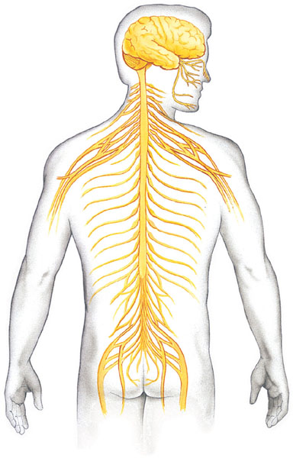
The vertebrate nervous system
Central nervous
system (CNS)
Peripheral nervous
system (PNS)
Brain
Cranial
nerves
Spinal cord
Ganglia
outside
CNS
Spinal
nerves

Slide 34
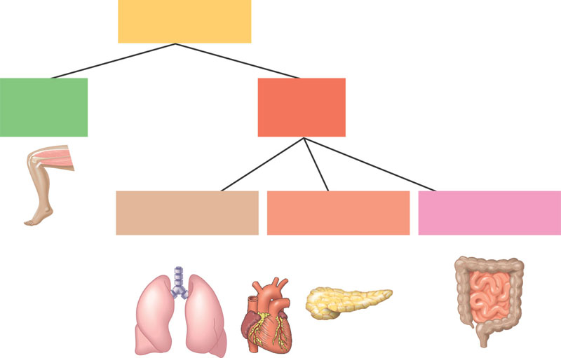
Functional hierarchy of the vertebrate peripheral nervous system
Peripheral
nervous system
Somatic
nervous
system
Autonomic
nervous
system
Sympathetic
division
Parasympathetic
division
Enteric
division

Slide 35
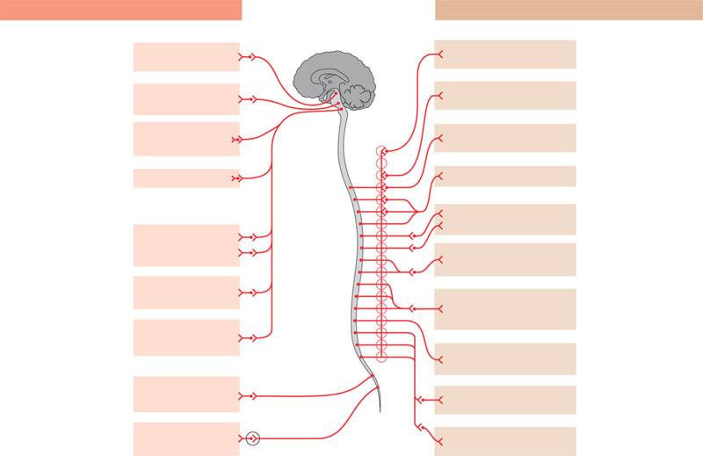
The parasympathetic and sympathetic divisions of the autonomic nervous system
Parasympathetic division
Sympathetic division
Action on target organs:
Action on target organs:
Location of
preganglionic neurons:
brainstem and sacral
segments of spinal cord
Constricts pupil
of eye
Dilates pupil
of eye
Location of
preganglionic neurons:
thoracic and lumbar
segments of spinal cord
Stimulates salivary
gland secretion
Inhibits salivary
gland secretion
Sympathetic
ganglia
Neurotransmitter
released by
preganglionic neurons:
acetylcholine
Constricts
bronchi in lungs
Relaxes bronchi
in lungs
Neurotransmitter
released by
preganglionic neurons:
acetylcholine
Cervical
Slows heart
Accelerates heart
Inhibits activity of
stomach and intestines
Location of
postganglionic neurons:
in ganglia close to or
within target organs
Stimulates activity
of stomach and
intestines
Thoracic
Location of
postganglionic neurons:
some in ganglia close to
target organs; others in
a chain of ganglia near
spinal cord
Inhibits activity
of pancreas
Stimulates activity
of pancreas
Stimulates glucose
release from liver;
inhibits gallbladder
Neurotransmitter
released by
postganglionic neurons:
acetylcholine
Stimulates
gallbladder
Lumbar
Stimulates
adrenal medulla
Neurotransmitter
released by
postganglionic neurons:
norepinephrine
Promotes emptying
of bladder
Inhibits emptying
of bladder
Promotes erection
of genitalia
Sacral
Promotes ejaculation and
vaginal contractions
Synapse

Slide 36
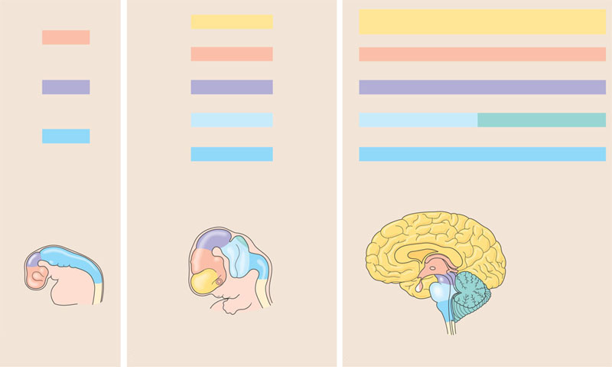
Development of the human brain
Embryonic brain regions
Brain structures present in adult
Telencephalon
Cerebrum (cerebral hemispheres; includes cerebral
cortex, white matter, basal nuclei)
Forebrain
Diencephalon
Diencephalon (thalamus, hypothalamus, epithalamus)
Midbrain
Mesencephalon
Midbrain (part of brainstem)
Metencephalon
Pons (part of brainstem), cerebellum
Hindbrain
Myelencephalon
Medulla oblongata (part of brainstem)
Diencephalon:
Mesencephalon
Cerebral hemisphere
Hypothalamus
Metencephalon
Thalamus
Midbrain
Diencephalon
Pineal gland
(part of epithalamus)
Hindbrain
Myelencephalon
Brainstem:
Midbrain
Spinal cord
Pituitary
gland
Pons
Forebrain
Telencephalon
Medulla
oblongata
Spinal cord
Cerebellum
(a) Embryo at one month
(b) Embryo at five weeks
(c) Adult
Central canal

Slide 37
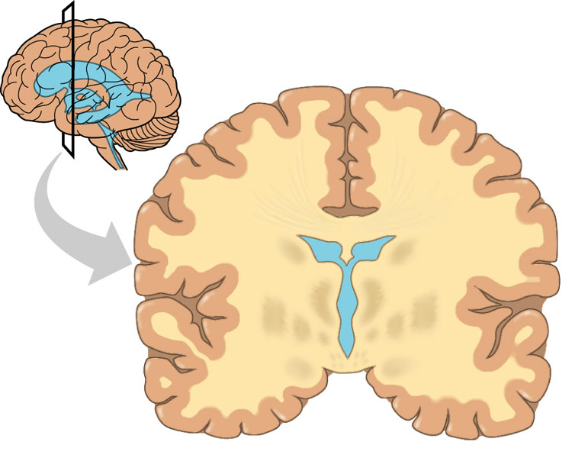
Ventricles, gray matter, and white matter
Gray matter
White
matter
Ventricles

Slide 38
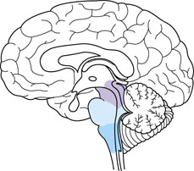
Medulla, Pons and Midbrain

Slide 39
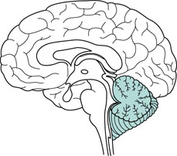
The Cerebellum

Slide 40
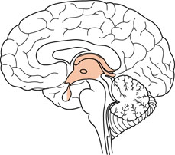
The Diencephalon

Slide 41
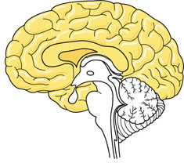
The Cerebrum

Slide 42
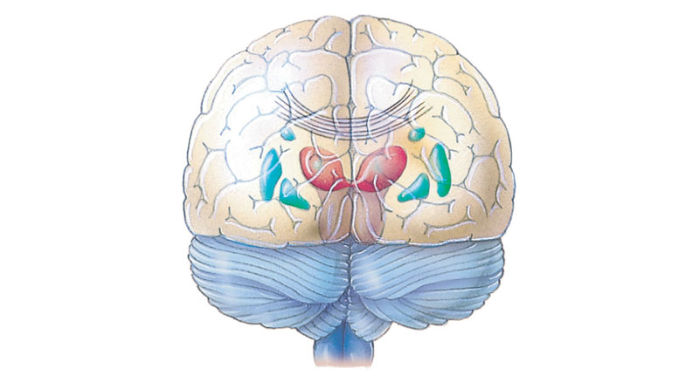
The human cerebrum viewed from the rear
Left cerebral
hemisphere
Right cerebral
hemisphere
Corpus
callosum
Basal
nuclei
Neocortex

Slide 43
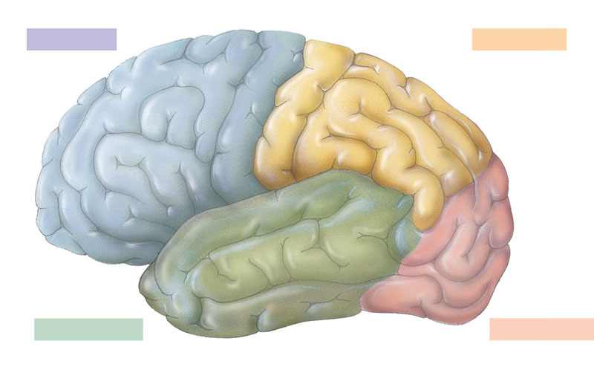
The human cerebral cortex
Frontal lobe
Parietal lobe
Motor cortex
Somatosensory cortex
Somatosensory
association
area
Frontal
association
area
Speech
Taste
Reading
Speech
Hearing
Visual
association
area
Smell
Auditory
association
area
Vision
Temporal lobe
Occipital lobe

Slide 44
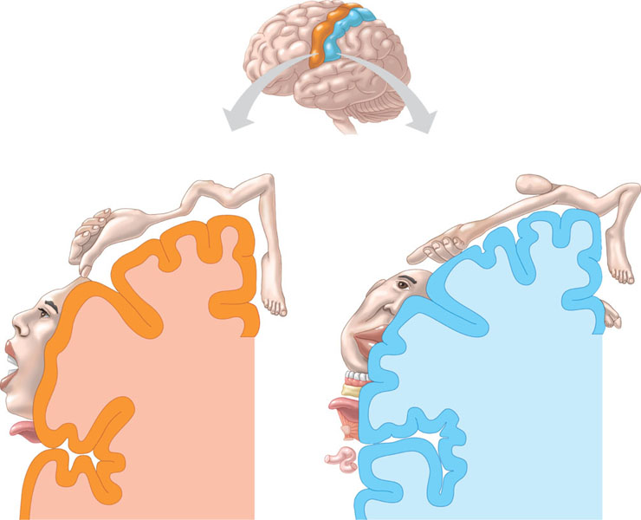
Body representations in the primary motor and primary somatosensory cortices
Frontal lobe
Parietal lobe
Elbow
Shoulder
Knee
Head
Forearm
Trunk
Upper arm
Neck
Wrist
Hip
Elbow
Trunk
Leg
Hand
Hip
Forearm
Fingers
Hand
Fingers
Thumb
Thumb
Neck
Eye
Brow
Nose
Eye
Face
Face
Toes
Lips
Genitalia
Teeth
Gums
Jaw
Lips
Jaw
Tongue
Tongue
Pharynx
Primary
motor cortex
Primary
somatosensory cortex
Abdominal
organs

Slide 45
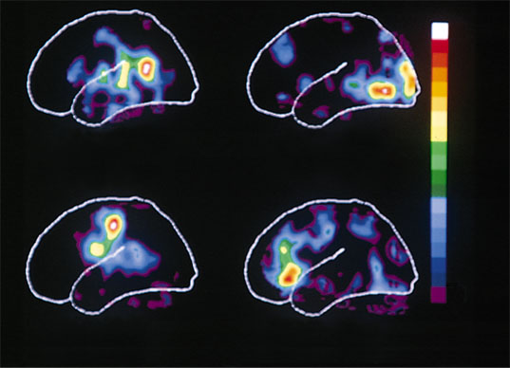
Mapping language areas in the cerebral cortex
Max
Hearing
words
Seeing
words
Min
Speaking
words
Generating
words

Slide 46
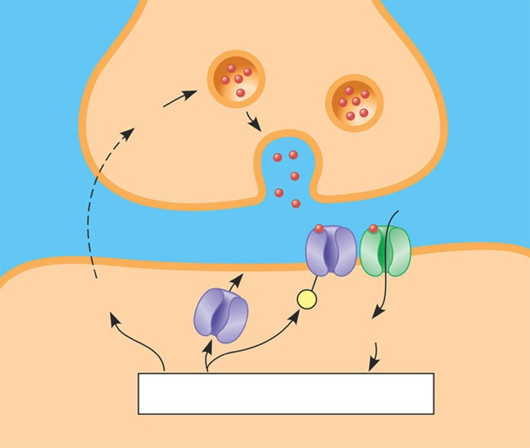
Mechanism of long-term potentiation in the vertebrate brain
The presynaptic
neuron releases glutamate.
1
Glutamate binds to AMPA
receptors, opening the AMPA-
receptor channel and depolarizing
the postsynaptic membrane.
PRESYNAPTIC NEURON
2
NO diffuses into the
presynaptic neuron, causing
it to release more glutamate.
7
NO
Ca²⁺ stimulates the
postsynaptic neuron to
produce nitric oxide (NO).
NMDA
receptor
Glutamate also binds to NMDA
receptors. If the postsynaptic
membrane is simultaneously
depolarized, the NMDA-receptor
channel opens.
6
3
Glutamate
AMPA receptor
NO
P
Ca²⁺ initiates the phos-
phorylation of AMPA receptors,
making them more responsive.
Ca²⁺ also causes more AMPA
receptors to appear in the
postsynaptic membrane.
5
Ca²⁺
Signal transduction pathways
Ca²⁺ diffuses into the
postsynaptic neuron.
4
POSTSYNAPTIC NEURON

Slide 47
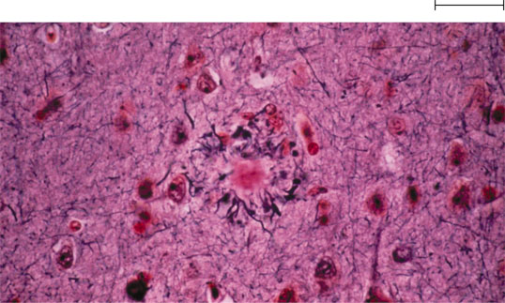
Microscopic signs of Alzheimer’s disease
Senile plaque
Neurofibrillary tangle
20 μm

Slide 48
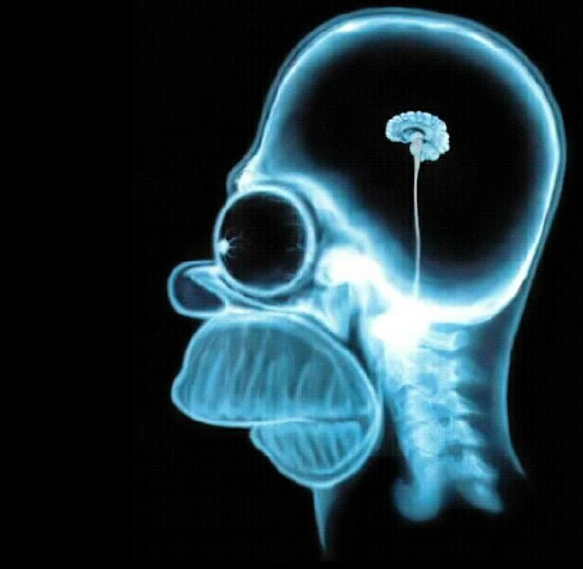
Ponder this…
Any Questions??

Slide 49
Make sure you can do the following:
Compare and contrast the regulatory structures and functions of the nervous and endocrine systems
Diagram the processes by which nervous signals are transmitted by and between neurons.
Label all parts of a neuron
Explain the relationships between the major divisions of the mammalian nervous system.
Explain the relationships between the major divisions of the human brain
Explain the causes of nervous system disruptions and how disruptions of the nervous system can lead to disruptions of homeostasis.

