Slide 1
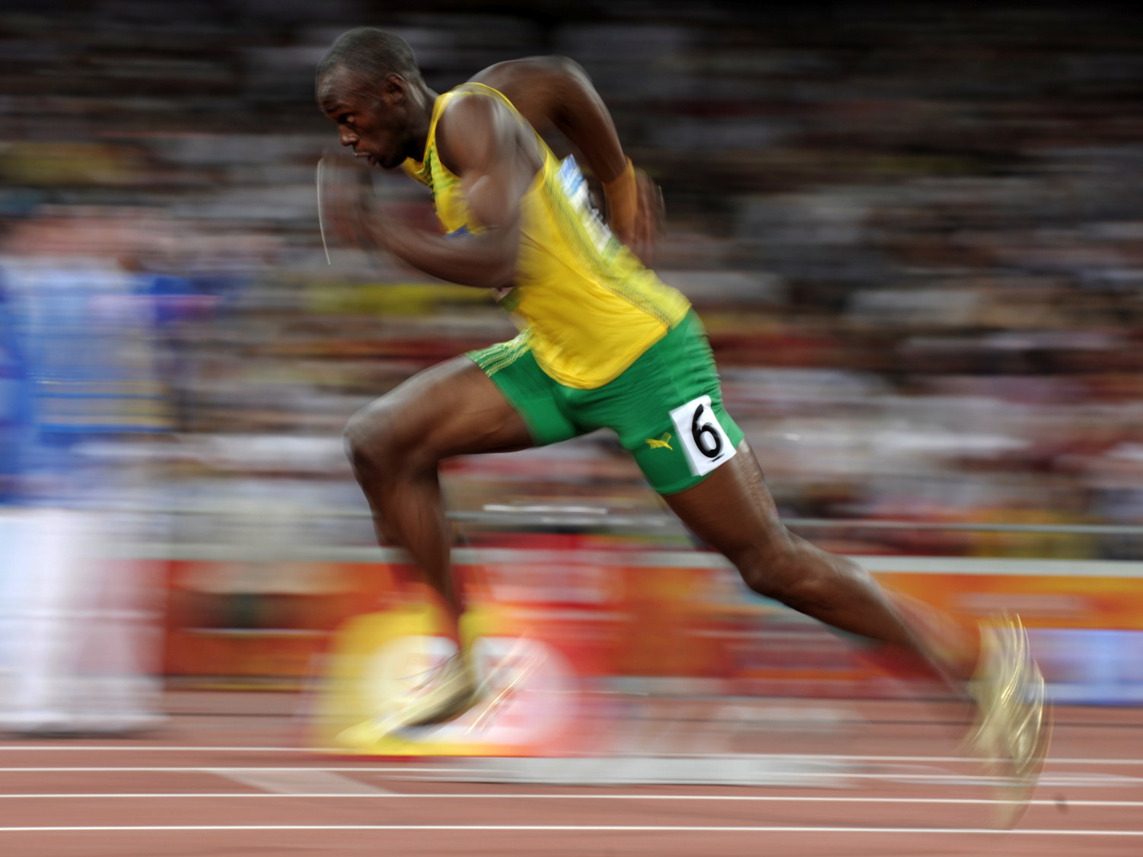
Muscles, Locomotion
& Sensation
(Ch. 49)

Slide 2
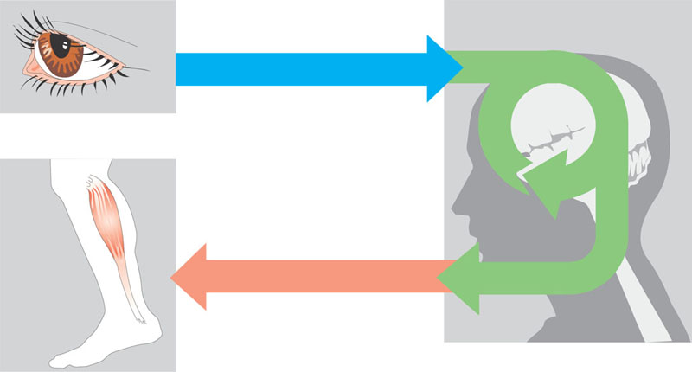
Overview of information processing by nervous systems
Sensory input
Integration
Sensor
Motor output
Effector
Peripheral nervous
system (PNS)
Central nervous
system (CNS)

Slide 3
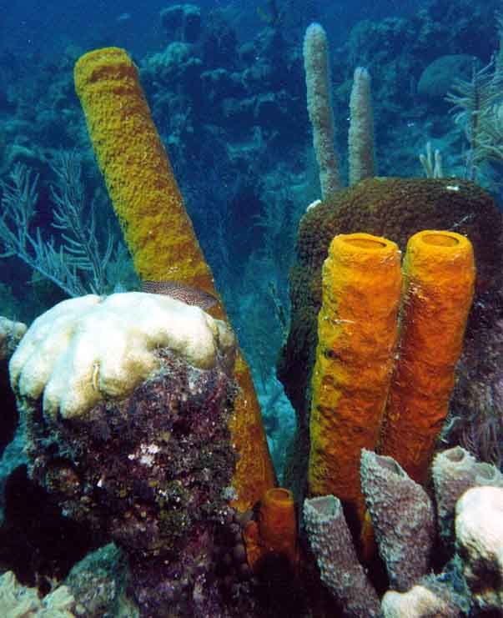
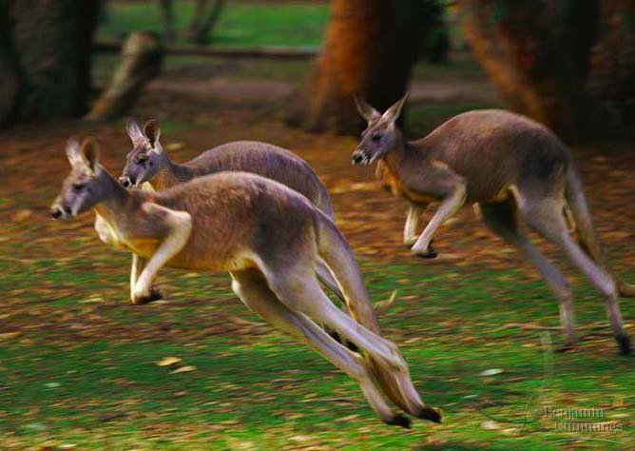
Animal Locomotion
What are the advantages of locomotion?
sessile
motile

Slide 4
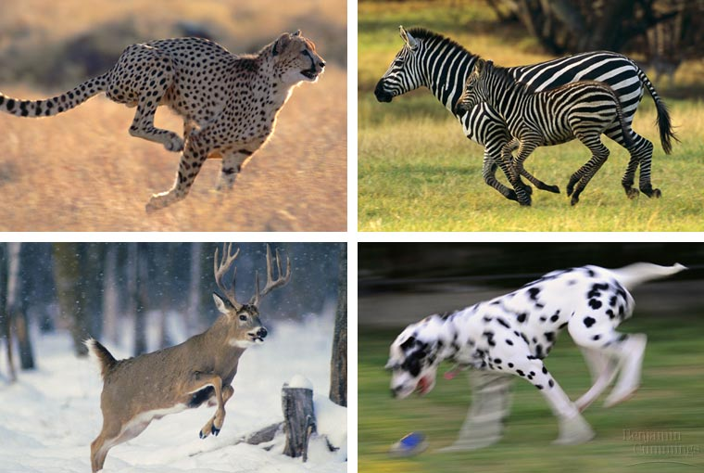
Lots of ways to get around…

Slide 5
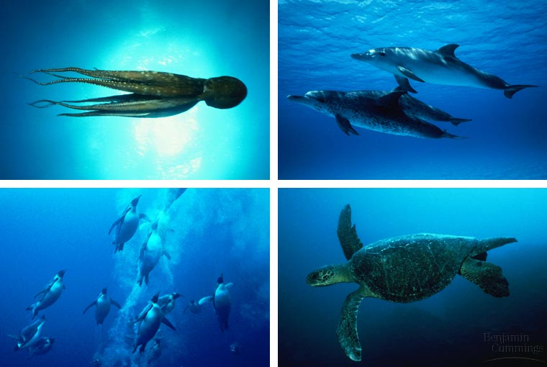
Lots of ways to get around…
mollusk
mammal
bird
reptile

Slide 6

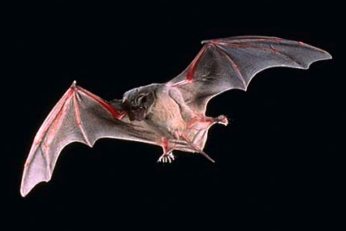
Lots of ways to get around…
bird
arthropod
mammal
bird

Slide 7
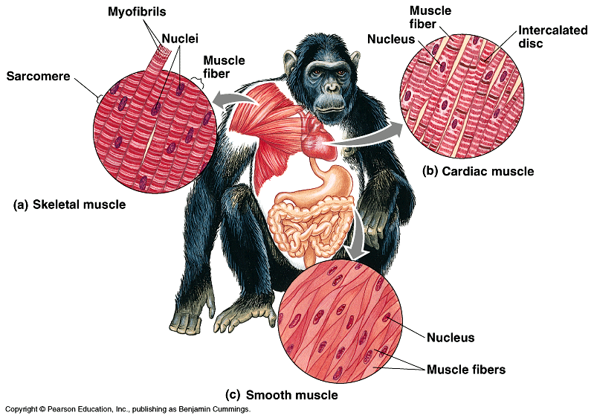
Muscle
involuntary, striated
auto-rhythmic
voluntary, striated
heart
moves bone
multi-nucleated
involuntary,
non-striated
digestive system
arteries, veins
evolved first
Notes:
All cells have a fine network of actin and myosin fibers that contribute to cellular movement. But only muscle cells have them in such great abundance and far more organized for contraction.
SMOOTH MUSCLE
Smooth muscle was the first to evolve.
Lining of blood vessels, wall of the gut, iris of the eye.
Some contract only when stimulated by nerve impulse. Others generate electrical impulses spontaneously and then are regulated by nervous system.
CARDIAC MUSCLE
Small interconnected cell with only one nucleus. Interconnected through gap junctions. Single functioning unit that contract in unison via this intercellular communication. Mostly generate electrical impulses spontaneously. Regulated rather than initial stimulation by nervous system.
SKELETAL MUSCLE
Fusion of many cells so multi-nucleated. Attached by tendon to bone. Long thin cells called muscle fibers.

Slide 8
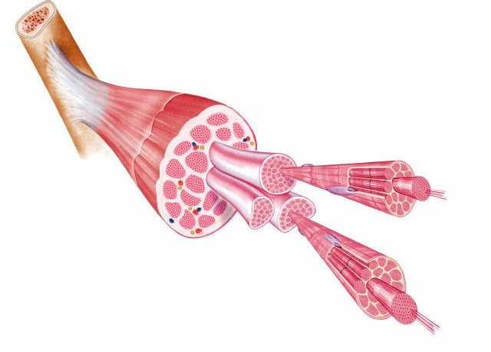
Organization of Skeletal muscle
skeletal muscle
plasma
membrane
nuclei
tendon
muscle fiber (cell)
myofibrils
myofilaments

Slide 9
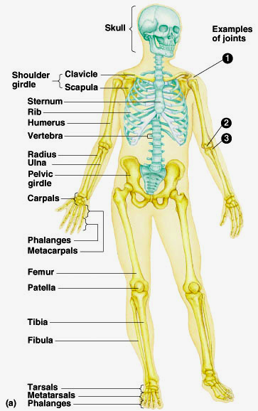
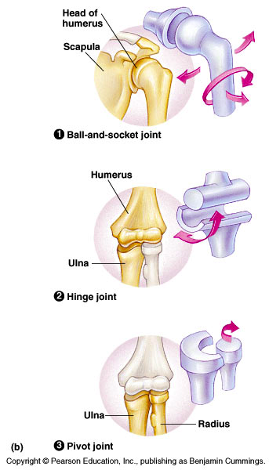
Human endoskeleton
206 bones

Slide 10
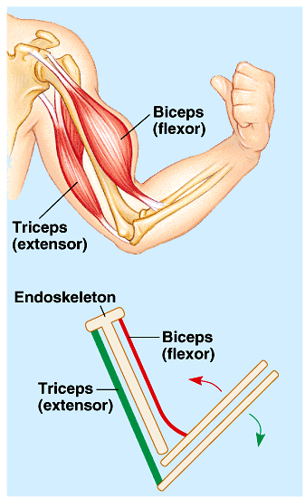
Muscles movement
Muscles do work by contracting
  skeletal muscles come in
  antagonistic pairs
    flexor vs. extensor
  contracting = shortening
    move skeletal parts
  tendons
    connect bone to muscle
  ligaments
    connect bone to bone

Slide 11
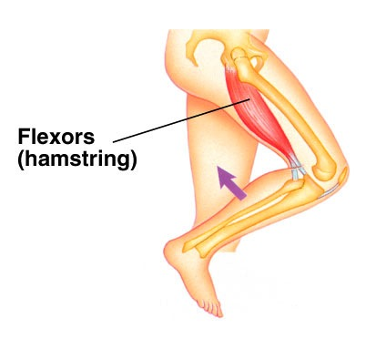
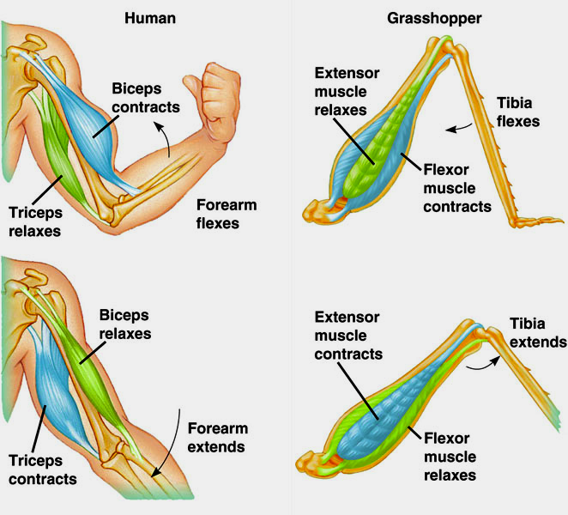
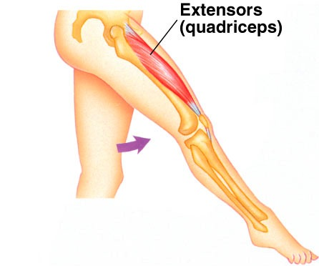

Slide 12
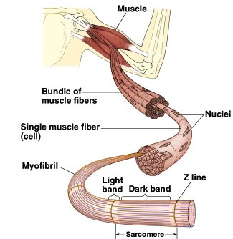
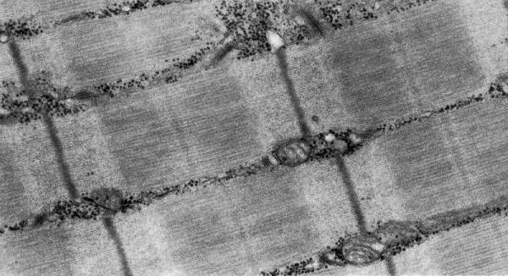
Structure of striated skeletal muscle
Muscle Fiber
  muscle cell
    divided into sections = sarcomeres
Sarcomere
  functional unit of muscle contraction
  alternating bands of
  thin (actin) & thick (myosin) protein filaments

Slide 13
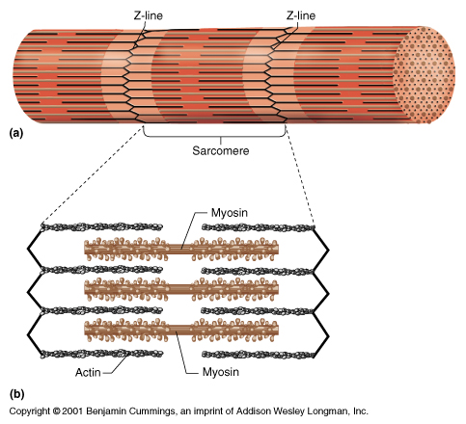
Muscle filaments & Sarcomere
Interacting proteins
  thin filaments
    braided strands
      actin
      tropomyosin
      troponin
  thick filaments
    myosin

Slide 14
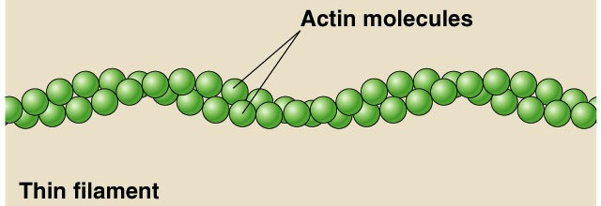
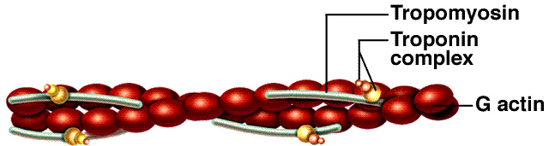
Thin filaments: actin
Complex of proteins
  braid of actin molecules & tropomyosin fibers
    tropomyosin fibers secured with troponin molecules

Slide 15
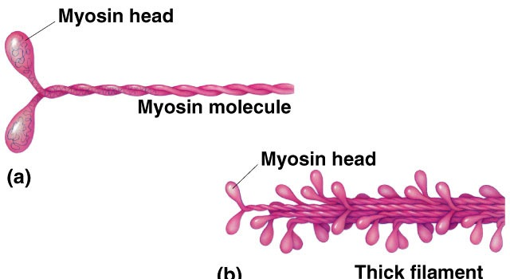
Thick filaments: myosin
Single protein
  myosin molecule
    long protein with globular head
bundle of myosin proteins:
globular heads aligned

Slide 16
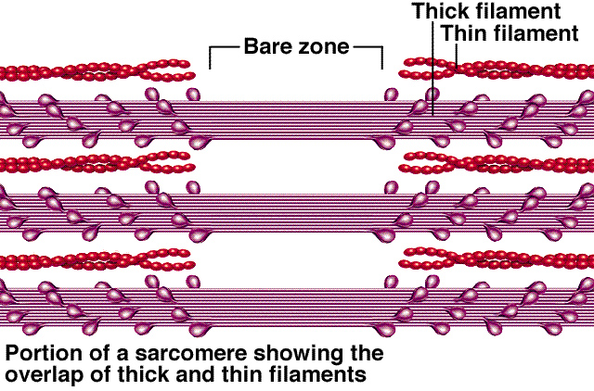
Thick & thin filaments
Myosin tails aligned together & heads pointed away from center of sarcomere

Slide 17
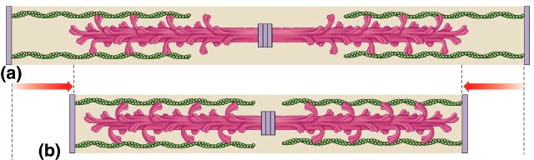
Interaction of thick & thin filaments
Cross bridges
  connections formed between myosin heads (thick filaments) & actin (thin filaments)
  cause the muscle to shorten (contract)
sarcomere
sarcomere

Slide 18
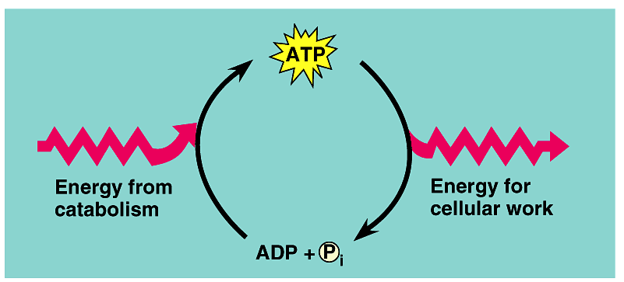
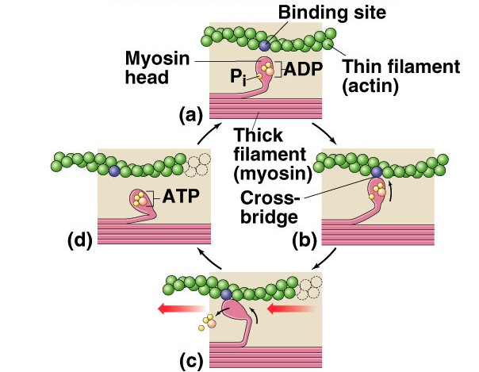

Where is ATP needed?
binding site
thin filament
(actin)
myosin head
ADP
thick filament
(myosin)
1
2
ATP
So that’s
where those
10,000,000 ATPs go!
Well, not all of it!
form
cross
bridge
1
1
1
3
release
cross
bridge
shorten
sarcomere
Cleaving ATP → ADP allows myosin head to bind to actin filament
1
4

Slide 19
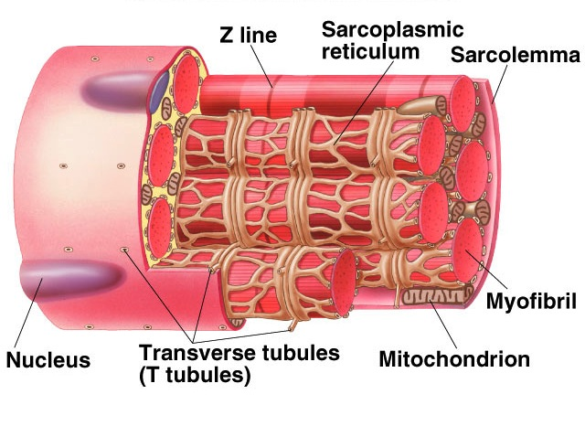
Closer look at muscle cell
Sarcoplasmic
reticulum
Transverse tubules
(T-tubules)
Mitochondrion
multi-nucleated

Slide 20
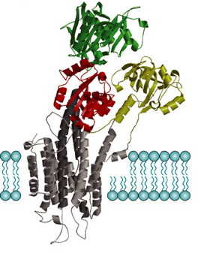
Muscle cell organelles
Ca²⁺ ATPase of SR
Sarcoplasm
  muscle cell cytoplasm
  contains many mitochondria
Sarcoplasmic reticulum (SR)
  organelle similar to ER
    network of tubes
  stores Ca²⁺
    Ca²⁺ released from SR through channels
    Ca²⁺ restored to SR by Ca²⁺ pumps
      pump Ca²⁺ from cytosol
      pumps use ATP
There’s
the rest
of the
ATPs!
But what
does the
Ca²⁺ do?
ATP

Slide 21
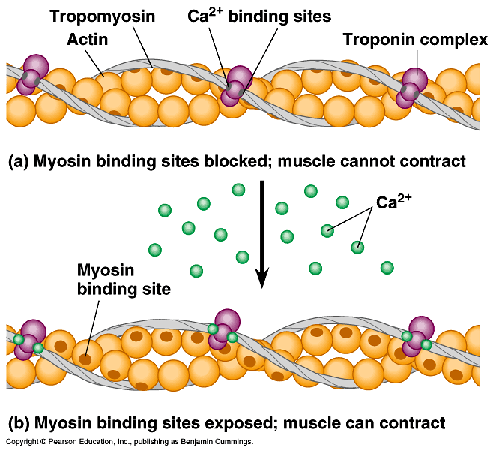
Muscle at rest
Interacting proteins
  at rest, troponin molecules hold tropomyosin fibers so that they cover the myosin-binding sites on actin
    troponin has Ca²⁺ binding sites

Slide 22
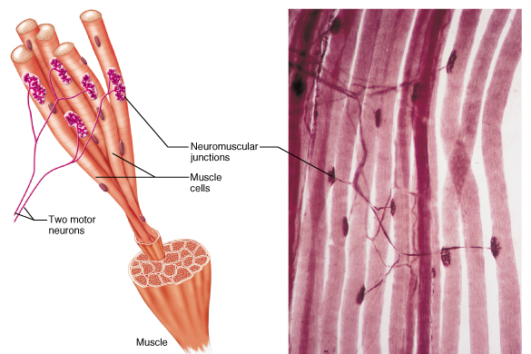
The Trigger: motor neurons
Motor neuron triggers muscle contraction
  release acetylcholine (Ach) neurotransmitter

Slide 23
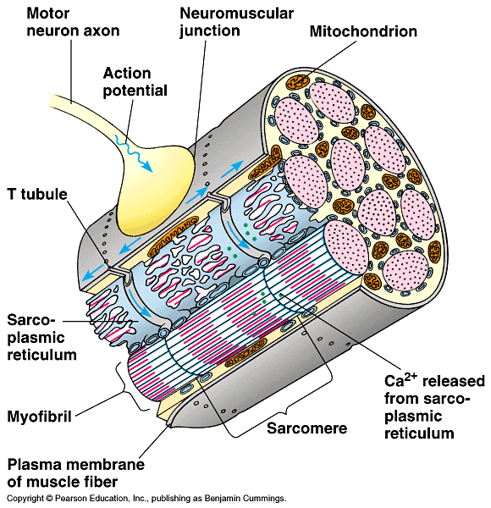
Nerve trigger of muscle action
Nerve signal travels down T-tubule
  stimulates sarcoplasmic reticulum (SR) of muscle cell to
  release stored Ca²⁺
  flooding muscle fibers with Ca²⁺

Slide 24
Ca²⁺ triggers muscle action
At rest, tropomyosin blocks myosin-binding sites on actin
  secured by troponin
Ca²⁺ binds to troponin
  shape change
  causes movement
  of troponin
  releasing tropomyosin
  exposes myosin-binding sites on actin

Slide 25
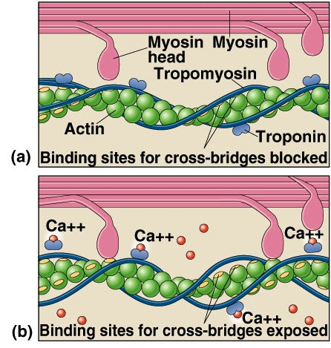
How Ca²⁺ controls muscle
Sliding filament model
  exposed actin binds to myosin
  fibers slide past each other
    ratchet system
  shorten muscle cell
    muscle contraction
  muscle doesn’t relax until Ca²⁺ is pumped back into SR
    requires ATP
ATP
ATP

Slide 26
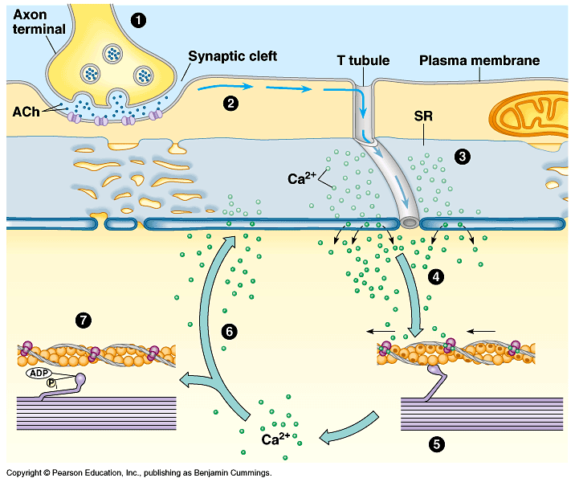
Put it all together…
1
2
3
ATP
7
4
6
ATP
5

