Slide 1
How it all works…
Action potential causes Ca²⁺ release from SR
Ca²⁺ binds to troponin
Troponin moves tropomyosin uncovering myosin binding site on actin
Myosin binds actin
uses ATP to "ratchet" each time
releases, "unratchets" & binds to next actin
Myosin pulls actin chain along
Sarcomere shortens
Z discs move closer together
Whole fiber shortens → contraction!
Ca²⁺ pumps restore Ca²⁺ to SR → relaxation!
pumps use ATP
ATP
ATP

Slide 2
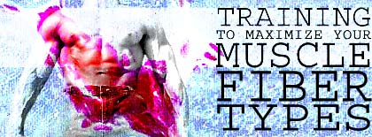
Fast twitch & slow twitch muscles
Slow twitch muscle fibers
contract slowly, but keep going for a long time
more mitochondria for aerobic respiration
less SR → Ca²⁺ remains in cytosol longer
long distance runner
“dark” meat = more blood vessels
Fast twitch muscle fibers
contract quickly, but get tired rapidly
store more glycogen for anaerobic respiration
sprinter
“white” meat

Slide 3
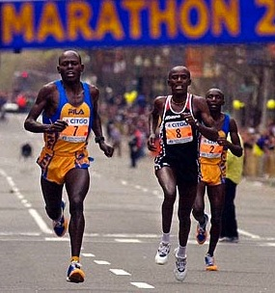
Muscle limits
Muscle fatigue
lack of sugar
lack of ATP to restore Ca²⁺ gradient
low O₂
lactic acid drops pH which interferes with protein function
synaptic fatigue
loss of acetylcholine
Muscle cramps
build up of lactic acid
ATP depletion
ion imbalance
massage or stretching increases circulation

Slide 4
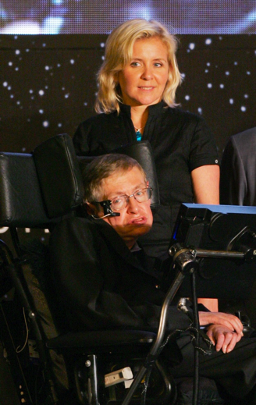
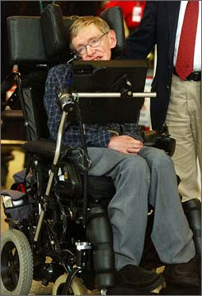
Diseases of Muscle tissue
ALS
amyotrophic lateral sclerosis
Lou Gehrig’s disease
motor neurons degenerate
Myasthenia gravis
auto-immune
antibodies to acetylcholine receptors
Stephen Hawking

Slide 5
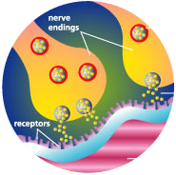
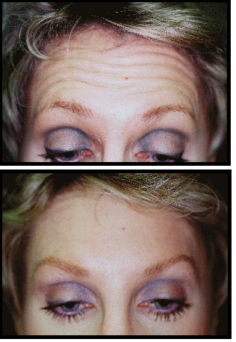
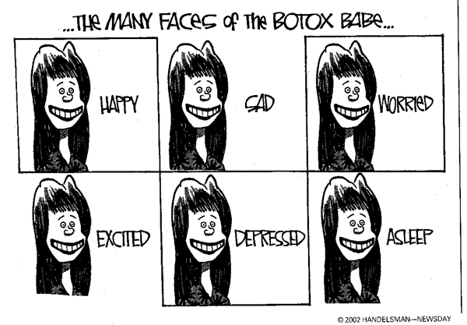
Botox
Bacteria Clostridium botulinum toxin
blocks release of acetylcholine
botulism can be fatal
muscle

Slide 6
Rigor mortis
So why are dead people “stiffs”?
no life, no breathing
no breathing, no O₂
no O₂, no aerobic respiration
no aerobic respiration, no ATP
no ATP, no Ca²⁺ pumps
Ca²⁺ stays in muscle cytoplasm
muscle fibers continually contract
tetany or rigor mortis
eventually tissues breakdown & relax
measure of time of death

Slide 7
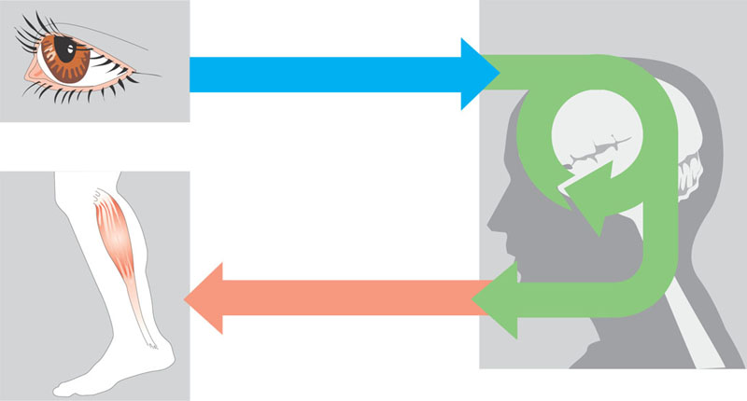
Overview of information processing by nervous systems
Sensory input
Integration
Sensor
Motor output
Effector
Peripheral nervous system (PNS)
Central nervous system (CNS)

Slide 8
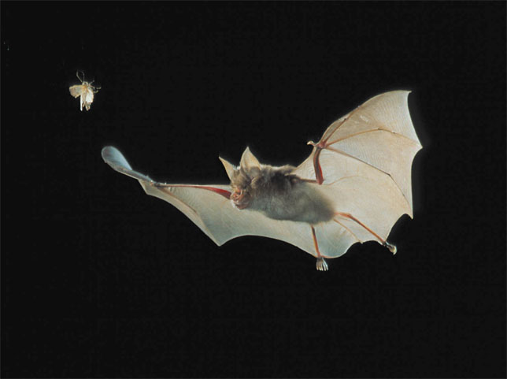
A bat using sonar to locate its prey

Slide 9
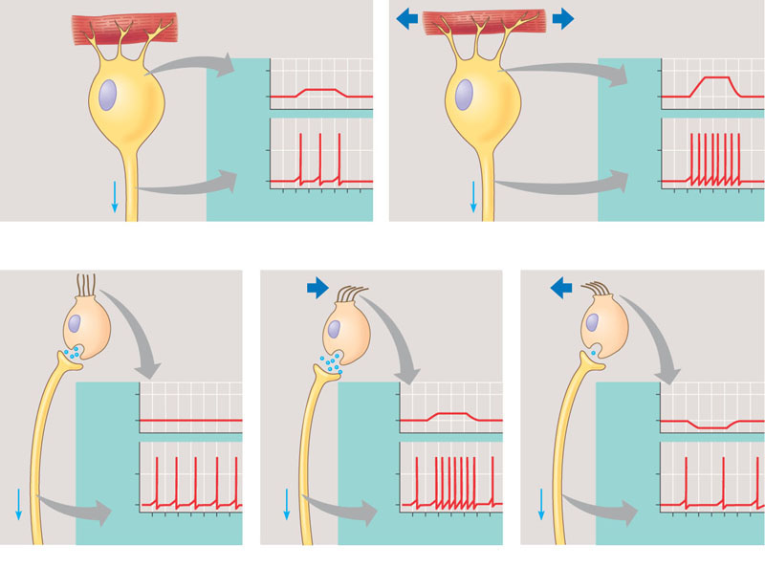
Sensory reception: two mechanisms
Muscle
Weak muscle stretch
Strong muscle stretch
Dendrites
Receptor potential
–50
–50
Stretch receptor
–70
–70
Membrane potential (mV)
Action potentials
Axon
0
0
–70
–70
1
2
3
4
5
6
7
1
2
3
4
5
6
0
Time (sec)
0
Time (sec)
7
(a) Crayfish stretch receptors have dendrites embedded in abdominal muscles. When the abdomen bends, muscles and dendrites
stretch, producing a receptor potential in the stretch receptor. The receptor potential triggers action potentials in the axon of the stretch
receptor. A stronger stretch produces a larger receptor potential and higher frequency of action potentials.
“Hairs” of hair cell
No fluid movement
Fluid moving in one direction
Fluid moving in other direction
Neuro- trans- mitter at synapse
More neuro- trans- mitter
Less neuro- trans- mitter
–50
–50
Receptor potential
–50
Axon
–70
–70
–70
Membrane potential (mV)
Action potentials
Membrane potential (mV)
Membrane potential (mV)
0
0
0
–70
–70
–70
1
2
3
0
4
5
6
7
1
2
3
4
5
6
7
1
2
3
4
5
0
Time (sec)
Time (sec)
0
6
7
Time (sec)
(b) Vertebrate hair cells have specialized cilia or microvilli (“hairs”) that bend when sur-rounding fluid moves. Each hair cell releases an excitatory neurotransmitter at a synapse
with a sensory neuron, which conducts action potentials to the CNS. Bending in one direction depolarizes the hair cell, causing it to release more neurotransmitter and increasing frequency
of action potentials in the sensory neuron. Bending in the other direction has the opposite effects. Thus, hair cells respond to the direction of motion as well as to its strength and speed.

Slide 10
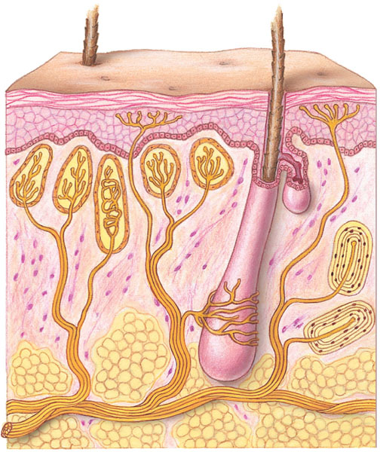
Sensory receptors in human skin
Cold
Light touch
Pain
Hair
Heat
Epidermis
Dermis
Nerve
Connective tissue
Hair movement
Strong pressure

Slide 11
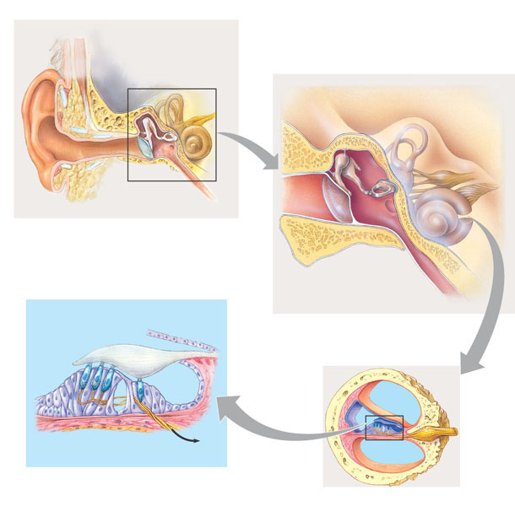
The Structure of the Human Ear
1
Overview of ear structure
2
The middle ear and inner ear
Incus
Skull bones
Semicircular canals
Middle ear
Stapes
Outer ear
Inner ear
Malleus
Auditory nerve, to brain
Pinna
Tympanic membrane
Eustachian tube
Cochlea
Auditory canal
Tympanic membrane
Oval window
Eustachian tube
Hair cells
Tectorial membrane
Round window
Cochlear duct
Bone
Vestibular canal
Auditory nerve
Basilar membrane
Axons of sensory neurons
To auditory nerve
Tympanic canal
4
The organ of Corti
3
The cochlea
Organ of Corti

Slide 12
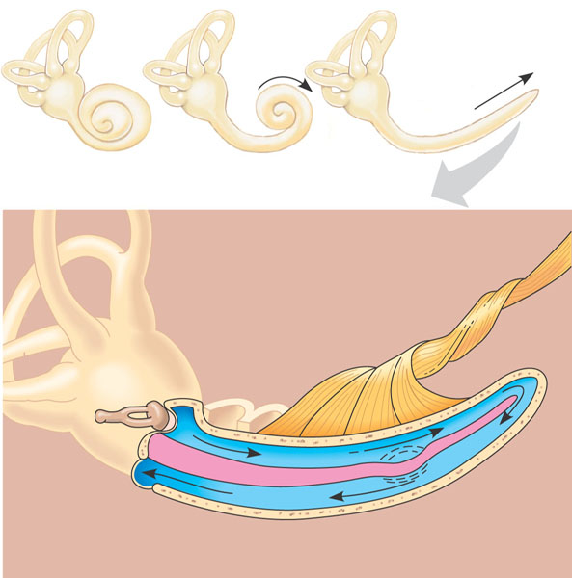
Transduction in the cochlea
Cochlea
Stapes
Axons of sensory neurons
Oval window
Vestibular canal
Perilymph
Apex
Base
Round window
Tympanic canal
Basilar membrane

Slide 13
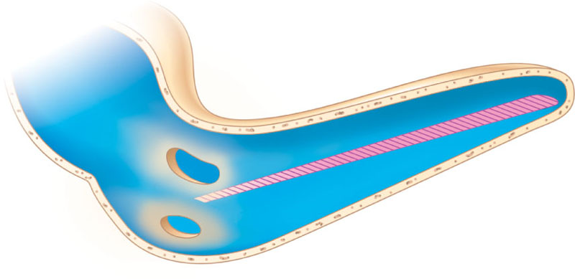
How the cochlea distinguishes pitch
Cochlea (uncoiled)
Apex (wide and flexible)
Basilar membrane
500 Hz (low pitch)
1 kHz
2 kHz
4 kHz
8 kHz
16 kHz (high pitch)
Frequency producing maximum vibration
Base (narrow and stiff)

Slide 14
Organs of equilibrium in the inner ear
The semicircular canals, arranged in three spatial planes, detect angular movements of the head.
Each canal has at its base a swelling called an ampulla, containing a cluster of hair cells.
When the head changes its rate of rotation, inertia prevents endolymph in the semicircular canals from moving with the head, so the endolymph presses against the cupula, bending the hairs.
Flow of endolymph
Flow of endolymph
Vestibular nerve
Cupula
Hairs
Hair cell
Vestibule
Nerve fibers
Utricle
Body movement
Saccule
The utricle and saccule tell the brain which way is up and inform it of the body’s position or linear acceleration.
The hairs of the hair cells project into a gelatinous cap called the cupula.
Bending of the hairs increases the frequency of action potentials in sensory neurons in direct proportion to the amount of rotational acceleration.

Slide 15
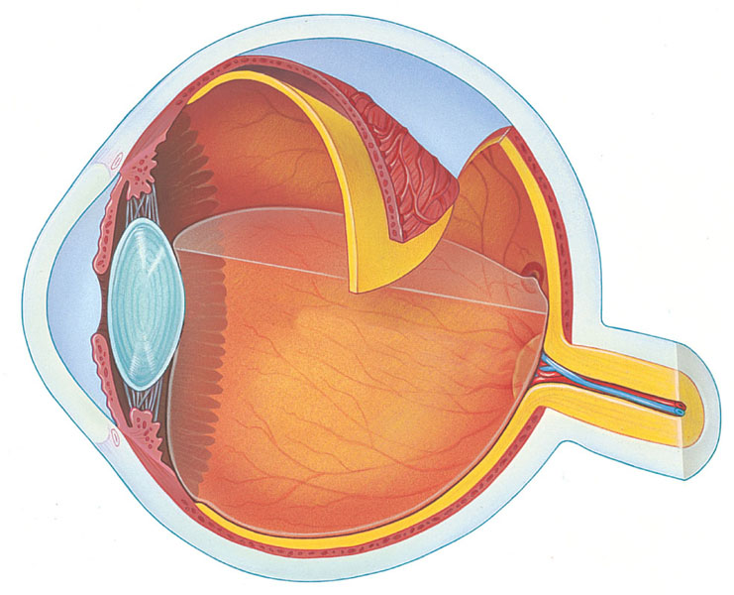
Structure of the vertebrate eye
Sclera
Choroid
Retina
Ciliary body
Fovea (center of visual field)
Suspensory ligament
Cornea
Iris
Optic nerve
Pupil
Aqueous humor
Lens
Vitreous humor
Central artery and
vein of the retina
Optic disk (blind spot)

Slide 16
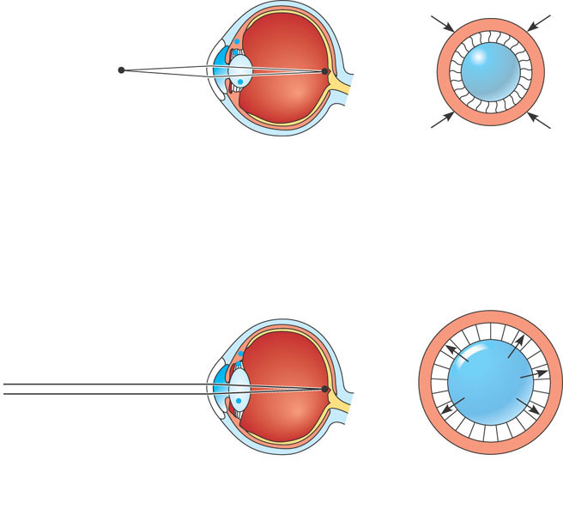
Focusing in the mammalian eye
Front view of lens and ciliary muscle
Ciliary muscles contract, pulling border of choroid toward lens
Choroid
Lens (rounder)
Suspensory ligaments relax
Retina
Ciliary muscle
Lens becomes thicker and rounder, focusing on near objects
Suspensory ligaments
(a) Near vision (accommodation)
Ciliary muscles relax, and border of choroid moves away from lens
Lens (flatter)
Suspensory ligaments pull against lens
Lens becomes flatter, focusing on distant objects
(b) Distance vision

Slide 17
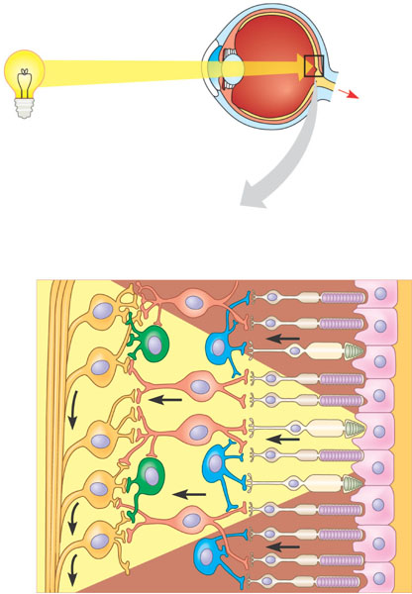
Cellular organization of the vertebrate retina
Retina
Optic nerve
To brain
Retina
Neurons
Photoreceptors
Cone
Rod
Amacrine cell
Horizontal cell
Optic nerve fibers
Ganglion cell
Bipolar cell
Pigmented epithelium

Slide 18
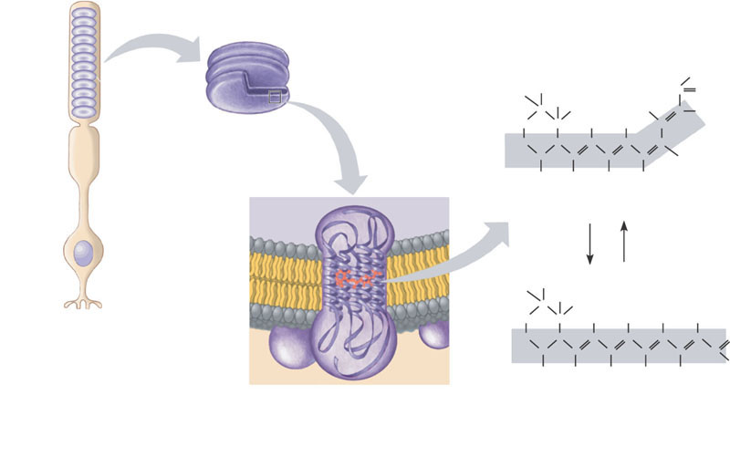
Rod structure and light absorption
Rod
Outer segment
H
H
H
CH₃
C
O
C
CH₃
H₃C
C
H
H₂C
C
H
H
C
Disks
H₂C
C
C
C
C
C
C
C
C
H
CH₃
H
CH₃
H
cis isomer
Cell body
Inside of disk
Light
Enzymes
Synaptic terminal
H
H
CH₃
C
CH₃
H₂C
C
H
H
H
H
H₂C
C
C
C
C
C
C
C
O
C
C
C
C
H
Cytosol
CH₃
H
CH₃
CH₃
CH₃
Rhodopsin
Retinal
trans isomer
Opsin
(b) Retinal exists as two isomers. Absorption of light converts the cis isomer to the trans isomer, which causes opsin to change its conformation (shape). After a few minutes, retinal detaches from opsin. In the dark, enzymes convert retinal back to its cis form, which recombines with opsin to form rhodopsin.
(a) Rods contain the visual pigment rhodopsin, which is embedded in a stack of membranous disks in the rod’s outer segment. Rhodopsin consists of the light-absorbing molecule retinal bonded to opsin, a protein. Opsin has seven α helices that span the disk membrane.

Slide 19
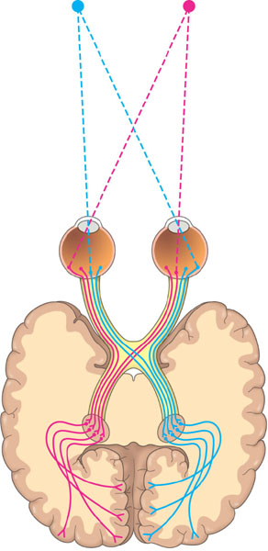
Neural pathways for vision
Left
visual
field
Right
visual
field
Left
eye
Right
eye
Optic nerve
Optic chiasm
Lateral geniculate nucleus
Primary visual cortex

Slide 20
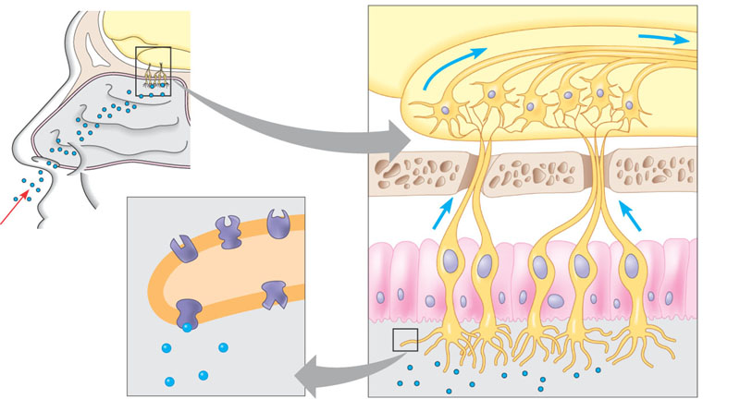
Smell in humans
Brain
Action potentials
Odorant
Olfactory bulb
Nasal cavity
Bone
Epithelial cell
Odorant receptors
Chemoreceptor
Plasma membrane
Cilia
Odorant
Mucus

Slide 21
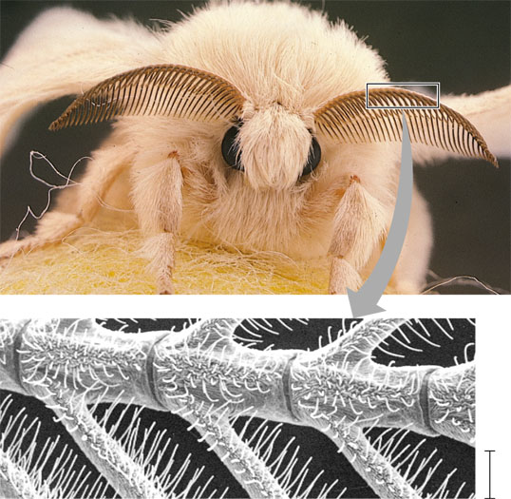
Chemoreceptors in an insect
0.1 mm

Slide 22
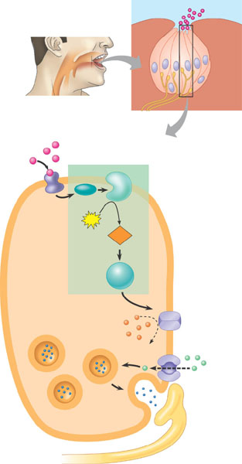
Sensory transduction by a sweetness receptor
Taste pore
Sugar molecule
Taste bud
Sensory receptor cells
Tongue
Sensory neuron
1 A sugar molecule binds to a receptor protein on the sensory receptor cell.
Sugar
Sugar receptor
G protein
Adenylyl cyclase
2 Binding initiates a signal transduction pathway involving cyclic AMP and protein kinase A.
ATP
cAMP
Protein kinase A
3 Activated protein kinase A closes K⁺ channels in the membrane.
SENSORY RECEPTOR CELL
K⁺
4 The decrease in the membrane’s permeability to K⁺ depolarizes the membrane.
Synaptic vesicle
—Ca²⁺
5 Depolarization opens voltage-gated calcium ion (Ca²⁺) channels, and Ca²⁺ diffuses into the receptor cell.
Neurotransmitter
6 The increased Ca²⁺ concentration causes synaptic vesicles to release neurotransmitter.
Sensory neuron

Slide 23
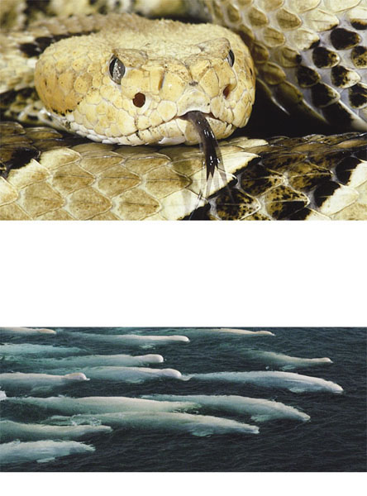
Specialized electromagnetic receptors
Eye
Infrared receptor
(a) This rattlesnake and other pit vipers have a pair of infrared receptors, one between each eye and nostril. The organs are sensitive enough to detect the infrared radiation emitted by a warm mouse a meter away. The snake moves its head from side to side until the radiation is detected equally by the two receptors, indicating that the mouse is straight ahead.
(b) Some migrating animals, such as these beluga whales, apparently sense Earth’s magnetic field and use the information, along with other cues, for orientation.

Slide 24
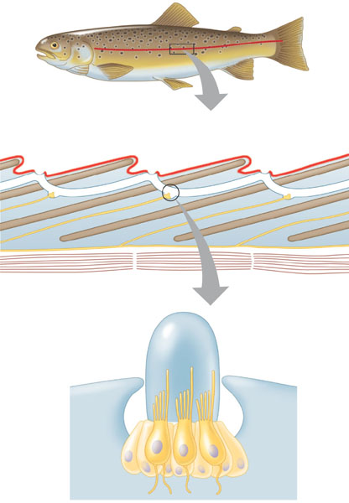
The lateral line system in a fish
Lateral line
Lateral line canal
Opening of lateral line canal
Scale
Epidermis
Neuromast
Segmental muscles of body wall
Lateral nerve
Cupula
Sensory hairs
Supporting cell
Hair cell
Nerve fiber

Slide 25
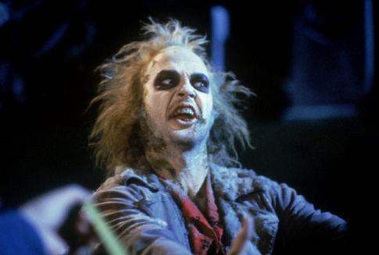
So don’t be a stiff! Ask Questions!!

Slide 26
Make sure you can do the following:
Label all parts of a striated motor unit and explain how those structure contribute to the function of the motor unit.
Explain the sliding filament model of muscle contraction
Compare and contrast the major sensory apparatus used by mammals and other animals
Explain the causes of sensory and motor system disruptions and how disruptions of the sensory and motor systems can lead to disruptions of homeostasis.

