Slide 1
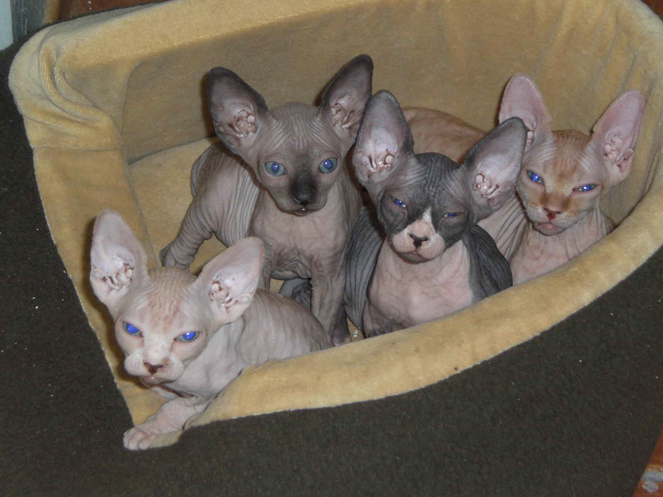
Animal Reproduction & Development
(Ch. 46, 47)

Slide 2
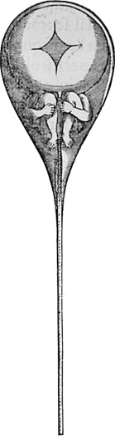
A “homunculus” inside the head of a human sperm

Slide 3
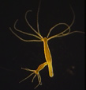
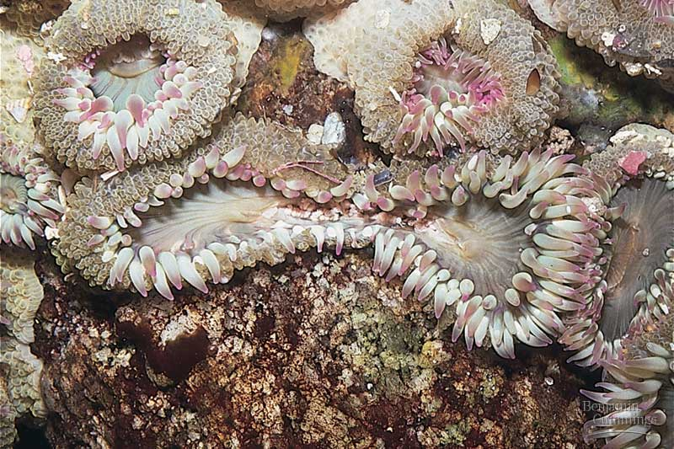
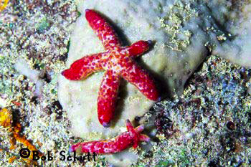
Sexual & asexual reproduction
Asexual
  offspring all have same genes (clones)
  no variation
Sexual
  gametes (sperm & egg) → fertilization
  mixing of genes → variation

Slide 4
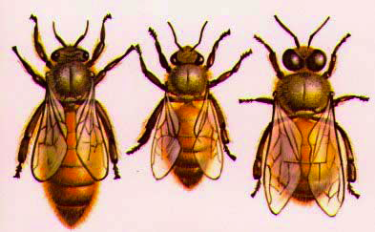
Parthenogenesis
Development of an unfertilized egg
  honey bees
    drones = males produced through parthenogenesis → haploid
    workers & queens = females produced from fertilized eggs → diploid
queen
worker
drone
Notes:
Honey bee eggs hatch regardless of whether the are fertilized. The female bees--queens & workers--develop from fertilized eggs that contain 32 chromosomes. These 32 chromosomes consist of two sets of 16, one set from each parent. Hence female bees are said to be diploid in origin. The males (drones) develop from unfertilized egg which contain only one set of 16 chromosomes from their mother. Drones are thus haploid in origin This reproduction by the development of unfertilized eggs is called parthenogenesis
Drones develop by parthenogenesis from unfertilized eggs that the queen produces by withholding sperm from the eggs laid in large drone cells. Drones lack stings and the structures needed for pollen collection; in the autumn they are ejected by the colony to starve, unless the colony is queenless. New drones are produced in the spring for mating.
Both queens and workers are produced from fertilized eggs. Queen larvae are reared in special peanut-shaped cells and fed more of the pharyngeal gland secretions of the nurse bees (bee milk or royal jelly) than the worker larvae are. The precise mechanism for this caste differentiation is still uncertain. Although workers are similar in appearance and behavior to other female bees, they lack the structures for mating. When no queen is present to inhibit the development of their ovaries, however, workers eventually begin to lay eggs that develop into drones.

Slide 5
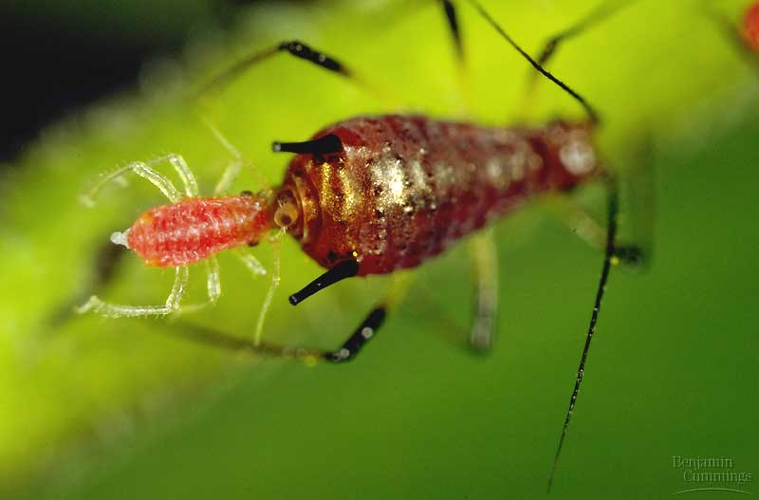
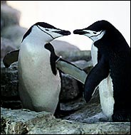
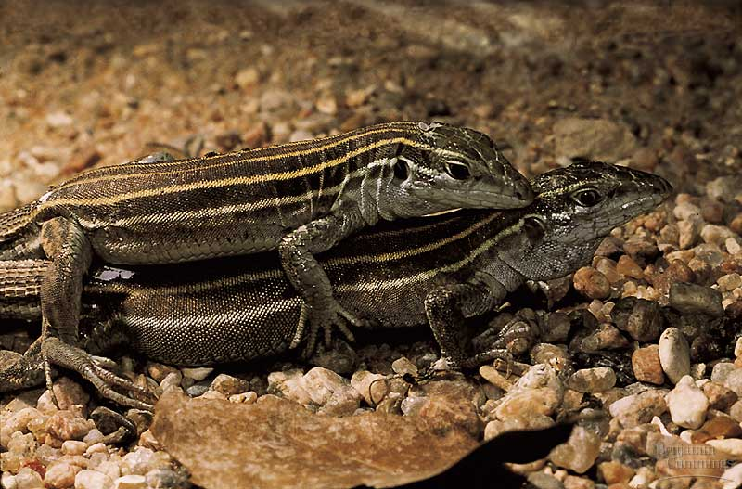
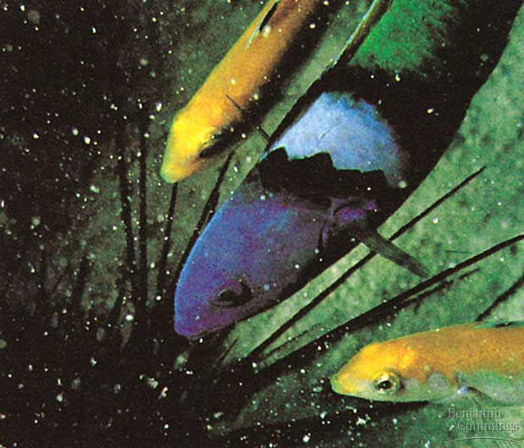
Different strokes…
gay
penguins
parthenogenesis in aphids
“lesbian” lizards
sex-change in fish

Slide 6
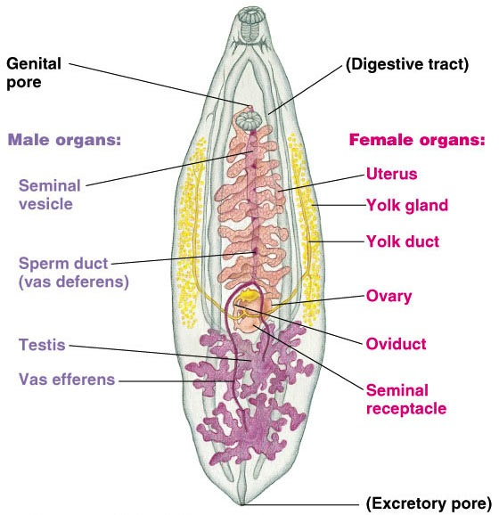
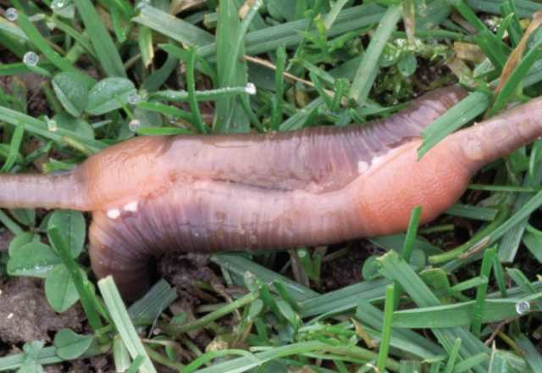
Hermaphrodites
Having functional reproductive system of both sexes
earthworms mating
flat worm

Slide 7
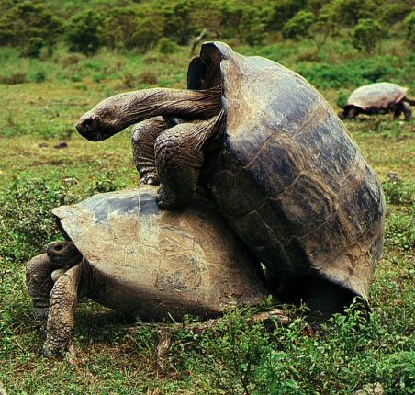
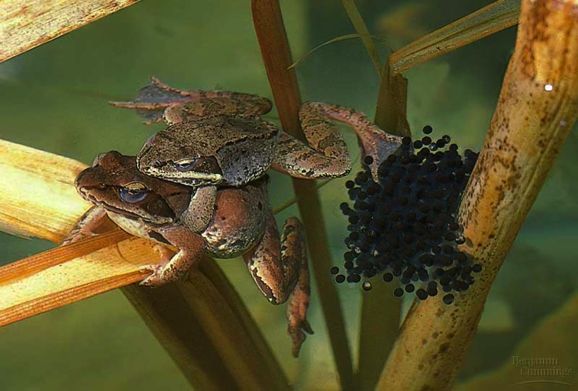
Fertilization
Joining of egg & sperm
  external
    usually aquatic animals
  internal
    usually land animals

Slide 8
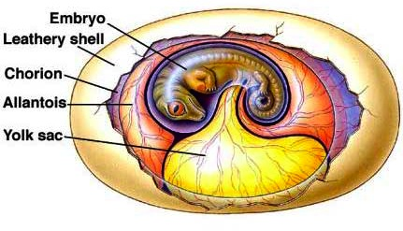
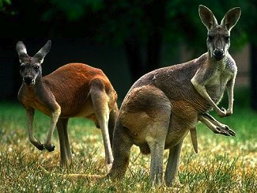
Development
External
  development in eggs
  fish & amphibians in water
    soft eggs= exchange across membrane
  birds & reptiles on land
    hard-shell amniotic eggs
    structures for exchange of food, O₂ & waste
  sharks & some snakes
    live births from eggs
Internal
  placenta
    exchange food & waste
  live birth

Slide 9
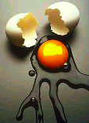
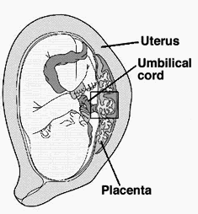
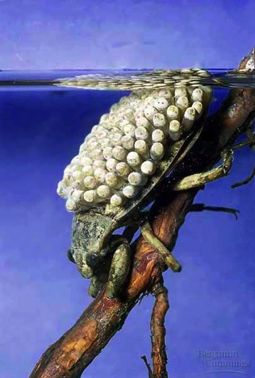

Adaptive advantages?
What is the adaptive value of each type of sexual reproduction
  number of eggs?
  level of parental of care
  habitat?

Slide 10
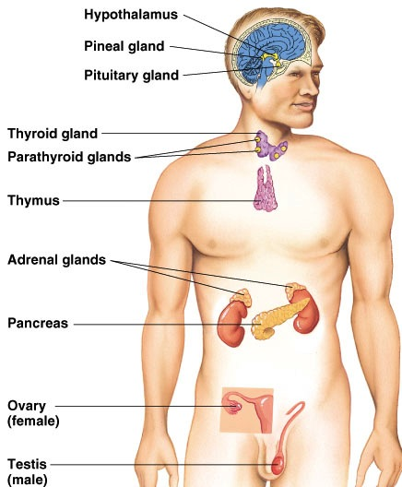
Reproductive hormones
Testosterone
  from testes
  functions
    sperm production
    2° sexual characteristics
Estrogen
  from ovaries
  functions
    egg production
    prepare uterus for fertilized egg
    2° sexual characteristics
LH &
FSH
testes
or
ovaries

Slide 11
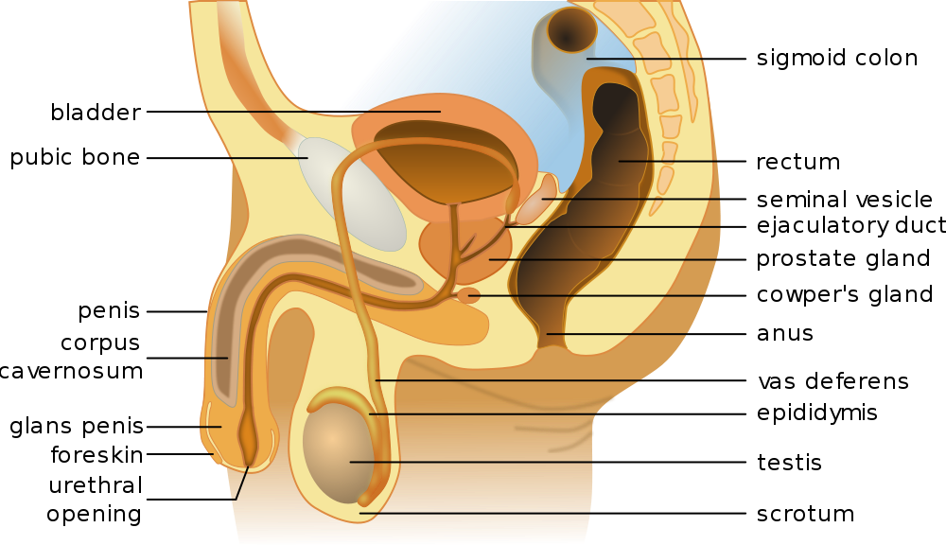
Male reproductive system
Sperm production
  over 100 million produced per day!
  ~2.5 million released per drop!

Slide 12
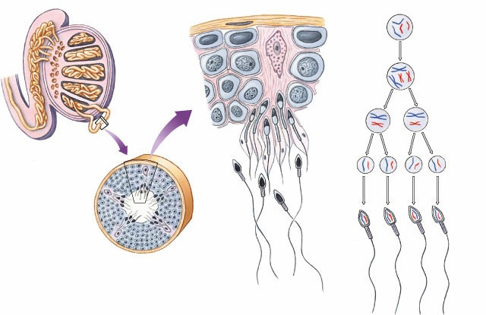
Spermatogenesis
Epididymis
Testis
Coiled
seminiferous
tubules
Germ cell
(diploid)
1°
spermatocyte
(diploid)
MEIOSIS I
2°
spermatocytes
(haploid)
Vas deferens
MEIOSIS II
Spermatids
(haploid)
Spermatozoa
Cross-section of
seminiferous tubule

Slide 13
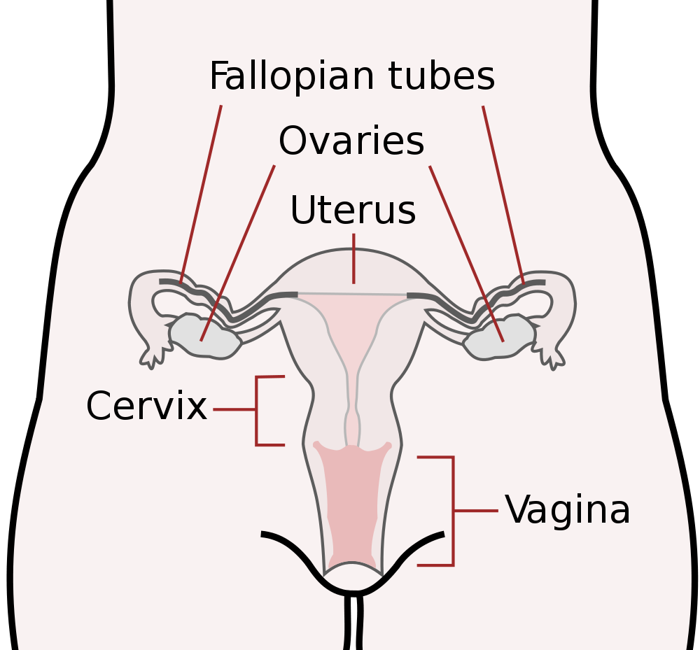
Female reproductive system

Slide 14
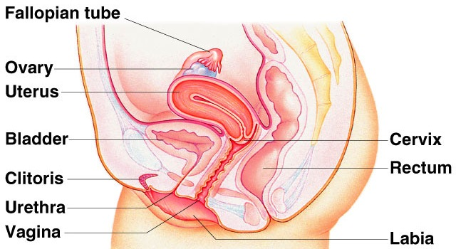
Female reproductive system

Slide 15
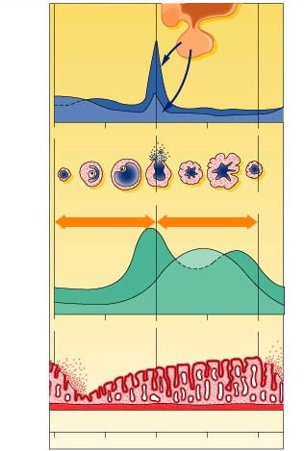
Menstrual cycle
LH
FSH
Hypothalamus
egg development
ovulation = egg release
GnRH
corpus luteum
Pituitary
FSH & LH
estrogen
progesterone
Ovaries
lining of uterus
estrogen
Body cells
days
0
7
14
21
28

Slide 16
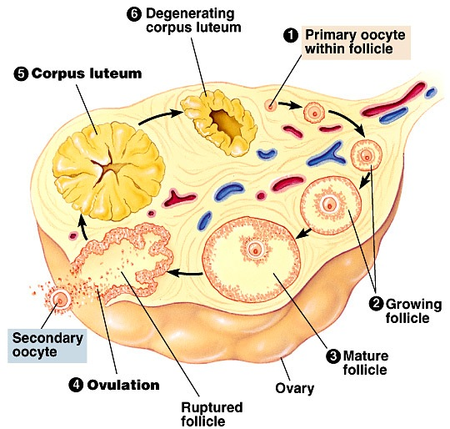
Egg maturation in ovary
Corpus luteum
  produces progesterone
  to maintain
  uterine lining

Slide 17
Female hormones
FSH & LH
  release from pituitary
  stimulates egg development & hormone release
  peak release = release of egg (ovulation)
Estrogen
  released from ovary cells around developing egg
  stimulates growth of lining of uterus
  lowered levels = menstruation
Progesterone
  released from “corpus luteum” in ovaries
    cells that used to take care of developing egg
  stimulates blood supply to lining of uterus
  lowered levels = menstruation

Slide 18
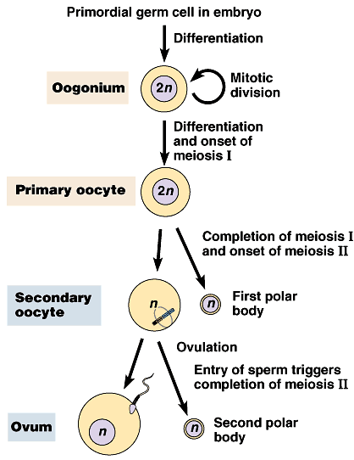
Oogenesis
What is the
advantage of
this development
system?
Unequal meiotic divisions
  unequal distribution
  of cytoplasm
  1 egg
  2 polar bodies
Meiosis 1 completed
during egg maturation
ovulation
Meiosis 2 completed
triggered by fertilization
Put all your egg
in one basket!

Slide 19
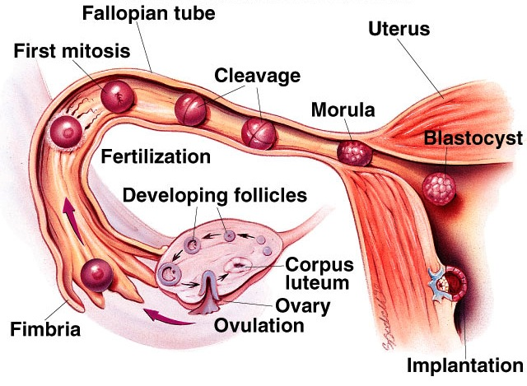

Fertilization
fertilization
cleavage
gastrulation
neurulation
organogenesis

Slide 20
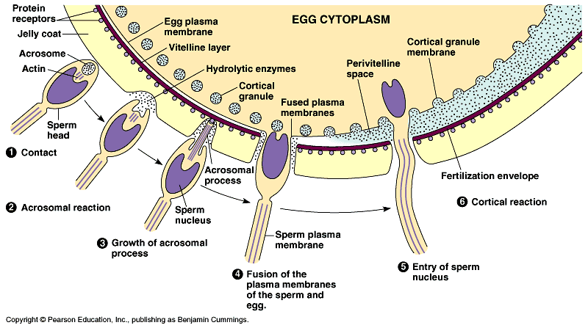
Fertilization
Joining of sperm & egg
  sperm head (nucleus) enters egg

Slide 21
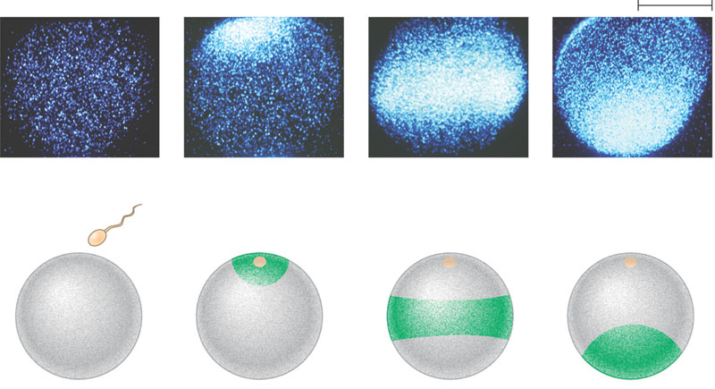
What is the effect of sperm binding on Ca²⁺ distribution in the egg?
EXPERIMENT
A fluorescent dye that glows when it binds free Ca²⁺ was injected into unfertilized sea urchin eggs. After sea urchin
sperm were added, researchers observed the eggs in a fluorescence microscope.
RESULTS
500 μm
1 sec before
fertilization
10 sec after
fertilization
20 sec
30 sec
Point of
Sperm
entry
Spreading wave
of calcium ions
The release of Ca²⁺ from the endoplasmic reticulum into the cytosol at the site of sperm entry triggers the release
of more and more Ca²⁺ in a wave that spreads to the other side of the cell. The entire process takes about 30 seconds.
CONCLUSION

Slide 22
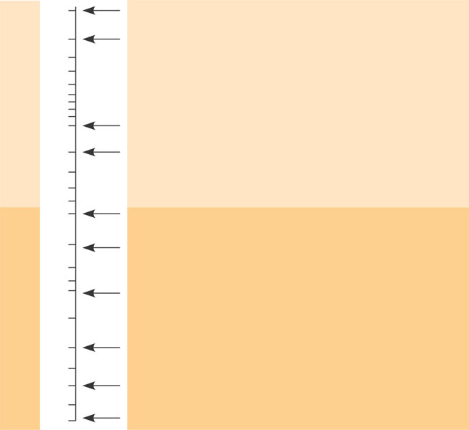
Timeline for the fertilization of sea urchin eggs
1
Binding of sperm to egg
2
Acrosomal reaction: plasma membrane
depolarization (fast block to polyspermy)
3
4
6
Seconds
8
10
Increased intracellular calcium level
20
Cortical reaction begins (slow block to polyspermy)
30
40
50
1
Formation of fertilization envelope complete
2
Increased intracellular pH
3
4
5
Increased protein synthesis
Minutes
10
20
Fusion of egg and sperm nuclei complete
30
40
Onset of DNA synthesis
60
90
First cell division

Slide 23
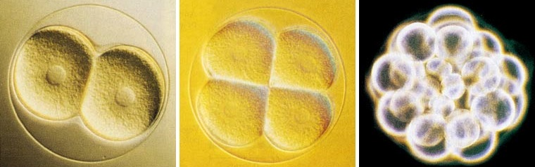
Cleavage
Repeated mitotic divisions of zygote
  1st step to becoming multicellular
  unequal divisions establishes body plan
    different cells receive different portions of egg cytoplasm & therefore different regulatory signals

Slide 24
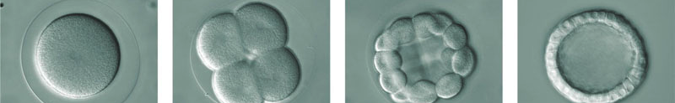
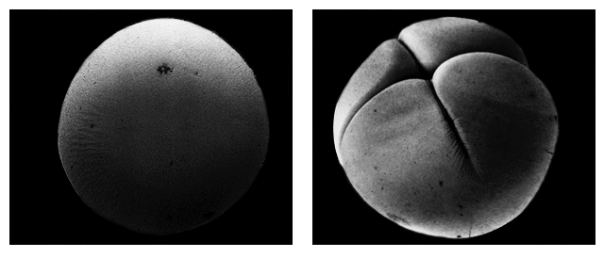
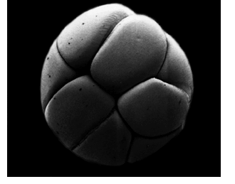
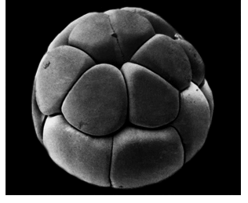
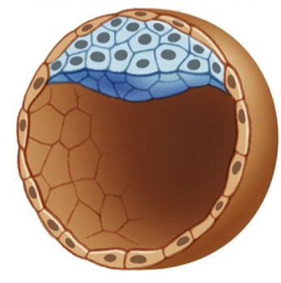
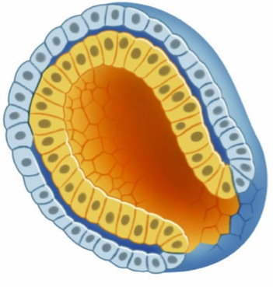
Cleavage
zygote → morula → blastula
  establishes future development
zygote
gastrulation
morula
blastula

Slide 25
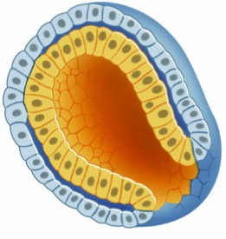
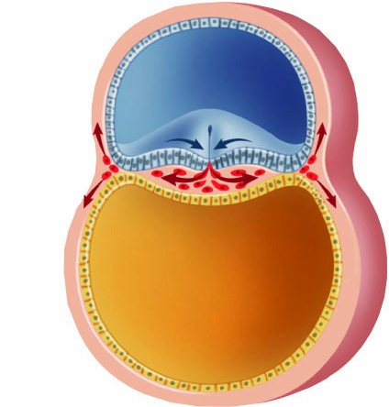
Gastrulation
gastrulation in
primitive chordates
Establish 3 cell layers
  ectoderm
    outer body tissues
      skin, nails, teeth,nerves, eyes, lining of mouth
  mesoderm
    middle tissues
      blood & lymph, bone & notochord, muscle, excretory & reproductive systems
  endoderm
    inner lining
      digestive system, lining of respiratory, excretory & reproductive systems
ectoderm
mesoderm
endoderm
protostome vs. deuterostome

Slide 26
Testing…
All of the following correctly describe the fate of the embryonic layers of a vertebrate EXCEPT
  A. neural tube and epidermis develop from ectoderm
  B. linings of digestive organs and lungs develop from endoderm
  C. notochord and kidneys develop from endoderm
  D. skeletal muscles and heart develop from mesoderm
  E. reproductive organs and blood vessels develop from mesoderm

Slide 27
Testing…
In a study of the development of frogs, groups of cells in the germ layers of several embryos in the early gastrula stage were stained with five different dyes that do not harm living tissue. After organogenesis (organ formation), the location of the dyes was noted, as shown in the table below.
Tissue Stain
Brain Red
Notochord Yellow
Liver Green
Lens of the eye Blue
Lining of the digestive tract Purple

Slide 28
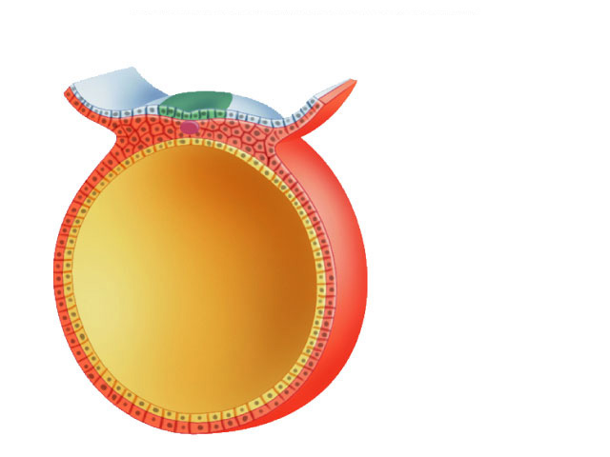
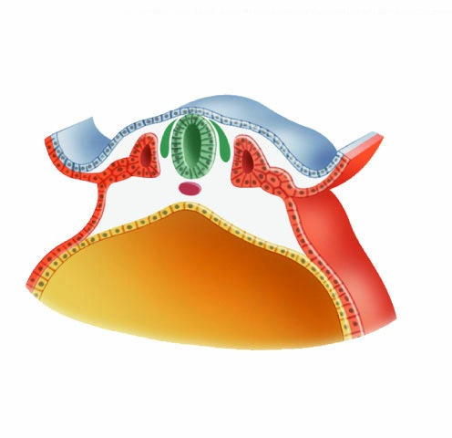
Neurulation
Formation of notochord & neural tube
  develop into nervous system
develops into CNS
(brain & spinal cord)
Neural tube
Notochord
develops into
vertebral column

Slide 29
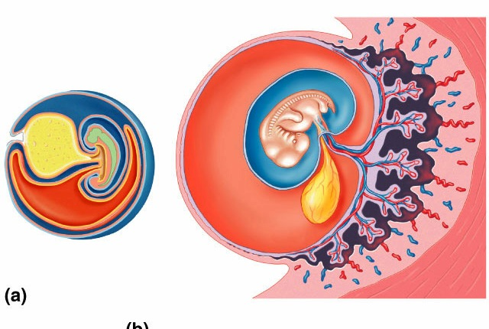
Organogenesis
Umbilical blood vessels
Mammalian embryo
Chorion
Bird embryo
Amnion
Yolk
sac
Allantois
Fetal blood vessels
Placenta
Maternal blood vessels

Slide 30
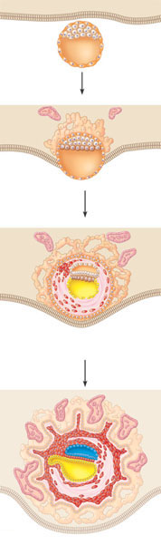
Four stages in early embryonic development of a human
Endometrium
(uterine lining)
Inner cell mass
Trophoblast
1
Blastocyst
reaches uterus.
Blastocoel
Expanding
region of
trophoblast
Maternal
blood
vessel
Epiblast
Hypoblast
Trophoblast
2
Blastocyst
implants.
Expanding
region of
trophoblast
Amnion
Amniotic
cavity
Epiblast
Hypoblast
3
Extraembryonic
membranes
start to form and
gastrulation begins.
Chorion (from
trophoblast)
Extraembryonic mesoderm cells
(from epiblast)
Yolk sac (from
hypoblast)
Allantois
Amnion
Chorion
Ectoderm
Mesoderm
Endoderm
4
Gastrulation has produced a three-
layered embryo with four
extraembryonic membranes.
Yolk sac
Extraembryonic
mesoderm

Slide 31
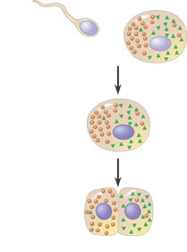
Sources of developmental information for the early embryo
Unfertilized egg cell
Sperm
Molecules of
another cyto-
plasmic deter-
minant
Molecules of a
a cytoplasmic
determinant
Nucleus
Fertilization
Zygote
(fertilized egg)
Mitotic cell division
Two-celled
embryo
(a)
Cytoplasmic determinants in the egg. The unfertilized egg cell has molecules in its cytoplasm,
encoded by the mother’s genes, that influence development. Many of these cytoplasmic
determinants, like the two shown here, are unevenly distributed in the egg. After fertilization
and mitotic division, the cell nuclei of the embryo are exposed to different sets of cytoplasmic
determinants and, as a result, express different genes.

Slide 32
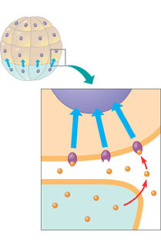
Early embryo
(32 cells)
NUCLEUS
Signal
transduction
pathway
Signal
receptor
Signal
molecule
(inducer)
(b)
Induction by nearby cells. The cells at the bottom of the early embryo depicted here are releasing
chemicals that signal nearby cells to change their gene expression.

Slide 33
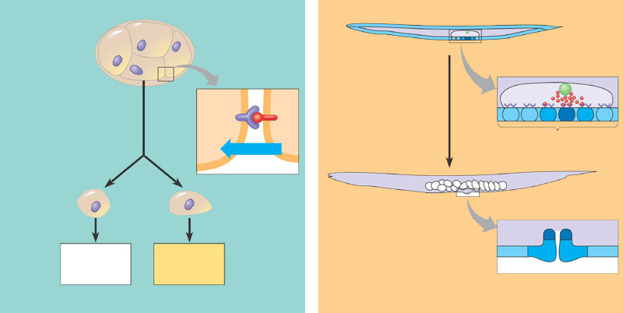
Cell signaling and induction during development of the nematode
Epidermis
2
Posterior
Anterior
1
4
Signal
protein
3
Receptor
Signal
protein
Gonad
Anchor cell
EMBRYO
3
4
Vulval precursor cells
Signal
Anterior
daughter
cell of 3
Posterior
daughter
cell of 3
ADULT
Inner vulva
Outer vulva
Will go on to
form muscle
and gonads
Will go on to
form adult
intestine
Epidermis
(a)
Induction of the intestinal precursor cell at the
four-cell stage.
(b)
Induction of vulval cell types during larval
development.

Slide 34
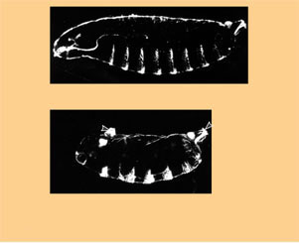
The effect of the bicoid gene, a maternal effect (egg-polarity) gene in Drosophila
Tail
Head
T1
T2
A8
T3
A6
A7
A1
A2
A3
A4
A5
Wild-type larva
Tail
Tail
A8
A8
A7
A6
A7
Mutant larva (bicoid)
(a)
Drosophila larvae with wild-type and bicoid mutant phenotypes. A mutation
in the mother’s bicoid gene leads to tail structures at both ends (bottom larva).
The numbers refer to the thoracic and abdominal segments that are present.

Slide 35
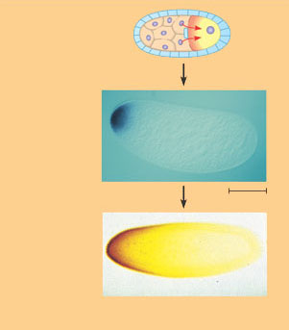
Nurse cells
Egg cell
1
Developing
egg cell
bicoid mRNA
2
Bicoid mRNA
in mature
unfertilized egg
Fertilization
100 µm
Translation of bicoid mRNA
Bicoid protein in
early embryo
3
Anterior end
(b) Gradients of bicoid mRNA and bicoid protein in normal egg and early embryo.

Slide 36
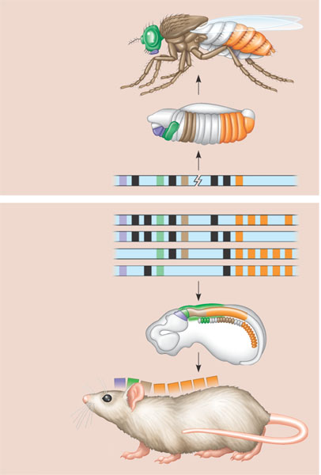
Conservation of homeotic genes in a fruit fly and a mouse
Adult
fruit fly
Fruit fly embryo
(10 hours)
Fly
chromosome
Mouse
chromosomes
Mouse embryo
(12 days)
Adult mouse

Slide 37

Effect of differences in Hox gene expression during development in crustaceans and insects
Genital
segments
Thorax
Abdomen
Thorax
Abdomen

Slide 38

Mutant Drosophila with an extra small eye on its antenna

Slide 39

Vertebrate limb development
(a)
Organizer regions. Vertebrate limbs develop from
protrusions called limb buds, each consisting of
mesoderm cells covered by a layer of ectoderm.
Two regions, termed the apical ectodermal ridge
(AER, shown in this SEM) and the zone of polarizing
activity (ZPA), play key organizer roles in limb
pattern formation.
Anterior
AER
Limb bud
ZPA
Posterior
Apical
ectodermal
ridge
50 µm
(b)
Wing of chick embryo. As the bud develops into a
limb, a specific pattern of tissues emerges. In the
chick wing, for example, the three digits are always
present in the arrangement shown here. Pattern
formation requires each embryonic cell to receive
some kind of positional information indicating
location along the three axes of the limb. The AER
and ZPA secrete molecules that help provide this
information.
Digits
Anterior
Ventral
Proximal
Distal
Dorsal
Posterior

Slide 40


What role does the zone of polarizing activity (ZPA) play in limb pattern formation in vertebrates?
EXPERIMENT
ZPA tissue from a donor chick embryo was transplanted under the ectoderm in the
anterior margin of a recipient chick limb bud.
Anterior
New ZPA
Donor
limb
bud
Host
limb
bud
ZPA
Posterior
RESULTS
In the grafted host limb bud, extra digits developed from host tissue in a mirror-image
arrangement to the normal digits, which also formed (see Figure 47.26b for a diagram of a normal
chick wing).
CONCLUSION
The mirror-image duplication observed in this experiment suggests that ZPA cells secrete
a signal that diffuses from its source and conveys positional information indicating “posterior.” As the
distance from the ZPA increases, the signal concentration decreases and hence more anterior digits develop.

Slide 41

Sex determination
Sperm
Zygote
Y
Develop in
early
embryo
XY
Testes
Ovum
X
SRY
Seminiferous
tubules
Indifferent
gonads
Leydig cells
X
No SRY
Ovaries
Ovum
XX
X
(Follicles do not
develop until
third trimester)
Sperm
Zygote

Slide 42

Placenta
Materials exchange across membranes

Slide 43

Placental circulation
Maternal
arteries
Maternal
veins
Placenta
Maternal portion
of placenta
Umbilical cord
Chorionic villus
containing fetal
capillaries
Fetal portion of
placenta (chorion)
Maternal blood
pools
Uterus
Fetal arteriole
Umbilical arteries
Fetal venule
Umbilical vein
Umbilical cord

Slide 44

Human fetal development
4 weeks
7 weeks

Slide 45

Human fetal development
10 weeks

Slide 46

Human fetal development
12 weeks
20 weeks

Slide 47


Human fetal development
The fetus just spends much of the 2nd & 3rd trimesters just growing
  …and doing various flip-turns & kicks inside amniotic fluid
Week 20

Slide 48

Human fetal development
24 weeks (6 months; 2nd trimester)
fetus is covered with fine, downy hair called lanugo. Its skin is protected by a waxy material called vernix

Slide 49

Human fetal development
30 weeks (7.5 months)
umbilical cord

Slide 50

Getting crowded in there!!
32 weeks (8 months)
The fetus sleeps 90-95% of the day & sometimes experiences REM sleep, an indication of dreaming

Slide 51


Birth
positive feedback
Estrogen
Oxytocin
from
ovaries
from fetus
and mother's
posterior pituitary
Induces oxytocin
receptors on uterus
Positive feedback
Stimulates uterus
to contract
Stimulates
placenta to make
Prostaglandins
Stimulate more
contractions
of uterus

Slide 52

The end of the journey!
And you think
9 months of
AP Bio is hard!

Slide 53

Mechanisms of some contraceptive methods
Male
Female
Method
Event
Event
Method
Production of
viable sperm
Production of
viable oocytes
Vasectomy
Combination
birth control
pill (or injection,
patch, or
vaginal ring)
Sperm transport
down male
duct system
Ovulation
Abstinence
Abstinence
Condom
Coitus
interruptus
(very high
failure rate)
Sperm
deposited
in vagina
Capture of the
oocyte by the
oviduct
Tubal ligation
Spermicides;
diaphragm;
cervical cap;
progestin alone
(minipill, implant,
or injection)
Sperm
movement
through
female
reproductive
tract
Transport
of oocyte in
oviduct
Meeting of sperm and oocyte
in oviduct
Union of sperm and egg
Morning-after
pill (MAP)
Progestin alone
Implantation of blastocyst
in properly prepared
endometrium
Birth

Slide 54

Reproductive Cloning of a Mammal by Nuclear Transplantation
APPLICATION
Mammary
cell donor
Egg cell
donor
This method is used to produce cloned
animals whose nuclear genes are identical to the donor
animal supplying the nucleus.
1
2
Egg cell
from ovary
TECHNIQUE
Nucleus
removed
Shown here is the procedure used to produce
Dolly, the first reported case of a mammal cloned using the nucleus
of a differentiated cell.
Nucleus
removed
Cultured
mammary cells
are semistarved,
arresting the cell
cycle and causing
dedifferentiation
Cells fused
3
RESULTS
The cloned animal is identical in appearance
and genetic makeup to the donor animal supplying the nucleus,
but differs from the egg cell donor and surrogate mother.
Nucleus from
mammary cell
4
Grown in culture
Early embryo
5
Implanted in uterus
of a third sheep
Surrogate
mother
6
Embryonic
development
Lamb (“Dolly”)
genetically identical to
mammary cell donor

Slide 55

Copy Cat, the first cloned cat

Slide 56

Working with stem cells
Embryonic stem cells
Adult stem cells
Early human embryo
at blastocyst stage
(mammalian equiva-
lent of blastula)
From bone marrow
in this example
Totipotent
cells
Pluripotent
cells
Cultured
stem cells
Different
culture
conditions
Different
types of
differentiated
cells
Liver cells
Nerve cells
Blood cells

Slide 57
Any Questions?

Slide 58
Make sure you can do the following:
Label all parts of the male and female reproductive systems and explain how they contribute to the functions of the systems.
Explain the major phases of animal development.
Demonstrate how reproductive technologies might have moral and ethical implications for society
Explain the causes of reproductive system disruptions and how disruptions of the reproductive system can lead to disruptions of homeostasis.

