Slide 1
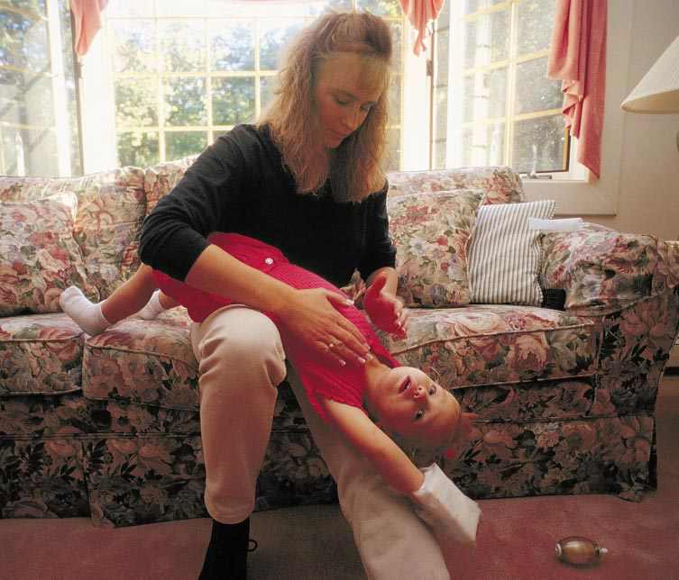
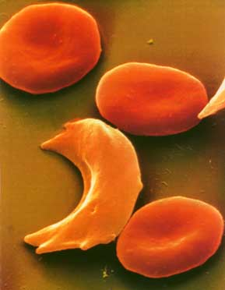
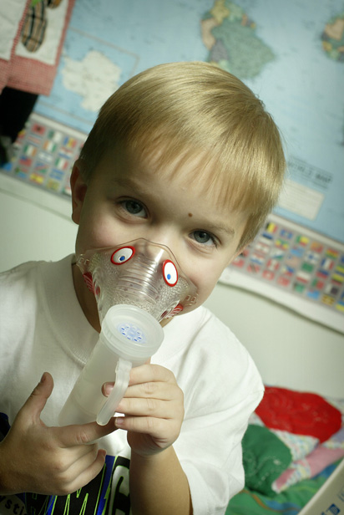
Human Genetic Diseases
(Ch. 15)
1
2
3
4
5
6

Slide 2
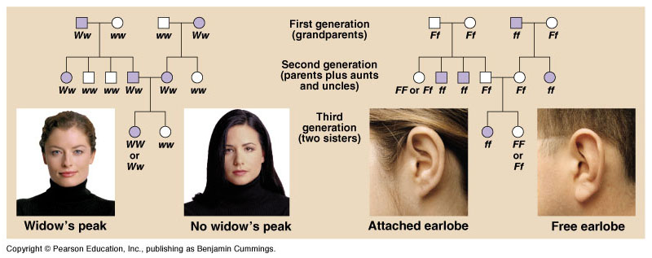
Pedigree analysis
Pedigree analysis reveals Mendelian patterns in human inheritance
  data mapped on a family tree
= male
= female
= male w/ trait
= female w/ trait

Slide 3
Simple pedigree analysis
What’s the
likely inheritance
pattern?
1
2
1
2
3
4
5
6
3
4
5
6

Slide 4
Genetic counseling
Pedigrees can help us understand the past & predict the future
Thousands of genetic disorders are inherited as simple recessive traits
  from benign conditions to deadly diseases
    albinism
    cystic fibrosis
    Tay sachs
    sickle cell anemia
    PKU

Slide 5
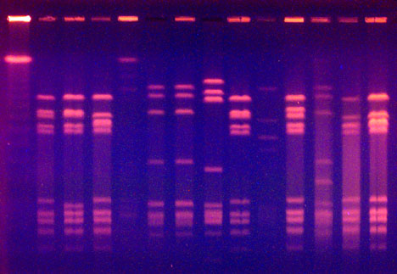
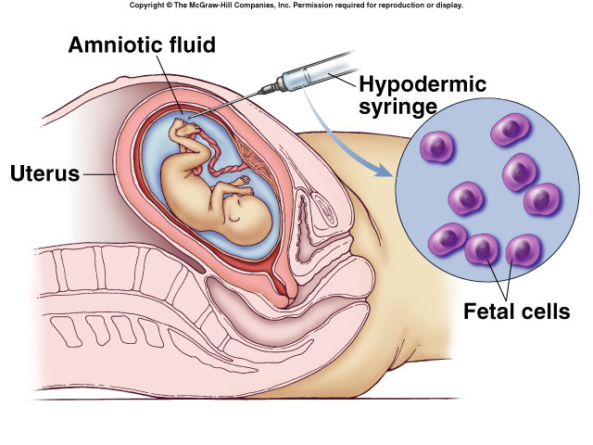
Genetic testing
sequence
individual genes

Slide 6
Recessive diseases
The diseases are recessive because the allele codes for either a malfunctioning protein or no protein at all
  Heterozygotes (Aa)
    carriers
    have a normal phenotype because one “normal” allele produces enough of the required protein
Notes:
Carriers are heterozygous individuals who carry the recessive allele but are phenotypically normal (i.e., pigmented)

Slide 7
Heterozygote crosses
Heterozygotes as carriers of recessive alleles
Aa x Aa
A
Aa
male / sperm
A
a
a
AA
Aa
AA
Aa
A
carrier
A
female / eggs
Aa
aa
Aa
Aa
aa
a
carrier
disease
a

Slide 8
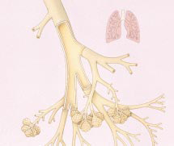
Cystic fibrosis (recessive)
Primarily whites of European descent
  strikes 1 in 2500 births
    1 in 25 whites is a carrier (Aa)
  normal allele codes for a membrane protein that transports Cl⁻ across cell membrane
    defective or absent channels limit transport of Cl⁻ & H₂O across cell membrane
    Thick, sticky, mucus coats around cells
    mucus build-up in the pancreas, lungs, digestive tract & causes bacterial infections
  without treatment children die before 5;
  with treatment can live past their late 20s
normal lung tissue
Notes:
Cystic fibrosis is an inherited disease that is relatively common in the U.S. Cystic fibrosis affects multiple parts of the body including the pancreas, the sweat glands, and the lungs. When someone has cystic fibrosis, they often have lots of lung problems. The cause of their lung problems is directly related to basic problems with diffusion and osmosis in the large airways of the lungs.
People without cystic fibrosis have a small layer of salt water in the large airways of their lungs. This layer of salt water is under the mucus layer which lines the airways. The mucus layer in the airways helps to clear dust and other inhaled particles from the lungs.

Slide 9
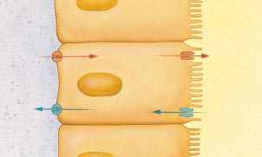
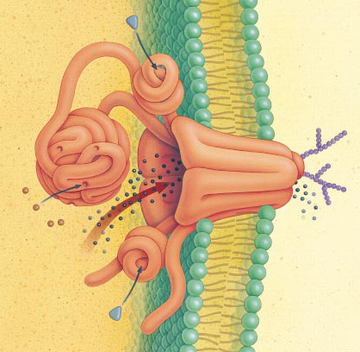
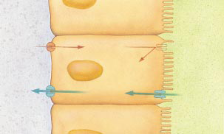
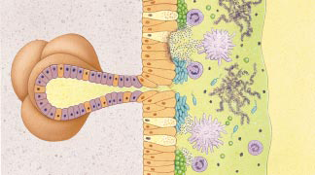
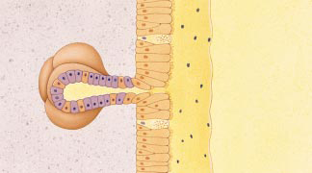
Effect on Lungs
Chloride channel
transports salt through protein channel out of cell
Osmosis: H₂O follows Cl–
normal lungs
airway
Cl–
Cl– channel
H₂O
cells lining lungs
cystic fibrosis
Cl–
H₂O
bacteria & mucus build up
thickened mucus
hard to secrete
mucus secreting glands
Notes:
In people without cystic fibrosis, working cystic fibrosis proteins allow salt (chloride) to enter the air space and water follows by osmosis. The mucus layer is dilute and not very sticky.
In people with cystic fibrosis, non-working cystic fibrosis proteins mean no salt (chloride) enters the air space and water doesn't either. The mucus layer is concentrated and very sticky.
People with cystic fibrosis have lung problems because:
Proteins for diffusion of salt into the airways don't work. (less diffusion)
Less salt in the airways means less water in the airways. (less osmosis)
Less water in the airways means mucus layer is very sticky (viscous).
Sticky mucus cannot be easily moved to clear particles from the lungs.
Sticky mucus traps bacteria and causes more lung infections.
Therefore, because of less diffusion of salt and less osmosis of water, people with cystic fibrosis have too much sticky mucus in the airways of their lungs and get lots of lung infections. Thus, they are sick a lot.

Slide 10
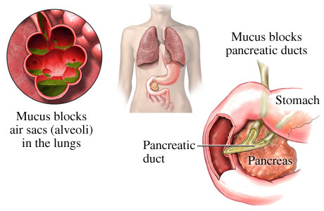
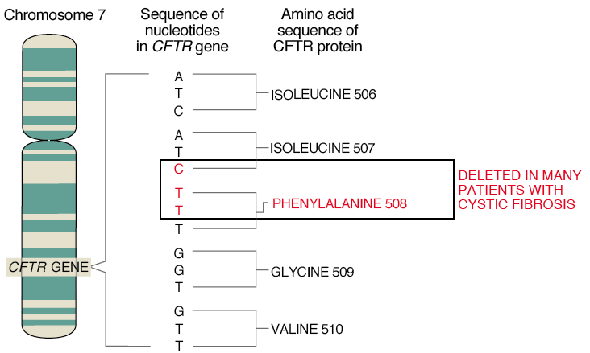

delta F508
loss of one
amino acid

Slide 11

Tay-Sachs (recessive)
Primarily Jews of eastern European (Ashkenazi) descent & Cajuns (Louisiana)
  1 in 3600 births
  non-functional enzyme fails to breakdown lipids in brain cells
    fats collect in cells destroying their function
    symptoms begin few months
    after birth
    seizures, blindness, muscular & mental degeneration
    child usually dies before 5

Slide 12
Sickle cell anemia (recessive)
Primarily Africans
  1 out of 400 African Americans
  caused by substitution of a single amino acid in hemoglobin
  when oxygen levels are low, sickle-cell hemoglobin crystallizes into long rods
    deforms red blood cells into
    sickle shape
    sickling creates pleiotropic
    effects = cascade of other
    symptoms

Slide 13
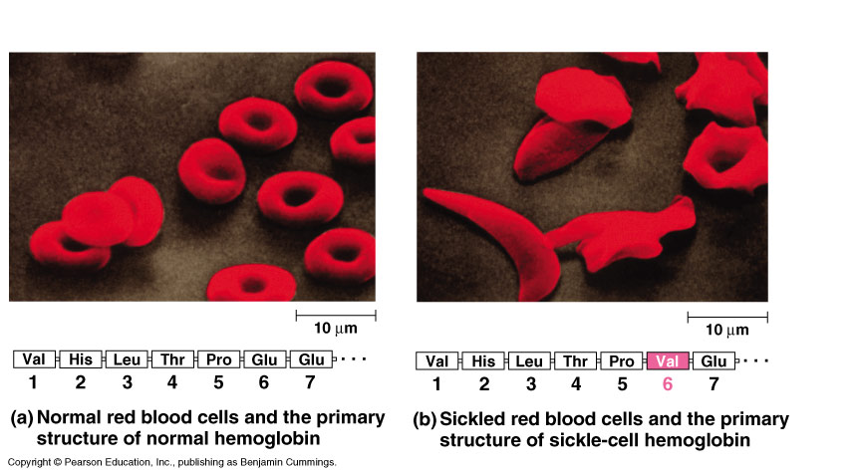
Sickle cell anemia
Substitution of one amino acid in polypeptide chain
hydrophilic
amino acid
hydrophobic
amino acid

Slide 14
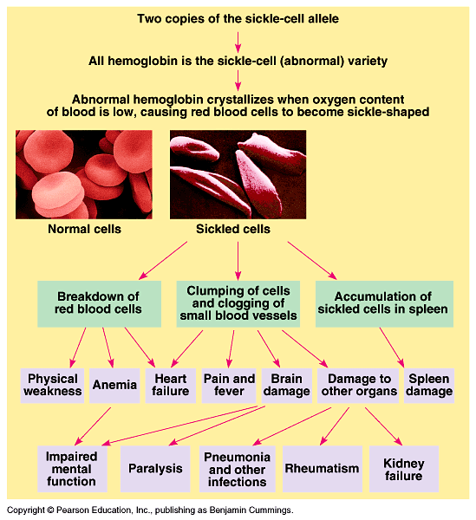
Notes:
Doctors can use regular blood transfusions to prevent brain damage and new drugs to prevent or treat other problems.

Slide 15
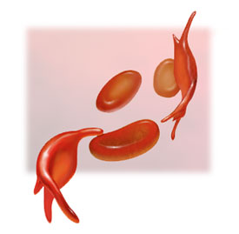
Sickle cell phenotype
2 alleles are codominant
  both normal & mutant hemoglobins are synthesized in heterozygote (Aa)
  50% cells sickle; 50% cells normal
  carriers usually healthy
  sickle-cell disease
  triggered under blood
  oxygen stress
    exercise

Slide 16
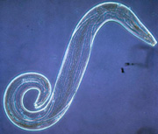
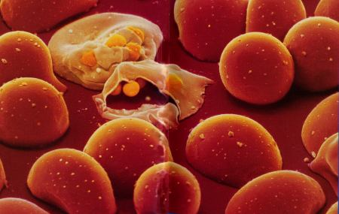
Heterozygote advantage
Malaria
  single-celled eukaryote parasite spends part of its life cycle in red blood cells
In tropical Africa, where malaria is common:
  homozygous dominant individuals die of malaria
  homozygous recessive individuals die of sickle cell anemia
  heterozygote carriers are relatively free of both
    reproductive advantage


Slide 17
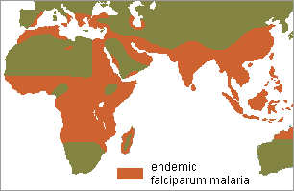
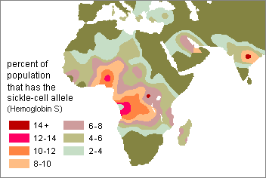
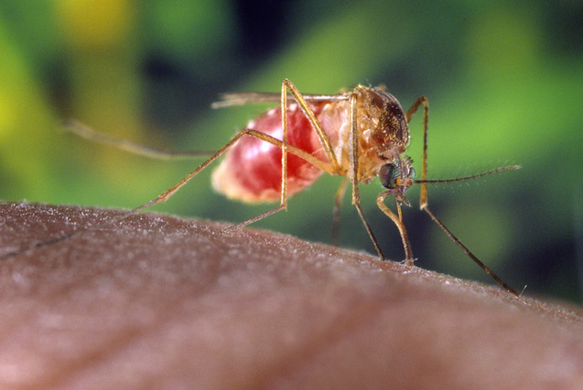
Prevalence of Malaria
Prevalence of Sickle
Cell Anemia

Slide 18
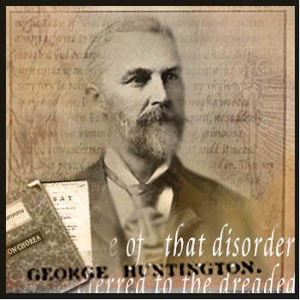

Huntington’s chorea (dominant)
Dominant inheritance
  repeated mutation on end of
  chromosome 4
    mutation = CAG repeats
    glutamine amino acid repeats in protein
    one of 1st genes to be identified
  build up of “huntingtin” protein in brain causing cell death
    memory loss
    muscle tremors, jerky movements
      “chorea”
    starts at age 30-50
    early death: 10-20 years after start
1872
Testing…
Would you
want to
know?

Slide 19
0
1. A couple who are both carriers of the gene
for cystic fibrosis have two children who have cystic fibrosis. What is the probability that their next child will have cystic fibrosis?
  0%
  25%
  50%
  75%
  100%
Notes:
Answer: b
Source: Barstow - Test Bank for Biology, Seventh Edition, Question #6

Slide 20
2. A couple who are both carriers of the gene
for cystic fibrosis have two children who have cystic fibrosis. What is the probability that their next child will be phenotypically normal?
  0%
  25%
  50%
  75%
  100%
Notes:
Answer: d
Source: Barstow - Test Bank for Biology, Seventh Edition, Question #7

Slide 21
4. A woman and her spouse both show the normal phenotype for pigmentation, but both had one parent who was an albino. Albinism is an autosomal recessive trait. If their first two children have normal pigmentation, what is the probability that their third child will be an albino?
  0
  1/4
  1/2
  3/4
  1
Notes:
Answer: b
Source: Barstow - Test Bank for Biology, Seventh Edition, Question #25

Slide 22
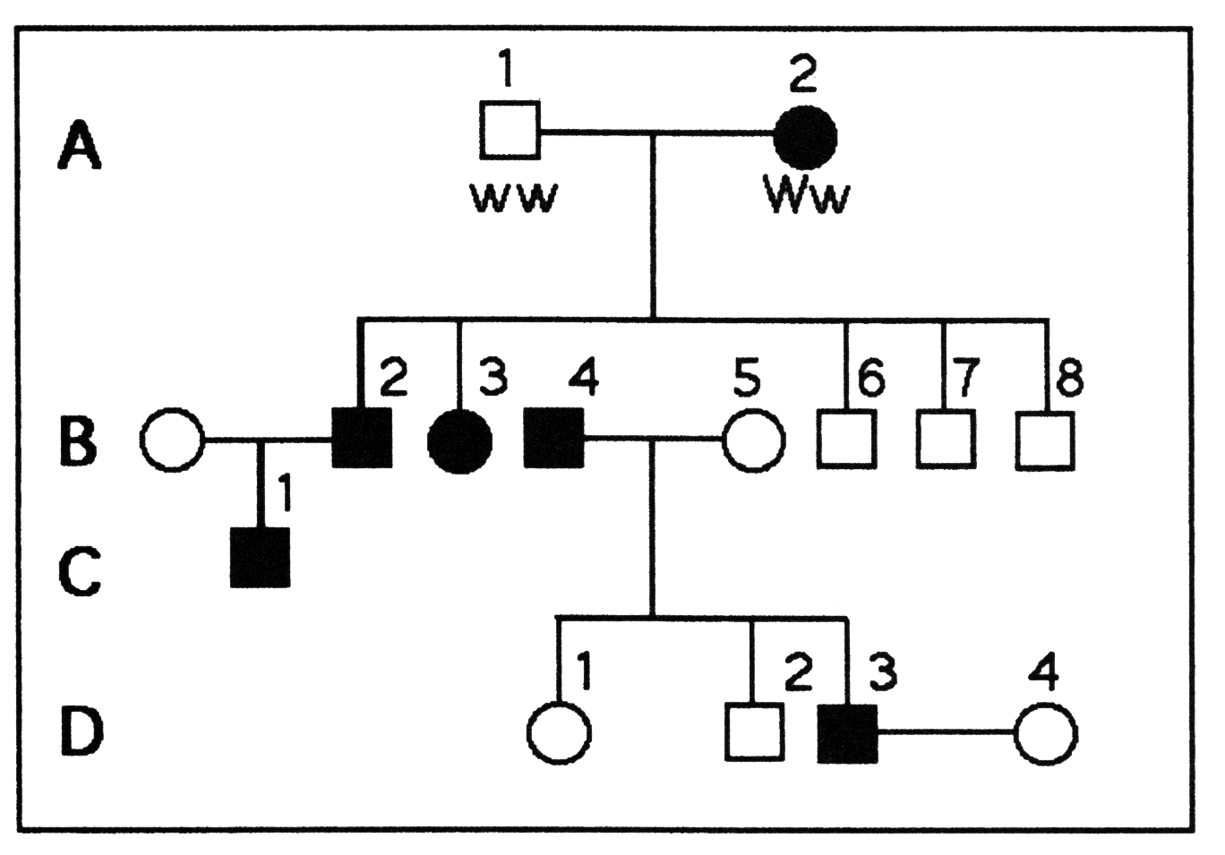
I. What is the probability that individual C-1
is Ww?
  3/4
  1/4
  2/4
  2/3
  1
Notes:
Answer: e
Source: Barstow - Test Bank for Biology, Seventh Edition, Question #19

