Slide 1
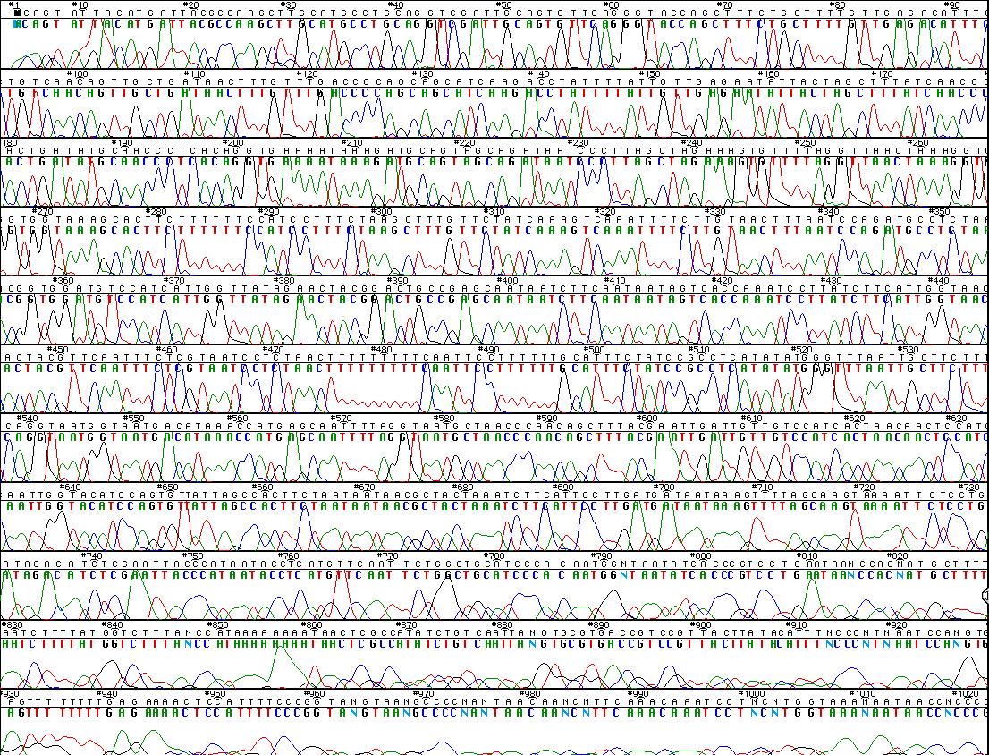
A Lot More Advanced Biotechnology Tools
DNA Sequencing

Slide 2
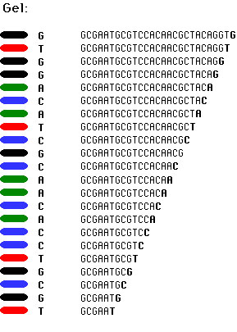
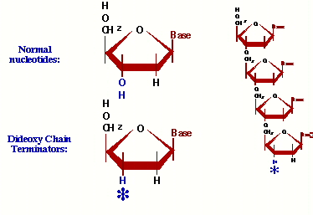
DNA Sequencing
dideoxynucleotides
ddATP, ddGTP, ddTTP, ddCTP
missing O for bonding of next nucleotide
terminates the growing chain

Slide 3
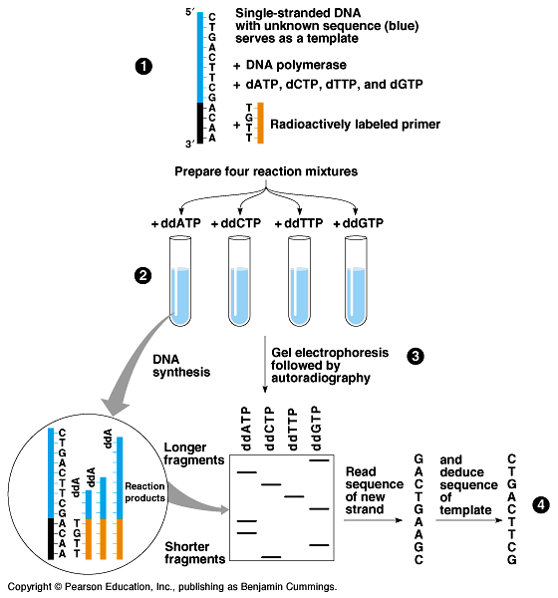
DNA Sequencing
1
Sanger method
synthesize complementary DNA strand in vitro
in each tube:
“normal” N-bases
dideoxy N-bases
ddA, ddC, ddG, ddT
DNA polymerase
primer
buffers & salt
2
3
4
2

Slide 4
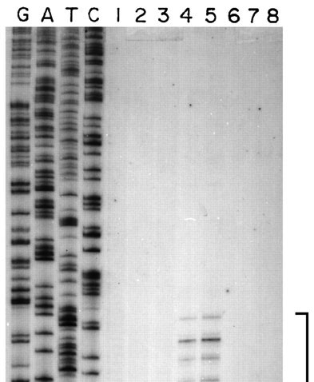
Reading the sequence
Load gel with sequences from ddA, ddT, ddC, ddG in separate lanes
read lanes manually & carefully
polyacrylamide gel

Slide 5
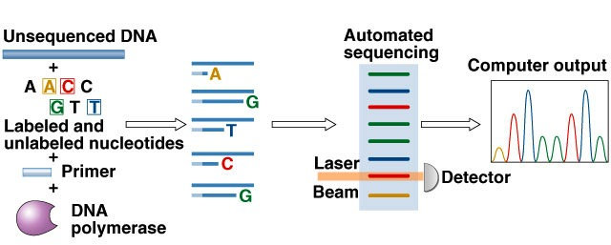
Advancements in sequencing
Fluorescent tagging
no more radioactivity
all 4 bases in 1 lane
each base a different color
Automated reading

Slide 6
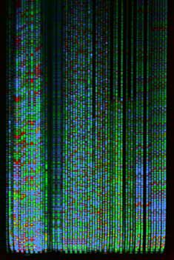
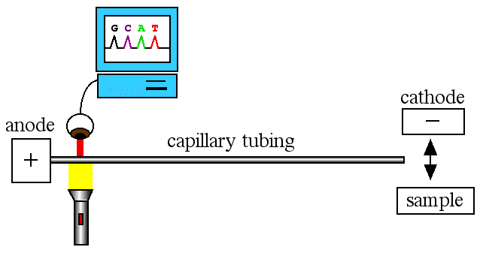
More Advancements in sequencing
Capillary tube electrophoresis
no more pouring gels
higher capacity & faster
Applied Biosystems, Inc (ABI) built an industry on these machines

Slide 7
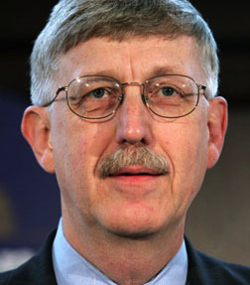
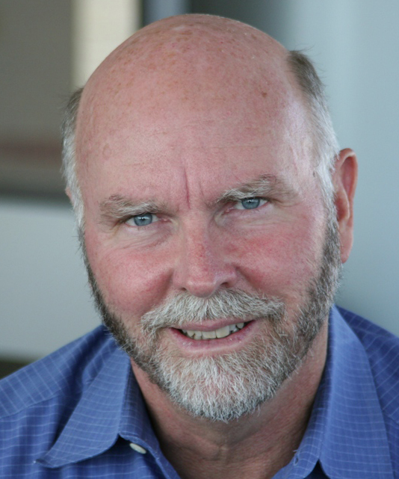
Human Genome Project
U.S government project
begun in 1990
estimated to be a 15 year project
DOE & NIH
initiated by Jim Watson
led by Francis Collins
goal was to sequence entire human genome
3 billion base pairs
Celera Genomics
Craig Venter challenged gov’t
would do it faster, cheaper
private company
Notes:
1990-1995
build the technology groundwork
improve sequencing methods
build clones
build better data management systems (computer tools to find overlaps)
better, cheaper, faster!
1996-1998
painstaking sequencing work
1998
Celera genomics challenge
2000
rough draft of human genome (90% sequence, 99% accurate)
2001
1st draft of human genome
2003
“finished” sequence of human genome
can’t sequence telomeres & centromeres

Slide 8
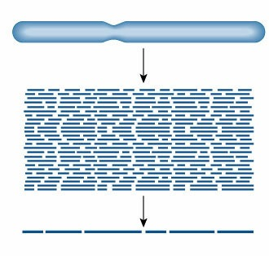
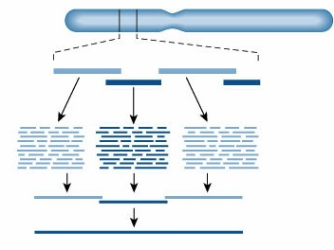
Different approaches
gov’t method
Craig Venter’s method
“map-based method”
“shotgun method”
Cut DNA segment into fragments, arrange based on overlapping nucleotide sequences, and clone fragments.
2. Cut and clone into smaller fragments.
1. Cut DNA entire chromosome into small fragments and clone.
2. Sequence each segment & arrange based on overlapping nucleotide sequences.
3. Assemble DNA sequence
using overlapping sequences.

