Slide 1
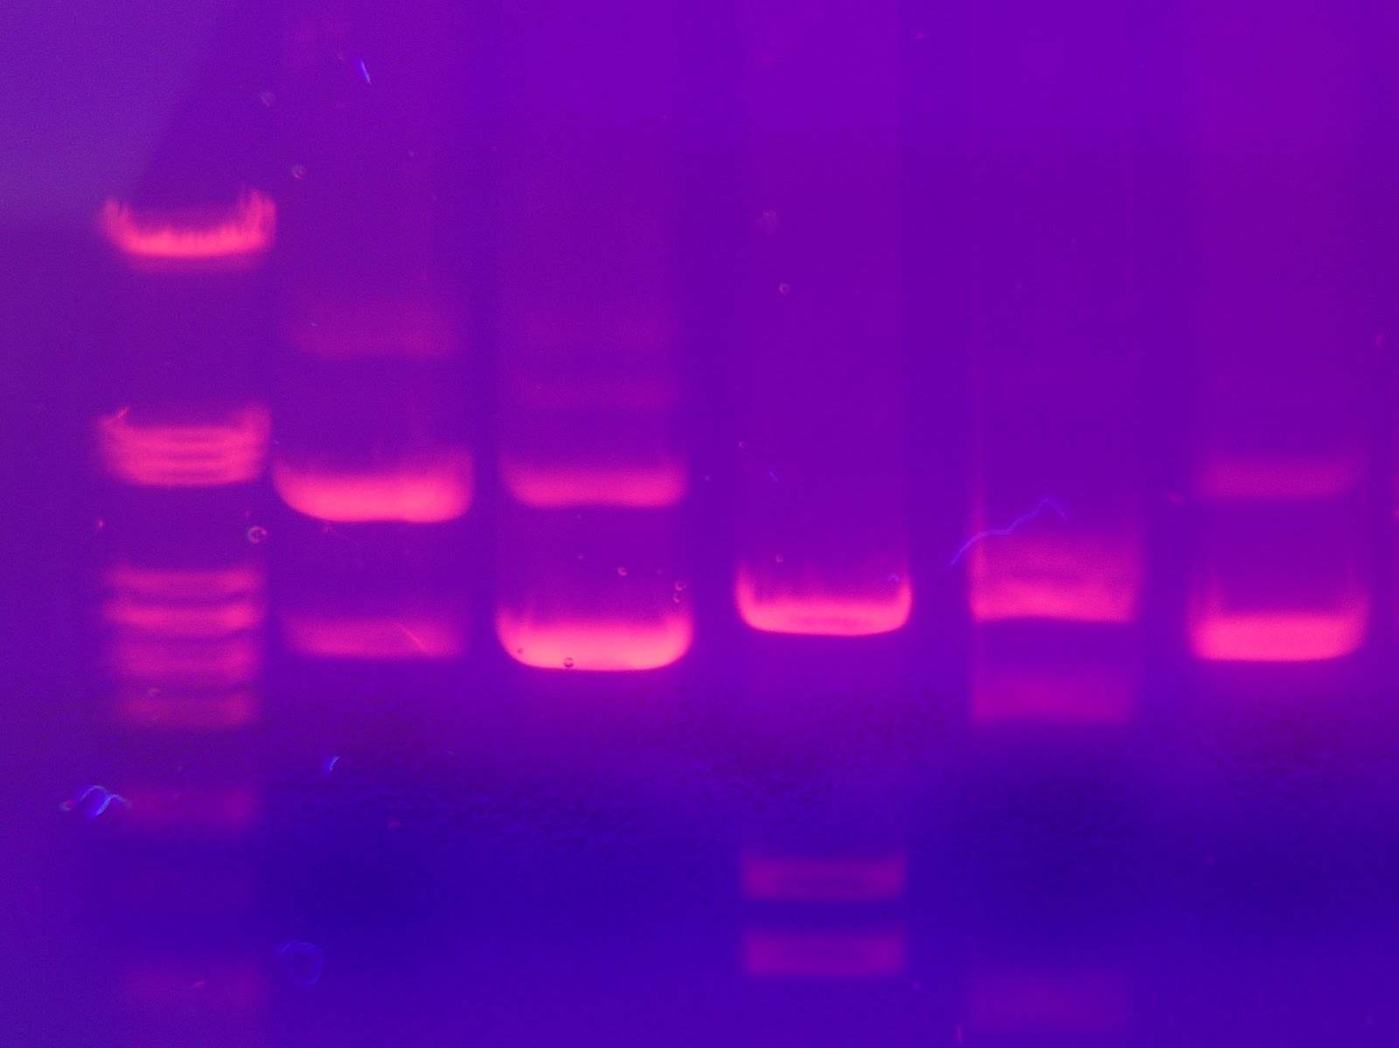
More Basic Biotechnology Tools
Sorting & Copying DNA

Slide 2
Many uses of restriction enzymes…
Now that we can cut DNA with restriction enzymes…
  we can cut up DNA from different people… or different organisms…
  and compare it
  why?
    forensics
    medical diagnostics
    paternity
    evolutionary relationships
    and more…

Slide 3
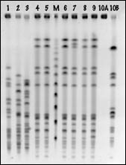
Comparing cut up DNA
How do we compare DNA fragments?
  separate fragments by size
How do we separate DNA fragments?
  run it through a gel
    agarose
    made from algae
  gel electrophoresis
DNA jello??
Can’t we just add those
little marshmallows?

Slide 4
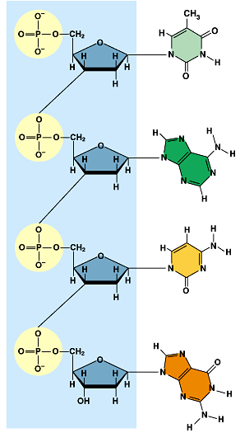
Gel electrophoresis
A method of separating DNA in a gelatin-like material using an electrical field
  DNA is negatively charged
  when it’s in an electrical field it moves toward the positive side
DNA → → → → → → → →
–
+
“swimming through Jello”

Slide 5
Gel electrophoresis
DNA moves in an electrical field…
    size of DNA fragment affects how far it travels
      small pieces travel farther
      large pieces travel slower & lag behind
      The Mac Truck vs. The Motorcycle
DNA → → → → → → →
–
+
“swimming through Jello”

Slide 6
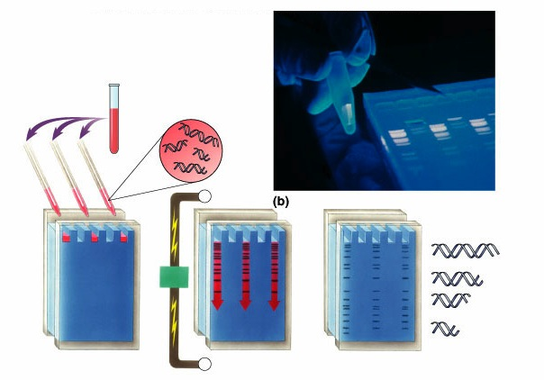
Gel Electrophoresis
DNA &
restriction enzyme
-
wells
longer fragments
power
source
gel
shorter fragments
+
completed gel

Slide 7
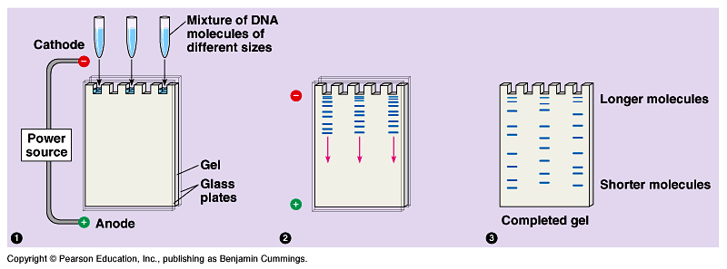
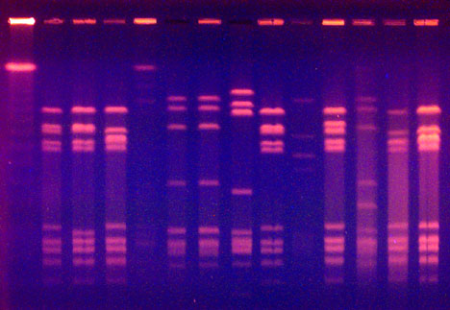
Running a gel
fragments of DNA
separate out based
on size
cut DNA with restriction enzymes
1
2
3
Stain DNA
  ethidium bromide binds to DNA
  fluoresces under UV light

Slide 8
Uses: Evolutionary relationships
Comparing DNA samples from different organisms to measure evolutionary relationships
turtle
snake
rat
squirrel
fruitfly
–
1
2
3
4
5
1
2
3
4
5
DNA
↓
+

Slide 9
Uses: Medical diagnostic
Comparing normal allele to disease allele
chromosome
with normal
allele 1
chromosome with
disease-causing
allele 2
allele 1
allele 2
–
DNA
↓
Example: test for Huntington’s disease
+

Slide 10
Uses: Forensics
Comparing DNA sample from crime scene with suspects & victim
suspects
crime
scene
sample
S1
S2
S3
V
–
DNA
↓
+

Slide 11
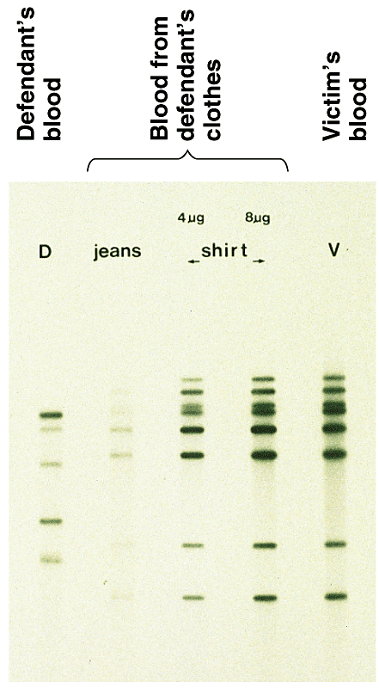
DNA fingerprints
Comparing blood samples on defendant’s clothing to determine if it belongs to victim
  DNA fingerprinting
  comparing DNA banding pattern between different individuals
  unique patterns

Slide 12
Differences at the DNA level
Why is each person’s DNA pattern different?
  sections of “junk” DNA
    doesn’t code for proteins
    made up of repeated patterns
      CAT, GCC, and others
      each person may have different number of repeats
    many sites on our 23 chromosomes with
    different repeat patterns
GCTTGTAACGGCCTCATCATCATTCGCCGGCCTACGCTT
CGAACATTGCCGGAGTAGTAGTAAGCGGCCGGATGCGAA
GCTTGTAACGGCATCATCATCATCATCATCCGGCCTACGCTT
CGAACATTGCCGTAGTAGTAGTAGTAGTAGGCCGGATGCGAA

Slide 13
DNA patterns for DNA fingerprints
Allele 1
cut sites
repeats
cut sites
GCTTGTAACGGCCTCATCATCATTCGCCGGCCTACGCTT
CGAACATTGCCGGAGTAGTAGTAAGCGGCCGGATGCGAA
Cut the DNA
GCTTGTAACG GCCTCATCATCATCGCCG GCCTACGCTT
CGAACATTGCCG GAGTAGTAGTAGCGGCCG GATGCGAA
1
2
3
–
DNA →
+
allele 1

Slide 14
Differences between people
Allele 1
cut sites
cut sites
GCTTGTAACGGCCTCATCATCATTCGCCGGCCTACGCTT
CGAACATTGCCGGAGTAGTAGTAAGCGGCCGGATGCGAA
Allele 2: more repeats
GCTTGTAACGGCCTCATCATCATCATCATCATCCGGCCTACGCTT
CGAACATTGCCGGAGTAGTAGTAGTAGTAGTAGGCCGGATGCGAA
1
2
3
DNA fingerprint
–
DNA →
+
allele 1
allele 2

Slide 15
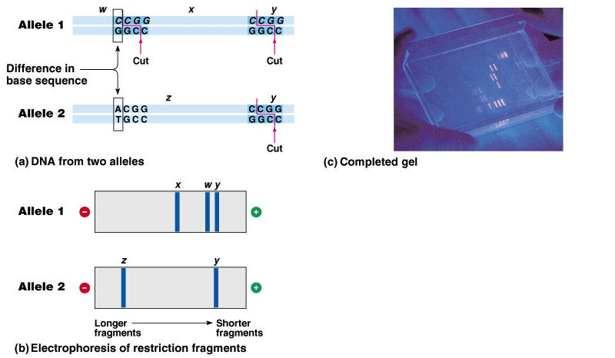
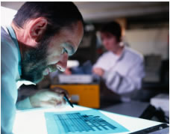
RFLPs
Restriction Fragment Length Polymorphism
  differences in DNA between individuals
Alec Jeffries 1984
  change in DNA sequence affects restriction enzyme “cut” site
  creates different fragment sizes & different band pattern

Slide 16
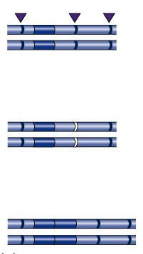
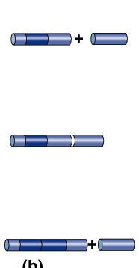
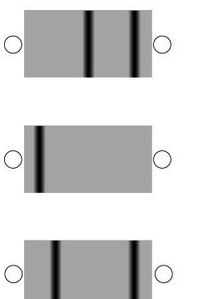
Polymorphisms in populations
Differences between individuals at
the DNA level
  many differences accumulate in “junk” DNA
restriction enzyme
cutting sites
2 bands
-
+
single base-pair
change
1 band
-
+
sequence
duplication
2 different bands
-
+

Slide 17
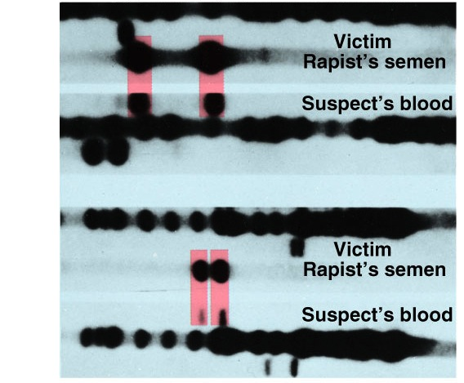
RFLP / electrophoresis use in forensics
1st case successfully using DNA evidence
  1987 rape case convicting Tommie Lee Andrews
“standard”
semen sample from rapist
blood sample from suspect
“standard”
How can you
compare DNA from
blood & from semen?
RBC?
“standard”
semen sample from rapist
blood sample from suspect
“standard”

Slide 18
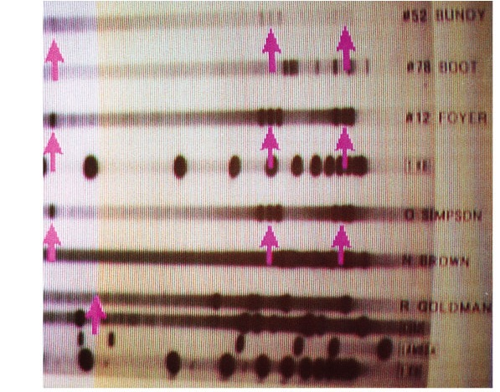
Electrophoresis use in forensics
Evidence from murder trial
  Do you think suspect is guilty?
blood sample 1 from crime scene
blood sample 2 from crime scene
blood sample 3 from crime scene
“standard”
blood sample from suspect
OJ Simpson
blood sample from victim 1
N Brown
blood sample from victim 2
R Goldman
“standard”

Slide 19
Uses: Paternity
Who’s the father?
–
Mom
F1
F2
child
DNA
↓
+

Slide 20
Making lots of copies of DNA
But it would be so much easier if we didn’t have to use bacteria every time…

Slide 21
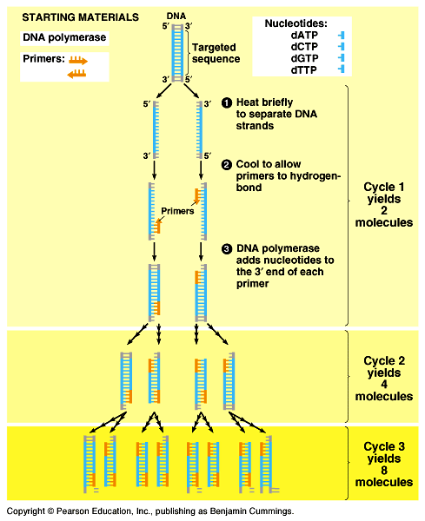
Copy DNA without plasmids? PCR!
Polymerase Chain Reaction
  method for making many, many copies of a specific segment of DNA
  only need 1 cell of DNA to start
No more bacteria,
No more plasmids,
No more E. coli
smelly looks!

Slide 22
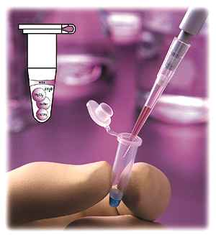
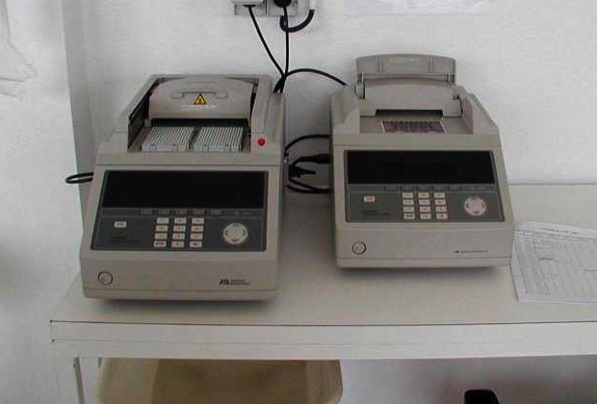
PCR process
It’s copying DNA in a test tube!
What do you need?
  template strand
  DNA polymerase enzyme
  nucleotides
    ATP, GTP, CTP, TTP
  primer
Thermocycler

Slide 23
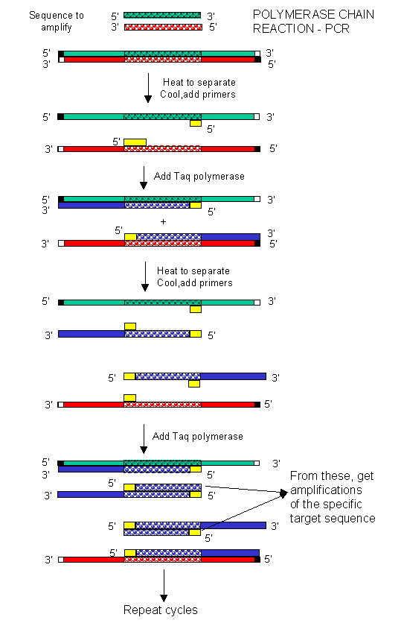

PCR primers
The primers are critical!
  need to know a bit of sequence to make proper primers
  primers can bracket target sequence
    start with long piece of DNA & copy a specified shorter segment
    primers define section of DNA to be cloned
20-30 cycles
3 steps/cycle
30 sec/step
Notes:
PCR is an incredibly versatile technique:
An important use of PCR now is to “pull out” a piece of DNA sequence, like a gene, from a larger collection of DNA, like the whole cellular genome. You don’t have to go through the process of restriction digest anymore to cut the gene out of the cellular DNA. You can just define the gene with “flanking” primers and get a lot of copies in 40 minutes through PCR.
Note: You can also add in a restriction site to the copies of the gene (if one doesn’t exist) by adding them at the end of the original primers.

Slide 24
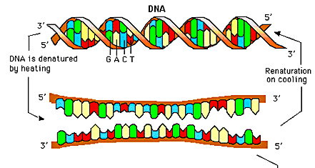
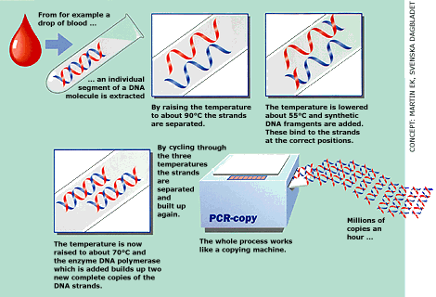
PCR process
What do you need to do?
  in tube: DNA, DNA polymerase enzyme, primer, nucleotides
  denature DNA: heat (90°C) DNA to separate strands
  anneal DNA: cool to hybridize with primers & build DNA (extension)
What does 90°C
do to our
DNA polymerase?
play DNAi movie

Slide 25
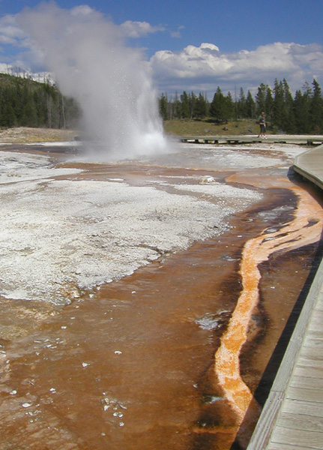
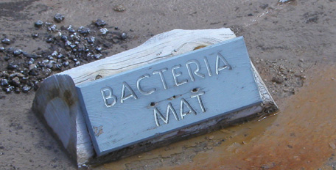
The polymerase problem
PCR
20-30 cycles
3 steps/cycle
30 sec/step
Heat DNA to denature (unwind) it
  90°C destroys DNA polymerase
  have to add new enzyme every cycle
    almost impractical!
Need enzyme that can
withstand 90°C…
  Taq polymerase
    from hot springs bacteria
      Thermus aquaticus
Notes:
Taq = Thermus aquaticus (an Archaebactera)
Highly thermostable – withstands temperatures up to 95°C for more than 40min.
BTW, Taq is patented by Roche and is very expensive. Its usually the largest consumable expense in a genomics lab. I’ve heard stories of blackmarket Taq clones, so scientists could grow up their own bacteria to produce Taq in the lab. It’s like pirated software -- pirated genes!

Slide 26
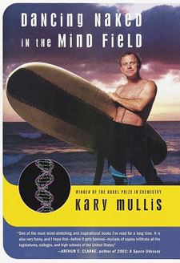

Kary Mullis
1985 | 1993
development of PCR technique
  a copying machine for DNA
I’m wacky!
Notes:
In 1985, Kary Mullis invented a process he called PCR, which solved a core problem in genetics: How to make copies of a strand of DNA you are interested in.
The existing methods were slow, expensive & imprecise. PCR turns the job over to the very biomolecules that nature uses for copying DNA: two "primers" that flag the beginning & end of the DNA stretch to be copied; DNA polymerase that walks along the segment of DNA, reading its code & assembling a copy; and a pile of DNA building blocks that the polymerase needs to make that copy.
As he wrote later in Scientific American:
"Beginning with a single molecule of the genetic material DNA, the PCR can generate 100 billion similar molecules in an afternoon. The reaction is easy to execute. It requires no more than a test tube, a few simple reagents and a source of heat. The DNA sample that one wishes to copy can be pure, or it can be a minute part of an extremely complex mixture of biological materials. The DNA may come from a hospital tissue specimen, from a single human hair, from a drop of dried blood at the scene of a crime, from the tissues of a mummified brain or from a 40,000-year-old wooly mammoth frozen in a glacier."

Slide 27
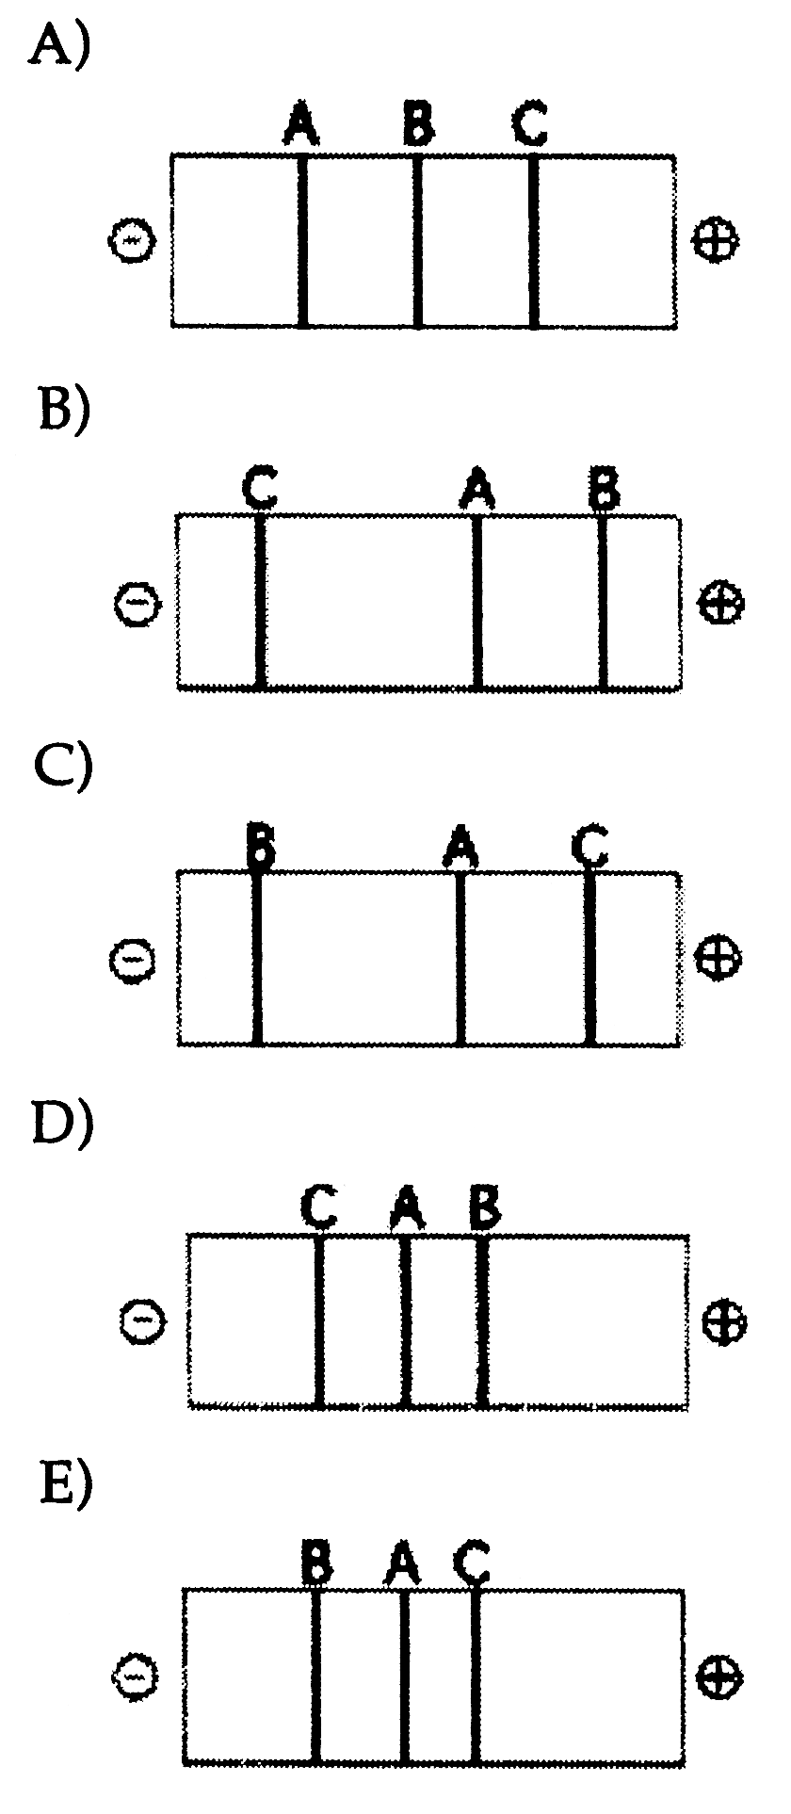
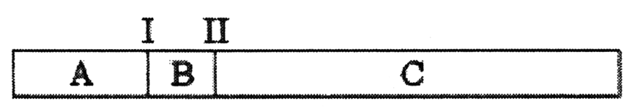
1. The segment of DNA shown in the figure below has restriction sites I and II, which create restriction fragments A, B, and C. Which of the gels produced
by electrophoresis shown below would represent the separation and identity of these fragments?
Notes:
Answer: b
Source: Barstow - Test Bank for Biology, Seventh Edition, Question #49

Slide 28
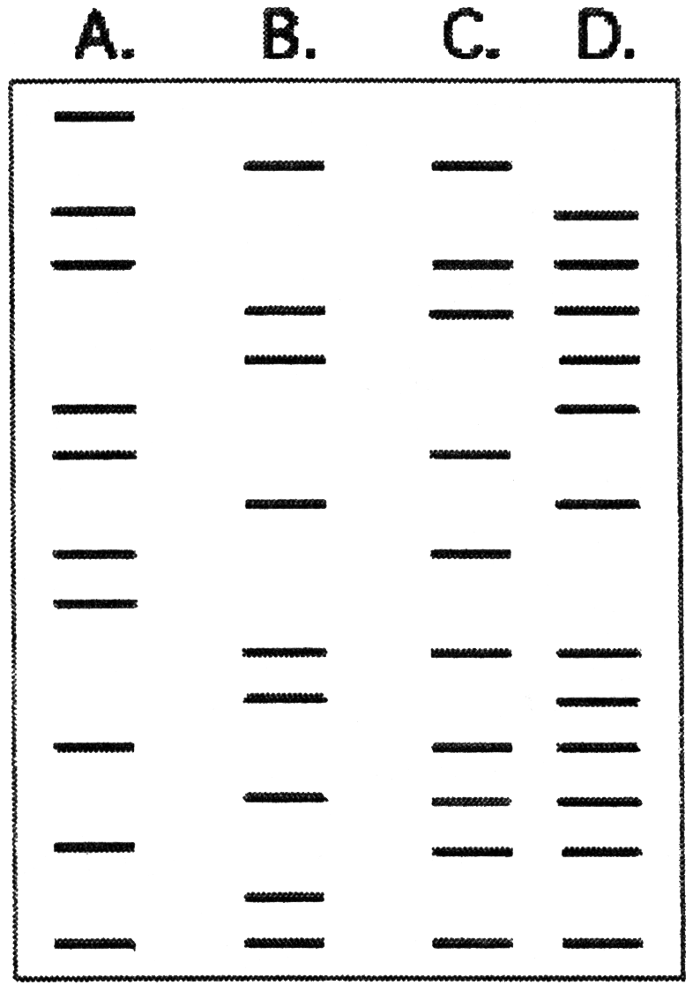
2. Which of the following statements is consistent with the results below? *
  B is the child of
  A and C.
  C is the child of
  A and B.
  D is the child of
  B and C.
  A is the child of
  B and C.
  A is the child of
  C and D.
Notes:
Answer: b
Source: Barstow - Test Bank for Biology, Seventh Edition, Question #39
Discussion Notes for the Instructor
There are several questions which can be asked to guide the discussion of this question, including:
Do offspring have all of the DNA from each parent?
If not, how much DNA did the offspring get from each parent?
Do offspring have any DNA that was not present in either parent?
Using these questions as an outline, discussion of the choices might look like this:
Choice A, B contains DNA not found in either A or C (bands 3, 4, 8 from the top down)
Choice B, correct
Choice C, D contains DNA not found in either B or C (bands 1, 4, 5 from the top down)
Choice D, A contains DNA not found in either B or C (bands 1, 2, 4, 6 from the top down)
Choice E, A contains DNA not found in either C or D (bands 1, 7 from the top down)

Slide 29
What is the order of the steps involved in the Polymerase Chain Reaction?
  I. Priming
  II. Heat
  III.Extension
  I, II, III
  II, I, III
  III, I, II
  II, III, I
  None of the above
Notes:
Answer: b
Source: Barstow - Test Bank for Biology, Seventh Edition, Question #40

