Slide 1
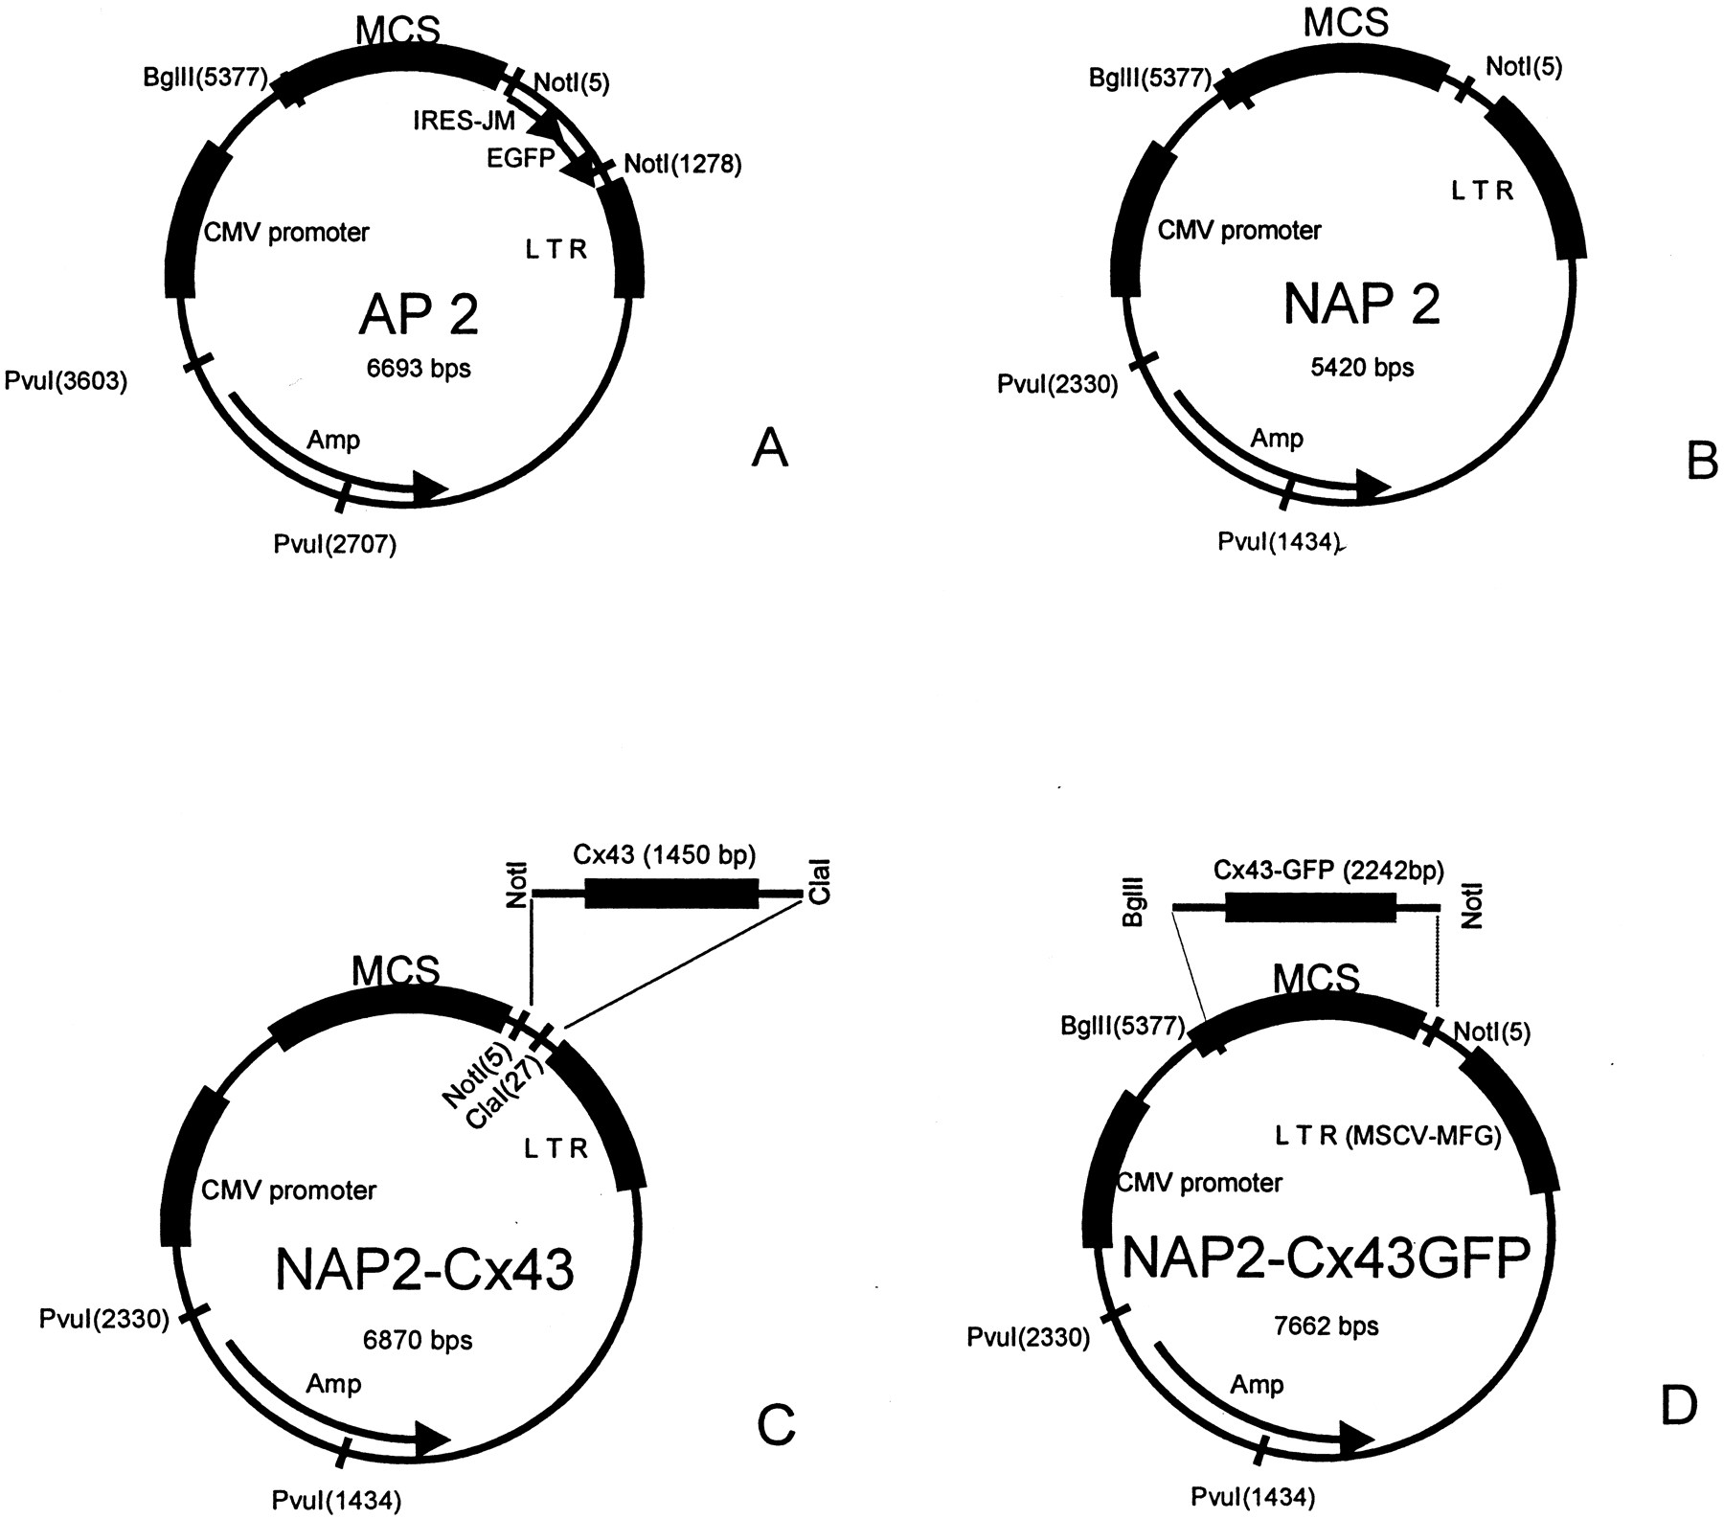
A Little More Advanced Biotechnology Tools
Better Plasmids & Finding Genes

Slide 2
Engineered plasmids
Building custom plasmids
  restriction enzyme sites
  antibiotic resistance genes as a selectable marker
EcoRI
BamHI
HindIII
restriction sites
Selectable marker
antibiotic resistance gene on plasmid
  ampicillin resistance
selecting for successful transformation
  successful uptake of recombinant plasmid
plasmid
ori
amp
resistance
Notes:
How do we know what’s the right combination of genes on a plasmid?
Trail and error research work.
selectable markers
high copy rate
convenient restriction sites
There are companies that still develop plasmids, patent them & sell them.
Biotech companies (ex. New England BioLabs)

Slide 3
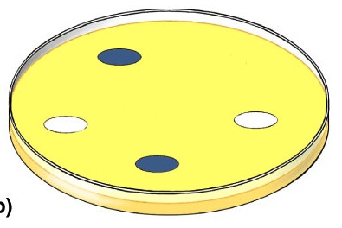
Selection for plasmid uptake
Antibiotic becomes a selecting agent
  only bacteria with the plasmid will grow on antibiotic (ampicillin) plate
only transformed
bacteria grow
all bacteria grow
a
a
a
a
a
a
a
a
a
a
a
a
a
a
a
a
a
LB plate
LB/amp plate
cloning

Slide 4
Need to screen plasmids
Need to make sure bacteria have recombinant plasmid
restriction sites
inserted
gene
of interest
EcoRI
all in LacZ gene
BamHI
HindIII
LacZ gene
broken
LacZ gene
lactose → blue color
X
lactose → white color
plasmid
recombinant
plasmid
amp
resistance
amp
resistance
origin of
replication

Slide 5
Screening for recombinant plasmid
Bacteria take up plasmid
Functional LacZ gene
Bacteria make blue color
Bacteria take up recombinant plasmid
Non-functional LacZ gene
Bacteria stay white color
Which colonies
do we want?

Slide 6
Finding your gene of interest
DNA hybridization
  find sequence of DNA using a labeled probe
    short, single stranded DNA molecule
    complementary to part of gene of interest
    labeled with radioactive P³² or fluorescent dye
  heat treat DNA in gel
    unwinds (denatures) strands
  wash gel with probe
    probe hybridizes with denatured DNA
labeled probe
genomic DNA
G
A
T
C
A
G
T
A
G
C
T
A
G
T
C
A
T
C

Slide 7
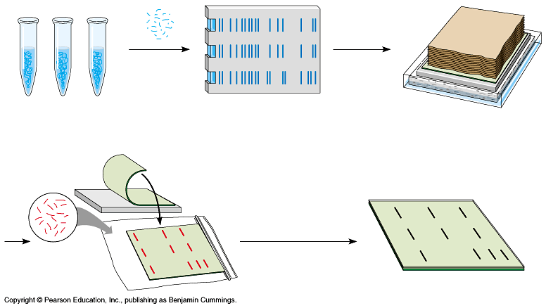
Southern blotting
restriction digest
gel electrophoresis
blot DNA off of gel
onto filter paper
expose filter paper to
X-ray film
wash filter with labeled probe

Slide 8
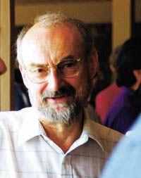
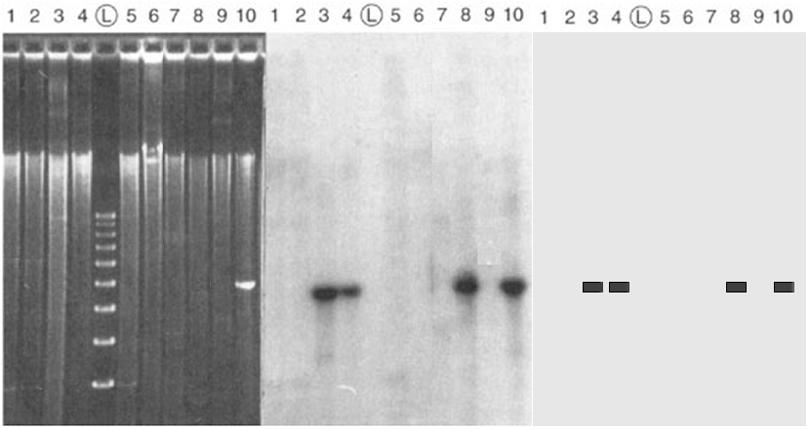
Southern blotting
Edwin Southern
gel of genomic DNA
Southern blot
IDing one gene
Southern blot
illustration
Notes:
Northern blot: RNA on filter & DNA probe
measures gene expression because grabbing mRNA from cell -- only expressed genes
Western blot: protein on filter labeled directly

Slide 9
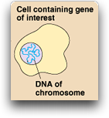

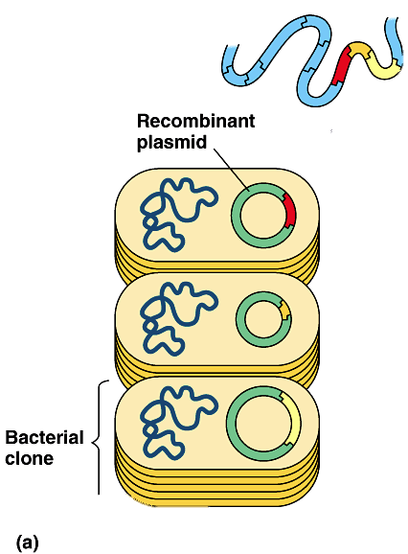
DNA libraries
Cut up all of nuclear DNA from many cells of an organism
  restriction enzyme
Clone all fragments into many plasmids at same time
  “shotgun” cloning
Create a stored collection of DNA fragments
  petri dish has a collection
  of all DNA fragments from the organism

Slide 10
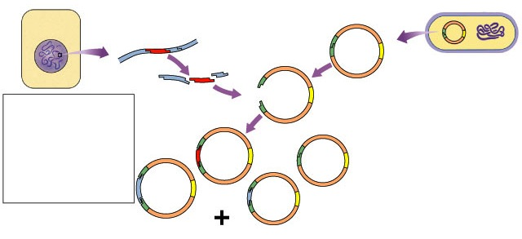


Making a DNA library
1
2
all DNA from many cells of an organism is cut with restriction enzymes
engineered plasmid with selectable marker & screening system
gene of interest
3
all DNA fragments inserted into many plasmids
4
clone plasmids into bacteria
Notes:
human genome = 3 billion bases
fragments are cut to ~5000 bases
therefore ~ 600,000 fragments per cell.
But you have to use many cells to make sure you have a complete set in the library, so… you may have millions of cells that you extracted the DNA from, so… you would need millions of colonies, so the human genome cloned into bacteria would be a walk-in freezer full of petri dishes.

Slide 11
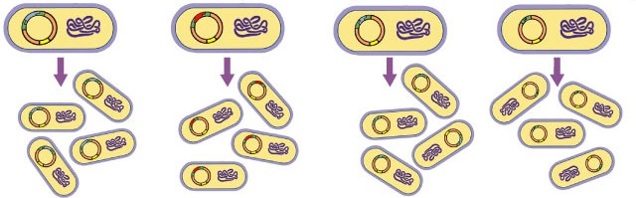
DNA library
But how
do we find
colony with our
gene of interest
in it?
recombinant plasmids inserted into bacteria
gene of interest
?
DNA Library
plate of bacterial colonies storing & copying all genes from an organism (ex. human)
Notes:
human genome = 3 billion bases
fragments are cut to ~5000 bases
therefore ~ 600,000 fragments per cell.
But you have to use many cells to make sure you have a complete set in the library, so… you may have millions of cells that you extracted the DNA from, so… you would need millions of colonies, so the human genome cloned into bacteria would be a walk-in freezer full of petri dishes.

Slide 12
Find your gene in DNA library
Locate Gene of Interest
  to find your gene you need some of gene’s sequence
    if you know sequence of protein…
      can “guess” part of DNA sequence
      “back translate” protein to DNA
    if you have sequence of similar gene from another organism…
      use part of this sequence
?
Which
bacterial colony
has our gene?
Like a needle
in a haystack!
Notes:
Complementation
if you have a mutant that lacks YFG, you can transform bacteria with plasmids from the library until one “cures” (complements) the mutation

Slide 13
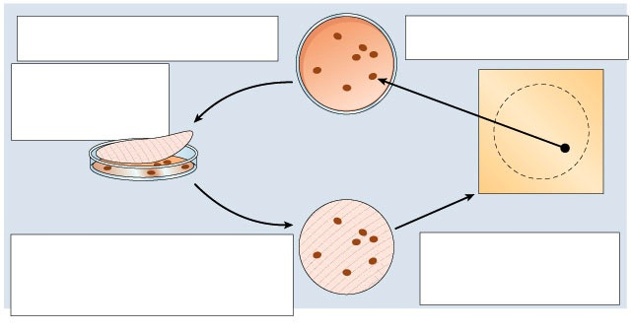
Colony Blots
4
Locate
expose film
locate colony on plate from film
1
Cloning
- plate with bacterial colonies carrying recombinant plasmids
plate
plate + filter
film
2
3
Hybridization
- heat filter paper to denature DNA
- wash filter paper with radioactive probe which will only attach to gene of interest
Replicate plate
press filter paper onto plate to take sample of cells from every colony
filter

Slide 14
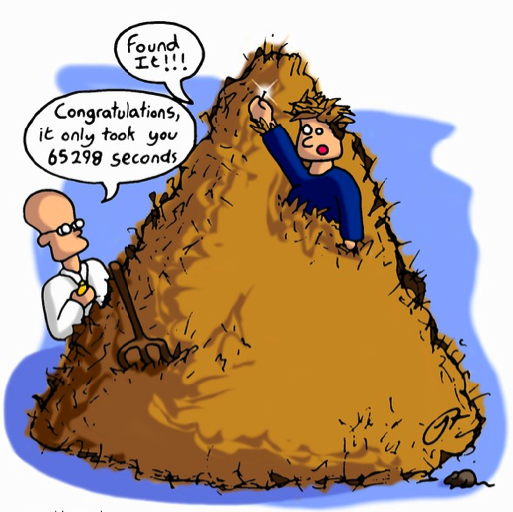
Problems…
Human Genome library
  are there only genes in there?
  nope! a lot of junk!
  human genomic library has more “junk” than genes in it
Clean up the junk!
  if you want to clone
  a human gene into
  bacteria, you can’t
  have…
introns

Slide 15
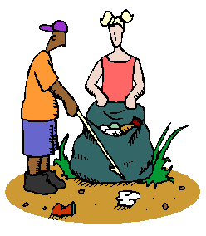


How do you clean up the junk?
Don’t start with DNA…
Use mRNA
  copy of the gene without the junk!
But in the end, you need DNA to clone into plasmid…
How do you go from RNA → DNA?
  reverse transcriptase from RNA viruses
    retroviruses
reverse
transcriptase

Slide 16
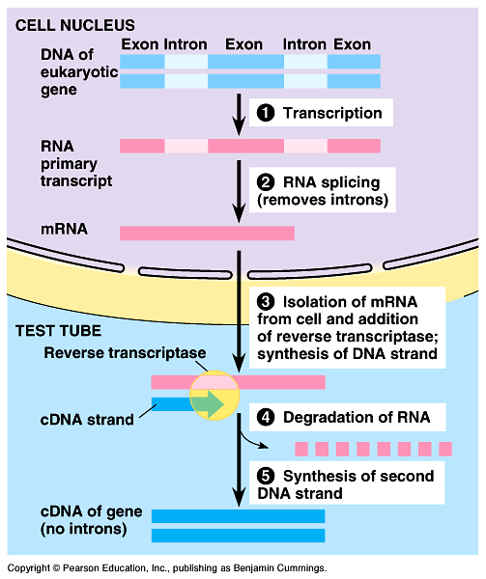
cDNA (copy DNA) libraries
Collection of only the coding sequences of expressed genes
  extract mRNA from cells
  reverse transcriptase
    RNA → DNA
    from retroviruses
  clone into plasmid
Applications
  need edited DNA for expression in bacteria
    human insulin
Notes:
Could you imagine how much that first insulin clone was worth to Genentech? One little piece of DNA in a plasmid worth billions!
It put them on the map & built a multi-billion dollar biotech company.

Slide 17
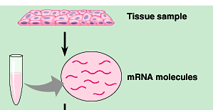
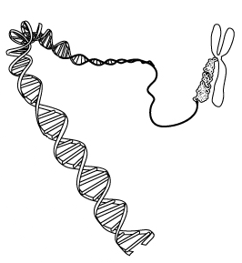
Where do we go next….
DNA
RNA
protein
trait
When a gene is turned on, it creates a trait
  want to know what gene is being expressed
extract mRNA from cells
mRNA = active genes
How do you match mRNA back to DNA in cells???
reverse transcriptase

Slide 18

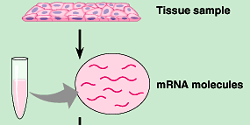

Microarrays
slide with spots of DNA
each spot = 1 gene
Create a slide with a sample of each gene from the organism
  each spot is one gene
Convert mRNA → labeled cDNA
mRNA → cDNA
mRNA from cells
reverse
transcriptase

Slide 19
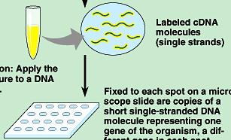
Microarrays
slide with spots of DNA
each spot = 1 gene
Labeled cDNA hybridizes with DNA on slide
  each yellow spot = gene matched to mRNA
  each yellow spot = expressed gene
mRNA → cDNA
cDNA matched to genomic DNA
Notes:
Developed by Pat Brown at Stanford in late 1980s
Realized quickly he needed an automated system: robot spotter
Designed spotter & put plans on Internet for benefit of scientific community.

Slide 20
Application of Microarrays “DNA Chip”
2-color fluorescent tagging
Comparing treatments or conditions =
Measuring change in gene expression
  sick vs. healthy; cancer vs. normal cells
  before vs. after treatment with drug
  different stages in development
Color coding: label each condition with different color
  red = gene expression in one sample
  green = gene expression in other sample
  yellow = gene expression in both samples
  black = no or low expression in both
Notes:
It’s all about comparisons!
Powerful research tool.

Slide 21
0
1. The principal problem with inserting an unmodified mammalian gene into the bacterial chromosome, and then getting that gene expressed, is that
  prokaryotes use a different genetic code from that of eukaryotes.
  bacteria translate polycistronic messages only.
  bacteria cannot remove eukaryotic introns.
  bacterial RNA polymerase cannot make RNA complementary to mammalian DNA.
  bacterial DNA is not found in a membrane-enclosed nucleus and is therefore incompatible with mammalian DNA.
Notes:
Answer: c
Source: Barstow - Test Bank for Biology, Seventh Edition, Question #26

Slide 22
What is the purpose of a screening gene in a plasmid?
  To enable tranformation.
  To enable recovery of the plasmid from solution.
  To enable identification of successful transformants.
  To disable the spread of GE organisms outside of the laboratory
  To make the engineered protein product.
Notes:
c

