Slide 1
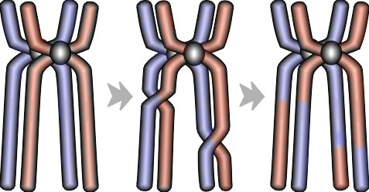
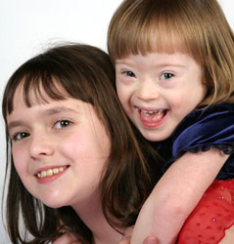
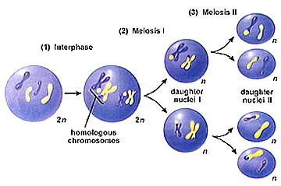
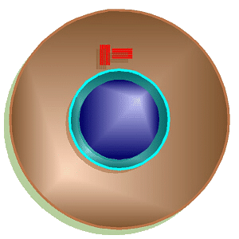
Errors of Meiosis
Chromosomal Abnormalities
(Ch. 15)

Slide 2
Chromosomal abnormalities
Incorrect number of chromosomes
nondisjunction
chromosomes don’t separate properly during meiosis
breakage of chromosomes
deletion
duplication
inversion
translocation

Slide 3
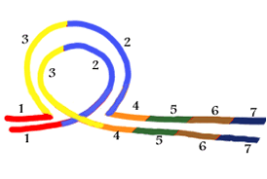
Changes in chromosome structure
deletion
loss of a chromosomal segment
duplication
repeat a segment
inversion
reverses a segment
translocation
move segment from one chromosome to another
error of replication
error of crossing over

Slide 4
Nondisjunction
Problems with meiotic spindle cause errors in daughter cells
homologous chromosomes do not separate properly during Meiosis 1
sister chromatids fail to separate during Meiosis 2
too many or too few chromosomes
2n
n
n-1
n
n+1

Slide 5
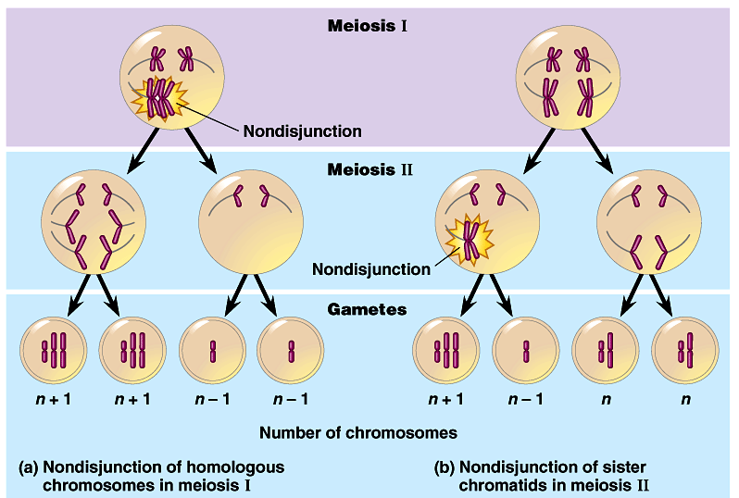
Alteration of chromosome number
error in Meiosis 1
error in Meiosis 2
all with incorrect number
1/2 with incorrect number

Slide 6
Nondisjunction
Offspring has wrong chromosome number
trisomy
cells have 3 copies of a chromosome
monosomy
cells have only 1 copy of a chromosome
n+1
n
n-1
n
trisomy
2n+1
monosomy
2n-1

Slide 7
Human chromosome disorders
High frequency in humans
most embryos are spontaneously aborted
alterations are too disastrous
developmental problems result from biochemical imbalance
imbalance in regulatory molecules?
hormones?
transcription factors?
Certain conditions are tolerated
upset the balance less = survivable
but characteristic set of symptoms = syndrome

Slide 8
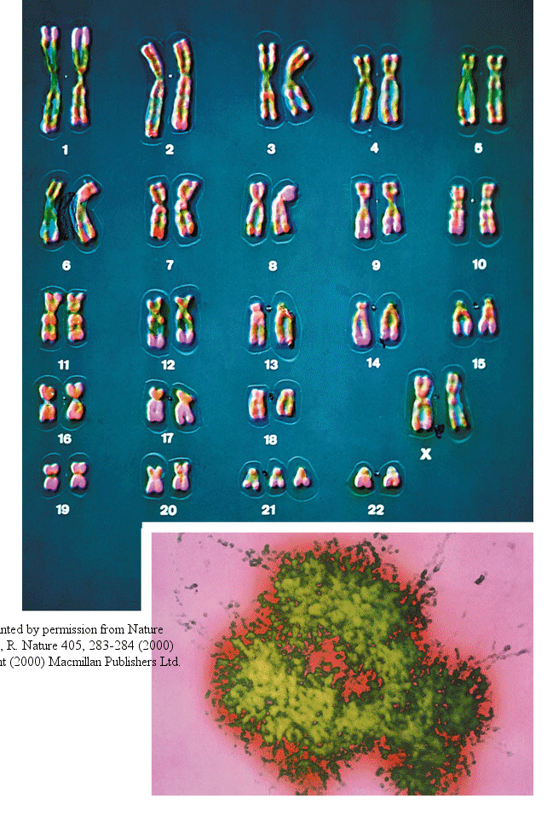
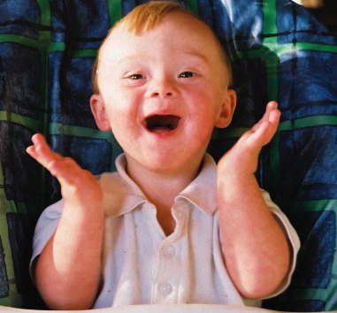
Down syndrome
Trisomy 21
3 copies of chromosome 21
1 in 700 children born in U.S.
Chromosome 21 is the smallest human chromosome
but still severe effects
Frequency of Down syndrome correlates with the age of the mother
Notes:
Trisomy 13 occurs in about 1 out of every 5,000 live births. It is a syndrome with multiple abnormalities, many of which are not compatible with life. More than 80% of children with trisomy 13 die in the first month. Trisomy 13 is associated with multiple abnormalities, including defects of the brain that lead to seizures, apnea, deafness, and eye abnormalities. The eyes are small with defects in the iris (coloboma ). Most infants have a cleft lip and cleft palate, and low-set ears. Congenital heart disease is present in approximately 80% of affected infants. Hernias and genital abnormalities are common.
Trisomy 18 is a relatively common syndrome affecting approximately 1 out of 3,000 live births, and affecting girls more than three times as often as boys. The presence of an extra number 18 chromosome leads to multiple abnormalities. Many of these abnormalities make it hard for infants to live longer than a few months.
The cri du chat syndrome is caused by the deletion of information on chromosome 5. It is likely that multiple genes on chromosome 5 are deleted. One deleted gene, called TERT (telomerase reverse transcriptase) is involved in control of cell growth, and may play a role in how some of the features of cri cu chat develop. The cause of this rare chromosomal deletion is not known, but it is expected that the majority of cases are due to spontaneous loss of a piece of chromosome 5 during development of an egg or sperm. A minority of cases result from one parent carrying a rearrangement of chromosome 5 called a translocation. Between 1 in 20,000 and 1 in 50,000 babies are affected. This disease may account for up to 1% of individuals with severe mental retardation. Infants with cri du chat syndrome commonly have a distinctive cat-like cry. They also have an extensive grouping of abnormalities, with severe mental retardation being the most important.

Slide 9
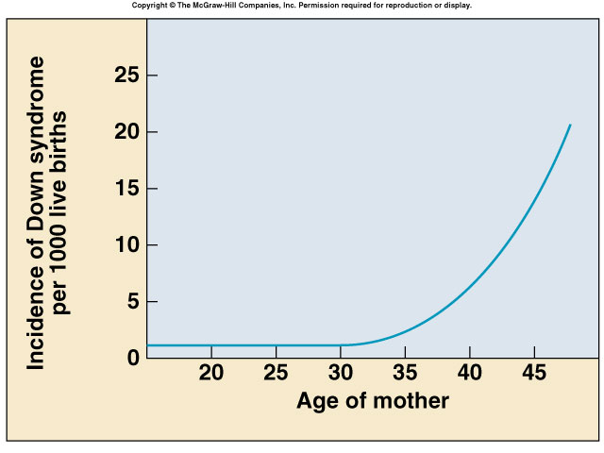
Down syndrome & age of mother
Mother’s age | Incidence of Down Syndrome
Under 30 | <1 in 1000
30 | 1 in 900
35 | 1 in 400
36 | 1 in 300
37 | 1 in 230
38 | 1 in 180
39 | 1 in 135
40 | 1 in 105
42 | 1 in 60
44 | 1 in 35
46 | 1 in 20
48 | 1 in 16
49 | 1 in 12
Rate of miscarriage due to amniocentesis:
1970s data 0.5%, or 1 in 200 pregnancies
2006 data <0.1%, or 1 in 1600 pregnancies

Slide 10
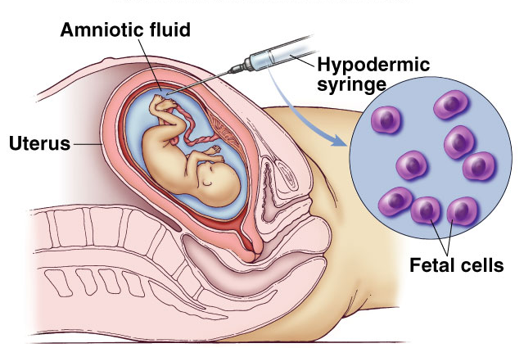
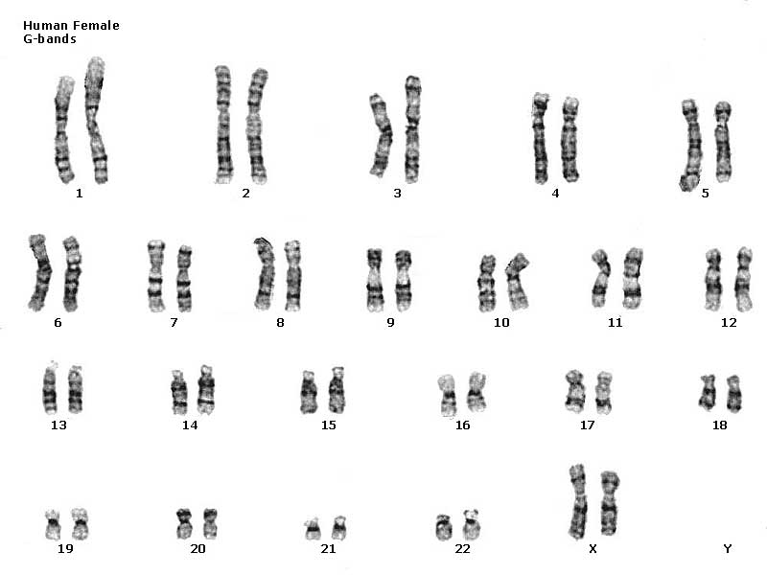
Genetic testing
Amniocentesis (2nd trimester)
sample of embryo cells
stain & photograph chromosomes
Analysis of karyotype

Slide 11
Pre-Sorted:

Slide 12
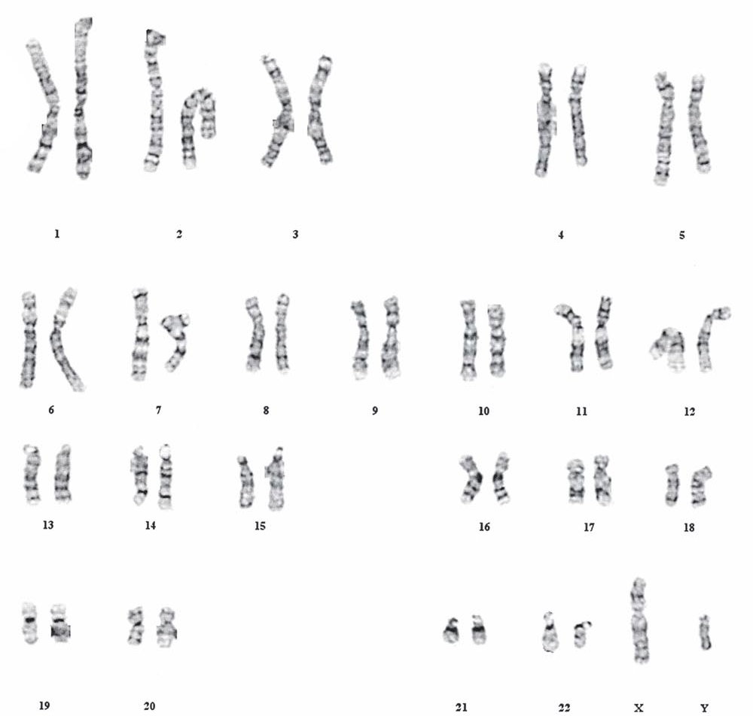
Post-Sorted:
It’s A Boy!

Slide 13
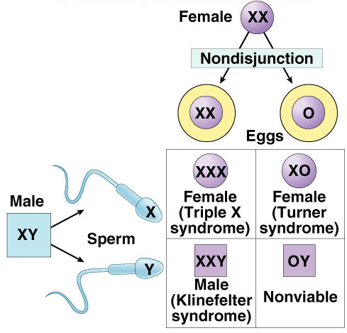
Sex chromosomes abnormalities
Human development more tolerant of wrong numbers in sex chromosome
But produces a variety of distinct syndromes in humans
XXY = Klinefelter’s syndrome male
XXX = Trisomy X female
XYY = Jacob’s syndrome male
XO = Turner syndrome female

Slide 14
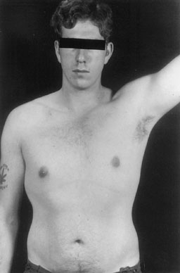
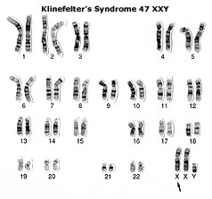
Klinefelter’s syndrome
XXY male
one in every 2000 live births
have male sex organs, but are sterile
feminine characteristics
some breast development
lack of facial hair
tall
normal intelligence

Slide 15
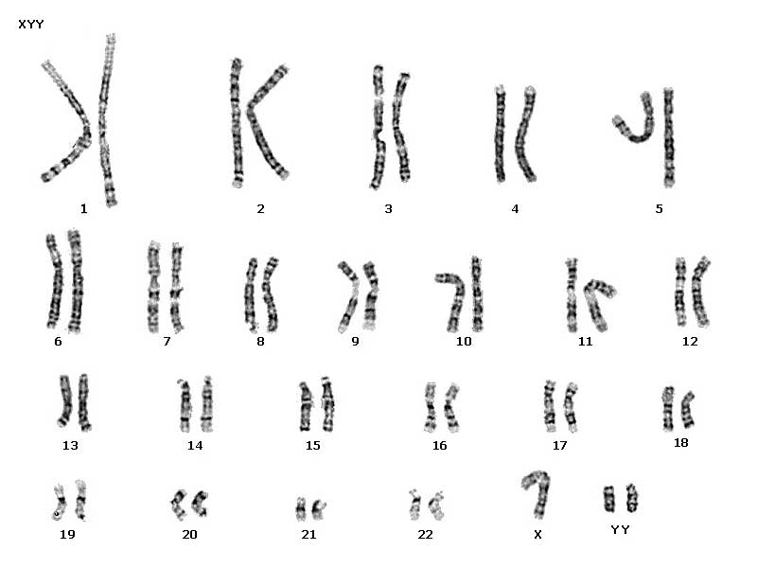
Jacob’s syndrome male
XYY Males
1 in 1000 live male births
extra Y chromosome
slightly taller than average
more active
normal intelligence, slight learning disabilities
delayed emotional maturity
normal sexual development

Slide 16
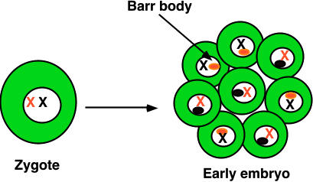
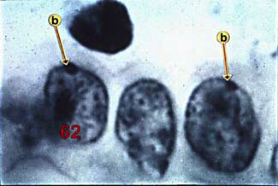
Trisomy X
XXX
1 in every 2000 live births
produces healthy females
Why?
Barr bodies
all but one X chromosome is inactivated
Notes:
How many Barr bodies would you expect?

Slide 17
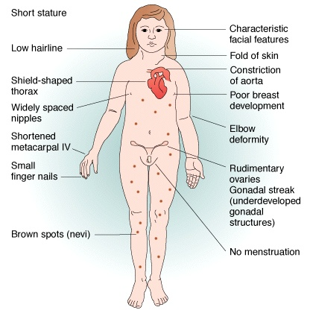
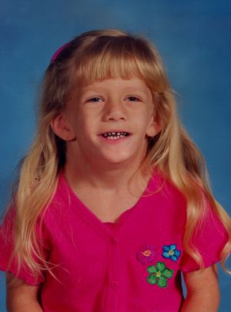
Turner syndrome
Monosomy X or X0
1 in every 5000 births
varied degree of effects
webbed neck
short stature
sterile
Notes:
How many Barr bodies would you expect?

Slide 18
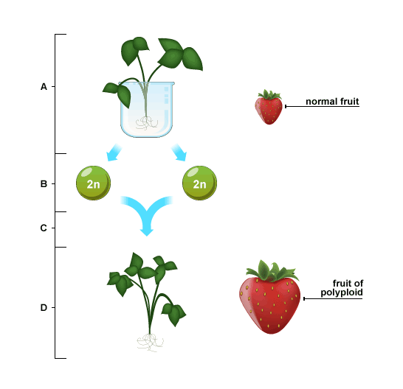
Meanwhile in Plants...
Plants are very tolerant of polyploid mutations. Offspring with extra sets of chromosomes experience gigantism.
Most crops are polyploid.

