Slide 1
Meiosis &
Sexual Reproduction

Slide 2
Cell division / Asexual reproduction
Mitosis
  produce cells with same information
    identical daughter cells
  exact copies
    clones
  same amount of DNA
    same number of chromosomes
    same genetic information
Aaaargh!
I’m seeing
double!

Slide 3
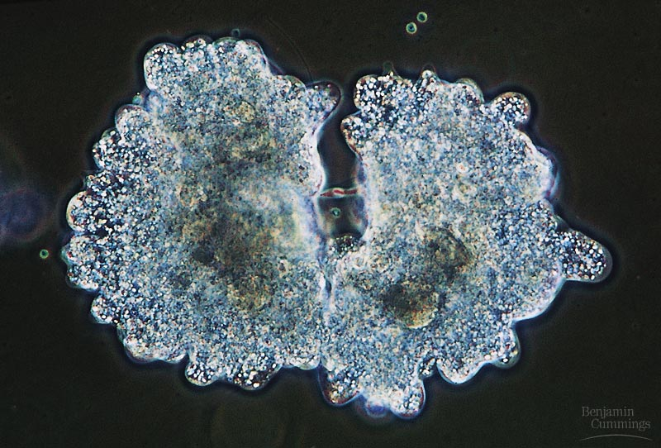
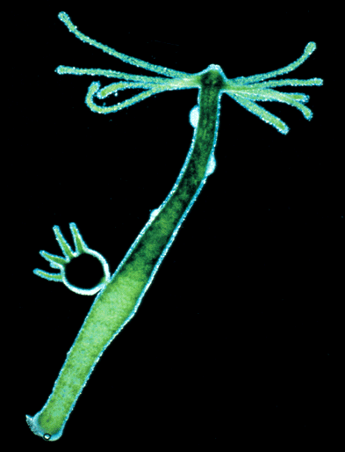
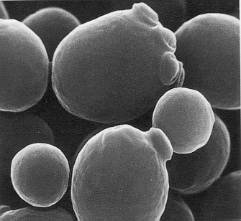
Asexual reproduction
Single-celled eukaryotes
  yeast (fungi)
  Protists
    Paramecium
    Amoeba
Simple multicellular eukaryotes
  Hydra
budding
budding
What are the
disadvantages of
asexual reproduction?
What are the
advantages?

Slide 4
How about the rest of us?
What if a complex multicellular organism (like us) wants to reproduce?
  joining of egg + sperm
Do we make egg & sperm by mitosis?
No!
What if we did, then….
46
+
46
92
egg
sperm
zygote
Doesn’t work!

Slide 5
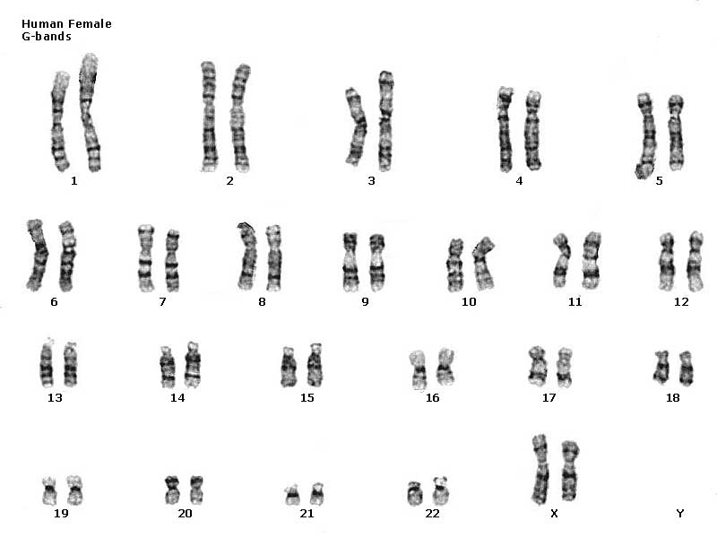
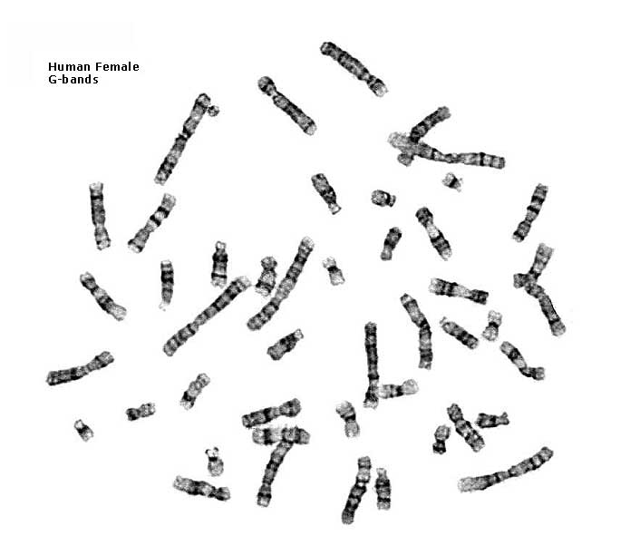
Human female karyotype
46 chromosomes
23 pairs

Slide 6
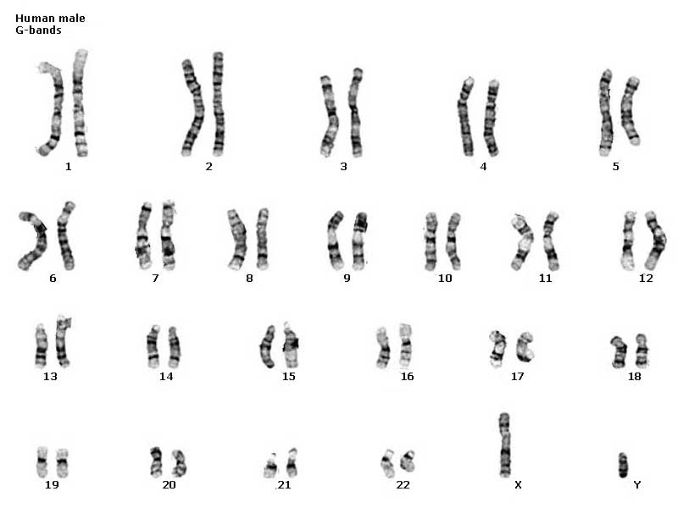
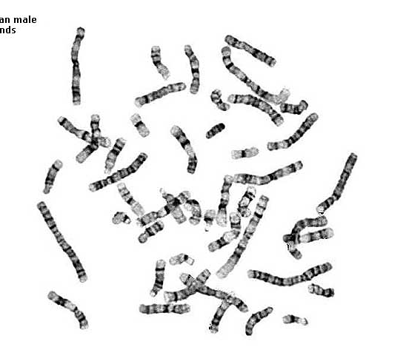
Human male karyotype
46 chromosomes
23 pairs

Slide 7
Homologous chromosomes
Paired chromosomes
  both chromosomes of a pair carry “matching” genes
    control same inherited characters
    homologous = same information
diploid
2n
2n = 4
single stranded
homologous
chromosomes
double stranded
homologous chromosomes

Slide 8
How do we make sperm & eggs?
Must reduce 46 chromosomes → 23
  must reduce the number of chromosomes by half
23
zygote
46
23
egg
46
meiosis
23
46
23
fertilization
sperm
gametes

Slide 9
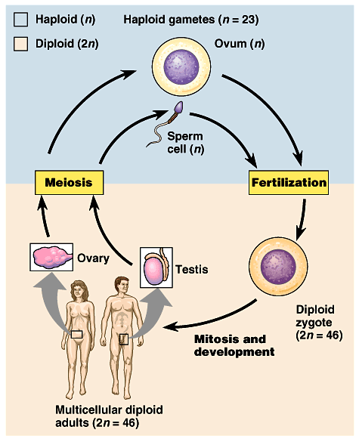
Meiosis: production of gametes
Meiosis
  chromosome number must be reduced
    diploid → haploid
    2n → n
      humans: 46 → 23
    makes gametes
  fertilization restores chromosome number
    haploid → diploid
    n → 2n
haploid
diploid

Slide 10
Sexual reproduction lifecycle
2 copies
diploid
2n
1 copy
haploid
1n
1 copy
haploid
1n
fertilization
meiosis
In the next
generation…
We’re mixing
things up here!
A good thing?
gametes
gametes

Slide 11
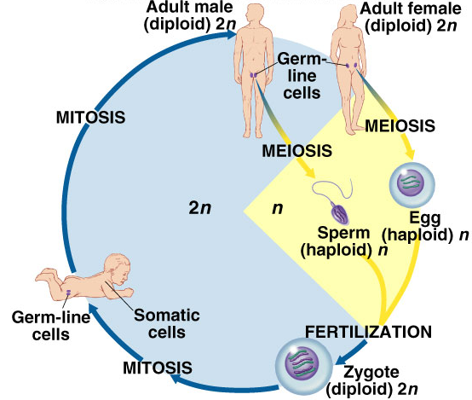
Meiosis
Reduction Division
  special cell division for sexual reproduction
  reduce 2n → 1n
  diploid → haploid
    “two” → “half”
  makes gametes
    sperm, eggs
Warning: meiosis evolved from mitosis, so stages & “machinery” are similar but the processes are radically different. Do not confuse the two!

Slide 12
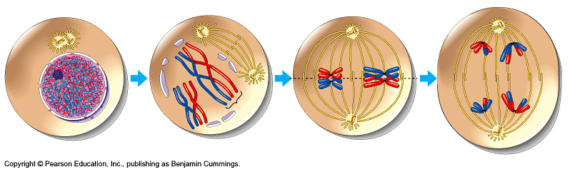
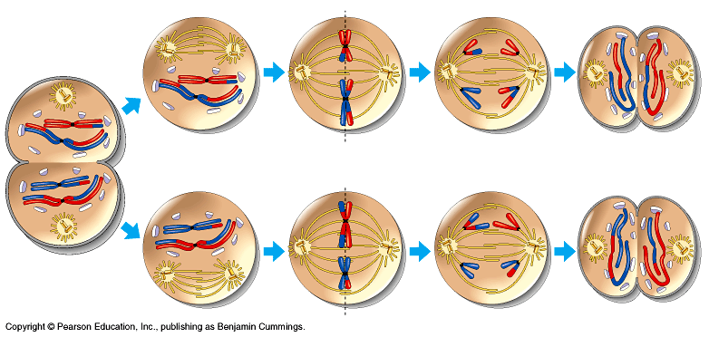
Overview of meiosis
I.P.M.A.T.P.M.A.T
2n = 4
Interphase
prophase 1
metaphase 1
anaphase 1
n = 2
n = 2
prophase 2
metaphase 2
anaphase 2
telophase 2
n = 2
telophase 1

Slide 13
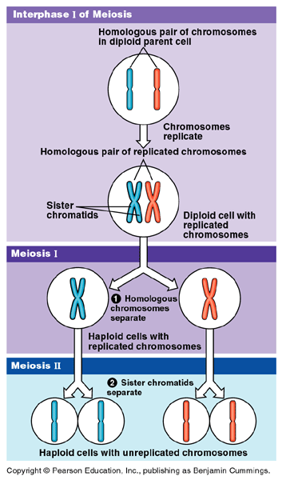
Double division of meiosis
DNA replication
1st division of
meiosis separates homologous pairs
Meiosis 1
Meiosis 2
2nd division of meiosis separates sister chromatids

Slide 14
Preparing for meiosis
1st step of meiosis
  Duplication of DNA
  Why bother?
    meiosis evolved after mitosis
    convenient to use
    “machinery” of mitosis
    DNA replicated in
    S phase of interphase
    of MEIOSIS
    (just like in mitosis)
2n = 6
single
stranded
2n = 6
double
stranded
M1 prophase

Slide 15
Meiosis 1
2n = 4
single
stranded
1st division of meiosis separates homologous pairs
2n = 4
double
stranded
prophase 1
synapsis
2n = 4
double
stranded
metaphase 1
tetrad
reduction
telophase 1
1n = 2
double
stranded

Slide 16
Meiosis 2
2nd division of meiosis separates sister
chromatids
1n = 2
double
stranded
prophase 2
What does
this division
look like?
1n = 2
double
stranded
metaphase 2
1n = 2
single
stranded
4
telophase 2

Slide 17
Steps of meiosis
Meiosis 1
  interphase
  prophase 1
  metaphase 1
  anaphase 1
  telophase 1
Meiosis 2
  prophase 2
  metaphase 2
  anaphase 2
  telophase 2
1st division of
meiosis separates homologous pairs
(2n → 1n)
“reduction division”
2nd division of meiosis separates sister chromatids
(1n → 1n)
* just like mitosis *

Slide 18
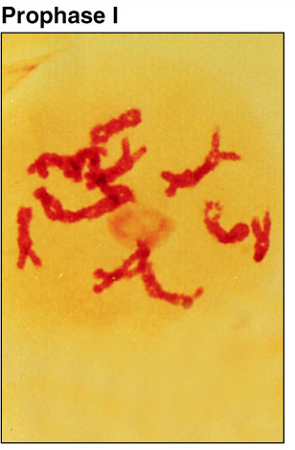
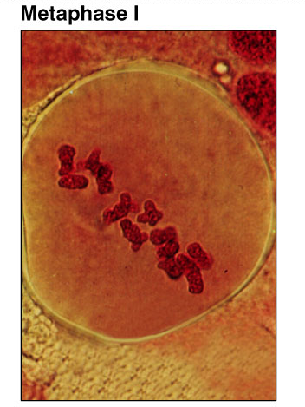
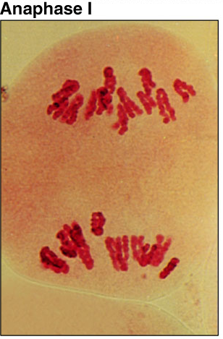
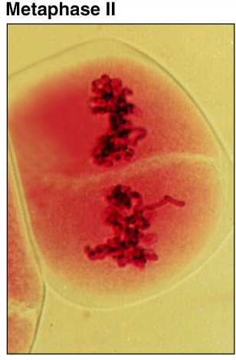
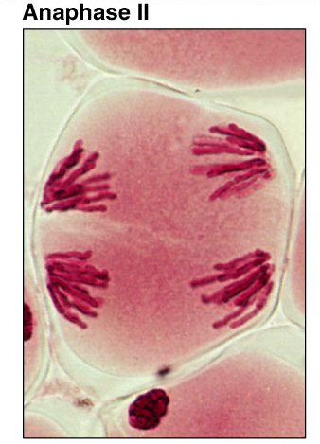
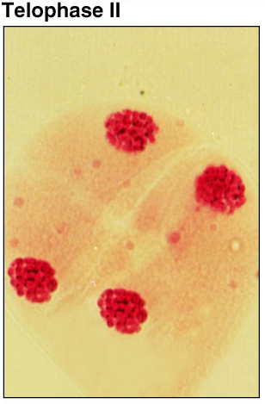
Meiosis 1 & 2

Slide 19
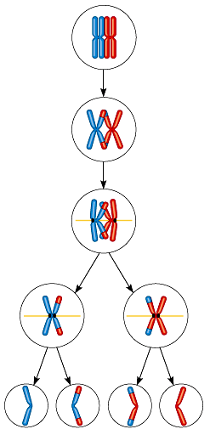

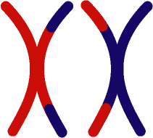
Trading pieces of DNA
Crossing over
  during Prophase 1, sister chromatids intertwine
    homologous pairs swap
    pieces of chromosome
      DNA breaks & re-attaches
prophase 1
synapsis
tetrad

Slide 20
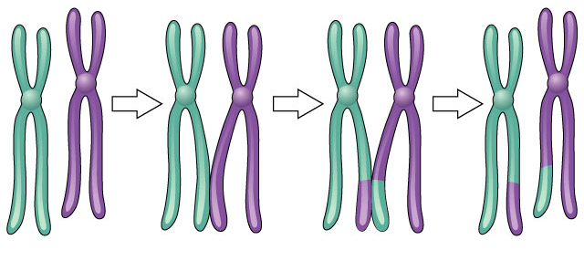
Crossing over
What are the
advantages of
crossing over in
sexual reproduction?
3 steps
  cross over
  breakage of DNA
  re-fusing of DNA
New combinations of traits
Notes:
Sexual reproduction is advantageous to species that benefit from genetic variability. However, since evolution occurs because of changes in an individual's DNA, crossing over and chromosome segregation is likely to result in progeny that are less well-adapted than their parents. On the other hand, asexual reproduction ensures the production of progeny as fit as the parent since they are identical to the parent. Remember the adage, “if it's not broken, don't fix it.” There are several hypotheses regarding the evolution of sexual reproduction. One is associated with repairing double-stranded DNA breaks induced by radiation or chemicals. The contagion hypothesis suggests that sex arose from infection by mobile genetic elements. The Red Queen hypothesis theorizes that sex is needed to store certain recessive alleles in case they are needed in the future. Along similar lines, eukaryotic cells build up large numbers of harmful mutations. Sex, as explained by Miller's rachet hypothesis, may simply be a way to reduce these mutations. The “whole truth” is likely a combination of these factors. Regardless of how and why, the great diversity of vertebrates and higher plants and their ability to adapt to the highly varied habitats is indeed a result of their sexual reproduction.

Slide 21
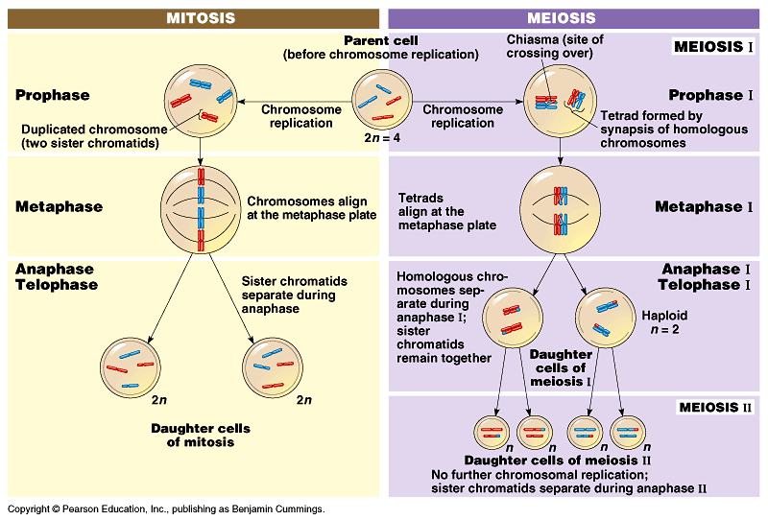
Mitosis vs. Meiosis

Slide 22
Mitosis vs. Meiosis
Mitosis
  1 division
  daughter cells genetically identical to parent cell
  produces 2 cells
  2n → 2n
  produces cells for growth & repair
  no crossing over
Meiosis
  2 divisions
  daughter cells genetically different from parent
  produces 4 cells
  2n → 1n
  produces gametes
  crossing over

Slide 23
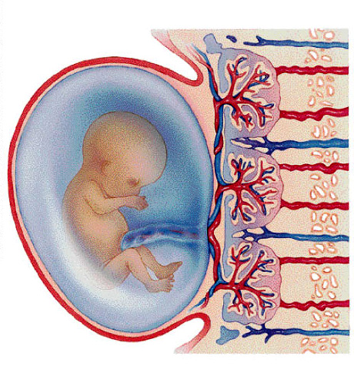
Putting it all together…
meiosis → fertilization → mitosis + development
gametes
46
23
46
23
46
46
46
46
46
meiosis
egg
46
46
23
46
46
23
zygote
fertilization
mitosis
sperm
development

Slide 24
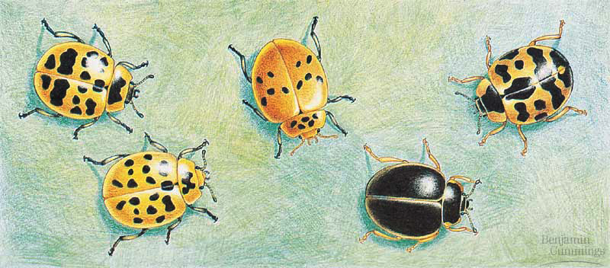
The value of sexual reproduction
Sexual reproduction introduces genetic variation
  genetic recombination
    independent assortment of chromosomes
      random alignment of homologous chromosomes in Metaphase 1
  crossing over
    mixing of alleles across homologous chromosomes
  random fertilization
    which sperm fertilizes which egg?
Driving evolution
  providing variation for natural selection
metaphase1

Slide 25
Variation from genetic recombination
Independent assortment of chromosomes
  meiosis introduces genetic variation
  gametes of offspring do not have same combination of genes as gametes from parents
    random assortment in humans produces
    2²³ (8,388,608) different combinations in gametes
new gametes
made by offspring
from Mom
from Dad
offspring

Slide 26
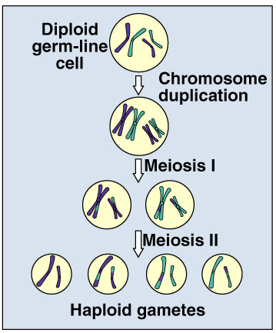
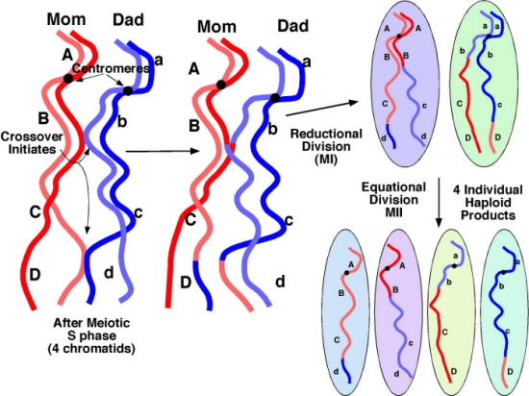
Variation from crossing over
Crossing over creates completely new combinations of traits on each chromosome
  creates an infinite
  variety in gametes

Slide 27
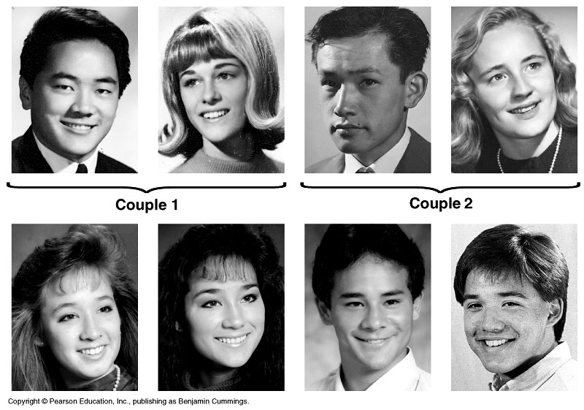
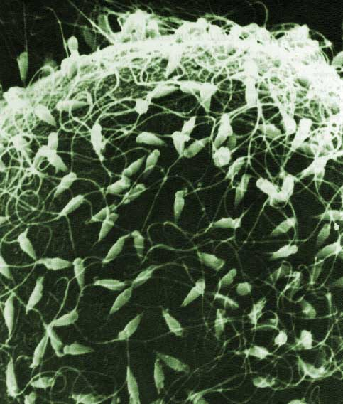
Variation from random fertilization
Sperm + Egg = ?
  any 2 parents will produce a zygote with over 70 trillion (2²³ x 2²³) possible diploid combinations (not even counting crossing over!!!!!!!!!)

Slide 28
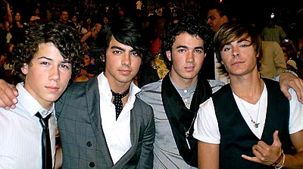
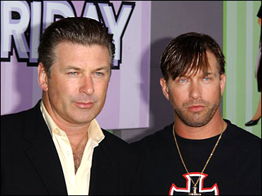
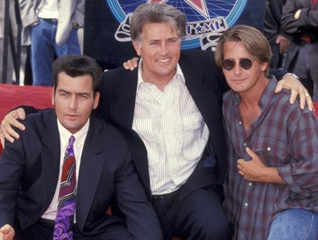

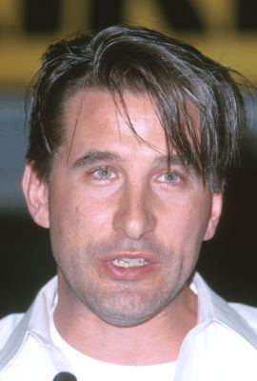

Sexual reproduction creates variability
Sexual reproduction allows us to maintain both genetic similarity & differences.
Jonas
Brothers
Baldwin brothers
Martin & Charlie Sheen, Emilio Estevez

Slide 29
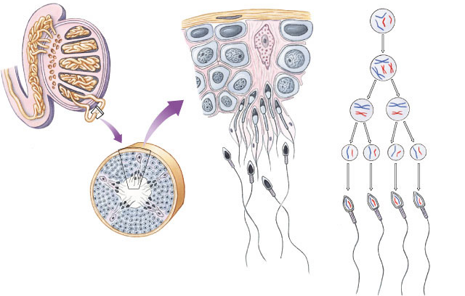
Sperm production
Epididymis
Testis
germ cell
(diploid)
Coiled
seminiferous
tubules
primary
spermatocyte
(diploid)
MEIOSIS I
secondary
spermatocytes
(haploid)
Vas deferens
spermatids
(haploid)
MEIOSIS II
spermatozoa
Spermatogenesis
  continuous & prolific process
  each ejaculation =
  100-600 million sperm
Cross-section of
seminiferous tubule

Slide 30
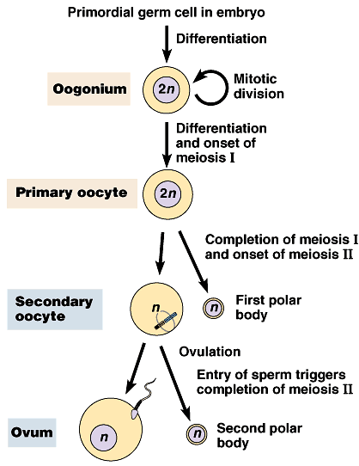
Egg production
Oogenesis
  eggs in ovaries halted before Anaphase 1
  Meiosis 1 completed during maturation
  Meiosis 2 completed after fertilization
  1 egg + 2 polar bodies
unequal divisions
Meiosis 1 completed
during egg maturation
ovulation
What is the advantage of this development system?
Meiosis 2 completed
triggered by fertilization

Slide 31
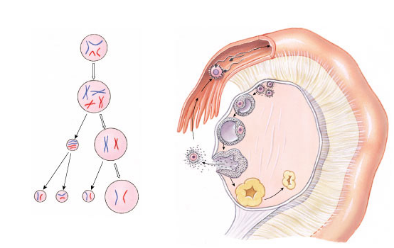
Oogenesis
Putting all
your egg
in one basket!
primary follicles
germinal cell
(diploid)
fallopian tube
fertilization
primary
oocyte
(diploid)
developing
follicle
MEIOSIS I
mature follicle with
secondary oocyte
secondary
oocyte
(haploid)
first polar body
ruptured follicle
(ovulation)
MEIOSIS II
after fertilization
ovum
(haploid)
second
polar body
corpus luteum

Slide 32
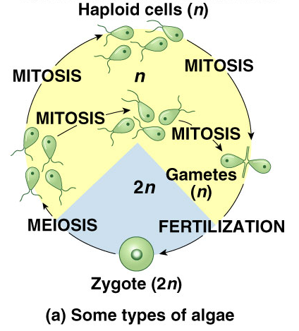
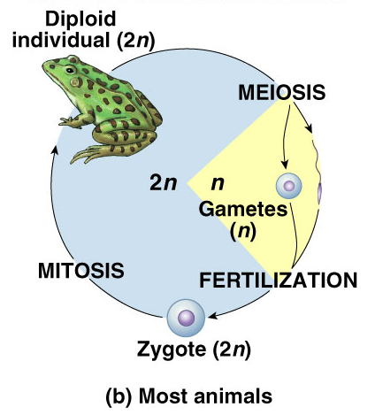
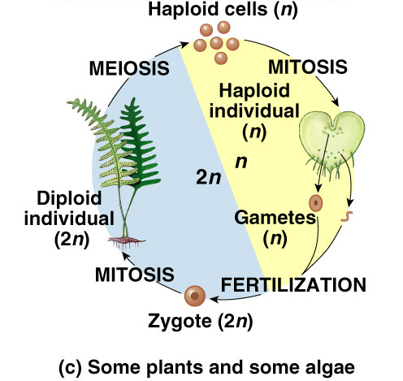
Differences across kingdoms
Not all organisms use haploid & diploid stages in same way
  which one is dominant (2n or n) differs
  but still alternate between haploid & diploid
    must for sexual reproduction

Slide 33
1. How do cells at the completion of meiosis compare with cells that have replicated their DNA and are just about to begin meiosis?
  They have twice the amount of cytoplasm and half the amount of DNA.
  They have half the number of chromosomes and half the amount of DNA.
  They have the same number of chromosomes and half the amount of DNA.
  They have half the number of chromosomes and one-fourth the amount of DNA.
  They have half the amount of cytoplasm and twice the amount of DNA.
Notes:
33
Answer: d
Source: Barstow - Test Bank for Biology, Seventh Edition, Question #18

Slide 34
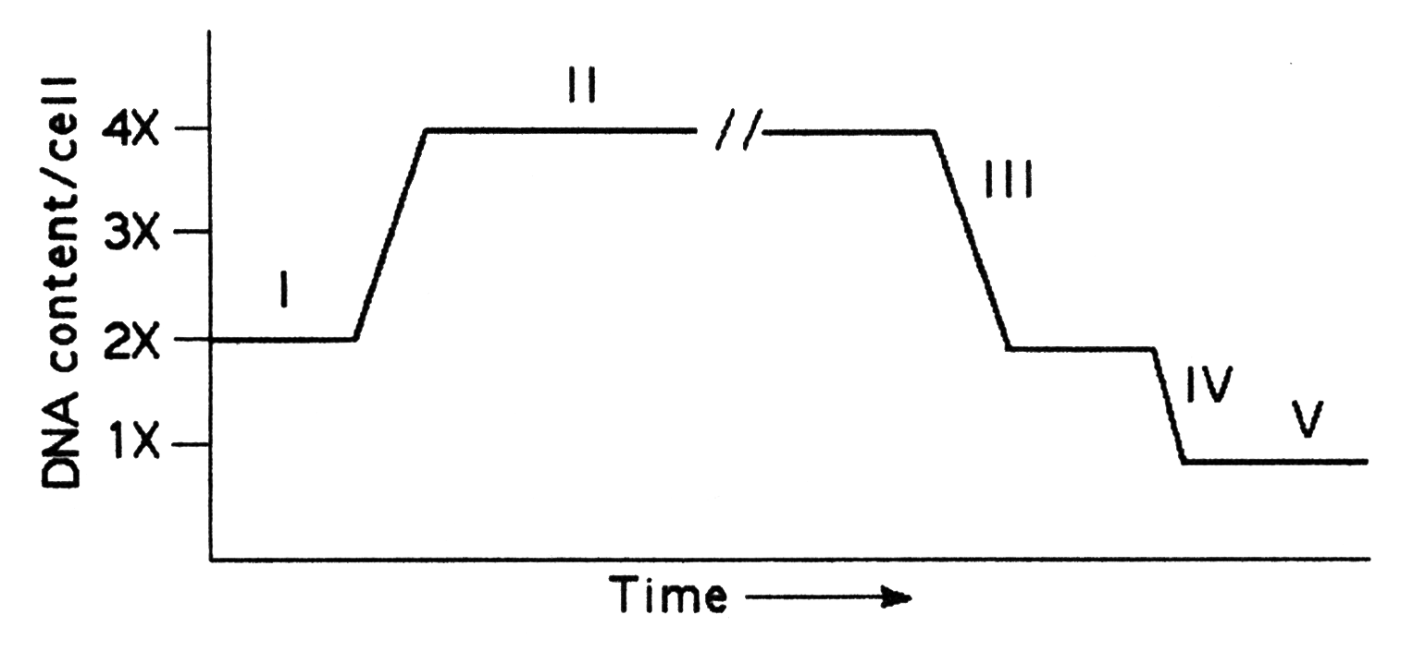
2. Which number represents G₂? *
    I
    II
    III
    IV
    V
Notes:
34
Answer: b
Source: Barstow - Test Bank for Biology, Seventh Edition, Question #46
Discussion Notes for the Instructor
Before showing this figure you might want to remind students that this represents a cell/s undergoing meiosis. There are several questions which can be asked to guide the discussion of this question, including:
During which stage of the meiotic cell cycle does a cell contain the greatest amount of DNA?
During which stage of the meiotic cell cycle does the cell contain the least amount of DNA?
Using these questions as an outline, discussion of the choices might look like this:
Choice A, during G2 the cell contains the greatest amount of DNA, so this can not be correct.
Choice B, correct
Choice C, similar to choice A
Choice D, similar to choice A
Choice E, similar to choice A

Slide 35
3.. Which number represents the DNA content of a sperm cell?
    I
    II
    III
    IV
    V
Notes:
35
Answer: e
Source: Barstow - Test Bank for Biology, Seventh Edition, Question #47

Slide 36
4. Which of the following would not be considered a haploid cell?
    daughter cell after meiosis II
    gamete
    daughter cell after mitosis in gametophyte generation of a plant
    cell in prophase I
    cell in prophase II
Notes:
36
Answer: d
Source: Taylor - Student Study Guide for Biology, Seventh Edition, Test Your Knowledge Question #17

Slide 37
5. A cell in G₂ before meiosis compared with one of the four cells produced by that meiotic division has
    twice as much DNA and twice as many chromosomes.
    four times as much DNA and twice as many chromosomes.
    four times as much DNA and four times as many chromosomes.
    half as much DNA but the same number of chromosomes.
    half as much DNA and half as many chromosomes.
Notes:
37
Answer: b
Source: Taylor - Student Study Guide for Biology, Seventh Edition, Test Your Knowledge Question #20

