Slide 1
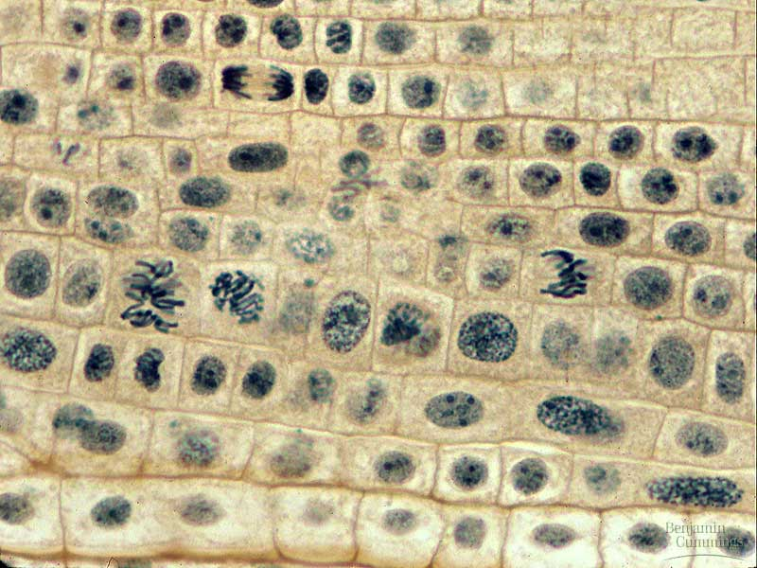
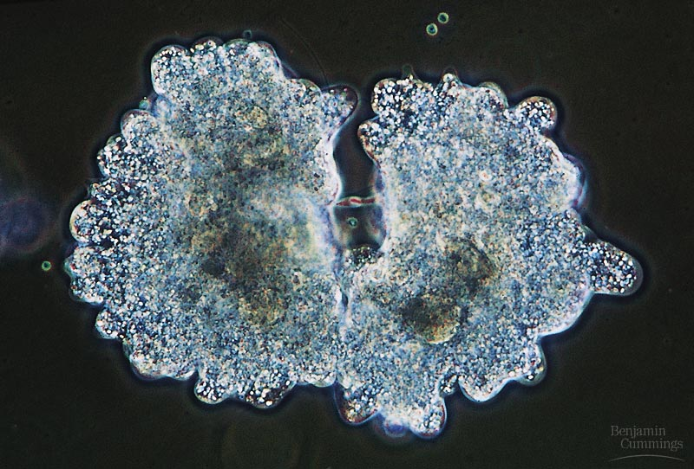
Biology is the only subject in which multiplication is the same thing as division…

Slide 2
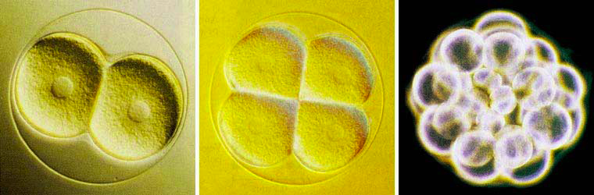
Getting from there to here…
Going from egg to baby….
  the original fertilized egg has to divide…
and divide…
and divide…
and divide…

Slide 3
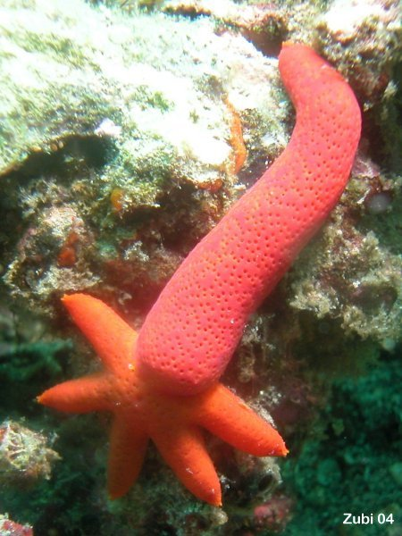
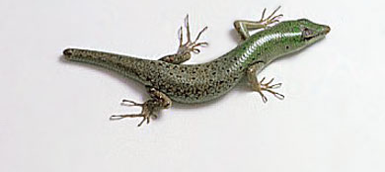
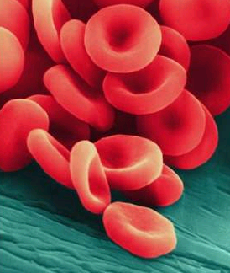

Why do cells divide?
For reproduction
  asexual reproduction
    one-celled organisms
For growth
  from fertilized egg to
  multi-celled organism
For repair & renewal
  replace cells that die from normal wear & tear or from injury
amoeba
Notes:
Unicellular organisms
Cell division = reproduction
Reproduces entire organism& increase population
Multicellular organisms
Cell division provides for growth & development in a multicellular organism that begins as a fertilized egg
Also use cell division to repair & renew cells that die from normal wear & tear or accidents

Slide 4
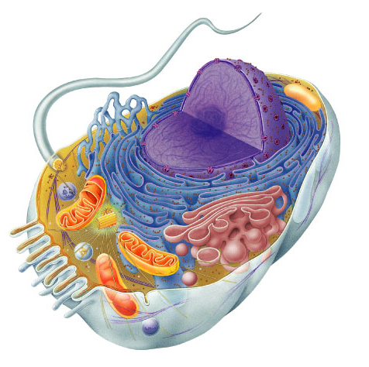
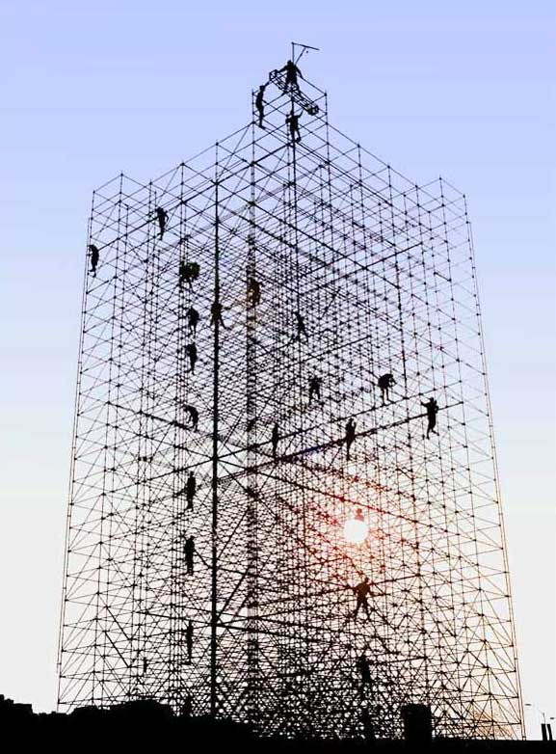
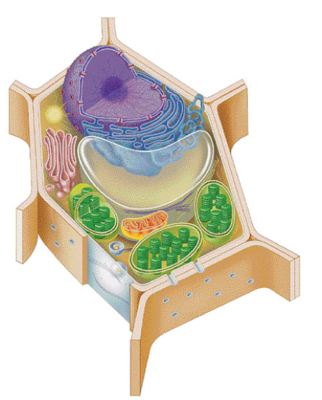
Making new cells
Nucleus
  chromosomes
  DNA
Cytoskeleton
  centrioles
    in animals
  microtubule spindle fibers

Slide 5
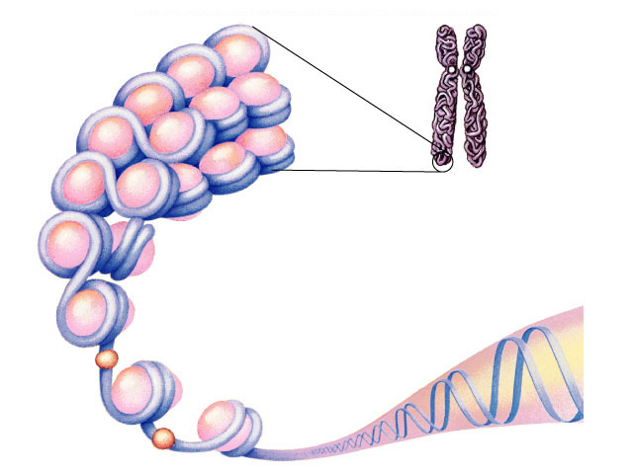
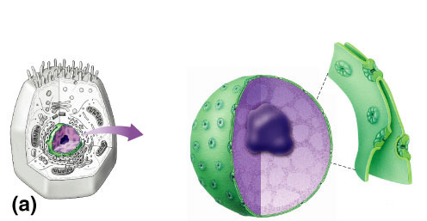
Nucleus
DNA
Function
  protects DNA
Structure
  nuclear envelope
    double membrane
    Has Pores for material exchange
chromosome
histone protein
nuclear
pores
What kind of
molecules need to
pass through?
nuclear
pore
nucleolus
nuclear envelope

Slide 6
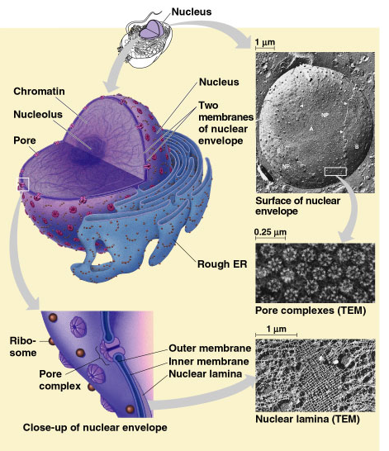
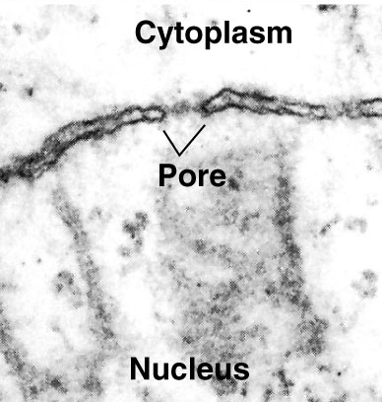

Slide 7

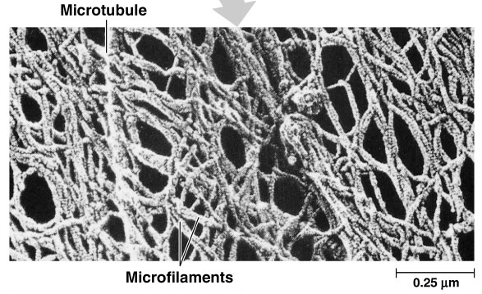
Cytoskeleton
Function
  structural support
    maintains shape, provides anchorage
      protein fibers
        microfilaments, intermediate filaments, microtubules
  motility
    cell locomotion
  regulation
    Organizes cell activities

Slide 8
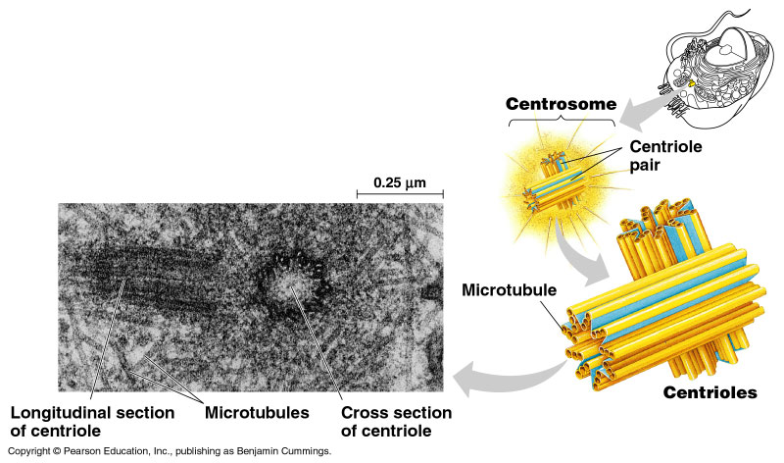
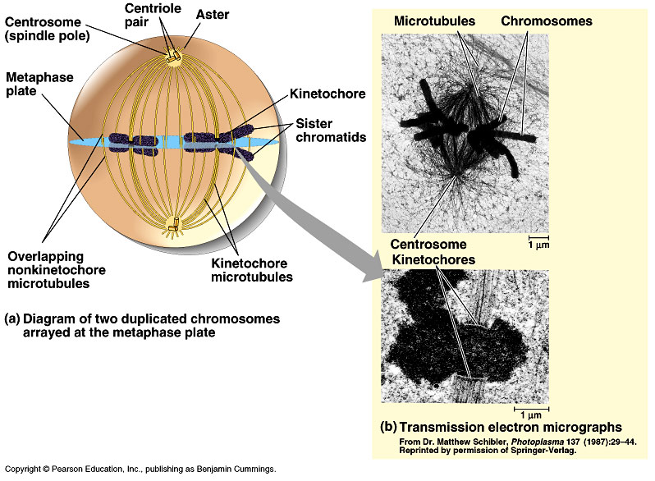
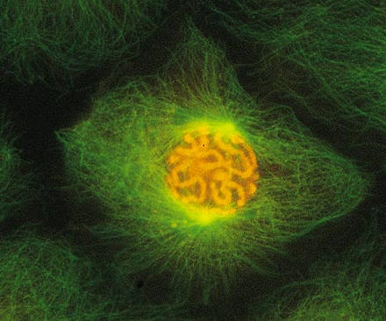
Centrioles
Cell division
  in animal cells, pair of centrioles
  organize microtubules
    spindle fibers
  guide chromosomes in mitosis

Slide 9
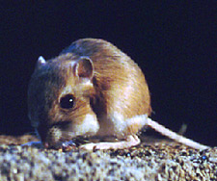
Getting the right stuff
What is passed on to daughter cells?
  exact copy of genetic material = DNA
  organelles, cytoplasm, cell membrane, enzymes
chromosomes (stained orange)
in kangaroo rat epithelial cell
→notice cytoskeleton fibers

Slide 10
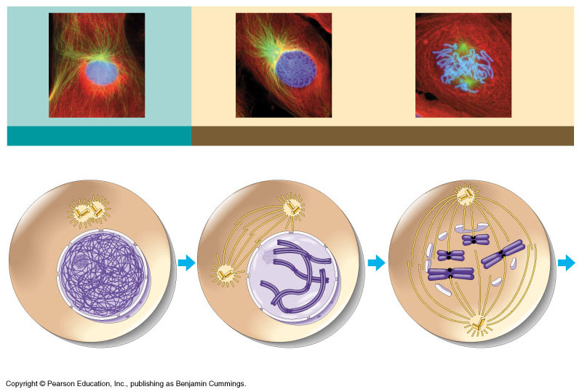
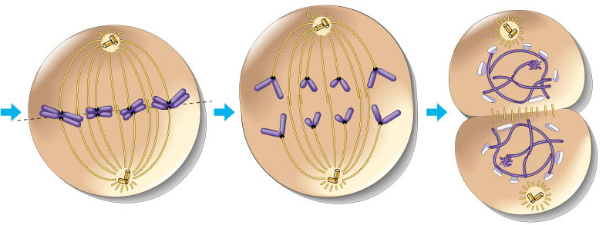
Overview of mitosis
I.P.M.A.T.
interphase
prophase
(pro-metaphase)
cytokinesis
metaphase
anaphase
telophase

Slide 11
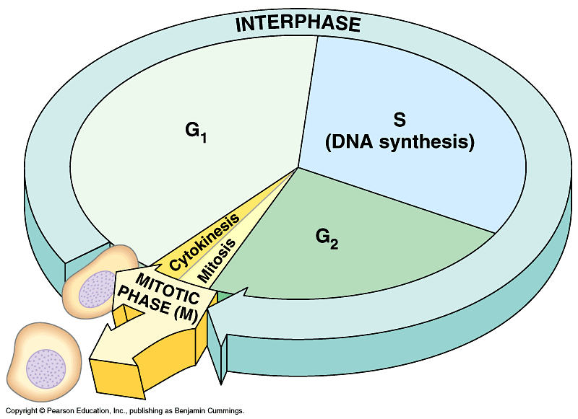
Interphase
Most of a cell’s life cycle (~95%)
  cell doing its “everyday job”
    synthesize proteins/enzymes, metabolism, etc.
  prepares for duplication if triggered
I’m working here!
Time to divide
& multiply!

Slide 12
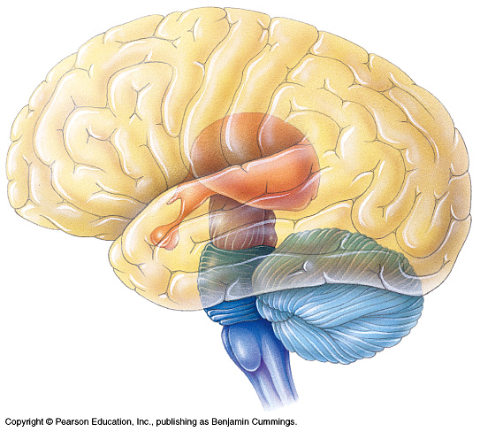
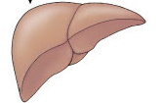
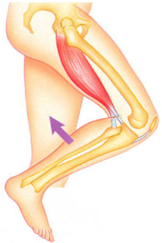
Cell cycle
Cell has a “life cycle”
cell is formed from
a mitotic division
cell grows & matures
to divide again
cell grows & matures
to never divide again
G₁, S, G₂, M
liver cells
G₁→G₀
epithelial cells,
blood cells,
stem cells
brain / nerve cells
muscle cells

Slide 13
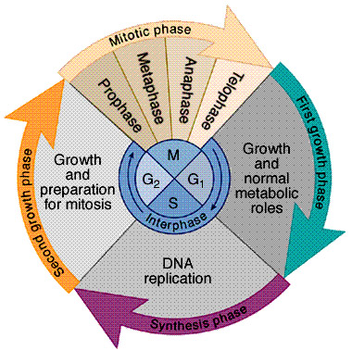
Interphase
Divided into 3 phases:
  G₁ = 1st Gap (Growth)
    Non-dividing life
  S = DNA Synthesis
    copies chromosomes
  G₂ = 2nd Gap (Growth)
    prepares for division
    cell grows (more)
    produces organelles,
    proteins, membranes
G₀
signal to divide

Slide 14
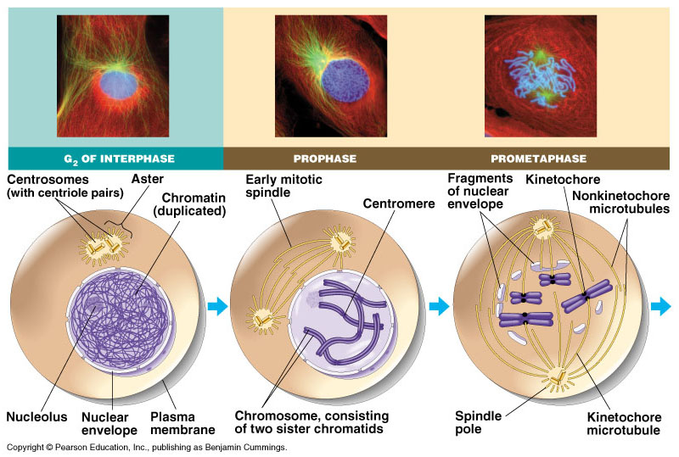
Interphase
green = key features
Nucleus well-defined
  DNA loosely packed in chromatin fibers
Prepares for mitosis
  replicates chromosome
    DNA & proteins
  produces proteins & organelles

Slide 15
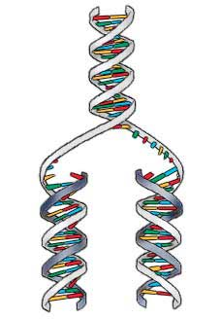
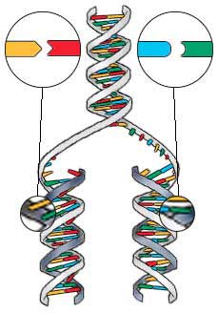
S phase: Copying / Replicating DNA
Synthesis phase of Interphase
  dividing cell replicates DNA
  must separate DNA copies correctly to 2 daughter cells
    human cell duplicates ~3 meters DNA
    each daughter cell gets complete
    identical copy
    error rate = ~1 per 100 million bases
      3 billion base pairs in mammalian genome
      ~30 errors per cell cycle
        mutations (to somatic (body) cells)

Slide 16
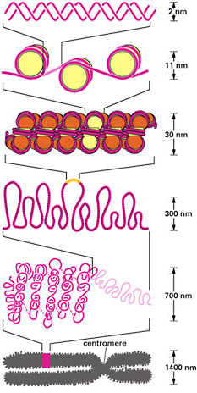
Organizing DNA
ACTGGTCAGGCAATGTC
DNA
DNA is organized in
chromosomes
  double helix DNA molecule
  wrapped around histone proteins
    like thread on spools
  DNA-protein complex =
  chromatin
    organized into long thin fiber
  condensed further during mitosis
histones
chromatin
double stranded chromosome
duplicated mitotic chromosome

Slide 17
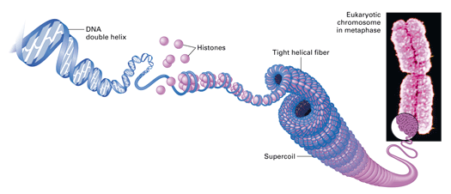
Copying DNA & packaging it…
After DNA duplication, chromatin condenses
  coiling & folding to make a smaller package
DNA
mitotic chromosome
chromatin

Slide 18
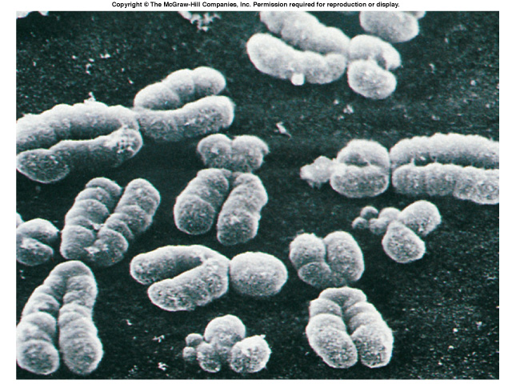
double-stranded
mitotic human
chromosomes

Slide 19
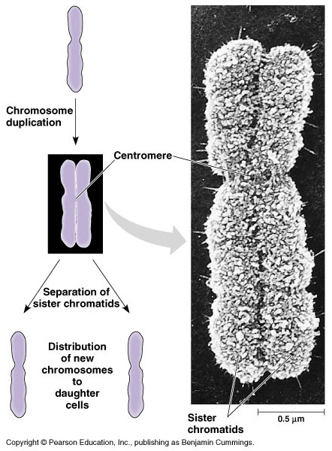
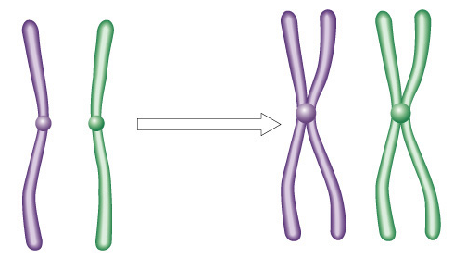
Mitotic Chromosome
Duplicated chromosome
  2 sister chromatids
  narrow at centromeres
  contain identical
  copies of original DNA
homologous
chromosomes
homologous
chromosomes
single-stranded
sister chromatids
homologous = “same information”
double-stranded
Notes:
Centromeres are segments of DNA which have long series of tandem repeats = 100,000s of bases long. The sequence of the repeated bases is quite variable. It has proven difficult to sequence.

Slide 20
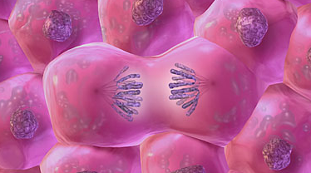
Mitosis
Dividing cell’s DNA between
2 daughter nuclei
  “dance of the chromosomes”
4 phases
  prophase
  metaphase
  anaphase
  telophase

Slide 21
Prophase
green = key features
Chromatin condenses
  visible chromosomes
Centrioles move to opposite poles of cell
  animal cells only
Protein fibers cross cell to form mitotic spindle
  microtubules
  coordinate movement of chromosomes
Nucleolus disappears
Nuclear membrane breaks down

Slide 22
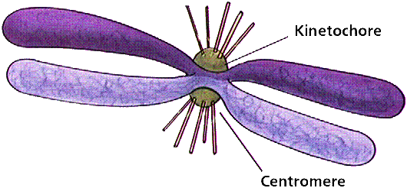
Transition to Metaphase
green = key features
Prometaphase
  spindle fibers attach to centromeres
  Kinetochores
    connect centromeres to centrioles
  chromosomes begin moving

Slide 23
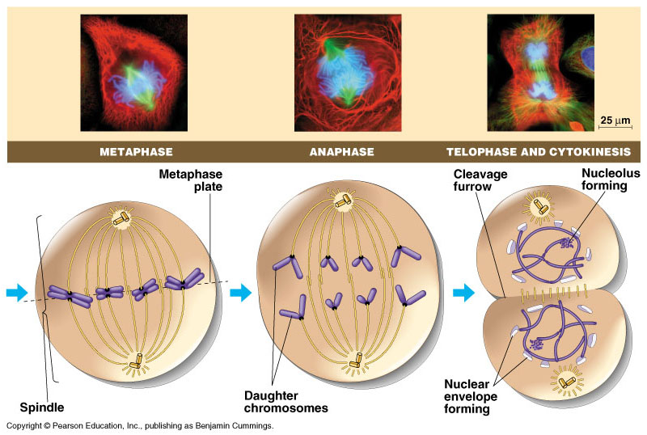
Metaphase
green = key features
Chromosomes align along middle of cell
  metaphase plate
    meta = middle
  spindle fibers coordinate movement
  ensure chromosomes separate properly
    each new nucleus receives 1 copy of each chromosome

Slide 25
Anaphase
green = key features
Sister chromatids separate at centromere
  move to opposite poles
  pulled by motor proteins “walking”along microtubules
Poles move farther apart
  polar microtubules lengthen

Slide 26
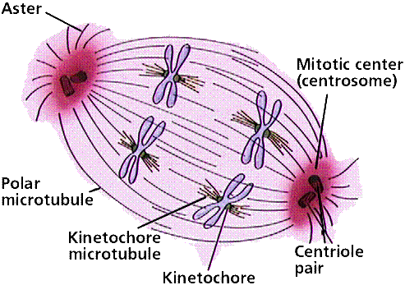
Separation of chromatids
In anaphase, proteins holding together sister chromatids are inactivated
  separate to become individual chromosomes
1 chromosome
2 chromatids
2 chromosomes
single-stranded
double-stranded

Slide 27
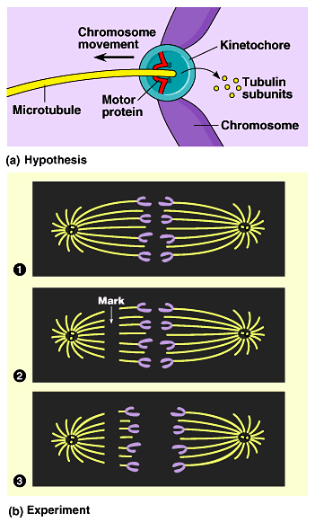
Chromosome movement
Kinetochores use motor proteins that “walk” chromosome along attached microtubule
  microtubule shortens by dismantling at kinetochore (chromosome) end
Notes:
Microtubules are NOT reeled in to centrioles like line on a fishing rod.
The motor proteins walk along the microtubule like little hanging robots on a clothes line.
In dividing animal cells, non-kinetochore microtubules are responsible for elongating the whole cell during anaphase, readying fro cytokinesis

Slide 28
Telophase
green = key features
Chromosomes arrive at opposite poles
  daughter nuclei form
  chromosomes disperse
Spindle fibers disperse
Cytokinesis begins
  cell division

Slide 29
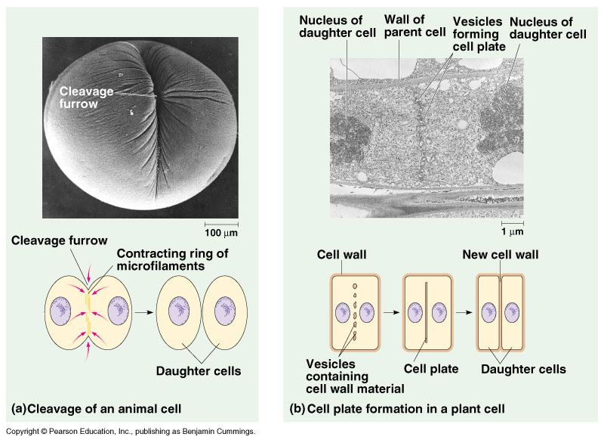
Cytokinesis
Animals
  constriction belt of actin microfilaments around equator of cell
    cleavage furrow forms
    splits cell in two
    like tightening a draw string
Notes:
Division of cytoplasm happens quickly.

Slide 30
Cytokinesis in Plants
Plants
  cell plate forms
    Vesicles (from golgi) line up at equator
    vesicles fuse to form 2 cell membranes
  new cell wall laid down between membranes
    new cell wall fuses with existing cell wall

Slide 31
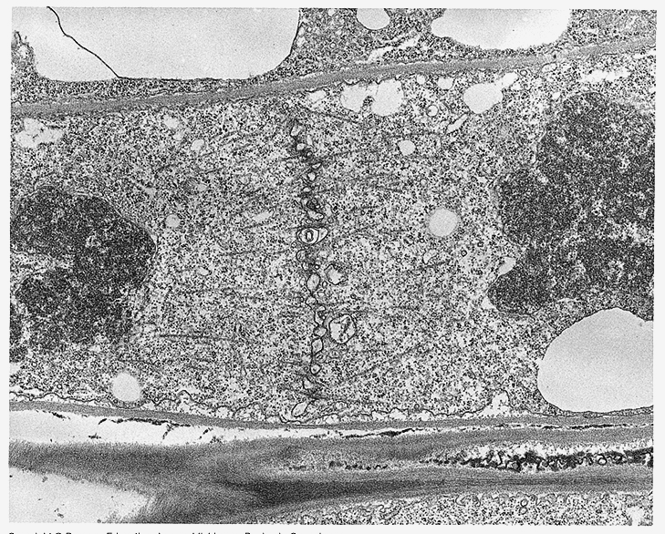
Cytokinesis in plant cell

Slide 32
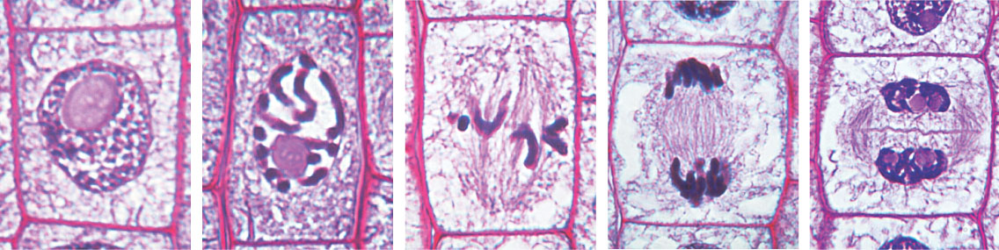
Mitosis in a plant cell
Nucleus
Chromatine
condensing
Chromosome
Nucleolus
1
Prophase.
The chromatin
is condensing.
The nucleolus is
beginning to
disappear.
Although not
yet visible
in the micrograph,
the mitotic spindle is
staring to from.
2
Prometaphase.
We now see discrete
chromosomes; each
consists of two
identical sister
chromatids. Later
in prometaphase, the
nuclear envelop will
fragment.
3
Metaphase. The
spindle is complete,
and the chromosomes,
attached to microtubules
at their kinetochores,
are all at the metaphase
plate.
5
Telophase. Daughter
nuclei are forming.
Meanwhile, cytokinesis
has started: The cell
plate, which will
divided the cytoplasm
in two, is growing
toward the perimeter
of the parent cell.
4
Anaphase. The
chromatids of each
chromosome have
separated, and the
daughter chromosomes
are moving to the ends
of cell as their
kinetochore
microtubles shorten.

Slide 33
onion root tip

Slide 34
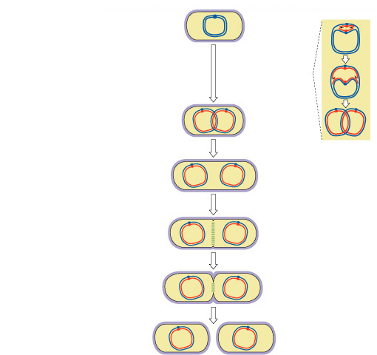
Evolution of mitosis
Origin of replication
chromosome:
double-stranded DNA
replication
of DNA
Mitosis in eukaryotes
likely evolved from binary fission in bacteria
  single circular chromosome
  no membrane-bound organelles
elongation of cell
ring of proteins
cell pinches
in two

Slide 35
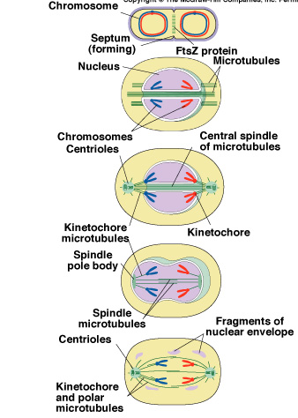
Evolution of mitosis
prokaryotes
(bacteria)
A possible progression of mechanisms intermediate between binary fission & mitosis is seen in modern organisms
protists
dinoflagellates
protists
diatoms
eukaryotes
yeast
eukaryotes
animals
Notes:
Prokaryotes (bacteria)
No nucleus; single circular chromosome. After DNA is replicated, it is partitioned in the cell. After cell elongation, FtsZ protein assembles into a ring and facilitates septation and cell division.
Protists (dinoflagellates)
Nucleus present and nuclear envelope remains intact during cell division. Chromosomes linear. Fibers called microtubules, composed of the protein tubulin, pass through tunnels in the nuclear membrane and set up an axis for separation of replicated
chromosomes, and cell division.
Protists (diatoms)
A spindle of microtubules forms between two pairs of centrioles at
opposite ends of the cell. The spindle passes through one tunnel in the intact nuclear envelope. Kinetochore microtubules form between kinetochores on the chromosomes and the spindle
poles and pull the chromosomes to each pole.
Eukaryotes (yeast)
Nuclear envelope remains intact; spindle microtubules form inside the nucleus between spindle pole bodies. A single kinetochore microtubule attaches to each chromosome and pulls each to a pole.
Eukaryotes (animals)
Spindle microtubules begin to form between centrioles outside of nucleus. As these centrioles move to the poles, the nuclear envelope breaks down, and kinetochore microtubules attach kinetochores of chromosomes to spindle poles. Polar microtubules extend toward the center of the cell and overlap.

Slide 36
0
1. Cytokinesis usually, but not always, follows mitosis. If a cell completed mitosis but not cytokinesis, what would be the result?
  a cell with a single large nucleus
  a cell with high concentrations of actin
  and myosin
  a cell with two abnormally small nuclei
  a cell with two nuclei
  a cell with two nuclei but with half the
  amount of DNA
Notes:
Answer: d
Source: Barstow - Test Bank for Biology, Sixth Edition, Question #20

Slide 37
0
2. Taxol is an anticancer drug extracted from the Pacific yew tree. In animal cells, taxol disrupts microtubule formation by binding to microtubules and accelerating their assembly from the protein precursor, tubulin. Surprisingly, this stops mitosis. Specifically, taxol must affect
  the fibers of the mitotic spindle.
  anaphase.
  formation of the centrioles.
  chromatid assembly.
  the S phase of the cell cycle.
Notes:
Answer: a
Source: Barstow - Test Bank for Biology, Sixth Edition, Question #24

Slide 38
0
3. Measurements of the amount of DNA per nucleus were taken on a large number of cells from a growing fungus. The measured DNA levels ranged from 3 to 6 picograms per nucleus. In which stage of the cell cycle was the nucleus with 6 picograms of DNA?
  G₀
  G₁
  S
  G₂
  M
Notes:
Answer: d
Source: Barstow - Test Bank for Biology, Sixth Edition, Question #33

Slide 39
0
4. A group of cells is assayed for DNA content immediately following mitosis and is found to have an average of 8 picograms of DNA per nucleus. Those cells would have __________ picograms at the end of the S phase and __________ picograms at the end of G₂.
  8 ... 8
  8 ... 16
  16 ... 8
  16 ... 16
  12 ... 16
Notes:
Answer: d
Source: Barstow - Test Bank for Biology, Sixth Edition, Question #50

Slide 40
5. A particular cell has half as much DNA as some of the other cells in a mitotically active tissue. The cell in question is most likely in
  G₁.
  G₂.
  prophase.
  metaphase.
  anaphase.
Notes:
Answer: a
Source: Campbell/Reece - Biology, Sixth Edition, EOC Self-Quiz Question #4

