Slide 1
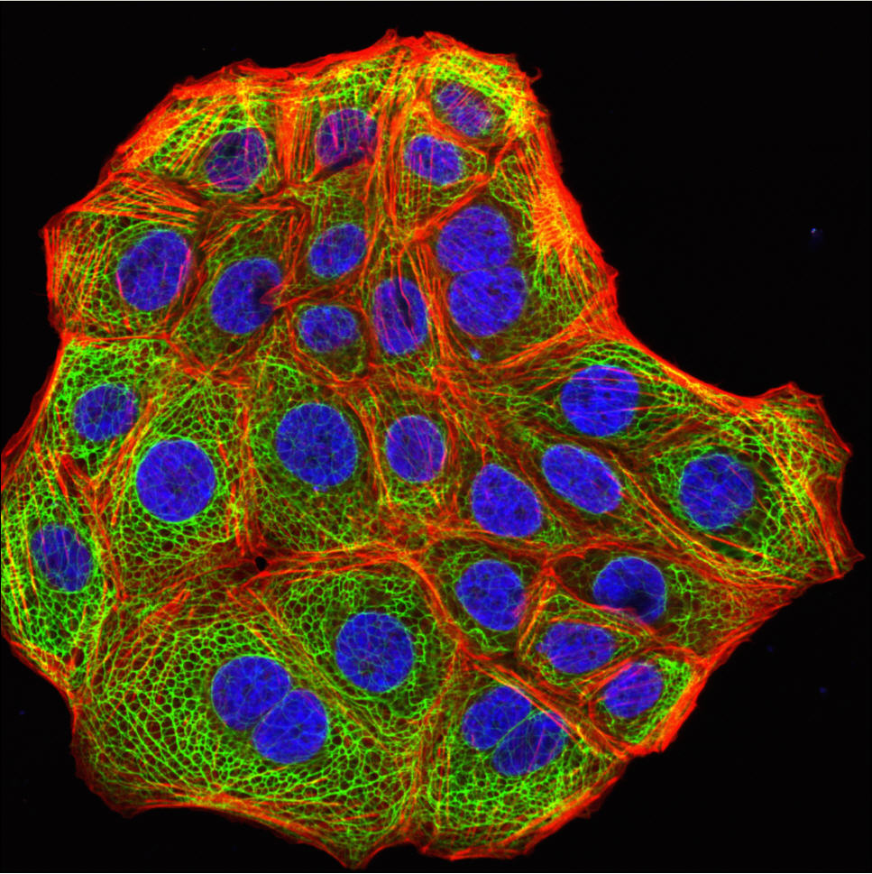
Regulation of Cell Division

Slide 2
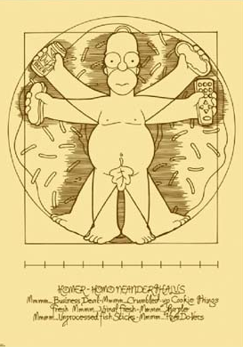
Coordination of cell division
A multicellular organism needs to coordinate cell division across different tissues & organs
  critical for normal growth,
  development & maintenance
  Timing, Rates and Orchestration all need to be controlled

Slide 3
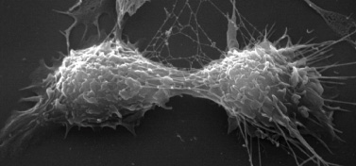
Frequency of cell division
Frequency of cell division varies by cell type
  embryo
    cell cycle < 20 minute
  skin cells
    divide frequently throughout life
    12-24 hour cycle
  liver cells
    retain ability to divide, keep it in reserve
    divide once every year or two
  mature nerve cells & muscle cells
    do not divide at all after maturity (?)
    permanently in G₀

Slide 4
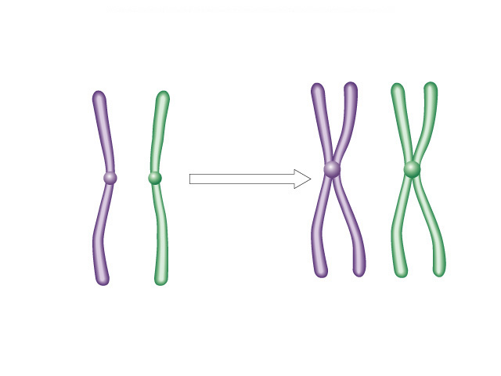
Overview of Cell Cycle Control
There’s no
turning back,
now!
Two irreversible points in cell cycle
  replication of genetic material
  separation of sister chromatids
Checkpoints
  process is assessed & possibly halted
sister chromatids
✓
✓
centromere
single-stranded
chromosomes
double-stranded
chromosomes

Slide 5
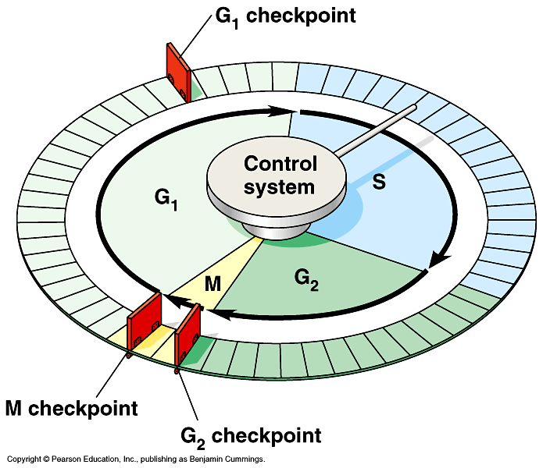
Checkpoint control system
Checkpoints
  cell cycle controlled by STOP & GO chemical signals at critical points
  signals indicate if key cellular processes have been completed correctly

Slide 6
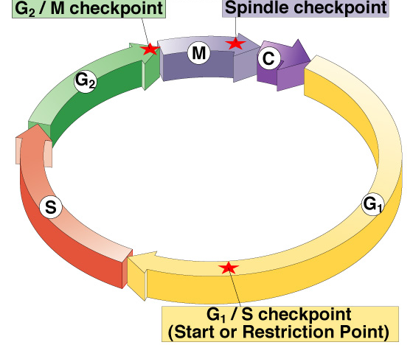
Checkpoint control system
3 major checkpoints:
  G₁/S
    can DNA synthesis begin?
  G₂/M
    has DNA synthesis been completed correctly?
    commitment to mitosis
  spindle checkpoint
    are all chromosomes attached to spindle?
    can sister chromatids separate correctly?

Slide 7
G₁/S checkpoint
G₁/S checkpoint is most critical
  primary decision point: “restriction point”
  if cell receives “GO” signal, it divides
    internal signals: cell growth (size), cell nutrition
    external signals: “growth factors”
  if cell does not receive
  signal, it exits cycle &
  switches to G₀ phase
    non-dividing, working state

Slide 8
G₀ phase
G₀ phase
  non-dividing, differentiated state
  most human cells in G₀ phase
liver cells
  in G₀, but can be “called back” to cell cycle by external cues
nerve & muscle cells
  highly specialized
  arrested in G₀ & can never divide

Slide 9
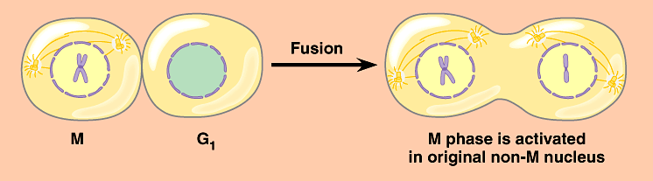
Activation of cell division
How do cells know when to divide?
  cell communication signals
    chemical signals in cytoplasm give cue
    signals usually mean proteins
      activators
      inhibitors
experimental evidence: Can you explain this?

Slide 10
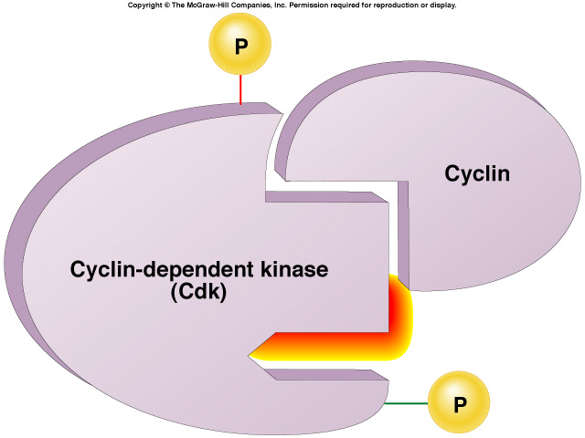
“Go-ahead” signals
Protein signals that promote cell growth & division
  internal signals
    “promoting factors”
  external signals
    “growth factors”
Primary mechanism of control
  phosphorylation
    kinase enzymes
    either activates or inactivates cell signals
Notes:
We still don’t fully understanding the regulation of the cell cycle. We only have “snapshots” of what happens in specific cases.

Slide 11
Cell cycle signals
inactivated Cdk
Cell cycle controls
  cyclins
    regulatory proteins
    levels cycle in the cell
  Cdks
    cyclin-dependent kinases
    phosphorylates cellular proteins
      activates or inactivates proteins
  Cdk-cyclin complex
    triggers passage through different stages of cell cycle
activated Cdk

Slide 12
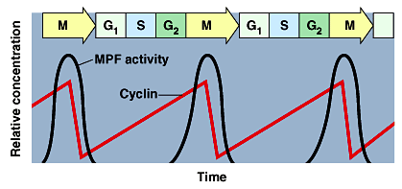
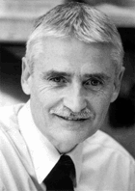
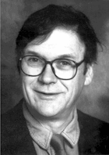
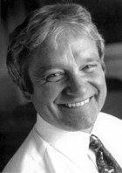
Cyclins & Cdks
1970s-80s | 2001
Interaction of Cdk’s & different cyclins triggers the stages of the cell cycle
Leland H. Hartwell
checkpoints
Tim Hunt
Cdks
Sir Paul Nurse
cyclins
Notes:
There are multiple cyclins, each with a specific role. Cyclins are unstable. Some are triggered for destruction by phosphorylation. Others are inherently unstable and are synthesized discontinuously during the cell cycle.
Oscillations in the activities of cyclin-dependent kinases (CDKs) dictate orderly progression through the cell division cycle. In the simplest case of yeast, a progressive rise in the activity of a single cyclin-CDK complex can initiate DNA synthesis and then mitosis, and the subsequent fall in CDK activity resets the system for the next cell cycle.
In most organisms, however, the cell cycle machinery relies on multiple cyclin-CDKs, whose individual but coordinated activities are each thought to be responsible for just a subset of cell cycle events.

Slide 13
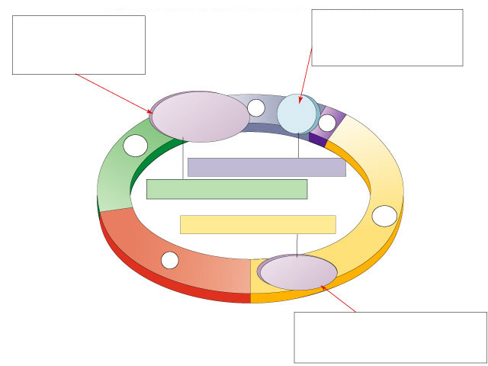
Spindle checkpoint
G₂ / M checkpoint
Chromosomes attached at metaphase plate
Replication completed
DNA integrity
Inactive
Active
Active
Inactive
Cdk / G₂
cyclin (MPF)
M
cytokinesis
APC
C
G₂
mitosis
G₁
S
Cdk / G₁
cyclin
MPF = Mitosis Promoting Factor
APC = Anaphase Promoting Complex
Inactive
Active
G₁ / S checkpoint
Growth factors
Nutritional state of cell
Size of cell

Slide 14
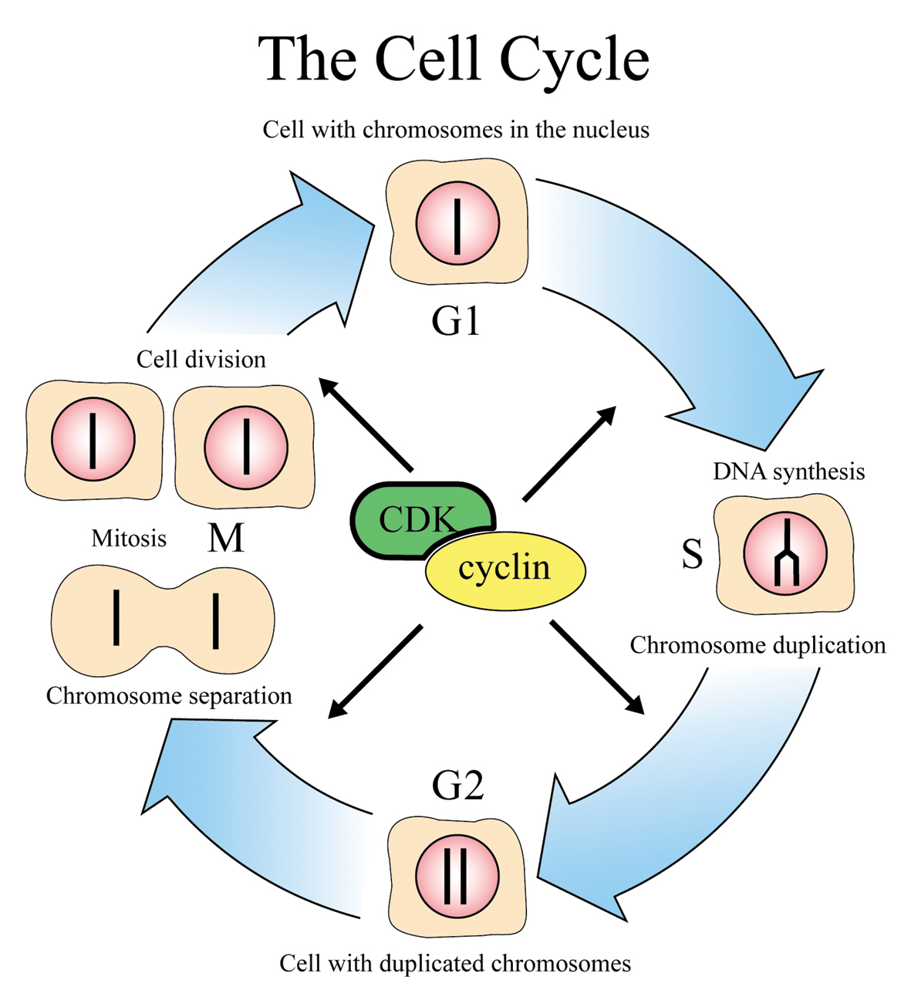
Cyclin & Cyclin-dependent kinases
CDKs & cyclin drive cell from one phase to next in cell cycle
proper regulation of cell cycle is so key to life that the genes for these regulatory proteins have been highly conserved through
evolution
the genes are basically the same in yeast, insects, plants & animals (including humans)
Notes:
CDK and cyclin together form an enzyme that activates other proteins by chemical modification (phosphorylation). The amount of CDK molecules is constant during the cell cycle, but their activities vary because of the regulatory function of the cyclins. CDK can be compared with an engine and cyclin with a gear box controlling whether the engine will run in the idling state or drive the cell forward in the cell cycle.

Slide 15
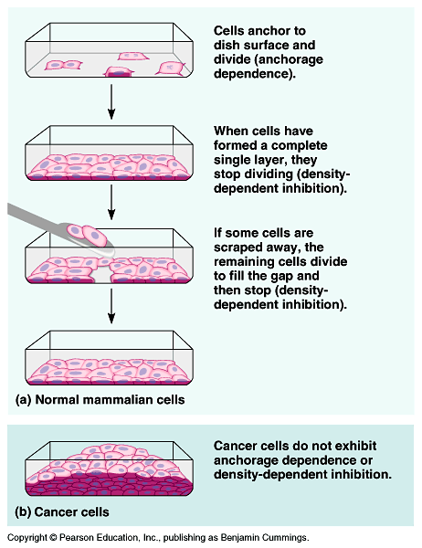
External signals
Growth factors
  coordination between cells
  Proteins released by body cells that stimulate other cells to divide
    density-dependent inhibition
      crowded cells stop dividing
    anchorage dependence
      to divide cells must be attached to a substrate

Slide 16
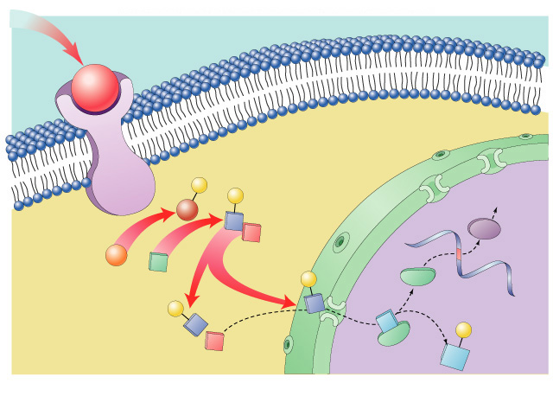
Growth factor signals
growth factor
nuclear pore
nuclear membrane
P
P
cell division
cell surface
receptor
Cdk
protein kinase
cascade
P
E2F
P
chromosome
Rb
E2F
P
cytoplasm
Rb
nucleus

Slide 17
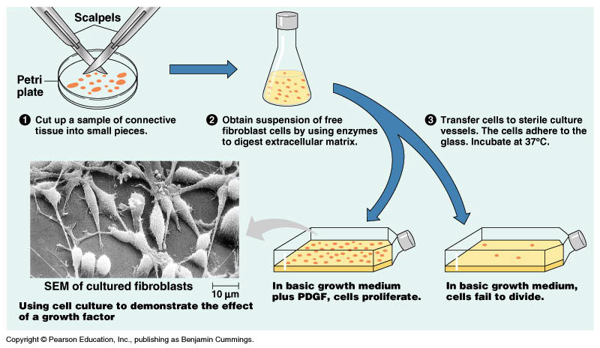
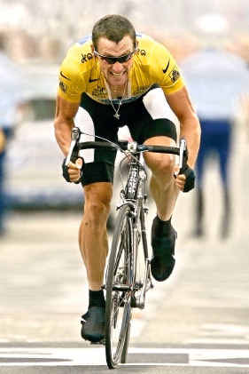

Example of a Growth Factor
Platelet Derived Growth Factor (PDGF)
  made by platelets in blood clots
  binding of PDGF to cell receptors stimulates cell division in connective tissue
    heal wounds
Don’t forget
to mention
erythropoietin!
(EPO)
Notes:
Erythropoietin (EPO): A hormone produced by the kidney that promotes the formation of red blood cells in the bone marrow. EPO is a glycoprotein (a protein with a sugar attached to it).
The kidney cells that make EPO are specialized and are sensitive to low oxygen levels in the blood. These cells release EPO when the oxygen level is low in the kidney. EPO then stimulates the bone marrow to produce more red cells and thereby increase the oxygen-carrying capacity of the blood.
EPO is the prime regulator of red blood cell production. Its major functions are to promote the differentiation and development of red blood cells and to initiate the production of hemoglobin, the molecule within red cells that transports oxygen.
EPO has been much misused as a performance-enhancing drug (“blood doping”) in endurance athletes including some cyclists (in the Tour de France), long-distance runners, speed skaters, and Nordic (cross-country) skiers. When misused in such situations, EPO is thought to be especially dangerous (perhaps because dehydration can further increase the viscosity of the blood, increasing the risk for heart attacks and strokes. EPO has been banned by the Tour de France, the Olympics, and other sports organizations.

Slide 18
Growth Factors and Cancer
Growth factors can create cancers
  proto-oncogenes
    normally activates cell division
      growth factor genes. Become “oncogenes” (cancer-causing) when mutated
    if switched “ON” can cause cancer
    example: RAS (activates cyclins)
  tumor-suppressor genes
    normally inhibits cell division
    if switched “OFF” can cause cancer
    example: p53

Slide 19
Cancer & Cell Growth
Cancer is essentially a failure
of cell division control
  unrestrained, uncontrolled cell growth
What control is lost?
  lose checkpoint stops
  gene p53 plays a key role in G₁/S restriction point
    p53 protein halts cell division if it detects damaged DNA
    ALL cancers have to shut down p53 activity
p53 is the
Cell Cycle
Enforcer
p53 discovered at Stony Brook by Dr. Arnold Levine

Slide 20
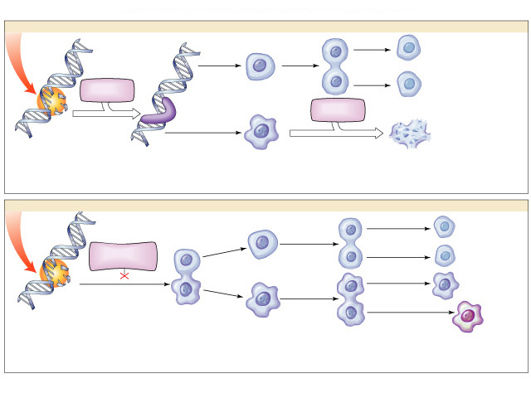
p53 — master regulator gene
NORMAL p53
p53 allows cells
with repaired
DNA to divide.
p53
protein
DNA repair enzyme
p53
protein
Step 1
Step 2
Step 3
DNA damage is caused
by heat, radiation, or
chemicals.
Cell division stops, and
p53 triggers enzymes to
repair damaged region.
p53 triggers the destruction
of cells damaged beyond repair.
ABNORMAL p53
abnormal
p53 protein
cancer
cell
Step 1
Step 2
DNA damage is
caused by heat,
radiation, or
chemicals.
The p53 protein fails to stop
cell division and repair DNA.
Cell divides without repair to
damaged DNA.
Step 3
Damaged cells continue to divide.
If other damage accumulates, the
cell can turn cancerous.

Slide 21
Development of Cancer
Cancer develops only after a cell experiences ~6 key mutations (“hits”)
  unlimited growth
    turn on growth promoter genes
  ignore checkpoints
    turn off tumor suppressor genes (p53)
  escape apoptosis
    turn off suicide genes
  immortality = unlimited divisions
    turn on chromosome maintenance genes
  promotes blood vessel growth
    turn on blood vessel growth genes
  overcome anchor & density dependence
    turn off touch-sensor gene
It’s like an
out-of-control
car with many
systems failing!

Slide 22
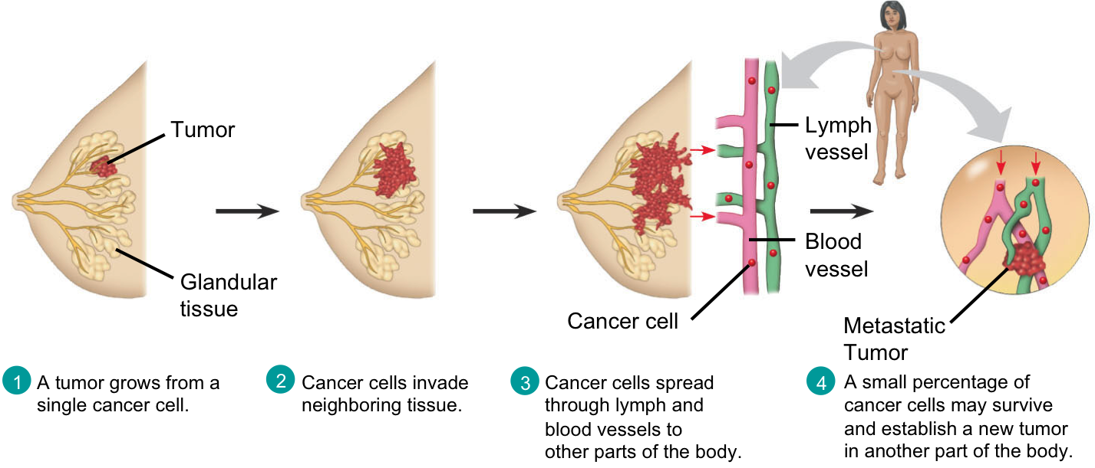
What causes these “hits”?
Mutations in cells can be triggered by
  UV radiation
  chemical exposure
  radiation exposure
  heat
  cigarette smoke
  pollution
  age
  genetics

Slide 23
Tumors
Mass of abnormal cells
  Benign tumor
    abnormal cells remain at original site as a lump
      p53 has halted cell divisions
    most do not cause serious problems &
    can be removed by surgery
  Malignant tumor
    cells leave original site
      lose attachment to nearby cells
      carried by blood & lymph system to other tissues. start more tumors = metastasis
    impair functions of organs throughout body

Slide 24
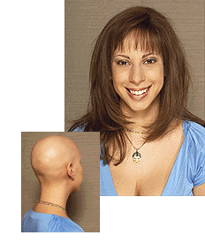
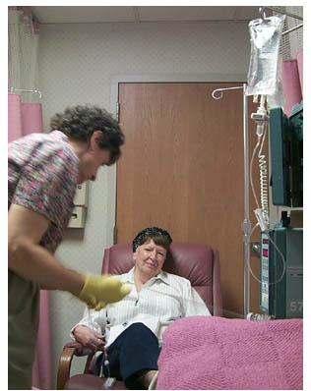
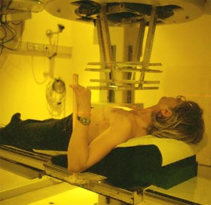
Traditional treatments for cancers
Treatments target rapidly dividing cells
  high-energy radiation: kills rapidly dividing cells
  chemotherapy
    stop DNA replication
    stop mitosis & cytokinesis
    stop blood vessel growth

Slide 25
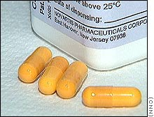
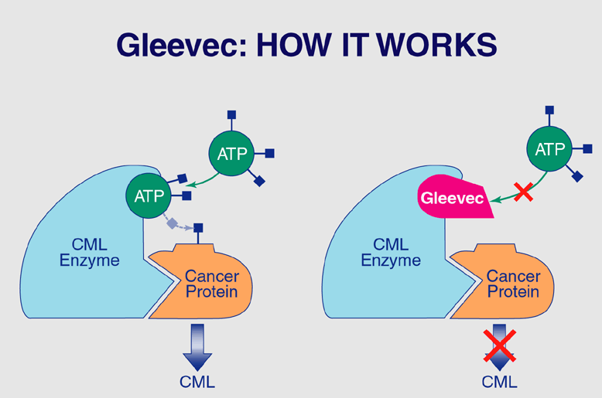
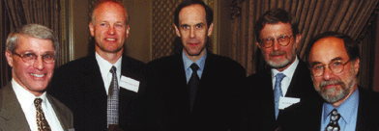
New “miracle drugs”
Drugs targeting proteins (enzymes) found only in cancer cells
  Gleevec
    treatment for adult leukemia (CML)
    & stomach cancer (GIST)
    1st successful drug targeting only cancer cells
without
Gleevec
with
Gleevec
Novartes
Notes:
Proof of Principle: you can treat cancer by targeting cancer-specific proteins.
GIST = gastrointestinal stromal tumors, which affect as many as 5,000 people in the United States
CML = chronic myelogenous leukemia, adult leukemia, which affect as many as 8,000 people in the United States
Fastest FDA approval — 2.5 months

