Slide 1
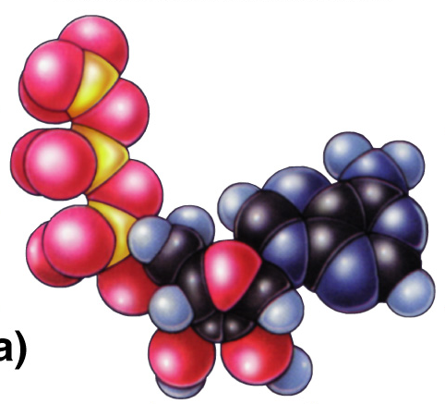
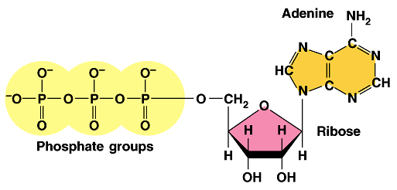
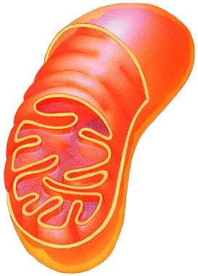
Cellular Respiration
Harvesting Chemical Energy
ATP

Slide 2
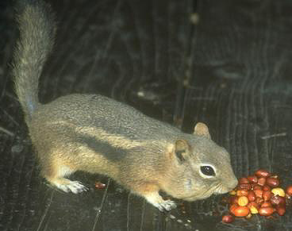
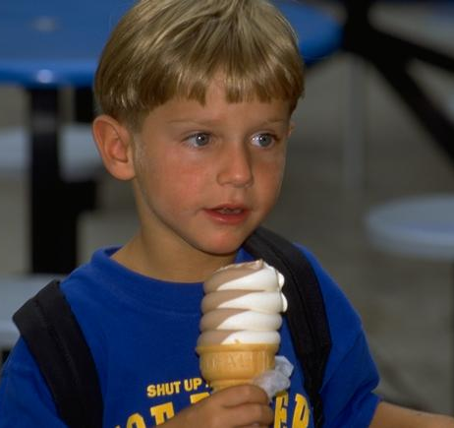
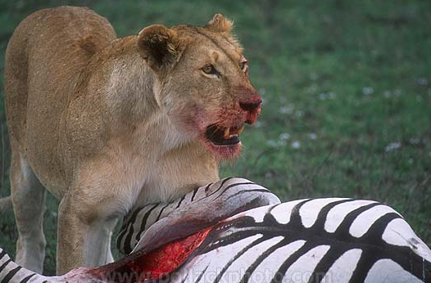
Harvesting stored energy
Energy is stored in organic molecules
  carbohydrates, fats, proteins
Heterotrophs eat these organic molecules → food
  digest organic molecules to get…
    raw materials for synthesis
    fuels for energy
      controlled release of energy
      “burning” fuels in a series of
      step-by-step enzyme-controlled reactions
Notes:
Energy is necessary for life processes
These include growth, transport, manufacture, movement, reproduction, and others
Energy that supports life on Earth is captured from sun rays reaching Earth through plant, algae, protist, and bacterial photosynthesis
Energy in sunlight is used in photosynthesis to make glucose from CO₂ and H₂O with release of O₂
Other organisms use the O₂ and energy in sugar and release CO₂ and H₂O
Together, these two processes are responsible for the majority of life on Earth
We eat to take in the fuels to make ATP which will then be used to help us build biomolecules and grow and move and… live!
heterotrophs = “fed by others”
vs.
autotrophs = “self-feeders”

Slide 3
Harvesting stored energy
Glucose is the model
  catabolism of glucose to produce ATP
glucose + oxygen → energy + water + carbon
dioxide
respiration
C₆H₁₂O₆
+
6O₂
→
ATP
+
6H₂O
+
6CO₂
+ heat
COMBUSTION = making a lot of heat energy
by burning fuels in one step
RESPIRATION = making ATP (& some heat)
by burning fuels in many small steps
ATP
enzymes
ATP
O₂
glucose
O₂
fuel
(carbohydrates)
CO₂ + H₂O + heat
CO₂ + H₂O + ATP (+ heat)
Notes:
Movement of hydrogen atoms from glucose to water
Cellular respiration is an exergonic process that transfers energy from the bonds in glucose to ATP
Cellular respiration produces 38 ATP molecules from each glucose molecule
Other foods (organic molecules) can be used as a source of energy as well
Respiration only retrieves 40% of the energy in a glucose molecule. The other 60% of the energy is released as heat. We use this heat to maintain a relatively steady body temperature near 37°C (98–99°F). This is about the same amount of heat generated by a 75-watt incandescent light bulb.
Organic compounds possess potential energy as a result of their arrangement of atoms.
Compounds that can participate in exergonic reactions can act as food.
Actually, cellular respiration includes both aerobic and anaerobic processes. However, it is generally used to refer to the aerobic process.
It takes about 10 million ATP molecules per second to power one active muscle cell.

Slide 4
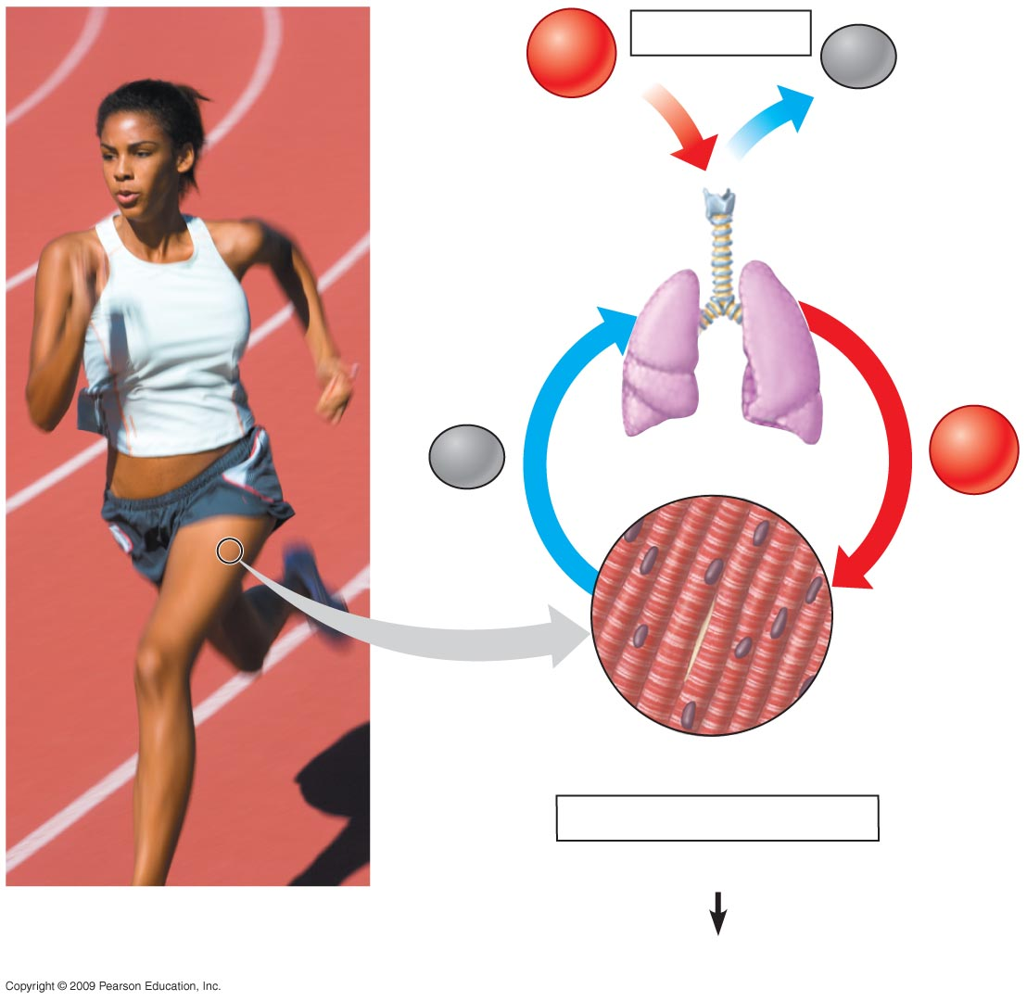
O₂
Breathing
CO₂
Lungs
CO₂
Bloodstream
O₂
Muscle cells carrying out
Cellular Respiration
Glucose + O₂
CO₂ + H₂O + ATP
Notes:
Figure 6.2 The connection between breathing and cellular respiration.
Breathing and cellular respiration are closely related
Breathing is necessary for exchange of CO₂ produced during cellular respiration for atmospheric O₂
Cellular respiration uses O₂ to help harvest energy from glucose and produces CO₂ in the process

Slide 5
How do we harvest energy from fuels?
Digest large molecules into smaller ones
  break bonds & move electrons from one molecule to another
    as electrons move they “carry energy” with them
    that energy is stored in another bond,
    released as heat or harvested to make ATP
loses e-
gains e-
oxidized
reduced
+
–
+
+
e⁻
e⁻
oxidation
reduction
e⁻
redox
Notes:
The energy necessary for life is contained in the arrangement of electrons in chemical bonds in organic molecules
• They are called oxidation reactions because it reflects the fact that in biological systems oxygen, which attracts electrons strongly, is the most common electron acceptor.
• Oxidation & reduction reactions always occur together therefore they are referred to as “redox reactions”.
• As electrons move from one atom to another they move farther away from the nucleus of the atom and therefore are at a higher potential energy state.
The reduced form of a molecule has a higher level of energy than the oxidized form of a molecule. • The ability to store energy in molecules by transferring electrons to them is called reducing power, and is a basic property of living systems.

Slide 6
How do we move electrons in biology?
Moving electrons in living systems
  electrons cannot move alone in cells
    electrons move as part of H atom
    move H = move electrons
e
p
loses e-
gains e-
oxidized
reduced
+
–
+
+
H
oxidation
reduction
H
oxidation
C₆H₁₂O₆
+
6O₂
→
6CO₂
+
6H₂O
+
ATP
H
reduction
e⁻
Notes:
Energy is transferred from one molecule to another via redox reactions.
When the carbon-hydrogen bonds of glucose are broken, electrons are transferred to oxygen
Oxygen has a strong tendency to attract electrons
C₆H₁₂O₆ has been oxidized fully == each of the carbons (C) has been cleaved off and all of the hydrogens (H) have been stripped off & transferred to oxygen (O) — the most electronegative atom in living systems. This converts O₂ into H₂O as it is reduced.
The reduced form of a molecule has a higher energy state than the oxidized form. The ability of organisms to store energy in molecules by transferring electrons to them is referred to as reducing power. The reduced form of a molecule in a biological system is the molecule which has gained a H atom, hence NAD⁺ → NADH once reduced.
soon we will meet the electron carriers NAD & FADH = when they are reduced they now have energy stored in them that can be used to do work.

Slide 7
Coupling oxidation & reduction
REDOX reactions in respiration
  release energy as breakdown organic molecules
    break C-C bonds
    strip off electrons from C-H bonds by removing H atoms
      C₆H₁₂O₆ → CO₂ = the fuel has been oxidized
    electrons attracted to more electronegative atoms
      in biology, the most electronegative atom?
      O₂ → H₂O = oxygen has been reduced
  couple REDOX reactions &
  use the released energy to synthesize ATP
O₂
oxidation
C₆H₁₂O₆
+
6O₂
→
6CO₂
+
6H₂O
+
ATP
reduction
Notes:
O₂ is 2 oxygen atoms both looking for electrons
LIGHT FIRE ==> oxidation
RELEASING ENERGY
But too fast for a biological system
A cellular respiration equation is helpful to show the changes in hydrogen atom distribution
Glucose loses its hydrogen atoms and is ultimately converted to CO₂
At the same time, O₂ gains hydrogen atoms and is converted to H₂O
Loss of electrons is called oxidation
Gain of electrons is called reduction
The movement of electrons is called an oxidation-reduction or redox reaction.
The combustion of gasoline in an automobile engine is also a redox reaction: the energy released pushes the pistons.
Our main energy foods are carbohydrates and fats because they are reservoirs of large numbers of electrons associated with hydrogen.
You may want to tell your students that a hydrogen atom consists of an electron and a proton, and although we have only considered the electron up to now, the proton becomes important later in the synthesis of ATP.

Slide 8
Oxidation & reduction
Oxidation
  adding O
  removing H
  loss of electrons
  releases energy
  exergonic
Reduction
  removing O
  adding H
  gain of electrons
  stores energy
  endergonic
oxidation
C₆H₁₂O₆
+
6O₂
→
6CO₂
+
6H₂O
+
ATP
reduction

Slide 9
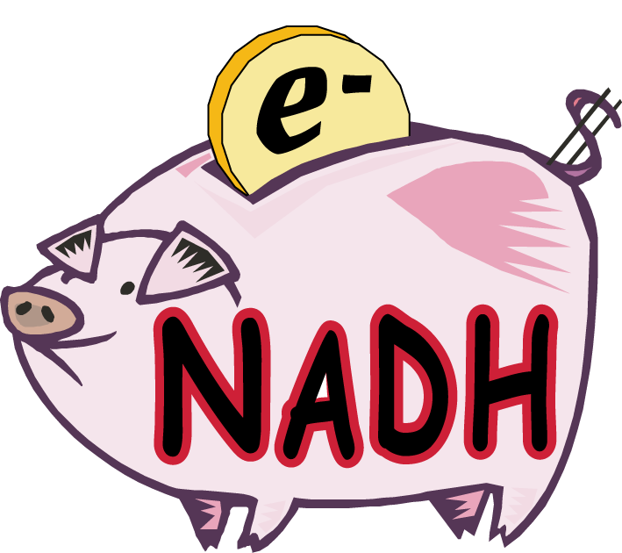
Moving electrons in respiration
like $$
in the bank
Electron carriers move electrons by
shuttling H atoms around
  NAD⁺ → NADH (reduced)
  FAD⁺² → FADH₂ (reduced)
reducing power!
NAD⁺
nicotinamide
Vitamin B3
niacin
O
NADH
H
O
H
H
C
C
NH₂
C
C
NH₂
N⁺
How efficient!
Build once,
use many ways
+
reduction
N⁺
O–
H
O–
P
P
–O
O–
oxidation
–O
O–
O
O
phosphates
O–
O–
P
adenine
P
–O
O–
–O
O–
O
O
ribose sugar
carries electrons as a reduced molecule
Notes:
Enzymes are necessary to oxidize glucose and other foods
The enzyme that removes hydrogen from an organic molecule is called dehydrogenase
Dehydrogenase requires a coenzyme called NAD⁺ (nicotinamide adenine dinucleotide) to shuttle electrons
NAD⁺ can become reduced when it accepts electrons and oxidized when it gives them up
Nicotinamide adenine dinucleotide (NAD) — and its relative nicotinamide adenine dinucleotide phosphate (NADP) which you will meet in photosynthesis — are two of the most important coenzymes in the cell.
In cells, most oxidations are accomplished by the removal of hydrogen atoms. Both of these coenzymes play crucial roles in this.
Nicotinamide is also known as Vitamin B3 is believed to cause improvements in energy production due to its role as a precursor of NAD (nicotinamide adenosine dinucleotide), an important molecule involved in energy metabolism. Increasing nicotinamide concentrations increase the available NAD molecules that can take part in energy metabolism, thus increasing the amount of energy available in the cell.
Vitamin B3 can be found in various meats, peanuts, and sunflower seeds. Nicotinamide is the biologically active form of niacin (also known as nicotinic acid).
FAD is built from riboflavin — also known as Vitamin B2. Riboflavin is a water-soluble vitamin that is found naturally in organ meats (liver, kidney, and heart) and certain plants such as almonds, mushrooms, whole grain, soybeans, and green leafy vegetables. FAD is a coenzyme critical for the metabolism of carbohydrates, fats, and proteins into energy.

Slide 10
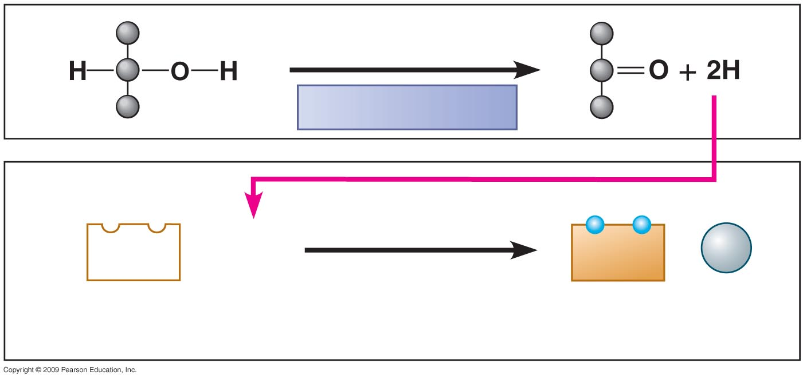
Oxidation
Dehydrogenase
Reduction
NAD⁺
+ 2 H
NADH
+
H⁺
(carries
2 electrons)
2 H⁺ + 2 e–
Notes:
Figure 6.5B A pair of redox reactions, occurring simultaneously.
The transfer of electrons to NAD⁺ results in the formation of NADH, the reduced form of NAD⁺
In this situation, NAD⁺ is called an electron acceptor, but it eventually becomes oxidized (loses an electron) and is then called an electron donor
Electrons are removed, transferred, and accepted in pairs.

Slide 11
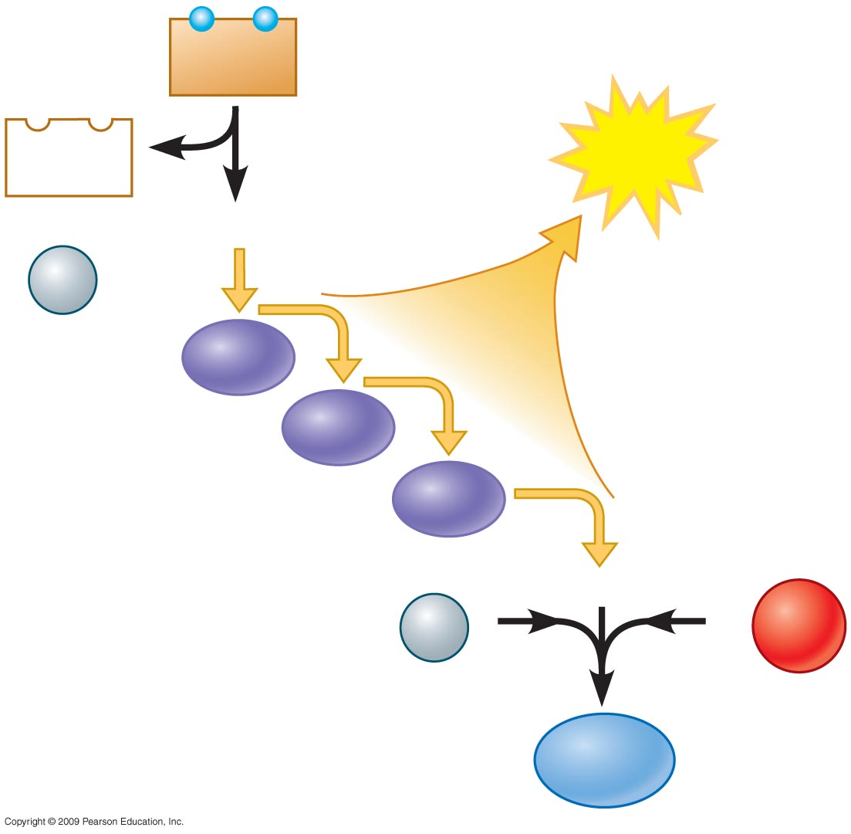
NADH
NAD⁺
ATP
+
2e–
Controlled
release of
energy for
synthesis
of ATP
H⁺
Electron transport
chain
2e–
H⁺
1
−
2
O₂
H₂O
Notes:
Figure 6.5C In cellular respiration, electrons fall down an energy staircase and finally reduce O₂.
There are other electron “carrier” molecules that function like NAD⁺
They form a staircase where the electrons pass from one to the next down the staircase
These electron carriers collectively are called the electron transport chain, and as electrons are transported down the chain, ATP is generated
Electron transport occurs in the cell’s inner membrane of a mitochondrion.
The final electron acceptor is oxygen, and the product of this reaction is water.

Slide 12
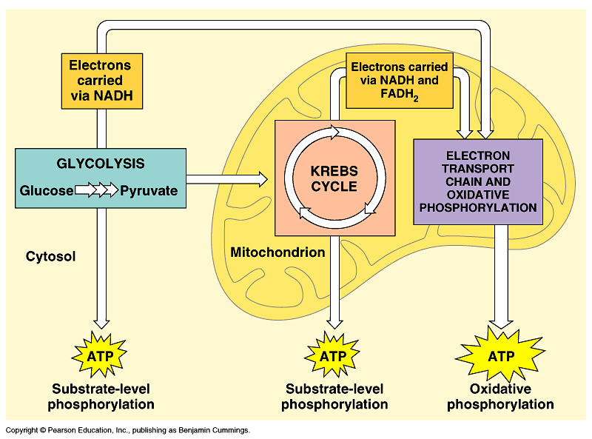
Overview of cellular respiration
4 metabolic stages
  Anaerobic respiration
    1. Glycolysis
      respiration without O₂
      in cytosol
  Aerobic respiration
      respiration using O₂
      in mitochondria
    2. Pyruvate oxidation
    3. Krebs cycle
    4. Electron transport chain
C₆H₁₂O₆
+
6O₂
→
ATP
+
6H₂O
+
6CO₂
(+ heat)

Slide 13
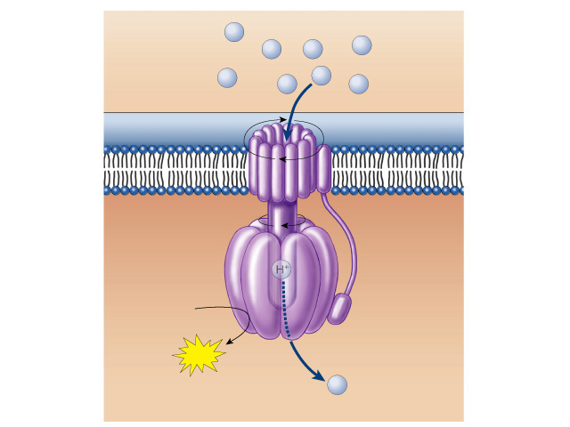
And how do we do that?
H⁺
H⁺
H⁺
H⁺
ATP synthase enzyme
  H⁺ flows through it
    conformational changes
    bond P_{i} to ADP to make ATP
  set up a H⁺ gradient
    allow the H⁺ to flow down concentration gradient through ATP synthase
    ADP + P_{i} → ATP
H⁺
H⁺
H⁺
H⁺
ADP
+
P
ATP
H⁺
But… How is the proton (H⁺) gradient formed?
Notes:
During the transport of electrons, a concentration gradient of H⁺ ions is formed across the inner membrane into the intermembrane space
The potential energy of this concentration gradient is used to make ATP by a process called chemiosmosis
The concentration gradient drives H⁺ through ATP synthases and enzymes found in the membrane, and ATP is produced
From studying the structure of ATP synthase, scientists have learned how the flow of H⁺ through this large enzyme powers ATP generation.
The authors develop an analogy between the function of the inner mitochondrial membrane and a dam. A reservoir of hydrogen ions is built up between the inner and outer mitochondrial membranes, like a dam holding back water. As the hydrogen ions move down their concentration gradient, they “spin” the ATP synthase, which helps generate ATP. In a dam, water rushing downhill turns giant turbines, which generate electricity.

Slide 14

Glycolysis
Breaking down glucose
  “glyco – lysis” (splitting sugar)
  ancient pathway which harvests energy
    where energy transfer first evolved
    transfer energy from organic molecules to ATP
    still is starting point for ALL cellular respiration
  but it’s inefficient
    generate only 2 ATP for every 1 glucose
  occurs in cytosol
In the
cytosol?
Why does
that make
evolutionary
sense?
glucose → → → → → pyruvate
6C
2x
3C
That’s not enough
ATP for me!
Notes:
Why does it make sense that this happens in the cytosol?
Who evolved first?

Slide 15
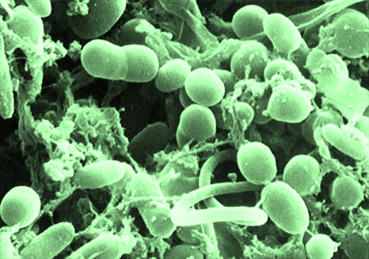
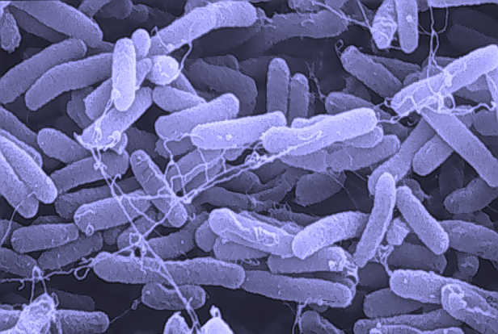
Evolutionary perspective
Prokaryotes
  first cells had no organelles
Anaerobic atmosphere
  life on Earth first evolved without free oxygen (O₂) in atmosphere
  energy had to be captured from organic molecules in absence of O₂
Prokaryotes that evolved glycolysis are ancestors of all modern life
  ALL cells still utilize glycolysis
Enzymes
of glycolysis are
“well-conserved”
You mean
we’re related?
Do I have to invite
them over for
the holidays?
Notes:
The enzymes of glycolysis are very similar among all organisms. The genes that code for them are highly conserved.
They are a good measure for evolutionary studies. Compare eukaryotes, bacteria & archaea using glycolysis enzymes.
Bacteria = 3.5 billion years ago
glycolysis in cytosol = doesn’t require a membrane-bound organelle
O₂ = 2.7 billion years ago
photosynthetic bacteria / proto-blue-green algae
Eukaryotes = 1.5 billion years ago
membrane-bound organelles!
Processes that all life/organisms share:
Protein synthesis
Glycolysis
DNA replication

Slide 16
Overview
glucose
C-C-C-C-C-C
10 reactions
  convert
  glucose (6C) to
  2 pyruvate (3C)
  produces:
  4 ATP & 2 NADH
  consumes:
  2 ATP
  net yield:
  2 ATP & 2 NADH
ATP
2
enzyme
2
enzyme
ADP
fructose-1,6bP
P-C-C-C-C-C-C-P
enzyme
enzyme
DHAP
P-C-C-C
enzyme
G3P
C-C-C-P
2
2H
NAD⁺
2P_{i}
enzyme
2
enzyme
4
2P_{i}
ADP
enzyme
ATP
4
DHAP = dihydroxyacetone phosphate
G3P = glyceraldehyde-3-phosphate
pyruvate
C-C-C
Notes:
1st ATP used is like a match to light a fire…
initiation energy / activation energy.
Destabilizes glucose enough to split it in two

Slide 17
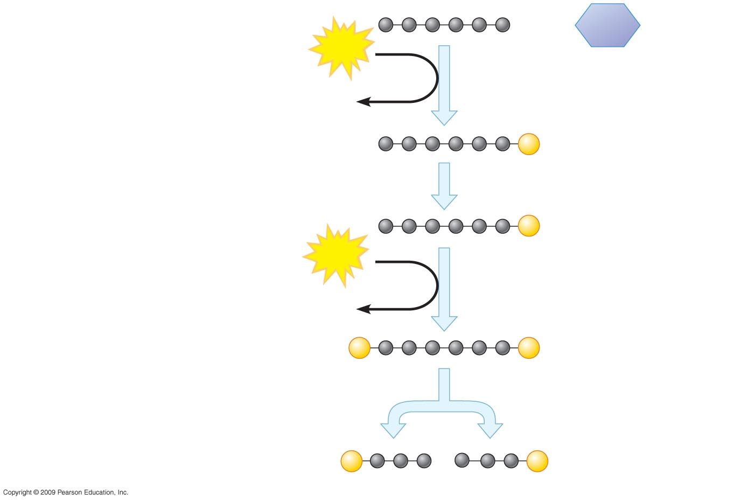
ENERGY
INVESTMENT
PHASE
Glucose
ATP
Steps – A fuel molecule is energized,
using ATP.
Step
1
3
1
ADP
P
Glucose-6-phosphate
2
P
Fructose-6-phosphate
ATP
3
ADP
P
P
Fructose-1,6-bisphosphate
Step A six-carbon intermediate splits
Into two three-carbon intermediates.
4
4
P
P
Glyceraldehyde-3-
phosphate (G3P)
Notes:
Figure 6.7C Details of glycolysis.

Slide 18
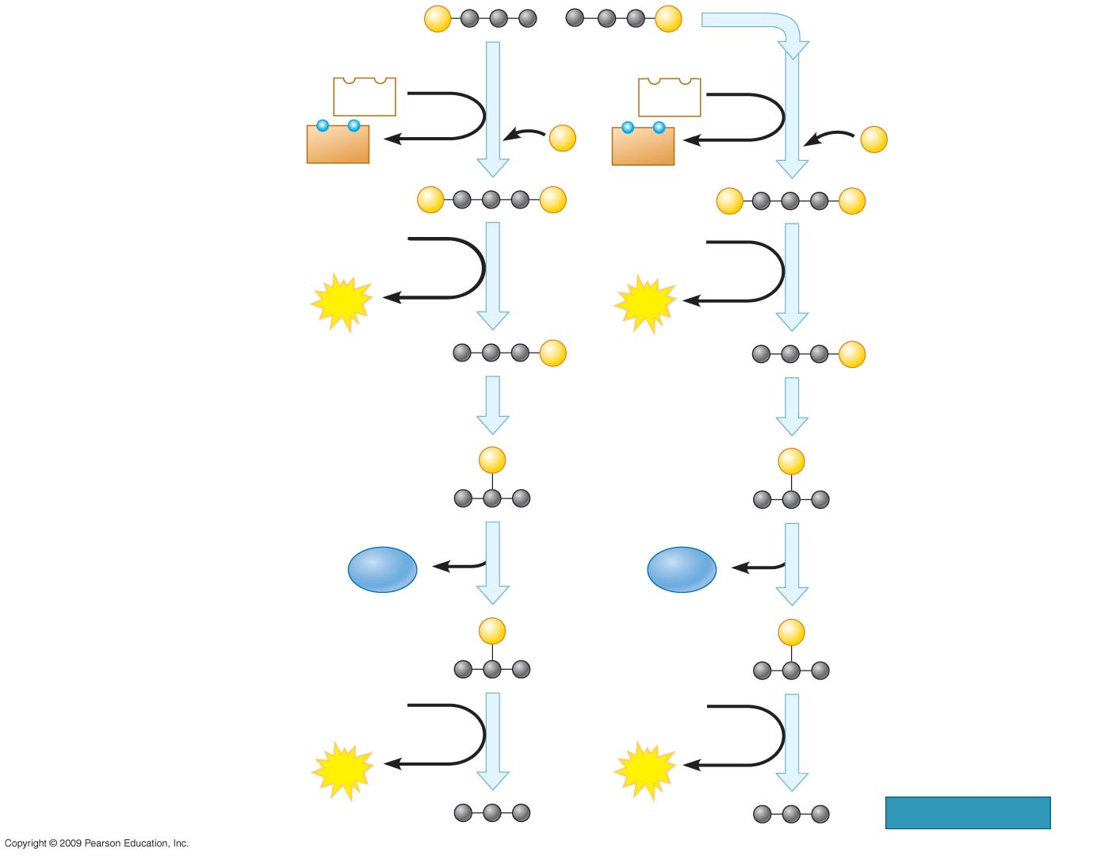
P
P
Glyceraldehyde-3-phosphate
(G3P)
Step A redox reaction
generates NADH.
NAD⁺
5
NAD⁺
5
5
ENERGY PAYOFF PHASE
NADH
P
NADH
P
+ H⁺
+ H⁺
P
P
P
P
1,3-Bisphosphoglycerate
ADP
ADP
6
6
ATP
ATP
P
P
3-Phosphoglycerate
7
7
Steps – ATP and pyruvate
are produced.
6
9
P
P
2-Phosphoglycerate
H₂O
8
H₂O
8
P
P
Phosphoenolpyruvate
(PEP)
ADP
ADP
9
9
ATP
ATP
Pyruvate
Notes:
Figure 6.7C Details of glycolysis.

Slide 19
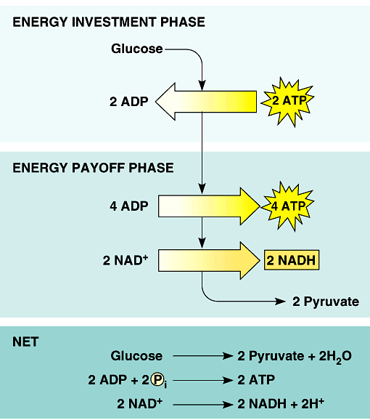
Glycolysis summary
endergonic
invest some ATP
ENERGY INVESTMENT
-2 ATP
G3P
C-C-C-P
exergonic
harvest a little
ATP & a little NADH
ENERGY PAYOFF
4 ATP
like $$
in the
bank
net yield
2 ATP
2 NADH
NET YIELD
Notes:
Glucose is a stable molecule it needs an activation energy
to break it apart.
phosphorylate it = Pi comes from ATP.
make NADH & put it in the bank for later.

Slide 20
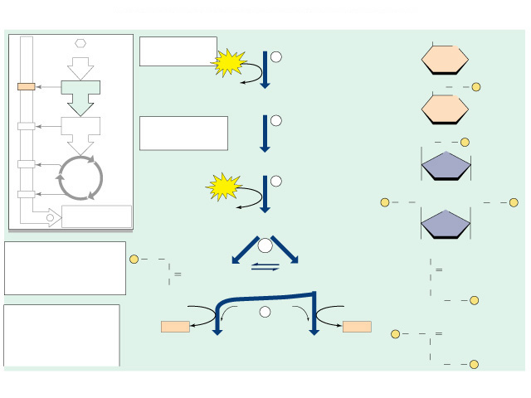
1st half of glycolysis (5 reactions)
Glucose “priming”
CH₂OH
Glucose
O
ATP
1
  get glucose ready to split
    phosphorylate glucose
    molecular rearrangement
  split destabilized glucose
hexokinase
ADP
CH₂
O
P
O
Glucose 6-phosphate
2
phosphoglucose
isomerase
CH₂
O
P
O
CH₂OH
Fructose 6-phosphate
ATP
3
phosphofructokinase
P
O
CH₂
CH₂
O
P
ADP
O
Fructose 1,6-bisphosphate
4,5
aldolase
H
P
O
CH₂
isomerase
C
O
Dihydroxyacetone
phosphate
Glyceraldehyde 3
-phosphate (G3P)
C
O
CH₂OH
CHOH
CH₂
O
P
NAD⁺
P_{i}
6
P_{i}
NAD⁺
NADH
glyceraldehyde
3-phosphate
dehydrogenase
NADH
P
O
O
1,3-Bisphosphoglycerate
(BPG)
1,3-Bisphosphoglycerate
(BPG)
CHOH
CH₂
O
P

Slide 21
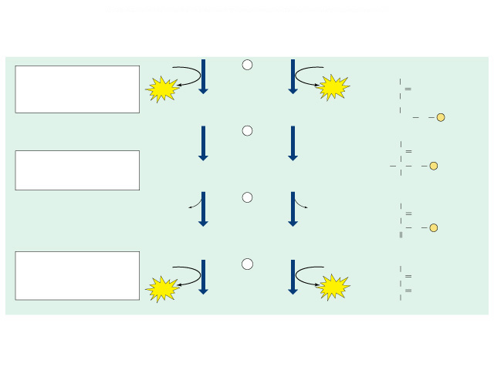
2nd half of glycolysis (5 reactions)
DHAP
P-C-C-C
G3P
C-C-C-P
Energy Harvest
  NADH production
    G3P donates H
    oxidizes the sugar
    reduces NAD⁺
    NAD⁺ → NADH
  ATP production
    G3P → → → pyruvate
    PEP sugar donates P
      “substrate level phosphorylation”
    ADP → ATP
NAD⁺
P_{i}
6
P_{i}
NAD⁺
NADH
NADH
ADP
7
ADP
O⁻
phosphoglycerate
kinase
ATP
ATP
C
3-Phosphoglycerate
(3PG)
3-Phosphoglycerate
(3PG)
CHOH
CH₂
O
P
8
O⁻
phosphoglycero-
mutase
C
O
2-Phosphoglycerate
(2PG)
2-Phosphoglycerate
(2PG)
H
C
O
P
CH₂OH
9
O⁻
H₂O
enolase
H₂O
C
O
C
O
P
Phosphoenolpyruvate
(PEP)
Phosphoenolpyruvate
(PEP)
CH₂
10
O⁻
ADP
ADP
C
O
pyruvate kinase
ATP
ATP
C
O
Pyruvate
Pyruvate
CH₃

Slide 22
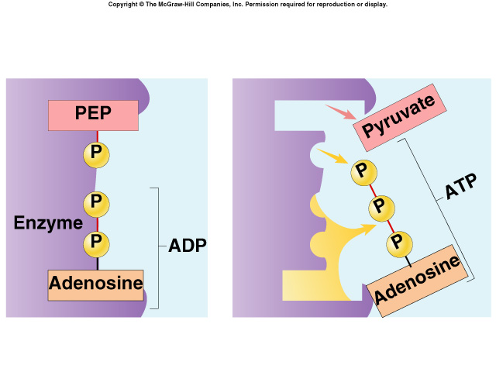
Substrate-level Phosphorylation
In the last steps of glycolysis, where did the P come from to make ATP?
  the sugar substrate (PEP)
9
O⁻
H₂O
enolase
H₂O
C
O
P is transferred from PEP to ADP
  kinase enzyme
  ADP → ATP
C
O
P
Phosphoenolpyruvate
(PEP)
Phosphoenolpyruvate
(PEP)
CH₂
10
O⁻
ADP
ADP
C
O
pyruvate kinase
ATP
ATP
C
O
ATP
Pyruvate
Pyruvate
CH₃
I get it!
The P_{i} came
directly from
the substrate!
Notes:
In substrate-level phosphorylation, an enzyme transfers a phosphate group from a substrate molecule to ADP, forming ATP
This ATP can be used immediately, but NADH must be transported through the electron transport chain to generate additional ATP

Slide 23
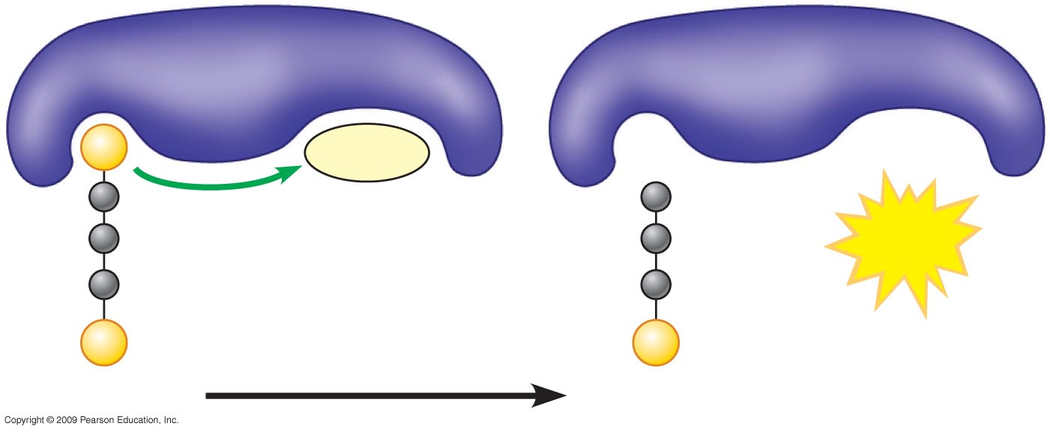
Enzyme
Enzyme
P
ADP
+
ATP
P
P
Substrate
Product
Notes:
Figure 6.7B Substrate-level phosphorylation: transfer of a phosphate group P from a substrate to ADP, producing ATP.

Slide 24
Energy accounting of glycolysis
2 ATP
2 ADP
glucose → → → → → pyruvate
6C
2x
3C
ATP
All that work!
And that’s all
I get?
4 ADP
4
2 NAD⁺
2
But
glucose has
so much more
to give!
Net gain = 2 ATP + 2 NADH
  some energy investment (-2 ATP)
  small energy return (4 ATP + 2 NADH)
1 6C sugar → 2 3C sugars
Notes:
And that’s how life subsisted for a billion years.
Until a certain bacteria ”learned” how to metabolize O₂; which was previously a poison.
But now pyruvate is not the end of the process
Pyruvate still has a lot of energy in it that has not been captured.
It still has 3 carbons bonded together!
There is still energy stored in those bonds.
It can still be oxidized further.

Slide 25

Is that all there is?
Not a lot of energy…
  for 1 billon years⁺ this is how life on Earth survived
    no O₂ = slow growth, slow reproduction
    only harvest 3.5% of energy stored in glucose
      more carbons to strip off = more energy to harvest
O₂
glucose → → → → pyruvate
O₂
6C
2x
3C
O₂
Hard way
to make
a living!
O₂
O₂
Notes:
So why does glycolysis still take place?

Slide 26
But can’t stop there!
DHAP
G3P
NAD⁺
P_{i}
P_{i}
NAD⁺
raw materials → products
NADH
P_{i}
NADH
NAD⁺
P_{i}
6
NAD⁺
NADH
1,3-BPG
1,3-BPG
NADH
ADP
7
ADP
Glycolysis
glucose + 2ADP + 2P_{i} + 2 NAD⁺ → 2 pyruvate + 2ATP + 2NADH
ATP
ATP
3-Phosphoglycerate
(3PG)
3-Phosphoglycerate
(3PG)
8
Going to run out of NAD⁺
  without regenerating NAD⁺,
  energy production would stop!
  another molecule must accept H
  from NADH
    so NAD⁺ is freed up for another round
2-Phosphoglycerate
(2PG)
2-Phosphoglycerate
(2PG)
9
H₂O
H₂O
Phosphoenolpyruvate
(PEP)
Phosphoenolpyruvate
(PEP)
ADP
10
ADP
ATP
ATP
Pyruvate
Pyruvate

Slide 27
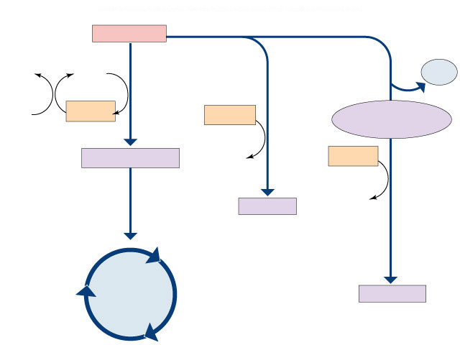

How is NADH recycled to NAD⁺?
Another molecule must accept H from NADH
with oxygen
aerobic respiration
without oxygen
anaerobic respiration
“fermentation”
pyruvate
H₂O
NAD⁺
CO²
O₂
NADH
NADH
acetaldehyde
recycle
NADH
acetyl-CoA
NADH
NAD⁺
lactate
NAD⁺
lactic acid
fermentation
which path you use depends on who you are…
Krebs
cycle
ethanol
alcohol
fermentation
Notes:
Fermentation is an anaerobic (without oxygen) energy-generating process
It takes advantage of glycolysis, producing two ATP molecules and reducing NAD⁺ to NADH
The trick is to oxidize the NADH without passing its electrons through the electron transport chain to oxygen

Slide 28
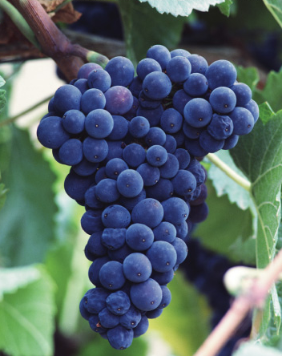
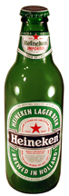
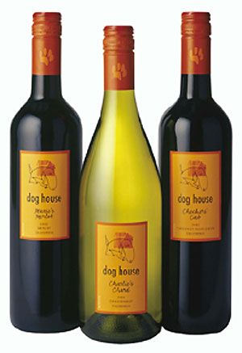

Fermentation (anaerobic)
Bacteria, yeast
pyruvate → ethanol + CO₂
3C
2C
1C
NADH
NAD⁺
back to glycolysis→→
    beer, wine, bread
Animals, some fungi
pyruvate → lactic acid
3C
3C
NADH
NAD⁺
back to glycolysis→→
    cheese, anaerobic exercise (no O₂)
Notes:
Count the carbons!!
Lactic acid is not a dead end like ethanol. Once you have O₂ again, lactate is converted back to pyruvate by the liver and fed to the Kreb’s cycle.
Fermentation is an anaerobic (without oxygen) energy-generating process
It takes advantage of glycolysis, producing two ATP molecules and reducing NAD⁺ to NADH
The trick is to oxidize the NADH without passing its electrons through the electron transport chain to oxygen

Slide 29
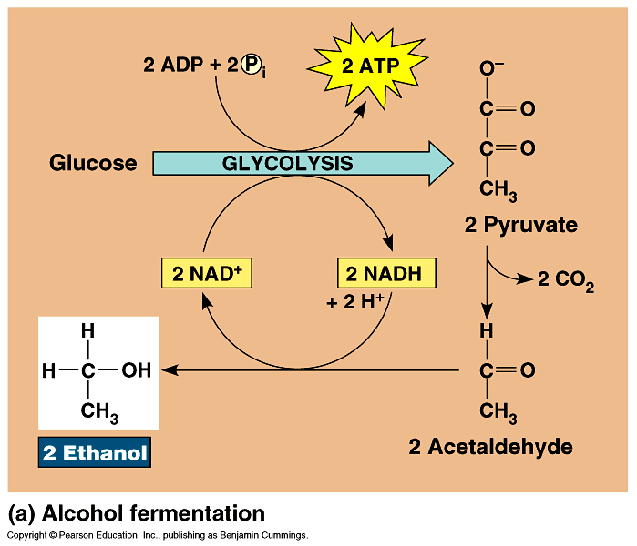
Alcohol Fermentation
bacteria yeast
recycle
NADH
pyruvate → ethanol + CO₂
3C
2C
1C
NADH
NAD⁺
back to glycolysis→→
Dead end process
  at ~12% ethanol, kills yeast
  can’t reverse the reaction
Count the
carbons!

Slide 30
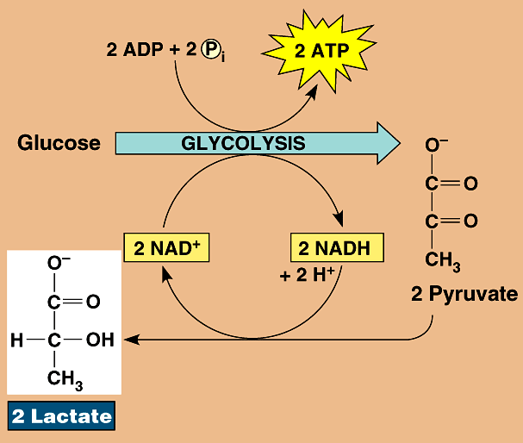
Lactic Acid Fermentation
animals
some fungi
recycle
NADH
pyruvate → lactic acid
O₂
→
3C
3C
NADH
NAD⁺
back to glycolysis→→
Reversible process
  once O₂ is available, lactate is converted back to pyruvate by the liver
Count the
carbons!

Slide 31
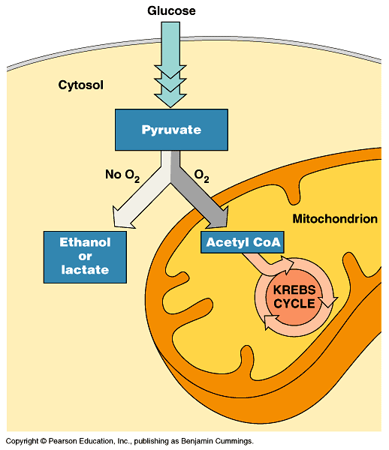
Pyruvate is a branching point
Pyruvate
O₂
O₂
fermentation
anaerobic
respiration
mitochondria
Krebs cycle
aerobic respiration

Slide 32
Glycolysis is only the start
Glycolysis
Pyruvate has more energy to yield
  3 more C to strip off (to oxidize)
  if O₂ is available, pyruvate enters mitochondria
  enzymes of Krebs cycle complete the full oxidation of sugar to CO₂
glucose → → → → → pyruvate
6C
2x
3C
pyruvate → → → → → → CO₂
3C
1C
Notes:
Can’t stop at pyruvate == not enough energy produced
Pyruvate still has a lot of energy in it that has not been captured.
It still has 3 carbons! There is still energy stored in those bonds.

Slide 33
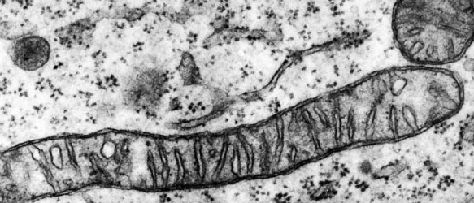
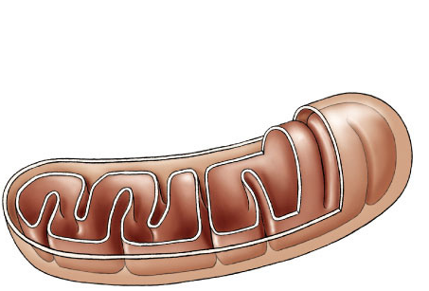
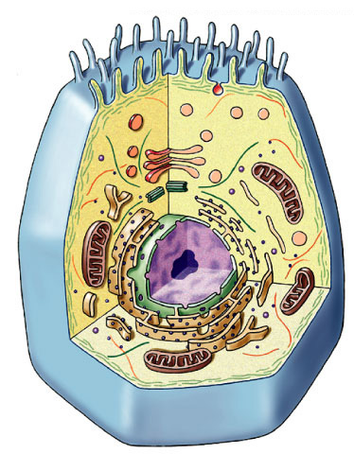
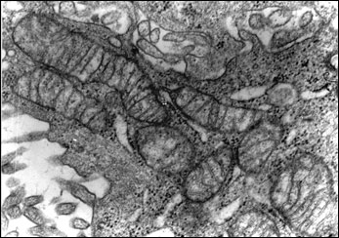
Mitochondria — Structure
Double membrane energy harvesting organelle
  smooth outer membrane
  highly folded inner membrane
    cristae
  intermembrane space
    fluid-filled space between membranes
  matrix
    inner fluid-filled space
  DNA, ribosomes
  enzymes
    free in matrix & membrane-bound
outer
membrane
intermembrane
space
inner
membrane
cristae
matrix
What cells would have a lot of mitochondria?
mitochondrial
DNA

Slide 34


Mitochondria – Function
Dividing mitochondria
Who else divides like that?
Membrane-bound proteins
Enzymes & permeases
bacteria!
What does this tell us about the evolution of eukaryotes?
Endosymbiosis!
Advantage of highly folded inner membrane?
More surface area for membrane-bound enzymes & permeases
Notes:
Almost all eukaryotic cells have mitochondria
there may be 1 very large mitochondrion or 100s to 1000s of individual mitochondria
number of mitochondria is correlated with aerobic metabolic activity
more activity = more energy needed = more mitochondria
What cells would have a lot of mitochondria?
Active cells:
• muscle cells
• nerve cells

Slide 35
Oxidation of pyruvate
Pyruvate enters mitochondrial matrix
  3 step oxidation process
  releases 2 CO₂ (count the carbons!)
  reduces 2 NAD → 2 NADH (moves e⁻)
  produces 2 acetyl CoA
Acetyl CoA enters Krebs cycle
[
]
2x
pyruvate → → → acetyl CoA + CO₂
3C
2C
1C
NAD
Where
does the
CO₂ go?
Exhale!
Notes:
CO₂ is fully oxidized carbon == can’t get any more energy out it
CH₄ is a fully reduced carbon == good fuel!!!
The pyruvate formed in glycolysis is transported to the mitochondria, where it is prepared for entry into the citric acid cycle
The first step is removal of a carboxyl group that forms CO₂
The second is oxidization of the two-carbon compound remaining
Finally, coenzyme A binds to the two-carbon fragment forming acetyl coenzyme A
With the help of CoA, the acetyl (two-carbon) compound enters the citric acid cycle
At this point, the acetyl group associates with a four-carbon molecule forming a six-carbon molecule
The six-carbon molecule then passes through a series of redox reactions that regenerate the four-carbon molecule (thus the “cycle” designation)

Slide 36
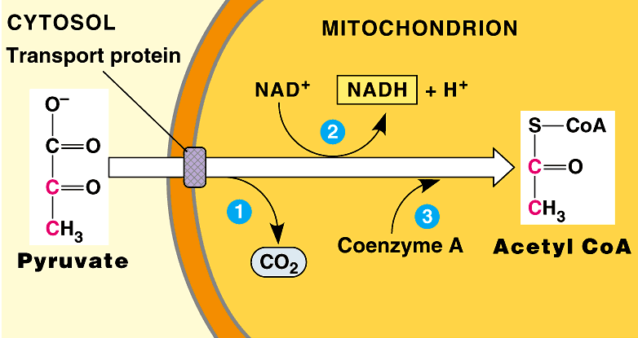
Pyruvate oxidized to Acetyl CoA
NAD⁺
reduction
Coenzyme A
Acetyl CoA
Pyruvate
CO₂
C-C
C-C-C
oxidation
2 x [
]
Yield = 2C sugar + NADH + CO₂
Notes:
Release CO₂ because completely oxidized…already released all energy it can release … no longer valuable to cell….
Because what’s the point?
The Point is to make ATP!!!

Slide 37

Krebs cycle
1937 | 1953
aka Citric Acid Cycle
  in mitochondrial matrix
  8 step pathway
    each catalyzed by specific enzyme
    step-wise catabolism of 6C citrate molecule
Evolved later than glycolysis
  does that make evolutionary sense?
    bacteria →3.5 billion years ago (glycolysis)
    free O₂ →2.7 billion years ago (photosynthesis)
    eukaryotes →1.5 billion years ago (aerobic respiration = organelles → mitochondria)
Hans Krebs
1900-1981
Notes:
The enzymes of glycolysis are very similar among all organisms. The genes that code for them are highly conserved.
They are a good measure for evolutionary studies. Compare eukaryotes, bacteria & archaea using glycolysis enzymes.
Bacteria = 3.5 billion years ago
glycolysis in cytosol = doesn’t require a membrane-bound organelle
O₂ = 2.7 billion years ago
photosynthetic bacteria / proto-blue-green algae
Eukaryotes = 1.5 billion years ago
membrane-bound organelles!
Processes that all life/organisms share:
Protein synthesis
Glycolysis
DNA replication

Slide 38
Count the carbons!
pyruvate
3C
2C
acetyl CoA
citrate
4C
6C
4C
6C
This happens twice for each glucose molecule
oxidation
of sugars
CO₂
x2
4C
5C
4C
4C
CO₂
Notes:
A 2 carbon sugar went into the Krebs cycle and was taken apart completely. Two CO2 molecules were produced from that 2 carbon sugar. Glucose has now been fully oxidized!
But where’s all the ATP???

Slide 39

Count the electron carriers!
CO₂
pyruvate
3C
2C
acetyl CoA
NADH
citrate
NADH
4C
6C
4C
reduction
of electron
carriers
6C
This happens twice for each glucose molecule
CO₂
x2
5C
NADH
4C
FADH₂
CO₂
4C
4C
ATP
NADH
Notes:
Everytime the carbons are oxidized, an NAD+ is being reduced.
But wait…where’s all the ATP??

Slide 40
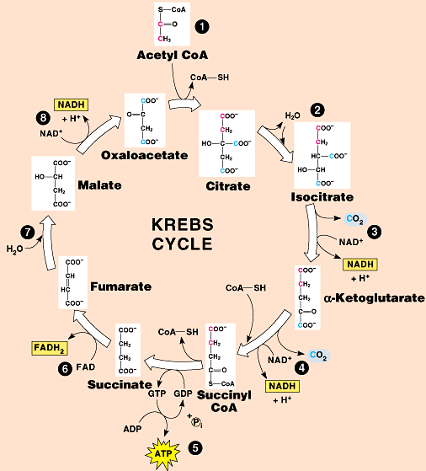
Whassup?
So we fully oxidized glucose
C₆H₁₂O₆
↓
CO₂
& ended up
with 4 ATP!
What’s the
point?

Slide 41
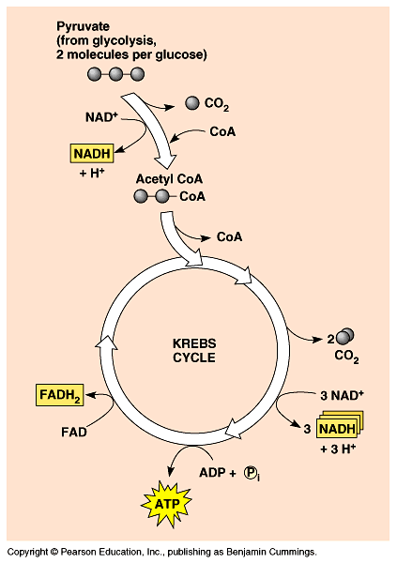
Electron Carriers = Hydrogen Carriers
Krebs cycle produces large quantities of electron carriers
  NADH
  FADH₂
  go to Electron Transport Chain!
H⁺
H⁺
H⁺
H⁺
H⁺
H⁺
H⁺
H⁺
ADP
+ P_{i}
ATP
H⁺
What’s so
important about
electron carriers?

Slide 42
Energy accounting of Krebs cycle
4 NAD + 1 FAD
4 NADH + 1 FADH₂
2x
pyruvate → → → → → → → → → CO₂
3C
3x
1C
1 ADP
ATP
1 ATP
Net gain = 2 ATP
= 8 NADH + 2 FADH₂

Slide 43
Value of Krebs cycle?
If the yield is only 2 ATP then how was the Krebs cycle an adaptation?
  value of NADH & FADH₂
    electron carriers & H carriers
      reduced molecules move electrons
      reduced molecules move H⁺ ions
    to be used in the Electron Transport Chain
like $$
in the
bank

Slide 44
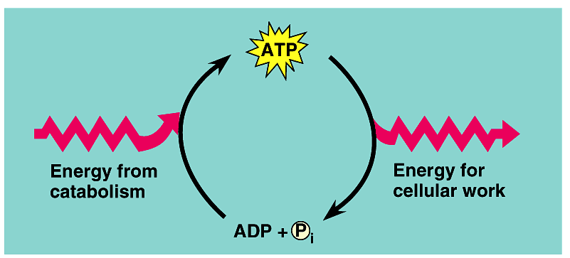
ATP accounting so far…
Glycolysis → 2 ATP
Kreb’s cycle → 2 ATP
Life takes a lot of energy to run, need to extract more energy than 4 ATP!
There’s got to be a better way!
I need a lot
more ATP!
A working muscle recycles over
10 million ATPs per second

Slide 45
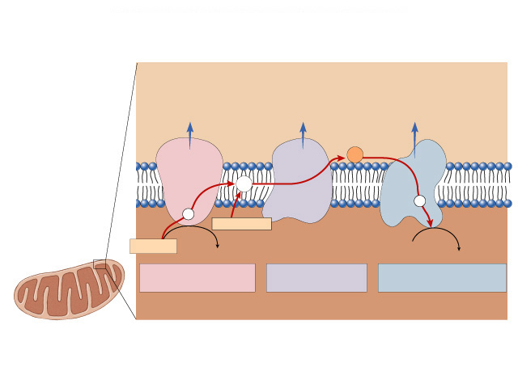
There is a better way!
Electron Transport Chain
  series of proteins built into
  inner mitochondrial membrane
    along cristae
    transport proteins & enzymes
  transport of electrons down ETC linked to pumping of H⁺ to create H⁺ gradient
  yields ~36 ATP from 1 glucose!
  only in presence of O₂ (aerobic respiration)
That
sounds more
like it!
O₂

Slide 46
Mitochondria
Double membrane
  outer membrane
  inner membrane
    highly folded cristae
    enzymes & transport proteins
  intermembrane space
    fluid-filled space between membranes
Oooooh!
Form fits
function!

Slide 47
Electron Transport Chain
Inner
mitochondrial
membrane
Intermembrane space
C
Q
NADH
dehydrogenase
cytochrome
bc complex
cytochrome c
oxidase complex
Mitochondrial matrix

Slide 48
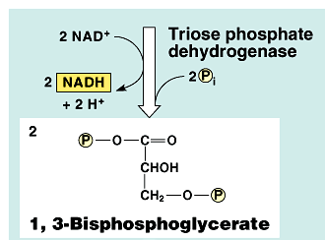
Remember the Electron Carriers?
glucose
Krebs cycle
Glycolysis
G3P
2 NADH
8 NADH
2 FADH₂
Time to
break open
the piggybank!

Slide 49
Electron Transport Chain
Building proton gradient!
NADH → NAD⁺ + H
e
intermembrane
space
p
H⁺
H⁺
H⁺
inner
mitochondrial
membrane
H → e- + H⁺
C
Q
e–
e–
H
e–
FADH₂
FAD
H
1
2
NADH
2H⁺ +
O₂
H₂O
NAD⁺
NADH
dehydrogenase
cytochrome
bc complex
cytochrome c
oxidase complex
mitochondrial
matrix
What powers the proton (H⁺) pumps?…

Slide 50
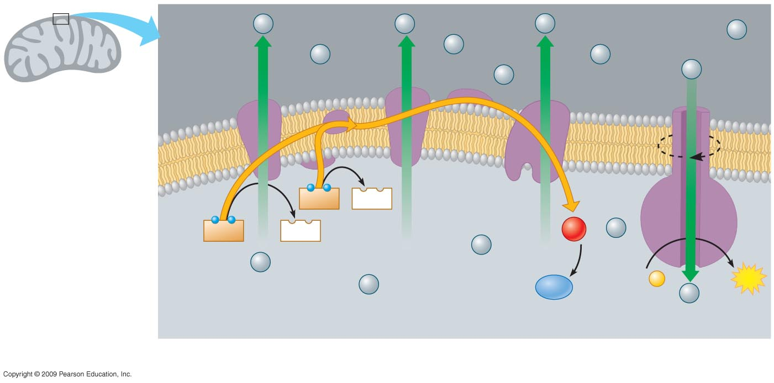
H⁺
H⁺
H⁺
H⁺
Protein
complex
of electron
carriers
H⁺
H⁺
H⁺
Electron
carrier
H⁺
H⁺
ATP
synthase
Intermembrane
space
Inner
mitochondrial
membrane
Electron
flow
FADH₂
FAD
NADH
NAD⁺
1
−
2
O₂
+ 2
H⁺
H⁺
Mitochondrial
matrix
H⁺
H⁺
H₂O
ADP +
P
ATP
H⁺
Electron Transport Chain
Chemiosmosis
OXIDATIVE PHOSPHORYLATION
Notes:
Figure 6.10 Oxidative phosphorylation, using electron transport and chemiosmosis in the mitochondrion.
Oxidative phosphorylation involves electron transport and chemiosmosis and requires an adequate supply of oxygen
NADH and FADH₂ and the inner membrane of the mitochondria are also involved
A H⁺ ion gradient formed from all of the redox reactions of glycolysis and the citric acid cycle provide energy for the synthesis of ATP
The extensive folds of the mitochondrial membranes provide space for thousands of copies of the electron transport chain and many ATP synthase complexes.
The process is called oxidative phosphorylation because the energy is derived from the oxidation-reduction reactions of the electron transport chain and is used to phosphorylate ADP.

Slide 51
Stripping H from Electron Carriers
Electron carriers pass electrons & H⁺ to ETC
  H cleaved off NADH & FADH₂
  electrons stripped from H atoms → H⁺ (protons)
    electrons passed from one electron carrier to next in mitochondrial membrane (ETC)
    flowing electrons = energy to do work
  transport proteins in membrane pump H⁺ (protons) across inner membrane to intermembrane space
TA-DA!!
Moving electrons
do the work!
H⁺
H⁺
H⁺
H⁺
H⁺
H⁺
H⁺
H⁺
H⁺
H⁺
H⁺
H⁺
H⁺
H⁺
C
Q
e–
e–
e–
FADH₂
FAD
ADP
+ P_{i}
NADH
2H⁺ +
1
2
O₂
H₂O
NAD⁺
NADH
dehydrogenase
cytochrome
bc complex
cytochrome c
oxidase complex
ATP
H⁺
Notes:
Oxidation refers to the loss of electrons to any electron acceptor, not just to oxygen.
Uses exergonic flow of electrons through ETC to pump H+ across membrane.

Slide 52
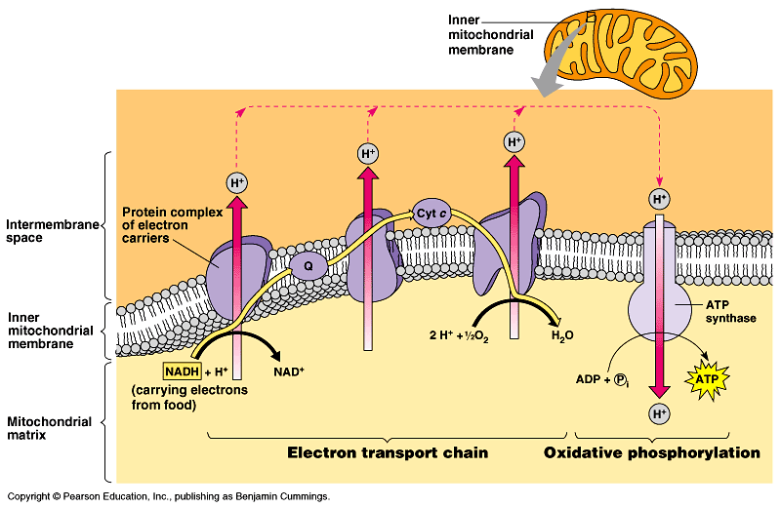
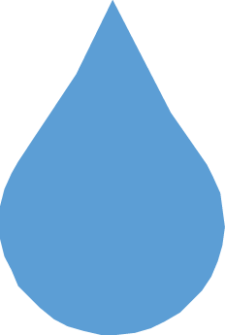
But what “pulls” the
electrons down the ETC?
H₂O
O₂
electrons
flow downhill
to O₂
oxidative phosphorylation
Notes:
Pumping H+ across membrane … what is energy to fuel that?
Can’t be ATP!
that would cost you what you want to make!
Its like cutting off your leg to buy a new pair of shoes. :-(
Flow of electrons powers pumping of H⁺
O₂ is 2 oxygen atoms both looking for electrons

Slide 53
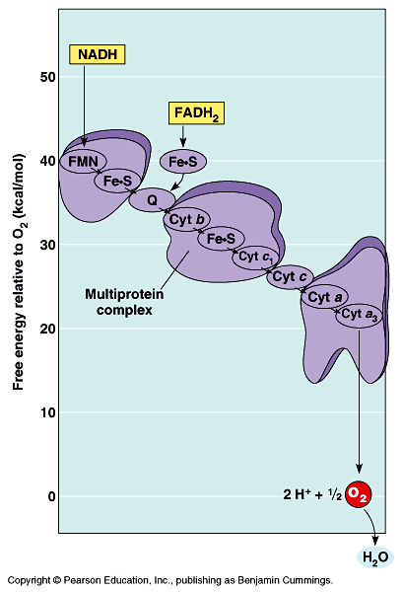
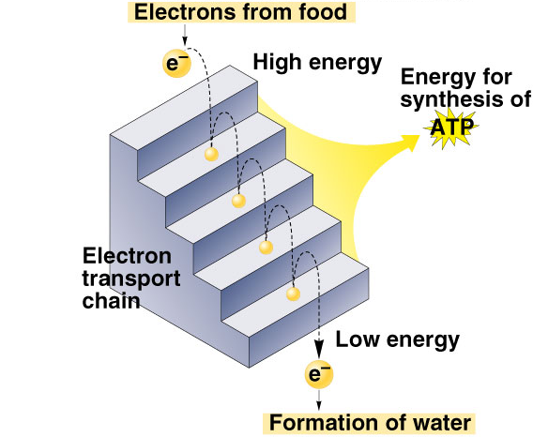
Electrons flow downhill
Electrons move in steps from
carrier to carrier downhill to oxygen
  each carrier more electronegative
  controlled oxidation
  controlled release of energy
make ATP
instead of
fire!
Notes:
Electrons move from molecule to molecule until they combine with O & H ions to form H₂O
It’s like pumping water behind a dam -- if released, it can do work

Slide 54
We did it!
“proton-motive” force
H⁺
H⁺
H⁺
H⁺
Set up a H⁺ gradient
Allow the protons
to flow through ATP synthase
Synthesizes ATP
ADP + P_{i} → ATP
H⁺
H⁺
H⁺
H⁺
ADP + P_{i}
ATP
Are we
there yet?
H⁺

Slide 55
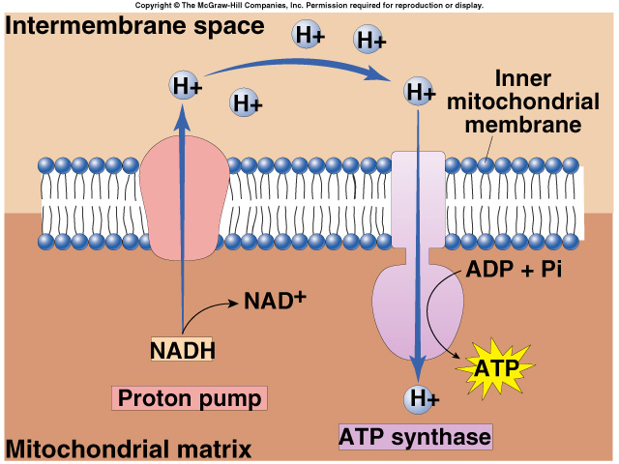
Chemiosmosis
The diffusion of ions across a membrane
  build up of proton gradient just so H+ could flow through ATP synthase enzyme to build ATP
Chemiosmosis links the Electron Transport Chain to ATP synthesis
So that’s
the point!
Notes:
Chemiosmosis is the diffusion of ions across a membrane. More specifically, it relates to the generation of ATP by the movement of hydrogen ions across a membrane.
Hydrogen ions (protons) will diffuse from an area of high proton concentration to an area of lower proton concentration. Peter Mitchell proposed that an electrochemical concentration gradient of protons across a membrane could be harnessed to make ATP. He likened this process to osmosis, the diffusion of water across a membrane, which is why it is called chemiosmosis.

Slide 56
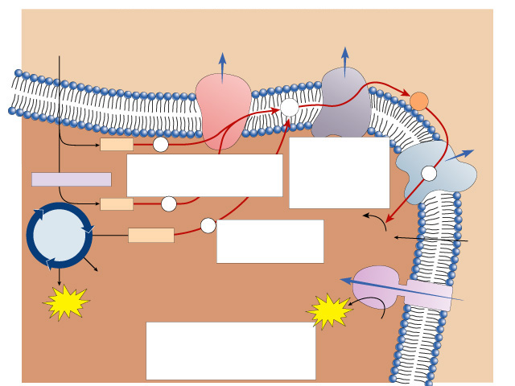
Pyruvate from
cytoplasm
Inner
mitochondrial
membrane
Intermembrane
space
H⁺
H⁺
Electron
transport
system
Q
C
NADH
e⁻
2. Electrons provide energy
to pump protons across the membrane.
H⁺
1. Electrons are harvested and carried to the transport system.
e⁻
Acetyl-CoA
NADH
e⁻
H₂O
Krebs
cycle
e⁻
3. Oxygen joins with protons to form water.
1
FADH₂
2
O₂
O₂
+
2H⁺
CO₂
H⁺
ATP
ATP
H⁺
ATP
4. Protons diffuse back in
down their concentration
gradient, driving the
synthesis of ATP.
ATP
synthase
Mitochondrial
matrix

Slide 57
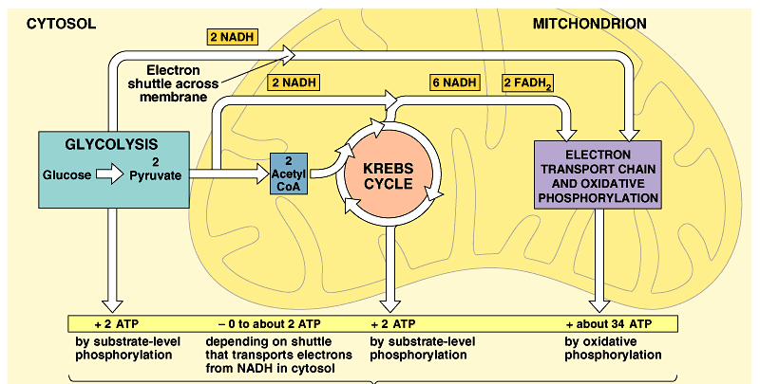
Cellular respiration
~40 ATP
2 ATP
+
2 ATP
+
~36 ATP

Slide 58
Summary of cellular respiration
C₆H₁₂O₆
+
6O₂
→
6CO₂
+
6H₂O
+
~40 ATP
Where did the glucose come from?
Where did the O₂ come from?
Where did the CO₂ come from?
Where did the CO₂ go?
Where did the H₂O come from?
Where did the ATP come from?
What else is produced that is not listed
in this equation?
Why do we breathe?
Notes:
Where did the glucose come from?
from food eaten
Where did the O₂ come from?
breathed in
Where did the CO₂ come from?
oxidized carbons cleaved off of the sugars (Krebs Cycle)
Where did the CO₂ go?
exhaled
Where did the H₂O come from?
from O₂ after it accepts electrons in ETC
Where did the ATP come from?
mostly from ETC
What else is produced that is not listed in this equation?
NAD, FAD, heat!

Slide 59
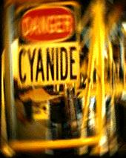
Taking it beyond…
H⁺
H⁺
H⁺
What is the final electron acceptor in Electron Transport Chain?
C
Q
e–
e–
e–
FADH₂
FAD
O₂
NADH
2H⁺ +
1
2
O₂
H₂O
NAD⁺
NADH
dehydrogenase
cytochrome
bc complex
cytochrome c
oxidase complex
So what happens if O₂ unavailable?
ETC backs up
  nothing to pull electrons down chain
  NADH & FADH₂ can’t unload H
ATP production ceases
cells run out of energy
and you die!
Notes:
What if you have a chemical that punches holes in the inner mitochondrial membrane?

Slide 60
Cellular Respiration
Other Metabolites &
Control of Respiration

Slide 61
Cellular respiration

Slide 62
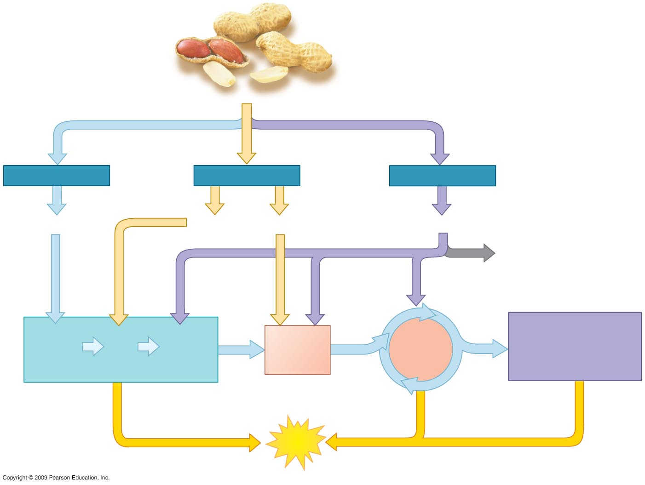
Food, such as
peanuts
Carbohydrates
Fats
Proteins
Sugars
Glycerol
Fatty acids
Amino acids
Amino
groups
OXIDATIVE
PHOSPHORYLATION
(Electron Transport
and Chemiosmosis)
Acetyl
CoA
CITRIC
ACID
CYCLE
Glucose
G3P
Pyruvate
GLYCOLYSIS
ATP
Notes:
Figure 6.15 Pathways that break down various food molecules.

Slide 63
Beyond glucose: Other carbohydrates
Glycolysis accepts a wide range of carbohydrates fuels
polysaccharides → → → glucose
hydrolysis
    ex. starch, glycogen
other 6C sugars → → → glucose
modified
    ex. galactose, fructose

Slide 64
Beyond glucose: Proteins
proteins → → → → → amino acids
hydrolysis
O
O
H
|
—C—
|
H
H
|
—C—
|
H
||
||
C—OH
C—OH
N
N
waste
glycolysis
Krebs cycle
H
H
R
R
amino group =
waste product excreted as ammonia, urea, or uric acid
2C sugar =
carbon skeleton =
enters glycolysis or Krebs cycle at
different stages

Slide 65
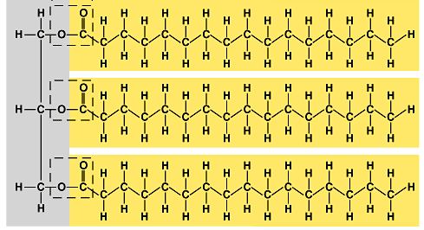
Beyond glucose: Fats
fats → → → → → glycerol + fatty acids
hydrolysis
glycerol (3C) → → G3P → → glycolysis
fatty acids → 2C acetyl → acetyl → Krebs
groups
coA
cycle
3C glycerol
2C fatty acids
enters
glycolysis
as G3P
enter
Krebs cycle
as acetyl CoA

Slide 66
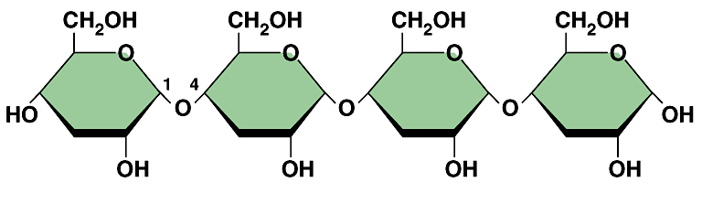
Carbohydrates vs. Fats
Fat generates 2x ATP vs. carbohydrate
  more C in gram of fat
    more energy releasing bonds
  more O in gram of carbohydrate
    so it’s already partly oxidized
    less energy to release
That’s why
it takes so much
to lose a
pound a fat!
fat
carbohydrate
Notes:
Carbohydrate
Wherever there is an oxygen, the molecule is already oxidized so it has less energy to release.
Fats
Large hydrocarbon chains (C-H bonds) of fatty acid.

Slide 67

Metabolism
Coordination of chemical processes across whole organism
  digestion
    catabolism when organism needs energy or needs raw materials
  synthesis
    anabolism when organism has enough energy & a supply of raw materials
  by regulating enzymes
    feedback mechanisms
    raw materials stimulate production
    products inhibit further production
CO₂

Slide 68
Metabolism
Digestion
  digestion of carbohydrates, fats & proteins
    all catabolized through same pathways
    enter at different points
  cell extracts energy from every source
Cells are
versatile &
selfish!
CO₂

Slide 69
Metabolism
Synthesis
  enough energy?
  build stuff!
  cell uses points in glycolysis & Krebs cycle as links to pathways for synthesis
    run pathways “backwards”
      have extra fuel, build fat!
Cells are
versatile &
thrifty!
pyruvate → → glucose
Krebs cycle
intermediaries
→ →
amino
acids
acetyl CoA → → fatty acids
Notes:
Metabolism is remarkably versatile & adaptable. Cells are thrifty, expedient, and responsive in their metabolism.
Glycolysis & the Krebs cycle function as metabolic interchanges that enable cells to convert one kind of molecule to another as needed.
A human cell can synthesize about half the 20 different amino acids by modifying compounds from the Krebs cycle.
Excess carbohydrates & proteins can be converted to fats through intermediaries of glycolysis and the Krebs cycle.
You can make fat from eating too much sugars and carbohydrates!!
Gluconeogenesis = running glycolysis in reverse

Slide 70


Carbohydrate
Metabolism
The many stops on the Carbohydrate Line
from Krebs cycle back through glycolysis
“gluconeogenesis”

Slide 71

Lipid Metabolism
The many stops on the Lipid Line
from Krebs cycle (acetyl CoA)
to a variety of lipid synthesis pathways

Slide 72

Amino Acid
Metabolism
The many stops on the
Amino Acid Line
from Krebs cycle & glycolysis to an array of amino acid synthesis pathways
8 essential amino acids
12 synthesized aa’s

Slide 73

Nucleotide
Metabolism
The many stops on the
GATC Line
• sugar from glycolysis
• phosphate & N-base from Krebs cycle

Slide 74

Central Role of Acetyl CoA
Glycolysis
Glucose
Pyruvate
Glycolysis
CO₂
Acetyl CoA is central to both energy production & biomolecule synthesis
Depending on organism’s need
  build ATP
    immediate use
  build fat
    stored energy
Pyruvate
oxidation
NAD⁺
NADH
Krebs
cycle
Protein
ETC
Lipid
Acetyl coA
coenzyme A
acetyl group
Fat
ATP

Slide 75

Control of Respiration
Feedback Control

Slide 76
Feedback Inhibition
Regulation & coordination of production
  final product is inhibitor of earlier step
    allosteric inhibitor of earlier enzyme
  no unnecessary accumulation of product
  production is self-limiting
A → B → C → D → E → F → G
→
→
→
→
→
→
X
enzyme
2
enzyme
3
enzyme
4
enzyme
5
enzyme
6
enzyme
1
allosteric inhibitor of enzyme 1

Slide 77
Respond to cell’s needs
Key point of control
  phosphofructokinase
    allosteric regulation of enzyme
      why here?
      “can’t turn back” step before splitting glucose
    AMP & ADP stimulate
    ATP inhibits
    citrate inhibits
Why is this regulation important?
Balancing act:
availability of raw materials vs. energy demands vs. synthesis
Notes:
Phosphofructokinase is the enzyme that controls the committed step of glycolysis right before glucose is cleaved into 2 3C sugars
This enzyme is inhibited by ATP and stimulated by AMP (derived from ADP).
responds to shifts in balance between production & degradation of ATP:
ATP ←→ ADP + P_{i} ←→ AMP + P_{i}
When ATP levels are high, inhibition of this enzyme slows glycolysis.
When ATP levels drop and ADP and AMP levels rise, the enzyme is active again and glycolysis speeds up.
Citrate, the first product of the Krebs cycle, is also an inhibitor of phosphofructokinase. Too much citrate means that Krebs cycle is backing up. This synchronizes the rate of glycolysis and the Krebs cycle.

Slide 78
A Metabolic economy
Basic principles of supply & demand regulate metabolic economy
  balance the supply of raw materials with the products produced
  these molecules become feedback regulators
    they control enzymes at strategic points in
    glycolysis & Krebs cycle
      levels of AMP, ADP, ATP
        regulation by final products & raw materials
      levels of intermediates compounds in pathways
        regulation of earlier steps in pathways
      levels of other biomolecules in body
        regulates rate of siphoning off to synthesis pathways
Notes:
If a cell has an excess of a certain amino acid, it typically uses feedback inhibition to prevent the diversion of more intermediary molecules from the Krebs cycle to the synthesis pathway of that amino acid.
Also, if intermediaries from the Krebs cycle are diverted to other uses (e.g., amino acid synthesis), glycolysis speeds up to replace these molecules.

Slide 79
It’s a Balancing Act
Glycolysis
Glucose
Pyruvate
Glycolysis
Balancing synthesis
with availability of
both energy & raw
materials is essential
for survival!
  do it well & you
  survive longer
  you survive longer &
  you have more offspring
  you have more offspring & you get to “take over the world”
Pyruvate
oxidation
Krebs
cycle
Protein
ETC
Lipid
Fat
ATP
Notes:
This is the essence of evolutionary survival.

Slide 80
6.11 CONNECTION: Certain poisons interrupt critical events in cellular respiration
There are three different categories of cellular poisons that affect cellular respiration
  The first category blocks the electron transport chain (for example, rotenone, cyanide, and carbon monoxide)
  The second inhibits ATP synthase (for example, oligomycin)
  Finally, the third makes the membrane leaky to hydrogen ions (for example, dinitrophenol)
Copyright © 2009 Pearson Education, Inc.
Notes:
Poisons like pesticides and antibiotics are obviously useful, but others are not.
Student Misconceptions and Concerns
1. Perhaps more than anywhere else in general biology, students studying aerobic metabolism may fail to see the forest for the trees. Students may focus on the details of each stage of aerobic metabolism and devote little attention to the overall process and products. Consider emphasizing the products and energy yields associated with glycolysis, the citric acid cycle, and oxidative phosphorylation before detailing the specifics of each reaction.
2. The location within a cell in which each reaction takes place is often forgotten in the details of the chemical processes, but it is important to emphasize. Consider using Figure 6.12 as a common reference to locate each stage as you discuss the details of cellular respiration.
3. Students frequently think that plants have chloroplasts instead of mitochondria. Take care to point out the need for mitochondria in plants when photosynthesis is not efficient or possible (such as during the night).
Teaching Tips
1. Module 6.11 explores the many points in cellular respiration where poisons may produce their deadly effects. Like any complex process, such as an engine of a car or the cooperation of athletes on a team, the results depend upon the proper functioning of each part. Poisons can stop a metabolic pathway by disrupting a single step in the process.

Slide 81
6.12 Review: Each molecule of glucose yields many molecules of ATP
Recall that the energy payoff of cellular respiration involves (1) glycolysis, (2) alteration of pyruvate, (3) the citric acid cycle, and (4) oxidative phosphorylation
  The total yield of ATP molecules per glucose molecule has a theoretical maximum of about 38
  This is about 40% of a glucose molecule potential energy
  Additionally, water and CO₂ are produced
Copyright © 2009 Pearson Education, Inc.
Notes:
The maximum ATP yield depends on an adequate supply of oxygen. However, some organisms can generate ATP without oxygen by a process called fermentation.
Student Misconceptions and Concerns
1. Perhaps more than anywhere else in general biology, students studying aerobic metabolism may fail to see the forest for the trees. Students may focus on the details of each stage of aerobic metabolism and devote little attention to the overall process and products. Consider emphasizing the products and energy yields associated with glycolysis, the citric acid cycle, and oxidative phosphorylation before detailing the specifics of each reaction.
2. The location within a cell in which each reaction takes place is often forgotten in the details of the chemical processes, but it is important to emphasize. Consider using Figure 6.12 as a common reference to locate each stage as you discuss the details of cellular respiration.
3. Students frequently think that plants have chloroplasts instead of mitochondria. Take care to point out the need for mitochondria in plants when photosynthesis is not efficient or possible (such as during the night).
Teaching Tips
1. Students should be reminded that the ATP yield of up to 38 ATP per glucose molecule is only a potential. The complex chemistry of aerobic metabolism can yield this amount only under ideal conditions, when every substrate and enzyme is immediately available. Such circumstances may occur only rarely in a working cell.

Slide 82

Electron shuttle
across membrane
Cytoplasm
Mitochondrion
2
NADH
2
NADH
(or 2 FADH₂)
2
NADH
6
NADH
2
FADH₂
GLYCOLYSIS
2
Pyruvate
OXIDATIVE
PHOSPHORYLATION
(Electron Transport
and Chemiosmosis)
2 Acetyl
CoA
CITRIC ACID
CYCLE
Glucose
+ 2 ATP
+ 2 ATP
+ about 34 ATP
by substrate-level
phosphorylation
by substrate-level
phosphorylation
by oxidative phosphorylation
Maximum per glucose:
About
38 ATP
Notes:
Figure 6.12 An estimated tally of the ATP produced by substrate-level and oxidative phosphorylation in cellular respiration.

Slide 83

ATP needed to drive biosynthesis
ATP
CITRIC
ACID
CYCLE
GLUCOSE SYNTHESIS
Acetyl
CoA
Pyruvate
G3P
Glucose
Amino
groups
Amino acids
Fatty acids
Glycerol
Sugars
Proteins
Fats
Carbohydrates
Cells, tissues, organisms
Notes:
Figure 6.16 Biosynthesis of large organic molecules from intermediates of cellular respiration.

