Slide 1
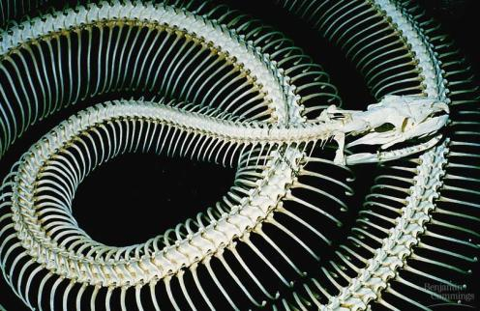
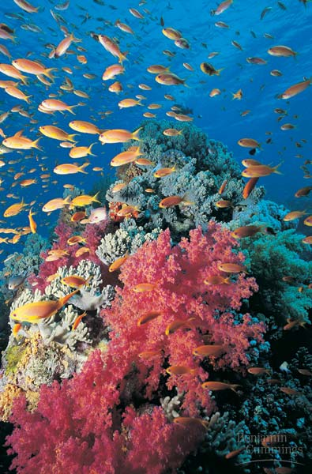
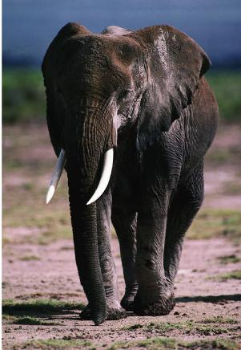
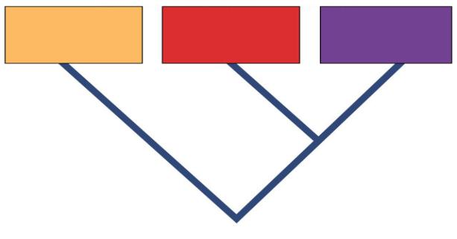
Kingdom: Animals
Domain Eukarya
(Ch. 32, 33, 34)
Domain
Bacteria
Domain
Archaea
Domain
Eukarya
Common ancestor

Slide 2
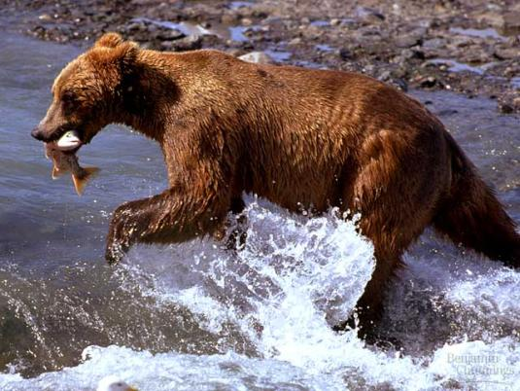
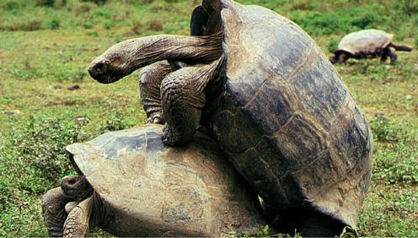
Animal Characteristics
Heterotrophs
must ingest orgnaisms (“food”) for nutrients
Multicellular
complex
No cell walls
Allows quickmovement
Sexual reproduction
no alternation of generations
no haploid gametophyte

Slide 3
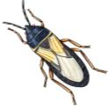
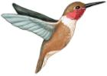
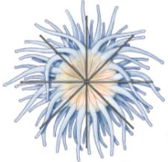
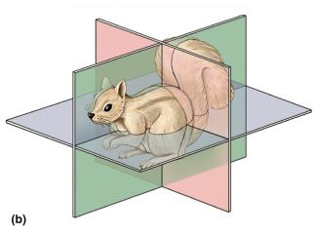
Animal Evolution
Cnidaria
Nematoda
Annelida
Echinodermata
Porifera
Platyhelminthes
Mollusca
Arthropoda
Chordata
sponges
jellyfish
flatworms
roundworms
mollusks
segmented worms
insects spiders
starfish
vertebrates
body & brain
size, ↑ mobility
backbone
redundancy,
specialization, ↑ mobility
segmentation
↑ body size
endoskeleton
coelom
↑ digestive sys
radial
body cavity
body complexity
↑ digestive & repro sys
bilateral symmetry
distinct body plan; cephalization
tissues
specialized structure & function,
muscle & nerve tissue
multicellularity
specialization & ↑ body complexity
bilateral
Ancestral Protist

Slide 4
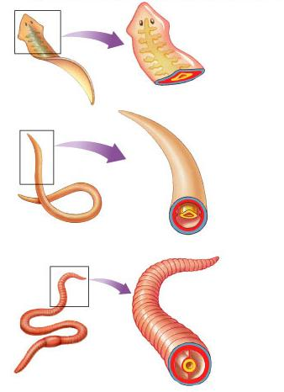
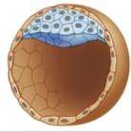
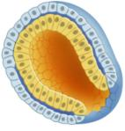
Body Cavity
acoelomate
ectoderm
Space for organ system development
increase digestive & reproductive systems
Coelom
mesoderm & endoderm interact during development
allows complex structures to develop
ex. stomach
mesoderm
endoderm
pseudocoelomate
ectoderm
mesoderm
endoderm
pseudocoel
coelomate
ectoderm
mesoderm
coelom cavity
endoderm
protostome vs. deuterostome

Slide 5
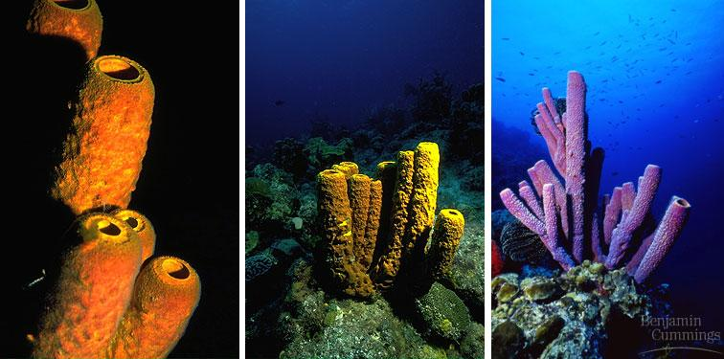
Invertebrate: Porifera
food taken into each cell by endocytosis
Sponges
no distinct tissues/organs
A few specialized cell types
no symmetry
sessile (as adults)

Slide 6
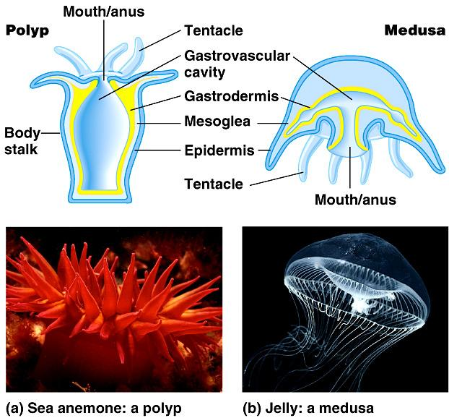
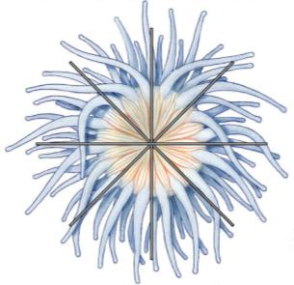
Invertebrate: Cnidaria
Jellyfish, hydra, sea anemone, coral
tissues, but no organs
two cell layers
radial symmetry
predators
tentacles surround gut opening
extracellular digestion
release enzymes into gut cavity
absorption by cells lining gut
polyp
medusa

Slide 7
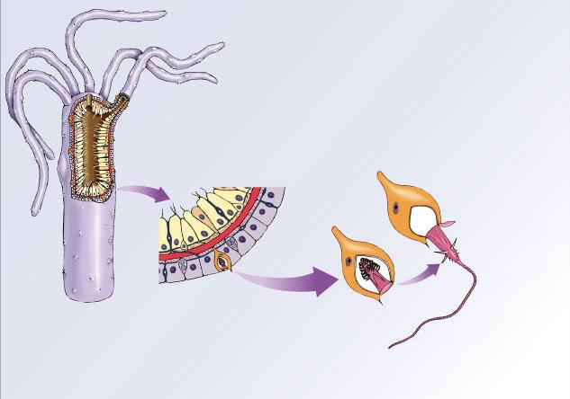
Stinging cells of Cnidarians
mouth
tentacles
sensory
cell
discharged
nematocyst
stinging cell
hydra
undischarged
nematocyst
trigger
stinging cell
with nematocyst

Slide 9
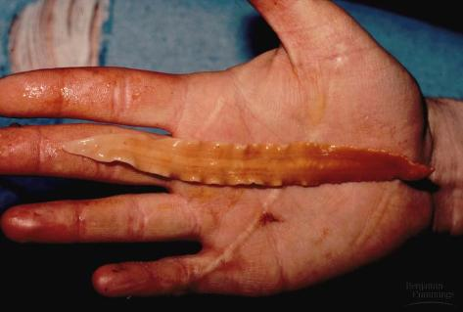
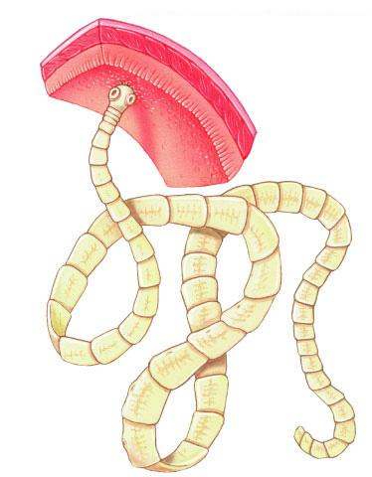
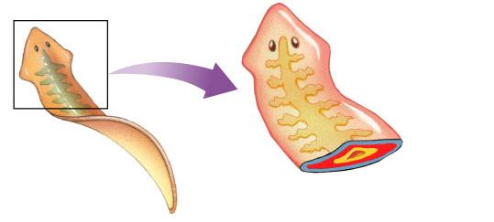
Invertebrate: Platyhelminthes
Flatworms
tapeworm, planaria
mostly parasitic
bilaterally symmetrical
right & left, head (anterior) end
& posterior end
cephalization = development of brain
concentration of sense organs in head
increased specialization in body plan
ectoderm
mesoderm
acoelomate
endoderm

Slide 10
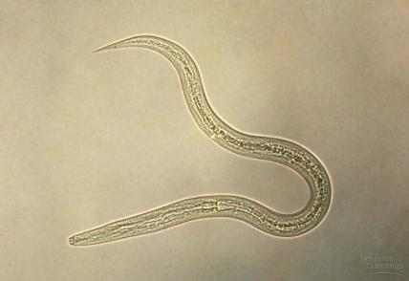
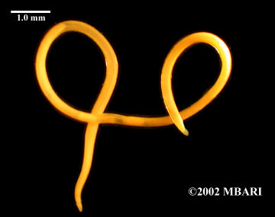
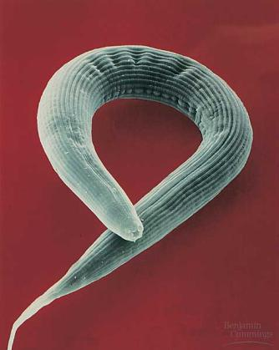
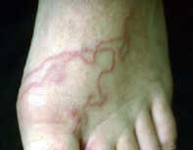
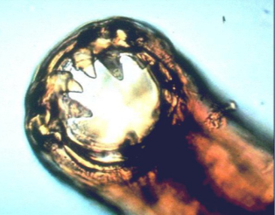
Invertebrate: Nematoda
Roundworms
bilaterally symmetrical
body cavity
pseudocoelom = simple body cavity
digestive system
tube running through length of body (mouth to anus)
many are parasitic
hookworm
C. elegans

Slide 11
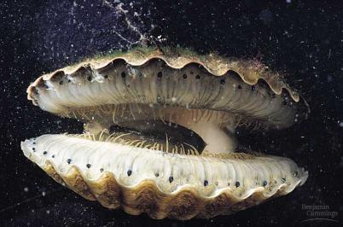
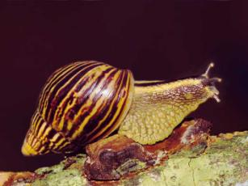
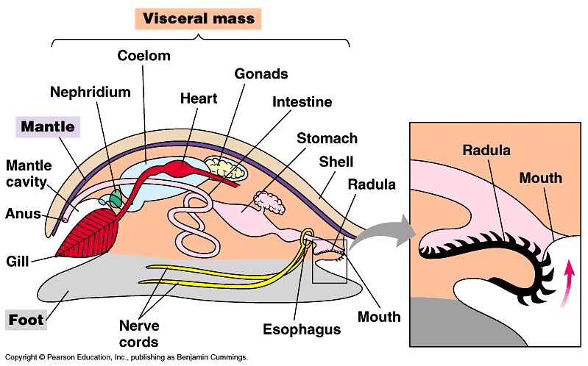
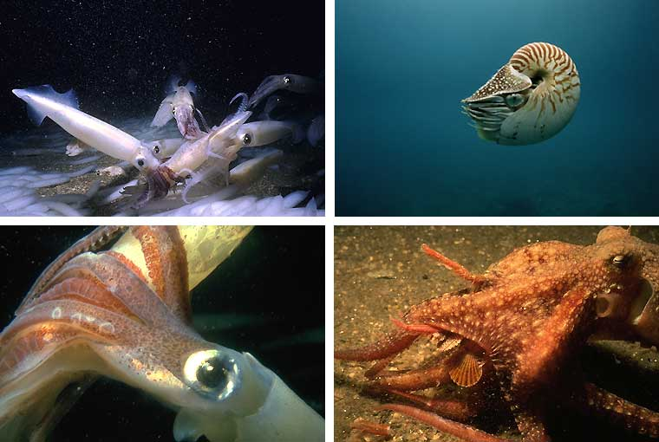
Invertebrate: Mollusca
Mollusks
slugs, snails, clams, squid
bilaterally symmetrical (with exceptions)
soft bodies, protected by hard shells (mostly)
true coelom
increases complexity & specialization of internal organs

Slide 12
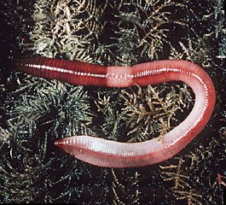
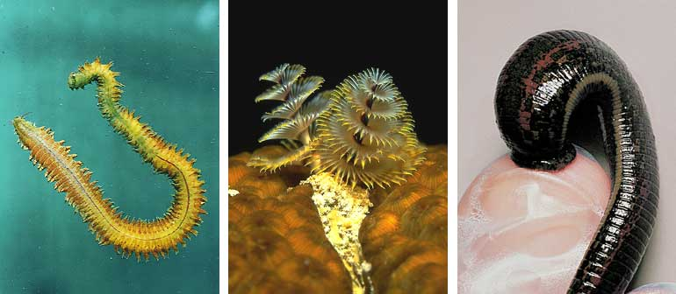
Invertebrate: Annelida
Segmented worms
earthworms, leeches
segments
increase mobility
redundancy in body sections
bilaterally symmetrical
true coelom
fan worm
leech

Slide 13
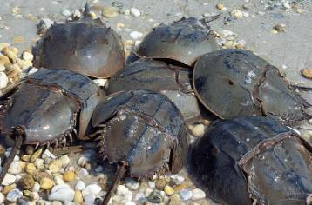
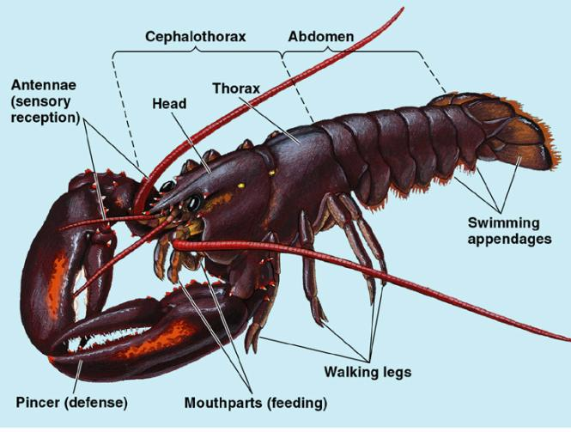
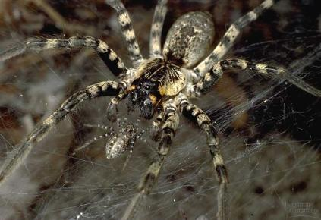
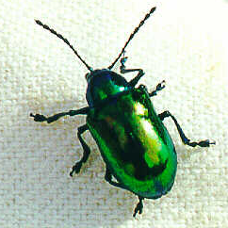
Invertebrate: Arthropoda
Spiders, insects, crustaceans
most successful animal phylum (Not even close)
bilaterally symmetrical
segmented
specialized segments
allows jointed appendages
exoskeleton
chitin + protein

Slide 14
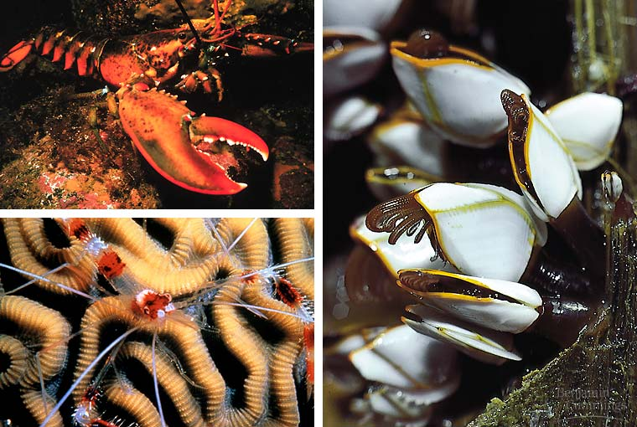
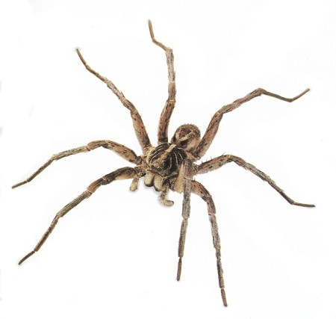
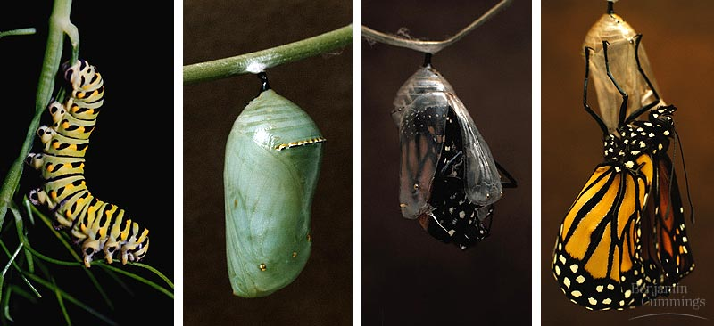
Arthropod groups
arachnids
8 legs, 2 body parts
spiders, ticks, scorpions
crustaceans
gills, 2 pairs antennae
crab, lobster, barnacles, shrimp
insects
6 legs, 3 body parts

Slide 15
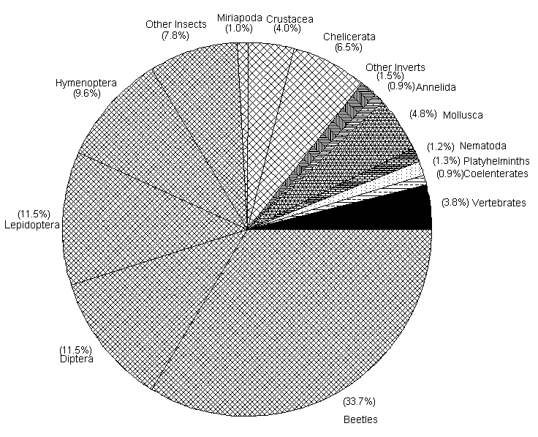

Slide 16
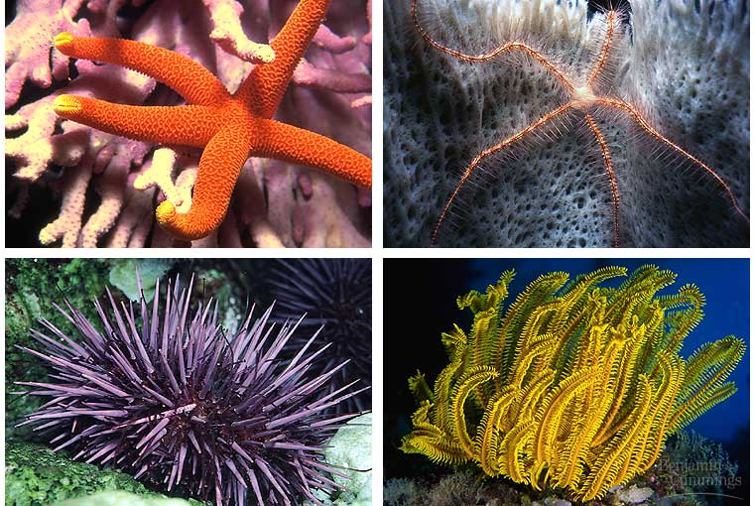
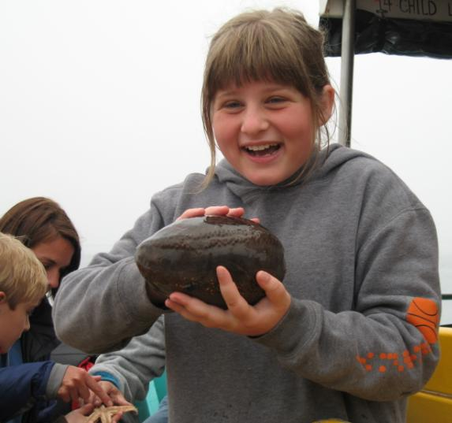
Invertebrate: Echinodermata
Seastars, sea urchins, sea cucumber
radially symmetrical as adults
spiny endoskeleton
deuterostome
loss of bilateral symmetry?

Slide 17
Invertebrate quick check…
Invertebrates: Porifera, Cnidaria, Platyhelminthes, Nematoda, Annelida, Mollusca, Arthropoda, Echinodermata
Which group includes snails, clams, and squid?
Which group is the sponges?
Which are the flatworms?
…segmented worms?
…roundworms?
Which group has jointed appendages & an exoskeleton?
Which two groups have radial symmetry?
What is the adaptive advantage of bilateral symmetry?
Which group has no symmetry?
Notes:
Which group includes snails, clams, and squid? Mollusks
Which group is the sponges? Porifera
Which are the flatworms? Platyhelminthes
…segmented worms? Annelids
…roundworms? Nematodes
Which group has jointed appendages & an exoskeleton? Arthropods
Which two groups have radial symmetry? Cnidaria, Echinoderm
What is the adaptive advantage of bilateral symmetry? cephalization
Which group has no symmetry? Porifera

Slide 18
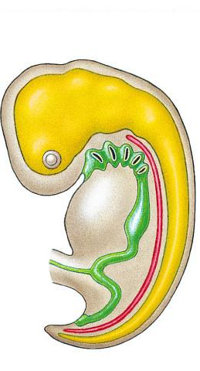
Chordata
Vertebrates
fish, amphibians, reptiles, birds, mammals
internal bony skeleton
backbone encasing spinal column
skull-encased brain
deuterostome
hollow dorsal
nerve cord
becomes brain & spinal cord
becomes gills or Eustachian tube
pharyngeal
pouches
becomes vertebrae
postanal
tail
becomes tail or tailbone
notochord

Slide 19
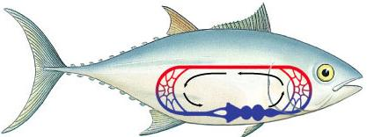
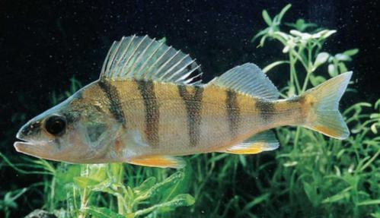
Vertebrates: Fish
450 mya
salmon, trout, sharks
Characteristics
body structure
bony & cartilaginous skeleton
jaws & paired appendages (fins)
scales
body function
gills for gas exchange
two-chambered heart; single loop circulation
ectothermic
reproduction
external fertilization
external development in egg
body
gills

Slide 20
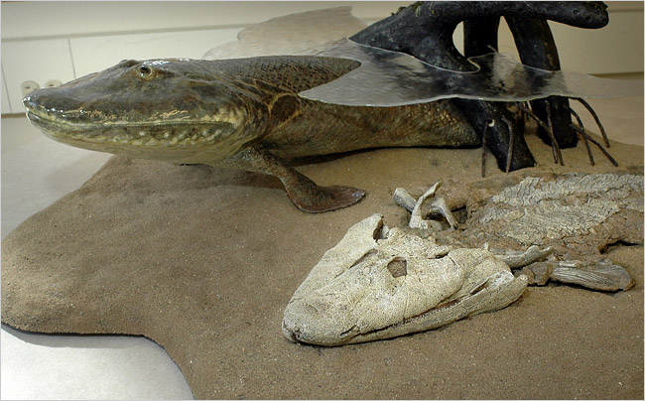
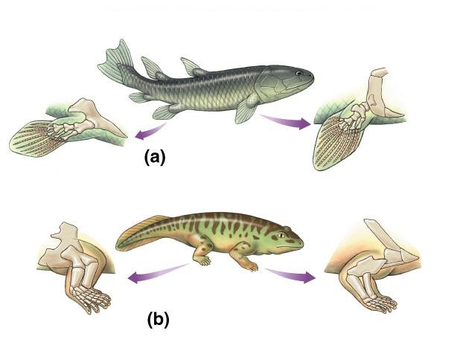
Transition to Land
Evolution of tetrapods
Humerus
Femur
Pelvis
Ulna
Shoulder
Tibia
Radius
Fibula
Lobe-finned fish
Pelvis
Femur
Humerus
Shoulder
Tibia
Radius
Ulna
Fibula
Early amphibian

Slide 21
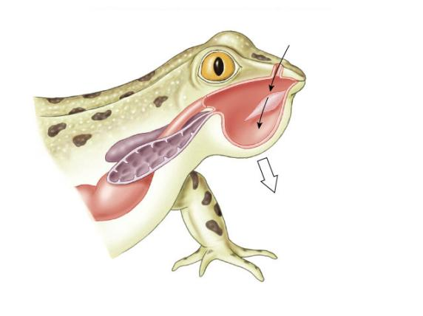
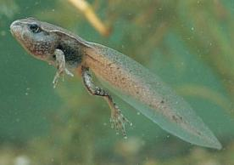
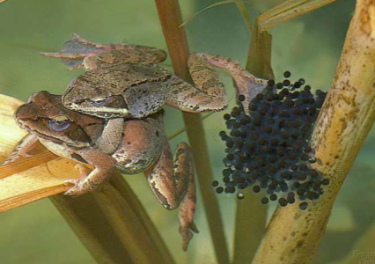
Vertebrates: Amphibian
350 mya
frogs
salamanders toads
Characteristics
body structure
legs (tetrapods)
moist skin
body function
lungs (positive pressure) & skin
for gas exchange
three-chambered heart; 2-loop
circulation
ectothermic
reproduction
external fertilization
external development in aquatic egg
metamorphosis (tadpole to adult)
lung
buccal
cavity
glottis
closed

Slide 22
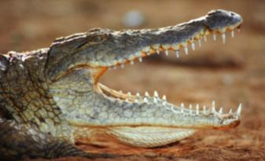
Vertebrates: Reptiles
250 mya
dinosaurs, turtles
lizards, snakes
alligators, crocodile
Characteristics
body structure
dry skin, scales, armor
body function
lungs for gas exchange
thoracic breathing; negative pressure
three-chambered heart (2-loops)
ectothermic
reproduction
internal fertilization
external development in amniotic egg
leathery
shell
embryo
amnion
chorion
allantois
yolk sac

Slide 23
Vertebrates: Birds (Aves)
150 mya
finches, hawk
ostrich, turkey
Characteristics
body structure
feathers & wings
thin, hollow bones
body function
very efficient lungs & air sacs
four-chambered heart
endothermic
reproduction
internal fertilization
external development in amniotic egg
trachea
lung
anterior
air sacs
posterior
air sacs

Slide 24
Vertebrates: Mammals
220 mya / 65 mya
mice, ferret
elephants, bats whales, humans
Characteristics
body structure
hair
specialized teeth
body function
lungs, diaphragm; negative pressure
four-chambered heart
endotherms
reproduction
internal fertilization
internal development in uterus
nourishment through placenta
birth live young
mammary glands make milk
muscles
contract
diaphragm
contracts

Slide 25
Vertebrates: Mammals
Sub-groups
monotremes
egg-laying mammals
lack placenta & true nipples
duckbilled platypus, echidna
marsupials
pouched mammals
offspring feed from nipples in pouch
short-lived placenta
koala, kangaroo, opossum
placental
true placenta
nutrient & waste filter
shrews, bats, whales, humans

Slide 26
Vertebrate quick check…
Which vertebrates lay eggs with shells?
Which vertebrates are covered with scales?
What adaptations do birds have for flying?
What kind of symmetry do all vertebrates have?
Which vertebrates are ectothermic and which are endothermic
Why must amphibians live near water?
What reproductive adaptations made mammals very successful?
What characteristics distinguish the 3 sub-groups of mammals?
Notes:
Reptiles and Birds
Reptiles and fish
Feathers, wings, hallow bones
Bilateral
Ecto: fish, amphibians, reptiles Endo: Birds and Mammals
To keep their skin moist so they can breathe
Internal development of embryos and mammary glands
How their young develop Monotremes: lay eggs Marsupials: Pouch, short lived placenta offspring must further develop in pouch Placentals: full placenta fetus develops to full term in pouch

