Slide 1
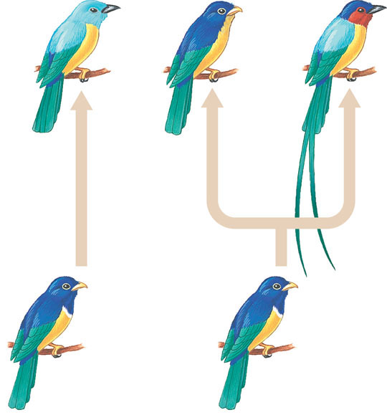
Two patterns of evolutionary change
(a) Anagenesis
(b) Cladogenesis

Slide 2
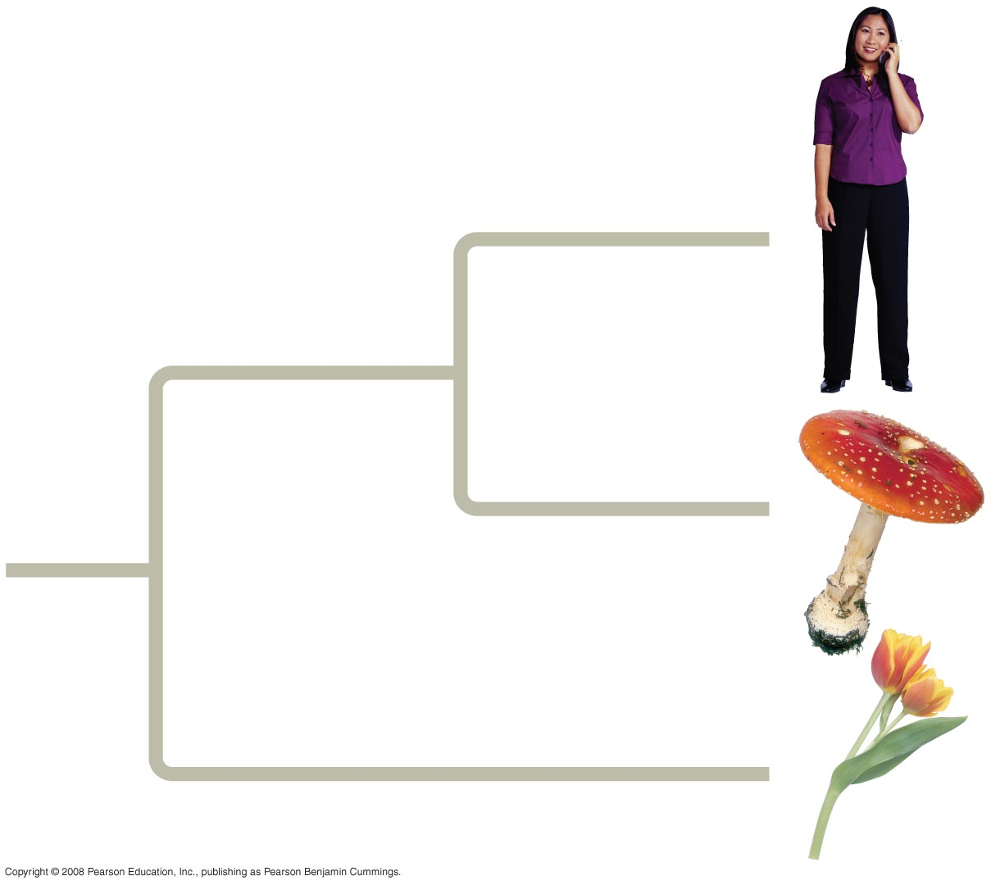
Overview: Investigating the Tree of Life
Phylogeny is the evolutionary history of a species or group of related species
The discipline of systematics classifies organisms and determines their evolutionary relationships
Systematists use fossil, molecular, and genetic data to infer evolutionary relationships

Slide 3
Concept 26.1: Phylogenies show evolutionary relationships
Taxonomy is the ordered division and naming of organisms
The two-part scientific name of a species is called a binomial
The first part of the name is the genus
The second part, called the specific epithet, is unique for each species within the genus
The first letter of the genus is capitalized, and the entire species name is italicized
Both parts together name the species (not the specific epithet alone)
Notes:
In the 18th century, Carolus Linnaeus published a system of taxonomy based on resemblances
Two key features of his system remain useful today: two-part names for species and hierarchical classification

Slide 4
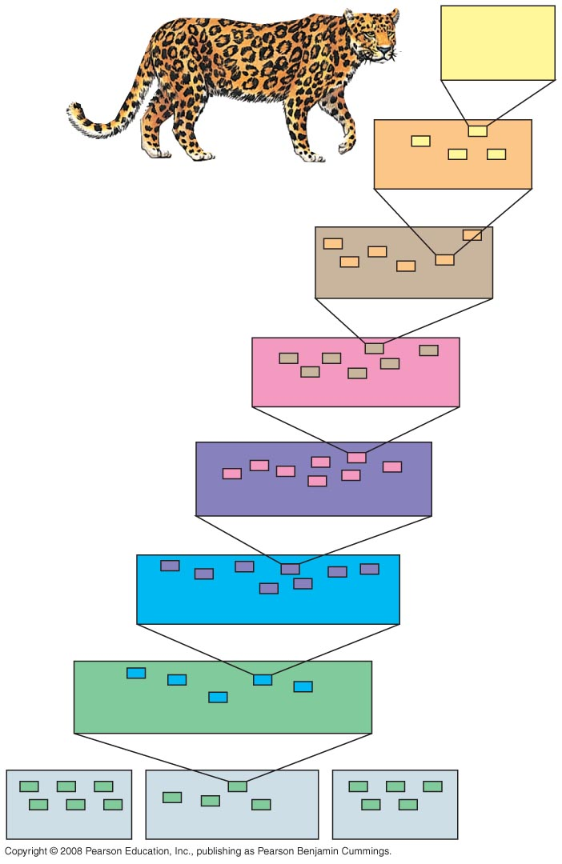
Fig. 26-3
Species:
Panthera
pardus
Genus: Panthera
Family: Felidae
Order: Carnivora
Class: Mammalia
Phylum: Chordata
Kingdom: Animalia
Bacteria
Domain: Eukarya
Archaea
Notes:
Figure 26.3 Hierarchical classification
Linnaeus introduced a system for grouping species in increasingly broad categories
The taxonomic groups from broad to narrow are domain, kingdom, phylum, class, order, family, genus, and species
A taxonomic unit at any level of hierarchy is called a taxon

Slide 5
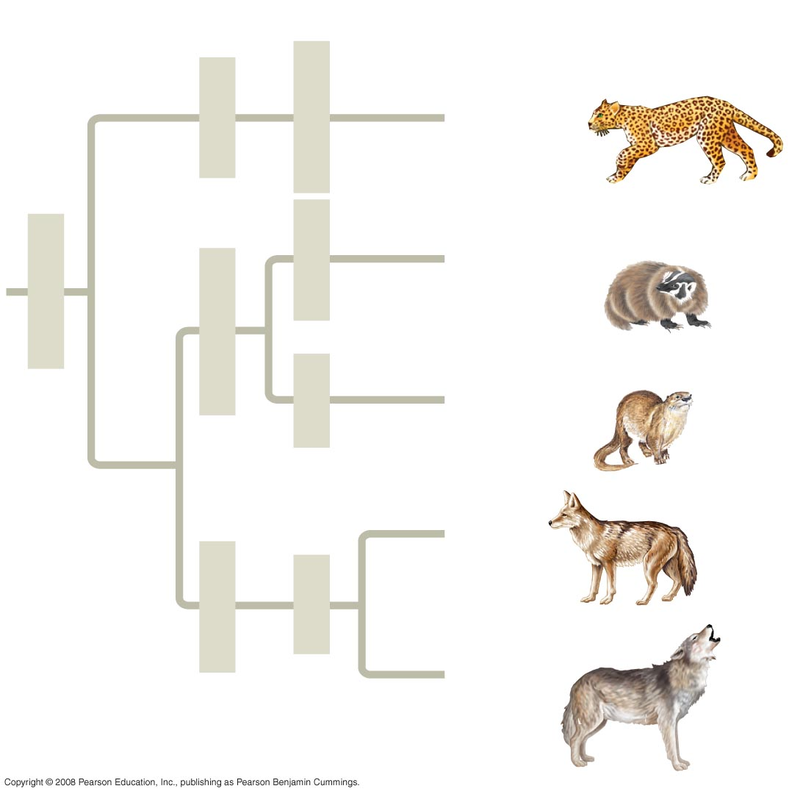
Fig. 26-4
Species
Order
Family
Genus
Felidae
Panthera
Pantherapardus
Taxidea
Taxidea
taxus
Carnivora
Mustelidae
Lutra
Lutra lutra
Canis
latrans
Canidae
Canis
Canis
lupus
Notes:
Figure 26.4 The connection between classification and phylogeny
Systematists depict evolutionary relationships in branching phylogenetic trees
\
Linnaean classification and phylogeny can differ from each other
Systematists have proposed the PhyloCode, which recognizes only groups that include a common ancestor and all its descendents

Slide 6
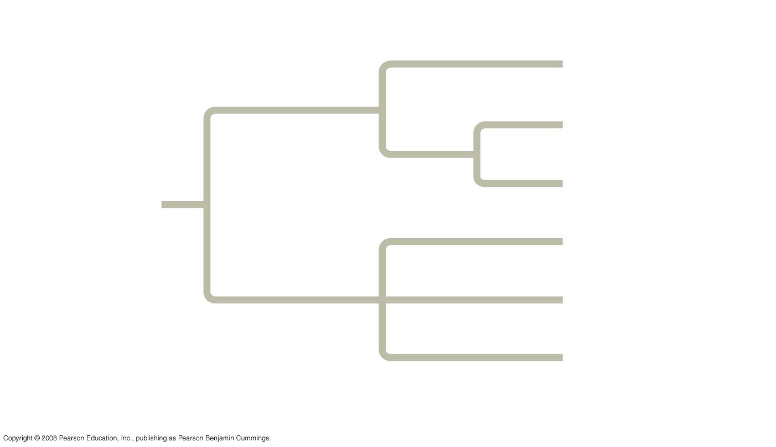
Fig. 26-5
Branch point
(node)
Taxon A
Taxon B
Sister
taxa
Taxon C
ANCESTRAL
LINEAGE
Taxon D
Taxon E
Taxon F
Common ancestor of
taxa A–F
Polytomy
Notes:
Figure 26.5 How to read a phylogenetic tree
A phylogenetic tree represents a hypothesis about evolutionary relationships
Each branch point represents the divergence of two species
Sister taxa are groups that share an immediate common ancestor
A rooted tree includes a branch to represent the last common ancestor of all taxa in the tree
A polytomy is a branch from which more than two groups emerge

Slide 7
What We Can and Cannot Learn from Phylogenetic Trees
Phylogenetic trees do show patterns of descent
Phylogenetic trees do not indicate when species evolved or how much genetic change occurred in a lineage
It shouldn’t be assumed that a taxon evolved from the taxon next to it
Notes:
Phylogeny provides important information about similar characteristics in closely related species
A phylogeny was used to identify the species of whale from which “whale meat” originated

Slide 8
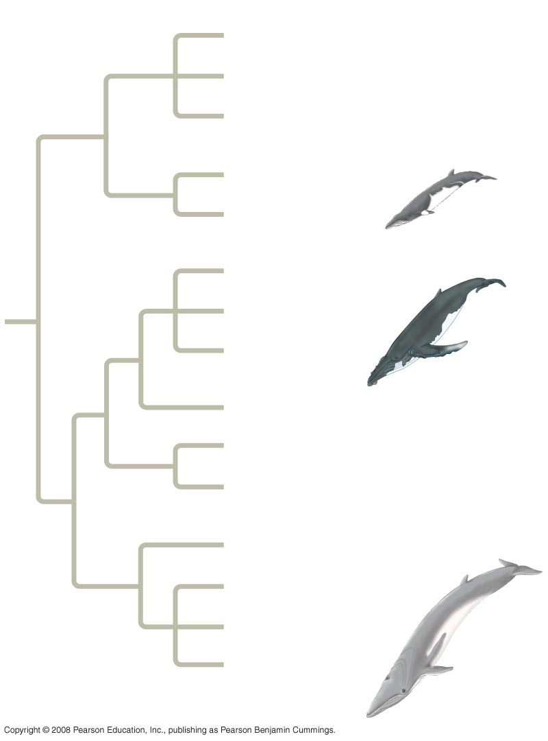
Fig. 26-6
RESULTS
Minke
(Antarctica)
Minke
(Australia)
Unknown #1a,
2, 3, 4, 5, 6, 7, 8
Minke
(North Atlantic)
Unknown #9
Humpback
(North Atlantic)
Humpback
(North Pacific)
Unknown #1b
Gray
Blue
(North Atlantic)
Blue
(North Pacific)
Unknown #10,
11, 12
Unknown #13
Fin
(Mediterranean)
Fin (Iceland)
Notes:
Figure 26.6 What is the species identity of food being sold as whale meat?
A phylogeny was used to identify the species of whale from which “whale meat” originated
Phylogenies of anthrax bacteria helped researchers identify the source of a particular strain of anthrax

Slide 9
Sorting Homology from Analogy
When constructing a phylogeny, systematists need to distinguish whether a similarity is the result of homology or analogy
Homology is similarity due to shared ancestry
Analogy is similarity due to convergent evolution
Notes:
To infer phylogenies, systematists gather information about morphologies, genes, and biochemistry of living organisms
Organisms with similar morphologies or DNA sequences are likely to be more closely related than organisms with different structures or sequences
Convergent evolution occurs when similar environmental pressures and natural selection produce similar (analogous) adaptations in organisms from different evolutionary lineages
Bat and bird wings are homologous as forelimbs, but analogous as functional wings
Analogous structures or molecular sequences that evolved independently are also called homoplasies
Homology can be distinguished from analogy by comparing fossil evidence and the degree of complexity
The more complex two similar structures are, the more likely it is that they are homologous

Slide 10
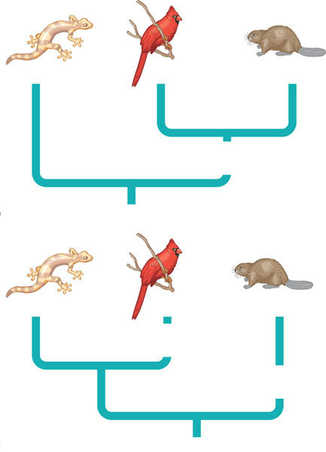
Parsimony and the analogy-versus-homology pitfall
Lizard
Bird
Mammal
Four-chambered heart
(a) Mammal-bird clade
Lizard
Bird
Mammal
Four-chambered heart
Four-chambered heart
(b) Lizard-bird clade

Slide 11
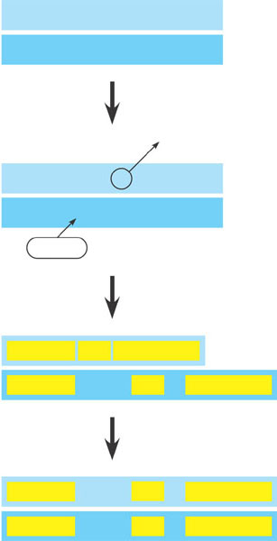
Aligning segments of DNA
1 Ancestral homologous DNA segments are identical as species 1 and species 2 begin to diverge from their common ancestor.
1 C C A T C A G A G T C C
2 C C A T C A G A G T C C
Deletion
2 Deletion and insertion mutations shift what had been matching sequences in the two species.
1 C C A T C A G A G T C C
2 C C A T C A G A G T C C
G T A
Insertion
3 Homologous regions (yellow) do not all align because of these mutations.
1 C C A T C A A G T C C
2 C C A T G T A C A G A G T C C
4 Homologous regions realign after a computer program adds gaps in sequence 1.
1 C C A T C A A G T C C
2 C C A T G T A C A G A G T C C
Notes:
Figure 26.8 Aligning segments of DNA
Systematists use computer programs and mathematical tools when analyzing comparable DNA segments from different organisms

Slide 12
Fig. 26-9
It is also important to distinguish homology from analogy in molecular similarities
Mathematical tools help to identify molecular homoplasies, or coincidences
Molecular systematics uses DNA and other molecular data to determine evolutionary relationships
Notes:
Figure 26.9 A molecular homoplasy
It is also important to distinguish homology from analogy in molecular similarities
Mathematical tools help to identify molecular homoplasies, or coincidences
Molecular systematics uses DNA and other molecular data to determine evolutionary relationships
Once homologous characters have been identified, they can be used to infer a phylogeny

Slide 13
Cladistics
Cladistics groups organisms by common descent
A clade is a group of species that includes an ancestral species and all its descendants
Clades can be nested in larger clades, but not all groupings of organisms qualify as clades

Slide 14
Monophyletic, paraphyletic, and polyphyletic groupings
Grouping 1
Grouping 2
Grouping 3
D
E
G
H
J
K
D
E
G
H
J
K
D
E
G
H
J
K
C
F
I
C
F
I
C
F
I
B
B
B
A
A
A
(a) Monophyletic. In this tree, grouping 1, consisting of the seven species B– H, is a monophyletic group, or clade. A mono- phyletic group is made up of an ancestral species (species B in this case) and all of its descendant species. Only monophyletic groups qualify as legitimate taxa derived from cladistics.
(b) Paraphyletic. Grouping 2 does not meet the cladistic criterion: It is paraphyletic, which means that it consists of an ancestor (A in this case) and some, but not all, of that ancestor’s descendants. (Grouping 2 includes the descendants I, J, and K, but excludes B–H, which also descended from A.)
(c) Polyphyletic. Grouping 3 also fails the cladistic test. It is polyphyletic, which means that it lacks the common ancestor of (A) the species in the group. Further- more, a valid taxon that includes the extant species G, H, J, and K would necessarily also contain D and E, which are also descended from A.
Notes:
A valid clade is monophyletic, signifying that it consists of the ancestor species and all its descendants
A paraphyletic grouping consists of an ancestral species and some, but not all, of the descendants
A polyphyletic grouping consists of various species that lack a common ancestor

Slide 15
Shared Ancestral and Shared Derived Characters
A shared ancestral character is a character that originated in an ancestor of the taxon
A shared derived character is an evolutionary novelty unique to a particular clade
A character can be both ancestral and derived, depending on the context
Notes:
In comparison with its ancestor, an organism has both shared and different characteristics
When inferring evolutionary relationships, it is useful to know in which clade a shared derived character first appeared

Slide 16
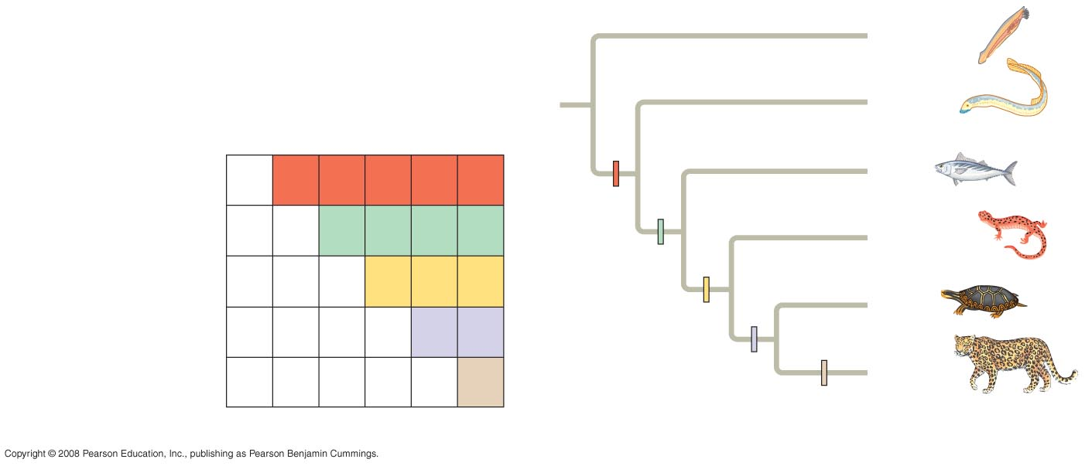
Fig. 26-11
TAXA
Lancelet
(outgroup)
Lancelet
(outgroup)
Lamprey
Salamander
Leopard
Lamprey
Tuna
Turtle
Vertebral column
(backbone)
0
1
1
1
1
1
Tuna
Vertebral
column
Hinged jaws
0
0
1
1
1
1
Salamander
Hinged jaws
CHARACTERS
Four walking legs
0
0
0
1
1
1
Four walking legs
Turtle
Amniotic (shelled) egg
0
0
0
0
1
1
Amniotic egg
Leopard
Hair
0
0
0
0
0
1
Hair
(a) Character table
(b) Phylogenetic tree
Notes:
Figure 26.11 Constructing a phylogenetic tree
An outgroup is a species or group of species that is closely related to the ingroup, the various species being studied
Systematists compare each ingroup species with the outgroup to differentiate between shared derived and shared ancestral characteristics
Homologies shared by the outgroup and ingroup are ancestral characters that predate the divergence of both groups from a common ancestor

Slide 17
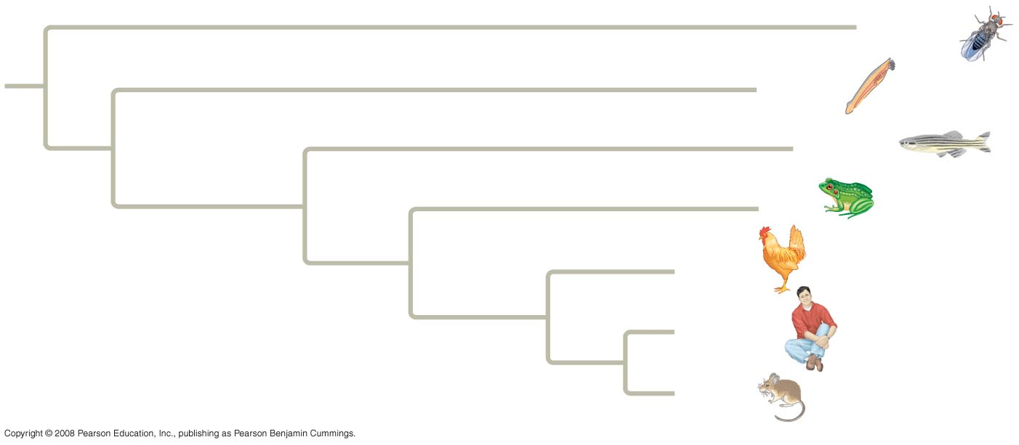
Fig. 26-12
Drosophila
Lancelet
Zebrafish
Frog
Chicken
Human
Mouse
Notes:
Figure 26.12 Branch lengths can indicate relative amounts of genetic change
In some trees, the length of a branch can reflect the number of genetic changes that have taken place in a particular DNA sequence in that lineage

Slide 18
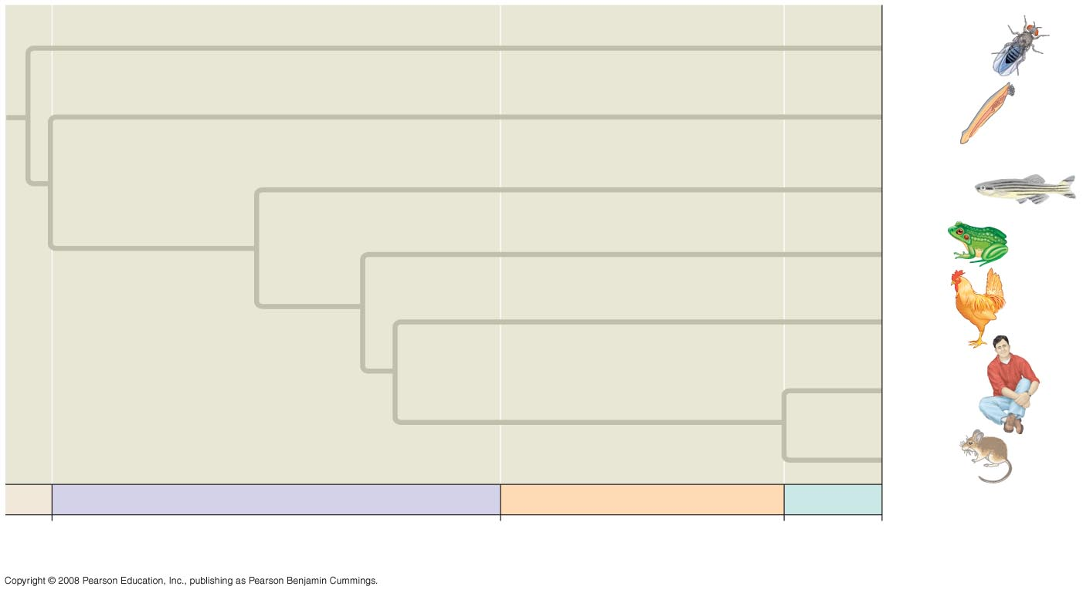
Fig. 26-13
Drosophila
Lancelet
Zebrafish
Frog
Chicken
Human
Mouse
PALEOZOIC
MESOZOIC
CENOZOIC
542
251
65.5
Present
Millions of years ago
Notes:
Figure 26.13 Branch lengths can indicate time
In other trees, branch length can represent chronological time, and branching points can be determined from the fossil record

Slide 19
Maximum Parsimony and Maximum Likelihood
Maximum parsimony assumes that the tree that requires the fewest evolutionary events (appearances of shared derived characters) is the most likely
The principle of maximum likelihood states that, given certain rules about how DNA changes over time, a tree can be found that reflects the most likely sequence of evolutionary events
Notes:
Systematists can never be sure of finding the best tree in a large data set
They narrow possibilities by applying the principles of maximum parsimony and maximum likelihood

Slide 20
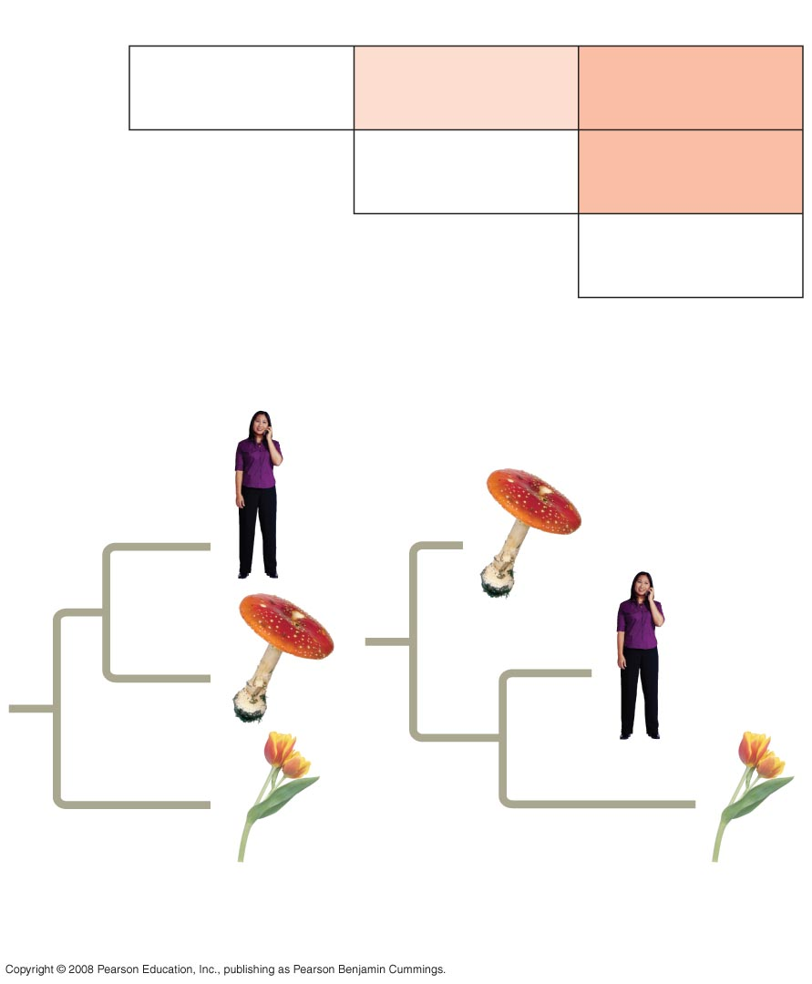
Fig. 26-14
Human
Mushroom
Tulip
Human
0
30%
40%
Mushroom
0
40%
Tulip
0
(a) Percentage differences between sequences
15%
5%
5%
15%
15%
10%
20%
25%
Tree 1: More likely
Tree 2: Less likely
(b) Comparison of possible trees
Notes:
Figure 26.14 Trees with different likelihoods
Computer programs are used to search for trees that are parsimonious and likely

Slide 21
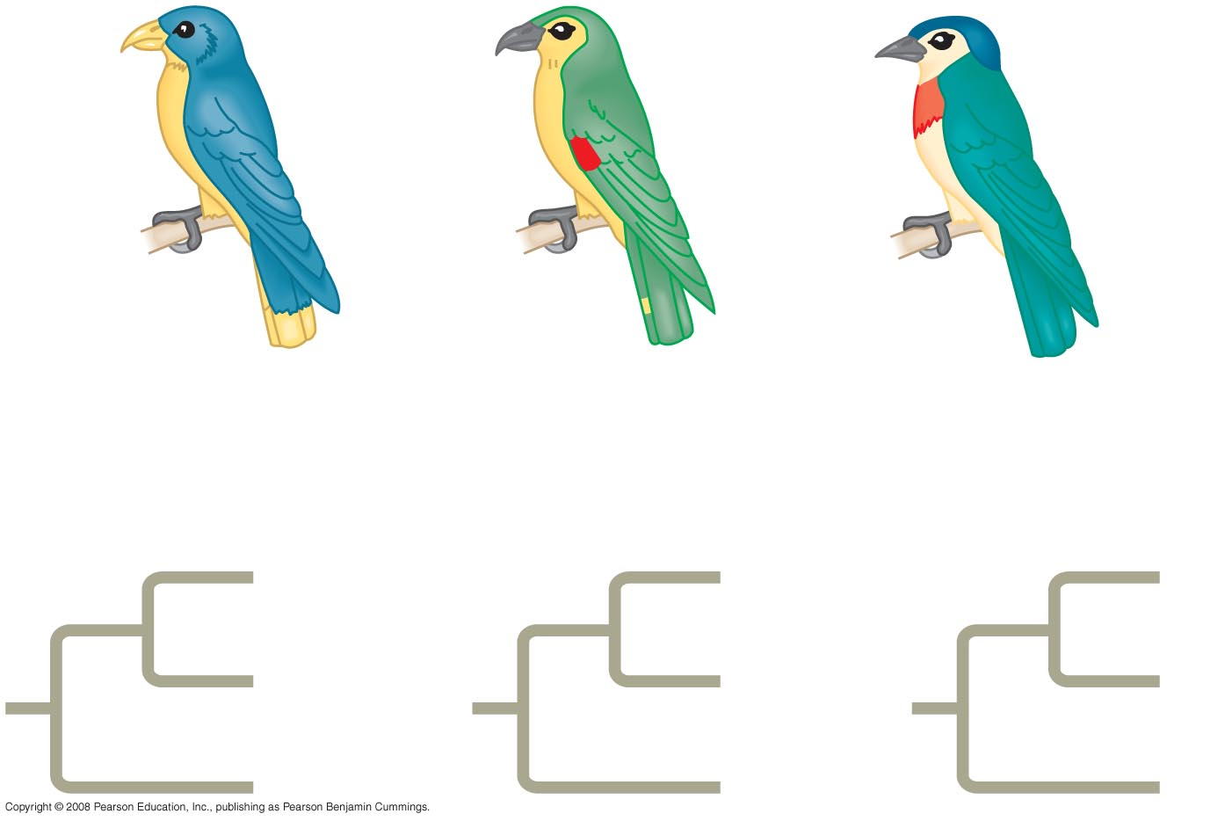
Fig. 26-15-1
Species I
Species II
Species III
Three phylogenetic hypotheses:
I
I
III
II
III
II
III
II
I
Notes:
Figure 26.15 Applying parsimony to a problem in molecular systematics

Slide 22
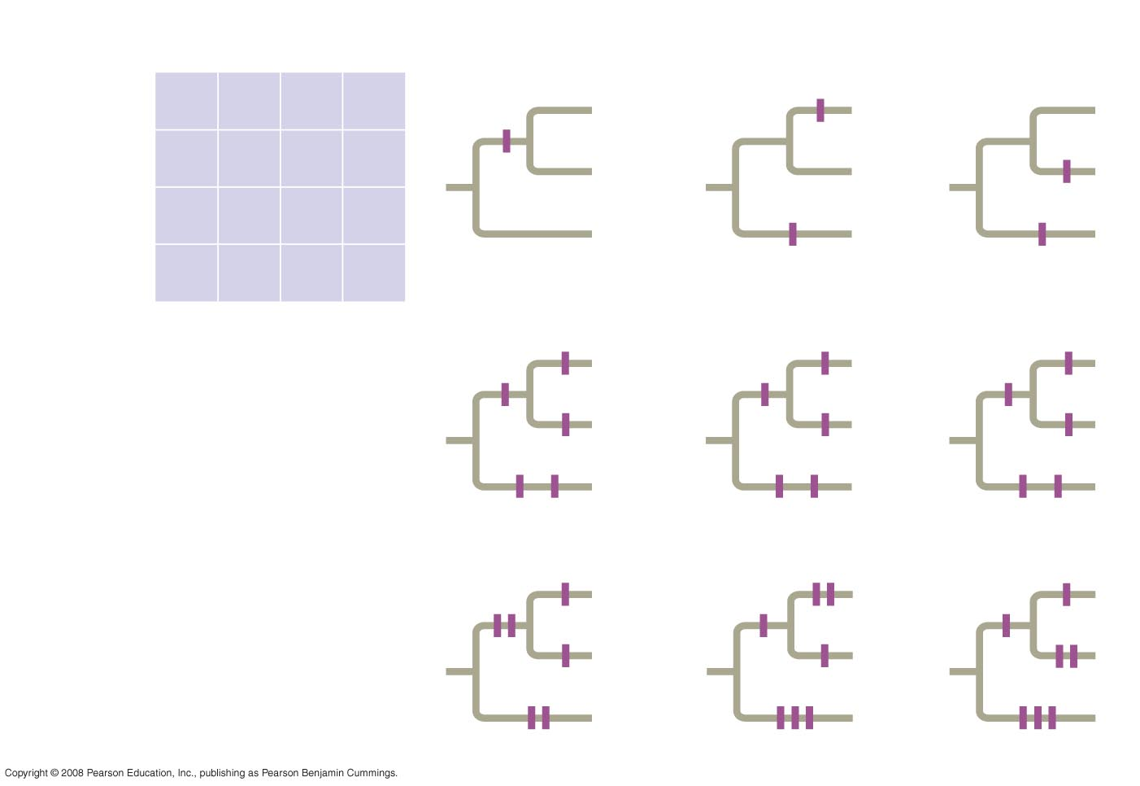
Fig. 26-15-4
Site
1
2
3
4
Species I
C
T
A
T
1/C
I
1/C
I
III
Species II
C
T
T
C
II
III
II
Species III
A
G
A
C
1/C
III
II
I
Ancestral
sequence
A
G
T
T
1/C
1/C
3/A
2/T
I
3/A
2/T
I
3/A
4/C
III
II
III
II
4/C
4/C
2/T
III
II
I
3/A
4/C
2/T
4/C
2/T
3/A
I
I
III
II
III
II
III
II
I
6 events
7 events
7 events
Notes:
Figure 26.15 Applying parsimony to a problem in molecular systematics
The best hypotheses for phylogenetic trees fit the most data: morphological, molecular, and fossil
Phylogenetic bracketing allows us to predict features of an ancestor from features of its descendents

Slide 23
Fig. 26-16
Lizards
and snakes
Crocodilians
Ornithischian
dinosaurs
Common
ancestor of
crocodilians,
dinosaurs,
and birds
Saurischian
dinosaurs
Birds
Notes:
lFigure 26.16 A phylogenetic tree of birds and their close relatives
This has been applied to infer features of dinosaurs from their descendents: birds and crocodiles
Animation: Geologic Record.

