Slide 1
Concept 26.4: An organism’s evolutionary history is documented in its genome
Comparing nucleic acids or other molecules to infer relatedness is a valuable tool for tracing organisms’ evolutionary history
DNA that codes for rRNA changes relatively slowly and is useful for investigating branching points hundreds of millions of years ago
mtDNA evolves rapidly and can be used to explore recent evolutionary events
Notes:
Gene duplication increases the number of genes in the genome, providing more opportunities for evolutionary changes
Like homologous genes, duplicated genes can be traced to a common ancestor

Slide 2
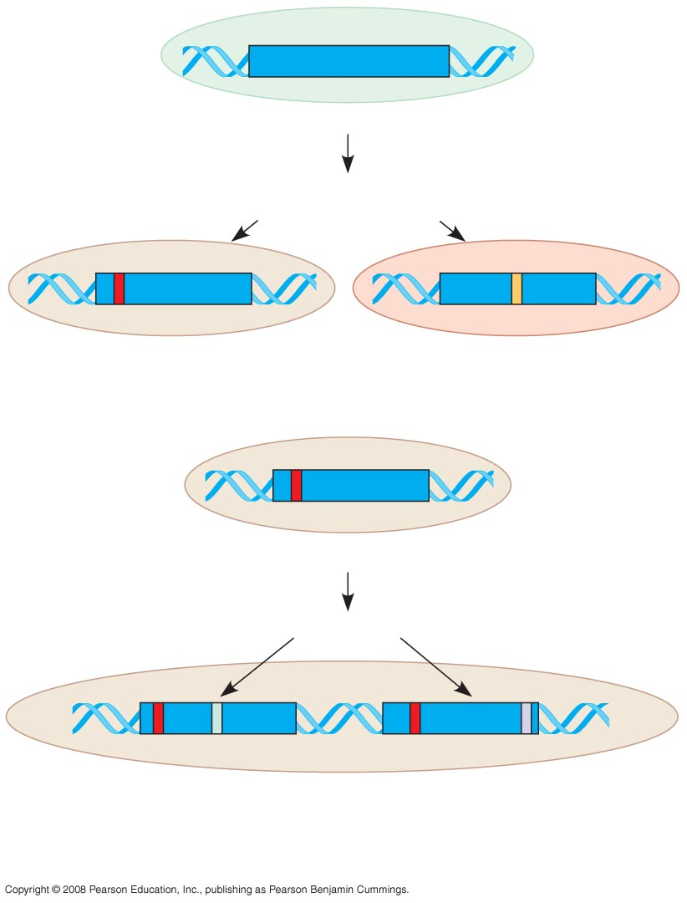
Fig. 26-18
Ancestral gene
Ancestral species
Speciation with
divergence of gene
Species A
Orthologous genes
Species B
(a) Orthologous genes
Species A
Gene duplication and divergence
Paralogous genes
Species A after many generations
(b) Paralogous genes
Notes:
Gene duplication increases the number of genes in the genome, providing more opportunities for evolutionary changes
Like homologous genes, duplicated genes can be traced to a common ancestor
Figure 26.18 How two types of homologous genes originate
Orthologous genes are found in a single copy in the genome and are homologous between species
They can diverge only after speciation occurs
Paralogous genes result from gene duplication, so are found in more than one copy in the genome
They can diverge within the clade that carries them and often evolve new functions
Orthologous genes are widespread and extend across many widely varied species
Gene number and the complexity of an organism are not strongly linked
Genes in complex organisms appear to be very versatile and each gene can perform many functions

Slide 3
Molecular Clocks
A molecular clock uses constant rates of evolution in some genes to estimate the absolute time of evolutionary change
In orthologous genes, nucleotide substitutions are proportional to the time since they last shared a common ancestor
In paralogous genes, nucleotide substitutions are proportional to the time since the genes became duplicated
Notes:
To extend molecular phylogenies beyond the fossil record, we must make an assumption about how change occurs over time
Molecular clocks are calibrated against branches whose dates are known from the fossil record

Slide 4
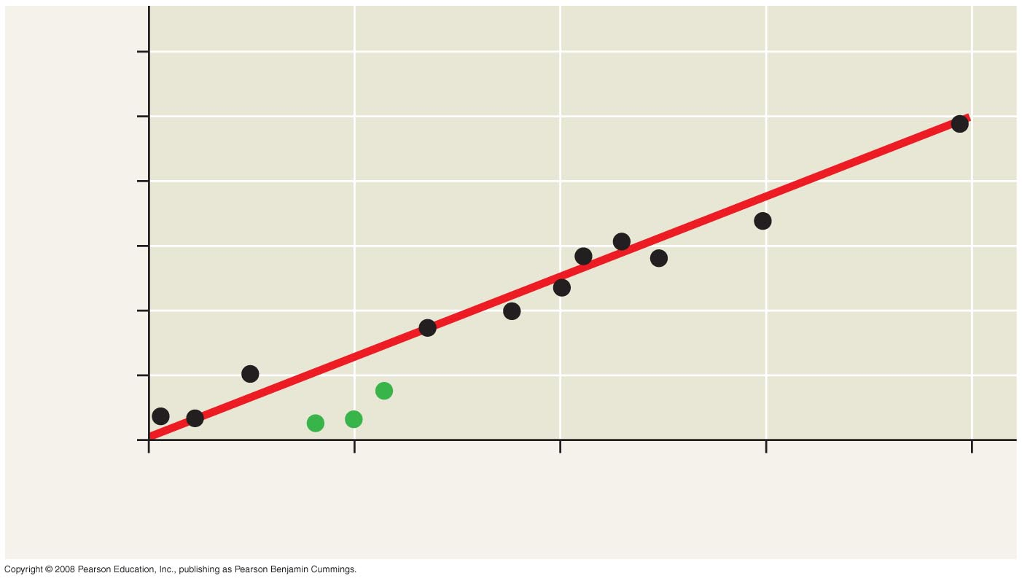
Fig. 26-19
90
60
Number of mutations
30
0
0
30
60
90
120
Divergence time (millions of years)
Notes:
Figure 26.19 A molecular clock for mammals
Molecular clocks are calibrated against branches whose dates are known from the fossil record
Neutral theory states that much evolutionary change in genes and proteins has no effect on fitness and therefore is not influenced by Darwinian selection
It states that the rate of molecular change in these genes and proteins should be regular like a clock

Slide 5
Difficulties with Molecular Clocks
The molecular clock does not run as smoothly as neutral theory predicts
Irregularities result from natural selection in which some DNA changes are favored over others
Estimates of evolutionary divergences older than the fossil record have a high degree of uncertainty
The use of multiple genes may improve estimates

Slide 6
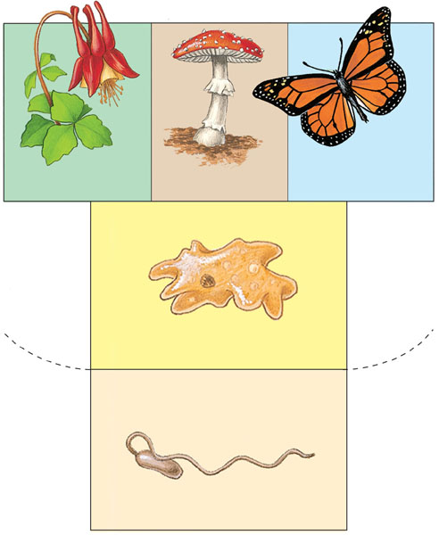
Whittaker’s five-kingdom system
Plantae
Fungi
Animalia
Eukaryotes
Protista
Prokaryotes
Monera
Notes:
Recently, we have gained insight into the very deepest branches of the tree of life through molecular systematics
Early taxonomists classified all species as either plants or animals
Later, five kingdoms were recognized: Monera (prokaryotes), Protista, Plantae, Fungi, and Animalia

Slide 7
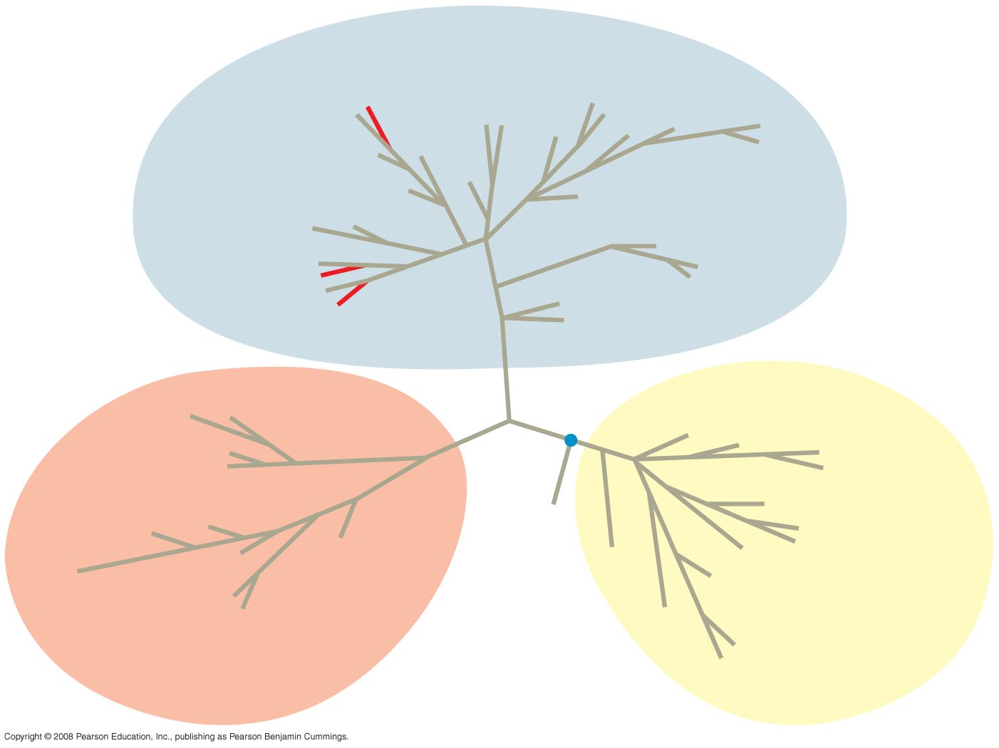
Fig. 26-21
EUKARYA
Land plants
Dinoflagellates
Green algae
Forams
Ciliates
Diatoms
Red algae
Cellular slime molds
Amoebas
Euglena
Animals
Trypanosomes
Leishmania
Fungi
Sulfolobus
Green nonsulfur bacteria
Thermophiles
(Mitochondrion)
Spirochetes
Halophiles
COMMON
ANCESTOR
OF ALL
LIFE
Chlamydia
Green
sulfur bacteria
Methanobacterium
BACTERIA
Cyanobacteria
ARCHAEA
(Plastids, including
chloroplasts)
Notes:
Figure 26.21 The three domains of life
More recently, the three-domain system has been adopted: Bacteria, Archaea, and Eukarya
The three-domain system is supported by data from many sequenced genomes
Animation: Classification Schemes.

Slide 8
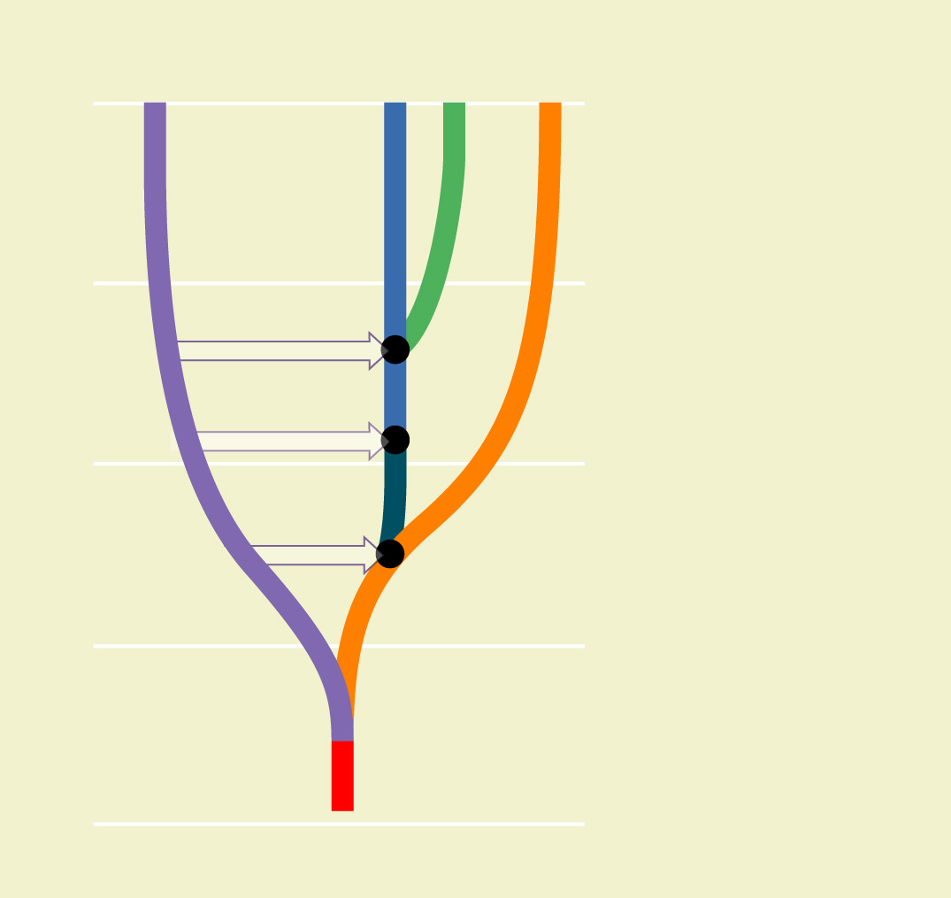
The universal tree of life
Bacteria
Eukarya
Archaea
0
4 Symbiosis of chloroplast ancestor with ancestor of green plants
1
3 Symbiosis of mitochondrial ancestor with ancestor of eukaryotes
4
Billion years ago
3
2
2 Possible fusion of bacterium and archaean, yielding ancestor of eukaryotic cells
2
3
1 Last common ancestor of all living things
1
Origin of life
4
Notes:
The tree of life suggests that eukaryotes and archaea are more closely related to each other than to bacteria
The tree of life is based largely on rRNA genes, as these have evolved slowly

Slide 9
0
1. The temperature at which hybrid DNA melts is indicative of the degree of homology between the DNA sequences. The more extensive the pairing, the higher the temperature required to separate the strands. You are trying to determine the phylogenetic relationships among species A, B, and C. You mix single-stranded DNA from all three species (in test groups of two) and measure the temperatures at which the hybrid DNA melts (separates). You find that hybrid BC has the highest melting temperature, AC the next highest, and AB the lowest.
Notes:
Answer: c
Source: Taylor - Student Study Guide for Biology, Seventh Edition, Test Your Knowledge Question #10.

Slide 10
0
(cont.) From these data you conclude that *
  species A and B are most closely related, whereas B and C are least closely related.
  B and C must be the same species, and A is more closely related to C than to B.
  species B and C must have diverged most recently, and A is more closely related to C than to B.
  A hybridizes most easily with B, and they must have a more recent common ancestor than do A and C.
  these tests are inconclusive and you had better go back and check the fossil record.
Notes:
Answer: c
Source: Taylor - Student Study Guide for Biology, Seventh Edition, Test Your Knowledge Question #10.
Discussion Notes for the Instructor
This question could be used to lead a discussion of phylogenetic relationships. It gets at many common student misconceptions about these relationships. One follow-up question would be to have the students draw a cladogram based on these data.
• Choice A: without more data the relative level of relatedness cannot be determined.
• Choice B: the data do not support this conclusion.
• Choice C: correct.
• Choice D; see answer A.
• Choice E: there are enough data to determine the basic pattern of relatedness.

Slide 11
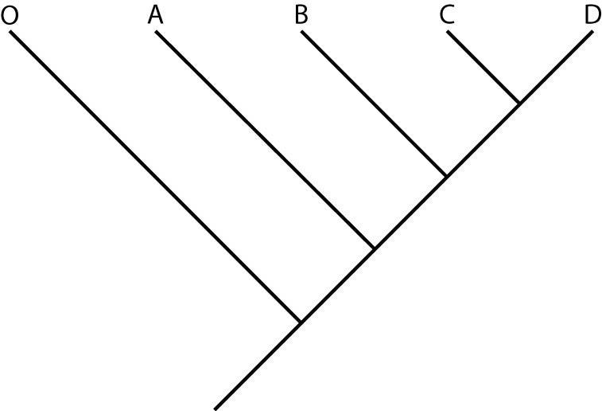
0
2. According to this dichotomous phylogenetic tree created using cladistic analysis, C and D are most closely related because they
  do not share a common ancestor with O, A, or B.
  are monophyletic.
  evolved from a common ancestor a long time ago.
  have the most shared derived characters in common.
  have the greatest number of anatomical similarities as shown by statistical analysis.
Notes:
Answer: d
Source: Taylor - Student Study Guide for Biology, Seventh Edition, Test Your Knowledge Question #15

Slide 12
0
3. A biologist discovers two new species of organisms, one in Africa and one in South America. The organisms resemble one another closely. Which type of evidence would probably be least useful in determining whether these organisms are closely related or are the products of convergent evolution?
  the history and timing of continental drift
  a comparison of DNA from the two species
  the fossil record of the two species
  analysis of the behavior of the two species
  comparative embryology
Notes:
Answer: d
Source: Barstow - Test Bank for Biology, Seventh Edition, Question #10

Slide 13
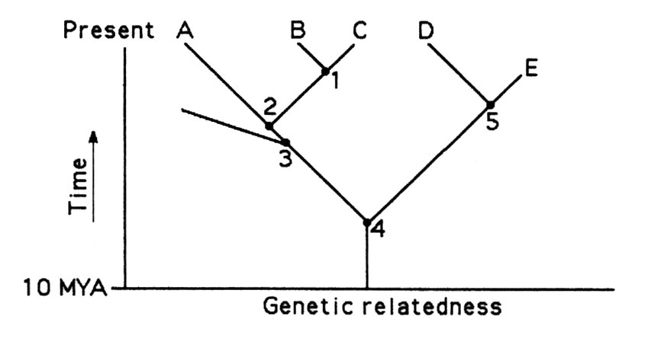
Use Figure 25.1 to answer the following questions.
4. A common ancestor for species C and E could be at position number
  1.
  2.
  3.
  4.
  5.
Notes:
Answer: d
Source: Barstow - Test Bank for Biology, Seventh Edition, Question #21

Slide 14
E. The two extant species that are most closely related to each other are
  A and B.
  B and D.
  C and B.
  D and E.
  E and A.
Notes:
Answer: c
Source: Barstow - Test Bank for Biology, Seventh Edition, Question #22

Slide 15
5. If this evolutionary tree is an accurate depiction of relatedness, then which of the following should be correct?
  The entire tree depicts
  anagenesis.
  If all species depicted
  here make up a taxon,
  this taxon is
  monophyletic.
  The last common ancestor
  of species B and C occurred
  more recently than the last
  common ancestor of species
  D and E.
  Species A is the ancestor of
  both species B and C.
  The species present at position number
  three is ancestral to three extant species.
  B only
  A and C
  C and D
  B, C, and D
  B, C, and E
Notes:
Answer: e
Source: Barstow - Test Bank for Biology, Seventh Edition, Question #26

Slide 16
A researcher compared the nucleotide sequences of a homologous gene from five different species of mammals. The sequence homology between each species' version of the gene and the human gene are presented as a percentage of similarity.
Species | Percentage
Chimpanzee | 99.7
Orangutan | 98.6
Baboon | 97.2
Rhesus Monkey | 96.9
Rabbit | 93.7

Slide 17
6. What conclusion can be validly drawn from these data?
  Humans and other primates evolved from rabbits.
  All organisms have similar DNA.
  Among the organisms listed, humans shared a common ancestor most recently with chimpanzees.
  Humans evolved from chimpanzees.
  Both A and D are correct.
Notes:
Answer: c
Source: Barstow - Test Bank for Biology, Seventh Edition, Question #44

Slide 18
7. Which statement represents the best explanation for the observation that the nuclear DNA of wolves and domestic dogs has a very high degree of homology?
  Dogs and wolves have very similar morphologies.
  Dogs and wolves belong to the same genus.
  Dogs and wolves are both members of the family Canidae.
  Dogs and wolves shared a common ancestor relatively recently.
  Convergent evolution has occurred.
Notes:
Answer: d
Source: Barstow - Test Bank for Biology, Seventh Edition, Question #55

Slide 19
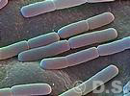
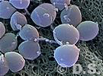
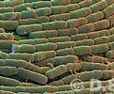
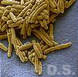
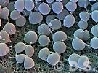
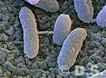
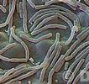
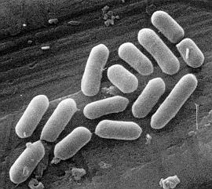
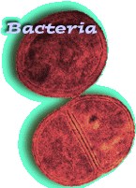
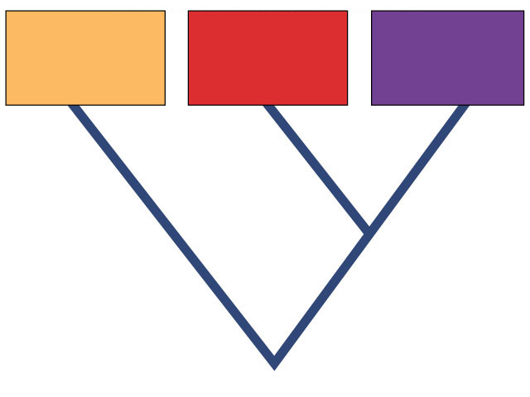
Prokaryotes
Domain Bacteria
Domain Archaebacteria
Domain
Bacteria
Domain
Archaea
Domain
Eukarya
Common ancestor

Slide 20
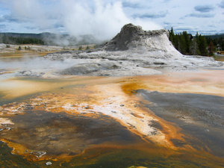
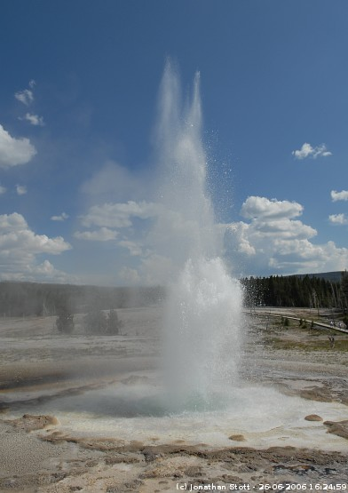
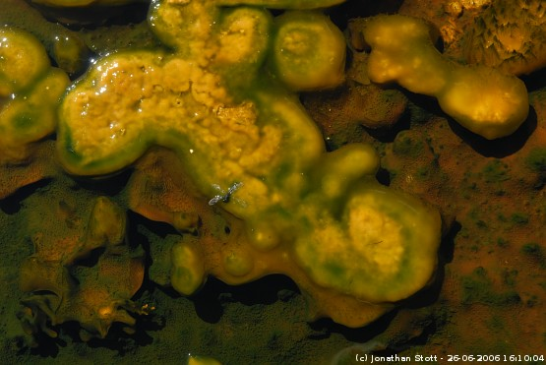
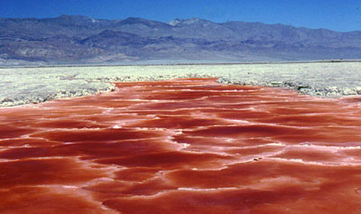
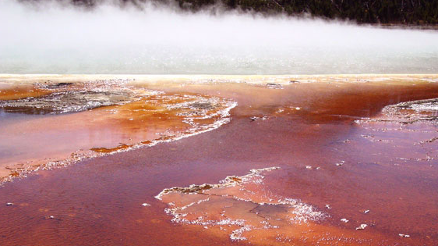
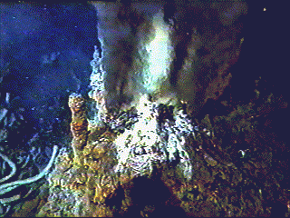
Bacteria live EVERYWHERE!
Bacteria live in all ecosystems
  on plants & animals
  in plants & animals
  in the soil
  In EXTREMES (hot, cold, acid, salt, deep)
  on the living
  on the dead

Slide 21
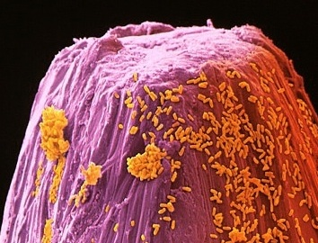
Prokaryote –
‘Pro’ = Before
‘Karyon’ = Nucleus

Slide 22
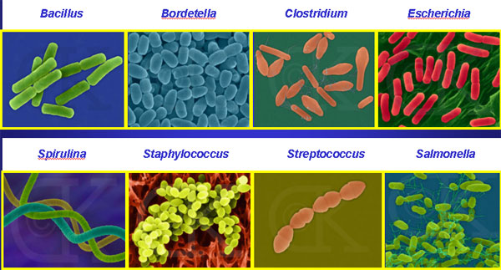
Bacterial diversity
rods and spheres and spirals… Oh My!
Notes:
Bacillus = anthrax, BT
Bordetella = pertussis or whooping cough, kennel cough
Clostridium = botulism & tetanus
Escherichia = E. coli
Spirulina = blue-gren algae
Staph
Strep
Salmonella

Slide 23
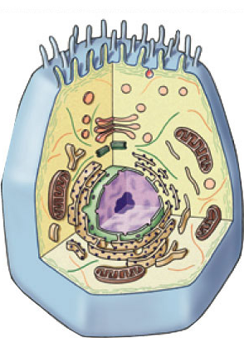

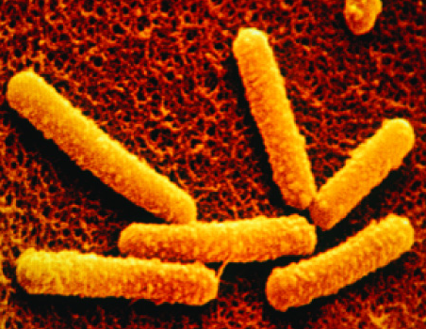
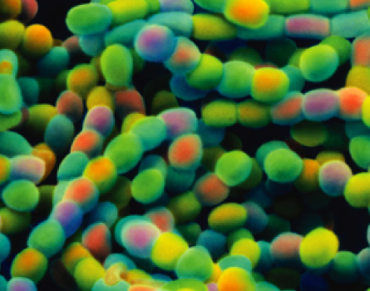
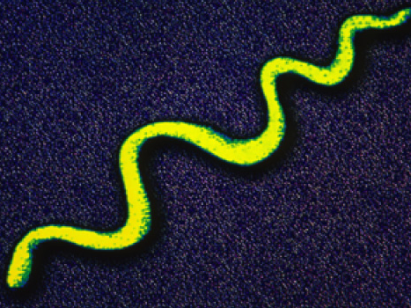
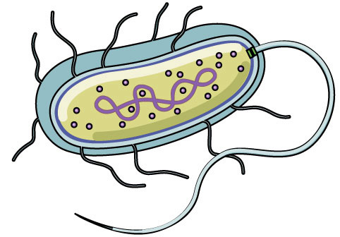

Prokaryote Structure
eukaryote cell
prokaryote
cell
Unicellular
  bacilli, cocci, spirilli
Size
  ~1/10 size of smallest eukaryotic cell
    1 micron (1um)
Internal structure
  no internal compartments
    no membrane-bound organelles
    only ribosomes
  circular chromosome, naked DNA
    not wrapped around proteins

Slide 24
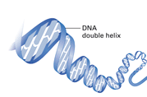
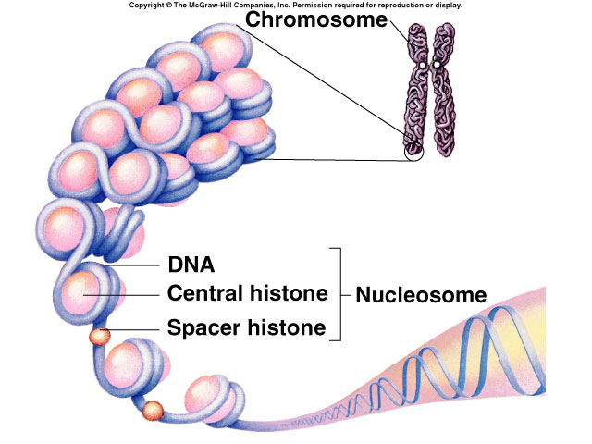
Prokaryote vs. Eukaryote Chromosome
Prokaryote
Eukaryote
double helix

Slide 25
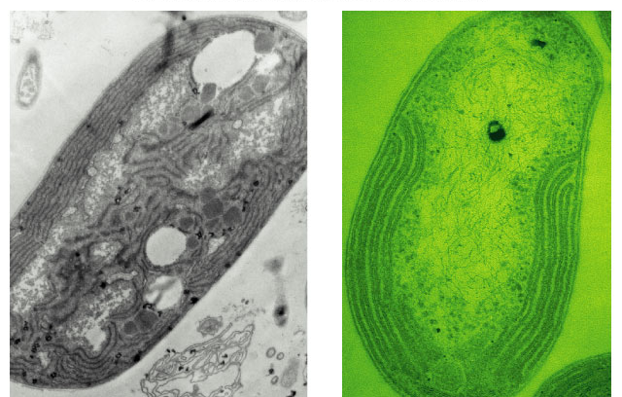
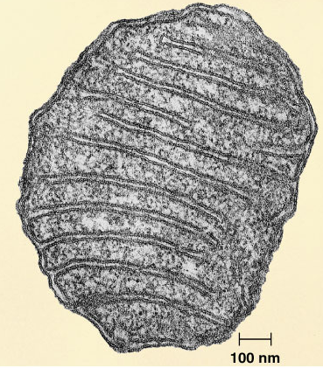
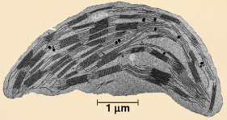
Variations in Cell Interior
cyanobacterium
(photosythetic) bacterium
aerobic bacterium
mitochondria
chloroplast
internal membranes
for photosynthesis
like a chloroplast
(thylakoids)
internal membranes
for respiration
like a mitochondrion
(cristae)

Slide 26
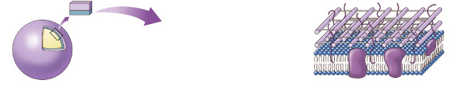
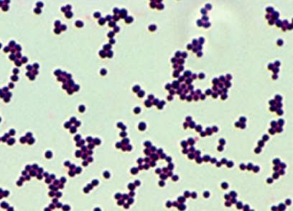
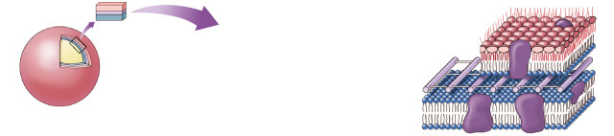
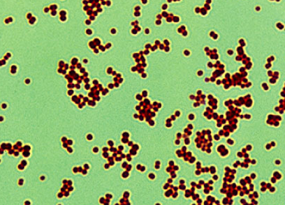
Prokaryote Cell Wall Structure
Gram-positive bacteria
peptide side
chains
cell wall
peptidoglycan
plasma membrane
protein
peptidoglycan = polysaccharides + amino acid chains
lipopolysaccharides = lipids + polysaccharides
Gram-negative bacteria
outer membrane of
lipopolysaccharides
outer
membrane
cell wall
peptidoglycan
plasma
membrane
Notes:
Most pathogenic bacteria in humans are gram-negative organisms.
Escherichia coli, Salmonella, and other Enterobacteriaceae, Pseudomonas, Moraxella, Helicobacter, Stenotrophomonas, Legionella and Wolbachia and many others, cyanobacteria, spirochaetes, green sulfur and green non-sulfur bacteria.
Medically relevant Gram-negative cocci include three organisms, which cause a sexually transmitted disease (Neisseria gonorrhoeae), a meningitis (Neisseria meningitidis), and respiratory symptoms (Moraxella catarrhalis).
Medically relevant Gram-negative bacilli include a multitude of species. Some of them primarily cause respiratory problems (Hemophilus influenzae, Klebsiella pneumoniae, Legionella pneumophila, Pseudomonas aeruginosa), primarily urinary problems (Escherichia coli, Proteus mirabilis, Enterobacter cloacae, Serratia marcescens), and primarily gastrointestinal problems (Helicobacter pylori, Salmonella enteritidis, Salmonella typhi).
Classically, six gram-positive organisms are typically pathogenic in humans. Two of these, Streptococcus and Staphylococcus, are cocci (round bacteria). The remaining organisms are bacilli (rod-shaped bacteria) and can be subdivided based on their ability to form spores. The non-spore formers are Corynebacterium and Listeria (food poisoning w/ 25% mortality vs 1% in Salmonella), while Bacillus and Clostridium (botulism & tetanus) produce spores. The spore-forming bacteria can again be divided based on their respiration: Bacillus is a facultative anaerobe, while Clostridium is an obligate anaerobe.

Slide 27
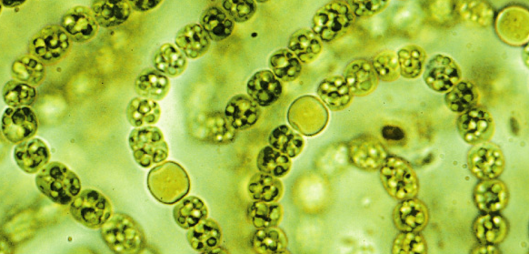
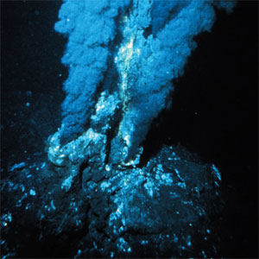
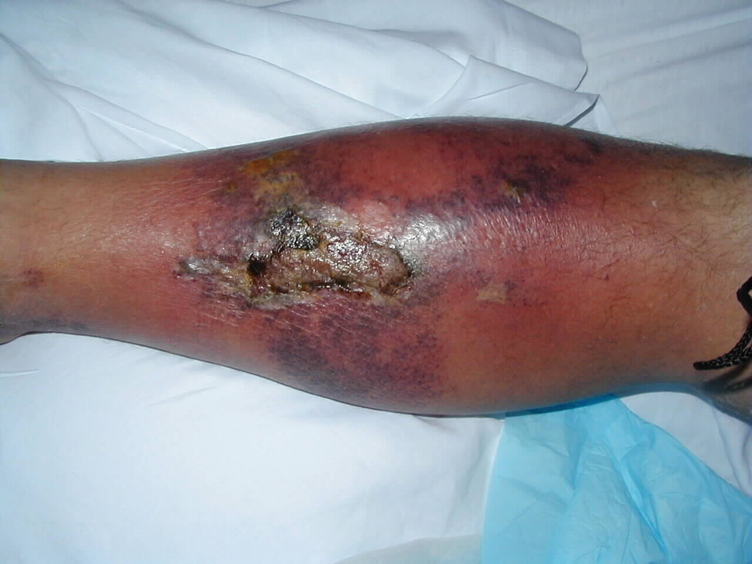
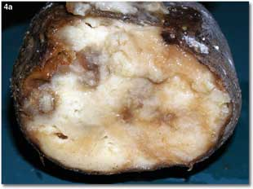
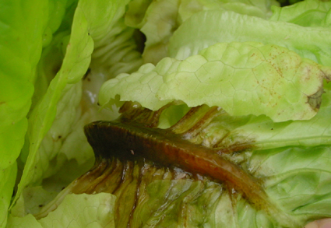
Prokaryotic metabolism
How do bacteria acquire their energy & nutrients?
  photoautotrophs
    photosynthetic bacteria
  chemoautotrophs
    oxidize inorganic compounds
      nitrogen, sulfur, hydrogen…
  heterotrophs
    live on plant & animal matter
    decomposers & pathogens

Slide 28
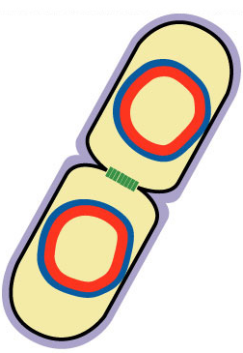
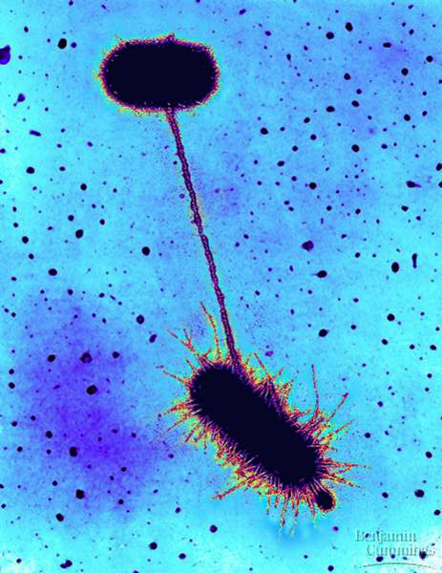
Genetic variation in bacteria
Mutations
  bacteria can reproduce every 20 minutes
    binary fission
  error rate in copying DNA
    1 in every 200 bacteria has a mutation
    you have billions of E. coli in your gut!
Genetic recombination
  bacteria swap genes
    plasmids
      small supplemental
      circles of DNA
    conjugation
      direct transfer of DNA
conjugation
Notes:
The adult human body contains an estimated 1 * 10^14 cells (a 1 followed by 14 zeros), 10% of which actually belong to us!! Thus, we have roughly 10 times more cells living in us than we do cells that make up our own bodies. Most of these 'outside' cells are bacteria living in the gastrointestinal tract. More than 400 species of microbes live in the colon alone, and can reach a density of 1 * 10^11 organism per milliliter of 'intestinal lumenal contents.'
Direct transfer of DNA between 2 bacterial cells that are temporarily joined
results from presence of F plasmid with F factor
F for “fertility” DNA
E. coli “male” extends sex pilli, attaches to female bacterium
cytoplasmic bridge allows transfer of DNA

Slide 29
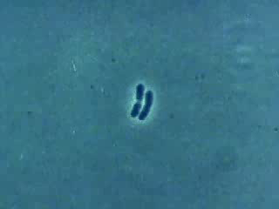
Behold the
power of
exponential
doubling!

Slide 30
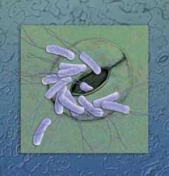
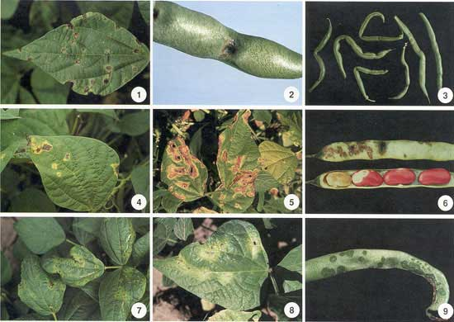
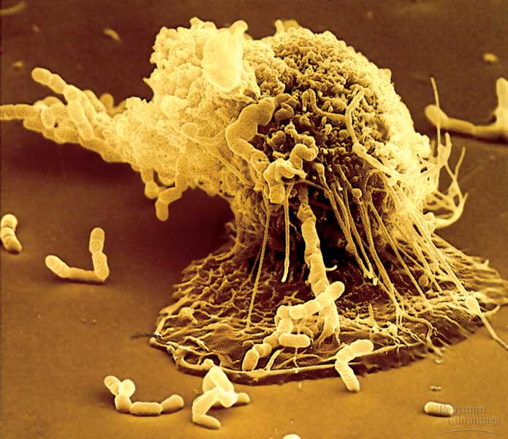

Bacteria as pathogens
Disease-causing microbes (< 1%)
  plant diseases
    wilts, rots, blights
  animal diseases
    tooth decay, ulcers
    anthrax, botulism
    plague, leprosy, “flesh-eating” disease
    STDs: gonorrhea, chlamydia
    typhoid, cholera
    TB, pneumonia
    lyme disease

Slide 31





Bacteria as beneficial (& necessary)
Life on Earth is dependent on bacteria
  Decomposers
  nitrogen fixation
    only organisms that can fix N from atmosphere
      needed for synthesis of proteins & nucleic acids
      plant root nodules
  help in digestion (E. coli)
    digest cellulose for herbivores
    produce vitamins K & B₁₂ for humans
  produce foods & medicines
    from yogurt to insulin

Slide 32
Which of the following is a prokaryote?
  E. coli
  Algae
  Slime mold
  Felis domesticus
  Pan troglodytes
Notes:
a

Slide 33
All life on Earth have all of the the following characteristics EXCEPT:
      Cell membranes
      Nuclei
      Ribosomes
      DNA
      None of the above
Notes:
b

