Slide 1
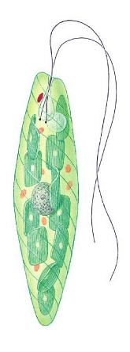
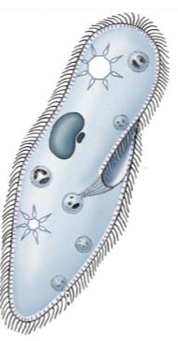
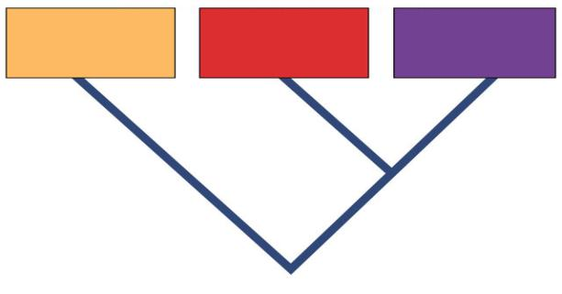
Kingdom: Protists
Domain Eukarya
(Ch. 28)
Domain
Bacteria
Domain
Archaea
Domain
Eukarya
Common ancestor

Slide 2
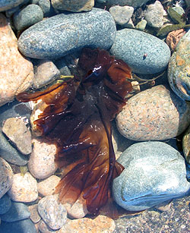
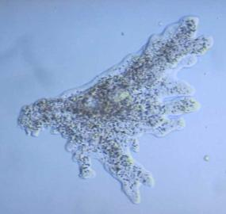
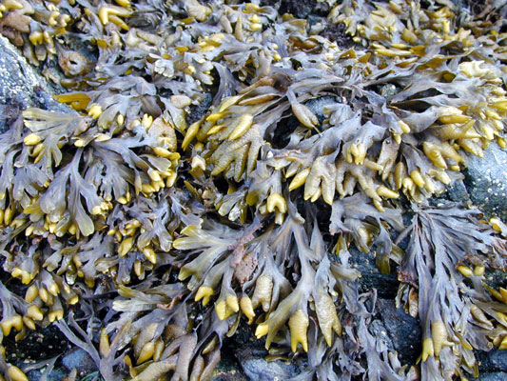
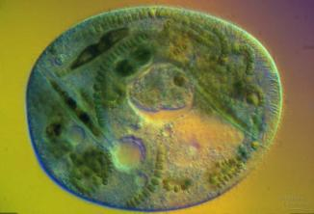
General characteristics
Classification criteria
eukaryotes
not animal, plant or fungi
That’s more of what they’re not & not what they are!

Slide 3
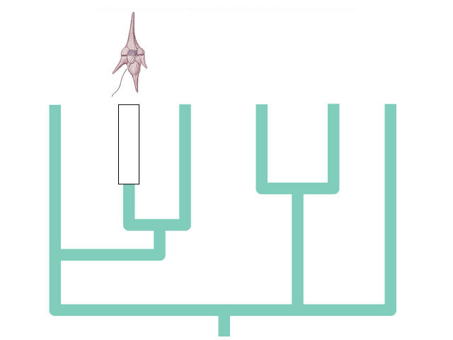
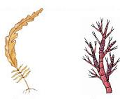
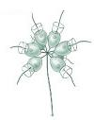
Great Diversity
dinoflagellates & ciliates
brown algae & diatoms
green algae
euglenoids
red algae
miscellaneous?

Slide 4
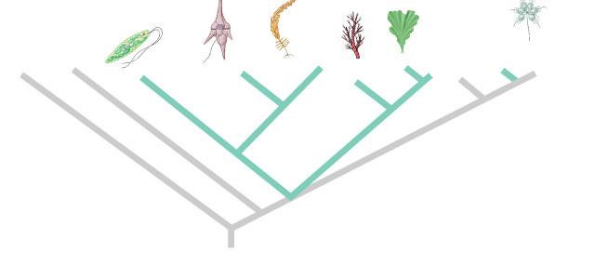
Problems with Protist Classification
Too Diverse!
doesn’t reflect any evolutionary relationship amongst all kingdom members
paraphyletic
Streptophyta
(includes land plants)
Archaea
Chlorophyta
Choanoflagellida
Bacteria
Euglenozoa
Stramenopila
Animals
Alveolata
Fungi
Rhodophyta
Something’s not right here!

Slide 5
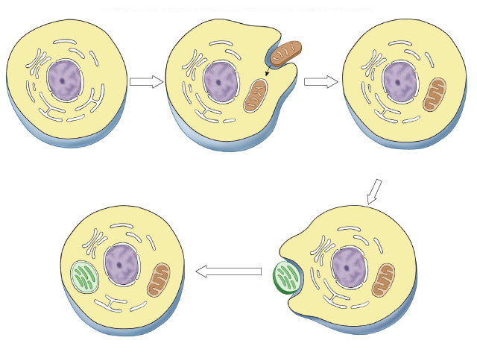
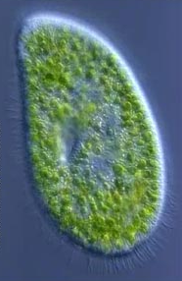
Theory of Endosymbiosis
internal membrane system
aerobic bacterium
mitochondrion
Ancestral eukaryotic cell
Eukaryotic cell with
mitochondrion
photosynthetic bacterium
chloroplast
Eukaryotic cell with chloroplasts
Paramecium & symbiont Chlorella

Slide 6
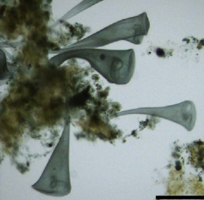
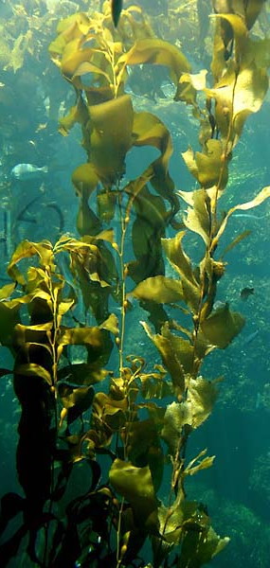
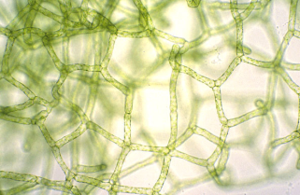
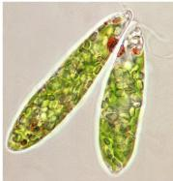
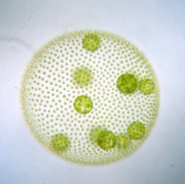
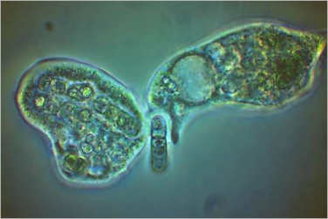
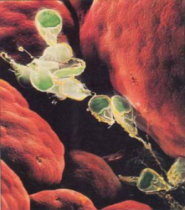
Protist Diversity
The full spectrum of modes of life
unicellular to multicellular
autotrophic to heterotrophic
asexual to sexual reproduction
pathogenic to beneficial
sessile to mobile

Slide 7
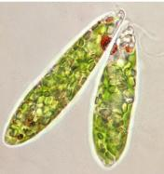
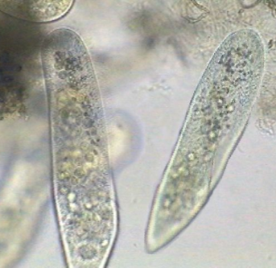
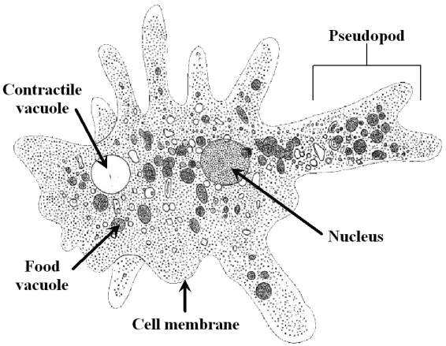
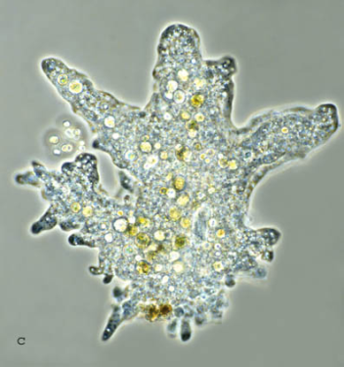
Mobility
How Protists move
flagellum
cilia
pseudopod

Slide 8
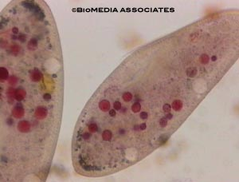
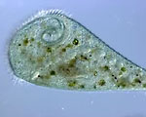
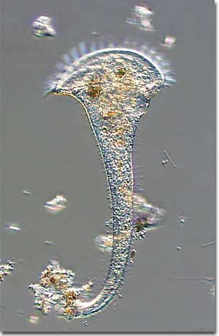
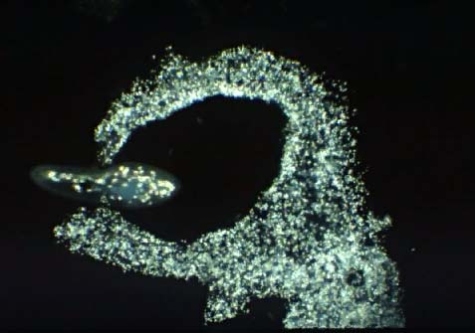
Protist Diversity
Animal-like Protists
heterotrophs, predators
Amoeba
Paramecium
Stentor
Paramecium with food vacuoles stained red
Amoeba ingesting a Paramecium

Slide 9
To Put It Another Way....

Slide 10
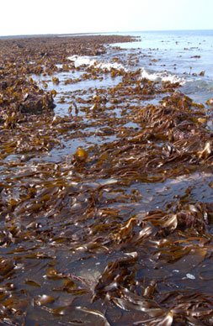
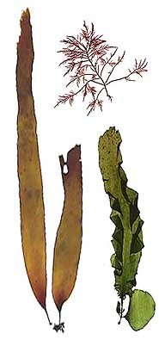
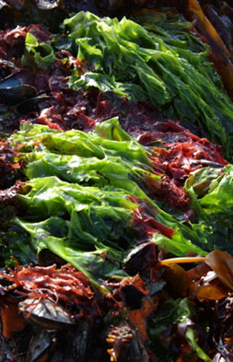
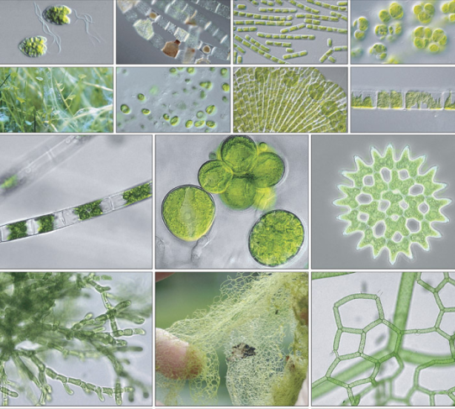
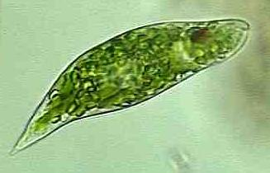
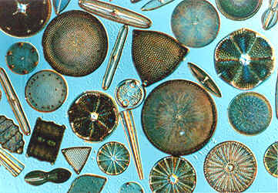
Protist Diversity
Plant-like Protists
autotrophs, photosynthesis
Euglena
algae
Diatoms
“Seaweeds”

Slide 11
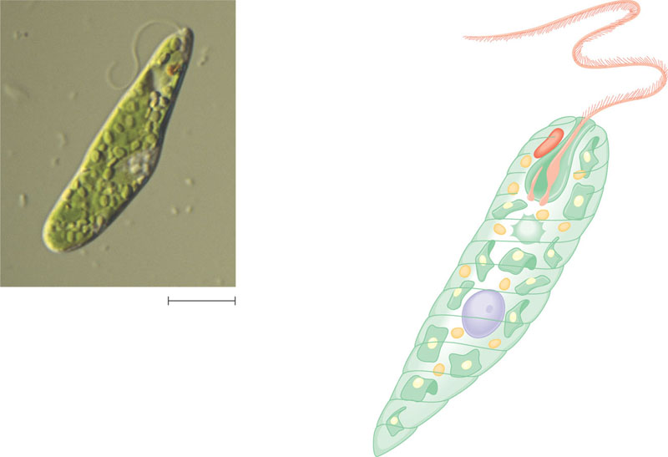
Euglena, a euglenid commonly found in pond water
Long flagellum
Eyespot: pigmented
organelle that functions
as a light shield, allowing
light from only a certain
direction to strike the
light detector
Light detector: swelling near the
base of the long flagellum; detects
light that is not blocked by the
eyespot; as a result, Euglena moves
toward light of appropriate
intensity, an important adaptation
that enhances photosynthesis
Short flagellum
Nucleus
Contractile vacuole
Euglena (LM)
5 µm
Plasma membrane
Pellicle: protein bands beneath
the plasma membrane that
provide strength and flexibility
(Euglena lacks a cell wall)
Chloroplast
Paramylon granule

Slide 12
Ain’t No Party Like A Euglena Party!

Slide 13
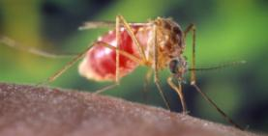
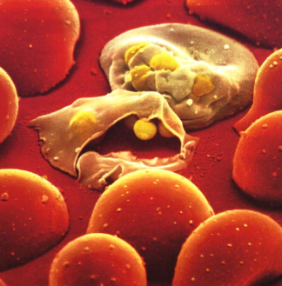
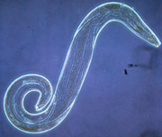
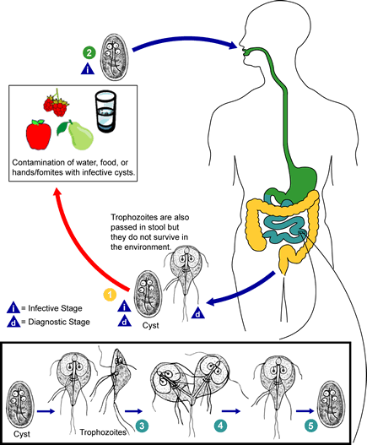
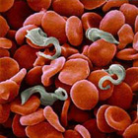
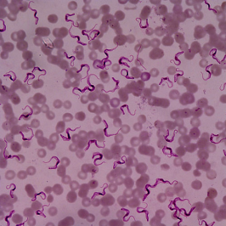
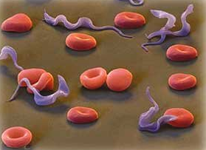
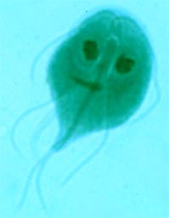
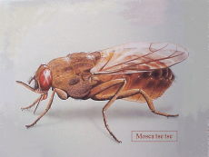
Protist Diversity
Parasitic & pathogenic Protists
malaria
Giardia
trypanosomes
Plasmodium
Giardia
Trypanosoma
Notes:
African Sleeping Sickness and South American Chagas Disease

Slide 14
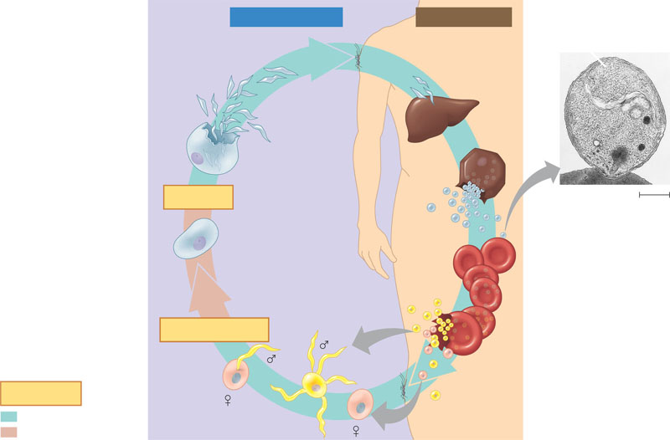
The two-host life cycle of Plasmodium, the apicomplexan that causes malaria
The sporozoites enter the person’s
liver cells. After several days, the sporozoites
undergo multiple divisions and become
merozoites, which use their apical complex
to penetrate red blood cells (see TEM below).
An infected Anopheles
mosquito bites a person,
injecting Plasmodium
sporozoites in its saliva.
2
1
Inside mosquito
Inside human
Merozoite
Sporozoites
(n)
Liver
An oocyst develops
from the zygote in the wall
of the mosquito’s gut. The
oocyst releases thousands
of sporozoites, which
migrate to the mosquito’s
salivary gland.
7
Liver cell
Oocyst
Apex
MEIOSIS
Merozoite
(n)
Red blood
cell
0.5 µm
Zygote
(2n)
Red blood
cells
The merozoites divide asexually inside the
red blood cells. At intervals of 48 or 72 hours
(depending on the species), large numbers of
merozoites break out of the blood cells, causing
periodic chills and fever. Some of the merozoites
infect new red blood cells.
3
FERTILIZATION
Gametes
Gametocytes
(n)
Key
Haploid (n)
Some merozoites
form gametocytes.
Diploid (2n)
4
Gametes form from gametocytes.
Fertilization occurs in the mosquito’s
digestive tract, and a zygote forms.
The zygote is the only diploid stage
in the life cycle.
Another Anopheles mosquito
bites the infected person and picks
up Plasmodium gametocytes along
with blood.
6
5

Slide 15
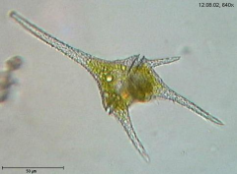
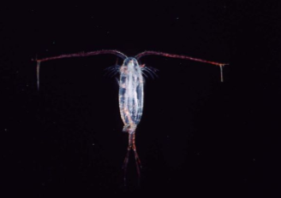
Protist Diversity
Beneficial & necessary Protists
phytoplankton
small algae + diatoms
much of the world’s photosynthesis
produces ~90% of atmospheric oxygen
zooplankton
heterotrophic protists + animals
key ecological role at base of marine food web

Slide 16
1. The current state of "protistan" taxonomy is an example of which feature of good scientific practice? The need to
suspend judgment until enough evidence is available to make an informed decision.
base conclusions on controlled, repeatable experiments.
be willing to change, or drop, one's hypotheses when the data warrant it.
avoid sampling techniques that can introduce bias.
Both A and C are correct.
Notes:
Answer: e
Source: Barstow - Test Bank for Biology, Sixth Edition, Question #27.

