Slide 1
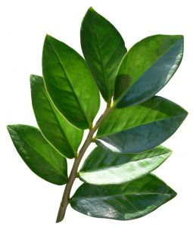
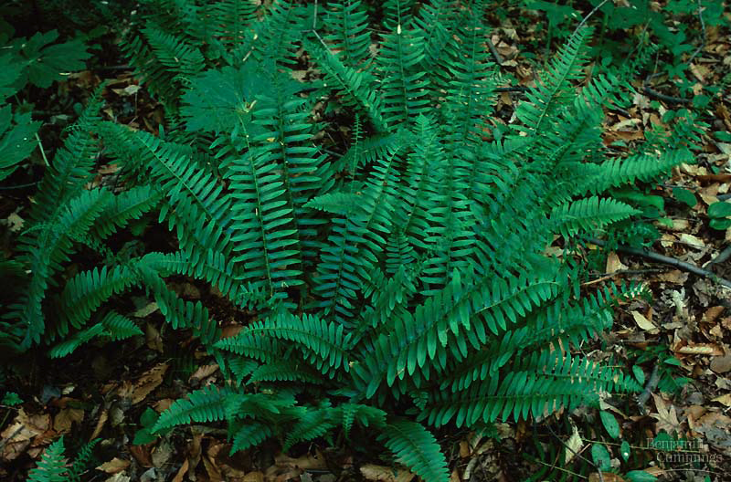
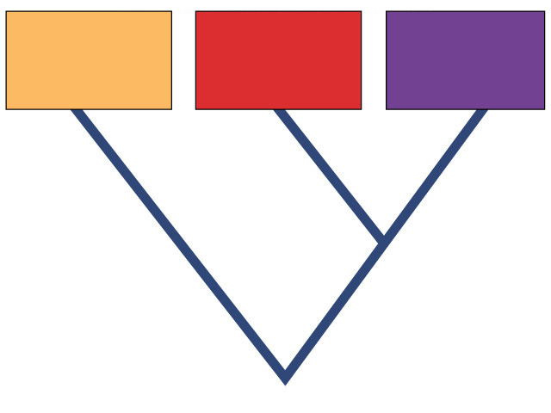
Kingdom: Plants
Domain Eukarya
(Ch. 29, 30)
Domain
Bacteria
Domain
Archaea
Domain
Eukarya
Common ancestor

Slide 2
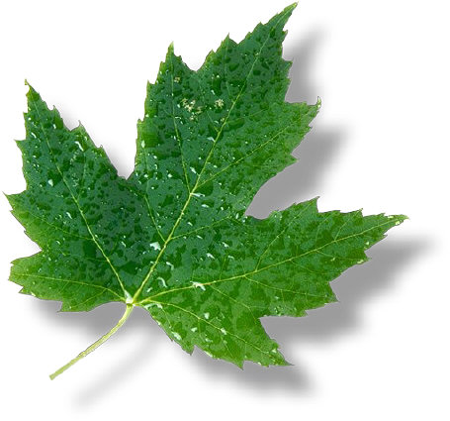
Evolution of Land Plants
500 mya land plants evolved
special adaptations for life on dry land
protection from drying = desiccation
waxy cuticle
gas exchange (through cuticle)
stomates
water & nutrient conducting systems
xylem & phloem
protection for embryo
seeds

Slide 3
Plant Diversity
Bryophytes non-vascular land plants
Pteridophytes seedless vascular plants
Gymnosperm pollen & “naked” seeds
Angiosperm flowers & fruit
flowering plants
conifers
flowers
mosses
ferns
pollen & seeds
vascular system = water conduction
Tracheophytes
colonization of land
Ancestral Protist
xylem cells = tracheids

Slide 4
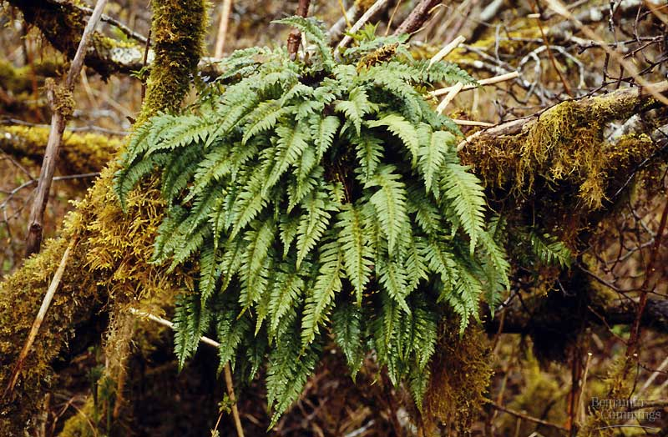
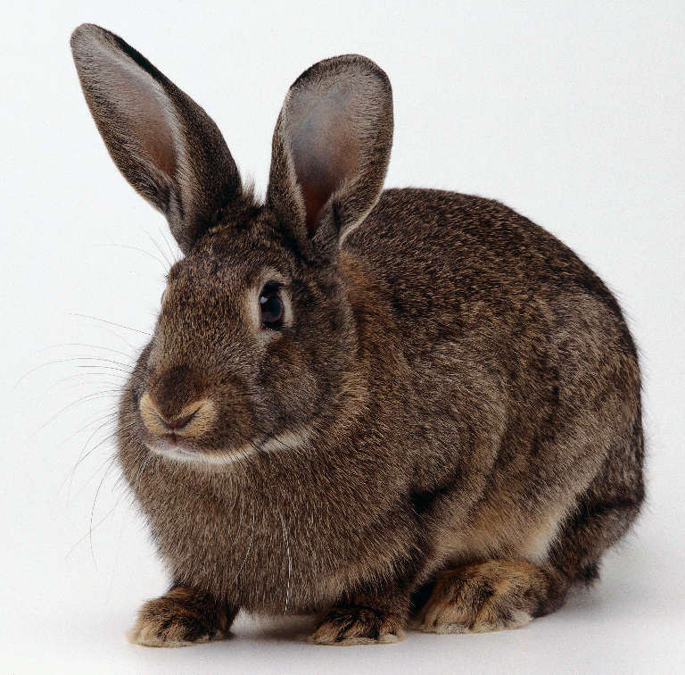
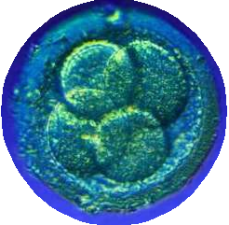
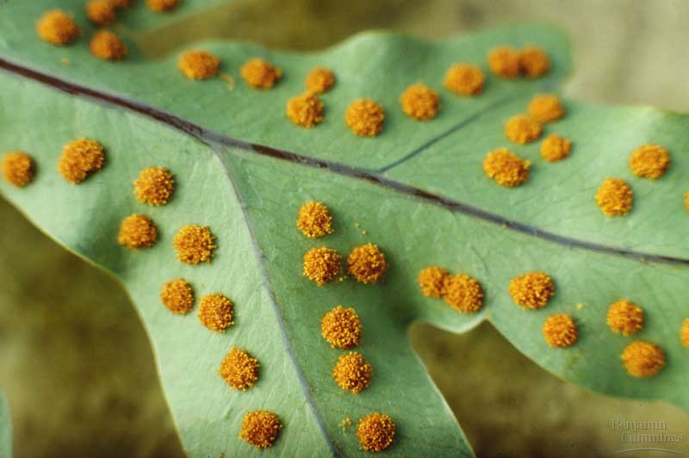
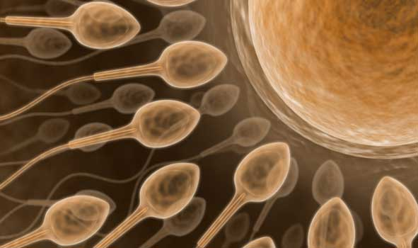
Animal vs. Plant life cycle
Animal
Plant
diploid multicellular individual
2n
diploid multicellular
sporophyte
2n
mitosis
zygote 2n
mitosis
meiosis
fertilization
meiosis
gametes
1n
spores
1n
zygote 2n
fertilization
mitosis
mitosis
haploid unicellular
gametes
1n
haploid multicellular
gametophyte
1n
no multicellular haploid
alternation of generations

Slide 5
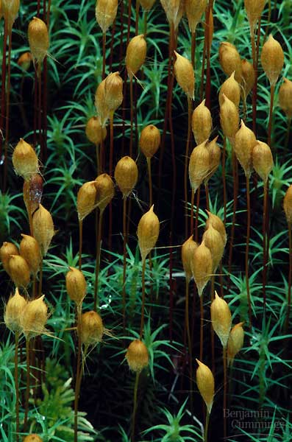
First land plants
Bryophytes: mosses & liverworts
non-vascular
no water transport system
no true roots
swimming sperm
flagellated sperm
lifecycle dominated by haploid gametophyte stage
fuzzy moss plant you are familiar with is haploid
spores for reproduction
haploid cells which sprout to form gametophyte
haploid
diploid

Slide 6
First vascular plants
diploid
Pteridophytes: ferns
vascular
water transport system
xylem, phloem, roots, leaves
swimming sperm
flagellated sperm
life cycle dominated by sporophyte stage
leafy fern plant you know = diploid
fragile independent gametophyte (prothallus)
spores for reproduction
haploid cells which sprout to form gametophyte
haploid

Slide 7
Alternation of generations
Fern gametophyte (1n)
small haploid plant which produces gametes
homospory: male & female on same plant
archegonia
antheridia

Slide 8
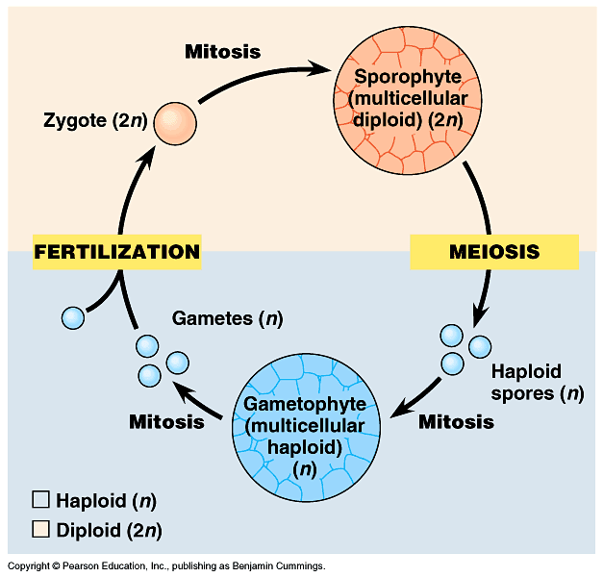
Alternation of generations
diploid
produces male & female gametes
archegonia
haploid
antheridia

Slide 9
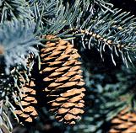
First seed plants
Gymnosperm: conifers
vascular
heterospory
male vs. female gametophytes
seeds
naked seeds (no fruit)
pollen
contain male gametophyte
life cycle dominated by sporophyte stage
coniferous trees you are familiar with are diploid
reduced (microscopic) gametophyte
reduction of gametophyte protects delicate egg & embryo in protective sporophyte
protected from drought & UV radiation

Slide 10
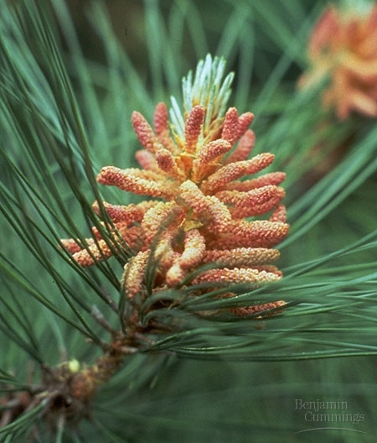
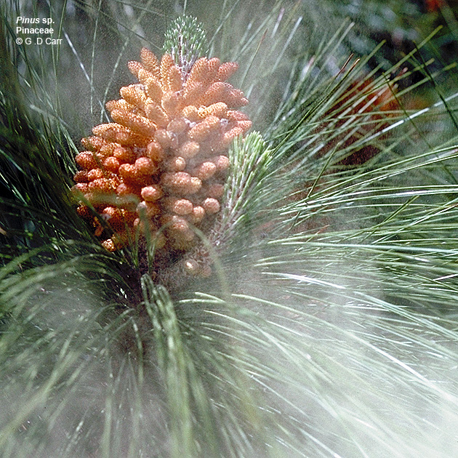
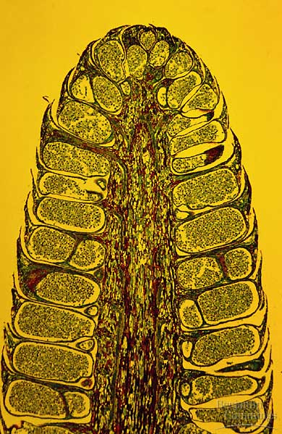
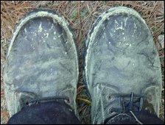
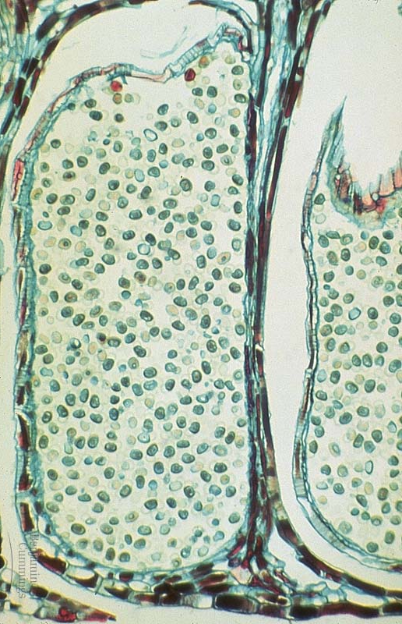
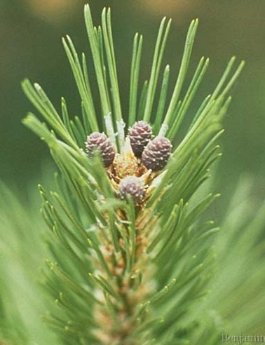
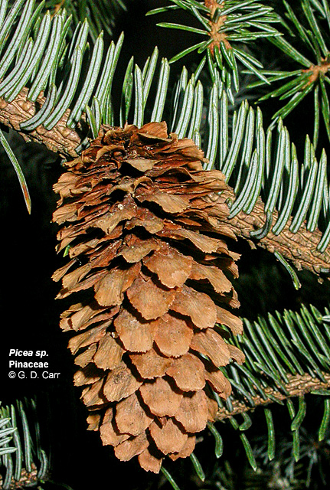
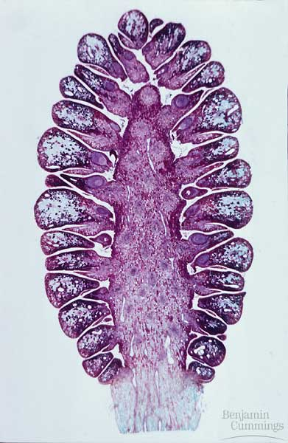
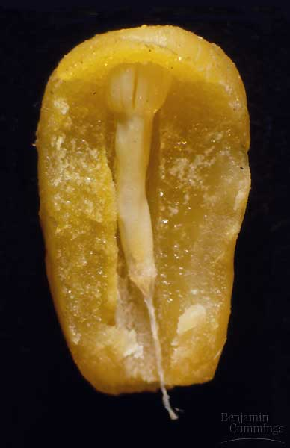
sporangium & pollen
male
male (pollen) cones
female
female cones
pine embryo

Slide 11
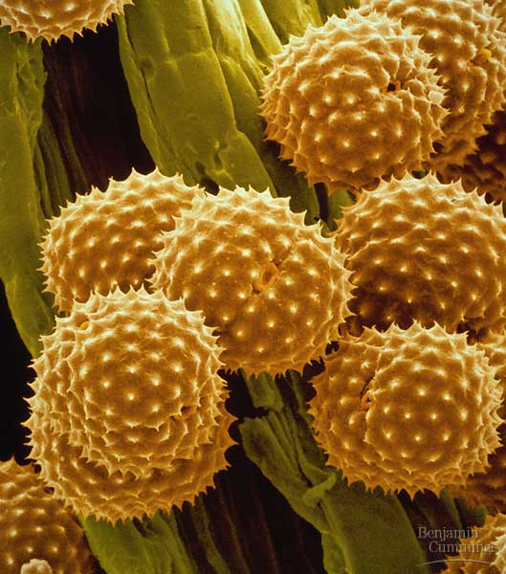
Pollen
Pollen eliminated the requirement for water for fertilization
spread through wind & animal

Slide 12
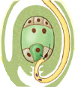
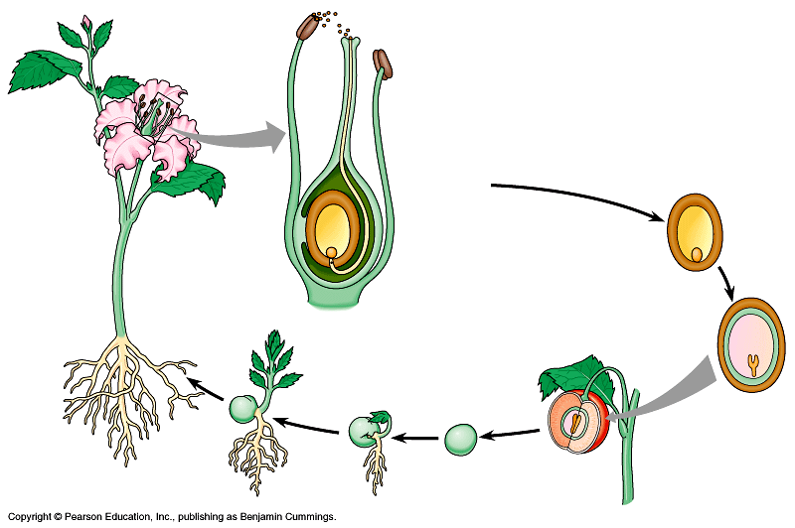
Angiosperm life cycle
polar
nuclei
male gametophyte = pollen grain (haploid)
pollen grains
egg
cell
ovary sac
sperm nuclei travel down pollen tube
3n endosperm
female gametophyte = ovary sac (haploid)
2n zygote
double fertilization
2n embryo
new sporophyte in seed (diploid)

Slide 13
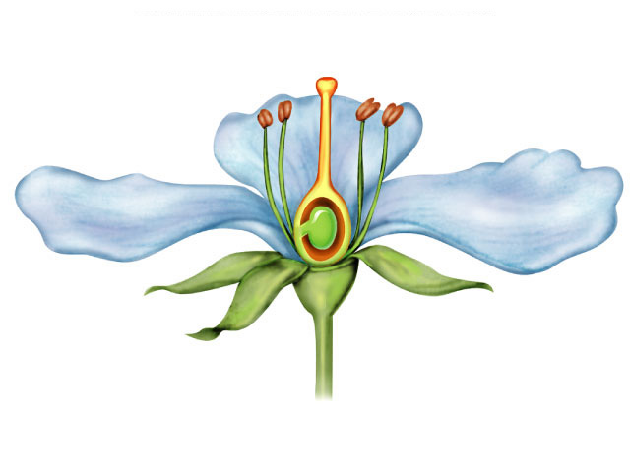
Flower
Modified shoot with 4 rings of modified leaves
sepals
petals
stamens
male
carpel
female
Stigma
Anther
Style
Carpel
Stamen
Ovary
Filament
sepals
Petal
petals
stamens
Ovule
carpel
Sepal
adaptations through mutations

Slide 14
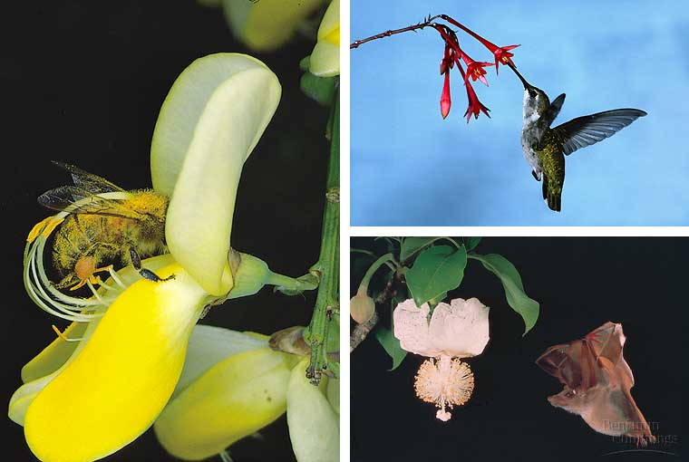
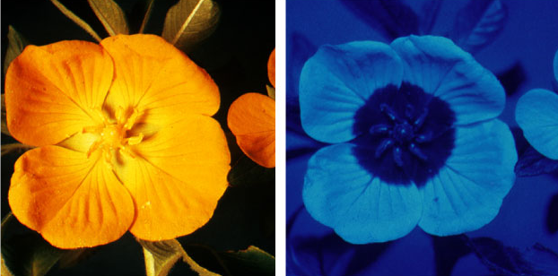
Co-evolution: flowers & pollinators
How a bee sees a flower…insects see UV light = a bulls-eye to the nectar

Slide 15
Seed & Plant embryo
seed coat
Seed offers…
protection for embryo
stored nutrients for growth of embryo
endosperm
(3n)
cotyledons
embryo (2n)
cotyledons = “seed” leaves,
first leaves of new plant

Slide 16
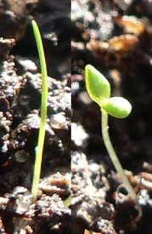
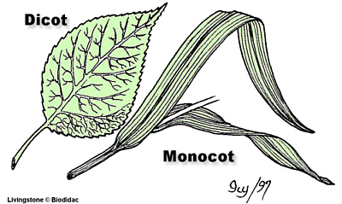
Monocots & dicots
Angiosperm are divide into 2 classes
dicots (eudicot)
2 cotyledons (seed leaves)
leaves with network of veins
woody plants, trees, shrubs, beans
monocots
1 cotyledon
leaves with parallel veins
grasses, palms, lilies

Slide 17
