Slide 1
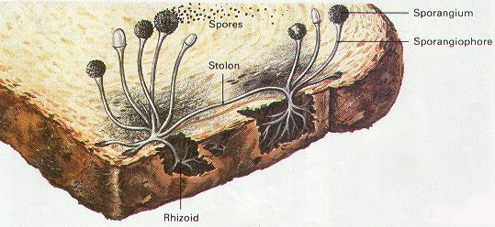
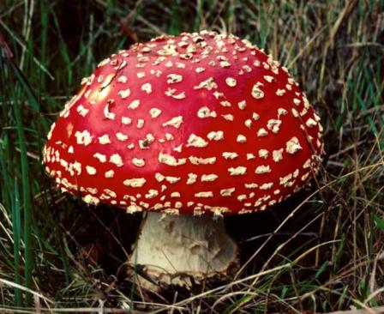
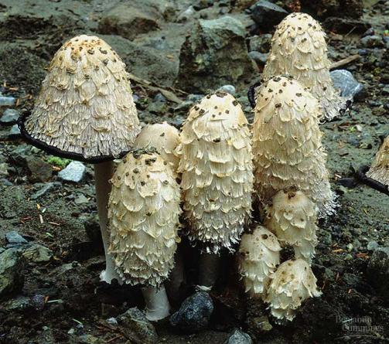
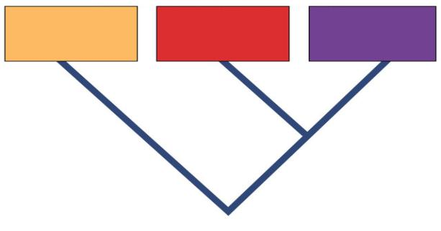
Kingdom: Fungi
Domain Eukarya
(Ch. 29)
Domain
Bacteria
Domain
Archaea
Domain
Eukarya
Common ancestor

Slide 2
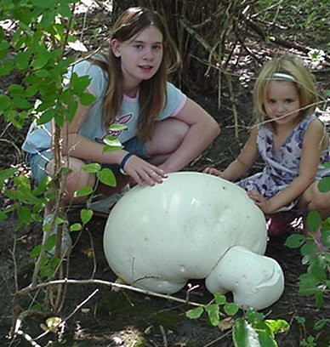
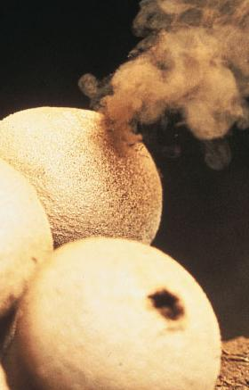
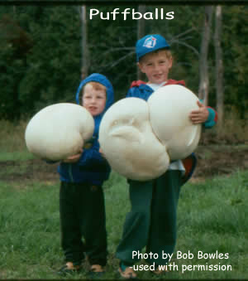
General characteristics
Classification criteria
eukaryotes
heterotrophs
Absorb nutrients
mostly multicellular
EXCEPT unicellular yeasts
cell wall
chitin
rigid polysaccharide
sexual & asexual reproduction

Slide 3
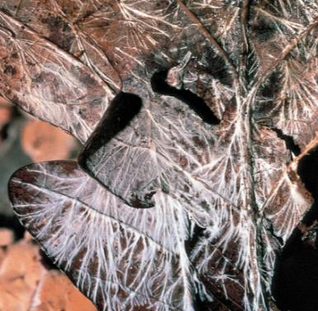
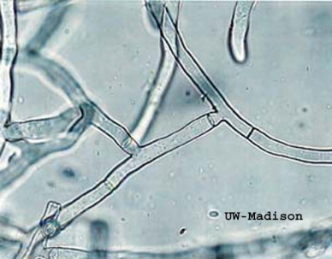
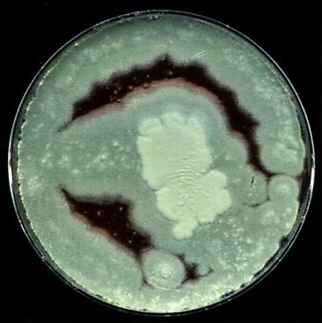
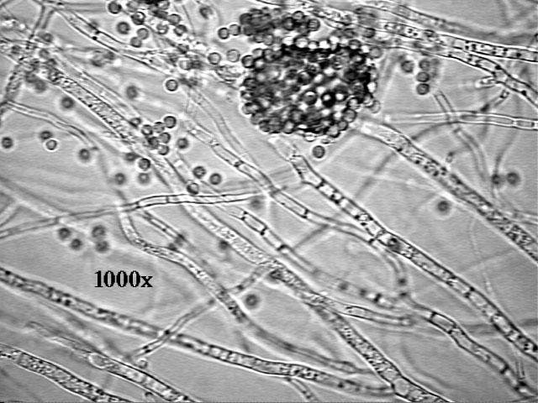
Fungal Structure
Fungal body
mycelium
thread-like cells
hyphae
Cells
multiple nuclei
Cell wall
chitin
just like crab shells

Slide 4
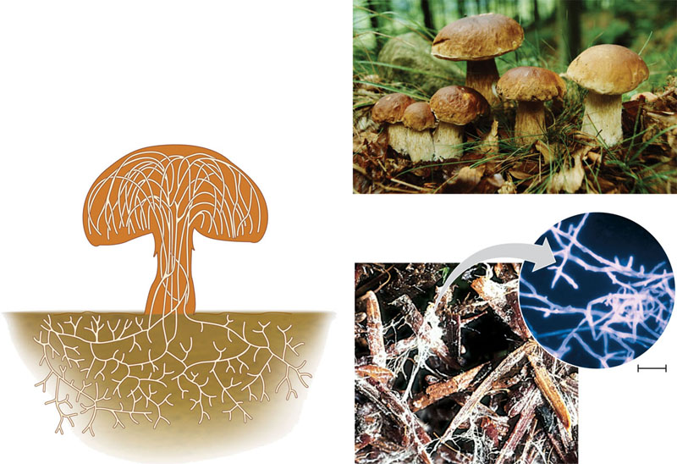
Structure of a multicellular fungus
Reproductive structure. The mushroom produces tiny cells called spores.
Hyphae. The mushroom and its subterranean mycelium are a continuous network of hyphae.
Spore-producing structures
20 μm
Mycelium

Slide 5
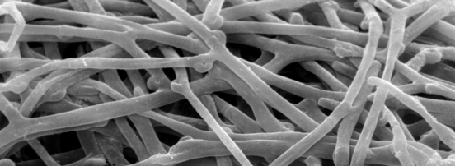
Internal structure
chitin cell wall
Eukaryotic cells
long, thread-like cells
filamentous
incomplete divisions between cells
septum
multiple nuclei
septum
pore
nuclei

Slide 6
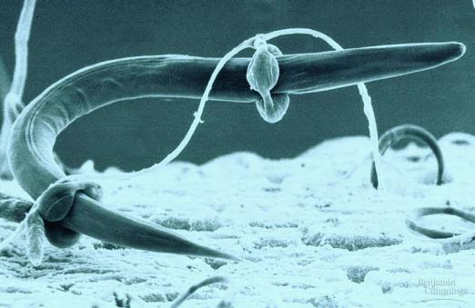
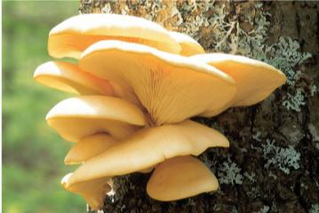
Modes of Nutrition
Heterotrophic
secrete digestive enzymes
feed by absorption
parasites
feeding on living creatures
predators
paralyzing prey
decomposer
breakdown dead remains
fungal hypha
plant cell wall
plant cell membrane
plant cell

Slide 7
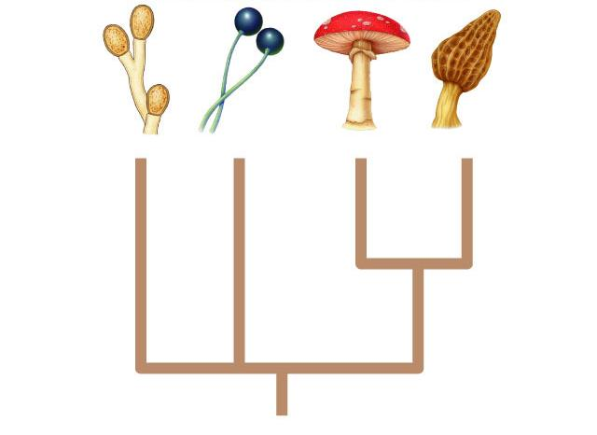
Fungal Diversity
Chytridiomycota
Zygomycota
Basidiomycota
Ascomycota
Fungi

Slide 8
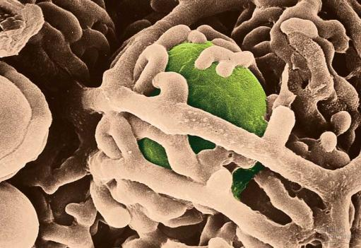
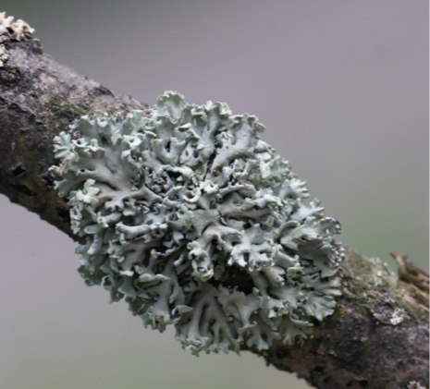
Ecological Roles
Decomposers
recycle nutrients
Symbiotic Relationships
lichen
fungi + algae
cyanobacteria or green algae
pioneer species in ecosystems
makes soil from bare rock
mycorrhizae
fungi + plants
enables plants to absorb more water
Lichens are fungi that have discovered agriculture!
Notes:
Lichens grow in the leftover spots of the natural world that are too harsh or limited for most other organisms. They are pioneers on bare rock, desert sand, cleared soil , dead wood, animal bones, rusty metal, and living bark. Able to shut down metabolically during periods of unfavorable conditions, they can survive extremes of heat, cold, and drought.
As adaptations for life in marginal habitats, lichens produce an arsenal of more than 500 unique biochemical compounds that serve to control light exposure, repel herbivores, kill attacking microbes, and discourage competition from plants. Among these are many pigments and antibiotics that have made lichens very useful to people in traditional societies.

Slide 9
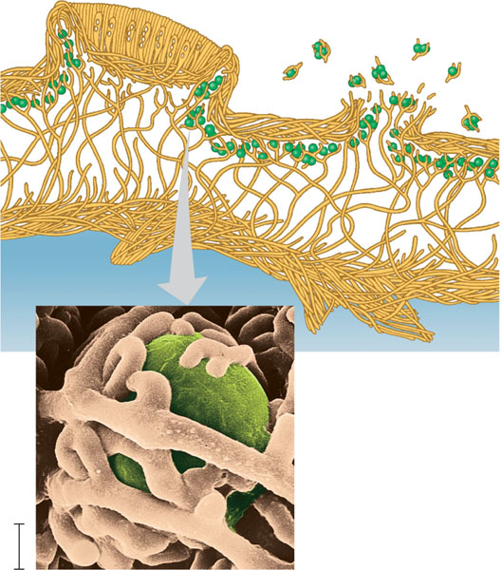
Anatomy of an ascomycete lichen (colorized SEM)
Ascocarp of fungus
Soredia
Fungal
hyphae
Algal
layer
Algal cell
Fungal hyphae
10 μm

Slide 10
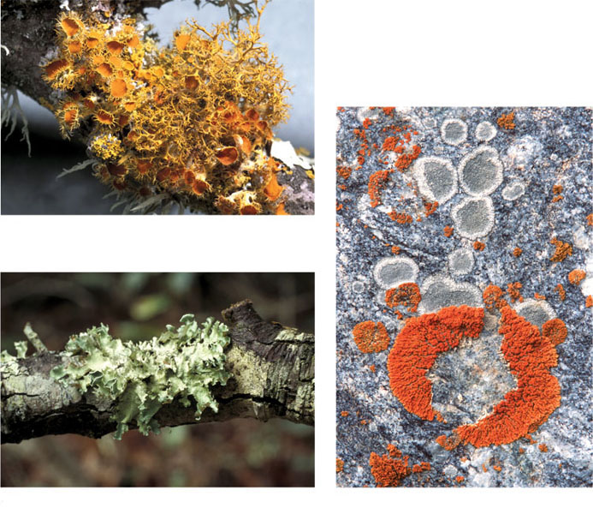
Variation in lichen growth forms
(a) A fruticose (shrub-like) lichen
(b) A foliose (leaf-like) lichen
(c) Crustose (crust-like) lichens

Slide 11
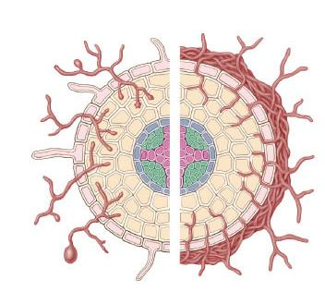
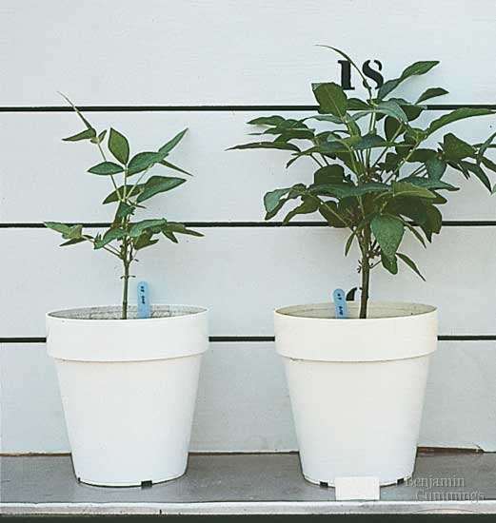
Mycorrhizae
Critical role in plant growth
extends water absorption of roots
without mycorrhizae
with mycorrhizae
Endomycorrhiza
Ectomycorrhiza

Slide 12
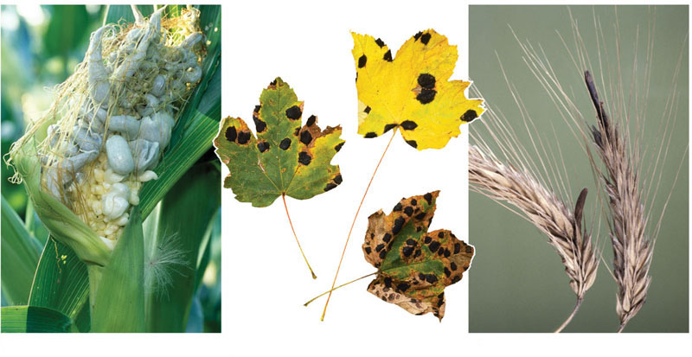
Examples of fungal diseases of plants
(a) Corn smut on corn
(b) Tar spot fungus on maple leaves
(c) Ergots on rye

Slide 13
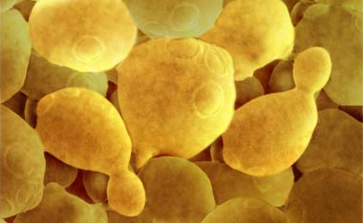
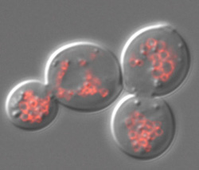
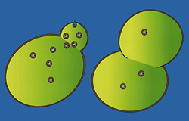
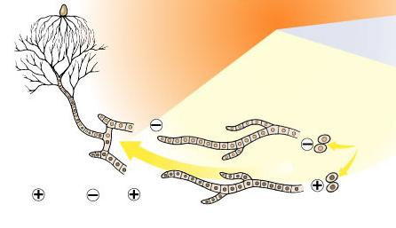
Reproduction
Asexual
budding in yeast
Sexual
spores
spread by wind
joining of + & – haploid spores
haploid spores

Slide 14
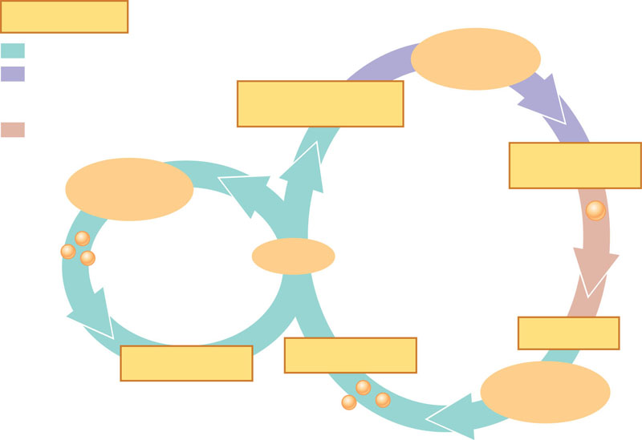
Generalized life cycle of fungi
Key
Haploid (n)
Heterokaryotic
stage
Heterokaryotic
(unfused nuclei from
different parents)
PLASMOGAMY
(fusion of cytoplasm)
Diploid (2n)
KARYOGAMY
(fusion of nuclei)
Spore-producing
structures
SEXUAL
REPRODUCTION
Zygote
Zygote
ASEXUAL
REPRODUCTION
Mycelium
Mycelium
Spores
MEIOSIS
GERMINATION
GERMINATION
Spore-producing
structures
Spores

Slide 15
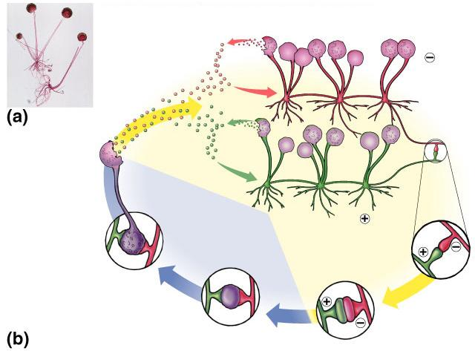
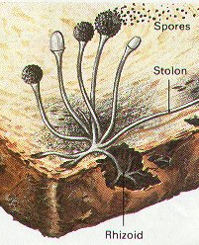
Zygomycete (Bread Mold) Life Cycle
spores (haploid)
mating strain
hypha
sporangium
MEIOSIS
(2n) diploid
mating strain
(n) haploid
FUSION of
+ and – gametangia

Slide 16
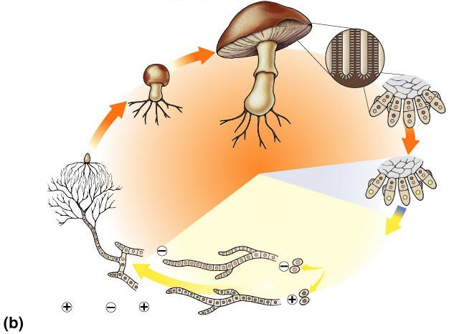
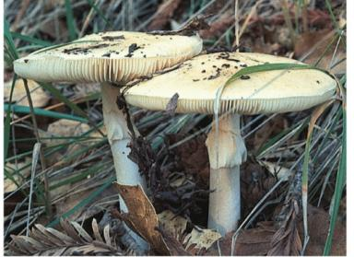
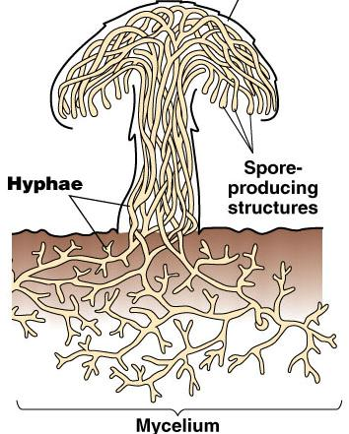
Basidiomycete Life Cycle
gills lined
with basidia
fruiting body
basidium
(n + n) dikaryotic
2n (diploid)
(n) haploid
zygote
strain
MEIOSIS
spores
FUSION of
and
hyphae
strain

Slide 17
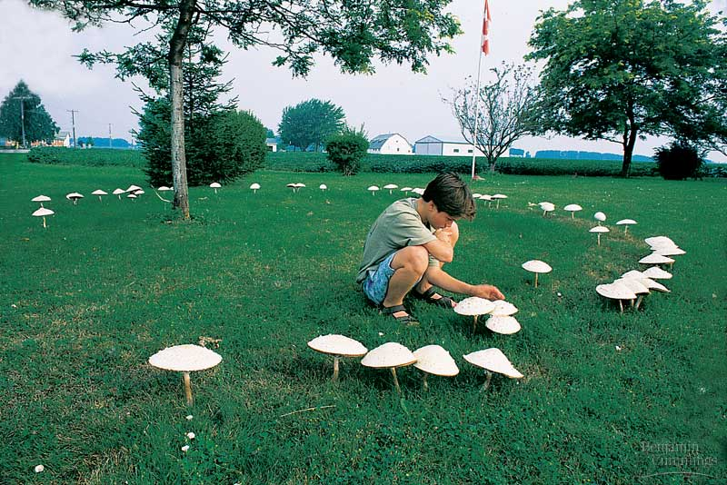
Fairy Rings

Slide 18
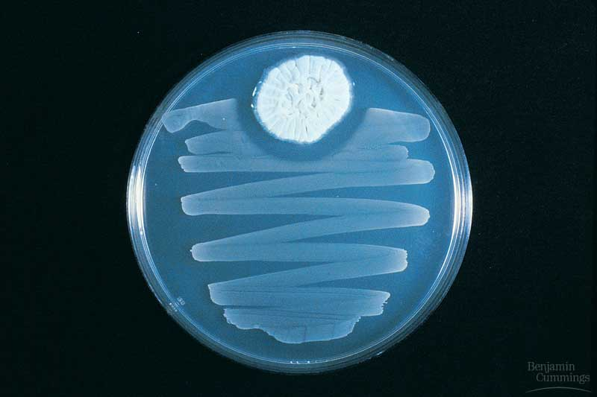
The FIRST Antibiotics

Slide 19
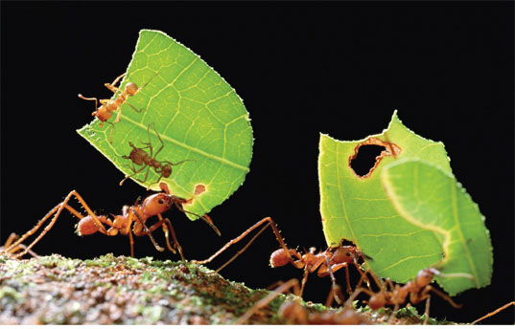
Fungus-gardening insects

Slide 20
Insect Assassinating Fungi

Slide 21
All of the following statements are true about fungi EXCEPT
They reproduce sexually and asexually
They have a cell wall
They feed using hyphae
They are multicellular organisms
They are autotrophic
Notes:
e

Slide 22
Which of the following is not an example of a fungus?
Mildew
Mold
Moss
Mushrooms
Yeast
Notes:
c

