Slide 1
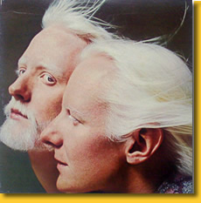
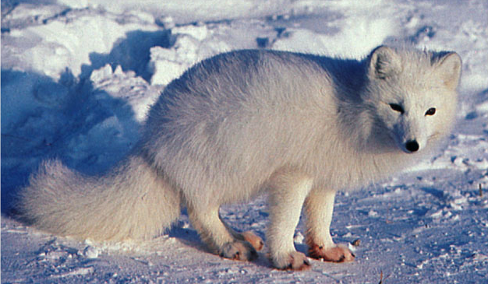
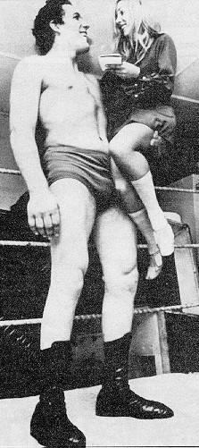
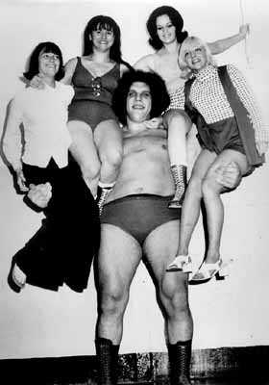
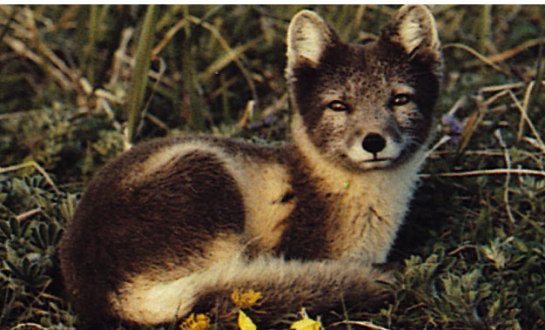
Beyond Mendel’s Laws
of Inheritance

Slide 2
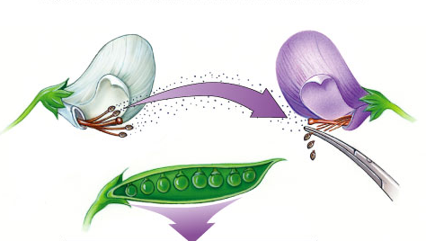
Extending Mendelian genetics
Mendel worked with a simple system
  peas are genetically simple
  most traits are controlled by a single gene
  each gene has only 2 alleles, 1 of which
  is completely dominant to the other
The relationship between
genotype & phenotype
is rarely that simple

Slide 3
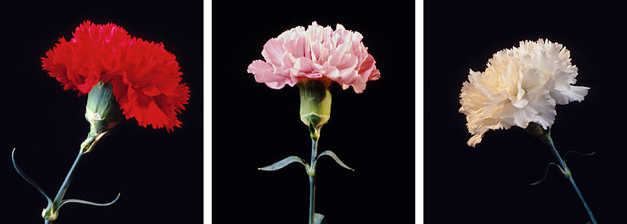
Incomplete dominance
Heterozygote shows an intermediate, blended phenotype
  example:
    RR = red flowers
    rr = white flowers
    Rr = pink flowers
      make 50% less color
→RR
→WW
→RW
RR
RW
WW

Slide 4
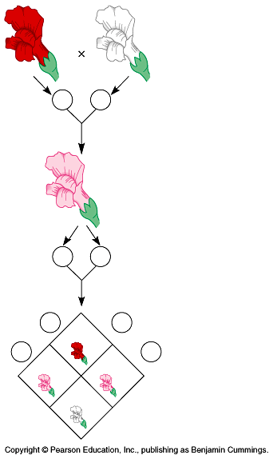
Incomplete dominance
P
true-breeding
red flowers
X
true-breeding
white flowers
100% pink flowers
F₁
generation
(hybrids)
100%
It’s like
flipping 2
pennies!
self-pollinate
25%
red
50%
pink
25%
white
1:2:1
F₂
generation

Slide 5
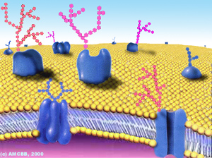
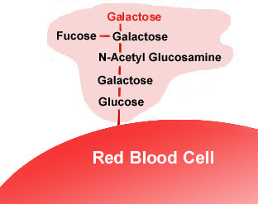
Co-dominance
2 alleles affect the phenotype equally & separately
  not blended phenotype
  human ABO blood groups
  3 alleles
    I^{A}, I^{B}, i
    I^{A} & I^{B} alleles are co-dominant
      glycoprotein antigens on RBC
      I^{A}I^{B} = both antigens are produced
    i allele recessive to both

Slide 6
Genetics of Blood type
pheno-type | genotype | antigen on RBC | antibodies in blood | donation status
A | I^{A} I^{A or} I^{A} i | type A antigens on surface of RBC | anti-B antibodies | __
B | I^{B} I^{B or} I^{B} i | type B antigens on surface of RBC | anti-A antibodies | __
AB | I^{A} I^{B} | both type A & type B antigens on surface of RBC | no antibodies | universal recipient
O | i i | no antigens on surface of RBC | anti-A & anti-B antibodies | universal donor

Slide 7
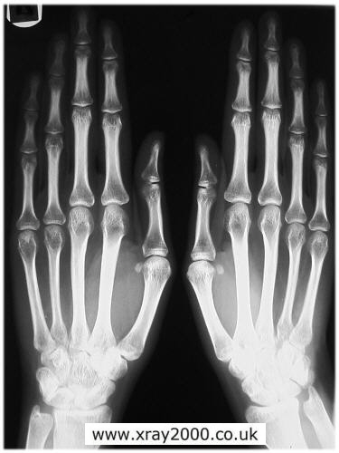
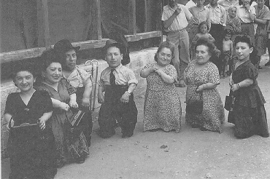
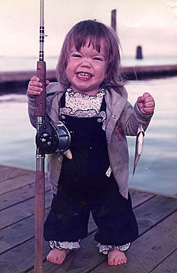
Pleiotropy
Most genes are pleiotropic
  one gene affects more than one phenotypic character
    1 gene affects more than 1 trait
    dwarfism (achondroplasia)
    gigantism (acromegaly)
Notes:
The genes that we have covered so far affect only one phenotypic character, but most genes are pleiotropic

Slide 8
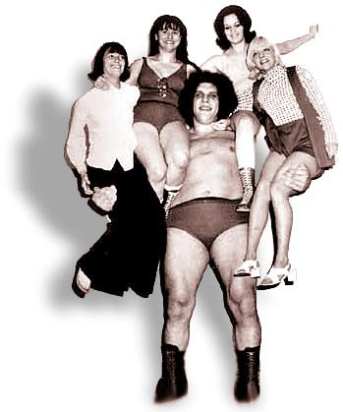
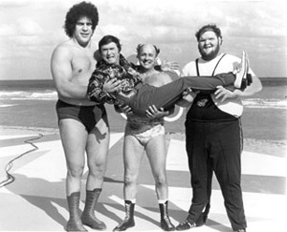

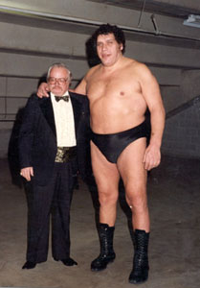
Acromegaly: André the Giant

Slide 9
Inheritance pattern of Achondroplasia
Aa x aa
Aa x Aa
dominant
inheritance
a
a
A
a

A
Aa
Aa
A
AA
Aa
dwarf
dwarf
lethal
a
aa
aa
a
Aa
aa
50% dwarf:50% normal or 1:1
67% dwarf:33% normal or 2:1

Slide 10
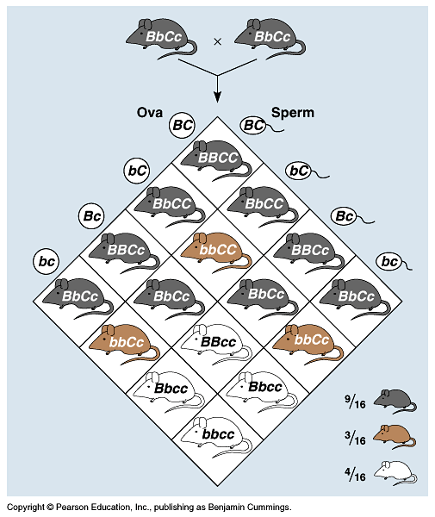
Epistasis
One gene completely masks another gene
  coat color in mice = 2 separate genes
    C,c:
    pigment (C) or
    no pigment (c)
    B,b:
    more pigment (black=B)
    or less (brown=b)
    cc = albino,
    no matter B allele
    9:3:3:1 becomes 9:3:4
B_C_
B_C_
bbC_
bbC_
_ _cc
_ _cc

Slide 11
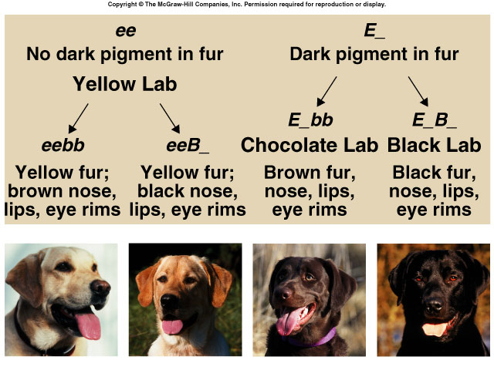
Epistasis in Labrador retrievers
2 genes: (E,e) & (B,b)
  pigment (E) or no pigment (e)
  pigment concentration: black (B) to brown (b)
eebb
eeB–
E–bb
E–B–

Slide 12
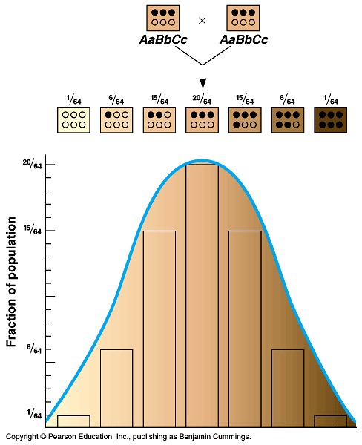
Polygenic inheritance
Some phenotypes determined by additive effects of 2 or more genes on a single character
  phenotypes on a continuum
  human traits
    skin color
    height
    weight
    intelligence
    behaviors

Slide 13
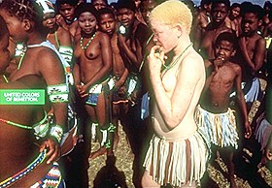
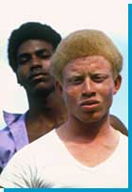
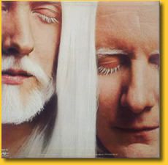
Skin color: Albinism
Johnny & Edgar Winter
However albinism can be inherited as a single gene trait
  aa = albino
albino
Africans
melanin = universal brown color
enzyme
tyrosine
melanin
albinism

Slide 14
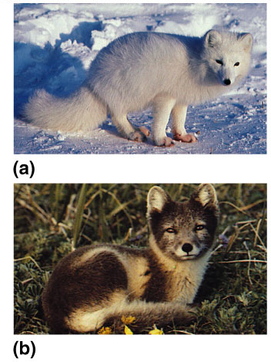
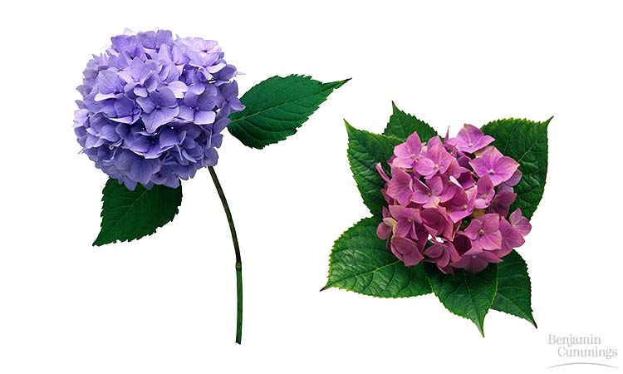

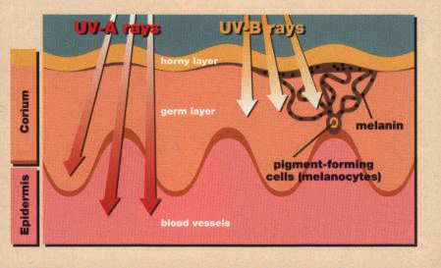
Environmental effects
Phenotype is controlled by both environment & genes
Human skin color is influenced by both genetics & environmental conditions
Coat color in arctic fox influenced by heat sensitive alleles
Color of Hydrangea flowers is influenced by soil pH
Notes:
The relative importance of genes & the environment in influencing human characteristics is a very old & hotly contested debate
a single tree has leaves that vary in size, shape & color, depending on exposure to wind & sun
for humans, nutrition influences height, exercise alters build, sun-tanning darkens the skin, and experience improves performance on intelligence tests
even identical twins — genetic equals — accumulate phenotypic differences as a result of their unique experiences

Slide 15
1. Three babies were recently mixed up in a hospital. After consideration of the data below, which of the following represent the correct baby/parent combinations?
Couple # Blood groups | I A and A | II A and B | III B and O
Baby # Blood groups | 1 B | 2 O | 3 AB
  I-3, II-1, III-2
  I-1, II-3, III-2
  I-2, II-3, III-1
  I-2, II-1, III-3
  I-3, II-2, III-1
Notes:
Answer: c
Source: Barstow - Test Bank for Biology, Seventh Edition, Question #49

Slide 16
2. A mother with type B blood has two children, one with type A blood and one with type O blood. Her husband has type O blood. Which of the following could you conclude from this information?
  The husband could not have fathered either child.
  The husband could have fathered both children.
  The husband must be the father of the child with type O blood and could be the father of the type A child.
  The husband could be the father of the child with type O blood, but not the type A child.
  Neither the mother nor the husband could be the biological parent of the type A child.
Notes:
Answer: d
Source: Taylor - Student Study Guide for Biology, Seventh Edition, Test Your Knowledge Question #14

Slide 17
11. In cattle, roan coat color (mixed red and white hairs) occurs in the heterozygous (Rr) offspring of red (RR) and white (rr) homozygotes. When two roan cattle are crossed, the phenotypes of the progeny are found to be in the ratio of 1 red:2 roan:1 white. Which of the following crosses could produce the highest percentage of roan cattle? *
  red × white
  roan × roan
  white × roan
  red × roan
  All of the above crosses would give the same percentage of roan.
Notes:
Answer: a
Source: Barstow - Test Bank for Biology, Seventh Edition, Question #10
Discussion Notes for the Instructor
There are several questions which can be asked to guide the discussion of this question, including:
What genotype produces a “roan” phenotype?
What cross would produce the greatest percentage of this genotype?
What type of inheritance does this show?
Using these questions as an outline, discussion of the choices might look like this:
Choice A, correct; this cross will produce 100% roan offspring
Choice B, roan X roan will produce only 50% roan offspring
Choice C, white X roan will produce only 50% roan offspring
Choice D, red X roan will produce only 50% roan offspring
Choice E, only choice A will produce 100% roan offspring

Slide 18
12. You think that two alleles for coat color in mice show incomplete dominance. What is the best and simplest cross to perform in order to support your hypothesis?
  a testcross of a homozygous recessive mouse with a mouse of unknown genotype
  a cross of F₁ mice to look for a 1:2:1 ratio in the offspring
  a reciprocal cross in which the sex of the mice of each coat color is reversed
  a cross of two true-breeding mice of different colors to look for an intermediate phenotype in the F₁
  a cross of F₁ mice to look for a 9:7 ratio in the offspring
Notes:
Answer: d
Source: Taylor - Student Study Guide for Biology, Seventh Edition, Test Your Knowledge Question #11

