Slide 1
Morgan’s Experimental Evidence: Scientific Inquiry
The first solid evidence associating a specific gene with a specific chromosome came from Thomas Hunt Morgan, an embryologist
Morgan’s experiments with fruit flies provided convincing evidence that chromosomes are the location of Mendel’s heritable factors
Copyright © 2008 Pearson Education Inc., publishing as Pearson Benjamin Cummings
Notes:
Several characteristics make fruit flies a convenient organism for genetic studies:
They breed at a high rate
A generation can be bred every two weeks
They have only four pairs of chromosomes

Slide 2
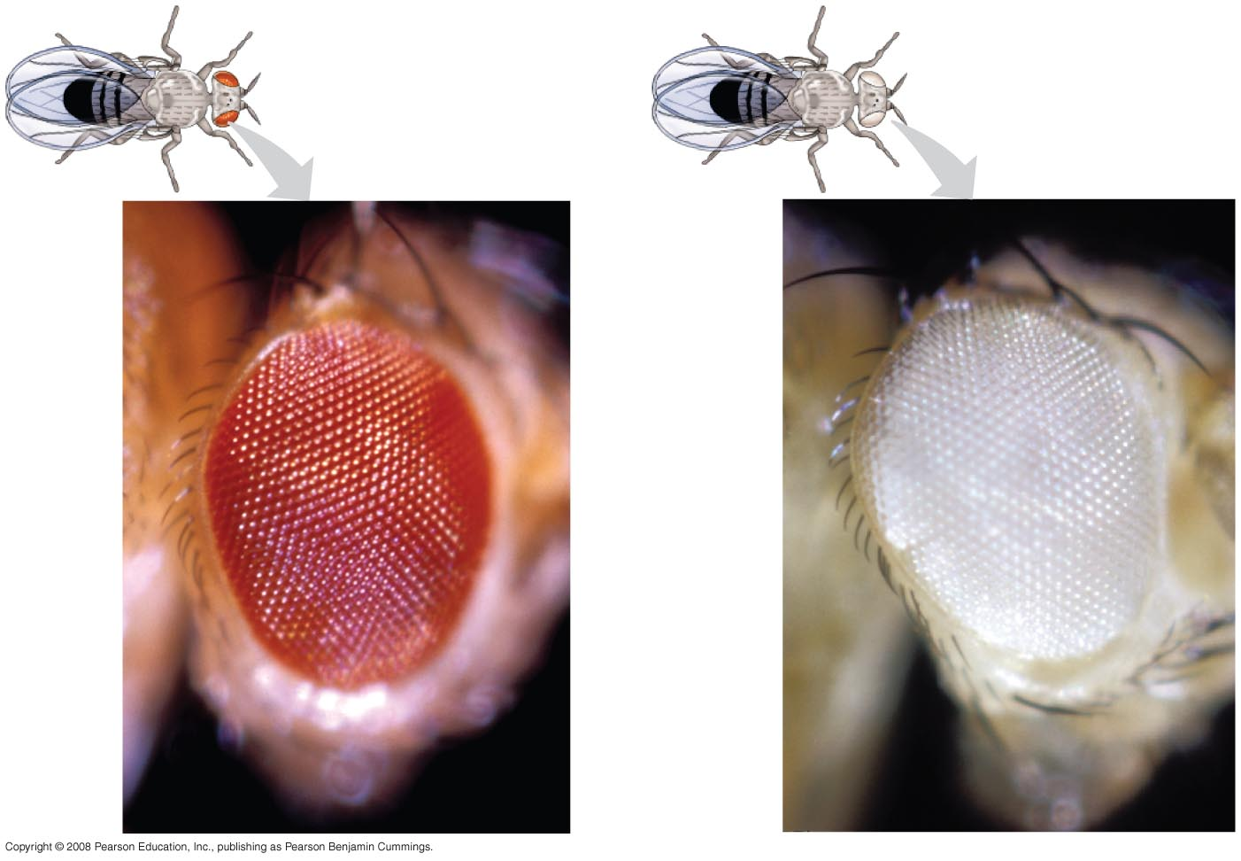
Morgan noted wild type, or normal, phenotypes that were common in the fly populations
Traits alternative to the wild type are called mutant phenotypes
Copyright © 2008 Pearson Education Inc., publishing as Pearson Benjamin Cummings

Slide 3
Correlating Behavior of a Gene’s Alleles with Behavior of a Chromosome Pair
In one experiment, Morgan mated male flies with white eyes (mutant) with female flies with red eyes (wild type)
  The F₁ generation all had red eyes
  The F₂ generation showed the 3:1 red:white eye ratio, but only males had white eyes
Morgan determined that the white-eyed mutant allele must be located on the X chromosome
Morgan’s finding supported the chromosome theory of inheritance
Copyright © 2008 Pearson Education Inc., publishing as Pearson Benjamin Cummings

Slide 4
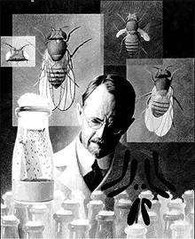
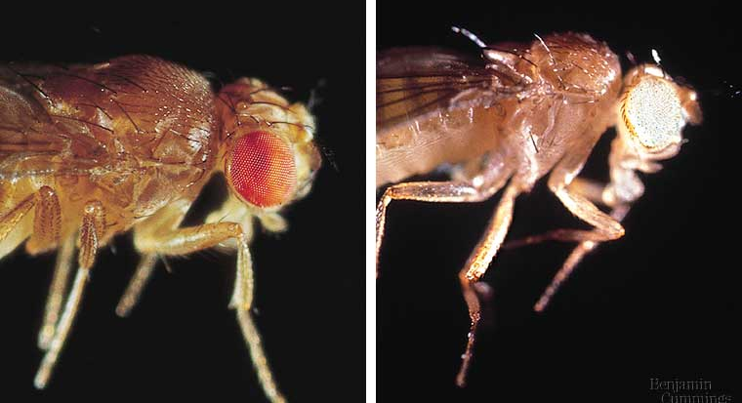
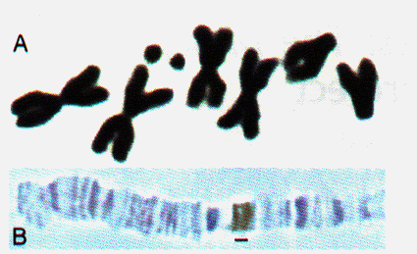
Sex linked traits
1910 | 1933
Genes are on sex chromosomes
  Discovered by T.H. Morgan at Columbia U.
  Drosophila breeding
    good genetic subject
      prolific breeders/2 week generations
      4 pairs of chromosomes
      XX=female, XY=male

Slide 5
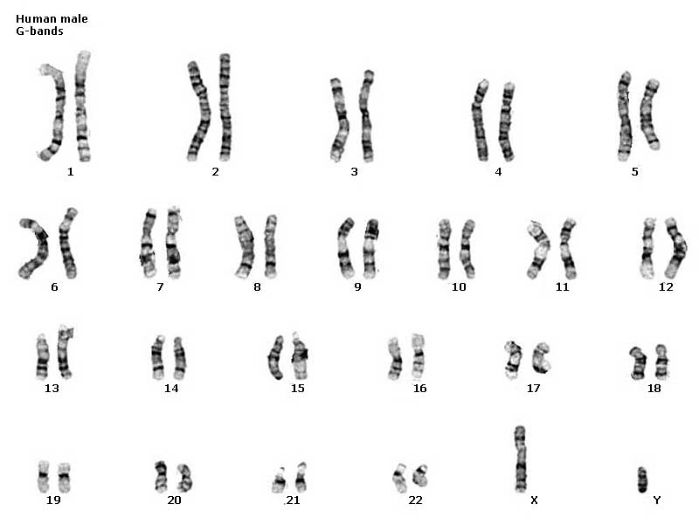
Classes of chromosomes
autosomal
chromosomes
sex
chromosomes

Slide 6
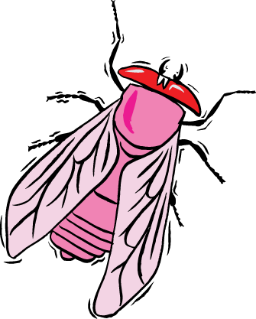
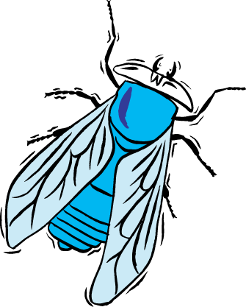
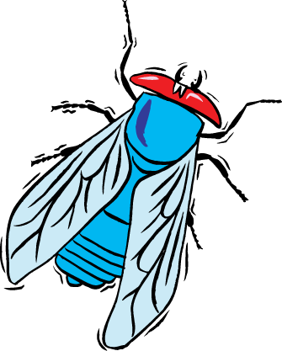
Discovery of sex linkage
true-breeding
red-eye female
true-breeding
white-eye male
P
X
Huh!
Sex matters?!
100%
red eye offspring
F₁
generation
(hybrids)
100%
red-eye female
50% red-eye male
50% white eye male
F₂
generation

Slide 7
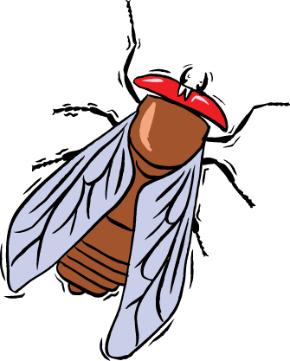
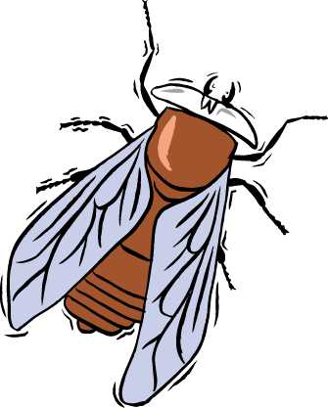
What’s up with Morgan’s flies?
x
x
RR
rr
Rr
Rr

r
r
R
r
R
Rr
Rr
R
RR
Rr
Doesn’t work
that way!
R
Rr
Rr
r
Rr
rr
100% red eyes
3 red : 1 white

Slide 8
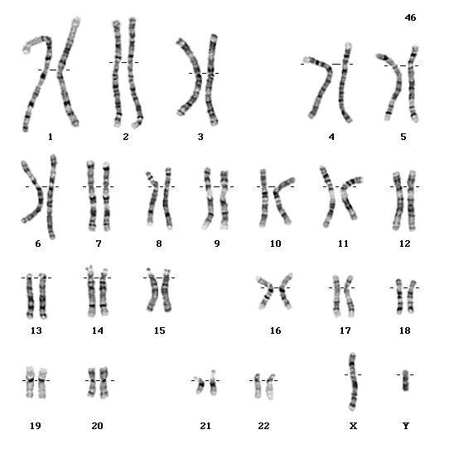
Genetics of Sex
In humans & other mammals, there are 2 sex chromosomes: X & Y
  2 X chromosomes
    develop as a female: XX
    gene redundancy,
    like autosomal chromosomes
  an X & Y chromosome
    develop as a male: XY
    no redundancy
X
Y
X
XX
XY
X
XX
XY
50% female : 50% male

Slide 9
Let’s reconsider Morgan’s flies…
x
x
X^{R}X^{R}
X^{r}Y
X^{R}X^{r}
X^{R}Y
X^{r}
Y
X^{R}
Y

X^{R}
X^{R}
X^{R}X^{r}
X^{R}Y
X^{R}X^{R}
X^{R}Y
BINGO!
X^{R}
X^{r}
X^{R}X^{r}
X^{R}Y
X^{R}X^{r}
X^{r}Y
100% red eyes
100% red females
50% red males; 50% white males

Slide 10
Genes on sex chromosomes
Y chromosome
  few genes other than SRY
    sex-determining region: master regulator for maleness
    turns on genes for production of male hormones
      many effects = pleiotropy!
X chromosome
  other genes/traits beyond sex determination
    mutations:
      Hemophilia, Duchenne muscular dystrophy, color-blindness
Notes:
Duchenne muscular dystrophy affects one in 3,500 males born in the United States.
Affected individuals rarely live past their early 20s.
This disorder is due to the absence of an X-linked gene for a key muscle protein, called dystrophin.
The disease is characterized by a progressive weakening of the muscles and loss of coordination.

Slide 11
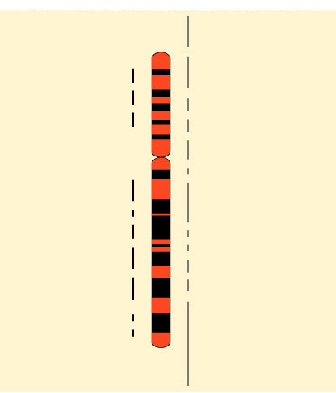
Human X chromosome
Ichthyosis, X-linked
Placental steroid sulfatase deficiency
Kallmann syndrome
Chondrodysplasia punctata,
X-linked recessive
Sex-linked
  usually means
  “X-linked”
  more than
  60 diseases traced to genes on X chromosome
Hypophosphatemia
Aicardi syndrome
Hypomagnesemia, X-linked
Ocular albinism
Retinoschisis
Duchenne muscular dystrophy
Becker muscular dystrophy
Chronic granulomatous disease
Retinitis pigmentosa-3
Adrenal hypoplasia
Glycerol kinase deficiency
Norrie disease
Retinitis pigmentosa-2
Ornithine transcarbamylase
deficiency
Incontinentia pigmenti
Wiskott-Aldrich syndrome
Menkes syndrome
Sideroblastic anemia
Aarskog-Scott syndrome
PGK deficiency hemolytic anemia
Androgen insensitivity
Charcot-Marie-Tooth neuropathy
Choroideremia
Cleft palate, X-linked
Spastic paraplegia, X-linked,
uncomplicated
Deafness with stapes fixation
Anhidrotic ectodermal dysplasia
Agammaglobulinemia
Kennedy disease
PRPS-related gout
Pelizaeus-Merzbacher disease
Alport syndrome
Fabry disease
Lowe syndrome
Lesch-Nyhan syndrome
HPRT-related gout
Immunodeficiency, X-linked,
with hyper IgM
Lymphoproliferative syndrome
Hunter syndrome
Hemophilia B
Hemophilia A
G6PD deficiency: favism
Drug-sensitive anemia
Chronic hemolytic anemia
Manic-depressive illness, X-linked
Colorblindness, (several forms)
Dyskeratosis congenita
TKCR syndrome
Adrenoleukodystrophy
Adrenomyeloneuropathy
Emery-Dreifuss muscular dystrophy
Diabetes insipidus, renal
Myotubular myopathy, X-linked
Albinism-deafness syndrome
Fragile-X syndrome

Slide 12
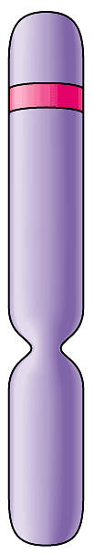
Map of Human Y chromosome?
< 30 genes on
Y chromosome
Sex-determining Region Y (SRY)
Channel Flipping (FLP)
Catching & Throwing (BLZ-1)
Self confidence (BLZ-2)
note: not linked to ability gene
Devotion to sports (BUD-E)
Addiction to death &
destruction movies (SAW-2)
Air guitar (RIF)
Scratching (ITCH-E)
linked
Spitting (P2E)
Inability to express
affection over phone (ME-2)
Selective hearing loss (HUH)
Total lack of recall for dates (OOPS)

Slide 13
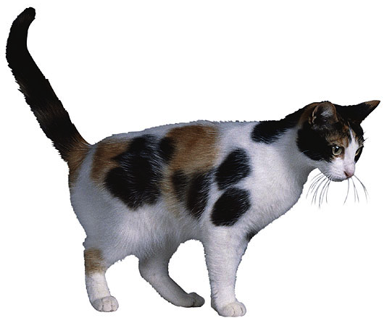
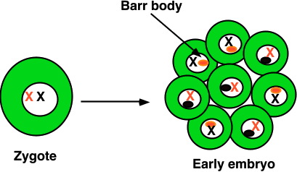
X-inactivation
Female mammals inherit 2 X chromosomes
  one X becomes inactivated during embryonic development
    condenses into compact object = Barr body
    which X becomes Barr body is random in each cell
      patchwork trait = “mosaic”
patches of black
X^{H}
X^{H}X^{h}
tricolor cats
can only be
female
X^{h}
patches of orange

Slide 14
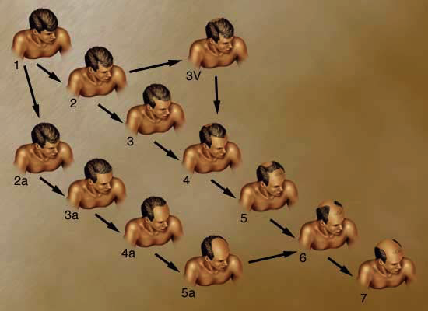
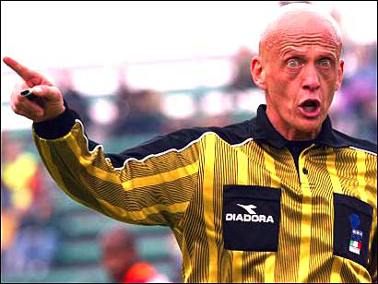
Male pattern baldness
Sex influenced trait
  autosomal trait influenced by sex hormones
    age effect as well = onset after 30 years old
  dominant in males & recessive in females
    B_ = bald in males; bb = bald in females

Slide 15
Another Sample Pedigree
Not Like Yours

Slide 16
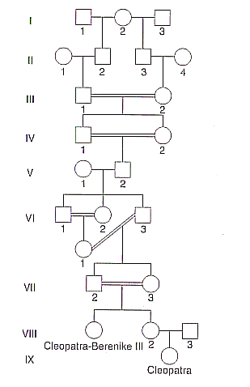

Slide 17
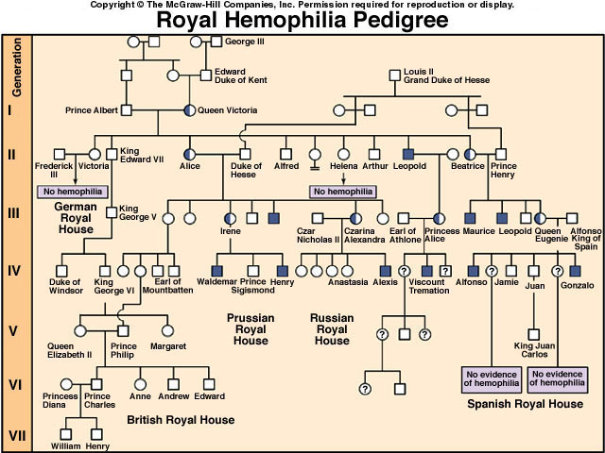
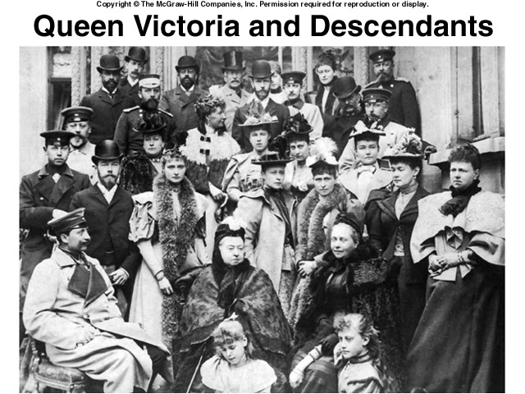
Notes:
Hemophilia is a sex-linked recessive trait defined by the absence of one or more clotting factors.
These proteins normally slow and then stop bleeding.
Individuals with hemophilia have prolonged bleeding because a firm clot forms slowly.
Bleeding in muscles and joints can be painful and lead to serious damage.
Individuals can be treated with intravenous injections of the missing protein.

Slide 18
Hemophilia
sex-linked recessive
X^{H}X^{h}
X^{H}Y
Hh x HH
X^{H}
male / sperm
X^{H}X^{h}
X^{H}
Y
X^{h}
X^{H}Y
X^{H}X^{H}
X^{H}Y
X^{H}
X^{H}X^{H}
X^{H}
female / eggs
X^{H}Y
X^{h}
X^{h}Y
X^{H}X^{h}
X^{h}Y
X^{H}X^{h}
Y
carrier
disease

Slide 19

Genetics & culture
All cultures have a taboo against incest.
  laws or cultural taboos forbidding marriages between close relatives are fairly universal
Fairly unlikely that 2 unrelated carriers of same rare harmful recessive allele will meet & mate
  matings between close relatives increase risk
    “consanguineous” (same blood) matings
  individuals who share a
  recent common ancestor
  are more likely to carry
  same recessive alleles

Slide 20
0
1. Vermilion eyes is a sex-linked recessive characteristic in fruit flies. If a female having vermilion eyes is crossed with a wild-type male, what percentage of the F₁ males will have vermilion eyes?
  0%
  25%
  50%
  75%
  100%
Notes:
Answer: e
Source: Barstow - Test Bank for Biology, Seventh Edition, Question #3

Slide 21
2. Barring in chickens is due to a sex-linked dominant gene (B). The sex of chicks at hatching is difficult to determine, but barred chicks can be distinguished from nonbarred at that time. To use this trait so that at hatching all chicks of one sex are barred, what cross would you make?
  barred males × barred females
  barred males × nonbarred females
  nonbarred males × barred females
  nonbarred males × nonbarred females
Notes:
Answer: b
Source: Barstow - Test Bank for Biology, Seventh Edition, Question #21

Slide 22
3. A recessive allele on the X chromosome is responsible for red-green color blindness in humans. A woman with normal vision whose father is color-blind marries a color-blind male. What is the probability that this couple’s son will be color-blind?
  0
  1/4
  1/2
  3/4
  1
Notes:
Answer: c
Source: Barstow - Test Bank for Biology, Seventh Edition, Question #29

Slide 23
4. An achondroplastic dwarf man with normal vision marries a color-blind woman of normal height. The man's father was six feet tall, and both the woman's parents were of average height. Achondroplastic dwarfism is autosomal dominant, and red-green color blindness is X-linked recessive.
How many of their male children would be color-blind and normal height?
  all
  none
  half
  one out of four
  three out of four
Notes:
Answer: c
Source: Barstow - Test Bank for Biology, Seventh Edition, Question #33

Slide 24
5. In cats, black color is caused by an X-linked allele; the other allele at this locus causes orange color. The heterozygote is tortoiseshell. What kinds of offspring would you expect from the cross of a black female and an orange male?
  tortoiseshell female; tortoiseshell male
  black female; orange male
  orange female; orange male
  tortoiseshell female; black male
  orange female; black male
Notes:
Answer: d
Source: Barstow - Test Bank for Biology, Seventh Edition, Question #38

Slide 25
6. An achondroplastic dwarf man with normal vision marries a color-blind woman of normal height. The man's father was six feet tall, and both the woman's parents were of average height. Achondroplastic dwarfism is autosomal dominant, and red-green color blindness is X-linked recessive.
How many of their female children might be expected to be color-blind dwarfs? *
  all
  none
  half
  one out of four
  three out of four
Notes:
Answer: b
Source: Barstow - Test Bank for Biology, Seventh Edition, Question #32
Discussion Notes for the Instructor
There are several questions which can be asked to guide the discussion of this question, including:
Are these genes linked?
Are the phenotypes of the individual parents useful?
What are the genotypes of the individuals involved?
Using these questions as an outline, discussion of the choices might look like this:
Choice A, in order for all the female offspring to be color-blind the man would have to be color-blind
Choice B, correct
Choice C, since red-green colorblindness is an X-linked recessive the female offspring can only be color-blind if the father is also color-blind
Choice D, since red-green colorblindness is an X-linked recessive the female offspring can only be color-blind if the father is also color-blind
Choice E, since red-green colorblindness is an X-linked recessive the female offspring can only be color-blind if the father is also color-blind
This discussion could be followed by just looking at dwarfism or color-blindness in the male or female offspring.

Slide 26
6. Red-green color blindness is a sex-linked recessive trait in humans. Two people with normal color vision have a color-blind son. What are the genotypes of the parents?
  XcXc and XcY
  XcXc and XCY
  XCXC and XcY
  XCXC and XCY
  XCXc and XCY
Notes:
Answer: e
Source: Barstow - Test Bank for Biology, Seventh Edition, Question #43

Slide 27
7. A color-blind son inherited this trait from his
  mother.
  father.
  mother only if she is color-blind.
  father only if he is color-blind.
  mother only if she is not color-blind.
Notes:
Answer: a
Source: Taylor - Student Study Guide for Biology, Seventh Edition, Test Your Knowledge Question #9

Slide 28
How Linkage Affects Inheritance
Morgan did other experiments with fruit flies to see how linkage affects inheritance of two characters
Morgan crossed flies that differed in traits of body color and wing size
Copyright © 2008 Pearson Education Inc., publishing as Pearson Benjamin Cummings

Slide 29
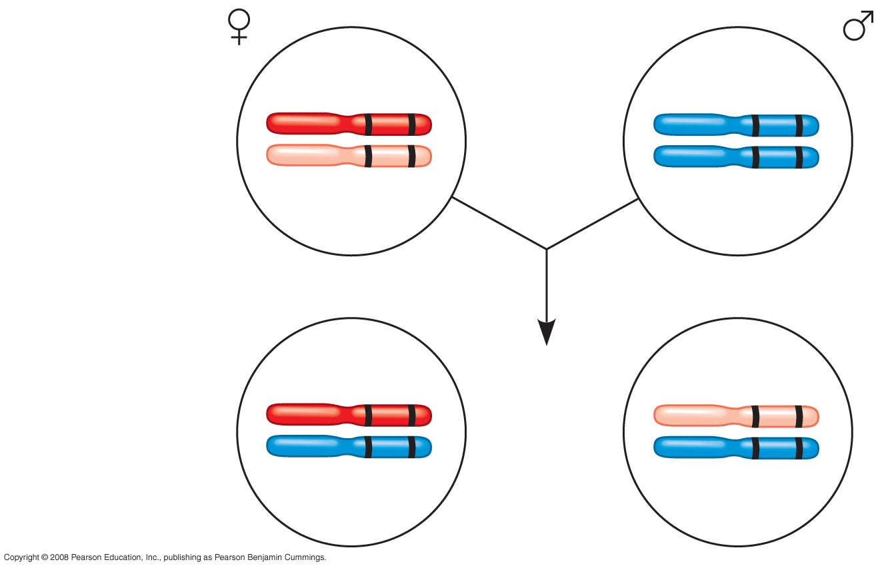
How Linkage Affects Inheritance
Fig. 15-UN1
b⁺ vg⁺
b vg
Parents
in testcross
×
b vg
b vg
b⁺ vg⁺
b vg
Most
offspring
or
b vg
b vg
Notes:
Morgan did other experiments with fruit flies to see how linkage affects inheritance of two characters
Morgan crossed flies that differed in traits of body color and wing size

Slide 30
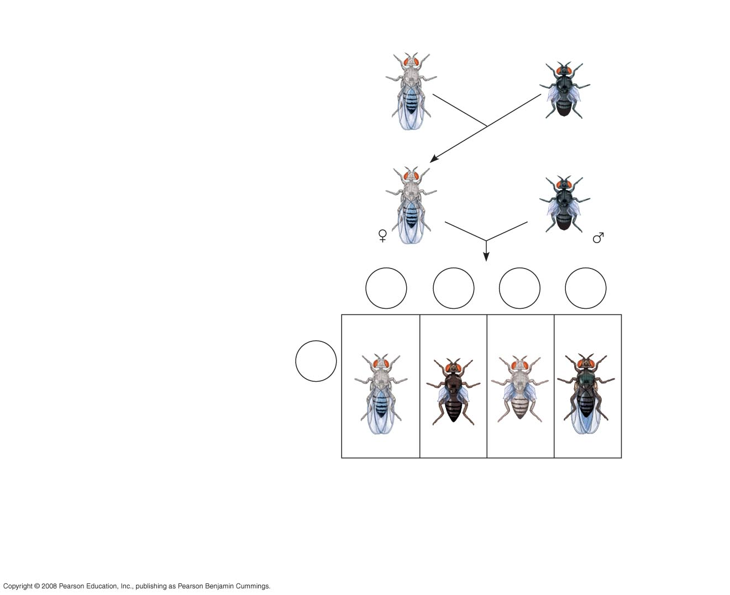
Fig. 15-9-4
EXPERIMENT
P Generation (homozygous)
Wild type
(gray body,
normal wings)
Double mutant
(black body,
vestigial wings)
×
b⁺ b⁺ vg⁺ vg⁺
b b vg vg
F₁ dihybrid
(wild type)
TESTCROSS
Double mutant
×
b⁺ b vg⁺ vg
b b vg vg
Testcross
offspring
Eggs
b⁺ vg⁺
b vg
b⁺ vg
b vg⁺
Wild type
(gray-normal)
Black-
vestigial
Gray-
vestigial
Black-
normal
b vg
Sperm
b⁺ b vg⁺ vg
b b vg vg
b⁺ b vg vg
b b vg⁺ vg
PREDICTED RATIOS
If genes are located on different chromosomes:
1
:
1
:
1
:
1
If genes are located on the same chromosome and
parental alleles are always inherited together:
1
:
1
:
0
:
0
RESULTS
965
:
944
:
206
:
185
Notes:
Figure 15.9 How does linkage between two genes affect inheritance of characters?
Morgan found that body color and wing size are usually inherited together in specific combinations (parental phenotypes)
He noted that these genes do not assort independently, and reasoned that they were on the same chromosome
However, nonparental phenotypes were also produced
Understanding this result involves exploring genetic recombination, the production of offspring with combinations of traits differing from either parent
The genetic findings of Mendel and Morgan relate to the chromosomal basis of recombination

Slide 31
Recombination of Unlinked Genes: Independent Assortment of Chromosomes
Mendel observed that combinations of traits in some offspring differ from either parent
Offspring with a phenotype matching one of the parental phenotypes are called parental types
Offspring with nonparental phenotypes (new combinations of traits) are called recombinant types, or recombinants
A 50% frequency of recombination is observed for any two genes on different chromosomes
Copyright © 2008 Pearson Education Inc., publishing as Pearson Benjamin Cummings

Slide 32
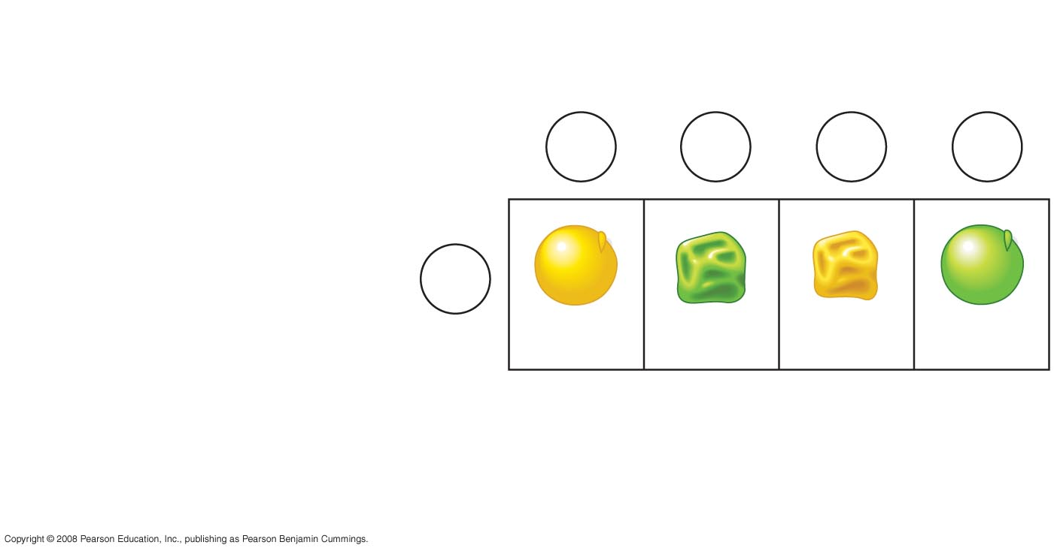
Fig. 15-UN2
Gametes from yellow-round
heterozygous parent (YyRr)
YR
yr
Yr
yR
Gametes from green-
wrinkled homozygous
recessive parent ( yyrr)
yr
YyRr
yyrr
Yyrr
yyRr
Parental-
type
offspring
Recombinant
offspring

Slide 33

Recombination of Linked Genes: Crossing Over
Morgan discovered that genes can be linked, but the linkage was incomplete, as evident from recombinant phenotypes
Morgan proposed that some process must sometimes break the physical connection between genes on the same chromosome
That mechanism was the crossing over of homologous chromosomes
Animation: Crossing Over
Copyright © 2008 Pearson Education Inc., publishing as Pearson Benjamin Cummings

Slide 34
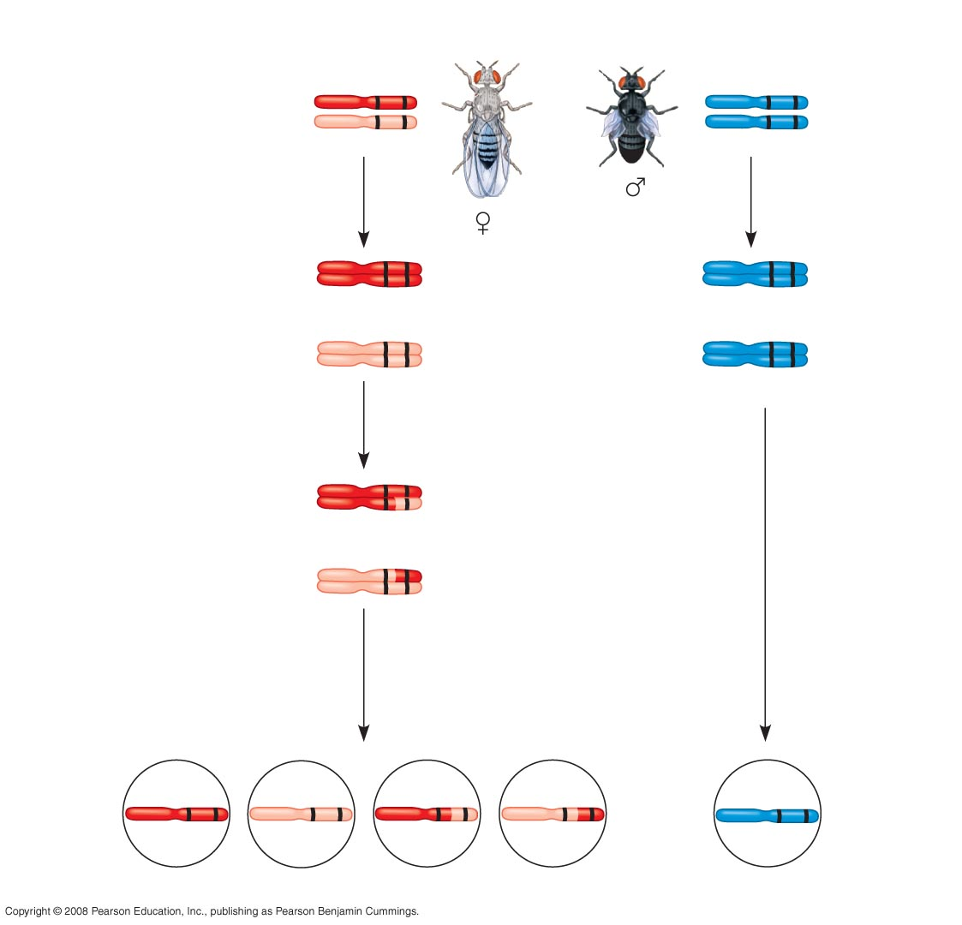
Fig. 15-10a
Testcross
parents
Gray body, normal wings
(F₁ dihybrid)
Black body, vestigial wings
(double mutant)
b⁺ vg⁺
b vg
b vg
b vg
Replication
of chromo-
somes
Replication
of chromo-
somes
b⁺ vg⁺
b vg
b⁺ vg⁺
b vg
b vg
b vg
Meiosis I
b vg
b vg
b⁺ vg⁺
Meiosis I and II
b⁺ vg
b vg⁺
Meiosis II
b vg
Recombinant
chromosomes
b⁺ vg⁺
b vg
b⁺ vg
b vg⁺
b vg
Eggs
Sperm
Notes:
Figure 15.10 Chromosomal basis for recombination of linked genes

Slide 35
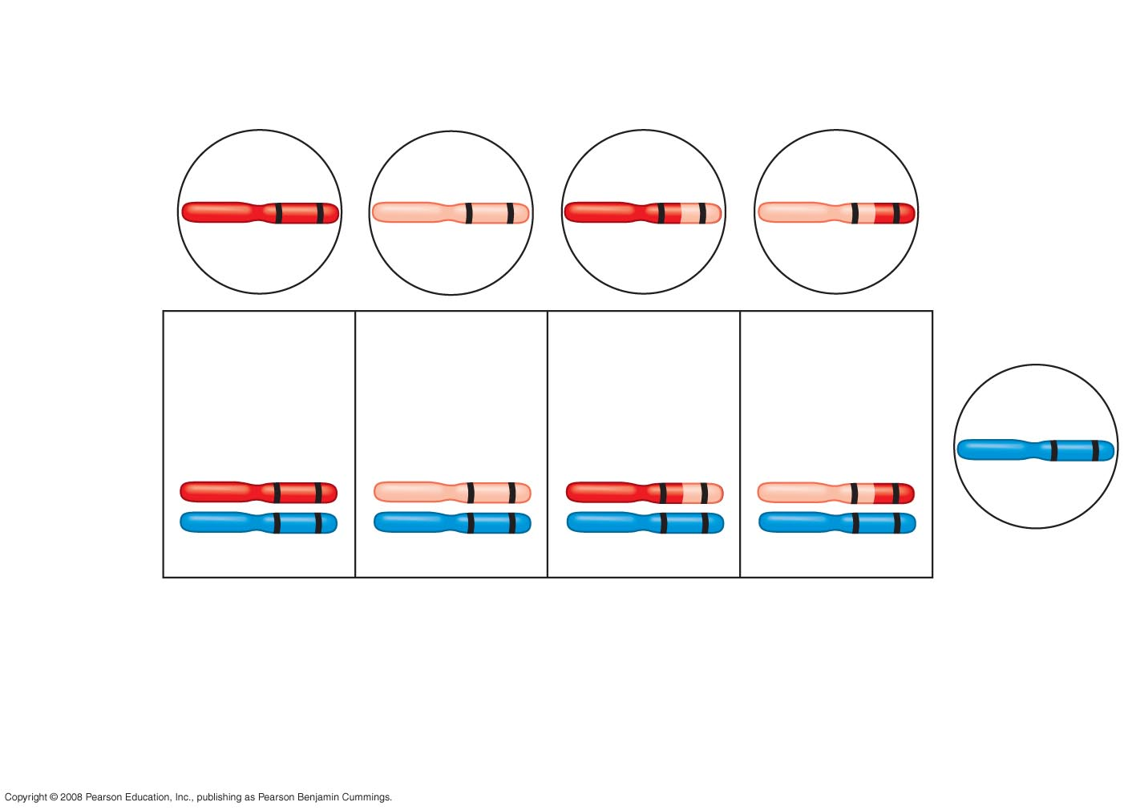
Fig. 15-10b
Recombinant
chromosomes
b⁺ vg⁺
b vg
b⁺ vg
b vg⁺
Eggs
Testcross
offspring
965
Wild type
(gray-normal)
944
Black-
vestigial
206
Gray-
vestigial
185
Black-
normal
b vg
b⁺ vg⁺
b vg
b⁺ vg
b vg⁺
b vg
b vg
b vg
b vg
Sperm
Parental-type offspring
Recombinant offspring
Recombination
frequency
391 recombinants
× 100 = 17%
=
2,300 total offspring
Notes:
Figure 15.10 Chromosomal basis for recombination of linked genes

Slide 36
Mapping the Distance Between Genes Using Recombination Data: Scientific Inquiry
genetic map: an ordered list of the genetic loci along a particular chromosome
  the farther apart two genes are, the higher the probability that a crossover will occur between them and therefore the higher the recombination frequency
Copyright © 2008 Pearson Education Inc., publishing as Pearson Benjamin Cummings
Notes:
Alfred Sturtevant, one of Morgan’s students, constructed a genetic map, an ordered list of the genetic loci along a particular chromosome
Sturtevant predicted that the farther apart two genes are, the higher the probability that a crossover will occur between them and therefore the higher the recombination frequency

Slide 37
A linkage map is a genetic map of a chromosome based on recombination frequencies
Distances between genes can be expressed as map units; one map unit, or centimorgan, represents a 1% recombination frequency
Map units indicate relative distance and order, not precise locations of genes
Copyright © 2008 Pearson Education Inc., publishing as Pearson Benjamin Cummings
Notes:
Genes that are far apart on the same chromosome can have a recombination frequency near 50%
Such genes are physically linked, but genetically unlinked, and behave as if found on different chromosomes

Slide 38
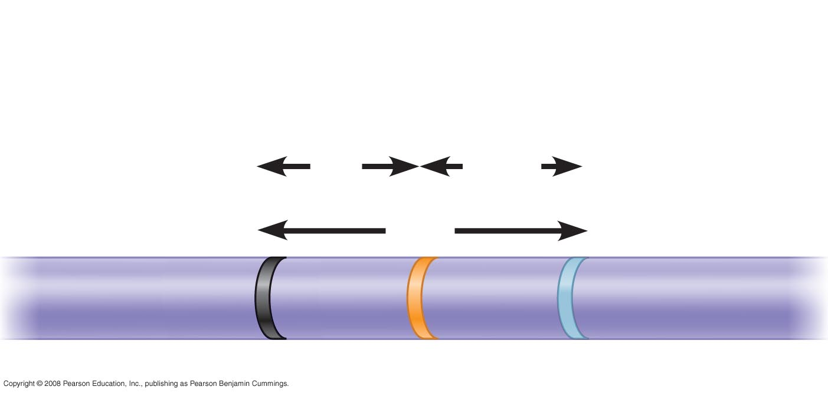
Fig. 15-11
RESULTS
Recombination
frequencies
9%
9.5%
Chromosome
17%
b
cn
vg
Notes:
Figure 15.11 Constructing a linkage map

Slide 39
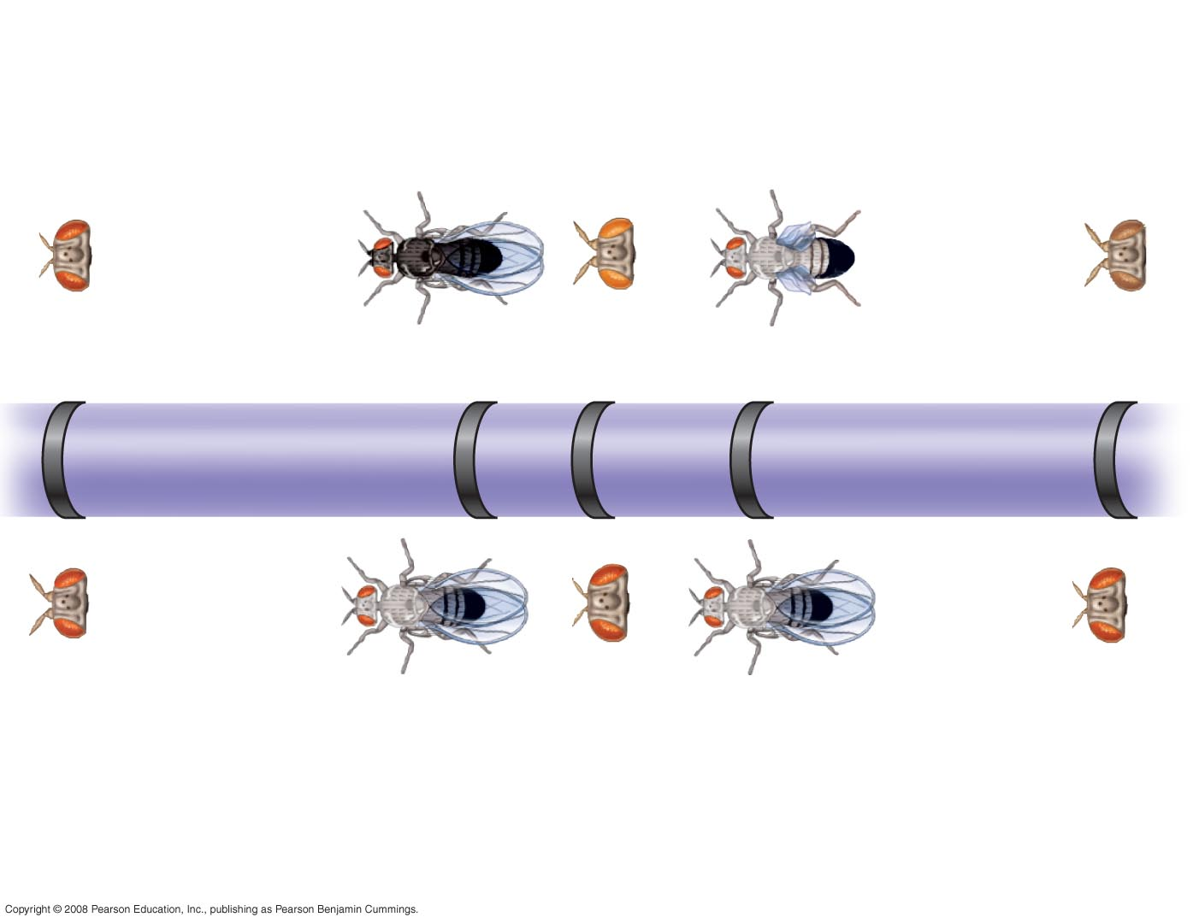
Fig. 15-12
Mutant phenotypes
Short
aristae
Black
body
Cinnabar
eyes
Vestigial
wings
Brown
eyes
0
48.5
57.5
67.0
104.5
Long aristae
(appendages
on head)
Gray
body
Red
eyes
Normal
wings
Red
eyes
Wild-type phenotypes
Notes:
Figure 15.12 A partial genetic (linkage) map of a Drosophila chromosome
Sturtevant used recombination frequencies to make linkage maps of fruit fly genes
Using methods like chromosomal banding, geneticists can develop cytogenetic maps of chromosomes
Cytogenetic maps indicate the positions of genes with respect to chromosomal features

Slide 40
Chi Square Test
Chi Square test (X ²)
  Test to see if data you observe from an experiment is the same as the data that you would predict from that experiment
  (observed – expected) ² ÷ expected

Slide 41
Chi Square Test
Null hypothesis (n₀) = observed will equal expected
p value: chance that you data is accurate
  p= 0.05 is the universally accepted critical value
Degrees of freedom = N - 1
  number of variances you are comparing -1
If X ² is below critical value then n₀ is accepted, if above then reject n₀

Slide 42
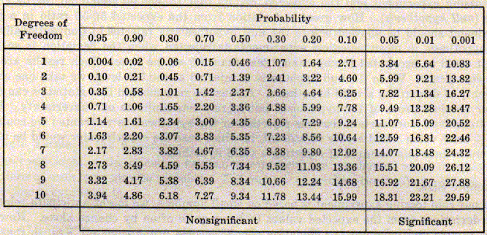
Chi Square Test

