Slide 1
4.4 Eukaryotic cells are partitioned into functional compartments
Membranes within a eukaryotic cell partition the cell into compartments, areas where cellular metabolism occurs
  Each compartment is fluid-filled and maintains conditions that favor particular metabolic processes and activities
Copyright © 2009 Pearson Education, Inc.
Notes:
Although the cell is compartmentalized, none of the cell’s components works alone. The cell is a living unit greater than the sum of its parts.
Teaching Tips
1. Some instructors have found that challenging students to come up with analogies for the many eukaryotic organelles is a highly effective teaching method. Students may wish to construct one inclusive analogy between a society or factory and a cell or construct separate analogies for each organelle. As with any analogy, it is important to list the similarities and exceptions.

Slide 2
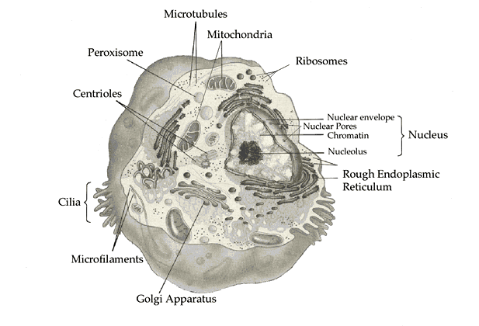
Why organelles?
Specialized structures
  specialized functions
Containers
  Compartments = different local environments
    pH, concentration differences
  distinct & incompatible functions
    lysosome & its digestive enzymes
Membranes as sites for chemical reactions
  Unique lipids & proteins
  embedded enzymes & reaction centers
    chloroplasts & mitochondria
Notes:
Why organelles?
There are several reasons why cells evolved organelles. First, organelles can perform specialized functions. Second, membrane bound organelles can act as containers, separating parts of the cell from other parts of the cell. Third, the membranes of organelles can act as sites for chemical reactions.
Organelles as specialized structures
An example of the first type of organelle is cilia, these short filaments act as "paddles" to help some cells move.
Organelles as Containers
Nothing ever invented by man is as complex as a living cell. At any one time hundreds of incompatible chemical reactions may be occurring in a cell. If the cell contained a uniform mixture of all the chemicals it would not be able to survive. Organelles surrounded by membranes act as individual compartments for these chemical reactions. An example of the second type of organelle is the lysosome. This structure contains digestive enzymes, these enzymes if allowed to float free in the cell would kill it.
Organelle membranes as sites for chemical reactions
An example of the third type of organelle is the chloroplast. The molecules that conduct the light reactions of photosynthesis are found embedded in the membranes of the chloroplast.

Slide 3
4.4 Eukaryotic cells are partitioned into functional compartments
There are four life processes in eukaryotic cells that depend upon structures and organelles
  Manufacturing
  Breakdown of molecules
  Energy processing
  Structural support, movement, and communication
Copyright © 2009 Pearson Education, Inc.
Notes:
Teaching Tips
1. Some instructors have found that challenging students to come up with analogies for the many eukaryotic organelles is a highly effective teaching method. Students may wish to construct one inclusive analogy between a society or factory and a cell or construct separate analogies for each organelle. As with any analogy, it is important to list the similarities and exceptions.

Slide 4
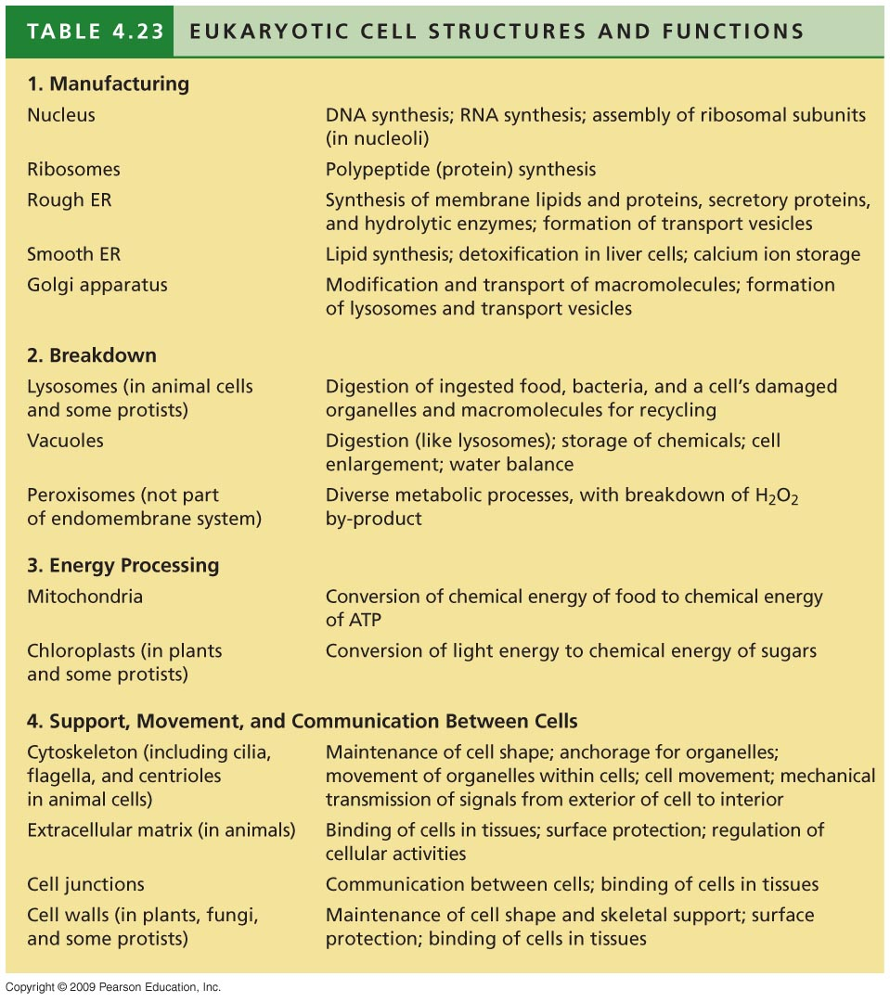
Notes:
Table 4.23 Eukaryotic Cell Structures and Functions.

Slide 5
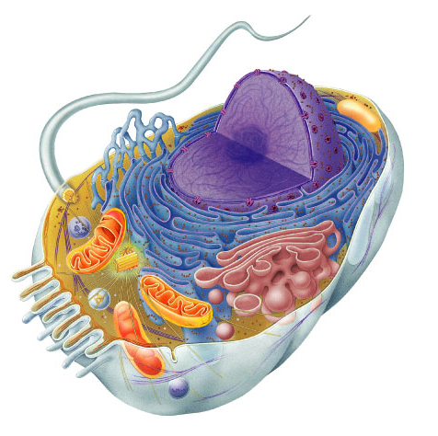
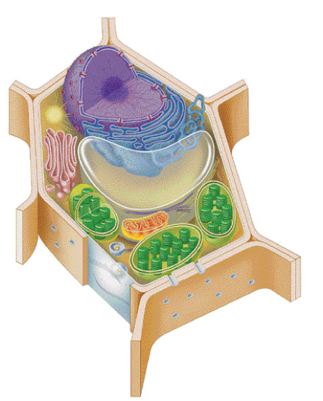
Cells got to work to live!
make proteins
  proteins control every
  cell function
  make energy
    for daily life
    for growth
  make more cells
    growth
    repair
    renewal

Slide 6
4.4 Eukaryotic cells are partitioned into functional compartments
Manufacturing involves the nucleus, ribosomes, endoplasmic reticulum, and Golgi apparatus
  Manufacture of a protein, perhaps an enzyme, involves all of these
Copyright © 2009 Pearson Education, Inc.
Notes:
The nuclear DNA directs protein synthesis by first transcribing DNA into mRNA. The mRNA reaches the ribosomes, which translate the genetic message into a protein. The entire process of transcription and translation requires enzymes, whose synthesis was also directed by DNA. The endoplasmic reticulum and Golgi apparatus further process the proteins.
Teaching Tips
1. Some instructors have found that challenging students to come up with analogies for the many eukaryotic organelles is a highly effective teaching method. Students may wish to construct one inclusive analogy between a society or factory and a cell or construct separate analogies for each organelle. As with any analogy, it is important to list the similarities and exceptions.

Slide 7
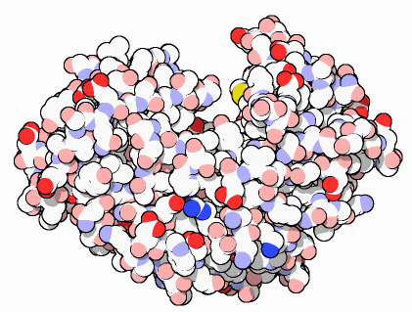
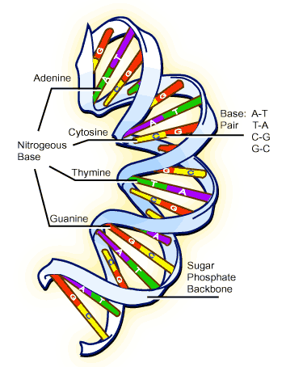
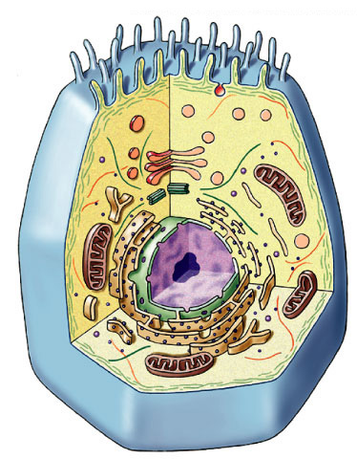
Proteins do all the work!
proteins
cells
DNA
Repeat after me…
Proteins do all the work!
organism

Slide 8
Cell functions
Building proteins
  copy DNA
  DNA -> RNA
  build proteins
  process proteins
    Folding, modifying
      Remove amino acids
      Add molecules (e.g. glycoproteins)
  address & transport proteins

Slide 9
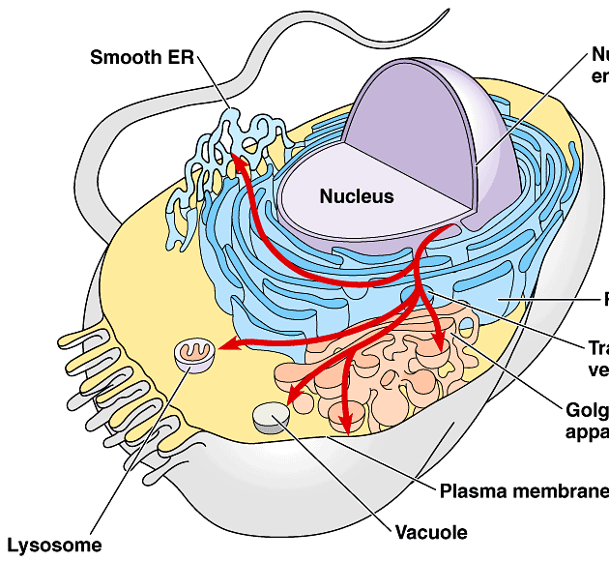

Protein Synthesis
Organelles involved
  nucleus
  ribosomes
  endoplasmic reticulum
  (ER)
  Golgi apparatus
  vesicles
The Protein Assembly Line
Golgi
apparatus
nucleus
ribosome
ER
vesicles
The Endomembrane System

Slide 10
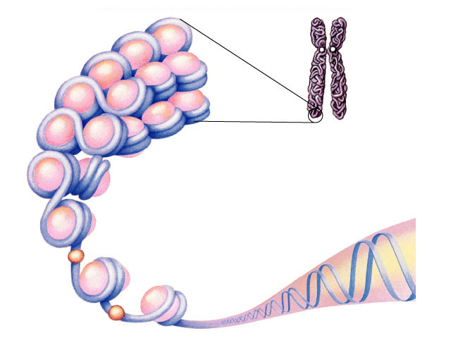
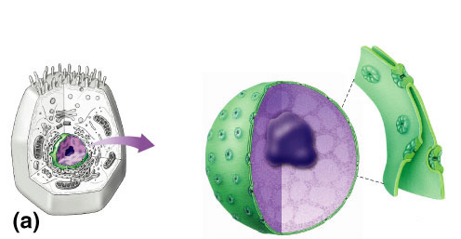
Nucleus
DNA
Function
  protects DNA
Structure
  nuclear envelope
    double membrane
    membrane fused in spots to create pores
chromosome
histone protein
nuclear
pores
What kind of
molecules need to
pass through?
nuclear
pore
nucleolus
nuclear envelope
Notes:
The nucleus controls the cell’s activities and is responsible for inheritance
Inside is a complex of proteins and DNA called chromatin, which makes up the cell’s chromosomes
DNA is copied within the nucleus prior to cell division
The nuclear envelope is a double membrane with pores that allow material to flow in and out of the nucleus
It is attached to a network of cellular membranes called the endoplasmic reticulum

Slide 11
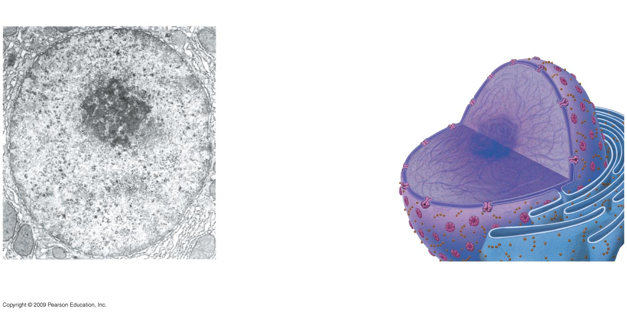
Two membranes of
nuclear envelope
Nucleus
Nucleolus
Chromatin
Pore
Endoplasmic
reticulum
Ribosomes
Notes:
Figure 4.6 TEM (left) and diagram (right) of the nucleus.

Slide 12
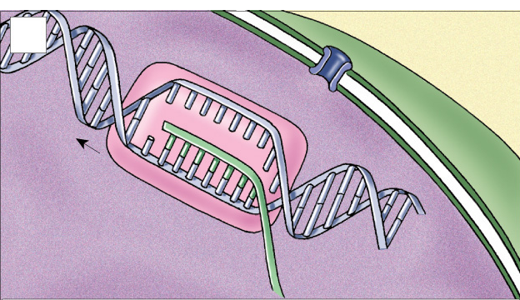
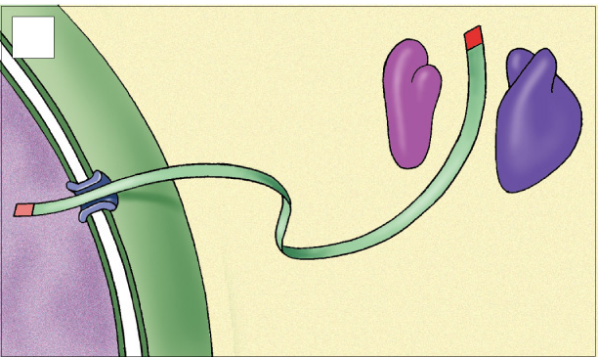
1
nuclear
membrane
production of mRNA from DNA in nucleus
DNA
Nucleus
mRNA
2
small
ribosomal
subunit
mRNA travels from nucleus to ribosome in cytoplasm through nuclear pore
nuclear pore
mRNA
large
ribosomal
subunit
cytoplasm

Slide 13
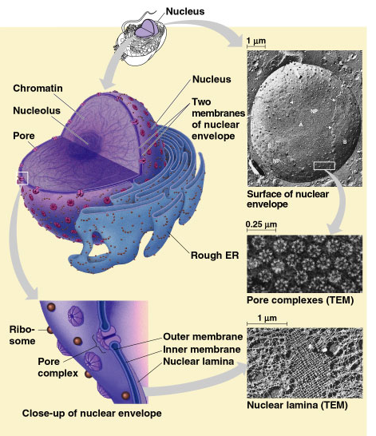
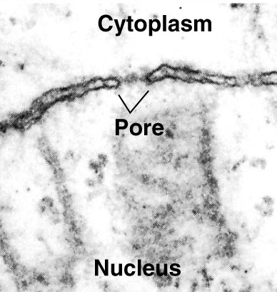

Slide 14
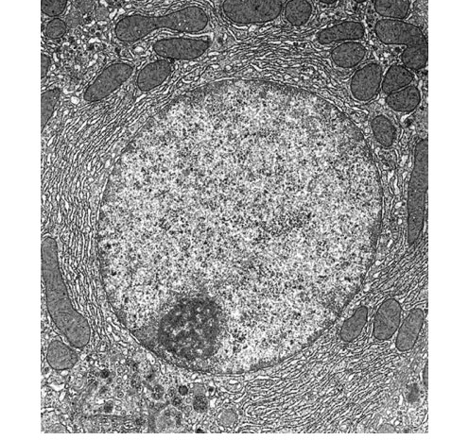
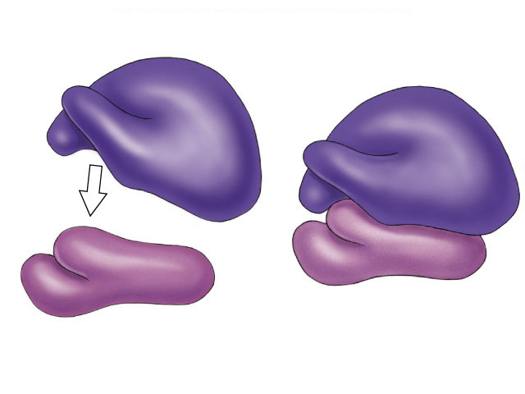
Nucleolus
Function
  ribosome production
    build ribosome subunits from rRNA & proteins
    Ribosome assembly is completed in cytoplasm
large subunit
rRNA &
proteins
small
subunit
ribosome
nucleolus

Slide 15
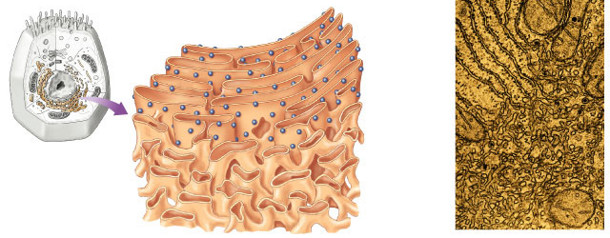
Ribosomes
large
subunit
Function
  protein production
Structure
  rRNA & protein
  2 subunits combine
small
subunit
0.08μm
Ribosomes
Rough
ER
Smooth
ER
Notes:
Ribosomes are involved in the cell’s protein synthesis
Ribosomes are synthesized in the nucleolus, which is found in the nucleus
Cells that must synthesize large amounts of protein have a large number of ribosomes
The genes for rRNA have the greatest commonality among all living things. There is very little difference in the DNA sequence of the rRNA genes in a humans vs. a bacteria.
Means that this function (building of a ribosome) is so integral to life that every cell does it almost exactly the same way.
Change a base and this changes the structure of the RNA which causes it to not function.

Slide 16
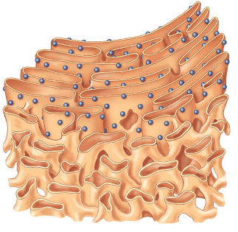
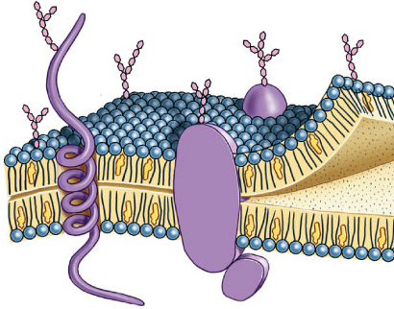
Types of Ribosomes
Free ribosomes
  suspended in cytosol
  synthesize proteins that stay in cytosol
Bound ribosomes
  attached to endoplasmic reticulum
  synthesize proteins
  for export or membranes
membrane proteins
Notes:
Some ribosomes are free ribosomes; others are bound
Free ribosomes are suspended in the cytoplasm
Bound ribosomes are attached to the endoplasmic reticulum (ER) associated with the nuclear envelope

Slide 17
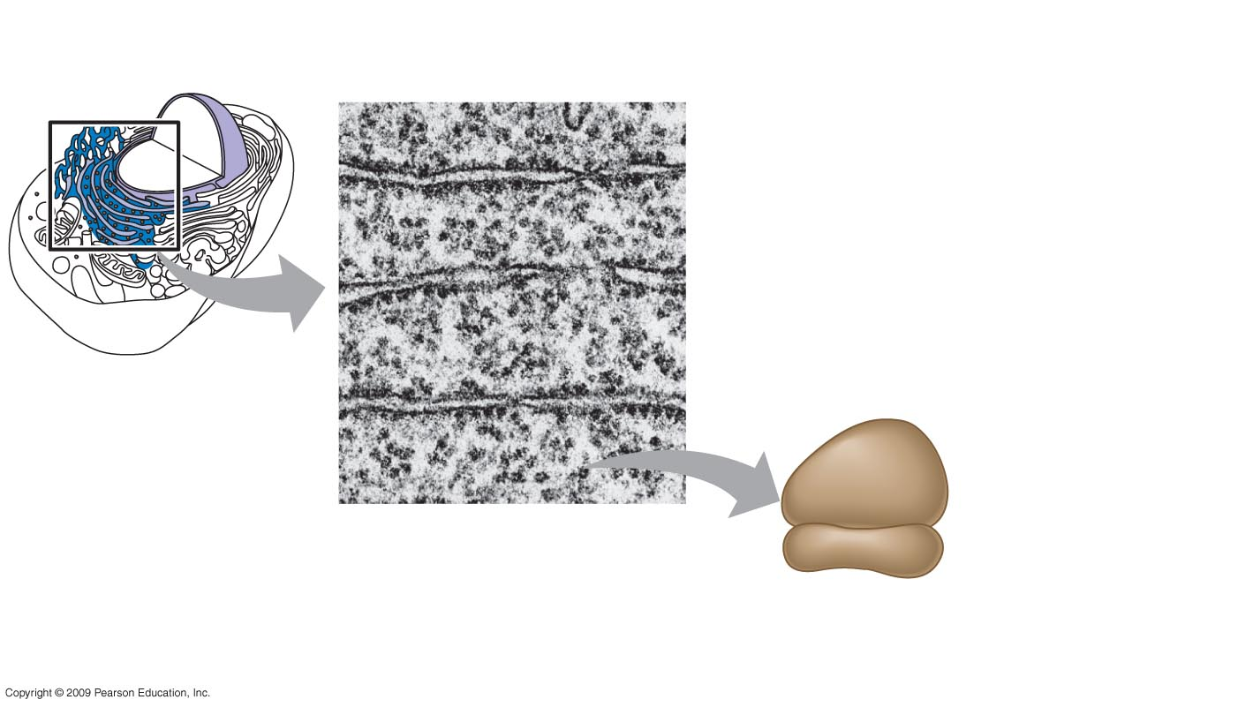
Ribosomes
Cytoplasm
ER
Endoplasmic reticulum (ER)
Free ribosomes
Bound ribosomes
Large
subunit
Small
subunit
TEM showing ER
and ribosomes
Diagram of
a ribosome
Notes:
Figure 4.7 Ribosomes.

Slide 18
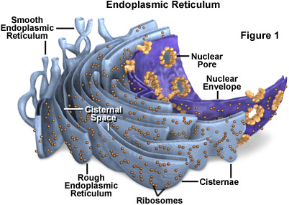
Endoplasmic Reticulum
Function
  processes proteins
  manufactures membrane
  synthesis & hydrolysis of many compounds
Structure
  membrane connected to nuclear envelope & extends throughout cell
Notes:
accounts for 50% membranes in eukaryotic cell

Slide 19
4.9 The endoplasmic reticulum is a biosynthetic factory
There are two kinds of endoplasmic reticulum—smooth and rough
Smooth ER lacks attached ribosomes
Rough ER lines the outer surface of membranes
  They differ in structure and function
  However, they are connected
Copyright © 2009 Pearson Education, Inc.
Notes:
Student Misconceptions and Concerns
1. Students can have trouble relating many cell organelles to their diverse functions. They may not realize that Modules 4.6–4.13 introduce the primary organelles in the order that they function in the production and release of secretory proteins. Products and information generally move from the central nucleus to the rough ER, through the more peripherally located Golgi apparatus and the secretory vesicles, and finally to the outer plasma membrane. Emphasizing the flow from center to periphery in this process will help students to remember the function of individual organelles as they recall the steps of the sequence.
2. Conceptually, some students seem to benefit from the well-developed cell-factory analogy developed in the text. The use of this analogy in lecture might help to anchor these relationships. As mentioned before, challenge students to find exceptions in the analogy, an exercise that promotes critical thinking.
Teaching Tips
1. If you continue the factory analogy, the addition of a molecular tag by the Golgi apparatus is like adding address labels in the shipping department of a factory.

Slide 20
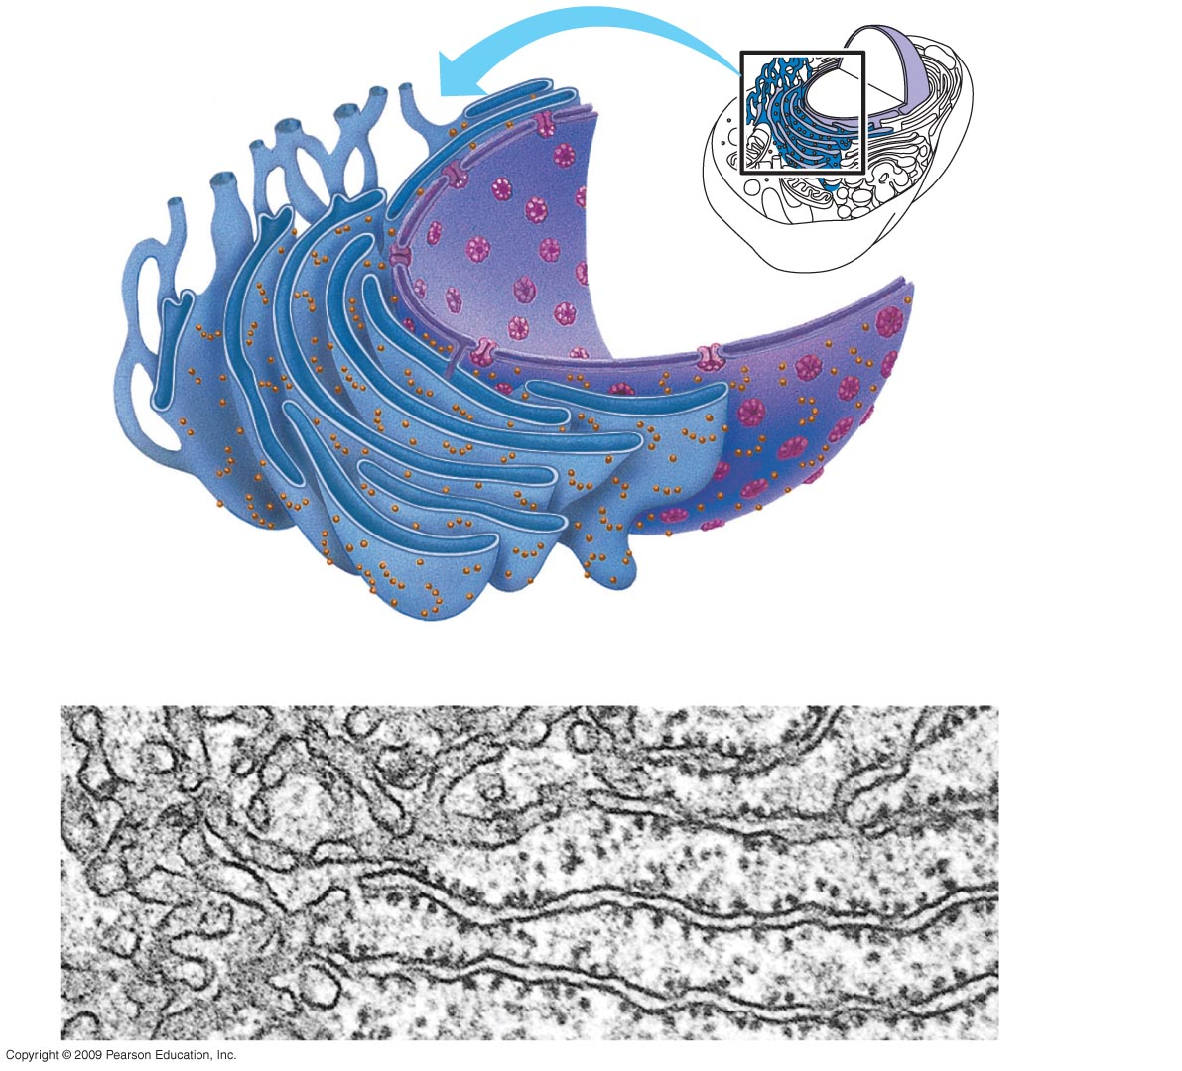
Nuclear
envelope
Ribosomes
Smooth ER
Rough ER
Notes:
Figure 4.9A Smooth and rough endoplasmic reticulum.

Slide 21
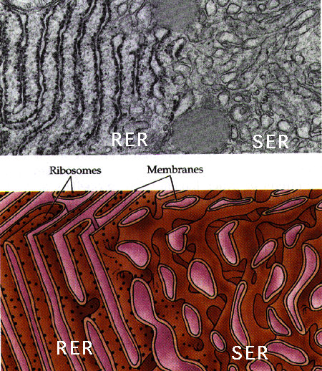
Types of ER
rough
smooth

Slide 22
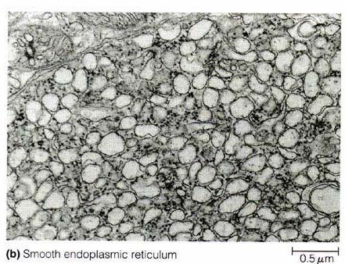
Smooth ER function
Membrane production
Metabolic processes
  Lipid Synthesis
  Glycogen hydrolysis (in liver)
  Drug detoxification (in liver)
Notes:
Smooth ER is involved in a variety of diverse metabolic processes
For example, enzymes produced by the smooth ER are involved in the synthesis of lipids, oils, phospholipids, and steroids
Smooth ER processes include synthesis of lipids, metabolism of carbohydrates, and detoxification of drugs and poisons.

Slide 23
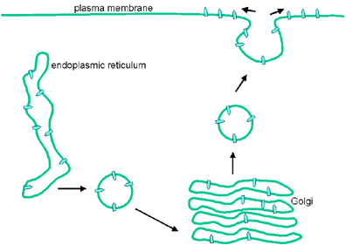
Membrane Factory
Build new membrane
  synthesize phospholipids
  ER membrane expands
    buds off & transfers to other parts of cell.

Slide 24

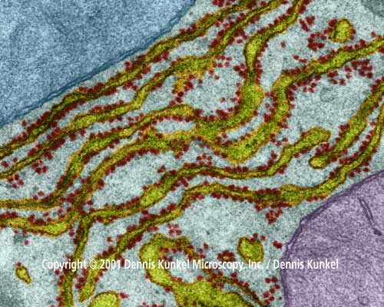
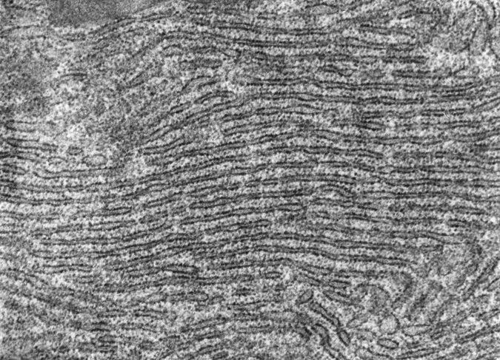
Rough ER function
Produces proteins for export out of cell
  protein secreting cells
  packaged into transport vesicles for export
Which cells
have lot of
rough ER?
Notes:
Which cells have a lot of ER?
protein production cells like pancreas = production of digestive enzymes
(rough endoplasmic reticulum from a cell of exocrine pancreas (88000X))

Slide 25
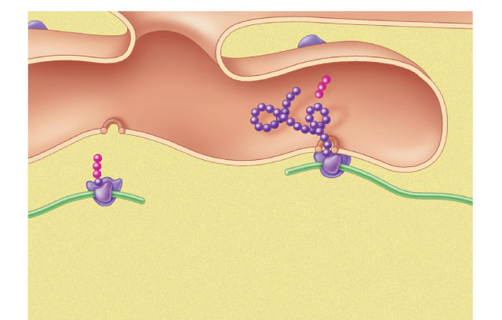
Synthesizing proteins
cisternal
space
polypeptide
signal
sequence
ribosome
ribosome
membrane of
endoplasmic reticulum
mRNA
cytoplasm

Slide 26

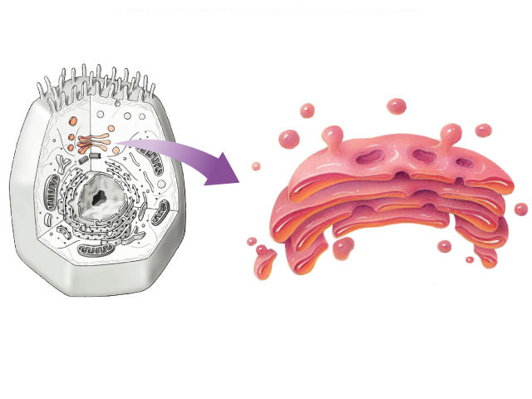
Golgi Apparatus
Function
  finishes, sorts, tags & ships products
    like “UPS shipping department”
  ships products in vesicles
    membrane sacs
    “UPS trucks”
secretory
vesicles
Which cells
have lots
of Golgi?
transport vesicles
Notes:
The Golgi apparatus functions in conjunction with the ER by modifying products of the ER
Products travel in transport vesicles from the ER to the Golgi apparatus
One side of the Golgi apparatus functions as a receiving dock for the product and the other as a shipping dock
Products are modified as they go from one side of the Golgi apparatus to the other and travel in vesicles to other sites
The finished product can become part of the plasma membrane or other organelle, or it may move to the plasma membrane for export from the cell.
Cells specialized for secretion?
endocrine glands: produce hormones
pituitary, pancreas, adrenal, testes, ovaries
exocrine glands: produce digestive enzymes & other products
pancreas, mammary glands, sweat glands

Slide 27
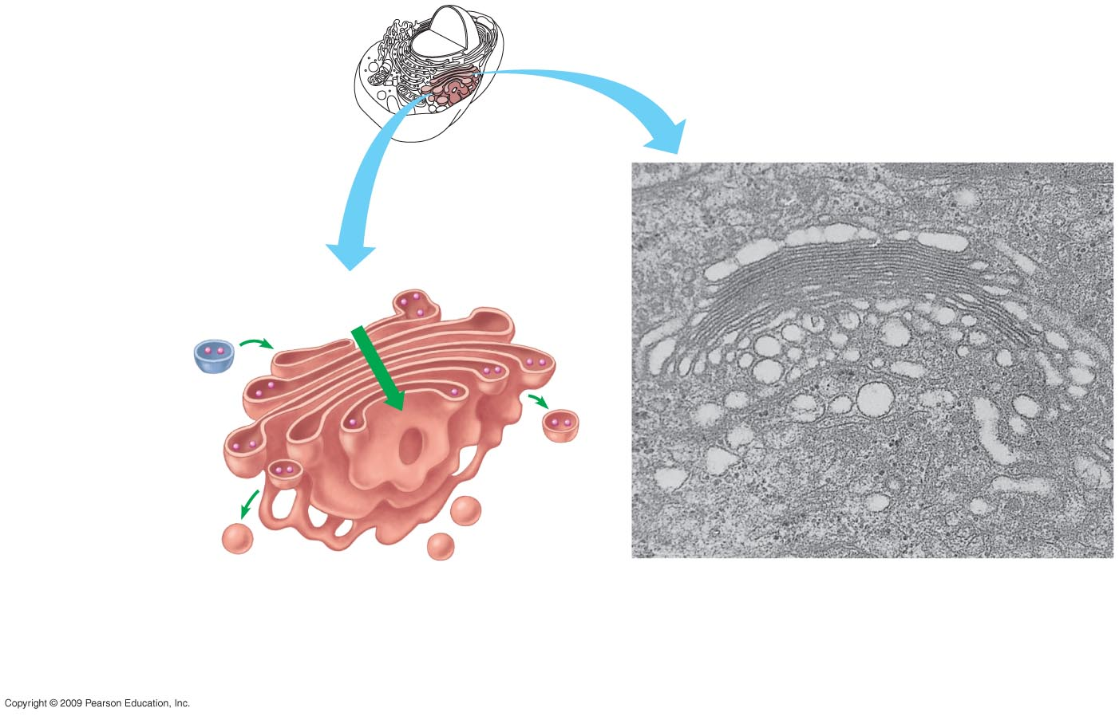
“Receiving” side of
Golgi apparatus
Golgi apparatus
Golgi
apparatus
Transport
vesicle
from ER
New vesicle
forming
Transport
vesicle from
the Golgi
“Shipping” side
of Golgi apparatus
Notes:
Figure 4.10 The Golgi apparatus.
You might tell your students that the Golgi apparatus looks like a stack of pita bread.

Slide 28
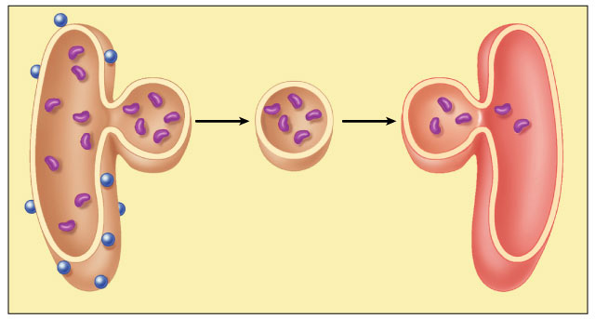
Vesicle transport
protein
vesicle
budding
from rough
ER
migrating
transport
vesicle
fusion
of vesicle
with Golgi
apparatus
ribosome
Notes:
Some components of the endomembrane system are able to communicate with others with formation and transfer of small membrane segments called vesicles
One important result of communication is the synthesis, storage, and export of molecules
For the BLAST Animation Vesicle Transport, go to Animation and Video Files.

