Slide 1
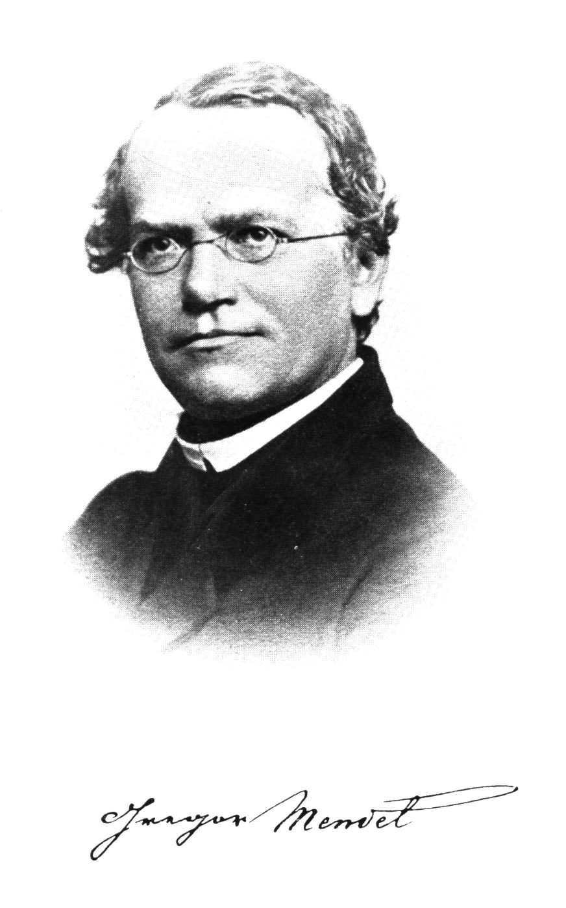
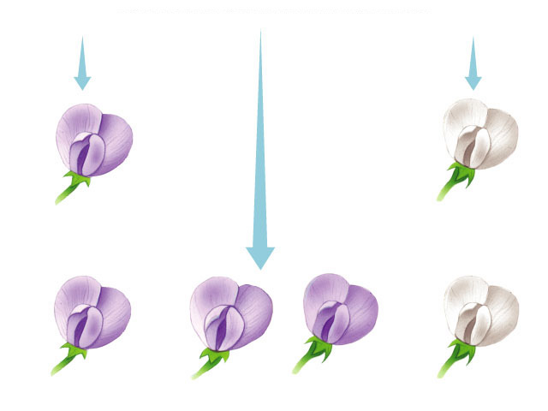
Genetics
&
The Work of Mendel

Slide 2
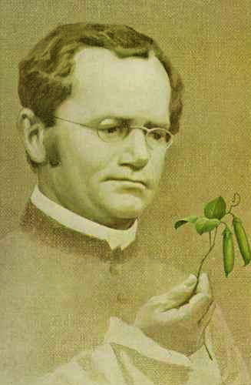
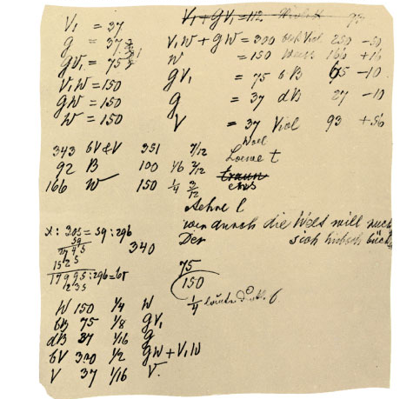
Gregor Mendel
Modern genetics began in the mid-1800s in an abbey garden, where a monk named Gregor Mendel documented inheritance in peas
  used experimental method
  used quantitative analysis
    collected data & counted them
  excellent example of scientific method
Notes:
He studied at the University of Vienna from 1851 to 1853 where he was influenced by a physicist who encouraged experimentation and the application of mathematics to science and a botanist who aroused Mendel’s interest in the causes of variation in plants. After the university, Mendel taught at the Brunn Modern School and lived in the local monastery.
The monks at this monastery had a long tradition of interest in the breeding of plants, including peas. Around 1857, Mendel began breeding garden peas to study inheritance.

Slide 3
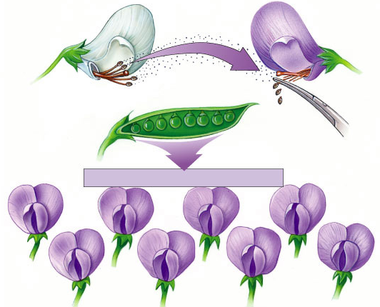
Mendel’s work
Pollen transferred from white flower to stigma of purple flower
Bred pea plants
  cross-pollinate
  true breeding parents (P)
    P = parental
  raised seed & then
  observed traits (F₁)
    F = filial
  allowed offspring
  to self-pollinate
  & observed next
  generation (F₂)
P
anthers
removed
all purple flowers result
F₁
self-pollinate
F₂
Notes:
P = parents
F = filial generation

Slide 4
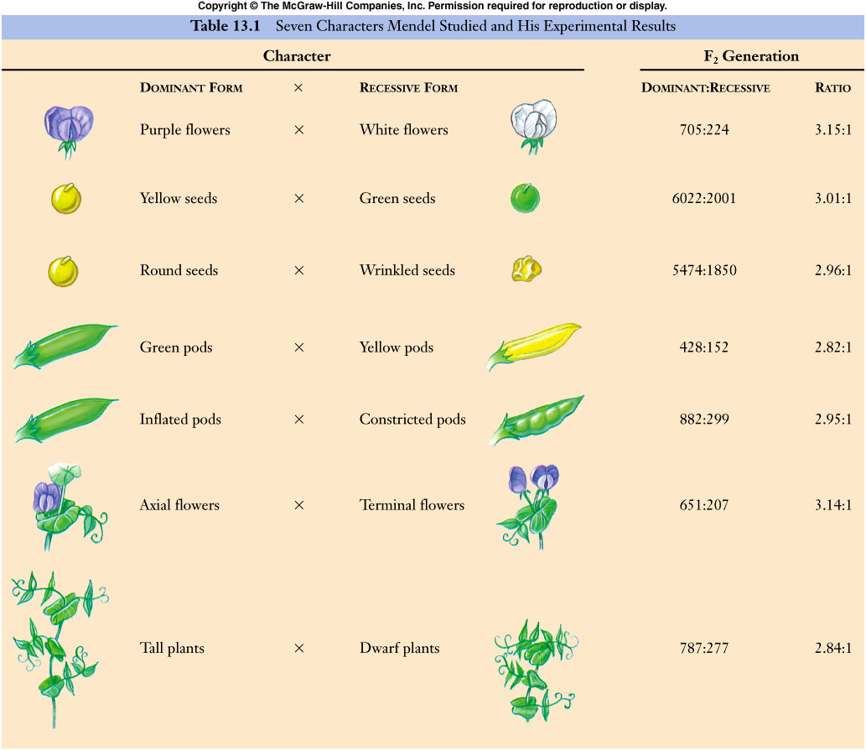
Mendel collected data for 7 pea traits

Slide 5
Looking closer at Mendel’s work
true-breeding
purple-flower peas
true-breeding
white-flower peas
P
X
Where did
the white
flowers go?
F₁
generation
(hybrids)
100%
purple-flower peas
100%
White
flowers came
back!
self-pollinate
75%
purple-flower peas
25%
white-flower peas
3:1
F₂
generation
Notes:
In a typical breeding experiment, Mendel would cross-pollinate (hybridize) two contrasting, true-breeding pea varieties.
The true-breeding parents are the P generation and their hybrid offspring are the F₁ generation.
Mendel would then allow the F₁ hybrids to self-pollinate to produce an F₂ generation.

Slide 6
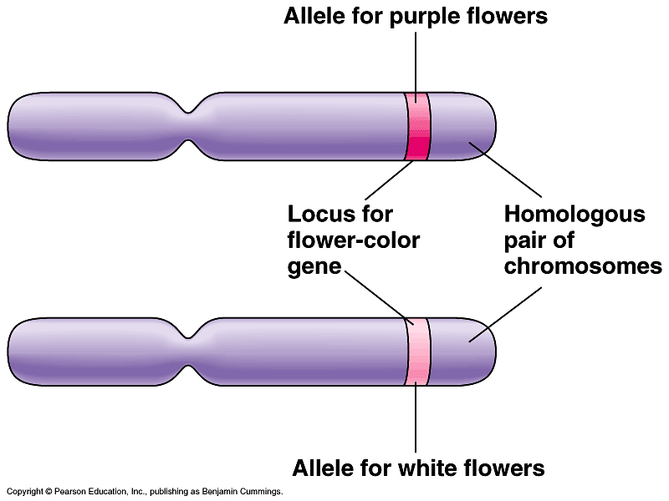
What did Mendel’s findings mean?
Traits come in alternative versions
  purple vs. white flower color
  alleles
    different alleles vary in the sequence of nucleotides at the specific locus of a gene
      some difference in sequence of A, T, C, G
purple-flower allele &
white-flower allele are two DNA variations at flower-color locus
different versions of gene at same location on homologous chromosomes

Slide 7
Traits are inherited as discrete units
For each characteristic, an organism inherits 2 alleles, 1 from each parent
  diploid organism
    inherits 2 sets of chromosomes,
    1 from each parent
    homologous chromosomes
    like having 2 editions of encyclopedia
      Encyclopedia Britannica
      Encyclopedia Americana
What are the
advantages of
being diploid?

Slide 8
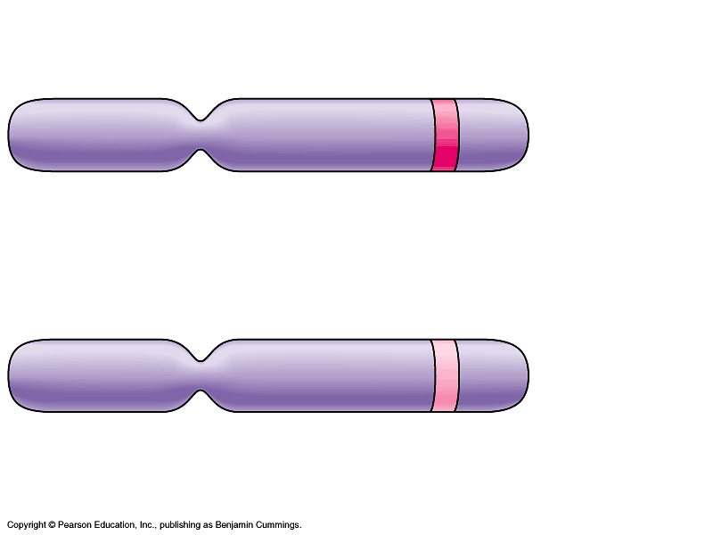
What did Mendel’s findings mean?
Some traits mask others
  purple & white flower colors are separate traits that do not blend
    purple x white ≠ light purple
    purple masked white
  dominant allele
    functional protein
    masks other alleles
  recessive allele
    allele makes a
    malfunctioning protein
I’ll speak for
both of us!
wild type
allele producing
functional protein
mutant
allele producing
malfunctioning
protein
homologous
chromosomes

Slide 9
Genotype vs. phenotype
Difference between how an organism “looks” & its genetics
  phenotype
    description of an organism’s trait
    the “physical”
  genotype
    description of an organism’s genetic makeup
P
X
Explain Mendel’s results using
…dominant & recessive
…phenotype & genotype
purple
white
F₁
all purple

Slide 10
Making crosses
Can represent alleles as letters
  flower color alleles → P or p
  true-breeding purple-flower peas → PP
  true-breeding white-flower peas → pp
PP
x
pp
P
X
purple
white
F₁
Pp
all purple

Slide 11
Looking closer at Mendel’s work
true-breeding
purple-flower peas
true-breeding
white-flower peas
phenotype
P
X
PP
pp
genotype
F₁
generation
(hybrids)
100%
purple-flower peas
100%
Pp
Pp
Pp
Pp
self-pollinate
75%
purple-flower peas
25%
white-flower peas
3:1
F₂
generation
?
?
?
?
Notes:
In a typical breeding experiment, Mendel would cross-pollinate (hybridize) two contrasting, true-breeding pea varieties.
The true-breeding parents are the P generation and their hybrid offspring are the F₁ generation.
Mendel would then allow the F₁ hybrids to self-pollinate to produce an F₂ generation.

Slide 12
Punnett squares
Aaaaah,
phenotype & genotype
can have different
ratios
Pp x Pp
F₁
generation
(hybrids)
%
genotype
%
phenotype
male / sperm
PP
P
p
25%
Pp
75%
P
PP
Pp
50%
Pp
female / eggs
p
Pp
pp
25%
25%
pp
1:2:1
3:1

Slide 13
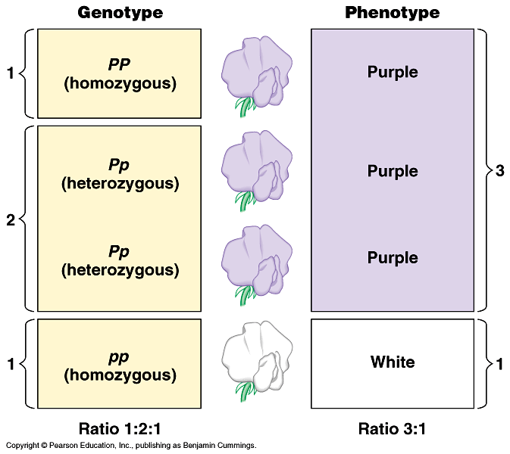
Genotypes
Homozygous = same alleles = PP, pp
Heterozygous = different alleles = Pp
homozygous
dominant
heterozygous
homozygous
recessive

Slide 14
Phenotype vs. genotype
2 organisms can have the same phenotype but have different genotypes
purple
PP
homozygous dominant
purple
Pp
heterozygous
Can’t tell
by lookin’
at ya!
How do you determine the
genotype of an individual with
with a dominant phenotype?

Slide 15
Test cross
Breed the dominant phenotype —
the unknown genotype — with a homozygous recessive (pp) to determine the identity of the unknown allele
How does
that work?
x
is it
PP or Pp?
pp

Slide 16
How does a Test cross work?
Am I
this?
x
Or am I
this?
x
PP
pp
Pp
pp
p
p
p
p
P
Pp
Pp
P
Pp
Pp
P
p
Pp
Pp
pp
pp
100% purple
50% purple:50% white or 1:1

Slide 17
Mendel’s 1st law of heredity
P
Law of segregation
  during meiosis, alleles segregate
    homologous chromosomes separate
  each allele for a trait is packaged into a separate gamete
PP
P
p
pp
p
P
Pp
p

Slide 18
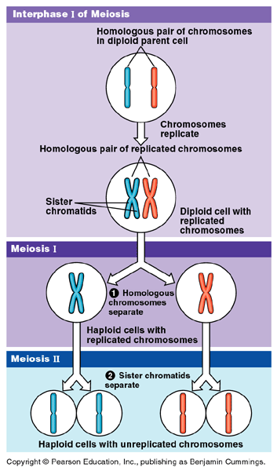
Law of Segregation
Which stage of meiosis creates the
law of segregation?
Metaphase 1
Whoa!
And Mendel
didn’t even know
DNA or genes
existed!

Slide 19
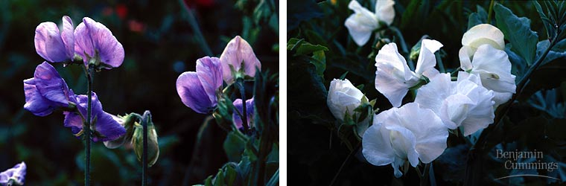
Monohybrid cross
Some of Mendel’s experiments followed the inheritance of single characters
  flower color
  seed color
  monohybrid crosses

Slide 20
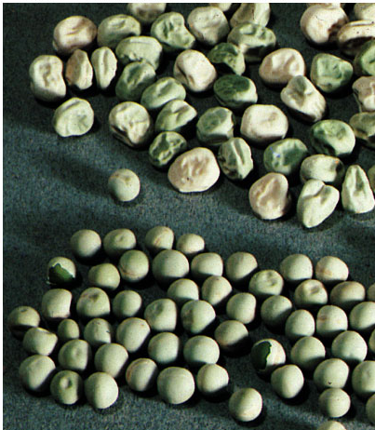
Dihybrid cross
Other of Mendel’s experiments followed the inheritance of 2 different characters
  seed color and
  seed shape
  dihybrid crosses
Mendel
was working out
many of the
genetic rules!

Slide 21
Dihybrid cross
P
true-breeding
yellow, round peas
x
true-breeding
green, wrinkled peas
YYRR
yyrr
Y = yellow
R = round
y = green
r = wrinkled
F₁
generation
(hybrids)
yellow, round peas
100%
YyRr
self-pollinate
9:3:3:1
F₂
generation
9/16
yellow
round
peas
3/16
green
round
peas
3/16
yellow
wrinkled
peas
1/16
green
wrinkled
peas
Notes:
Wrinkled seeds in pea plants with two copies of the recessive allele are due to the accumulation of monosaccharides and excess water in seeds because of the lack of a key enzyme. The seeds wrinkle when they dry.
Both homozygous dominants and heterozygotes produce enough enzyme to convert all the monosaccharides into starch and form smooth seeds when they dry.

Slide 22
What’s going on here?
If genes are on different chromosomes…
  how do they assort in the gametes?
  together or independently?
YyRr
Is it this?
Or this?
YyRr
YR
yr
YR
Yr
yR
yr
Which system
explains the
data?

Slide 23
Is this the way it works?
YyRr
or
YyRr
YyRr
x
YyRr
YR
yr
YR
Yr
yR
yr
9/16
yellow
round

YR
yr
3/16
green
round
YR
Well, that’s
NOT right!
YYRR
YyRr
3/16
yellow
wrinkled
yr
YyRr
yyrr
1/16
green
wrinkled

Slide 24
Dihybrid cross
YyRr
or
YyRr
YyRr
x
YyRr
YR
yr
YR
Yr
yR
yr
9/16
yellow
round
YR
Yr
yR
yr
YR
YYRR

3/16
green
round
YYRr
YyRR
YyRr
Yr
BINGO!
YYRr
YYrr
YyRr
Yyrr
3/16
yellow
wrinkled
yR
YyRR
YyRr
yyRR
yyRr
yr
YyRr
Yyrr
yyRr
yyrr
1/16
green
wrinkled

Slide 25
Mendel’s 2nd law of heredity
Law of independent assortment
  different loci (genes) separate into gametes independently
    non-homologous chromosomes align independently
    classes of gametes produced in equal amounts
      YR = Yr = yR = yr
    only true for genes on separate chromosomes or
    on same chromosome but so far apart that crossing over happens frequently
yellow
green
round
wrinkled
YyRr
Yr
Yr
yR
yR
YR
YR
yr
yr
1
:
1
:
1
:
1

Slide 26
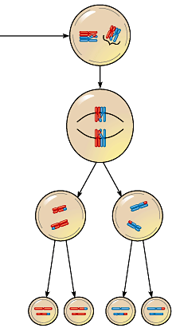
Law of Independent Assortment
Which stage of meiosis creates the law of independent assortment?
Remember
Mendel didn’t
even know DNA
—or genes—
existed!
Metaphase 1
EXCEPTION
If genes are on same chromosome & close together
  will usually be inherited together
  rarely crossover separately
  “linked”

Slide 27
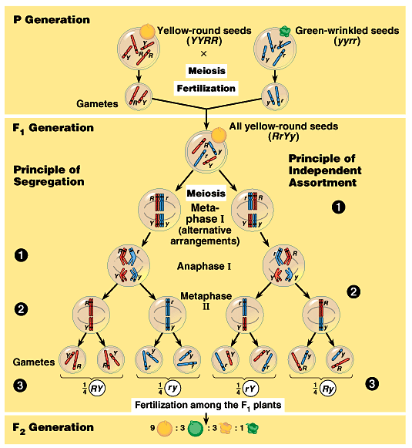
The chromosomal
basis of Mendel’s
laws…
Trace the genetic
events through
meiosis, gamete
formation &
fertilization to offspring

Slide 28
Review: Mendel’s laws of heredity
Law of segregation
  each allele segregates into separate gametes
    Metaphase 1
Law of independent assortment
  genes on separate chromosomes
  assort into gametes independently
    Metaphase 1
EXCEPTION
linked genes
metaphase1

Slide 29
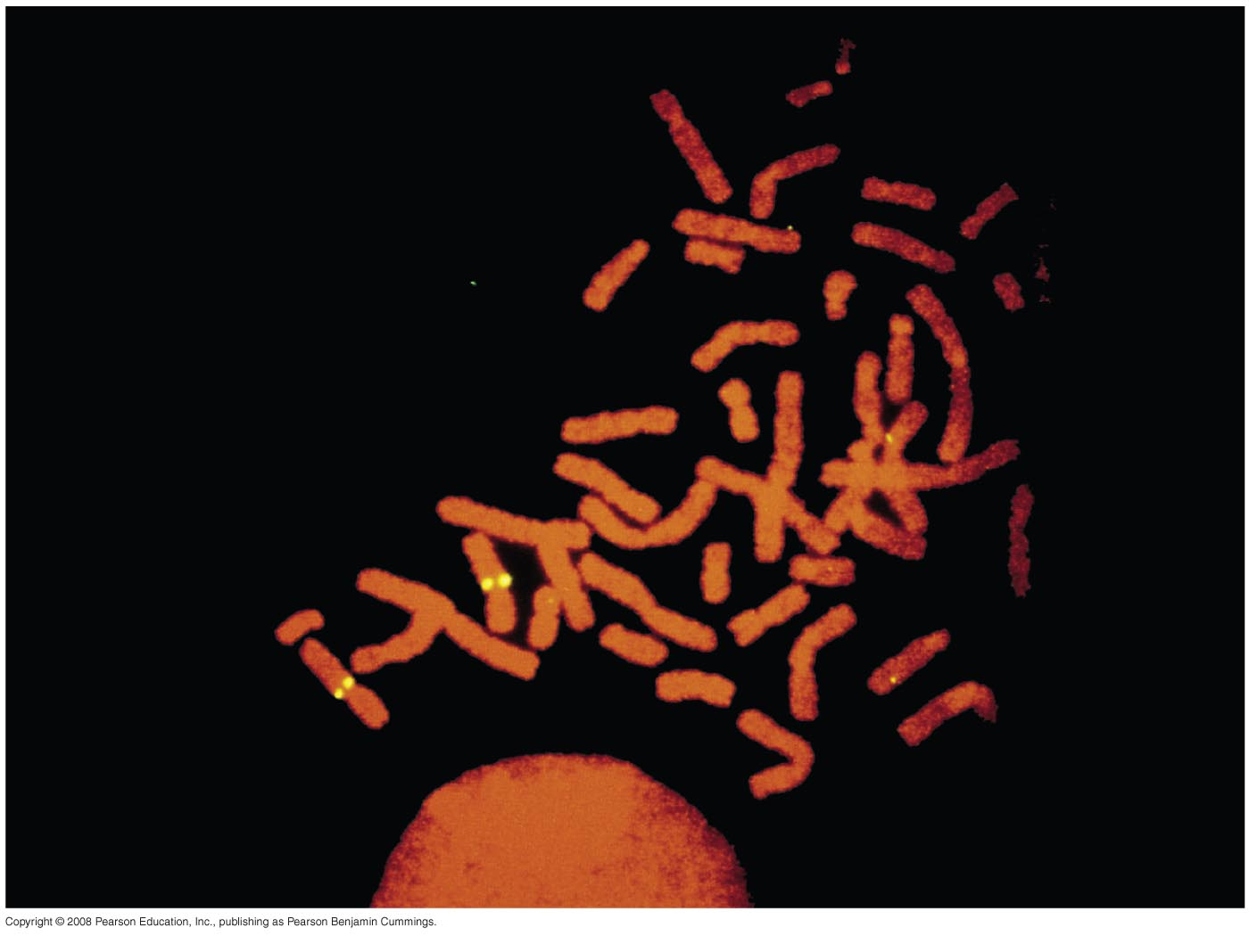
Overview: Locating Genes Along Chromosomes
Mendel’s “hereditary factors” were genes, though this wasn’t known at the time
Today we can show that genes are located on chromosomes
Copyright © 2008 Pearson Education Inc., publishing as Pearson Benjamin Cummings
Notes:
The location of a particular gene can be seen by tagging isolated chromosomes with a fluorescent dye that highlights the gene

Slide 30
Mendelian inheritance has its physical basis in the behavior of chromosomes
Mitosis and meiosis were first described in the late 1800s
The chromosome theory of inheritance states:
  Mendelian genes have specific loci (positions) on chromosomes
  Chromosomes undergo segregation and independent assortment
The behavior of chromosomes during meiosis was said to account for Mendel’s laws of segregation and independent assortment
Copyright © 2008 Pearson Education Inc., publishing as Pearson Benjamin Cummings

Slide 31
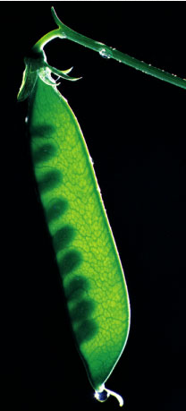
Mendel chose peas wisely
Pea plants are good for genetic research
  available in many varieties with distinct heritable features with different variations
    flower color, seed color, seed shape, etc.
  Mendel had strict control over
  which plants mated with which
    each pea plant has male & female
    structures
    pea plants can self-fertilize
    Mendel could also cross-pollinate
    plants: moving pollen from one plant
    to another

Slide 32
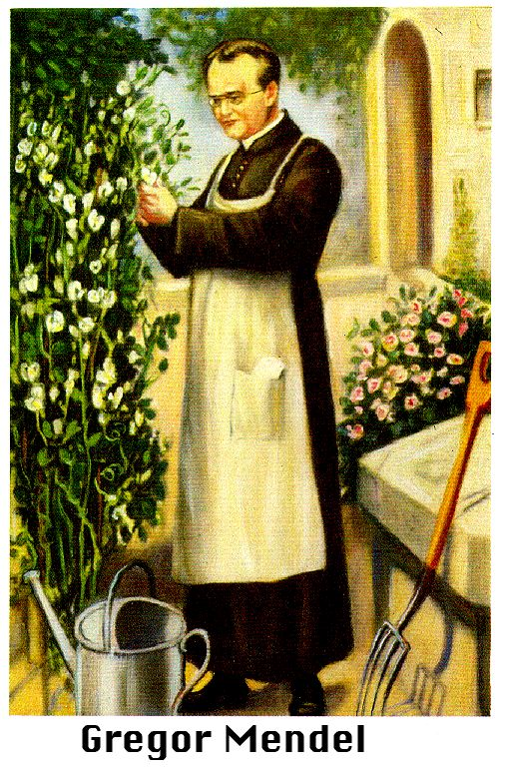

Mendel chose peas luckily
Pea plants are good for genetic research
  relatively simple genetically
    most characters are controlled by a single gene with each gene having only 2 alleles,
      one completely dominant over
      the other

Slide 33
The laws of probability govern Mendelian inheritance
Mendel’s laws of segregation and independent assortment reflect the rules of probability
When tossing a coin, the outcome of one toss has no impact on the outcome of the next toss
In the same way, the alleles of one gene segregate into gametes independently of another gene’s alleles
Copyright © 2008 Pearson Education Inc., publishing as Pearson Benjamin Cummings

Slide 34
The Multiplication and Addition Rules Applied to Monohybrid Crosses
The multiplication rule:
  the probability that two or more independent events will occur together is the product of their individual probabilities
Segregation in a heterozygous plant is like flipping a coin: Each gamete has a 50% chance of carrying the dominant allele and a 50% chance of carrying the recessive allele
Copyright © 2008 Pearson Education Inc., publishing as Pearson Benjamin Cummings
Notes:
Probability in an F₁ monohybrid cross can be determined using the multiplication rule

Slide 35
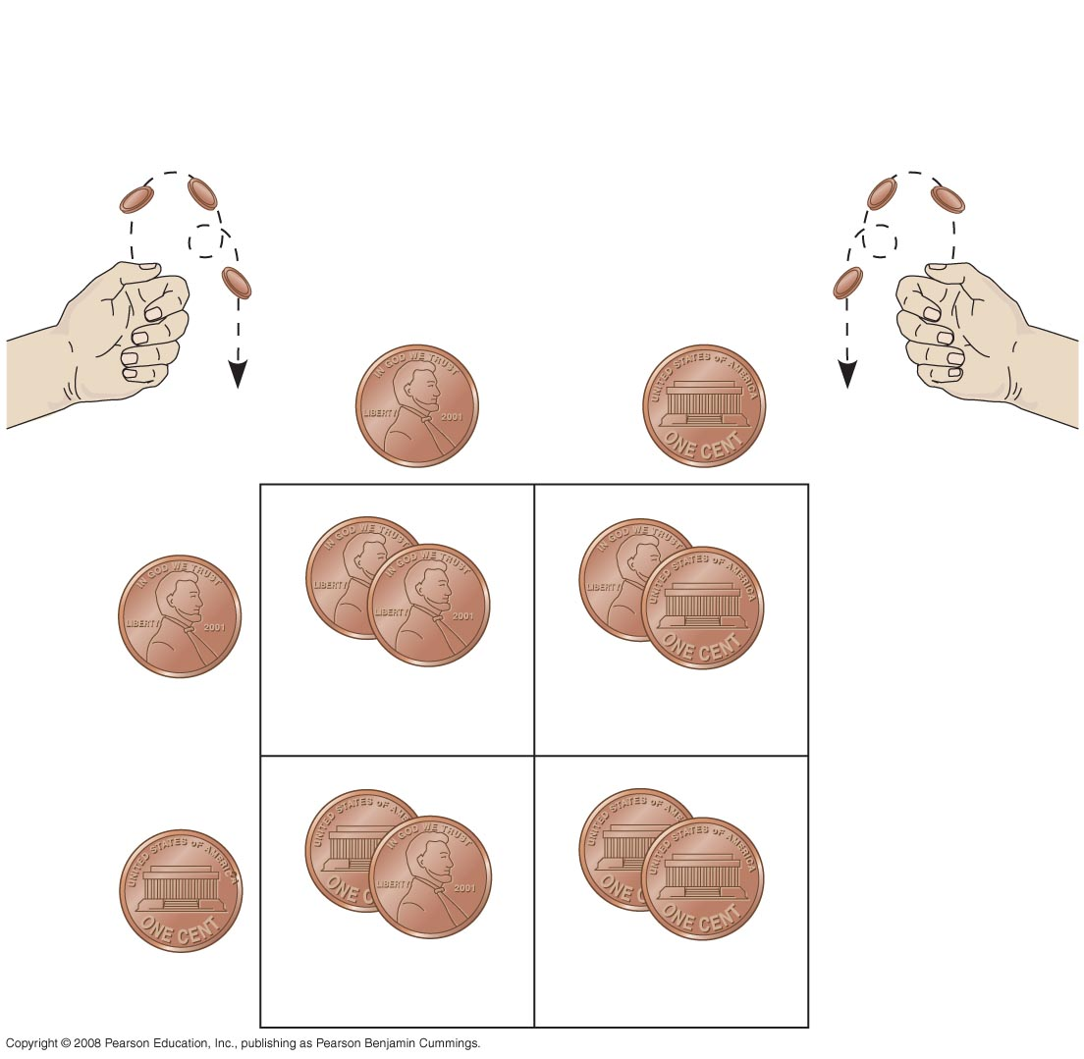
Fig. 14-9
Rr
×
Rr
Segregation of
alleles into eggs
Segregation of
alleles into sperm
Sperm
¹/₂
R
¹/₂
r
R
R
¹/₂
R
R
r
¹/₄
¹/₄
Eggs
r
r
¹/₂
r
R
r
¹/₄
¹/₄
Notes:
Figure 14.9 Segregation of alleles and fertilization as chance events

Slide 36
The rule of addition:
  the probability that any one of two or more exclusive events will occur is calculated by adding together their individual probabilities
The rule of addition can be used to figure out the probability that an F₂ plant from a monohybrid cross will be heterozygous rather than homozygous
Copyright © 2008 Pearson Education Inc., publishing as Pearson Benjamin Cummings

Slide 37
Solving Complex Genetics Problems with the Rules of Probability
We can apply the multiplication and addition rules to predict the outcome of crosses involving multiple characters
A dihybrid or other multicharacter cross is equivalent to two or more independent monohybrid crosses occurring simultaneously
In calculating the chances for various genotypes, each character is considered separately, and then the individual probabilities are multiplied together
Copyright © 2008 Pearson Education Inc., publishing as Pearson Benjamin Cummings

Slide 38
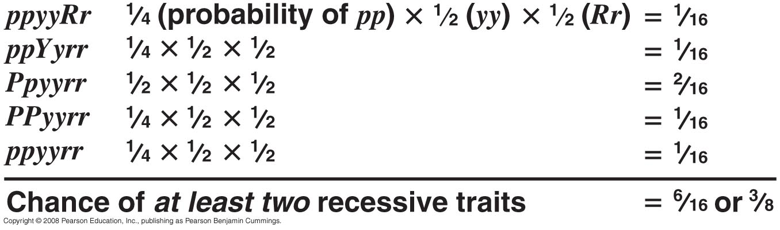
Fig. 14-UN1
Parents: PpYyRr X Ppyyrr

Slide 39
1. In a cross AaBbCc × AaBbCc, what is the probability of producing the genotype AABBCC?
  1/4
  1/8
  1/16
  1/32
  1/64
Notes:
Answer: e
Source: Barstow - Test Bank for Biology, Seventh Edition, Question #33

Slide 40
2. You are handed a “mystery’’ pea plant with long stems and axial flowers, and asked to determine its genotype as quickly as possible. You know the allele for long stems (L) is dominant to that for dwarf stems (l) and that the allele for axial flowers (A) is dominant to that for terminal flowers (a). You cross the “mystery” plant with a dwarf stemmed terminal flowered plant. If your mystery plant is heterozygous at both loci, what is/are the expected proportion of offspring?
  100% long stemmed terminal flowered
  100% dwarf stemmed terminal flowered
  100% long stemmed axial flowered
  50% long stemmed axial flowered, 50% dwarf stemmed terminal flowered
  25% long stemmed axial flowered, 25% long stemmed terminal flowered, 25% dwarf stemmed axial flowered, 25% dwarf stemmed terminal flowered
Notes:
Answer: e
Source: Campbell/Reece - Biology, Seventh Edition, EOC Process of Science Question

Slide 41
F. Feather color in budgies is determined by two different genes that affect the pigmentation of the outer feather and its core. Y_B_ is green; yyB_ is blue; Y_bb is yellow; and yybb is white. A green budgie is crossed with a blue budgie. Which of the following results is not possible?
  all green offspring
  all blue offspring
  all white offspring
  all yellow offspring
  All of the above are possible, but with different probabilities.
Notes:
Answer: e
Source: Barstow - Test Bank for Biology, Seventh Edition, Question #35

