Slide 1
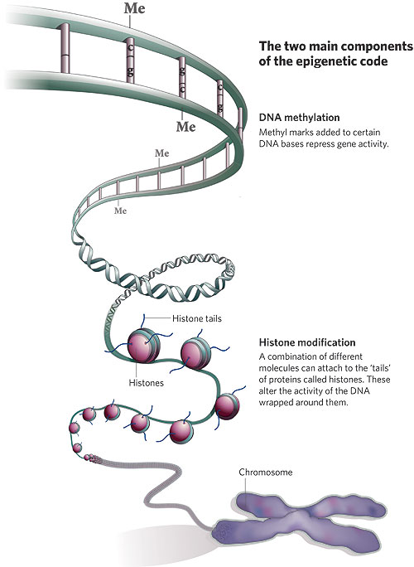
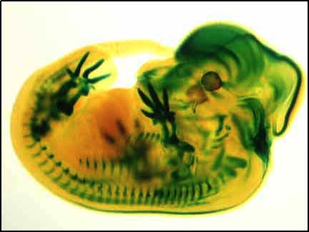
Control of Eukaryotic Genes

Slide 2
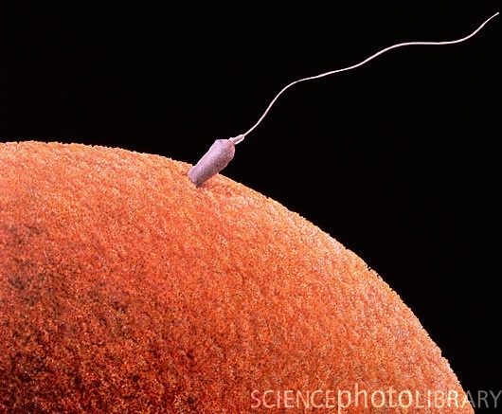
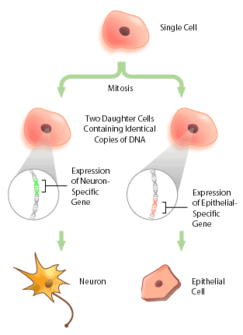
The BIG Questions…
How are genes turned on & off in eukaryotes?
How do cells with the same genes differentiate to perform completely different, specialized functions?

Slide 3
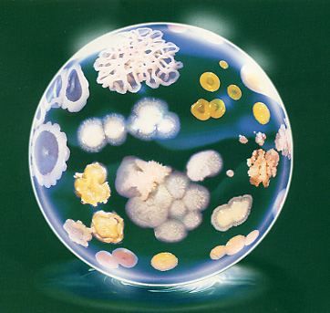
Evolution of gene regulation
Prokaryotes
single-celled
evolved to grow & divide rapidly
must respond quickly to changes in external environment
exploit transient resources
Gene regulation
turn genes on & off rapidly
flexibility & reversibility
adjust levels of enzymes for synthesis & digestion
Notes:
prokaryotes use operons to regulate gene transcription, however eukaryotes do not.
since transcription & translation are fairly simultaneous there is little opportunity to regulate gene expression after transcription, so control of genes in prokaryotes really has to be done by turning transcription on or off.

Slide 4
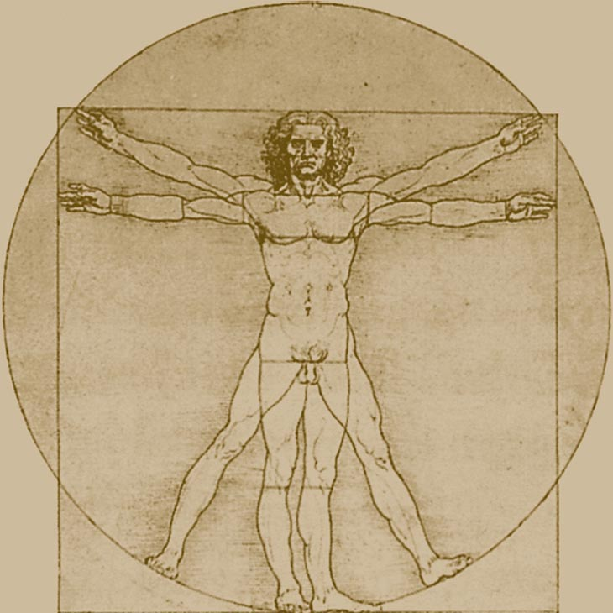
Evolution of gene regulation
Eukaryotes
multicellular
evolved to maintain constant internal conditions while facing changing external conditions
homeostasis
regulate body as a whole
growth & development
long term processes
specialization
turn on & off large number of genes
must coordinate the body as a whole rather than serve the needs of individual cells
Notes:
Specialization
each cell of a multicellular eukaryote expresses only a small fraction of its genes
Development
different genes needed at different points in life cycle of an organism
afterwards need to be turned off permanently
Continually responding to organism’s needs
homeostasis
cells of multicellular organisms must continually turn certain genes on & off in response to signals from their external & internal environment

Slide 5
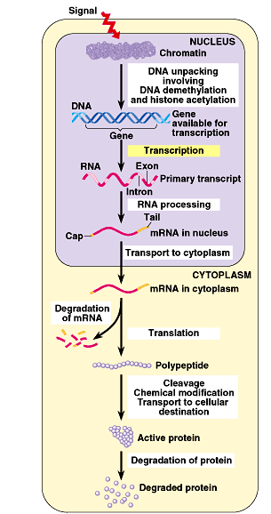
Points of control
The control of gene expression can occur at any step in the pathway from gene to functional protein
1. packing/unpacking DNA
2. transcription
3. mRNA processing
4. mRNA transport
5. translation
6. protein processing
7. protein degradation

Slide 6
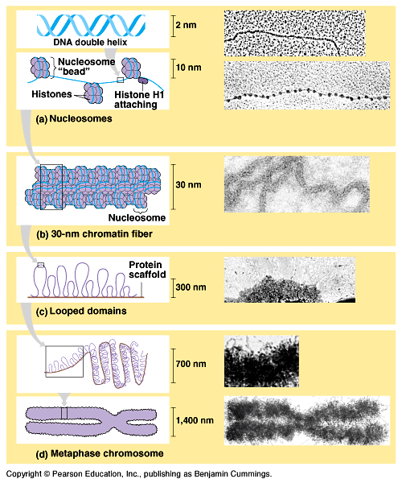
1. DNA packing
How do you fit all that DNA into nucleus?
DNA coiling & folding
double helix
nucleosomes
chromatin fiber
looped domains
chromosome
from DNA double helix to condensed chromosome
Notes:
nucleosomes
“beads on a string”
1st level of DNA packing
histone proteins have high proportion of positively charged amino acids (arginine & lysine)
bind tightly to negatively charged DNA

Slide 7
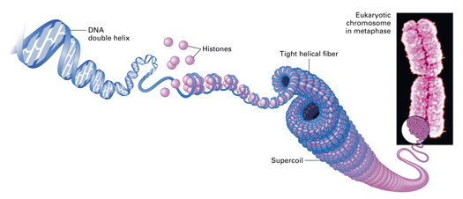
Nucleosomes
8 histone molecules
“Beads on a string”
1st level of DNA packing
histone proteins
8 protein molecules
positively charged amino acids
bind tightly to negatively charged DNA

Slide 8
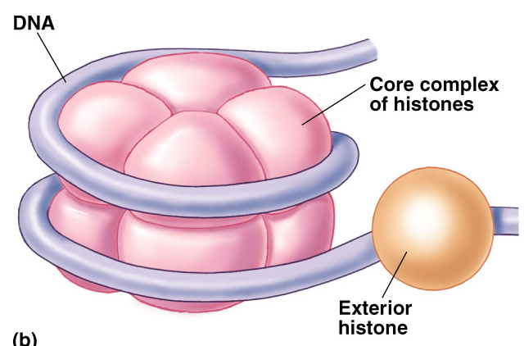
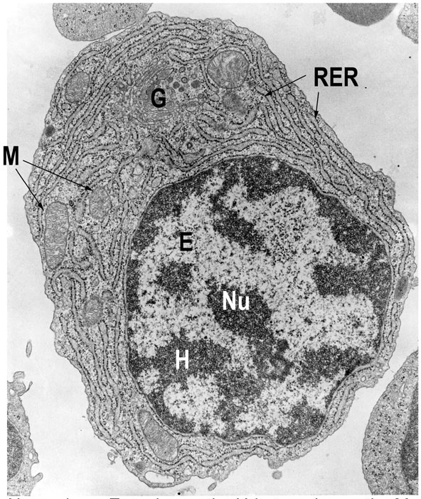
DNA packing as gene control
Degree of packing of DNA regulates transcription
tightly wrapped around histones
no transcription
genes turned off
heterochromatin
darker DNA (H) = tightly packed
euchromatin
lighter DNA (E) = loosely packed

Slide 9
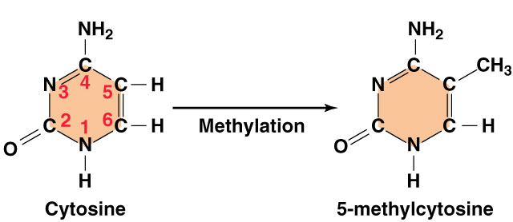
DNA methylation
Methylation of DNA blocks transcription factors
no transcription
→ genes turned off
attachment of methyl groups (–CH₃) to cytosine
nearly permanent inactivation of genes
ex. inactivated mammalian X chromosome = Barr body

Slide 10
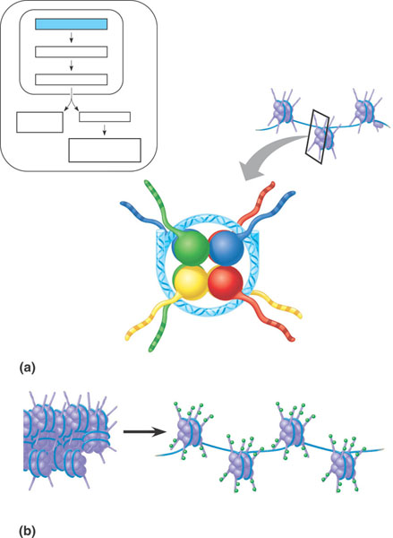
Histone acetylation
Acetylation of histones unwinds DNA
Loose histone wrapping
enables transcription
genes turned on
attachment of acetyl groups (–COCH₃) to histones
conformational change in histone proteins
transcription factors have easier access to genes
Chromatin changes
Transcription
RNA processing
mRNA
degradation
Translation
Protein processing
and degradation
Histone
tails
DNA
double helix
Amino acids
available
for chemical
modification
(a) Histone tails protrude outward from a nucleosome
Unacetylated histones
Acetylated histones
(b) Acetylation of histone tails promotes loose chromatin
structure that permits transcription

Slide 11
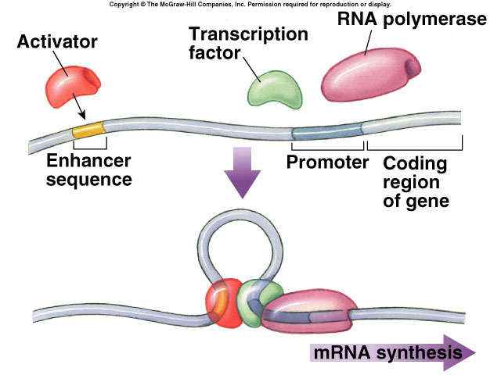
2. Transcription initiation
Control regions on DNA
promoter
nearby control sequence on DNA
binding of RNA polymerase & transcription factors
“base” rate of transcription
enhancer
distant control sequences on DNA
binding of activator proteins
“enhanced” rate (high level) of transcription

Slide 12
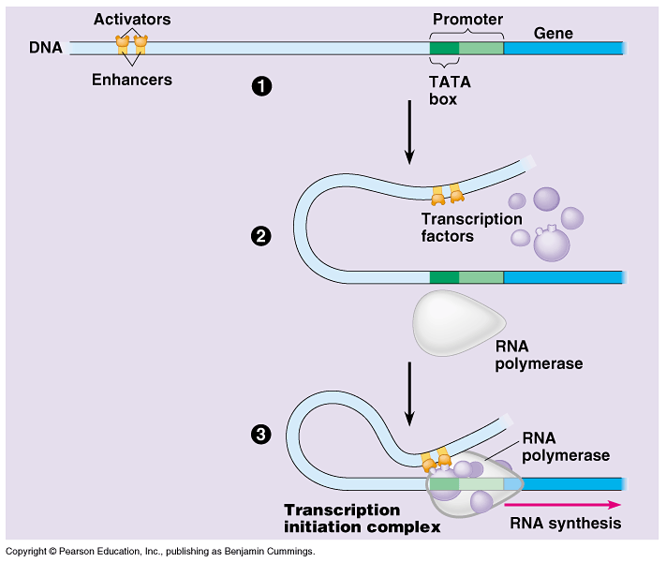
Model for Enhancer action
Enhancer DNA sequences
distant control sequences
Activator proteins
bind to enhancer sequence & stimulates transcription
Silencer proteins
bind to enhancer sequence & block gene transcription
Notes:
Much of molecular biology research is trying to understand this: the regulation of transcription.
Silencer proteins are, in essence, blocking the positive effect of activator proteins, preventing high level of transcription.

Slide 13
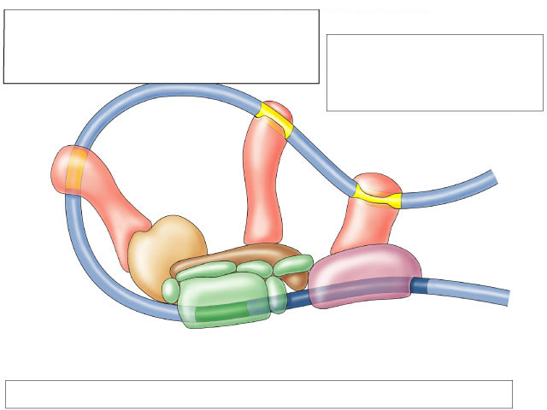
Transcription complex
Activator Proteins
• regulatory proteins bind to DNA at distant enhancer sites
• increase the rate of transcription
Enhancer Sites
regulatory sites on DNA distant from gene
Enhancer
Activator
Activator
Activator
Coactivator
B
F
E
RNA polymerase II
A
TFIID
H
Coding region
T A T A
Core promoter
and initiation complex
Initiation Complex at Promoter Site binding site of RNA polymerase

Slide 14
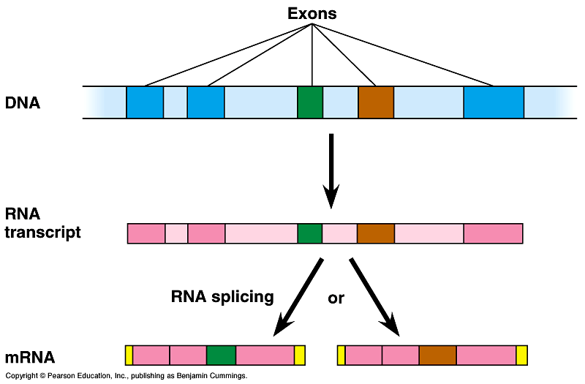
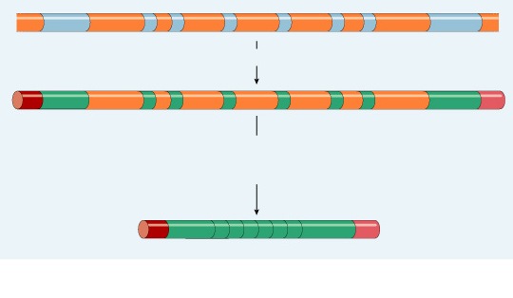
3. Post-transcriptional control
Alternative RNA splicing
variable processing of exons creates a family of proteins

Slide 15
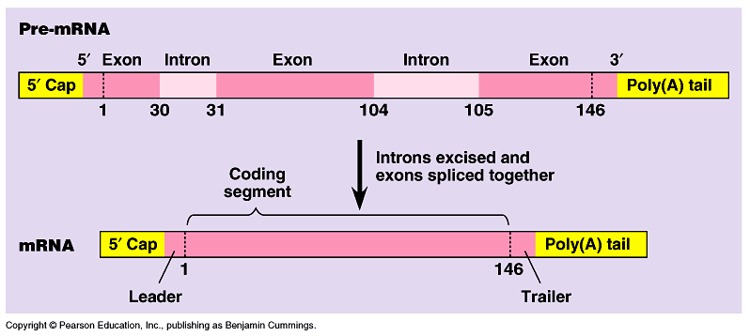
4. Regulation of mRNA degradation
Life span of mRNA determines amount of protein synthesis
mRNA can last from hours to weeks

Slide 16
RNA interference
NEW!
Small interfering RNAs (siRNA)
short segments of RNA (21-28 bases)
bind to mRNA
create sections of double-stranded mRNA
“death” tag for mRNA
triggers degradation of mRNA
cause gene “silencing”
post-transcriptional control
turns off gene = no protein produced
siRNA

Slide 17
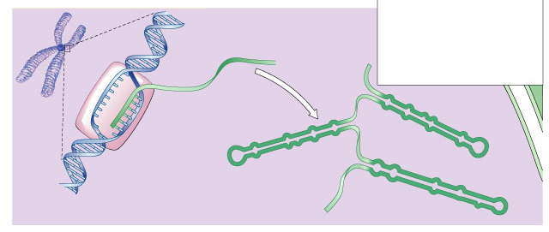
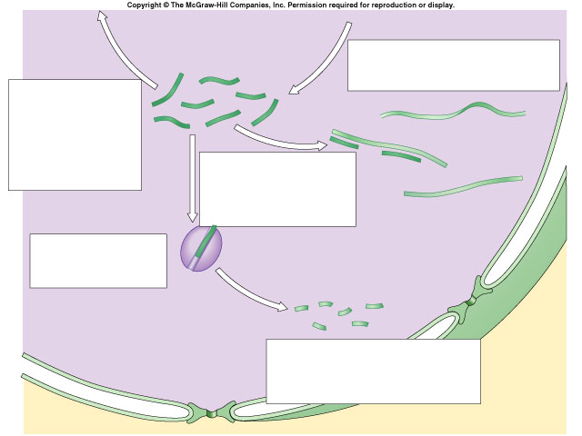
Action of siRNA
Hot…Hot new topic in biology
dicer enzyme
mRNA for translation
siRNA
double-stranded miRNA + siRNA
breakdown enzyme
(RISC)
mRNA degraded
functionally turns gene off

Slide 18
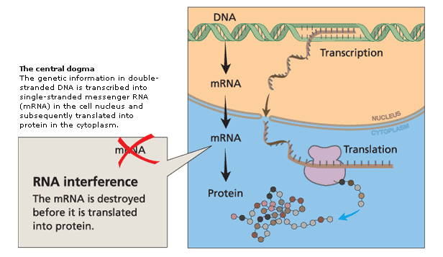
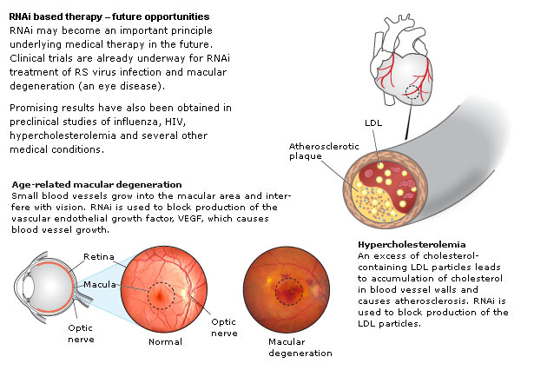
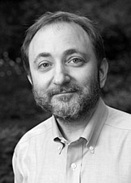
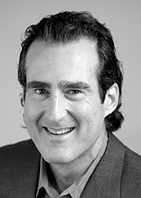
RNA interference
1990s | 2006
“for their discovery of RNA interference — gene silencing by double-stranded RNA”
Andrew Fire
Stanford
Craig Mello
U Mass

Slide 19
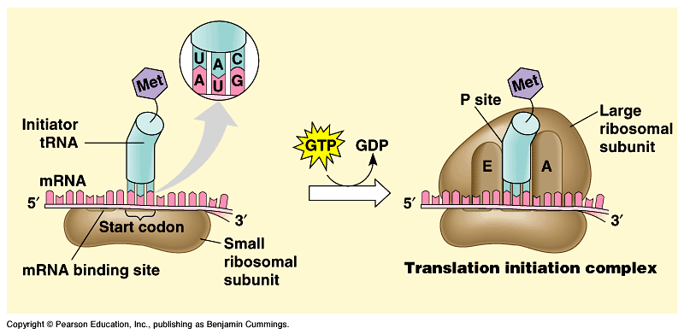
5. Control of translation
Block initiation of translation stage
regulatory proteins attach to 5' end of mRNA
prevent attachment of ribosomal subunits & initiator tRNA
block translation of mRNA to protein

Slide 20
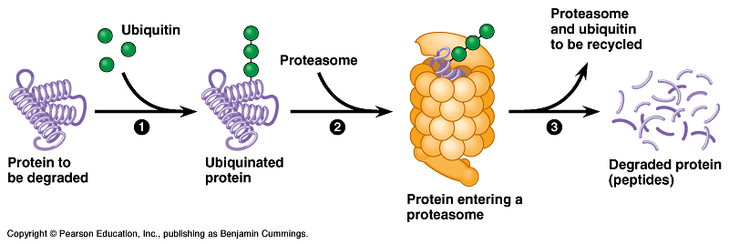
6-7. Protein processing & degradation
Protein processing
folding, cleaving, adding sugar groups, targeting for transport
Protein degradation
ubiquitin tagging
proteasome degradation
Notes:
The cell limits the lifetimes of normal proteins by selective degradation. Many proteins, such as the cyclins involved in regulating the cell cycle, must be relatively short-lived.

Slide 21
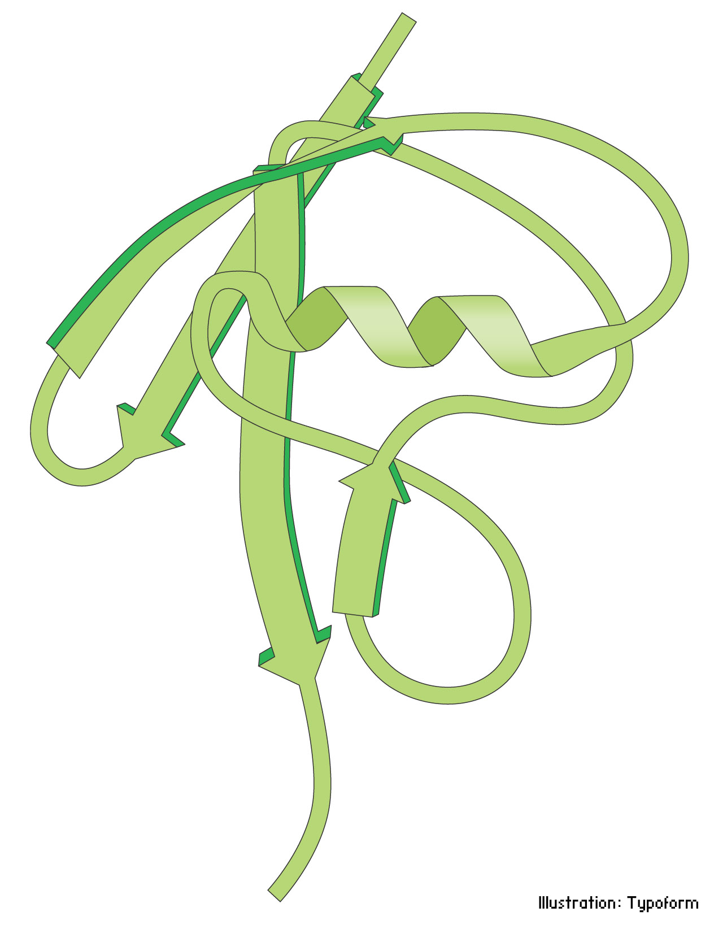
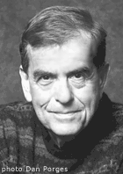
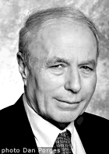
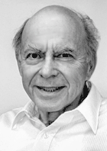
Ubiquitin
1980s | 2004
“Death tag”
mark unwanted proteins with a label
76 amino acid polypeptide, ubiquitin
labeled proteins are broken down rapidly in "waste disposers"
proteasomes
Aaron Ciechanover
Israel
Avram Hershko
Israel
Irwin Rose
UC Riverside
Notes:
Since the molecule was subsequently found in numerous different tissues and organisms – but not in bacteria – it was given the name ubiquitin (from Latin ubique, "everywhere")

Slide 22
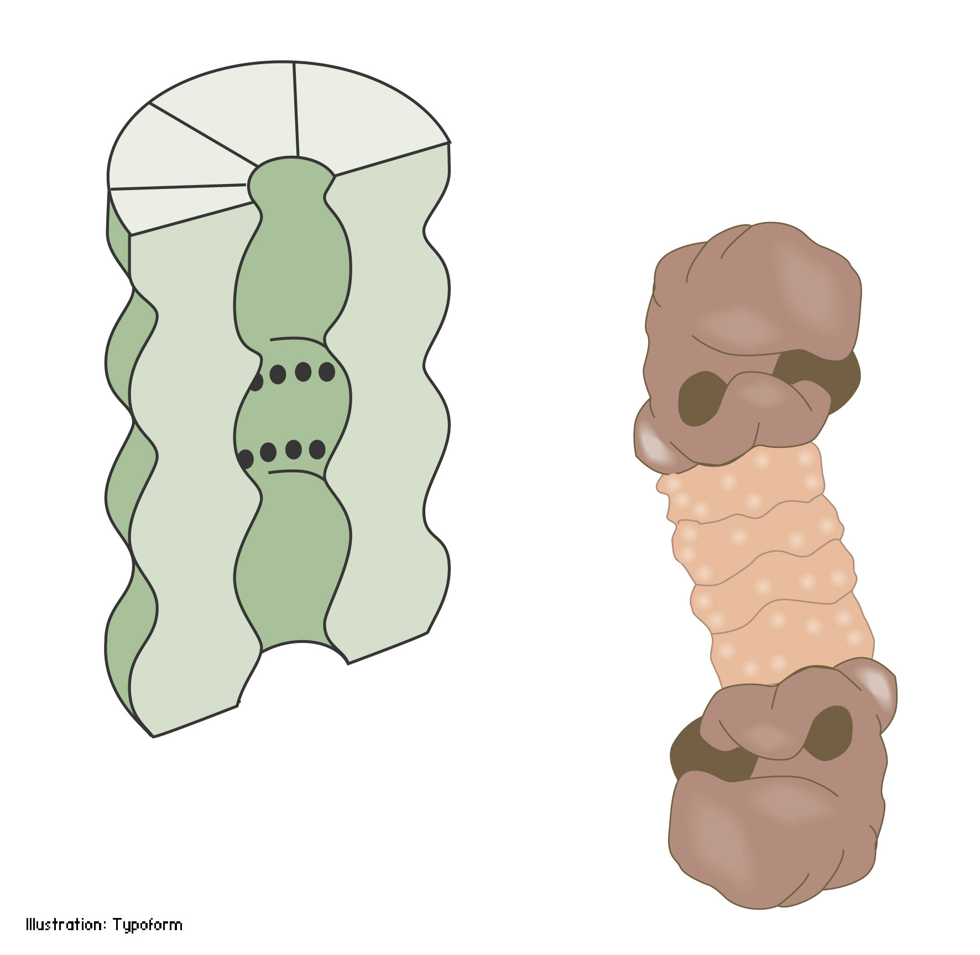
Proteasome
Protein-degrading “machine”
cell’s waste disposer
breaks down any proteins into 7-9 amino acid fragments
cellular recycling
Notes:
A human cell contains about 30,000 proteasomes: these barrel-formed structures can break down practically all proteins to 7-9-amino-acid-long peptides. The active surface of the proteasome is within the barrel where it is shielded from the rest of the cell. The only way in to the active surface is via the "lock", which recognises polyubiquitinated proteins, denatures them with ATP energy and admits them to the barrel for disassembly once the ubiquitin label has been removed. The peptides formed are released from the other end of the proteasome. Thus the proteasome itself cannot choose proteins; it is chiefly the E3 enzyme that does this by ubiquitin-labelling the right protein for breakdown

Slide 23
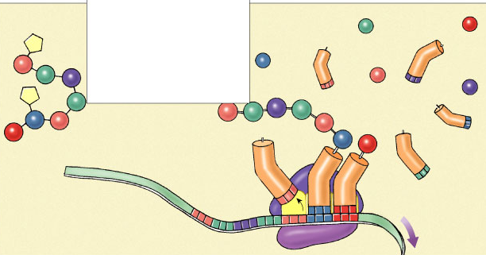
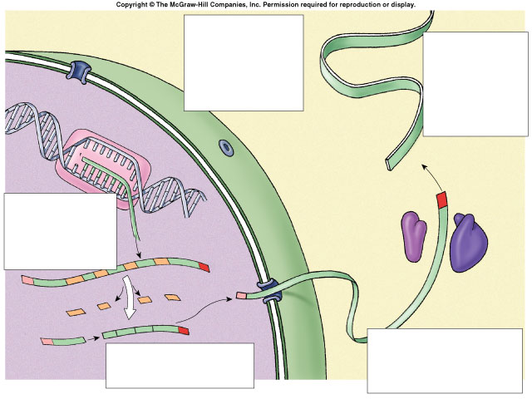
6
7
Gene Regulation
protein processing & degradation
1 & 2. transcription
- DNA packing
- transcription factors
3 & 4. post-transcription
- mRNA processing
- splicing
- 5’ cap & poly-A tail
- breakdown by siRNA
5. translation
- block start of translation
6 & 7. post-translation
- protein processing
- protein degradation
5
initiation of translation
4
mRNA processing
1
2
initiation of transcription
4
mRNA protection
3
mRNA splicing

Slide 24
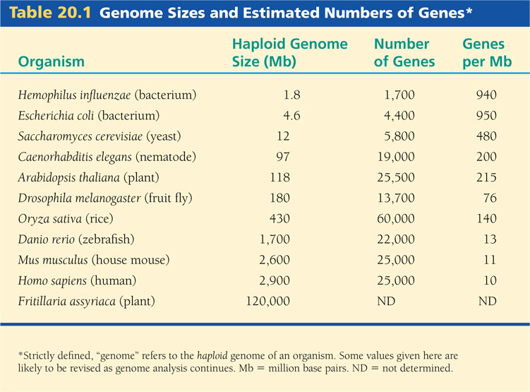
Genome Sizes and Estimated Numbers of Genes*

Slide 25
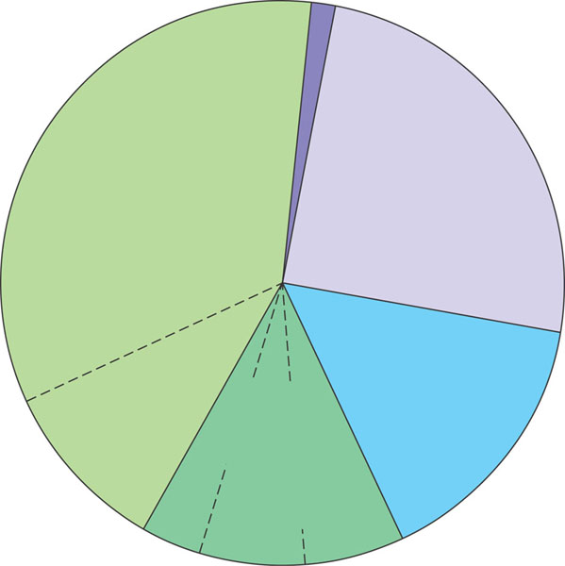
Types of DNA sequences in the human genome
Exons (regions of genes coding
for protein, rRNA, tRNA) (1.5%)
Repetitive
DNA that
includes
transposable
elements
and related
sequences
(44%)
Introns and
regulatory
sequences
(24%)
Unique
noncoding
DNA (15%)
Repetitive
DNA
unrelated to
transposable
elements
(about 15%)
Alu elements
(10%)
Simple sequence
DNA (3%)
Large-segment
duplications (5–6%)

