Slide 1
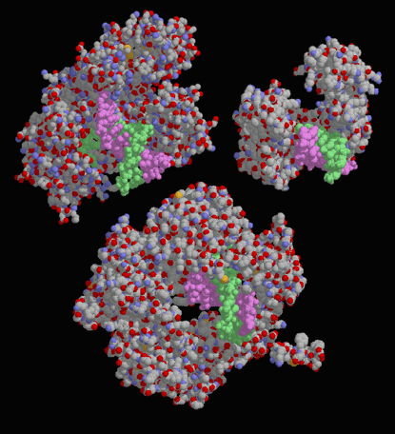
DNA Replication
Ch. 10

Slide 2
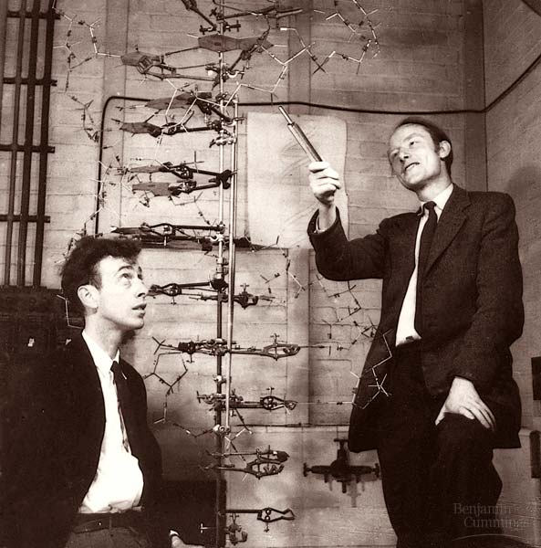
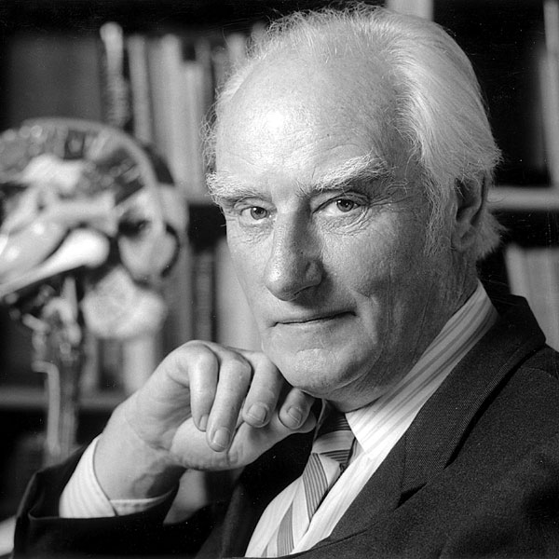

Watson and Crick
1953 article in Nature

Slide 3
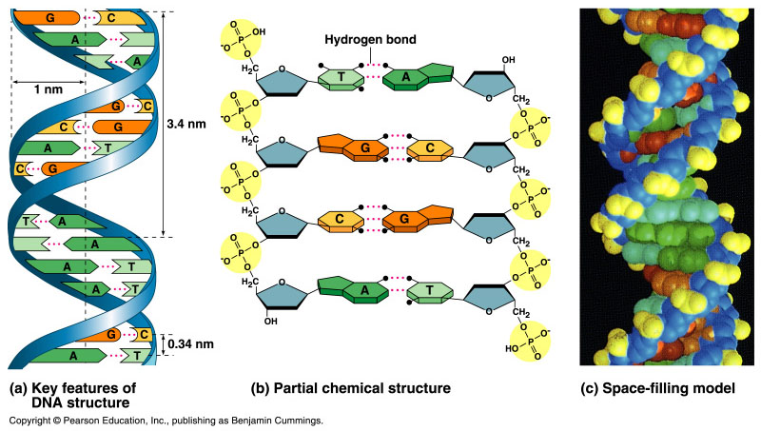
Double helix structure of DNA
“It has not escaped our notice that the specific pairing we have postulated immediately suggests a possible copying mechanism for the genetic material.” Watson & Crick

Slide 4
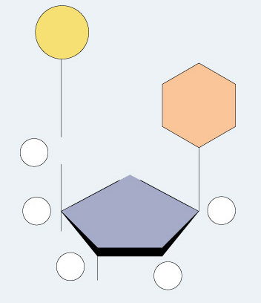
Directionality of DNA
You need to number the carbons!
  it matters!
nucleotide
PO₄
N base
5′
CH₂
This will be
IMPORTANT!!
O
4′
1′
ribose
3′
2′
OH

Slide 5
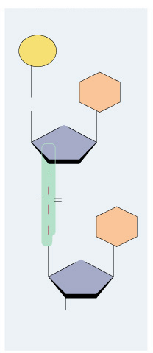
The DNA backbone
5′
PO₄
Putting the DNA backbone together
  refer to the 3′ and 5′ ends of the DNA
    the last trailing carbon
base
5′
CH₂
O
4′
C
1′
3′
2′
O
–O
P
O
Sounds trivial, but…
this will be
IMPORTANT!!
O
base
5′
CH₂
O
4′
1′
3′
2′
OH
3′

Slide 6
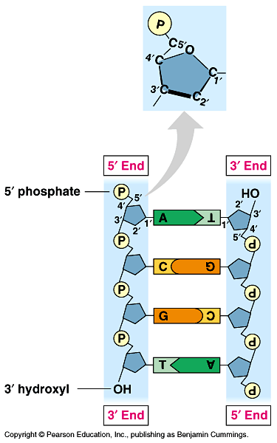
Anti-parallel strands
Nucleotides in DNA backbone are bonded from phosphate to sugar between 3′ & 5′ carbons
  DNA molecule has “direction”
  complementary strand runs in opposite direction
5′
3′
3′
5′

Slide 7
Bonding in DNA
hydrogen
bonds
5′
3′
covalent
phosphodiester
bonds
3′
5′
….strong or weak bonds?
How do the bonds fit the mechanism for copying DNA?

Slide 8
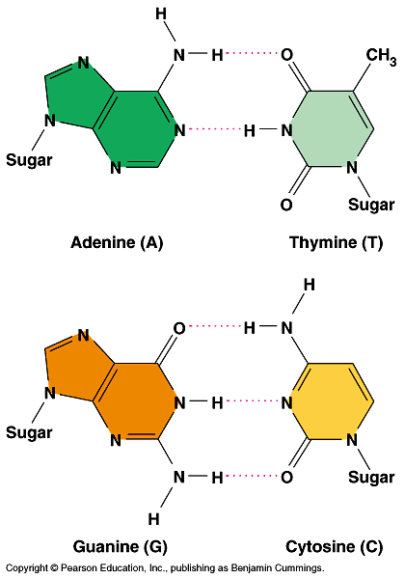
Base pairing in DNA
Purines
  adenine (A)
  guanine (G)
Pyrimidines
  thymine (T)
  cytosine (C)
Pairing
  A : T
    2 bonds
  C : G
    3 bonds

Slide 9
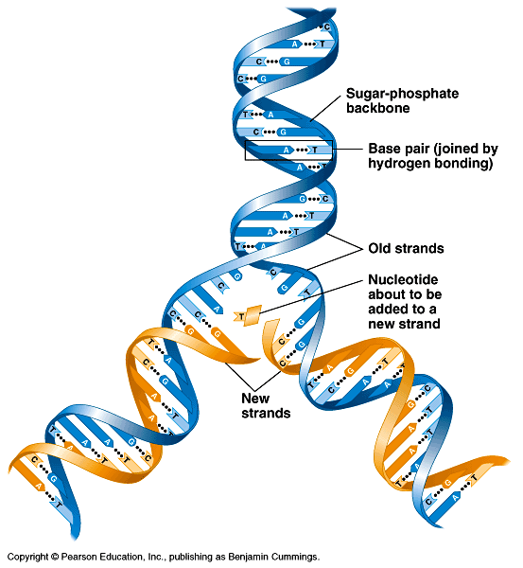
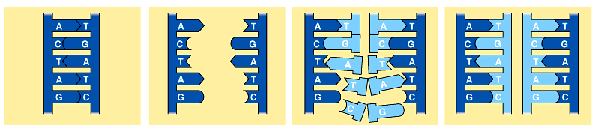
Copying DNA
Replication of DNA
  base pairing allows each strand to serve as a template for a new strand
  new strand is 1/2 parent template &
  1/2 new DNA
    semi-conservative
    copy process

Slide 10
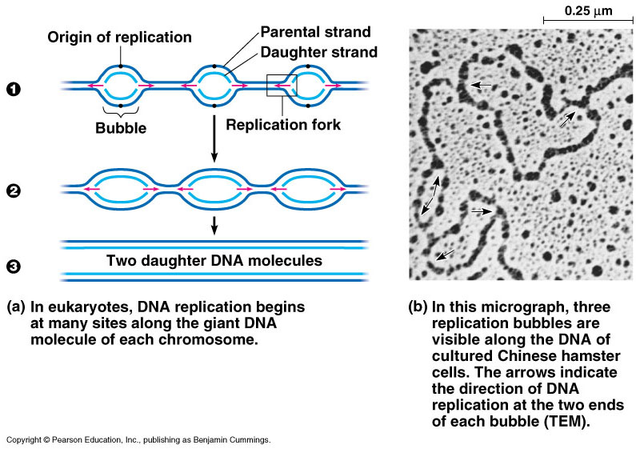
DNA Replication
Let’s meet
the team…
Large team of enzymes coordinates replication
Notes:
Enzymes
more than a dozen enzymes & other proteins participate in DNA replication

Slide 11
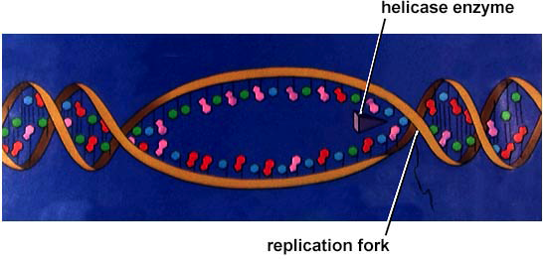
Replication: 1st step
I’d love to be
helicase & unzip
your genes…
Unwind DNA
  helicase enzyme
    unwinds part of DNA helix
    stabilized by single-stranded binding proteins
helicase
single-stranded binding proteins
replication fork

Slide 12
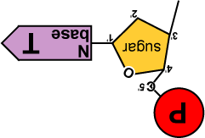
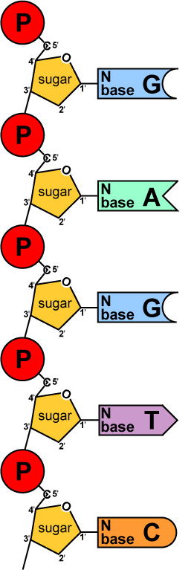
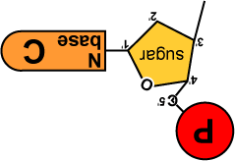
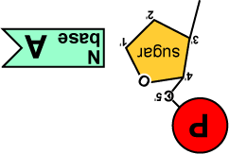
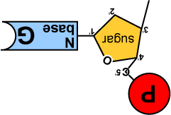
Replication: 2nd step
Build daughter DNA strand
  add new complementary bases
  DNA polymerase III
But…
We’re missing
something!
What?
Where’s the
ENERGY
for the bonding!
DNA
Polymerase III

Slide 13


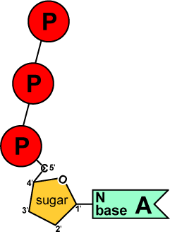
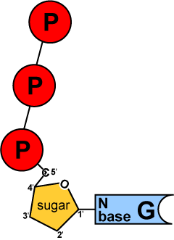
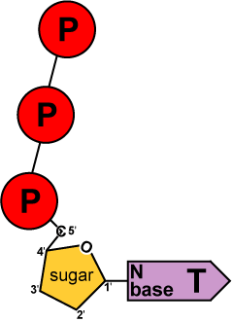
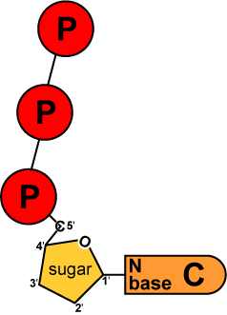
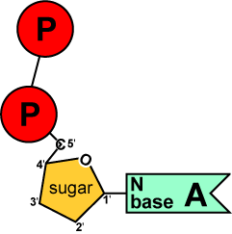
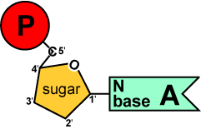
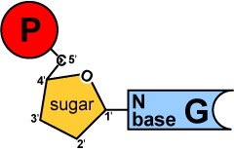
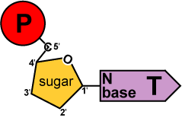
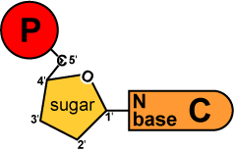
Energy of Replication
Where does energy for bonding usually come from?
We come
with our own
energy!
energy
You
remember
ATP!
Are there
other ways
to get energy
out of it?
energy
Are there
other energy
nucleotides?
You bet!
And we
leave behind a
nucleotide!
ATP
GTP
TTP
CTP
ADP
AMP
GMP
TMP
CMP
modified nucleotide

Slide 14
Energy of Replication
The nucleotides arrive as nucleosides
  DNA bases with P–P–P
    P-P-P = energy for bonding
  DNA bases arrive with their own energy source for bonding
  bonded by enzyme: DNA polymerase III
ATP
GTP
TTP
CTP

Slide 15
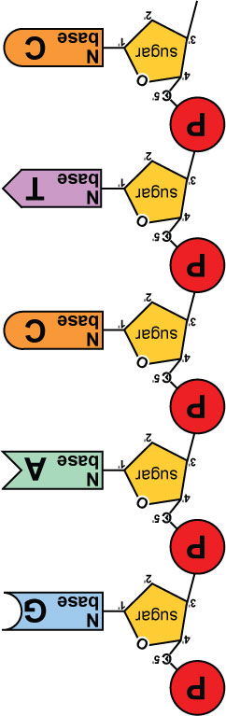
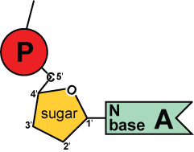
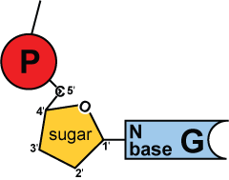
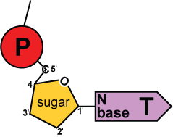
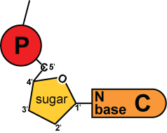
Replication
3′
5′
energy
DNA
Polymerase III
Adding bases
  can only add nucleotides to
  3′ end of a growing DNA strand
    need a “starter” nucleotide to
    bond to
  strand only grows
  5′→3′
DNA
Polymerase III
energy
DNA
Polymerase III
energy
DNA
Polymerase III
energy
B.Y.O. ENERGY!
The energy rules
the process
3′
5′
Notes:
The energy rules the process.

Slide 16

Leading & Lagging strands
Okazaki
Limits of DNA polymerase III
  can only build onto 3′ end of an existing DNA strand
5′
✗
Okazaki fragments
5′
3′
3′
5′
3′
5′
5′
Lagging strand
3′
ligase
growing
replication fork
3′
5′
✓
Leading strand
3′
5′
Lagging strand
  Okazaki fragments
  joined by ligase
    “spot welder” enzyme
3′
DNA polymerase III
Leading strand
  continuous synthesis

Slide 17
Replication fork / Replication bubble
3′
5′
5′
3′
DNA polymerase III
leading strand
3′
5′
3′
5′
5′
5′
5′
3′
3′
lagging strand
3′
5′
5′
3′
5′
lagging strand
leading strand
growing
replication fork
3′
5′
5′
growing
replication fork
leading strand
5′
3′
3′
lagging strand
5′
5′
5′

Slide 18
Starting DNA synthesis: RNA primers
Limits of DNA polymerase III
  can only build onto 3′ end of an existing DNA strand
5′
3′
5′
3′
3′
5′
3′
5′
growing
replication fork
3′
primase
5′
DNA polymerase III
RNA
5′
RNA primer
  built by primase
  serves as starter sequence for DNA polymerase III
3′

Slide 19
Replacing RNA primers with DNA
DNA polymerase I
  removes sections of RNA primer and replaces with DNA nucleotides
DNA polymerase I
5′
3′
3′
ligase
5′
growing
replication fork
3′
5′
RNA
5′
3′
But DNA polymerase I still can only build onto 3′ end of an existing DNA strand

Slide 20
Chromosome erosion
Houston, we
have a problem!
All DNA polymerases can only add to 3′ end of an existing DNA strand
DNA polymerase I
5′
3′
3′
5′
growing
replication fork
3′
5′
DNA polymerase III
RNA
5′
Loss of bases at 5′ ends
in every replication
  chromosomes get shorter with each replication
  limit to number of cell divisions?
3′

Slide 21
Telomeres
Repeating, non-coding sequences at the end of chromosomes = protective cap
  limit to ~50 cell divisions
5′
3′
3′
5′
growing
replication fork
3′
telomerase
5′
Telomerase
  enzyme extends telomeres
  can add DNA bases at 5′ end
  different level of activity in different cells
    high in stem cells & cancers -- Why?
5′
TTAAGGG
TTAAGGG
TTAAGGG
3′

Slide 22
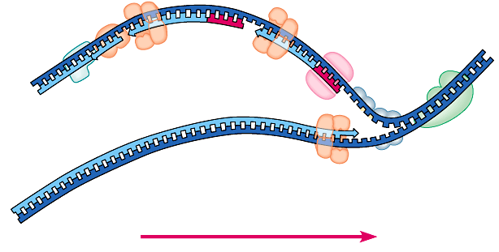
Replication fork
DNA
polymerase III
lagging strand
DNA
polymerase I
3’
Okazaki
fragments
primase
5’
5’
ligase
3’
5’
SSB
3’
helicase
DNA
polymerase III
5’
leading strand
3’
direction of replication
SSB = single-stranded binding proteins

Slide 23
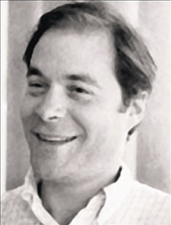
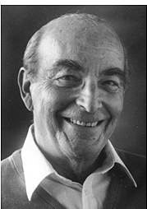
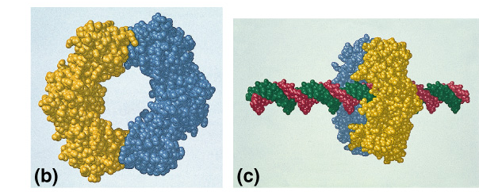
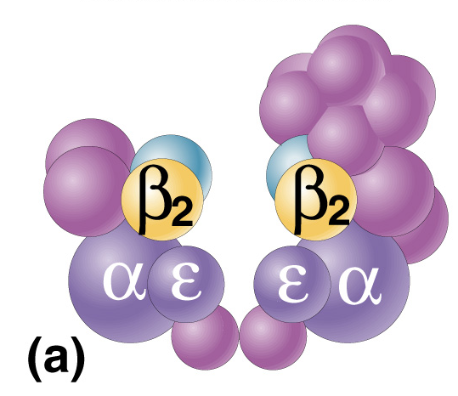
DNA polymerases
DNA polymerase III
  1000 bases/second!
  main DNA builder
DNA polymerase I
  20 bases/second
  editing, repair & primer removal
Thomas Kornberg
??
DNA polymerase III
enzyme
Arthur Kornberg
1959
Notes:
In 1953, Kornberg was appointed head of the Department of Microbiology in the Washington University School of Medicine in St. Louis. It was here that he isolated DNA polymerase I and showed that life (DNA) can be made in a test tube. In 1959, Kornberg shared the Nobel Prize for Physiology or Medicine with Severo Ochoa — Kornberg for the enzymatic synthesis of DNA, Ochoa for the enzymatic synthesis of RNA.

Slide 24
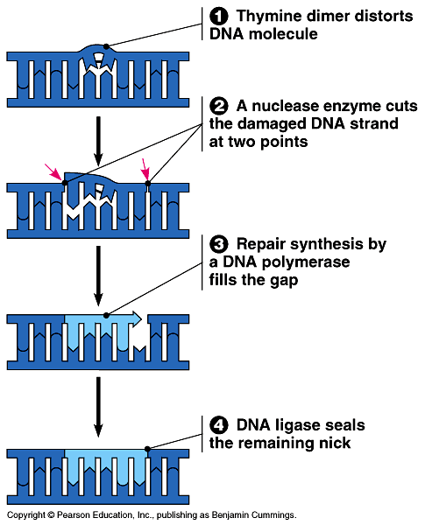
Editing & proofreading DNA
1000 bases/second =
lots of typos!
DNA polymerase I
  proofreads & corrects typos
  repairs mismatched bases
  removes abnormal bases
    repairs damage
    throughout life
  reduces error rate from
  1 in 10,000 to
  1 in 100 million bases

Slide 25
Fast & accurate!
It takes E. coli <1 hour to copy
5 million base pairs in its single chromosome
  divide to form 2 identical daughter cells
Human cell copies 6 billion bases & divide into daughter cells in only few hours
  remarkably accurate
  only ~1 error per 100 million bases
  ~30 errors per cell cycle

Slide 26
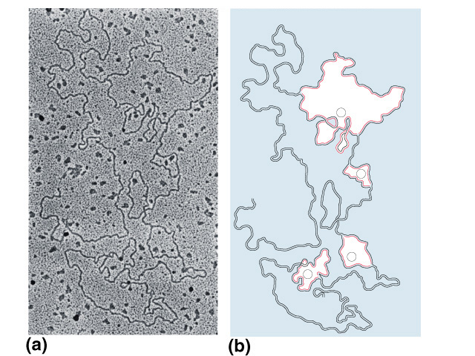
What does it really look like?
1
2
3
4

Slide 27
Base your answers to the following questions on the choices below:
A. Helicase
B. Polymerase
C. Ligase
D. Primase
Brings together the Okazaki fragments.
Adds nucleotides to the leading strand.
Recognizes the origin of replication in the DNA.
Notes:
1.C
2.B
3.A

Slide 28
In DNA synthesis, DNA is
  Read 3’ to 5’ and made 5’ to 3’
  Read 3’ to 5’ and made 3’ to 5’
  Read 5’ to 3’ and made 3’ to 5’
  Read 5’ to 3’ and made 5’ to 3;
Notes:
A

