Slide 1
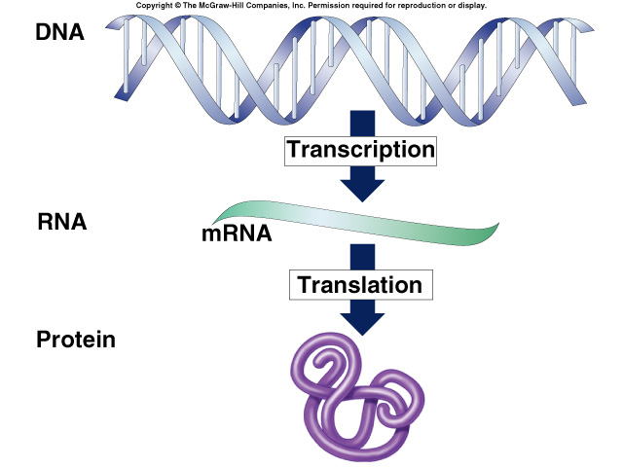
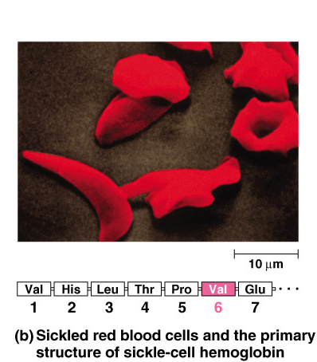
Mutations

Slide 2
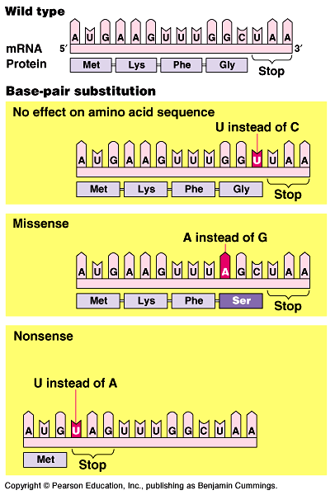
Mutations
Point mutations
  single base change
    silent mutation
      no amino acid change
      redundancy in code
    missense
      change amino acid
    nonsense
      change to stop codon
When do mutations
affect the next
generation?

Slide 3
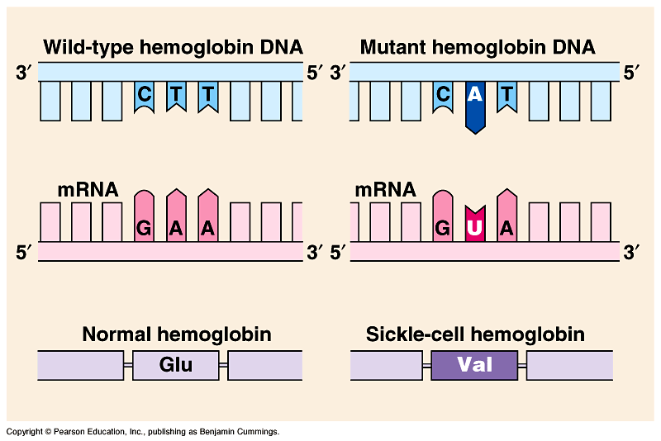
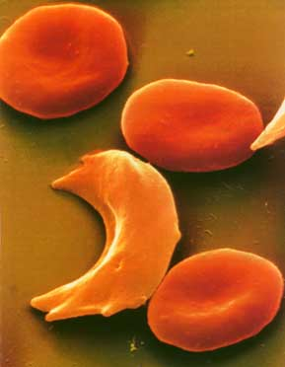
Point mutation lead to Sickle cell anemia
What kind of mutation?
Missense!

Slide 4
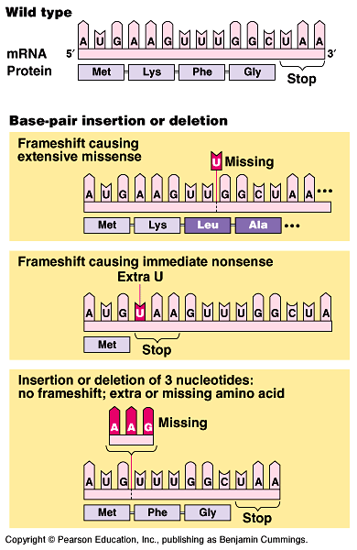
Mutations
Frameshift
  shift in the reading frame
    changes everything “downstream”
  insertions
    adding base(s)
  deletions
    losing base(s)
Where would this mutation
cause the most change:
beginning or end of gene?

Slide 5
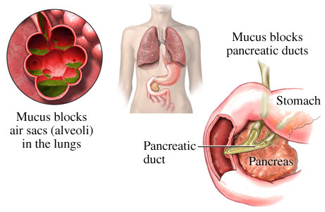
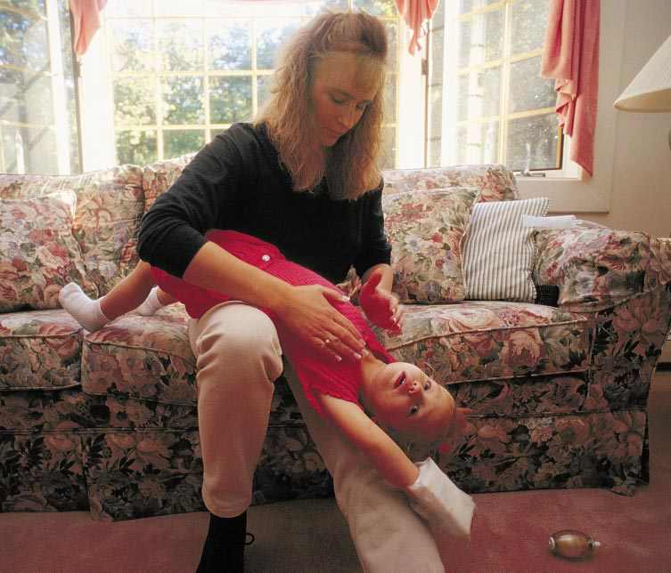
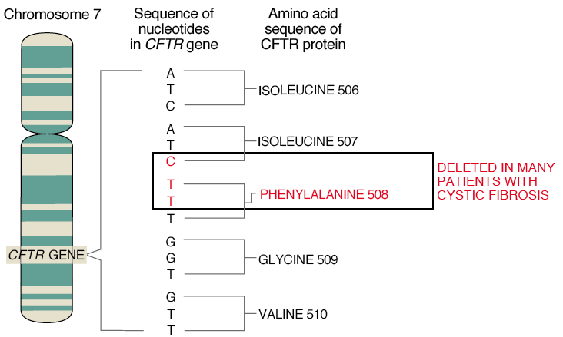
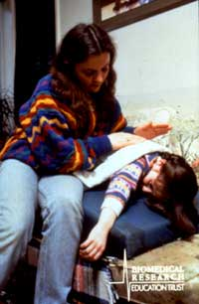

Slide 6
2. A portion of the genetic code is UUU = phenylalanine, GCC = alanine, AAA = lysine, and CCC = proline. Assume the correct code places the amino acids phenylalanine, alanine, and lysine in a protein (in that order). Which of the following DNA sequences would substitute proline for alanine?
  AAA-CGG-TTA
  AAT-CGG-TTT
  AAA-CCG-TTT
  AAA-GGG-TTT
  AAA-CCC-TTT
Notes:
Answer: d
Source: Barstow - Test Bank for Biology, Seventh Edition, Question #20

Slide 7
3. What is the relationship among DNA, a gene, and a chromosome?
  A chromosome contains hundreds of genes, which are composed of protein.
  A chromosome contains hundreds of genes, which are composed of DNA.
  A gene contains hundreds of chromosomes, which are composed of protein.
  A gene is composed of DNA, but there is no relationship to a chromosome.
  A gene contains hundreds of chromosomes, which are composed of DNA.
Notes:
Answer: b
Source: Barstow - Test Bank for Biology, Seventh Edition, Question #75

Slide 8
4. A particular triplet of bases in the coding sequence of DNA is AAA. The anticodon on the tRNA that binds the mRNA codon is
  TTT.
  UUA.
  UUU.
  AAA.
  either UAA or TAA, depending on wobble in the first base.
Notes:
Answer: d
Source: Barstow - Test Bank for Biology, Seventh Edition, Question #39

Slide 9
5. A part of an mRNA molecule with the following sequence is being read by a ribosome: 5' CCG-ACG 3' (mRNA). The following activated transfer RNA molecules are available. Two of them can correctly match the mRNA so that a dipeptide can form.
tRNA Anticodon | Amino Acid
GGC | Proline
CGU | Alanine
UGC | Threonine
CCG | Glycine
ACG | Cysteine
CGG | Alanine
The dipeptide that will form will be
  cysteine-alanine.
  proline-threonine.
  glycine-cysteine.
  alanine-alanine.
  threonine-glycine.
Notes:
Answer: b
Source: Barstow - Test Bank for Biology, Seventh Edition, Question #42

Slide 10
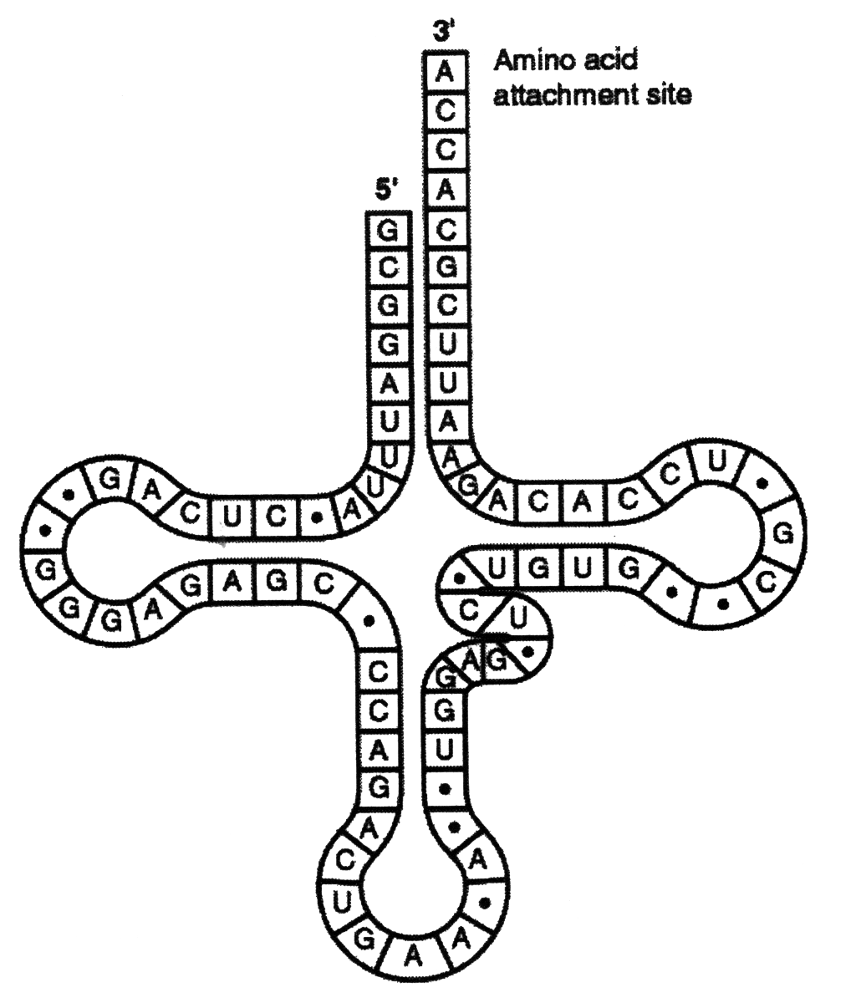
6. This figure represents tRNA that recognizes and binds a particular amino acid (in this instance, phenylalanine). Which of the following triplets of bases on the mRNA strand codes for this amino acid?
  UGG
  GUG
  GUA
  UUC
  CAU
Notes:
Answer: d
Source: Barstow - Test Bank for Biology, Seventh Edition, Question #44

Slide 11
7. How is the template strand for a particular gene determined?
  It is the DNA strand that runs from the 5' → 3' direction.
  It is the DNA strand that runs from the 3' → 5' direction.
  It depends on the orientation of RNA polymerase, whose position is determined by particular sequences of nucleotides within the promoter.
  It doesn’t matter which strand is the template because they are complementary and will produce the same mRNA.
  The template strand always contains the TATA box.
Notes:
Answer: c
Source: Taylor - Student Study Guide for Biology, Seventh Edition, Test Your Knowledge Question #5

Slide 12
8. A biologist inserts a gene from a human liver cell into
the chromosome of a bacterium. The bacterium then transcribes this gene into mRNA and translates the mRNA into protein. The protein produced is useless.
The biologist extracts the protein and mature mRNA that codes for it. When analyzed you would expect which of the following results? *
  the protein and the mature mRNA are longer than in human cells
  the protein and mature mRNA are shorter than expected
  the protein is longer and the mRNA is shorter than expected
  the protein is shorter and the mRNA is longer than expected
Notes:
Answer: a
Source: Campbell/Reece - Biology, Seventh Edition, EOC Process of Science Question
Discussion Notes for the Instructor
There are several questions which can be asked to guide the discussion of this question, including:
What are the differences between the way the genetic information in prokaryotes and eukaryotes is packaged?
How do transcription and translation differ in prokaryotes and eukaryotes?
Using these questions as an outline, discussion of the choices might look like this:
Choice A, correct
Choice B, eukaryotes contain introns that are normally removed after transcription. In bacteria these introns would not be removed and then subsequently would be translated
Choice C, the protein would not be expected to be longer if the mRNA is shorter
Choice D, while it is possible for the protein to be shorter, owing to a termination sequence being found in what was an intron, this is unlikely.

Slide 13
0
9. If the structure of a TV show is analogous to the structure of a gene, then the introns of a gene would be analogous to
  the opening theme music.
  the segments of the show.
  the commercials between segments of the show.
  the commercials between shows.
  the closing credits.
*
Notes:
Answer: c
Source: Barstow - Test Bank for Biology, Seventh Edition, Question #41

Slide 14
10. Each of the following is a modification of the sentence THECATATETHERAT.
A. THERATATETHECAT
B. THETACATETHERAT
C. THECATARETHERAT
D. THECATATTHERAT
E. CATATETHERAT
Which of the above is analogous to a frameshift mutation?
  A
  B
  C
  D
  E
Notes:
Answer: d
Source: Barstow - Test Bank for Biology, Seventh Edition, Question #68

Slide 15
11. Each of the following is a modification of the sentence THECATATETHERAT.
A. THERATATETHECAT
B. THETACATETHERAT
C. THECATARETHERAT
D. THECATATTHERAT
E. CATATETHERAT
Which of the above is analogous to a single substitution mutation?
  A
  B
  C
  D
  E
Notes:
Answer: c
Source: Barstow - Test Bank for Biology, Seventh Edition, Question #69

