Slide 1
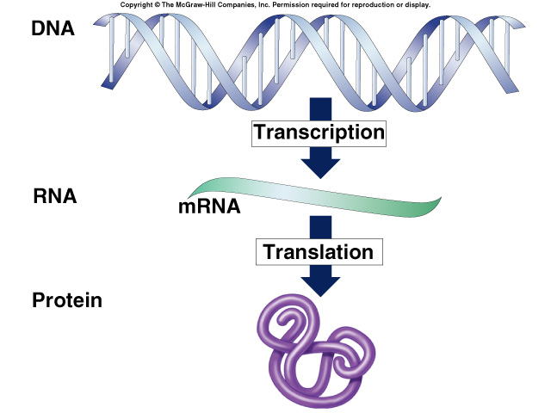
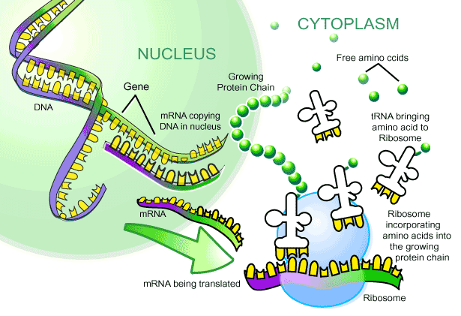
From Gene
to Protein
How Genes
Work

Slide 2

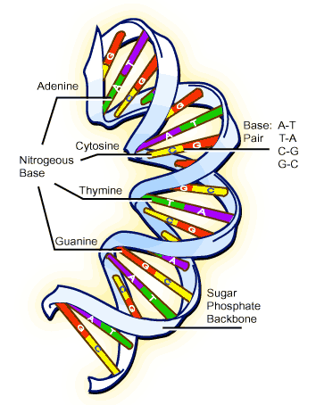
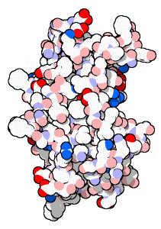
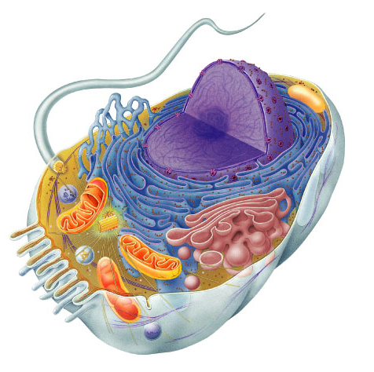
What do genes code for?
How does DNA code for cells & bodies?
  how are cells and bodies made from the instructions in DNA
DNA
proteins
cells
bodies

Slide 3
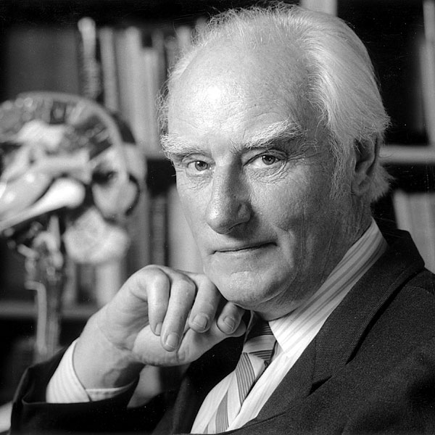
The “Central Dogma”
Flow of genetic information in a cell
  How do we move information from DNA to proteins?
transcription
translation
DNA
RNA
protein
trait
DNA gets
all the glory,
but proteins do
all the work!
replication
Notes:
To get from the chemical language of DNA to the chemical language of proteins requires 2 major stages:
transcription and translation

Slide 4
Metabolism taught us about genes
Inheritance of metabolic diseases
  suggested that genes coded for enzymes
  each disease (phenotype) is caused by non-functional gene product
    lack of an enzyme
    Tay sachs
    PKU (phenylketonuria)
    albinism
Am I just the
sum of my proteins?
metabolic pathway
disease
disease
disease
disease
A
✗
B
✗
C
✗
D
✗
E
enzyme 1
enzyme 2
enzyme 3
enzyme 4

Slide 5
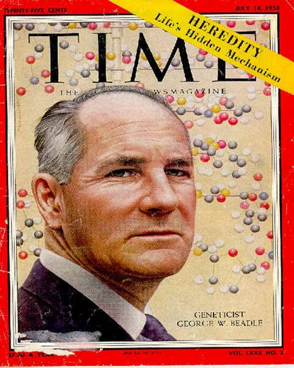
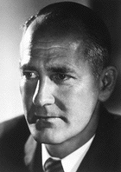
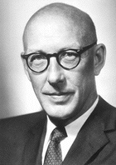
Beadle & Tatum
1941 | 1958
one gene : one enzyme hypothesis
George Beadle
Edward Tatum
"for their discovery that genes act by regulating definite chemical events"

Slide 6
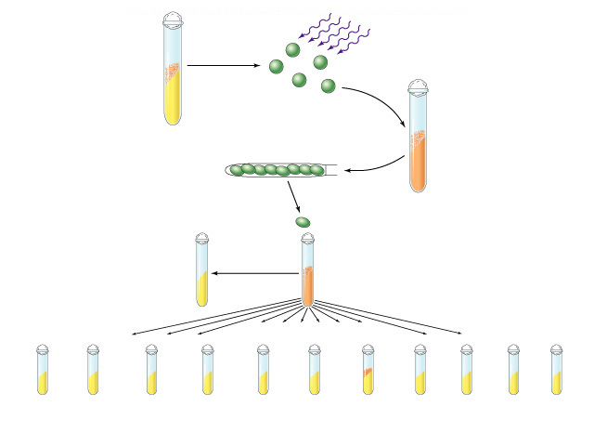
Beadle & Tatum
Wild-type
Neurospora
X rays or ultraviolet light
create mutations
Minimal
medium
asexual
spores
Growth on
complete
medium
spores
positive control
Select one of
the spores
Test on minimal
medium to confirm
presence of mutation
Grow on
complete medium
negative control
Minimal media supplemented only with…
mutation identified
experimentals
Pyridoxine
Choline
Nucleic
acid
Arginine
Riboflavin
Minimal
control
amino acid
supplements
Inositol
Folic
acid
Niacin
p-Amino
benzoic acid
Thiamine

Slide 7
From gene to protein
a
a
nucleus
cytoplasm
a
a
a
aa
transcription
translation
aa
DNA
mRNA
protein
aa
aa
a
aa
ribosome
trait

Slide 8
Transcription
From DNA nucleic acid language
to RNA nucleic acid language

Slide 9
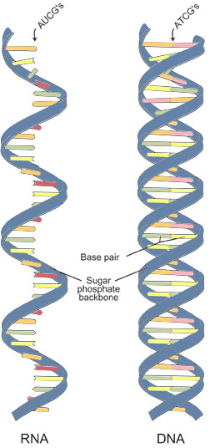
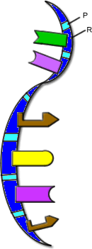
RNA
ribose sugar
N-bases
  uracil instead of thymine
  U : A
  C : G
single stranded
lots of RNAs
  mRNA, tRNA, rRNA, siRNA…
transcription
DNA
RNA

Slide 10
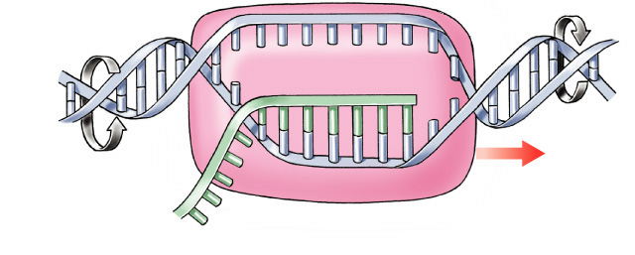
Transcription
Making mRNA
  transcribed DNA strand = template strand
  untranscribed DNA strand = coding strand
    same sequence as RNA
  synthesis of complementary RNA strand
  enzyme
    RNA polymerase
coding strand
3′
5′
A
G
A
G
C
A
T
C
G
T
A
A
A
G
T
T
C
T
C
A
T
C
C
A
G
T
DNA
G
A
T
3′
A
C
T
5′
T
G
G
C
A
U
C
G
U
T
3′
C
G
T
A
G
C
A
unwinding
rewinding
mRNA
RNA polymerase
template strand
build RNA 5′→3′
5′

Slide 11
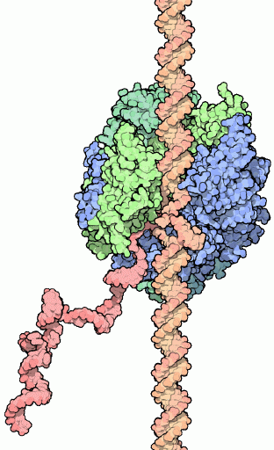
RNA polymerases
3 RNA polymerase enzymes
  RNA polymerase 1
    only transcribes rRNA genes
    makes ribosomes
  RNA polymerase 2
    transcribes genes into mRNA
  RNA polymerase 3
    only transcribes tRNA genes
  each has a specific promoter sequence it recognizes

Slide 12
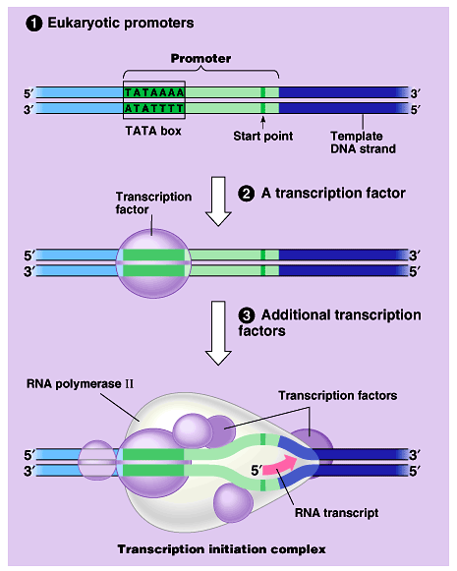
Which gene is read?
Promoter region
  binding site before beginning of gene
  TATA box binding site
  binding site for RNA polymerase
  & transcription
  factors
Enhancer region
  binding site far
  upstream of gene
    turns transcription
    on HIGH

Slide 13
Transcription Factors
Initiation complex
  transcription factors bind to promoter region
    suite of proteins which bind to DNA
    hormones?
    turn on or off transcription
  trigger the binding of RNA polymerase to DNA

Slide 14
Matching bases of DNA & RNA
A
Match RNA bases to DNA bases on one of the DNA strands
C
G
U
G
A
U
G
U
C
U
C
G
A
A
C
U
A
G
A
C
U
5'
A
3'
RNA
polymerase
G
A
C
C
T
G
G
T
A
C
A
G
C
T
A
G
T
C
A
T
C
G
T
A
C
C
G
T

Slide 15
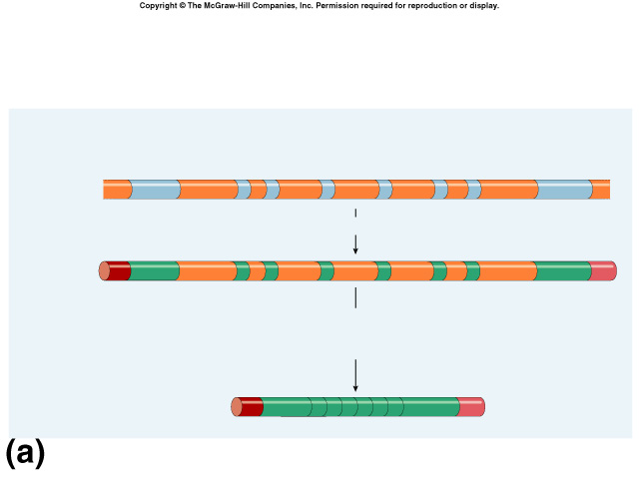
Eukaryotic genes have junk!
Eukaryotic genes are not continuous
  exons = the real gene
    expressed / coding DNA
  introns = the junk
    inbetween sequence
introns
come out!
intron = noncoding (inbetween) sequence
eukaryotic DNA
exon = coding (expressed) sequence

Slide 16
mRNA splicing
Post-transcriptional processing
  eukaryotic mRNA needs work after transcription
  primary transcript = pre-mRNA
  mRNA splicing
    edit out introns
  make mature mRNA transcript
intron = noncoding (inbetween) sequence
~10,000 bases
eukaryotic DNA
exon = coding (expressed) sequence
pre-mRNA
primary mRNA
transcript
~1,000 bases
mature mRNA
transcript
spliced mRNA
Notes:
eukaryotic RNA is about 10% of eukaryotic gene.

Slide 17
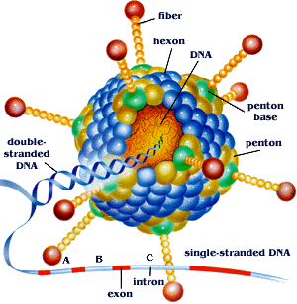
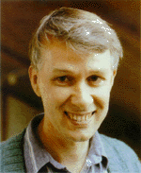
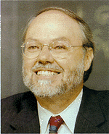
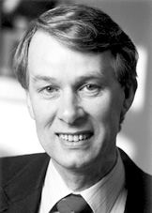
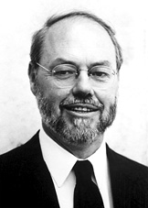
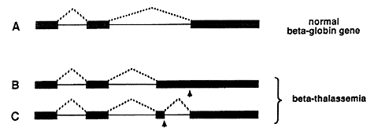

Discovery of exons/introns
1977 | 1993
Richard Roberts
Philip Sharp
CSHL
adenovirus
MIT
common cold
beta-thalassemia
Notes:
Beta thalassemia is an inherited blood disorder that reduces the production of hemoglobin. Symptoms of beta thalassemia occur when not enough oxygen gets to various parts of the body due to low levels of hemoglobin and a shortage of red blood cells (anemia).
Signs and symptoms of thalassemia major appear in the first 2 years of life. Infants have life-threatening anemia and become pale and listless. They also have a poor appetite, grow slowly, and may develop yellowing of the skin and whites of the eyes (jaundice). The spleen, liver, and heart may be enlarged, and bones may be deformed. Adolescents with thalassemia major may experience delayed puberty.
Thalassemia is a quantitative problem of too few globins synthesized, whereas sickle-cell anemia is a qualitative problem of synthesis of an incorrectly functioning globin.

Slide 18
Splicing must be accurate
No room for mistakes!
  a single base added or lost throws off the reading frame
AUGCGGCTATGGGUCCGAUAAGGGCCAU
AUGCGGUCCGAUAAGGGCCAU
AUG|CGG|UCC|GAU|AAG|GGC|CAU
Met|Arg|Ser|Asp|Lys|Gly|His
AUGCGGCTATGGGUCCGAUAAGGGCCAU
AUGCGGGUCCGAUAAGGGCCAU
AUG|CGG|GUC|CGA|UAA|GGG|CCA|U
Met|Arg|Val|Arg|STOP|

Slide 19
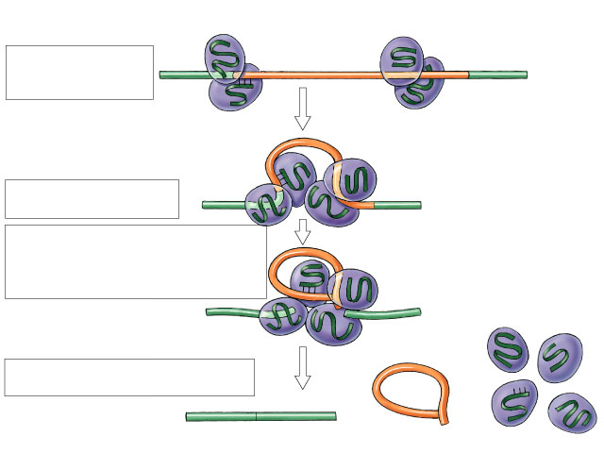
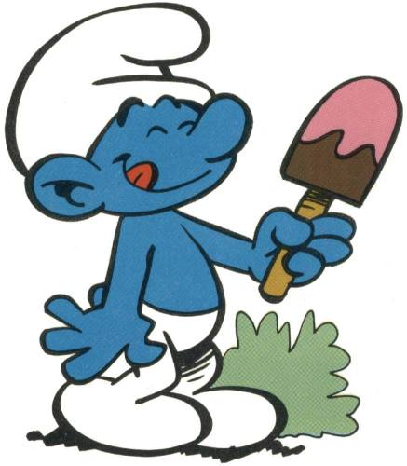
RNA splicing enzymes
snRNPs
  small nuclear RNA
  proteins
Spliceosome
  several snRNPs
  recognize splice site sequence
    cut & paste gene
snRNA
snRNPs
exon
intron
exon
5'
3'
spliceosome
5'
3'
No,
not smurfs!
“snurps”
lariat
5'
3'
exon
exon
mature mRNA
excised
intron
5'
3'

Slide 20
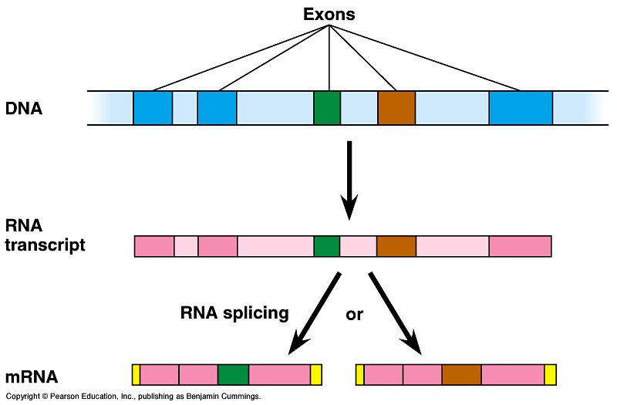
Alternative splicing
Alternative mRNAs produced from same gene
  when is an intron not an intron…
  different segments treated as exons
Starting to get
hard to
define a gene!

Slide 21
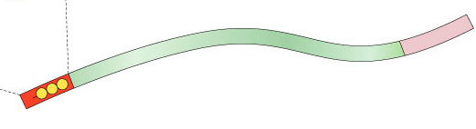
More post-transcriptional processing
Need to protect mRNA on its trip from nucleus to cytoplasm
  enzymes in cytoplasm attack mRNA
    protect the ends of the molecule
    add 5′ GTP cap
    add poly-A tail
      longer tail, mRNA lasts longer: produces more protein
3' poly-A tail
3'
A
A
A
A
A
mRNA
50-250 A’s
5' cap
P
P
P
5'
G
Notes:
eukaryotic RNA is about 10% of eukaryotic gene.

Slide 22
Translation
From nucleic acid language
to amino acid language

Slide 23
How does mRNA code for proteins?
DNA
TACGCACATTTACGTACGCGG
4
ATCG
mRNA
AUGCGUGUAAAUGCAUGCGCC
4
AUCG
?
protein
Met Arg Val Asn Ala Cys Ala
20
How can you code for 20 amino acids with only 4 nucleotide bases (A,U,G,C)?

Slide 24
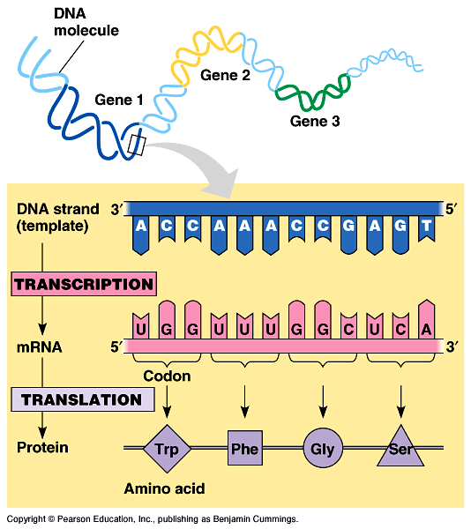
mRNA codes for proteins in triplets
DNA
TACGCACATTTACGTACGCGG
codon
AUGCGUGUAAAUGCAUGCGCC
mRNA
AUGCGUGUAAAUGCAUGCGCC
mRNA
?
protein
Met Arg Val Asn Ala Cys Ala

Slide 25
Cracking the code
1960 | 1968
Nirenberg & Khorana
Crick
  determined 3-letter (triplet) codon system
WHYDIDTHEREDBATEATTHEFATRAT
WHYDIDTHEREDBATEATTHEFATRAT
Nirenberg (47) & Khorana (17)
  determined mRNA–amino acid match
  added fabricated mRNA to test tube of ribosomes, tRNA & amino acids
    created artificial UUUUU… mRNA
    found that UUU coded for phenylalanine

Slide 26

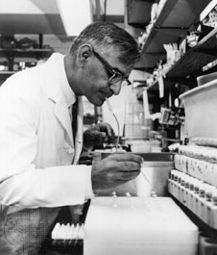
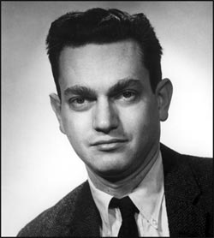
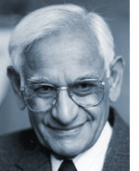
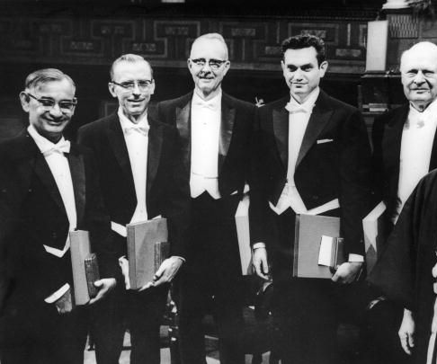
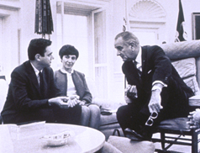
Marshall Nirenberg
1960 | 1968
Har Khorana

Slide 27
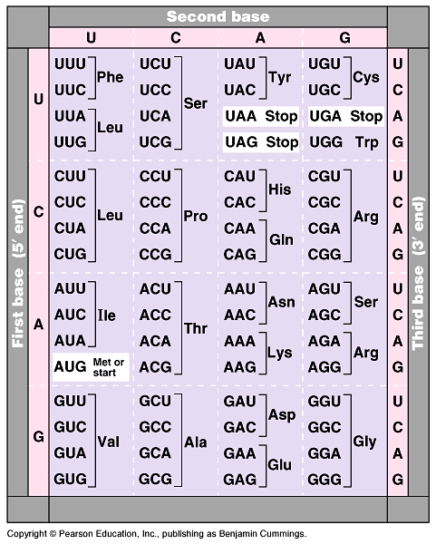
The code
Code for ALL life!
  strongest support for a common origin for all life
Code is redundant
  several codons for each amino acid
  3rd base “wobble”
Why is the
wobble good?
Start codon
  AUG
  methionine
Stop codons
  UGA, UAA, UAG
Notes:
Strong evidence for a single origin in evolutionary theory.

Slide 28
How are the codons matched to amino acids?
3′
5′
DNA
TACGCACATTTACGTACGCGG
5′
3′
mRNA
AUGCGUGUAAAUGCAUGCGCC
codon
3′
5′
UAC
GCA
tRNA
CAU
anti-codon
Met
amino
acid
Arg
Val

Slide 29
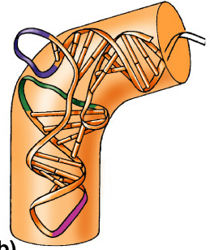
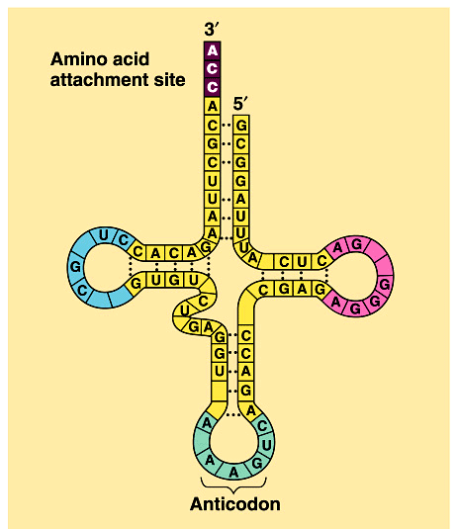
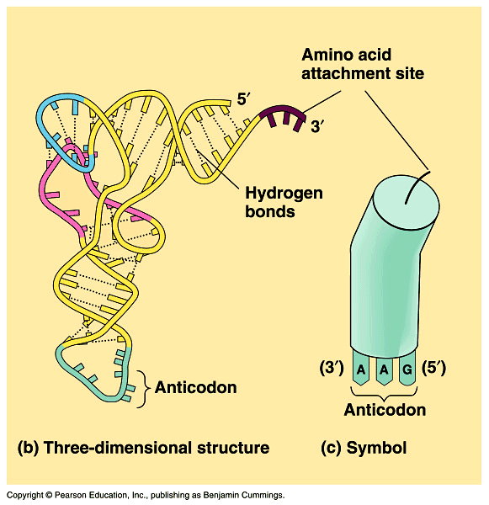
Transfer RNA structure
“Clover leaf” structure
  anticodon on “clover leaf” end
  amino acid attached on 3′ end

Slide 30
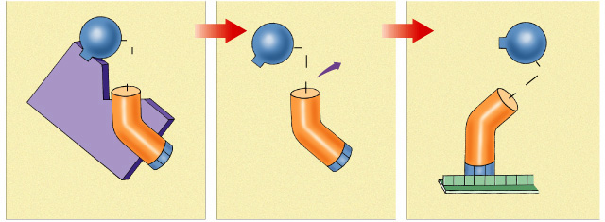
Loading tRNA
Aminoacyl tRNA synthetase
  enzyme which bonds amino acid to tRNA
  bond requires energy
    ATP → AMP
    bond is unstable
    so it can release amino acid at ribosome easily
Trp
C=O
Trp
Trp
C=O
OH
H₂O
OH
O
C=O
activating
enzyme
O
tRNA^{Trp}
A
C
C
anticodon
U
G
G
mRNA
tryptophan attached to tRNA^{Trp}
tRNA^{Trp} binds to UGG condon of mRNA
Notes:
The tRNA-amino acid bond is unstable. This makes it easy for the tRNA to later give up the amino acid to a growing polypeptide chain in a ribosome.

Slide 31
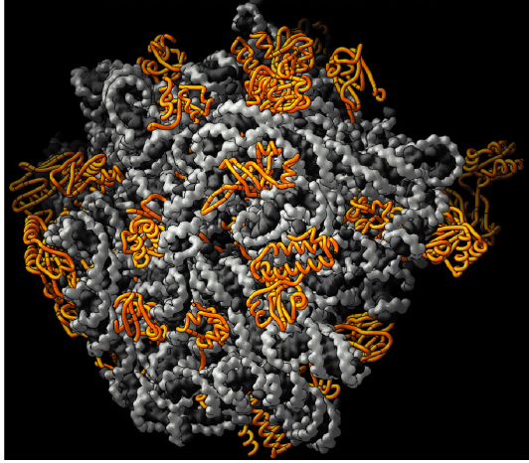
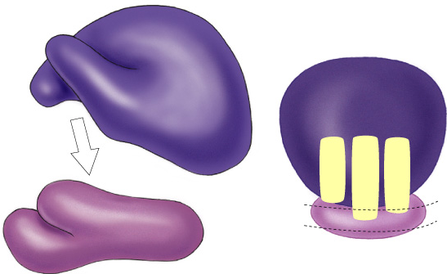
Ribosomes
Facilitate coupling of
tRNA anticodon to
mRNA codon
  organelle or enzyme?
Structure
  ribosomal RNA (rRNA) & proteins
  2 subunits
    large
    small
E
P
A

Slide 32
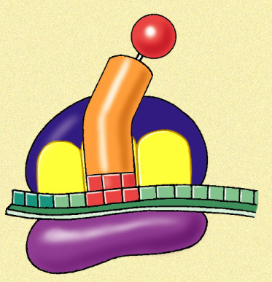
Ribosomes
A site (aminoacyl-tRNA site)
  holds tRNA carrying next amino acid to be added to chain
P site (peptidyl-tRNA site)
  holds tRNA carrying growing polypeptide chain
E site (exit site)
  empty tRNA
  leaves ribosome
  from exit site
Met
5'
U
A
C
A
U
G
E
P
A
3'

Slide 33
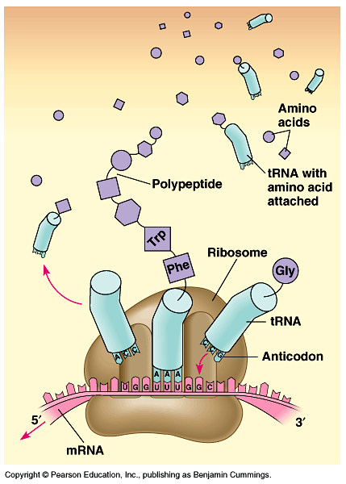
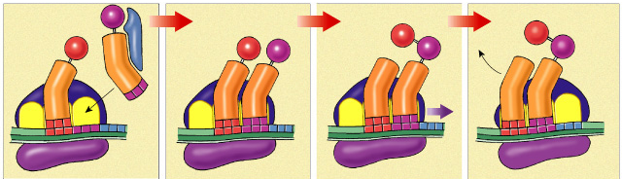
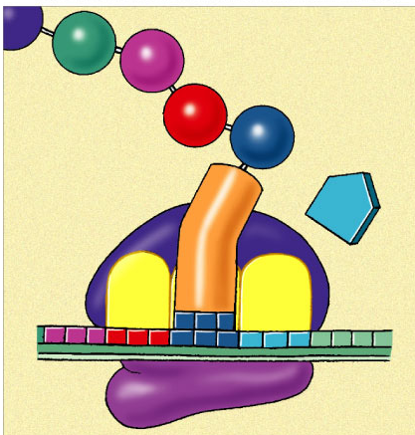
Building a polypeptide
Initiation
  mRNA, ribosome subunits, initiator tRNA come together
Elongation
  adding amino acids based on codons
Termination
  STOP codon = Release factor
3
2
1
Leu
Val
Ser
release
factor
Met
Met
Ala
Met
Met
Leu
Leu
Leu
Trp
tRNA
A
C
G
U
A
C
U
A
C
G
A
C
U
A
C
G
A
C
A
U
A
C
G
A
C
U
5'
A
U
G
C
U
G
A
A
U
5'
A
U
G
C
U
G
A
A
U
5'
A
U
G
C
U
G
A
U
5'
A
U
G
C
U
G
A
A
3'
A
C
C
mRNA
3'
3'
3'
U
G
G
U
A
A
3'
E
P
A

Slide 34
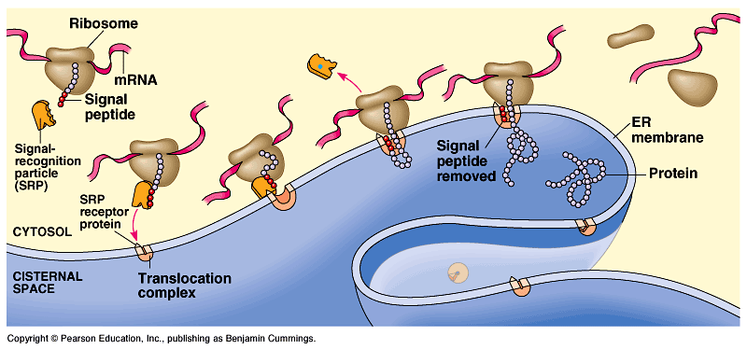
Protein targeting
Destinations:
  secretion
  nucleus
  mitochondria
  chloroplasts
  cell membrane
  cytoplasm
  etc…
Signal peptide
  address label
start of a secretory pathway

Slide 35
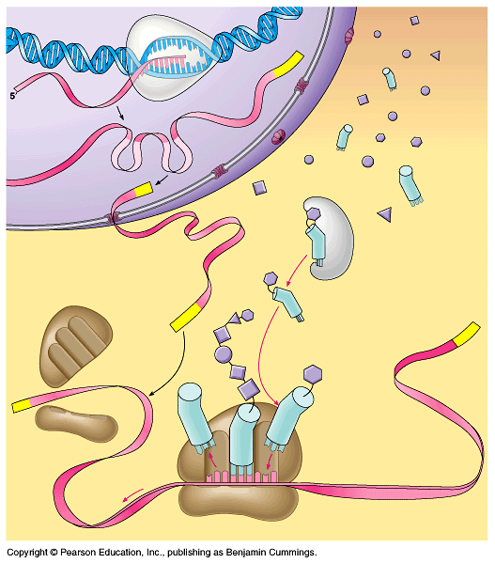
RNA polymerase
DNA
Can you tell the story?
amino
acids
exon
intron
tRNA
pre-mRNA
5' GTP cap
mature mRNA
aminoacyl tRNA
synthetase
poly-A tail
large ribosomal subunit
3'
polypeptide
5'
tRNA
small ribosomal subunit
E
P
A
ribosome

Slide 36
The Transcriptional unit (gene?)
enhancer
translation
start
translation
stop
1000⁺b
exons
20-30b
transcriptional unit (gene)
3'
TAC
ACT
5'
RNA
polymerase
TATA
DNA
DNA
UTR
UTR
introns
promoter
transcription
start
transcription
stop
5'
3'
pre-mRNA
5'
3'
GTP
mature mRNA
AAAAAAAA

Slide 37
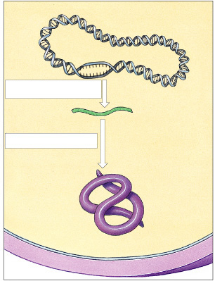
Protein Synthesis in Prokaryotes
Bacterial chromosome
Transcription
mRNA
Psssst…
no nucleus!
Cell
membrane
Cell wall

Slide 38
Prokaryote vs. Eukaryote genes
Prokaryotes
  DNA in cytoplasm
  circular chromosome
  naked DNA
  no introns
Eukaryotes
  DNA in nucleus
  linear chromosomes
  DNA wound on histone proteins
  introns vs. exons
intron = noncoding (inbetween) sequence
eukaryotic
DNA
introns
come out!
exon = coding (expressed) sequence
Notes:
Walter Gilbert hypothesis:
Maybe exons are functional units and introns make it easier for them to recombine, so as to produce new proteins with new properties through new combinations of domains.
Introns give a large area for cutting genes and joining together the pieces without damaging the coding region of the gene…. patching genes together does not have to be so precise.

Slide 39
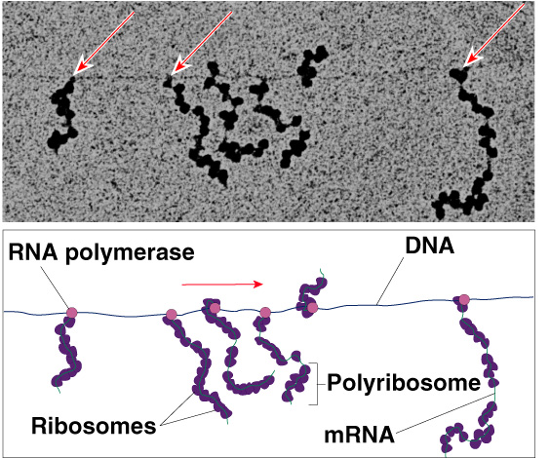
Translation in Prokaryotes
Transcription & translation are simultaneous in bacteria
  DNA is in
  cytoplasm
  no mRNA
  editing
  ribosomes
  read mRNA
  as it is being
  transcribed

Slide 40
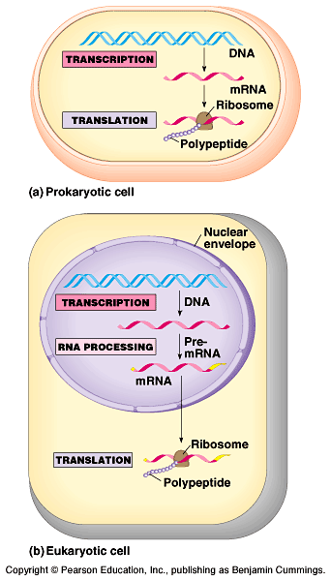
Translation: prokaryotes vs. eukaryotes
Differences between prokaryotes & eukaryotes
  time & physical separation between processes
    takes eukaryote ~1 hour
    from DNA to protein
  no RNA processing

