Slide 1
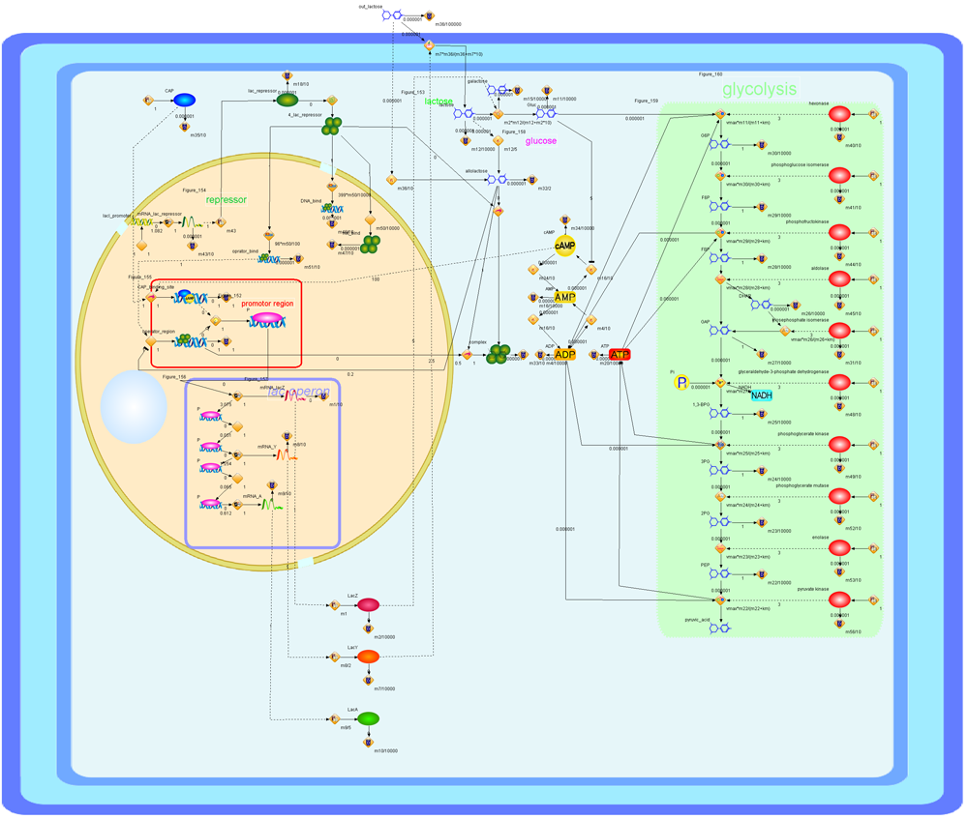
Control of
Prokaryotic (Bacterial) Genes

Slide 2
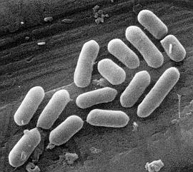
Bacterial metabolism
Bacteria need to respond quickly to changes in their environment
  if they have enough of a product, need to stop production
    why? waste of energy to produce more
    how? stop production of enzymes for synthesis
  if they find new food/energy source,
  need to utilize it quickly
    why? metabolism, growth, reproduction
    how? start production of enzymes for digestion
STOP
GO

Slide 3
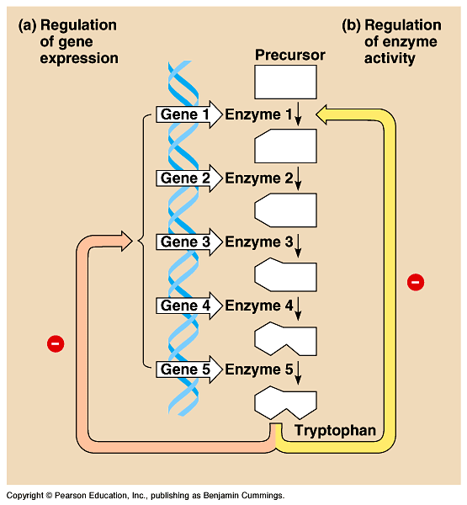
How to Regulate Metabolism?
Feedback inhibition
  The product acts
  as an allosteric inhibitor of the 1st enzyme in tryptophan pathway
  but this is wasteful production of enzymes
-
= inhibition
-
What kind of
feedback do we
have here?

Slide 4
A Different way to Regulate Metabolism
Gene regulation
  Don’t block the enzyme’s function, block transcription of genes for all enzymes in tryptophan pathway
    saves energy by
    not wasting it on unnecessary protein synthesis
-
= inhibition
-
-
Now, that’s a
good idea from a
lowly bacterium!

Slide 5
Gene regulation in bacteria
Cells vary amount of specific enzymes by regulating gene transcription
  turn genes on or turn genes off
    turn genes OFF example
    if bacterium has enough tryptophan then it doesn’t need to make enzymes used to build tryptophan
    turn genes ON example
    if bacterium encounters new sugar (energy source), like lactose, then it needs to start making enzymes used to digest lactose
STOP
GO
Notes:
Remember:
rapid growth
generation every ~20 minutes
10⁸ (100 million) colony overnight!
Anybody that can put more energy to growth & reproduction takes over the toilet.
An individual bacterium, locked into the genome that it has inherited, can cope with environmental fluctuations by exerting metabolic control.
First, cells vary the number of specific enzyme molecules by regulating gene expression.
Second, cells adjust the activity of enzymes already present (for example, by feedback inhibition).

Slide 6
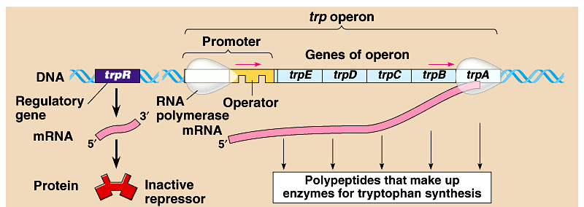
Bacteria group genes together
Operon
  genes grouped together with related functions
  promoter = RNA polymerase binding site
    single promoter controls transcription of all genes in operon
    transcribed as one unit & a single mRNA is made
  operator = DNA binding site of repressor protein

Slide 7
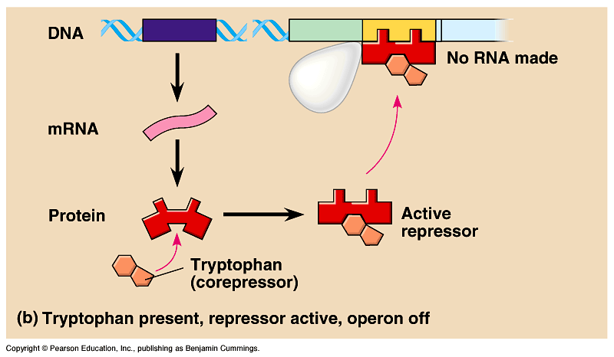
So how can these genes be turned off?
Repressor protein
  binds to DNA at operator site
  blocking RNA polymerase
  blocks transcription

Slide 8
Operon model
Operon:
operator, promoter & genes they control
serve as a model for gene regulation
RNA
polymerase
RNA
polymerase
repressor
gene1
gene2
gene3
gene4
TATA
DNA
mRNA
1
2
3
4
enzyme1
enzyme2
enzyme3
enzyme4
promoter
operator
Repressor protein turns off gene by blocking RNA polymerase binding site.
repressor
= repressor protein

Slide 9
Repressible operon: tryptophan
Synthesis pathway model
When excess tryptophan is present, it binds to tryp repressor protein & triggers repressor to bind to DNA
  blocks (represses) transcription
RNA
polymerase
RNA
polymerase
gene1
gene2
gene3
gene4
TATA
repressor
DNA
trp
mRNA
1
2
3
4
trp
trp
enzyme1
enzyme2
enzyme3
enzyme4
trp
trp
promoter
operator
trp
trp
repressor
repressor protein
trp
trp
trp
tryptophan
trp
conformational change in repressor protein!
tryptophan – repressor protein
complex
trp
repressor

Slide 10
Tryptophan operon
What happens when tryptophan is present?
Don’t need to make tryptophan-building enzymes
Tryptophan is allosteric regulator of repressor protein

Slide 11
Inducible operon: lactose
lac
lac
Digestive pathway model
When lactose is present, binds to
lac repressor protein & triggers repressor to release DNA
  induces transcription
RNA
polymerase
lac
lac
lac
lac
lac
RNA
polymerase
lac
repressor
gene1
gene2
gene3
gene4
TATA
DNA
mRNA
1
2
3
4
enzyme1
enzyme2
enzyme3
enzyme4
promoter
operator
repressor
repressor protein
lac
lactose
conformational change in repressor protein!
lactose – repressor protein
complex
lac
repressor

Slide 12
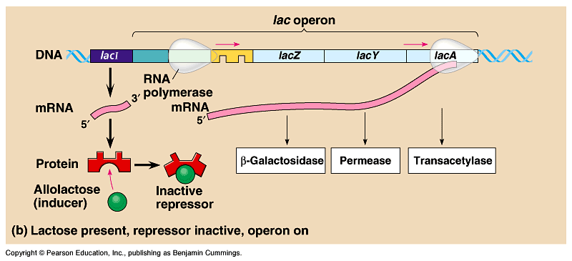
Lactose operon
What happens when lactose is present?
Need to make lactose-digesting enzymes
Lactose is allosteric regulator of repressor protein

Slide 13
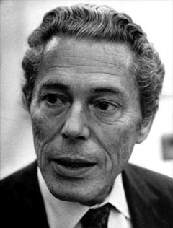


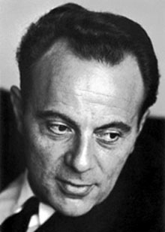
Jacob & Monod: lac Operon
1961 | 1965
Francois Jacob & Jacques Monod
  first to describe operon system
  coined the phrase “operon”
Jacques Monod
Francois Jacob

Slide 14
Operon summary
Repressible operon
  usually functions in anabolic (‘building’) pathways
    synthesizing end products
  when end product is present in excess, cell allocates resources to other uses
Inducible operon
  usually functions in catabolic (‘destroying’) pathways,
    digesting nutrients to simpler molecules
  produce enzymes only when nutrient is available
    cell avoids making proteins that have nothing to do, cell allocates resources to other uses

Slide 15
1. A mutation that inactivates the regulator gene of a repressible operon in an E. coli cell would result in
  continuous transcription of the structural gene controlled by that regulator.
  complete inhibition of transcription of the structural gene controlled by that regulator.
  irreversible binding of the repressor to the operator.
  inactivation of RNA polymerase.
  both B and C.
Notes:
Answer: a
Source: Barstow - Test Bank for Biology, Seventh Edition, Question #52

Slide 16
2. A mutation that makes the regulatory gene of an inducible operon nonfunctional would result in
  continuous transcription of the operon's genes.
  reduced transcription of the operon's genes.
  accumulation of large quantities of a substrate for the catabolic pathway controlled by the operon.
  irreversible binding of the repressor to the promoter.
  overproduction of cAMP receptor protein.
Notes:
Answer: a
Source: Campbell/Reece - Biology, Seventh Edition, EOC Self-Quiz Question #7

Slide 17
3. A mutation that renders nonfunctional the product of a regulatory gene for an inducible operon would result in *
  continuous transcription of the genes of the operon.
  complete blocking of the attachment of RNA polymerase to the promoter.
  irreversible binding of the repressor to the operator.
  no difference in transcription rate when an activator protein was present.
  negative control of transcription.
Notes:
Answer: a
Source: Taylor - Student Study Guide for Biology, Seventh Edition, Test Your Knowledge Question #25
Discussion Notes for the Instructor
There are several questions which can be asked to guide the discussion of this question, including:
What does the regulatory gene in the operon produce?
In an inducible operon is this product normally active or inactive?
Using these questions as an outline, discussion of the choices might look like this:
Choice A, correct
Choice B, there would be no repressor molecule and therefore nothing to block RNA polymerase
Choice C, there would be no repressor molecule
Choice D, normally the repressor molecule would still be blocking transcription, so there would be a difference in rate.
Choice E, similar to Choice C

