Slide 1
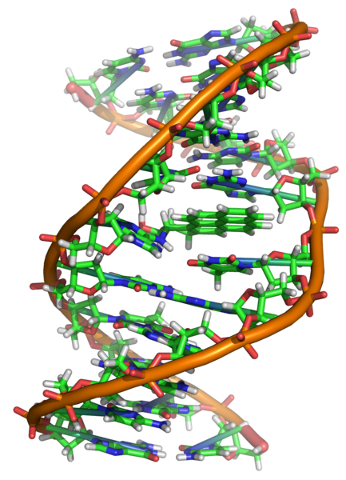
DNA

Slide 2
Brief History
Many people contributed to our understanding of DNA
  T.H. Morgan (1908)
  Frederick Griffith (1928)
  Avery, McCarty & MacLeod (1944)
  Erwin Chargaff (1947)
  Hershey & Chase (1952)
  Watson & Crick (1953)
  Meselson & Stahl (1958)

Slide 3
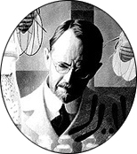
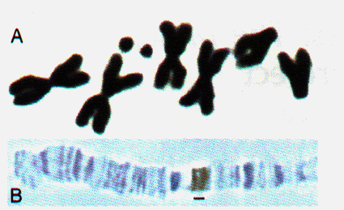
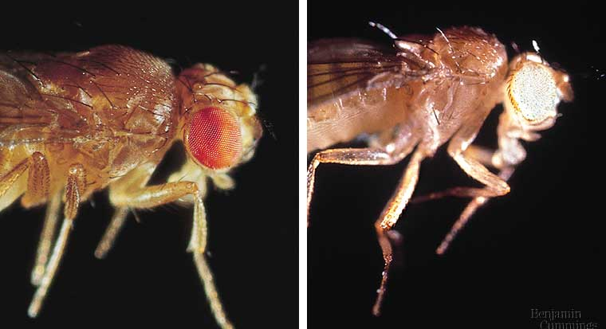
Chromosomes related to phenotype
1908 | 1933
T.H. Morgan
  working with Drosophila
  associated phenotype with specific chromosome
    white-eyed male had specific X chromosome

Slide 4
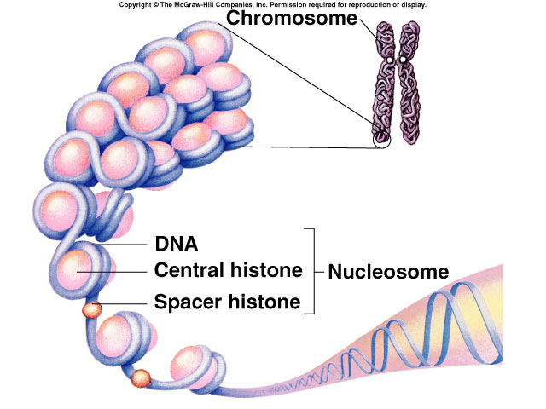
Genes are on chromosomes
1908 | 1933
Morgan’s conclusions
  genes are on chromosomes
  but is it the protein or the DNA of the chromosomes that are the genes?
    initially proteins were thought to be genetic material…

Slide 5
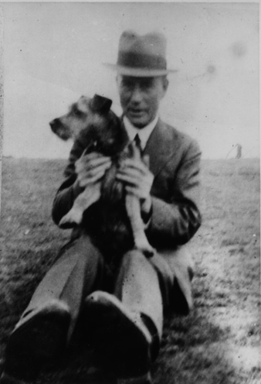
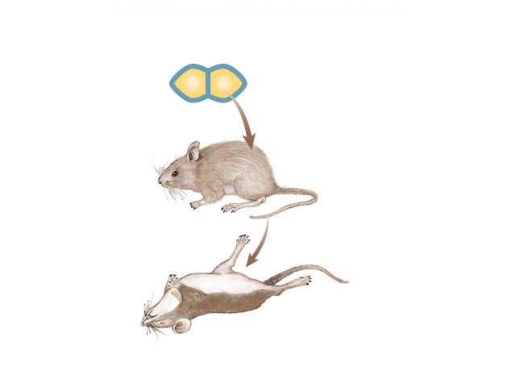
The “Transforming Principle”
1928
Frederick Griffith
  Streptococcus pneumonia bacteria
  harmless live bacteria (“rough”) mixed with heat-killed pathogenic bacteria (“smooth”) causes fatal disease in mice
  a substance passed from dead bacteria to live bacteria
    “Transforming Principle”
Notes:
Fred Griffith, English microbiologist, dies in the Blitz in London in 1941

Slide 6
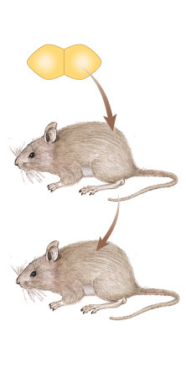
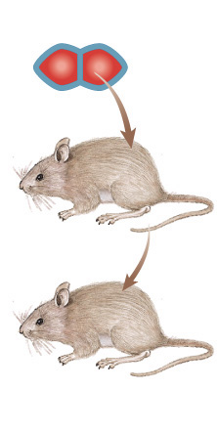
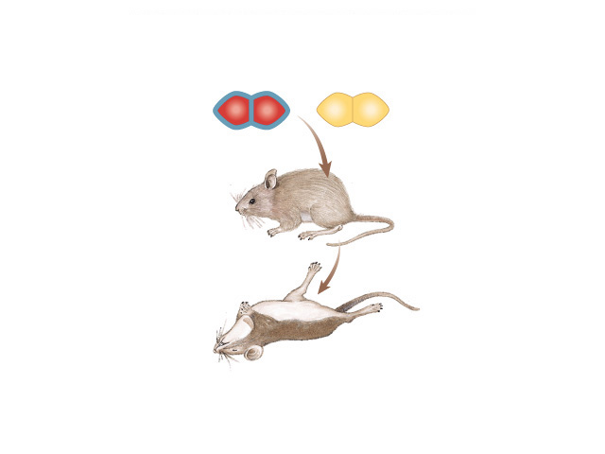
The “Transforming Principle”
mix heat-killed
pathogenic &
non-pathogenic
bacteria
live pathogenic
strain of bacteria
live non-pathogenic
strain of bacteria
heat-killed
pathogenic bacteria
A.
B.
C.
D.
mice die
mice live
mice live
mice die
Transformation = change in phenotype
something in heat-killed bacteria could still transmit disease-causing properties

Slide 7
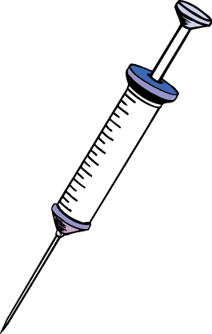
DNA is the “Transforming Principle”
1944
Avery, McCarty & MacLeod
  Purified DNA & proteins from Streptococcus pneumonia bacteria
  injected protein into bacteria
    no effect
  injected DNA into bacteria
    transformed harmless bacteria into
    virulent bacteria
mice die
What’s the
conclusion?
Notes:
1. Purified S strain extracts to characterize the transforming principle.
2. Material was resistant to proteases; it contained no lipid or carbohydrate.
3. If DNA in the extract is destroyed, the transforming principle is lost.
4. Pure DNA isolated from the S strain extract transforms R strain.
5. Avery cautiously suggested that DNA was the genetic material.
6. This was the first experimental evidence that DNA is the genetic material.

Slide 8


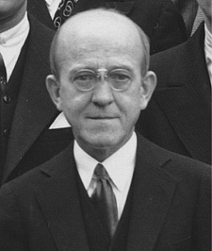
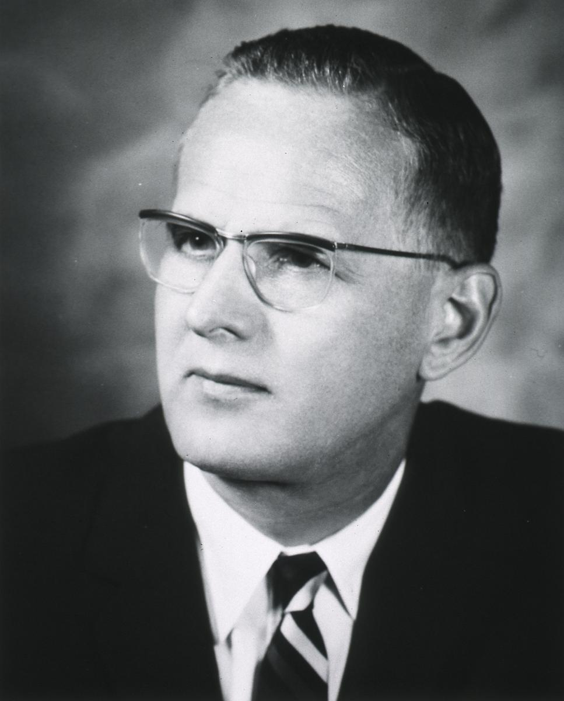
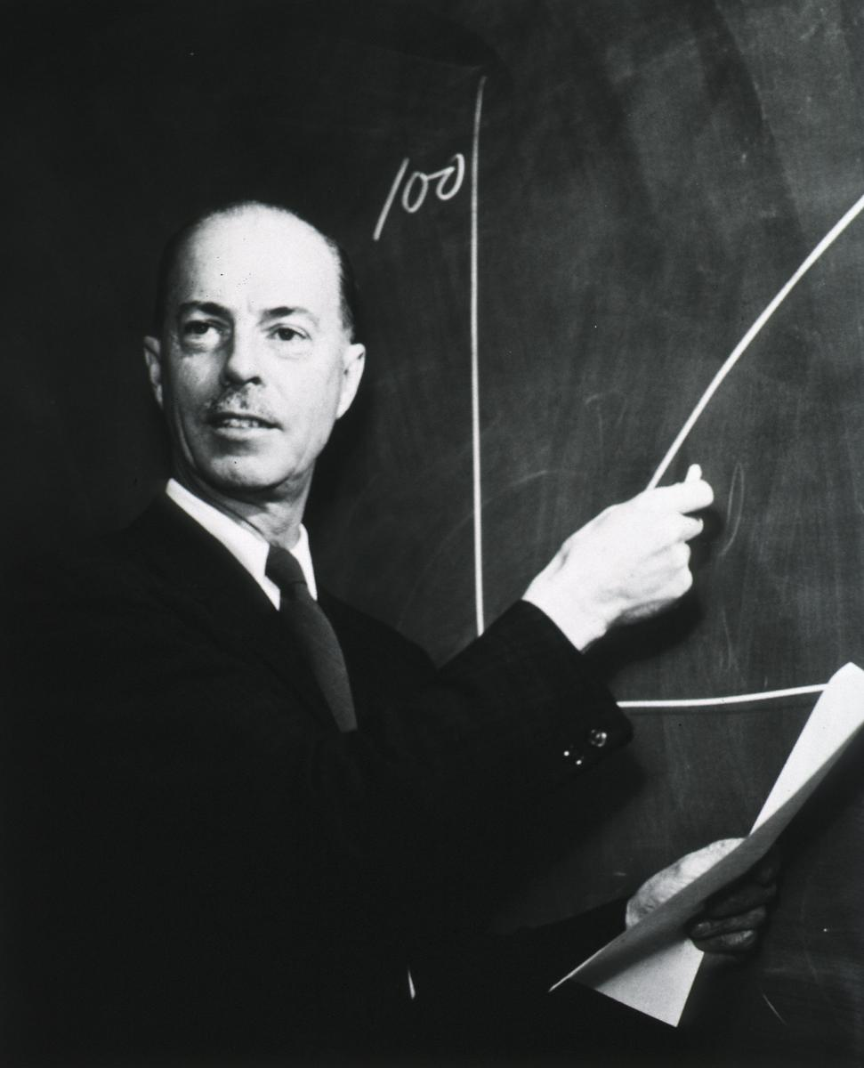
Avery, McCarty & MacLeod
1944 | ??!!
Conclusion
  first experimental evidence that DNA was the genetic material
Oswald Avery
Maclyn McCarty
Colin MacLeod
Notes:
Maclyn McCarty (June 9, 1911 – January 2, 2005) was an American geneticist.
Oswald Avery (October 21, 1877–2 February 1955) was a Canadian-born American physician and medical researcher.
Colin Munro MacLeod (January 28, 1909 — February 11, 1972) was a Canadian-American geneticist.
After Oswald T. Avery, Colin M. MacLeod, and Maclyn McCarty published the 1944 article, a number of their contemporaries immediately understood that transformation was the transfer of genetic material from one bacterium to another, and that the transforming substance, DNA, must be the genetic material. However, the team's somewhat tentatively stated conclusions were not met with complete acceptance. At the time, the belief that DNA was a monotonous chain of four repeating nucleotides--structurally important but of little physiological interest--was still difficult to overcome. The belief that only proteins possessed the structural complexity necessary to carry hereditary information was pervasive among geneticists. Many of the scientists who had previously thought that genetic material was protein still believed that the effects of the transforming principle were perhaps due to some undetected protein associated with the DNA.

Slide 9
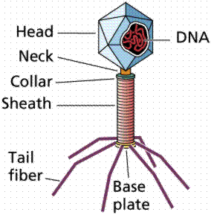
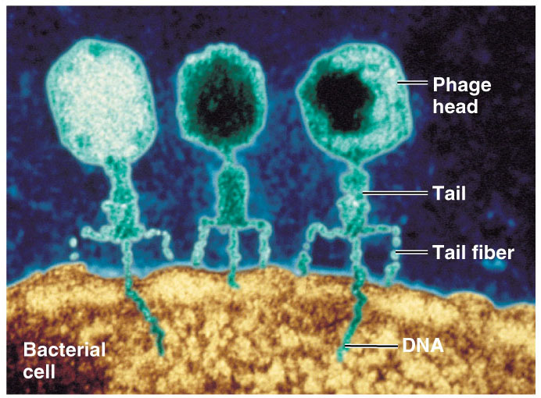
Confirmation of DNA
1952 | 1969
Hershey
Hershey & Chase
  classic “blender” experiment
  worked with bacteriophage
    viruses that infect bacteria
  grew phages in 2 media, radioactively labeled with either
    ³⁵S in their proteins
    ³²P in their DNA
  infected bacteria phages
Why use
Sulfur
vs.
Phosphorus?

Slide 10
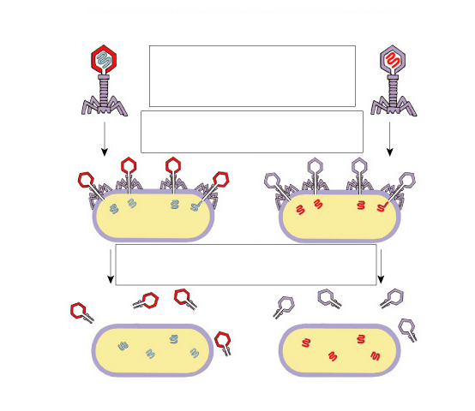
Hershey & Chase
Protein coat labeled
with ³⁵S
DNA labeled with ³²P
T2 bacteriophages
are labeled with
radioactive isotopes
S vs. P
bacteriophages infect
bacterial cells
bacterial cells are agitated
to remove viral protein coats
Which radioactive marker is found inside the cell?
Which molecule carries viral genetic info?
³⁵S radioactivity
found in the medium
³²P radioactivity found
in the bacterial cells

Slide 11
Blender experiment
Radioactive phage & bacteria in blender
  ³⁵S phage
    radioactive proteins stayed in supernatant
    therefore viral protein did NOT enter bacteria
  ³²P phage
    radioactive DNA stayed in pellet
    therefore viral DNA did enter bacteria
  Confirmed DNA is “transforming factor”
Taaa-Daaa!

Slide 12

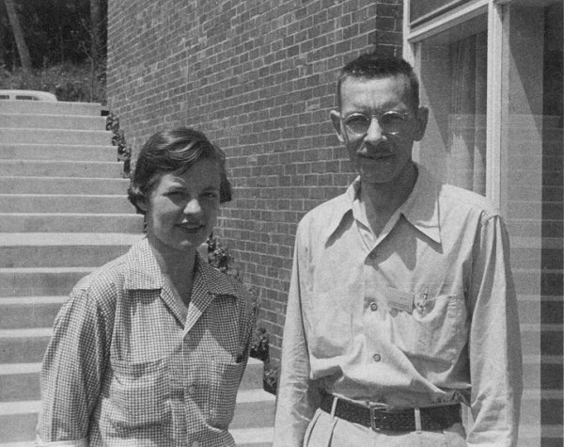
Hershey & Chase
1952 | 1969
Hershey
Martha Chase
Alfred Hershey
Notes:
Martha Cowles Chase (1927 – August 8, 2003) was a young laboratory assistant in the early 1950s when she and Alfred Hershey conducted one of the most famous experiments in 20th century biology. Devised by American bacteriophage expert Alfred Hershey at Cold Spring Harbor Laboratory New York, the famous experiment demonstrated the genetic properties of DNA over proteins. By marking bacteriophages with radioactive isotopes, Hershey and Chase were able to trace protein and DNA to determine which is the molecule of heredity.
Hershey and Chase announced their results in a 1952 paper. The experiment inspired American researcher James D. Watson, who along with England's Francis Crick figured out the structure of DNA at the Cavendish Laboratory of the University of Cambridge the following year.
Hershey shared the 1969 Nobel Prize in Physiology or Medicine with Salvador Luria and Max Delbrück. Chase, however, did not reap such rewards for her role. A graduate of The College of Wooster in Ohio (she had grown up in Shaker Heights, Ohio), she continued working as a laboratory assistant, first at the Oak Ridge National Laboratory in Tennessee and then at the University of Rochester before moving to Los Angeles in the late 1950s. There she married biologist Richard Epstein and earned her Ph.D. in 1964 from the University of Southern California. A series of personal setbacks through the 1960s ended her career in science. She spent decades suffering from a form of dementia that robbed her of short-term memory. She died on August 8, 2003.

Slide 13
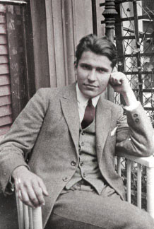
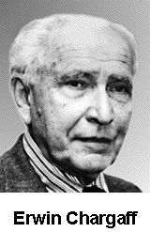
Erwin Chargaff
1947
DNA composition: “Chargaff’s rules”
  varies from species to species
  all 4 bases not in equal quantity
  bases present in characteristic ratio
    humans:
    A = 30.9%
    T = 29.4%
    G = 19.9%
    C = 19.8%
Rules
A = T
C = G
That’s interesting!
What do you notice?

Slide 14
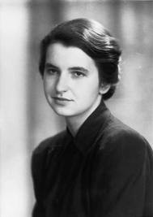
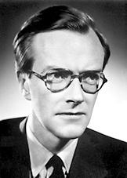
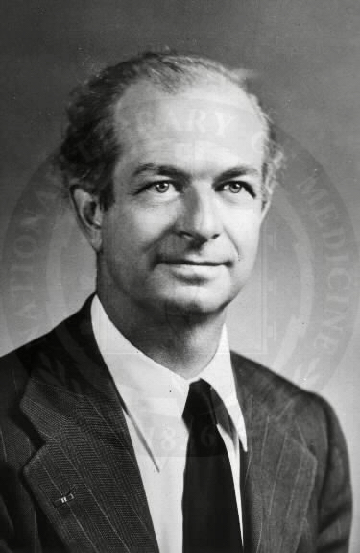
Structure of DNA
1953 | 1962
Watson & Crick
  developed double helix model of DNA
    other leading scientists working on question:
      Rosalind Franklin
      Maurice Wilkins
      Linus Pauling
Franklin
Wilkins
Pauling
Notes:
Watson & Crick’s model was inspired by 3 recent discoveries:
Chargaff’s rules
Pauling’s alpha helical structure of a protein
X-ray crystallography data from Franklin & Wilkins

Slide 15
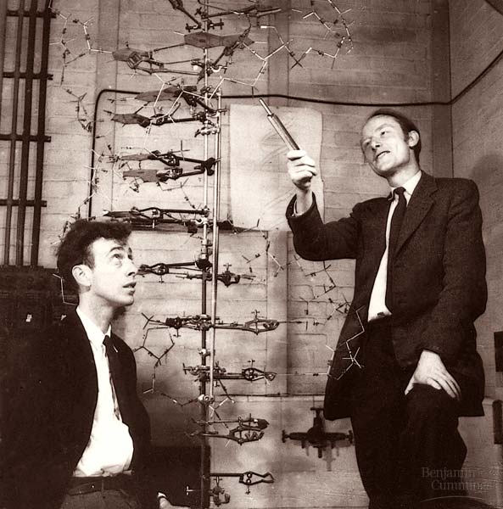
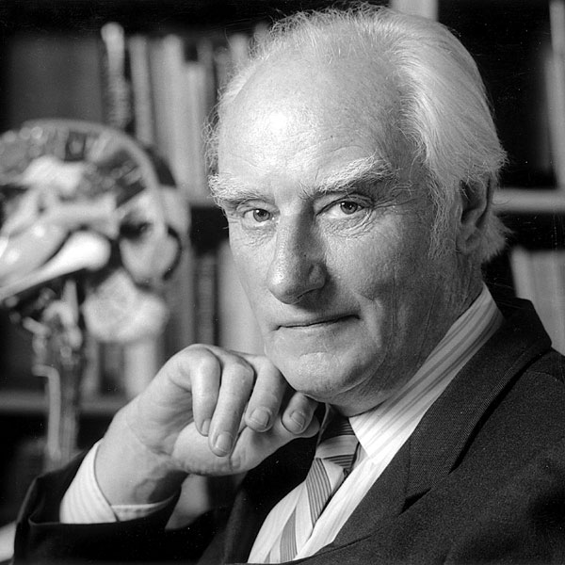

Watson and Crick
1953 article in Nature
Watson
Crick

Slide 16
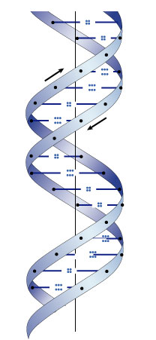
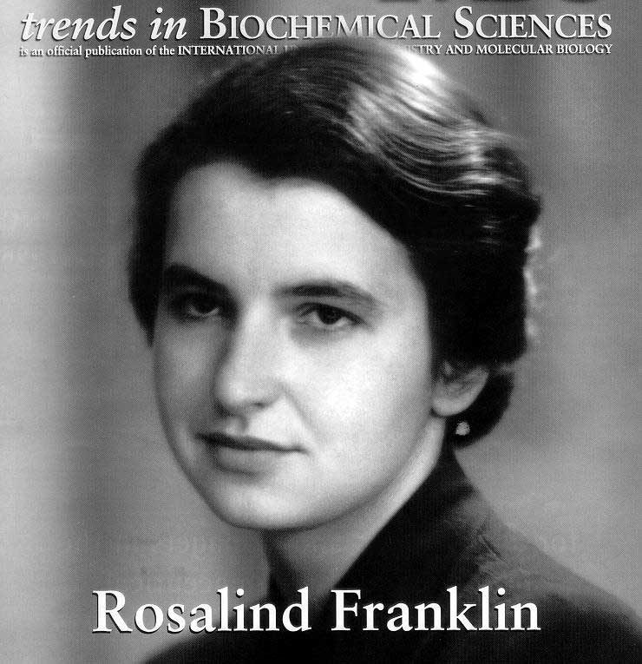
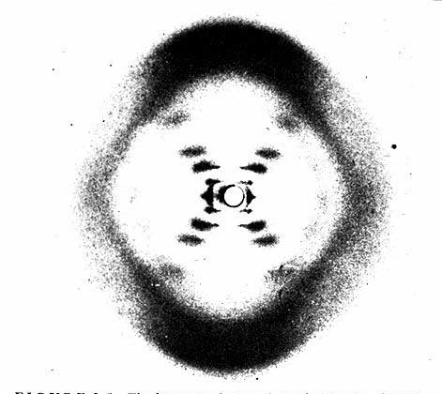
Rosalind Franklin (1920-1958)
Notes:
A chemist by training, Franklin had made original and essential contributions to the understanding of the structure of graphite and other carbon compounds even before her appointment to King's College. Unfortunately, her reputation did not precede her. James Watson's unflattering portrayal of Franklin in his account of the discovery of DNA's structure, entitled "The Double Helix," depicts Franklin as an underling of Maurice Wilkins, when in fact Wilkins and Franklin were peers in the Randall laboratory. And it was Franklin alone whom Randall had given the task of elucidating DNA's structure. The technique with which Rosalind Franklin set out to do this is called X-ray crystallography. With this technique, the locations of atoms in any crystal can be precisely mapped by looking at the image of the crystal under an X-ray beam. By the early 1950s, scientists were just learning how to use this technique to study biological molecules. Rosalind Franklin applied her chemist's expertise to the unwieldy DNA molecule. After complicated analysis, she discovered (and was the first to state) that the sugar-phosphate backbone of DNA lies on the outside of the molecule. She also elucidated the basic helical structure of the molecule.
After Randall presented Franklin's data and her unpublished conclusions at a routine seminar, her work was provided - without Randall's knowledge - to her competitors at Cambridge University, Watson and Crick. The scientists used her data and that of other scientists to build their ultimately correct and detailed description of DNA's structure in 1953. Franklin was not bitter, but pleased, and set out to publish a corroborating report of the Watson-Crick model. Her career was eventually cut short by illness. It is a tremendous shame that Franklin did not receive due credit for her essential role in this discovery, either during her lifetime or after her untimely death at age 37 due to cancer.

Slide 17
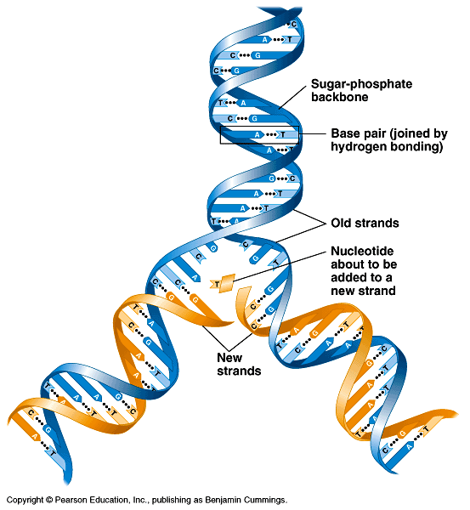
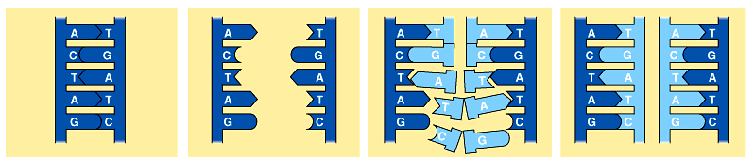
But how is DNA copied?
Replication of DNA
  base pairing suggests that it will allow each side to serve as a template for a new strand
“It has not escaped our notice that the specific pairing we have postulated immediately suggests a possible copying mechanism for the genetic material.” — Watson & Crick

Slide 18
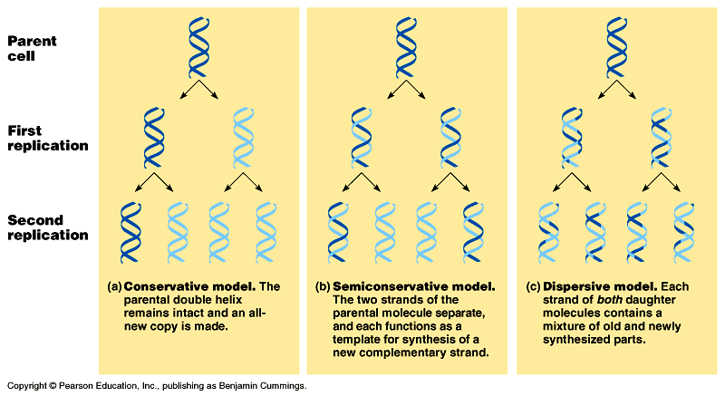
Models of DNA Replication
Can you design
a nifty experiment
to verify?
Alternative models
  become experimental predictions
conservative
semiconservative
dispersive
P
1
2

Slide 19
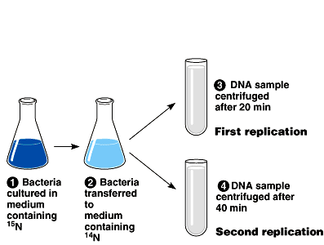
Semiconservative replication
1958
Meselson & Stahl
  label “parent” nucleotides in DNA strands with
  heavy nitrogen = ¹⁵N
  label new nucleotides with lighter isotope = ¹⁴N
“The Most Beautiful Experiment in Biology”
Make predictions…
parent
replication
¹⁵N/¹⁵N
¹⁵N parent
strands

Slide 20
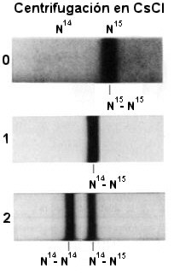
Predictions

¹⁴N/¹⁴N
1st round of
replication
¹⁵N/¹⁴N
¹⁵N/¹⁴N
¹⁵N/¹⁵N
semi-
conservative
conservative
dispersive
2nd round of
replication



P
¹⁴N/¹⁴N
¹⁴N/¹⁴N
¹⁵N/¹⁴N
¹⁵N/¹⁴N
¹⁵N/¹⁵N
1
¹⁵N/¹⁵N
semi-
conservative
2
¹⁵N parent
strands
conservative
dispersive

Slide 21
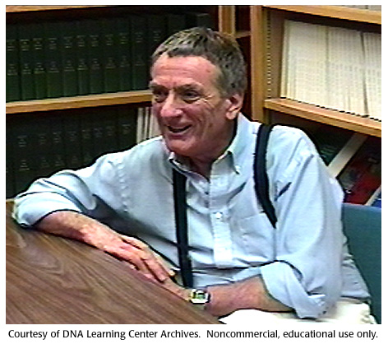
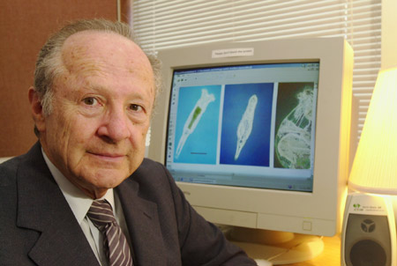
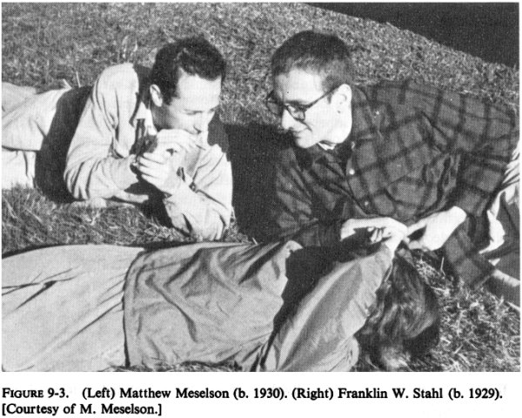
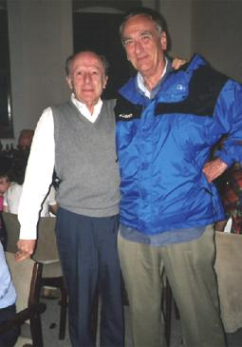
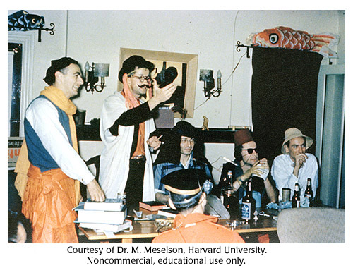
Meselson & Stahl
Matthew Meselson
Franklin Stahl
Franklin Stahl
Matthew Meselson

Slide 22
Scientific History
March to understanding that DNA is the genetic material
  T.H. Morgan (1908): genes are on chromosomes
  Frederick Griffith (1928): a transforming factor can change phenotype
  Avery, McCarty & MacLeod (1944): transforming factor is DNA
  Erwin Chargaff (1947): Chargaff rules: A = T, C = G
  Hershey & Chase (1952): confirmation that DNA is genetic material
  Watson & Crick (1953): determined double helix structure of DNA
  Meselson & Stahl (1958): semi-conservative replication

Slide 23
The “Central Dogma”
Flow of genetic information in a cell
transcription
translation
DNA
RNA
protein
replication

Slide 24
0
1. Tobacco mosaic virus has RNA rather than DNA as its genetic material. In a hypothetical situation where RNA from a tobacco mosaic virus is mixed with proteins from a related DNA virus, the result could be a hybrid virus. If that virus were to infect a cell and reproduce, what would the resulting "offspring" viruses be like?
  tobacco mosaic virus
  the related DNA virus
  a hybrid: tobacco mosaic virus RNA and protein from the DNA virus
  a hybrid: tobacco mosaic virus protein and nucleic acid from the DNA virus
  a virus with a double helix made up of one strand of DNA complementary to a strand of RNA surrounded by viral protein
Notes:
Answer: a
Source: Barstow - Test Bank for Biology, Seventh Edition, Question #4

Slide 25
2. Cytosine makes up 38% of the nucleotides in a sample of DNA from an organism. What percent of the nucleotides in this sample will be thymine?
  12
  24
  31
  38
  It cannot be determined from the
  information provided.
Notes:
Answer: a
Source: Barstow - Test Bank for Biology, Seventh Edition, Question #16

Slide 26
3. In an analysis of the nucleotide composition of DNA, which of the following is true?
  A = C
  A = G and C = T
  A + C = G + T
  A + T = G + C
  Both B and C are true
Notes:
Answer: c
Source: Barstow - Test Bank for Biology, Seventh Edition, Question #21

Slide 27
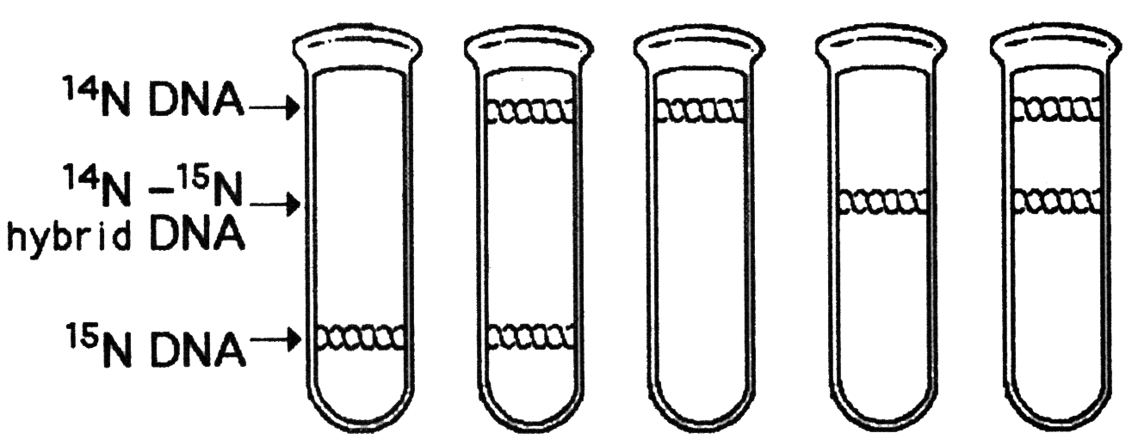
4. A space probe returns with a culture of a microorganism found on a distant planet. Analysis shows that it is a carbon-based life form that has DNA. You grow the cells in ¹⁵N medium for several generations and then transfer it to ¹⁴N medium. Which pattern in this figure would you expect if the DNA were replicated in a conservative manner?
a.
b.
c.
d.
e.
Notes:
Answer: b
Source: Barstow - Test Bank for Biology, Seventh Edition, Question #24

Slide 28
5. In analyzing the number of different bases
in a DNA sample, which result would be consistent with the base-pairing rules?
  A = G
  A + G = C + T
  A + T = G + T
  A = C
  G = T
Notes:
Answer: b
Source: Campbell/Reece - Biology, Seventh Edition, EOC Self-Quiz Question #5

Slide 29
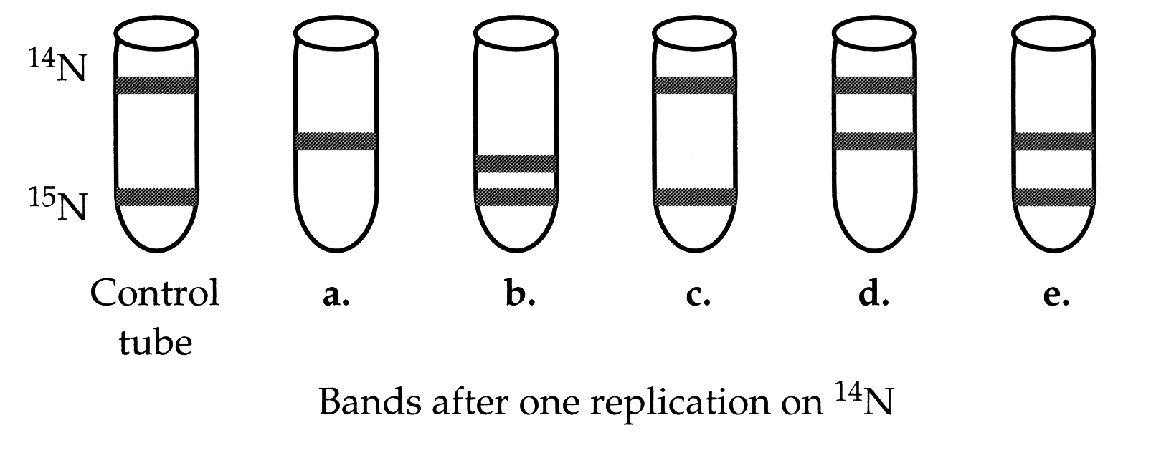
6. Imagine the following experiment is done: Bacteria are first grown for several generations in a medium containing the lighter isotope of nitrogen, ¹⁴N, then switched into a medium containing ¹⁵N. The rest of the experiment is identical to the Meselson and Stahl experiment. Which of the following represents the band positions you would expect after two generations? *
Notes:
Answer: e
Source: Campbell/Reece - Biology, Seventh Edition, EOC Process of Science Question
Discussion Notes for the Instructor
There are several questions which can be asked to guide the discussion of this question, including:
Which isotope will the new nucleotides contain?
As DNA is being replicated the new backbone (strand) will contain which isotope?
How many templates are formed from one molecule of DNA?
Using these questions as an outline. discussion of the choices might look like this:
Choice A, since the original ¹⁴N labeled backbones will act as templates with new ¹⁵N nucleotides there should an intermediate band.
Choice B, the intermediate band should have a mass exactly half way between the ¹⁴N and ¹⁵N marks
Choice C, since there are no new ¹⁴N labeled nucleotides there can be no bands that are just ¹⁴N
Choice D, since there are no new ¹⁴N labeled nucleotides there can be no bands that are just ¹⁴N
Choice E, correct

