Slide 1
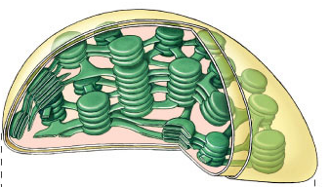
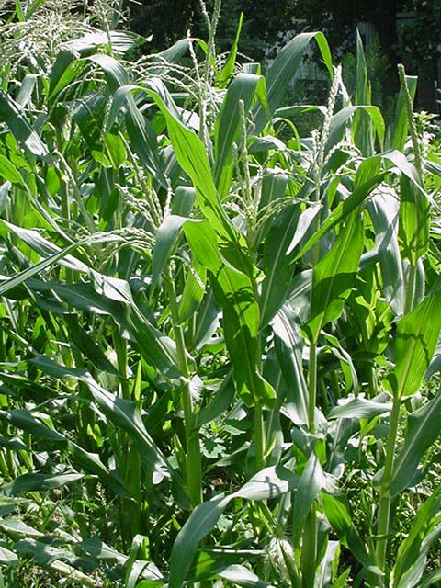
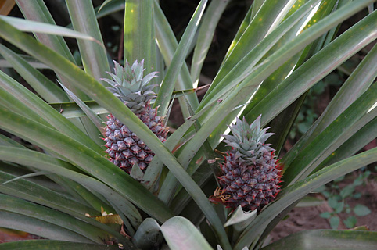
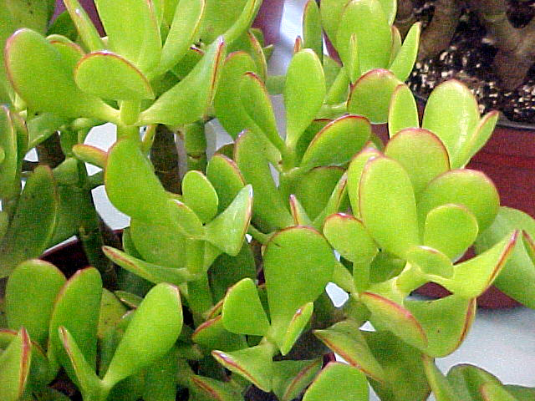
Photosynthesis:
Variations on the Theme

Slide 2
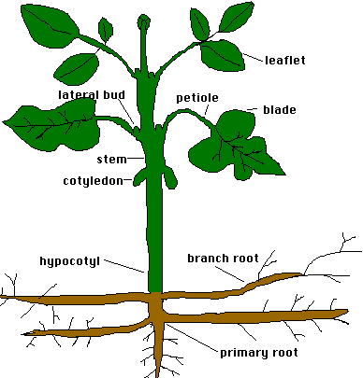

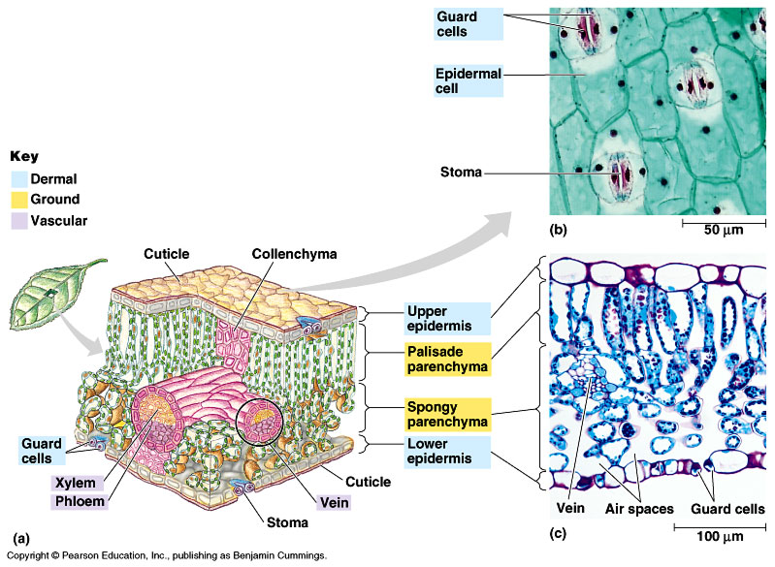
Remember what plants need…
Photosynthesis
  light reactions
    light
    H₂O
  Calvin cycle
    CO₂
O
← sun
C
O
← ground
← air
What structures have plants evolved to supply these needs?

Slide 3

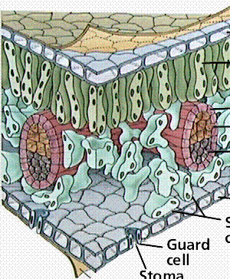
Leaf Structure
vascular bundle
xylem (water)
phloem (sugar)
cuticle
epidermis
O₂
CO₂
palisades
layer
H₂O
spongy
layer
CO₂
H₂O
O₂
guard
cell
Transpiration
stomata
Gas exchange

Slide 4
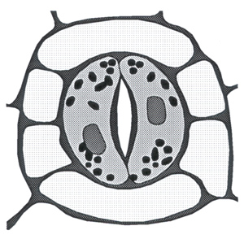
Controlling water loss from leaves
Hot or dry days
  stomates close to conserve water
  guard cells
    gain H₂O = stomates open
    lose H₂O = stomates close
  adaptation to
  living on land,
  but…
  creates PROBLEMS!
Notes:
On sunny hot days, balancing 2 processes/ 2 forces:
Lots of sun so guard cells producing glucose, therefore increasing sugar concentration, therefore increase osmosis into guard cells = turgid & open
Lots of sun so plant starts to wilt, therefore guard cells shrink = flaccid & closed

Slide 5
When stomates close…
Closed stomates lead to…
  O₂ build up → from light reactions
  CO₂ is depleted → in Calvin cycle
    causes problems in Calvin Cycle

Slide 6
7.12 EVOLUTION CONNECTION: Adaptations that save water in hot, dry climates evolved in C₄ and CAM plants
In hot climates, plant stomata close to reduce water loss so oxygen builds up
  Rubisco adds oxygen instead of carbon dioxide to RuBP and produces a two-carbon compound, a process called photorespiration
  Unlike photosynthesis, photorespiration produces no sugar, and unlike respiration, it produces no ATP
Copyright © 2009 Pearson Education, Inc.
Notes:
Botanists believe photorespiration is an evolutionary relic, left from times when there was little oxygen in the atmosphere.
Teaching Tips
1. If you can find examples of C₃, C₄, and CAM plants, consider bringing them to class. Referring to living plants helps students understand these abstract concepts. Nice photographs can serve as a fine substitute.
2. Relate the properties of C₃ and C₄ plants to the regions of the country where each is grown. Students might generally understand that crops have specific requirements, but may not specifically relate these physiological differences to their geographic sites of production or specific evolutionary histories.

Slide 7
Inefficiency of RuBisCo: CO₂ vs O₂
RuBisCo in Calvin cycle
  carbon fixation enzyme
    normally bonds C to RuBP
    CO₂ is the optimal substrate
    reduction of RuBP
    building sugars
  when O₂ concentration is high
    RuBisCo bonds O to RuBP
    O₂ is a competitive substrate
    oxidation of RuBP
    breakdown sugars
photosynthesis
photorespiration

Slide 8
Calvin cycle when CO₂ is abundant
1C
CO₂
RuBP
ATP
5C
RuBisCo
unstable
intermediate
ADP
6C
G3P
to make
glucose
5C
C3 plants
PGA
3C
G3P
3C
NADPH
ATP
NADP
ADP
3C

Slide 9
Calvin cycle when O₂ is high
to
mitochondria
–––––––
lost as CO₂
without
making ATP
O₂
RuBP
5C
Hey Dude,
are you high
on oxygen!
RuBisCo
2C
3C
It’s so
sad to see a
good enzyme,
go BAD!
photorespiration

Slide 10
Impact of Photorespiration
Oxidation of RuBP
  short circuit of Calvin cycle
  loss of carbons to CO₂
    can lose 50% of carbons fixed by Calvin cycle
  reduces production of photosynthesis
    no ATP (energy) produced
    no C₆H₁₂O₆ (food) produced
  if photorespiration could be reduced, plant would become 50% more efficient
    strong selection pressure to evolve alternative carbon fixation systems

Slide 11
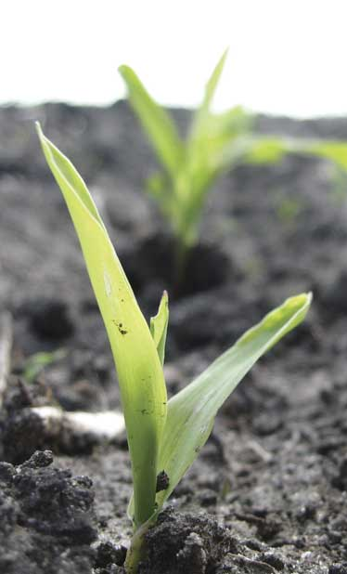
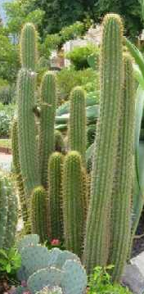
Reducing photorespiration
Separate carbon fixation from Calvin cycle
  C4 plants
    PHYSICALLY separate carbon fixation from Calvin cycle
      different cells to fix carbon vs. where Calvin cycle occurs
      store carbon in 4C compounds
    different enzyme to capture CO₂ (fix carbon)
      PEP carboxylase
    different leaf structure
  CAM plants
    separate carbon fixation from Calvin cycle by TIME OF DAY
    fix carbon during night
      store carbon in 4C compounds
    perform Calvin cycle during day
Notes:
The key point is how carbon dioxide is grabbed out of the air -- carbon fixation -- and then handed off to the Calvin cycle.
C4 plants separate the 2 steps of carbon fixation anatomically. They use 2 different cells to complete the process.
CAM plants separate the 2 steps of carbon fixation temporally. They do them at 2 different times.
The key problem they are trying to overcome is that Rubisco is a very inefficient enzyme in the presence of high O2. In high O2, Rubisco bonds oxygen to RuBP rather than carbon, so the plants have to keep O2 away from Rubsico.
C4 & CAM should be seen as variations on *carbon fixation*, because plants had to evolve alternative systems given the limitations of their enzymes and their need to conserve water.

Slide 12
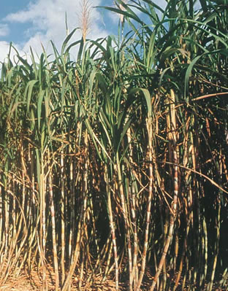
C4 plants
A better way to capture CO₂
  1st step before Calvin cycle,
  fix carbon with enzyme
  PEP carboxylase
    store as 4C compound
  adaptation to hot,
  dry climates
    have to close stomates a lot
    different leaf anatomy
  sugar cane, corn,
  other grasses…
corn
sugar cane
Notes:
Some plants have evolved a means of carbon fixation that saves water during photosynthesis
One group can shut its stomata when the weather is hot and dry to conserve water but is able to make sugar by photosynthesis
These are called the C₄ plants because they first fix carbon dioxide into a four-carbon compound

Slide 13
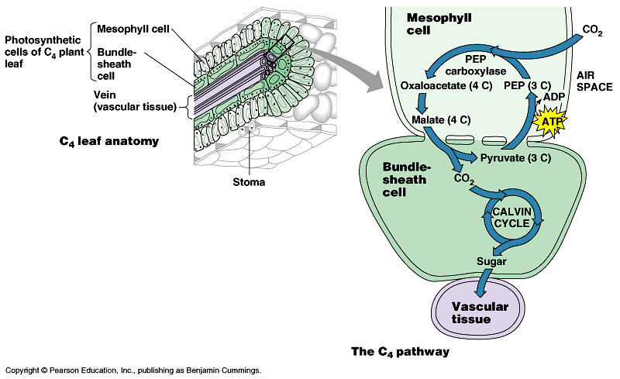
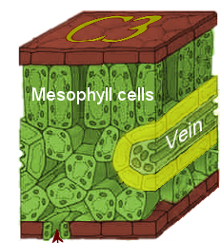
C4 leaf anatomy
PEP (3C) + CO₂ → oxaloacetate (4C)
O₂
light reactions
CO₂
PEP
carboxylase
C3 anatomy
bundle
sheath
cell
stomate
CO₂
PEP carboxylase enzyme
  higher attraction for CO₂ than O₂
    better than RuBisCo
  fixes CO₂ in 4C compounds
  regenerates CO₂ in inner cells for RuBisCo
    keeping O₂ away from RuBisCo
RuBisCo
C4 anatomy
Notes:
PEP = phosphoenolpyruvate
C4 plants solve the photorespiration problem by fixing carbon in outer ring of mesophyll cells using a different enzyme -- PEP carboxylase -- which has a higher affinity for CO2 than O2 (better than Rubisco), so it fixes CO2 in 4C "storage" compounds (oxaloacetate, malate). It then passes the carbon on by regenerating CO2 in the inner bundle sheath cells for Rubisco to use in the Calvin cycle.

Slide 14
C4 photosynthesis
PHYSICALLY separated C fixation from Calvin cycle
Outer cells
  light reaction & carbon fixation
  pumps CO₂ to inner cells
  keeps O₂ away from inner cells
    away from RuBisCo
Inner cells
  Calvin cycle
  glucose to veins
CO₂
O₂
O₂
CO₂

Slide 15
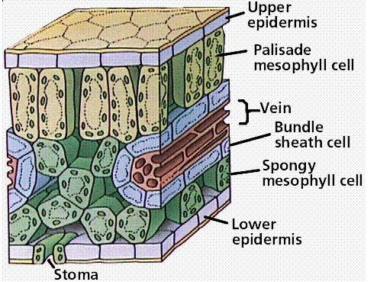
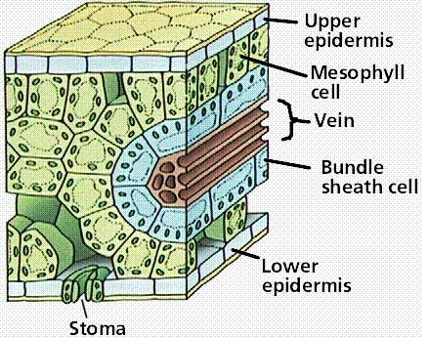
Comparative anatomy
Location,
location,location!
C3
C4
PHYSICALLY separate C fixation from Calvin cycle

Slide 16
CAM (Crassulacean Acid Metabolism) plants
Adaptation to hot, dry climates
  separate carbon fixation from Calvin cycle by TIME
    close stomates during day
    open stomates during night
  at night: open stomates & fix carbon
  in 4C “storage” compounds
  in day: release CO₂ from 4C acids
  to Calvin cycle
    increases concentration of CO₂ in cells
  succulents, some cacti, pineapple
It’s all in
the timing!
Notes:
Crassulacean Acid Metabolism (CAM)
Succulents are in the family Crassulaceae
the name Crassula is derived from the Latin "crassus" meaning thick and refers to the leaves of these succulent plants
Another adaptation to hot and dry environments has evolved in the CAM plants, such as pineapples and cacti
CAM plants conserve water by opening their stomata and admitting CO₂ only at night
When CO₂ enters, it is fixed into a four-carbon compound, like in C₄ plants, and in this way CO₂ is banked
It is released into the Calvin cycle during the day
CAM plants solve the photorespiration problem by fixing carbon at night (when stomates are open), and put it in "storage" compounds (organic acids like malic acid, isocitric acid) and then in the day (when stomates are closed), they release the CO2 from the "storage" compounds to the Calvin cycle
(thereby increasing CO2 in the cells, improving Rubisco's efficiency)

Slide 17
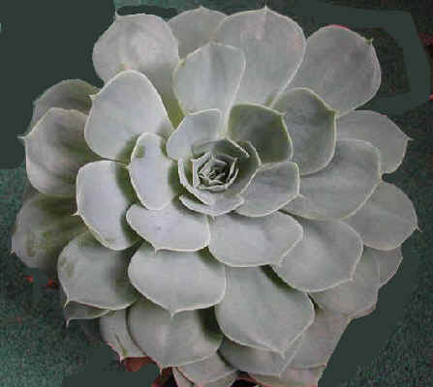
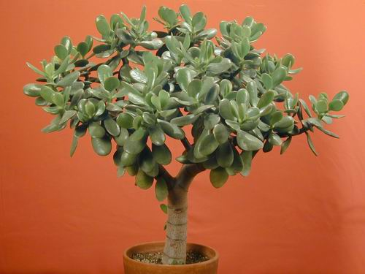
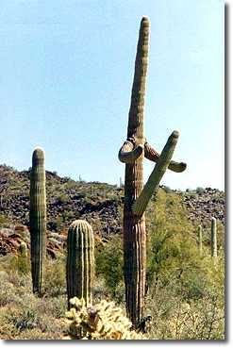
CAM plants
cacti
succulents
pineapple

Slide 18
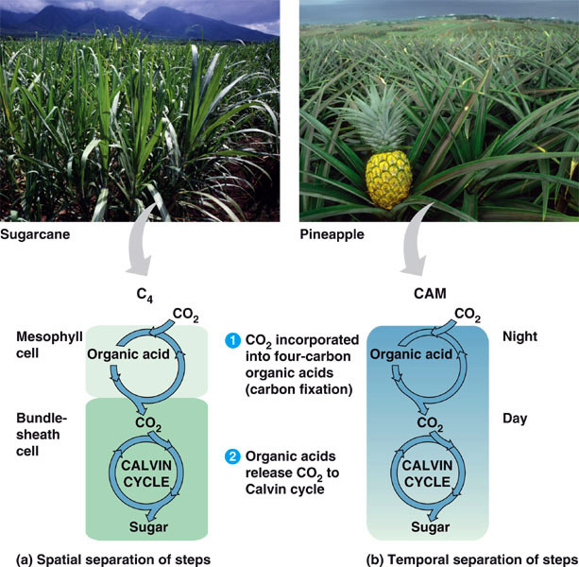
C4 vs CAM Summary
solves CO₂ / O₂ gas exchange vs. H₂O loss challenge
C4 plants
separate 2 steps of C fixation anatomically in 2 different cells
CAM plants
separate 2 steps of C fixation temporally =
2 different times
night vs. day
Notes:
C3, C4, and CAM truly refer to the alternative method of carbon fixation -- grabbing carbon out of the air -- and not the Calvin Cycle itself. They *all* use the Calvin Cycle for sugar generation, but they differ in how they turn carbon from thin air into solid stuff.
In C4, CO2 is fixed into 4-carbon "storage" compounds like oxaloacetate & malate (hence C4)
In CAM, CO2 is fixed into organic acids like malic acid & isocitric acid (hence Crassulacean Acid Metabolism)
In C3, while CO2 is initially fixed into a 6-carbon molecule, it is unstable & quickly breaks down to 3-carbon phosphoglycerate (PGA) (hence C3)
C4 & CAM should be seen as variations on *carbon fixation*, because plants had to evolve alternative systems given the limitations of their enzymes and their need to conserve water.

Slide 19
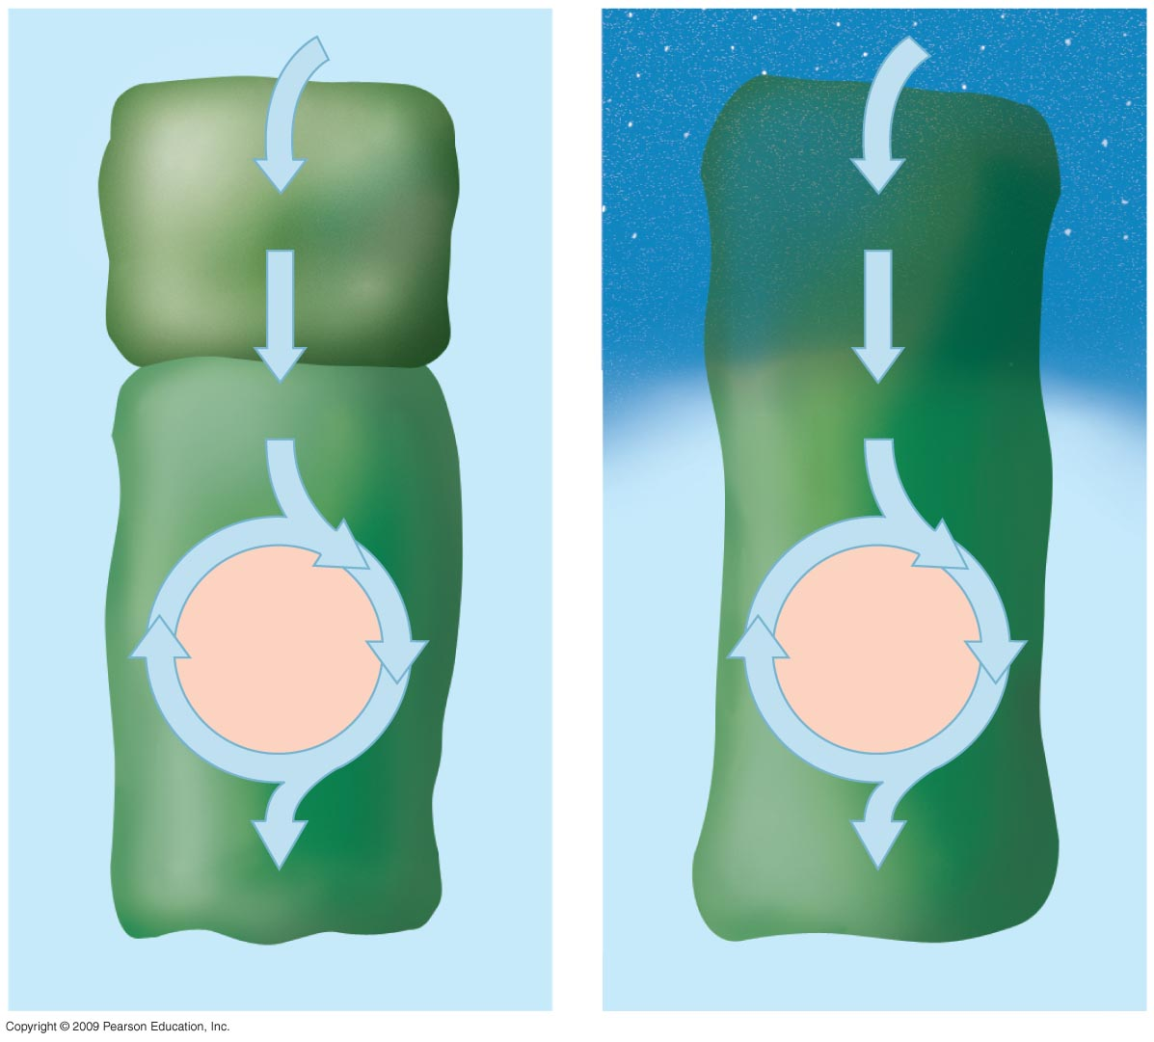
Mesophyll
cell
CO₂
CO₂
Night
4-C compound
4-C compound
CO₂
CO₂
CALVIN
CYCLE
CALVIN
CYCLE
Bundle-
sheath
cell
3-C sugar
3-C sugar
C₄ plant
CAM plant
Day
Notes:
Figure 7.12 Comparison of photosynthesis in C₄ and CAM plants: In both pathways, CO₂ is first incorporated into a four-carbon compound, which then provides CO₂ to the Calvin cycle.

Slide 20
Why the C3 problem?
We’ve all got
baggage!
Possibly evolutionary baggage
  Rubisco evolved in high CO₂ atmosphere
    there wasn’t strong selection against active site of Rubisco accepting both CO₂ & O₂
Today it makes a difference
  21% O₂ vs. 0.03% CO₂
  photorespiration can drain away 50% of carbon fixed by Calvin cycle on a hot, dry day
  strong selection pressure to evolve better way
  to fix carbon & minimize photorespiration

Slide 21
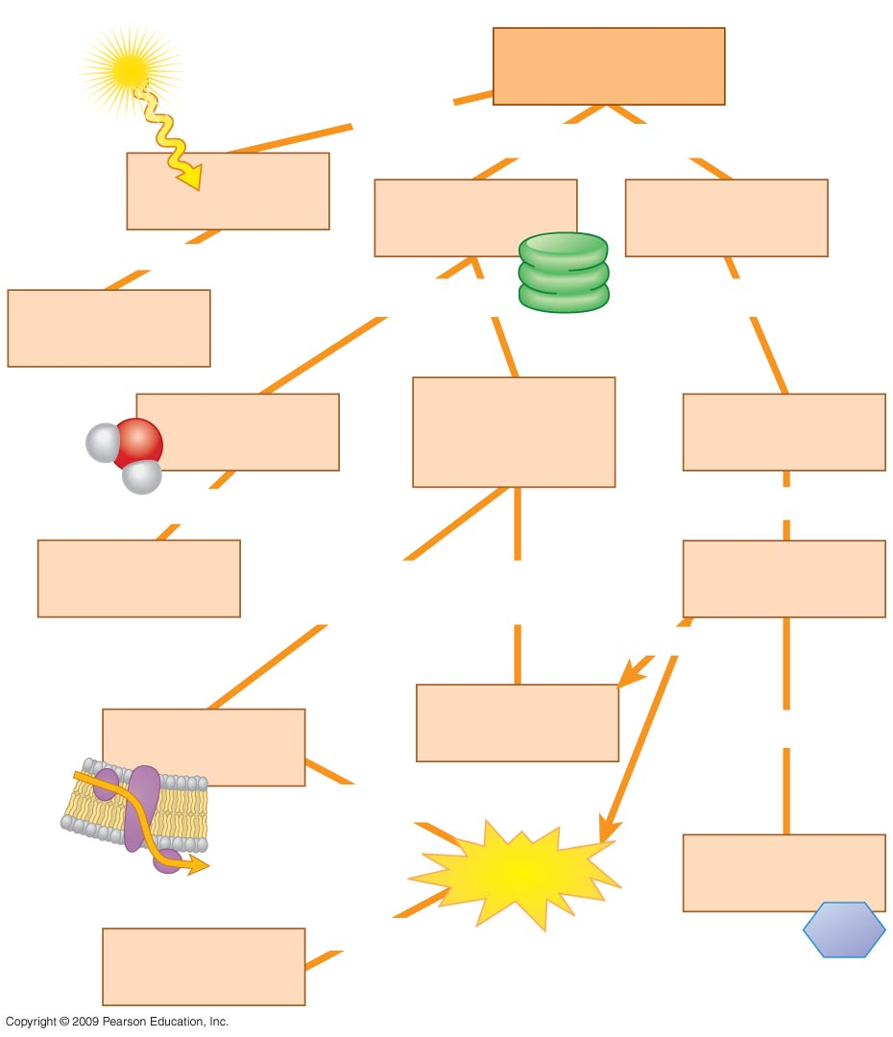
Photosynthesis
converts
includes both
(a)
(b)
(c)
to
chemical
energy
in which
in which
light-excited
electrons of
chlorophyll
CO₂ is fixed to
RuBP
H₂O is split
and
and then
(d)
are passed
down
reduce
NADP⁺ to
(h)
using
(f)
to produce
(e)
producing
(g)
sugar
(G3P)
by
chemiosmosis

