Slide 1
The Tree of Life Evolves
Changing Number of Kingdoms
Introduced
Names of Kingdoms
1700’s
Plantae
Animalia
Late 1800’s
Protista
Plantae
Animalia
1950’s
Monera
Protista
Fungi
Plantae
Animalia
1990’s
Eubacteria
Archae-bacteria
Protista
Fungi
Plantae
Animalia
Notes:
This diagram shows some of the ways organisms have been classified into kingdoms over the years. The six-kingdom system includes the following kingdoms: Eubacteria, Archaebacteria, Protista, Fungi, Plantae, and Animalia.

Slide 2
The Three-Domain System
The domain is a more inclusive category than any other—larger than a kingdom.
The three domains are:
Eukarya
protists, fungi, plants, and animals
Bacteria
Eubacteria
Archaea
Archaebacteria
Notes:
Molecular analyses have given rise to a new taxonomic category that is now recognized by many scientists. Modern classification is a rapidly changing science.
As new information is gained about organisms in the domains Bacteria and Archaea, they may be subdivided into additional kingdoms.

Slide 3
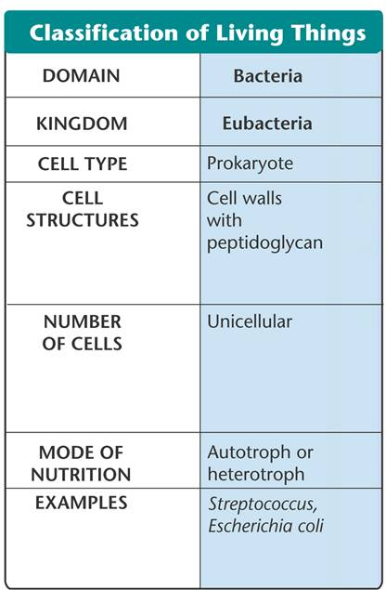
Domain Bacteria

Slide 4
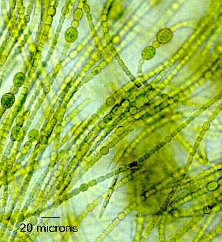
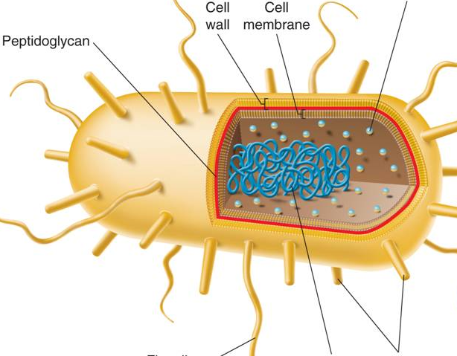
Domain Bacteria
Eubacteria
have a cell membrane
have a cell wall
Some have a second membrane that provides added protection
E. coli

Slide 5
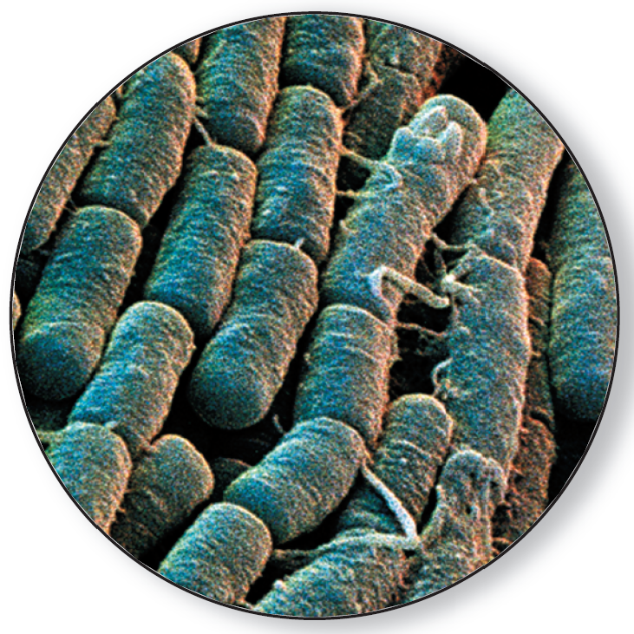
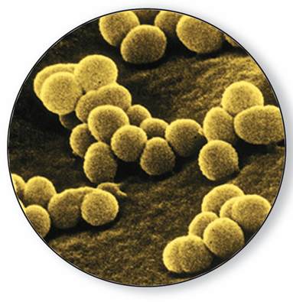
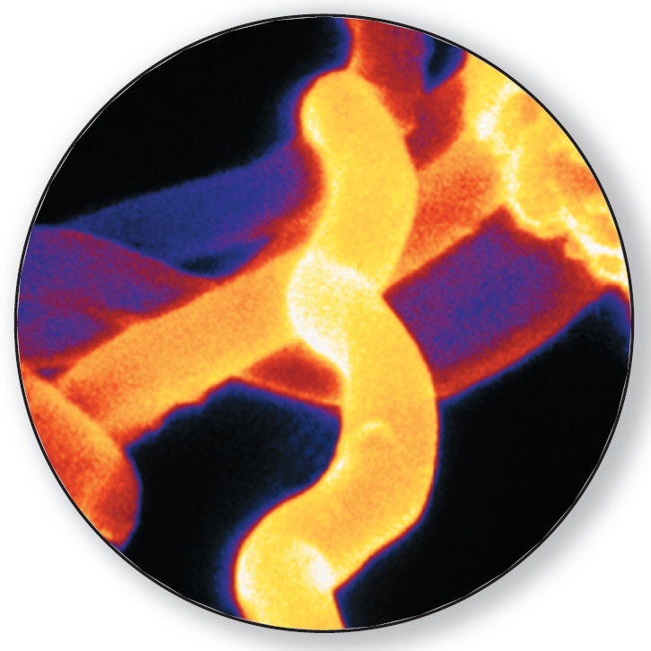
Eubacteria
Bacteria can be identified by their shape.
Rod-shaped are called bacilli.
Spherical are called cocci.
Spiral and corkscrew-shaped are called spirilla.
Notes:
Prokaryotes can be identified by their shapes. Photo Credit: ©David Scharf/Peter Arnold, Inc.

Slide 6
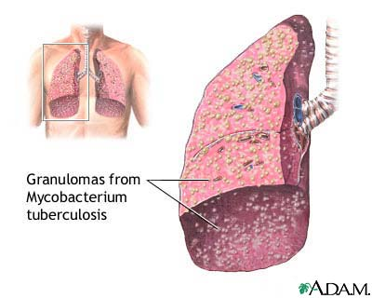
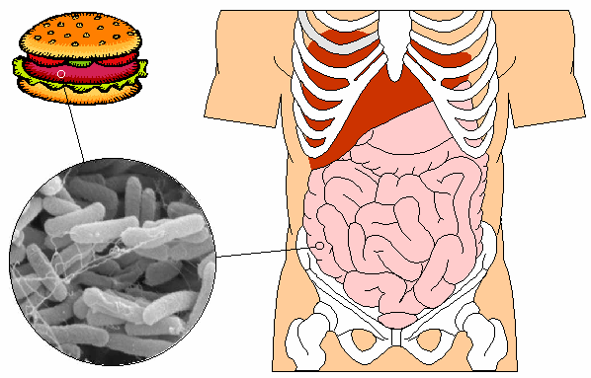
Importance of Bacteria
Some cause disease
use tissues of infected organism for food
Example: tuberculosis
release toxins (poisons)
Example: strains of E.coli (food poisoning)
Notes:
damage tissues of infected organism directly by breaking them down for food – example a heterotrophic bacteria causes tuberculosis, which breaks down lung tissue
release toxins (poisons) that harm the infected organism – example most food poisonings

Slide 7
Importance of Bacteria
Bacteria are vital to the living world.
Some are photosynthesis (produce oxygen)
some are decomposers - break down the nutrients in dead matter
Notes:
Some are producers that capture energy by photosynthesis (produce oxygen)
some are decomposers - break down the nutrients in dead matter
Bacteria recycle nutrients and maintain equilibrium in the environment.

Slide 8
Importance of Bacteria
Human Uses of Bacteria
We depend on bacteria for many things, including:
foods and beverages
removal of waste and poisons from water (detoxification)
mining minerals from the ground
synthesis of drugs and chemicals via genetic engineering
production of vitamins in human intestines
Notes:
bacteria are used to make cheese, yogurt, buttermilk, sour cream, pickles, sauerkraut, among other food
can digest oil to help clean oil spills, can remove waste products and poisons from water

Slide 9
How to Control Bacteria
In general
Sterilization: using intense heat or chemicals (disinfectants)
With food
Refrigeration
Canning
Cooking food thoroughly
Preserving
Notes:
Sterilization: destroying bacteria by subjecting them to great heat or chemicals; can be done using boiling water or disinfectants (chemical solutions that kill bacteria)
With food
Refrigeration: slows bacteria growth
Canning: heat food to high temperatures then immediately place into sterilized jar or can and seal
Cooking food thoroughly: sterilizes food by raising the temp of the food until the bacteria are killed
Preserving: treating food with everyday chemicals (salt, vinegar, sugar) to inhibit the growth of bacteria

Slide 10
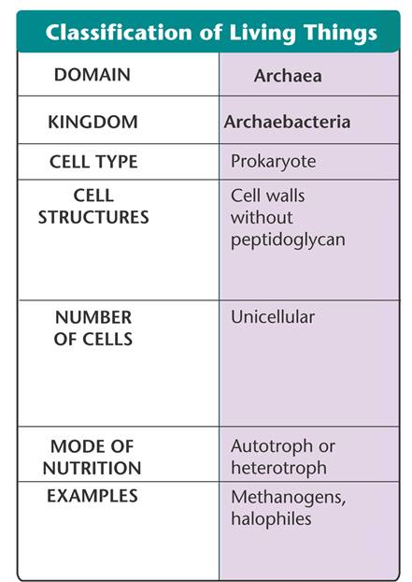
Domain Archaea

Slide 11
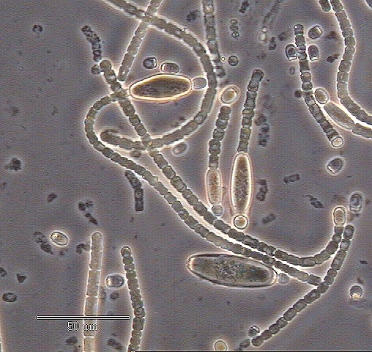
Domain Archaea
Archaebacteria
Cell membranes made of different material than eubacteria
Based on DNA, Archaebacteria are more closely related to eukaryotes than eubacteria

Slide 12
Domain Archaea
Many archaebacteria live in extreme environments.
Deep ocean volcanic vents
Geysers
Volcanoes
Yellowstone Geysers
Notes:
Methanogens live in oxygen-free environments, such as thick mud and animal digestive tracts.
Other archaebacteria live in salty environments or in hot springs where water temperatures approach the boiling point.

