Slide 1

Innate: Directed movements
Taxis
  change in direction
  automatic movement toward (positive taxis) or
  away from
  (negative taxis) a
  stimulus
    phototaxis
    chemotaxis
Kinesis
  change in rate of
  movement in
  response to a stimulus
Notes:
The sow bugs become more active in dry areas and less active in humid areas. Though sow bugs do not move toward or away from specific conditions, their increased movement under dry conditions increases the chance that they will leave a dry area and encounter a moist area. And since they slow down in a moist area, they tend to stay there once they encounter it.
In contrast to a kinesis, a taxis is a more or less automatic, oriented movement toward (a positive taxis) or away from (a negative taxis) some stimulus. For example, many stream fish, such as trout, exhibit positive rheotaxis (from the Greek rheos, current); they automatically swim or orient themselves in an upstream direction (toward the current). This taxis keeps the fish from being swept away and keeps them facing the direction from which food will come.

Slide 2

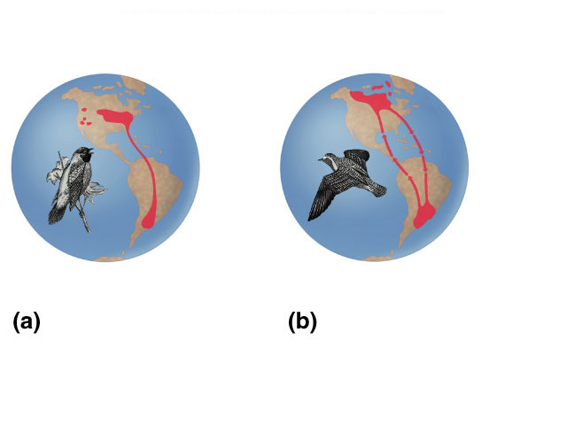
Complex Innate behaviors
Migration
  “migratory restlessness” seen in birds bred & raised in captivity
  navigate by sun, stars, Earth magnetic fields
ancient
fly-ways
Bobolink
Golden plover
Notes:
Bird migration, a behavior that is largely under genetic control. Each spring, migrating western sandpipers (Calidris mauri), such as those shown here, migrate from their wintering grounds, which may be as far south as Peru, to their breeding grounds in Alaska. In the autumn, they return to the wintering grounds.

Slide 3
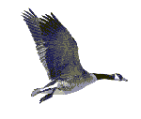
Innate & Learning: Imprinting
Learning to form social attachments at a specific critical period
  both learning & innate components
Konrad Lorenz
Notes:
But how do the young know on whom—or what—to imprint? How do young geese know that they should follow the mother goose? The tendency to respond is innate in the birds; the outside world provides the imprinting stimulus, something to which the response will be directed. Experiments with many species of waterfowl indicate that they have no innate recognition of “mother.” They respond to and identify with the first object they encounter that has certain key characteristics. In classic experiments done in the 1930s, Konrad Lorenz showed that the most important imprinting stimulus in graylag geese is movement of an object away from the young. When incubator–hatched goslings spent their first few hours with Lorenz rather than with a goose, they imprinted on him, and from then on, they steadfastly followed him and showed no recognition of their biological mother or other adults of their own species. Again, there are both proximate and ultimate explanations

Slide 4
Conservation
Conservation biologists have taken advantage of imprinting by young whooping cranes as a means to teach the
birds a migration
route. A pilot wearing
a crane suit in an
Ultralight plane acts
as a surrogate parent.
Notes:
Cranes also imprint as hatchlings, creating both problems and opportunities in captive rearing programs designed to save endangered crane species. For instance, a group of 77 endangered whooping cranes hatched and raised by sandhill cranes imprinted on the sandhill foster parents; none of these whooping cranes ever formed a mating pair–bond with another whooping crane. As a consequence, captive breeding programs now isolate young cranes and expose them to the sights and sounds of members of their own species. But imprinting can also be used to aid crane conservation
Young whooping cranes imprinted on humans in “crane suits” have been taught to follow these “parents” flying ultralight aircraft along new migration routes. And importantly, such cranes have formed mating pair–bonds with other whooping cranes.

Slide 5
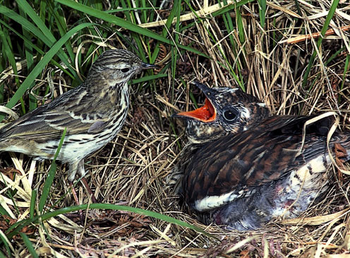
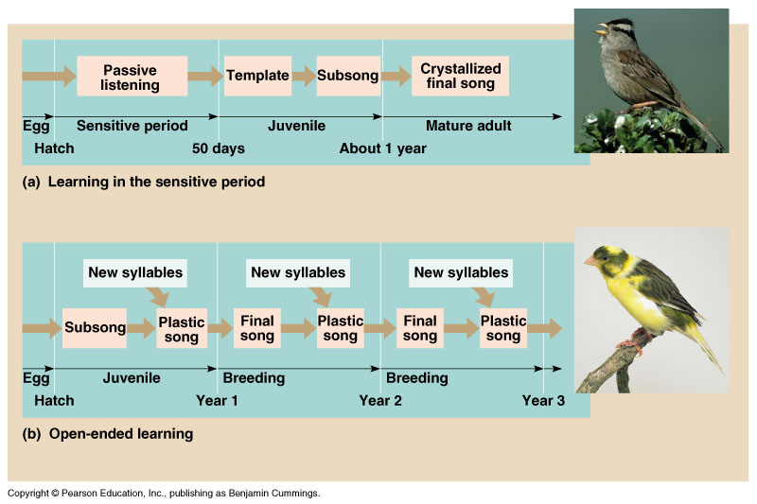
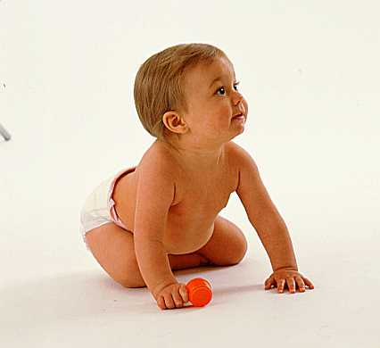
Critical period
Sensitive phase for optimal imprinting
  some behavior must be learned during a receptive time period
As a brood parasite, the Cuckoo never learn the song of their species as a nestling. Song development is totally innate.
imprinting/critical period in humans?

Slide 6
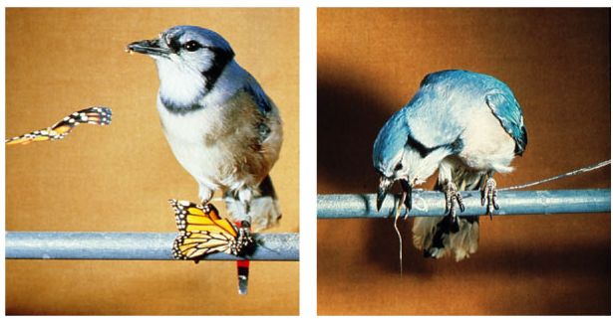
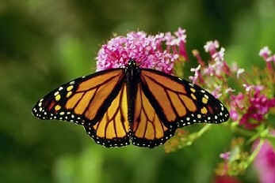
Learned behavior
Associative learning
  learning to associate
  a stimulus with a consequence
    operant conditioning
      trial & error learning
      associate behavior with reward or punishment
      ex: learning what to eat
    classical conditioning
      Pavlovian conditioning
      associate a “neutral stimulus” with a “significant stimulus”

Slide 7
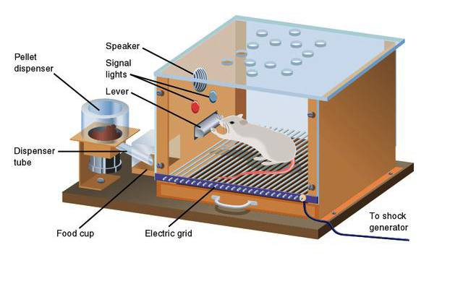
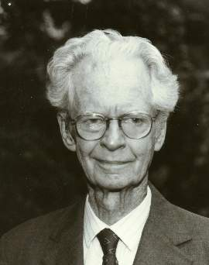
Operant conditioning
Skinner box
B. F. Skinner
mouse learns to associate behavior (pressing lever) with reward (food pellet)

Slide 8
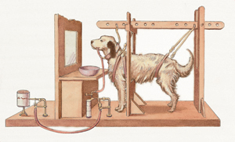
Classical conditioning
Ivan Pavlov’s dogs
  connect reflex behavior (salivating at sight of food) to associated stimulus (ringing bell)

Slide 9
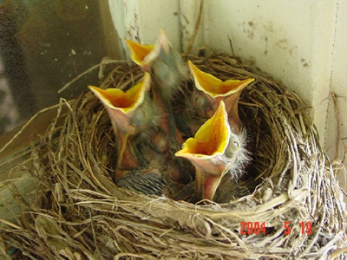
Learning: Habituation
Loss of response to stimulus
  “cry-wolf” effect
  decrease in response to repeated occurrences of stimulus
  enables animals to disregard unimportant stimuli
    ex: falling leaves not triggering fear response in baby birds

Slide 10
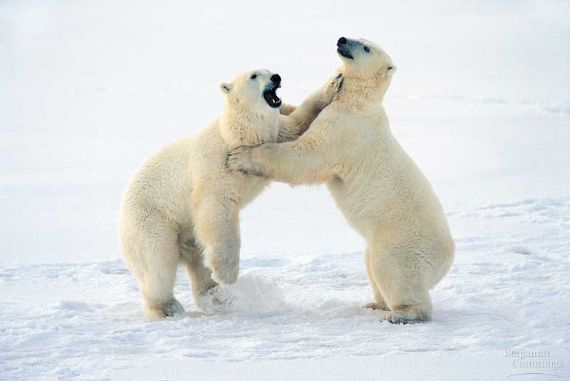
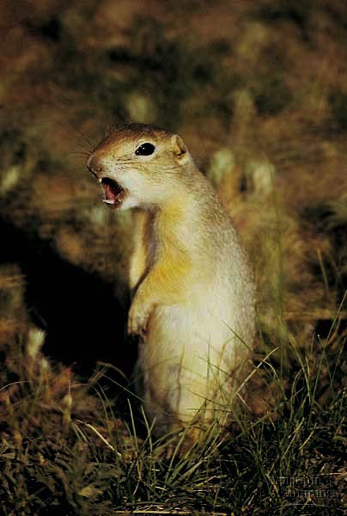
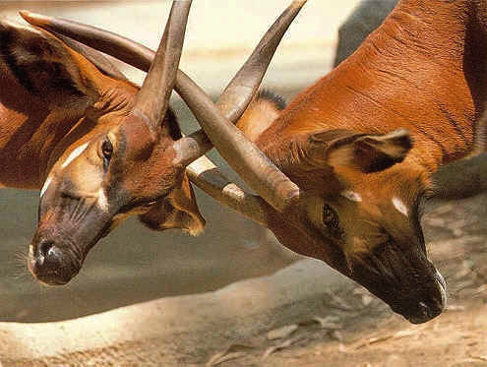
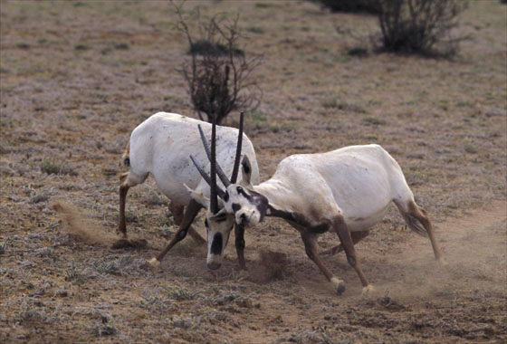
Social behaviors
Interactions between individuals
  develop as evolutionary adaptations
  communication / language
  agonistic behaviors
  dominance hierarchy
  cooperation
  altruistic behavior

Slide 11
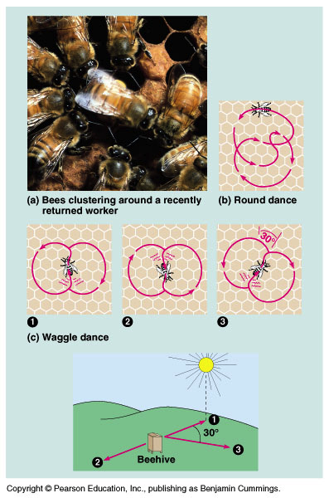
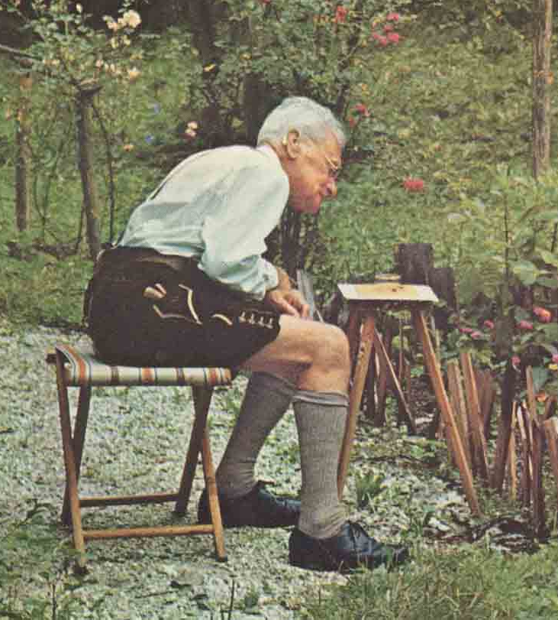
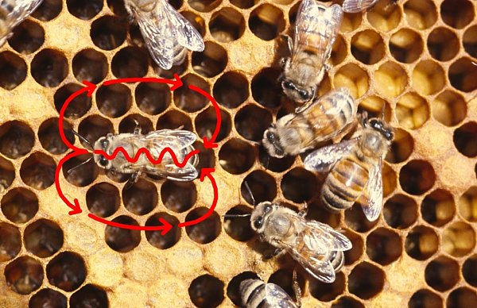
Language
Let’s go to
the videotape!
Honey bee communication
  dance to communicate location of food source
  waggle dance
Notes:
View Waggle Dance AVI file: waggledance180x135.avi

Slide 12
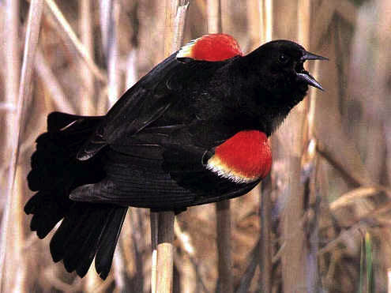

Communication by song
Bird song
  species identification & mating ritual
  mixed learned & innate
  critical learning period
Insect song
  mating ritual & song
  innate, genetically
  controlled
Red-winged blackbird

Slide 13
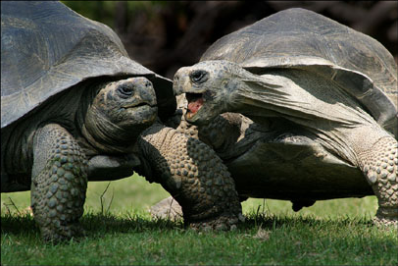
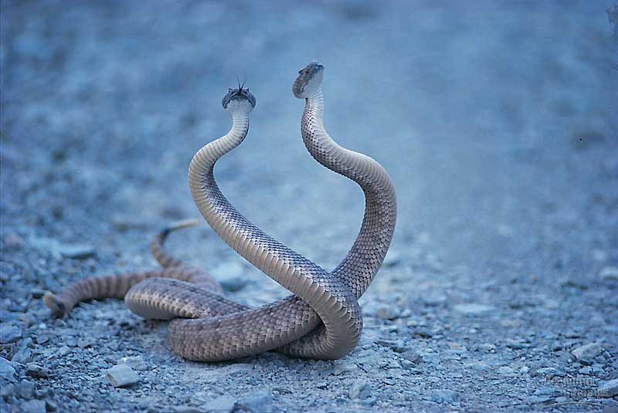
Social behaviors
Agonistic behaviors
  threatening & submissive rituals
    symbolic, usually no harm done
  ex: territoriality, competitor aggression
Let’s go to
the videotape!
Notes:
View Lifewire territoriality video: “lizards cost of defending-lifewire.swf”
Review setting up a behavior experiment:

Slide 14
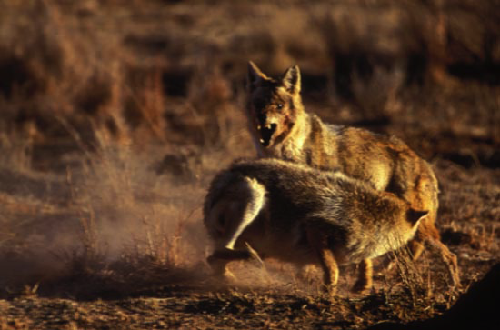
Social behaviors
Dominance hierarchy
  social ranking within a group
    pecking order

Slide 15
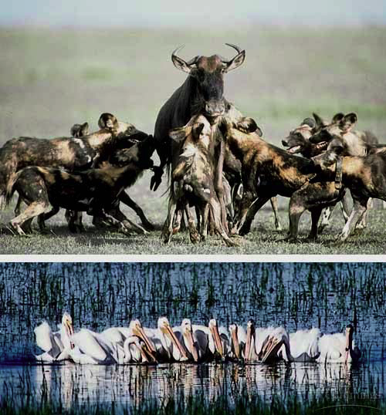
Social behaviors
Cooperation
  working together in coordination
Pack of African dogs hunting wildebeest cooperatively
White pelicans “herding” school of fish

Slide 16
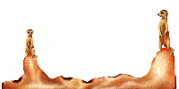
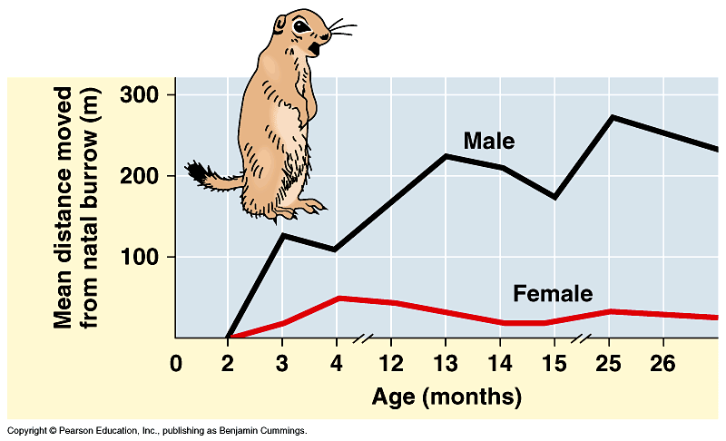
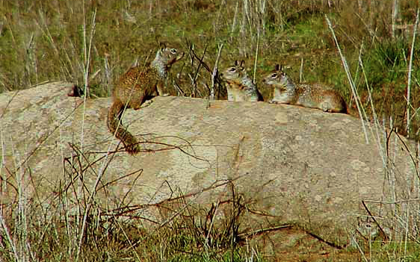
Social behaviors
Altruistic behavior
  reduces individual fitness but
  increases fitness of recipient
  kin selection
    increasing survival of close relatives passes
    these genes on to the next generation
I would lay
down my life for
2 brothers or
8 cousins!
How can this be of adaptive value?
Belding ground squirrel

Slide 17



Social interaction requires communication
Pheromones
  chemical signal that stimulates a response from other individuals
    alarm pheromones
    sex pheromones

Slide 18


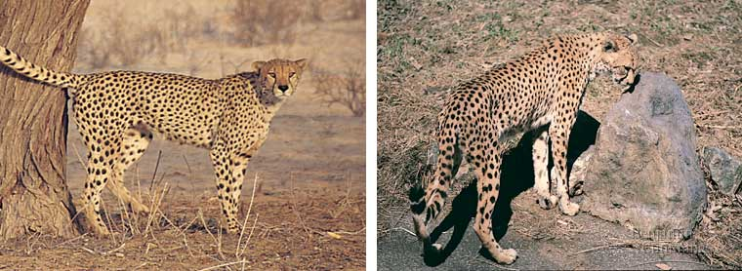


Pheromones
human sex pheromone?
Female mosquito use CO₂ concentrations to locate victims
marking territory
Spider using moth sex pheromones, as allomones, to lure its prey
The female lion lures male by spreading sex pheromones, but also by posture & movements
Notes:
The luring function of sex pheromones is a perfect way for predators to get heir prey without having to work too hard. The spider Mastophora hutchinsoni spreads sex pheromones of moths, using them as allomones. This way he can lure about enough moths to sustain. When the moths fly in, convinced they are about to mate, the spider shoots a sticky ball on wire towards them. As they stick to the ball, he drags them in and eats them.

Slide 19

Colonial mammals
convergent evolution:
bees, ants, termites…
mole rats
Naked mole rats
  underground colony, tunnels
  queen, breeding males, non-breeding workers
  hairless, blind
“Picture a hot dog that's been left in a microwave a little too long…add some buck teeth at one end, and you've got a fairly good idea of what a Naked Mole Rat looks like.”

Slide 20
Mating & parental behavior
Genetic influences
  changes in behavior at different stages of mating
    pair bonding
    competitor aggression
Environmental influences
  modifies behavior
    quality of diet
    social interactions
    learning opportunities

