Slide 1
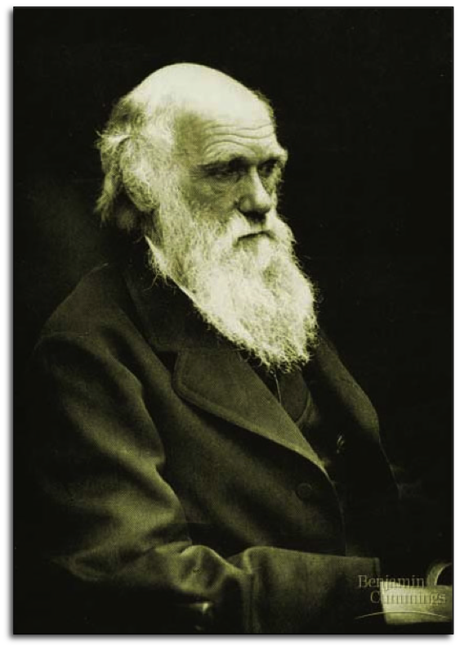
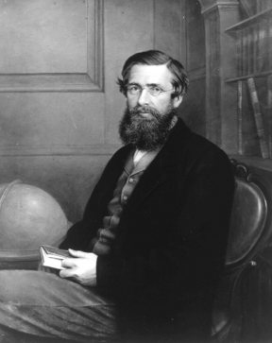
Evolution by Natural Selection

Slide 2
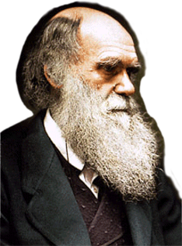
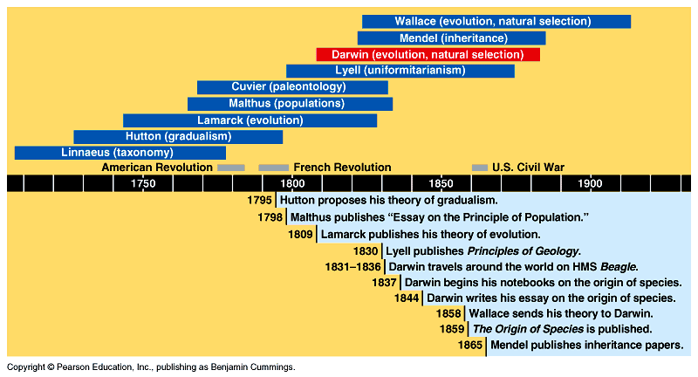
Darwin In historical context
“Science Does Not Happen In A Vacuum”
competition:
struggle for survival
population growth
exceeds food supply
land masses change over
immeasurable time

Slide 3
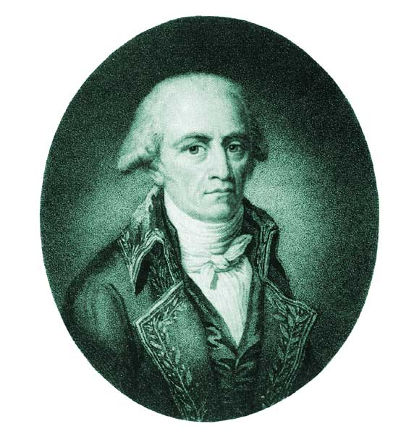
Jean-Baptiste LaMarck
Organisms adapted to their environments by acquiring traits
    Use &Disuse
    organisms lose parts because they don’t use them.
    Perfection with Use & Need
    the constant use of an organ leads that organ to increase in utility.
  transmit acquired characteristics to offspring
Notes:
Lamarck noted how well-adapted organisms were to their environments, and believed that fossils could be understood as less perfect forms which had perished in the struggle for increasing perfection. He explained adaptation as a result of change caused by environmental pressures.

Slide 4
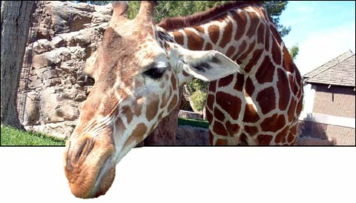
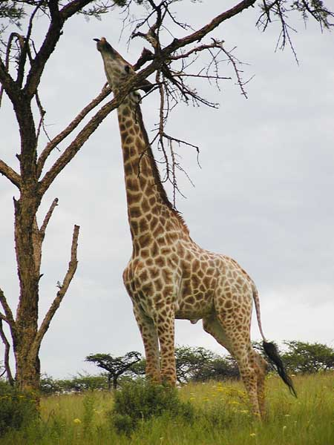
LaMarckian vs. Darwinian view
LaMarck
  in reaching higher
  vegetation giraffes
  stretch their necks & transmits the acquired longer neck to offspring
Darwin
  giraffes born with longer necks survive better & leave more offspring who inherit their long necks
✓

Slide 5
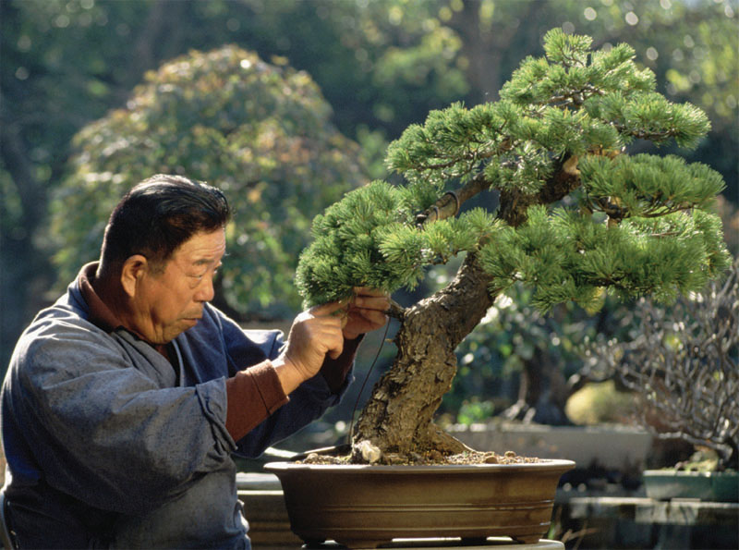
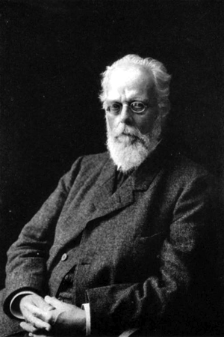
Acquired traits cannot be inherited
A.Weismann

Slide 6
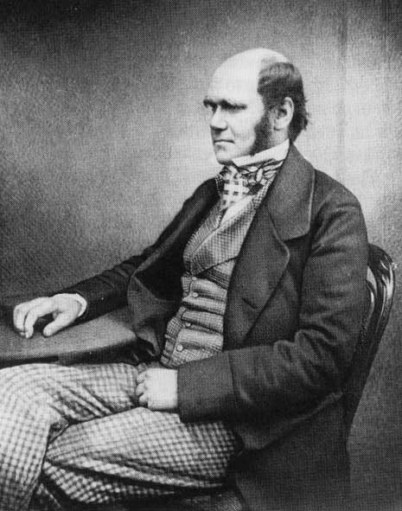
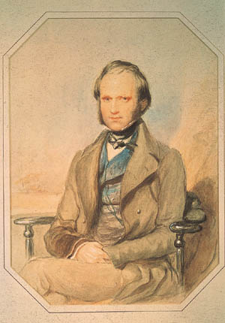
Charles Darwin
1809-1882
British naturalist
Evolution by natural selection
Supported the theory with evidence.
Notes:
What did Darwin say?
What evidence supports Evolution by Natural Selection?
What impact did Evolution have on biology?
Figure 22.5 The voyage of HMS Beagle
For the Discovery Video Charles Darwin, go to Animation and Video Files.
As a boy and into adulthood, Charles Darwin had a consuming interest in nature
Darwin first studied medicine (unsuccessfully), and then theology at Cambridge University

Slide 7
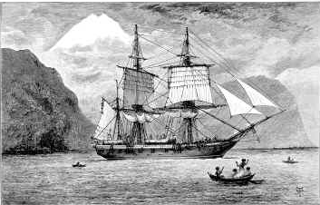
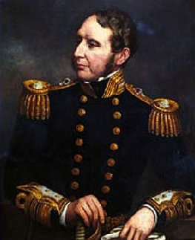
Voyage of the HMS Beagle
Traveled around the world
  1831-1836 (22 years old!)
  makes many observations of nature
Robert Fitzroy
Notes:
After graduating, he took an unpaid position as naturalist and companion to Captain Robert FitzRoy for a 5-year around the world voyage on the Beagle
During his travels on the Beagle, Darwin collected specimens of South American plants and animals
He observed adaptations of plants and animals that inhabited many diverse environments
Darwin was influenced by Lyell’s Principles of Geology and thought that the earth was more than 6000 years old

Slide 8
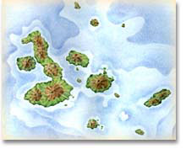
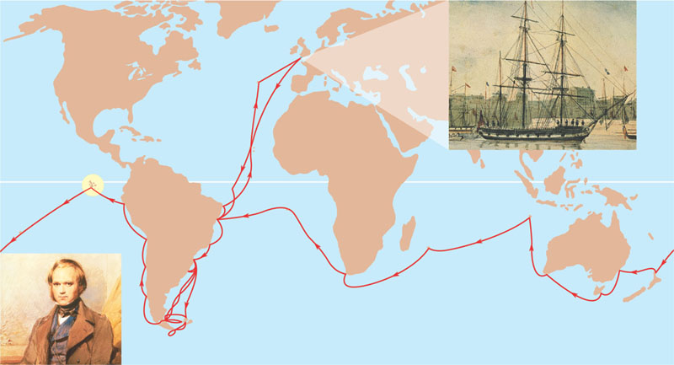
Voyage of the HMS Beagle
Stopped in Galapagos Islands
  500 miles off coast of Ecuador
England
EUROPE
NORTH
AMERICA
PACIFIC
OCEAN
ATLANTIC
OCEAN
Galápagos
Islands
AFRICA
HMS Beagle in port
SOUTH
AMERICA
Darwin in 1840,
after his return
AUSTRALIA
Andes
Cape of
Good Hope
Tasmania
Cape Horn
New
Zealand
Tierra del Fuego
Notes:
The origin of the fauna of the Galapagos, 900 km west of the South American coast, especially puzzled Darwin.
On further study after his voyage, Darwin noted that while most of the animal species on the Galapagos lived nowhere else, they resembled species living on the South American mainland.
It seemed that the islands had been colonized by plants and animals from the mainland that had then diversified on the different islands
His interest in geographic distribution of species was kindled by a stop at the Galápagos Islands near the equator west of South America
Darwin’s observations of biogeography, the geographic distribution of species, formed an important part of his theory of evolution
Islands have many endemic species that are often closely related to species on the nearest mainland or island
Earth’s continents were formerly united in a single large continent called Pangaea, but have since separated by continental drift
An understanding of continent movement and modern distribution of species allows us to predict when and where different groups evolved

Slide 9
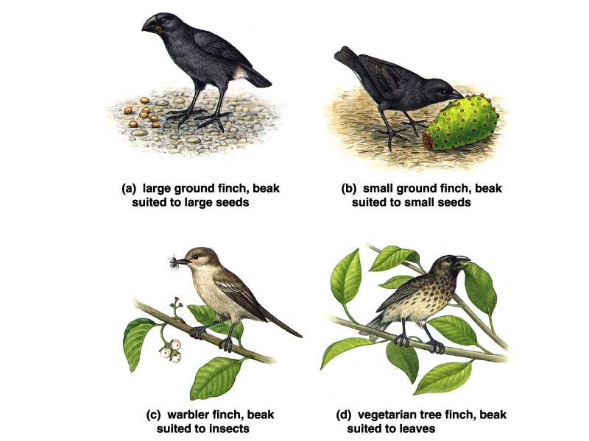
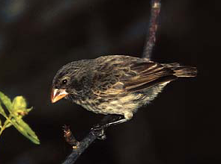
Darwin found… birds
Collected many different birds on the Galapagos Islands.
Thought he found
very different kinds…
Finch?
Finch?
Sparrow?
Sparrow?
Warbler?
Woodpecker?
Warbler?
Woodpecker?

Slide 10
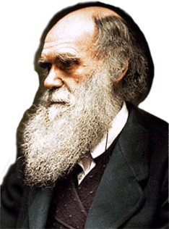
But Darwin found… a lot of finches
Darwin was amazed to
find out:
All 14 species of birds
were finches…
But there is only one species of finch on the mainland!
Large Ground
Finch
Small Ground Finch
Finch?
Sparrow?
How did
one species
of finches become
so many different
species now?
Warbler Finch
Veg. Tree Finch
Woodpecker?
Warbler?
Notes:
In reassessing his observations, Darwin perceived adaptation to the environment and the origin of new species as closely related processes
From studies made years after Darwin’s voyage, biologists have concluded that this is indeed what happened to the Galápagos finches

Slide 11
The Origin of Species
Darwin developed two main ideas:
  Descent with modification explains life’s unity and diversity
  Natural selection is a cause of adaptive evolution
Copyright © 2008 Pearson Education, Inc., publishing as Pearson Benjamin Cummings
Notes:
In 1844, Darwin wrote an essay on the origin of species and natural selection but did not introduce his theory publicly, anticipating an uproar
In June 1858, Darwin received a manuscript from Alfred Russell Wallace, who had developed a theory of natural selection similar to Darwin’s
Darwin quickly finished The Origin of Species and published it the next year
Darwin never used the word evolution in the first edition of The Origin of Species
The phrase descent with modification summarized Darwin’s perception of the unity of life
The phrase refers to the view that all organisms are related through descent from an ancestor that lived in the remote past

Slide 12
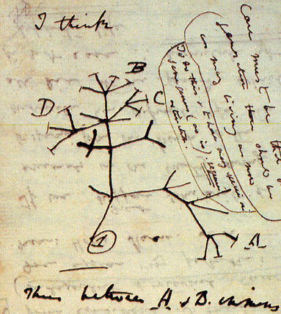
“Tree Thinking”
Descendant
species
Ancestral
species
Large-seed eater?
Large Ground
Finch
Small-seed eater?
Small Ground
Finch
Warbler?
Leaf-browser?
Warbler Finch
Veg. Tree Finch
Notes:
Darwin noted that the plants and animals of South America were very distinct from those of Europe.
Organisms from temperate regions of South America were more similar to those from the tropics of South America than to those from temperate regions of Europe.
Further, South American fossils more closely resembled modern species from that continent than those from Europe.
Figure 22.7 “I think . . .”
In the Darwinian view, the history of life is like a tree with branches representing life’s diversity
Darwin’s theory meshed well with the hierarchy of Linnaeus

Slide 13
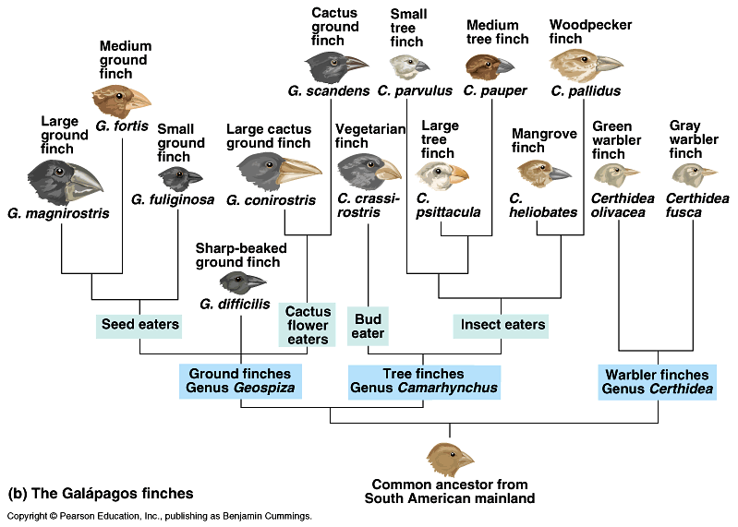
Correlation of species to food source
Seed
eaters
Flower
eaters
Insect
eaters
Rapid speciation:
new species filling new niches,
because they inherited
successful adaptations.
Adaptive radiation

Slide 14
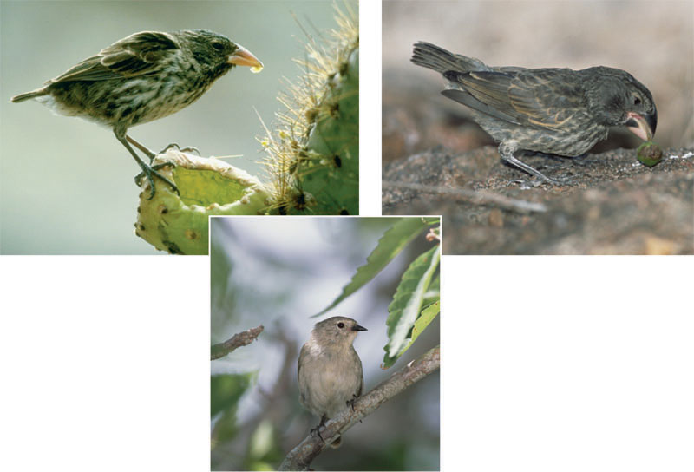
Beak variation in Galápagos finches
(a) Cactus eater. The long,
sharp beak of the cactus
ground finch (Geospiza
scandens) helps it tear
and eat cactus flowers
and pulp.
(c) Seed eater. The large ground
finch (Geospiza magnirostris)
has a large beak adapted for
cracking seeds that fall from
plants to the ground.
(b) Insect eater. The green warbler
finch (Certhidea olivacea) uses its
narrow, pointed beak to grasp insects.

Slide 15
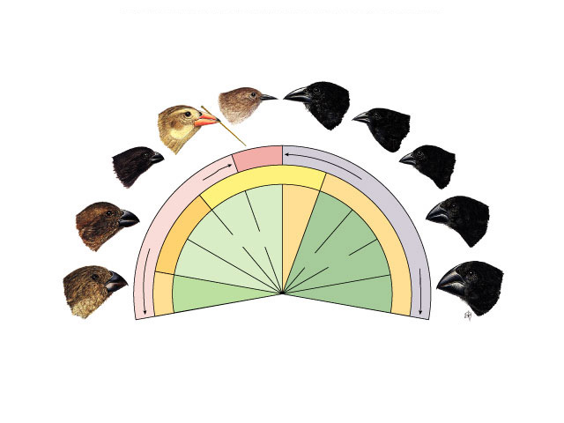
Darwin’s finches
Differences in beaks
  associated with food type
  Adaptations to available food on islands led to differential survival and reproduction
Warbler finch
Cactus finch
Woodpecker finch
Sharp-beaked finch
Small insectivorous
tree finch
Warbler
finch
Small ground
finch
Large
insectivorous
tree finch
Cactus
eater
Tree finches
Medium
ground finch
Ground finches
Insect eaters
Seed eaters
Vegetarian
tree finch
Large
ground finch
Bud eater

Slide 16

Darwin’s finches
Darwin’s conclusions
  small populations of original South American finches landed on islands
    variation in beaks enabled individuals to gather food successfully in the different environments
  over many generations, the populations of finches changed anatomically & behaviorally
    accumulation of advantageous traits in population
    emergence of different species

Slide 17
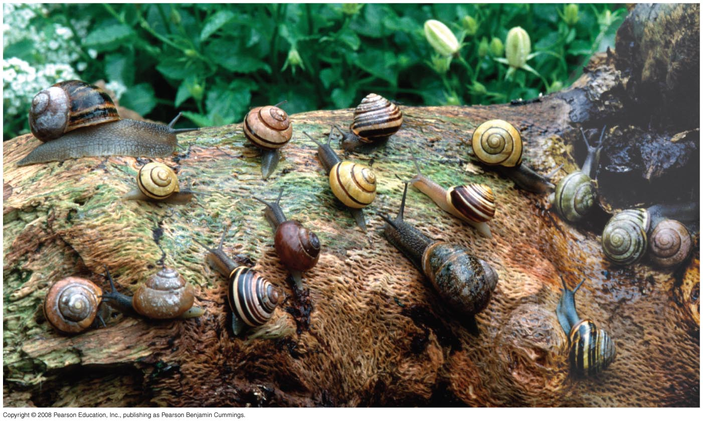
Observation #1: Members of a population often vary greatly in their traits
Copyright © 2008 Pearson Education, Inc., publishing as Pearson Benjamin Cummings
Notes:
Darwin then described four observations of nature and from these drew two inferences

Slide 18
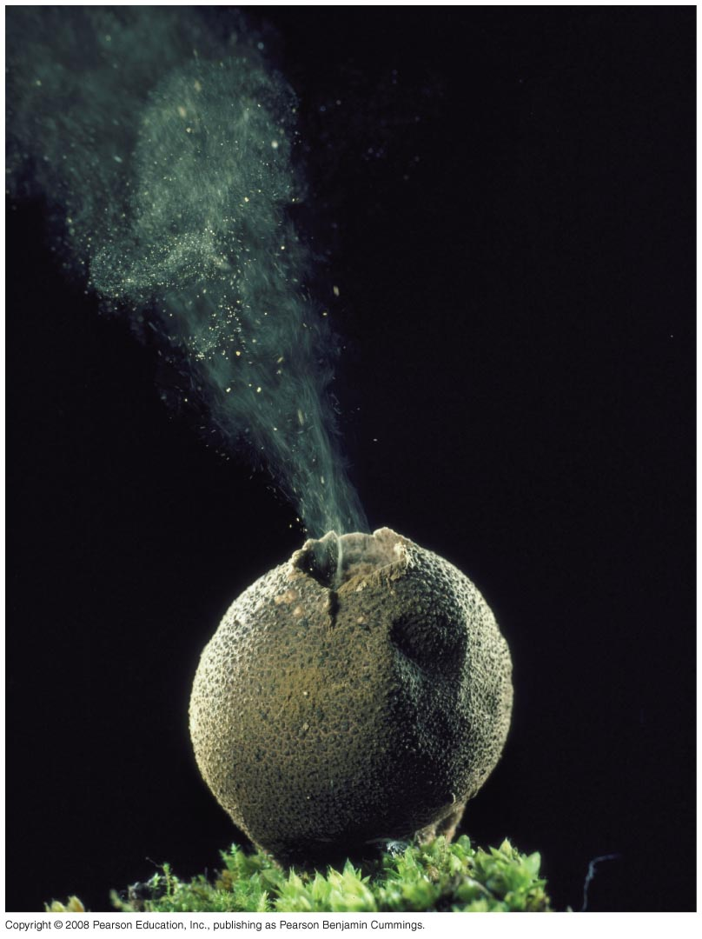
Observation #2: Traits are inherited from parents to offspring
Observation #3: All species are capable of producing more offspring than the environment can support
Observation #4: Owing to lack of food or other resources, many of these offspring do not survive
Copyright © 2008 Pearson Education, Inc., publishing as Pearson Benjamin Cummings

Slide 19
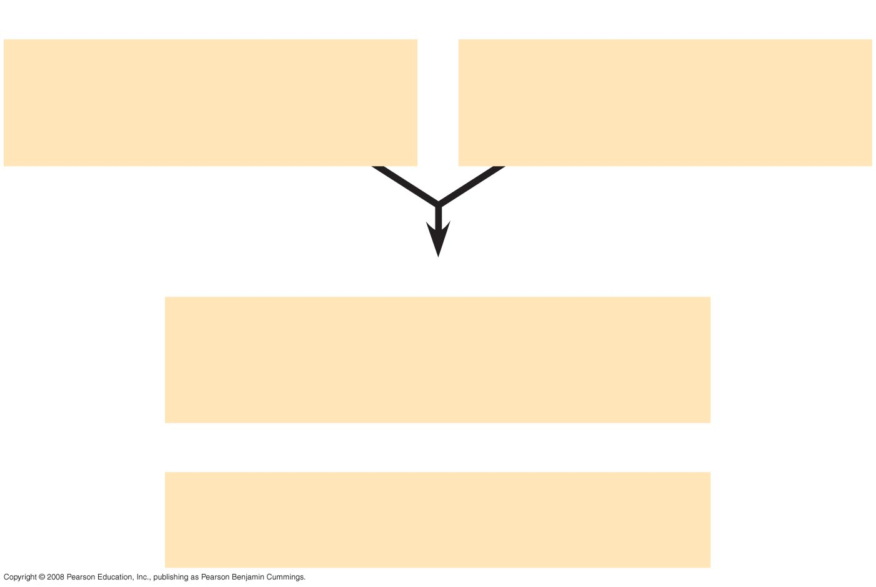
Fig. 22-UN1
Observations
Individuals in a population
vary in their heritable
characteristics.
Organisms produce more
offspring than the
environment can support.
Inferences
Individuals that are well suited
to their environment tend to leave
more offspring than other individuals
and
Over time, favorable traits
accumulate in the population.

Slide 20
Note that individuals do not evolve; populations evolve over time
Natural selection can only increase or decrease heritable traits in a population
Adaptations vary with different environments
Copyright © 2008 Pearson Education, Inc., publishing as Pearson Benjamin Cummings
Notes:
New discoveries continue to fill the gaps identified by Darwin in The Origin of Species
Two examples provide evidence for natural selection: the effect of differential predation on guppy populations and the evolution of drug-resistant HIV

Slide 21
Natural selection does not create new traits, but edits or selects for traits already present in the population
The local environment determines which traits will be selected for or selected against in any specific population
Copyright © 2008 Pearson Education, Inc., publishing as Pearson Benjamin Cummings

Slide 22
Essence of Darwin’s ideas
Natural selection
  variation exists in populations
  over-production of offspring
    more offspring than the environment can support (Malthus)
  competition
    for food, mates, nesting sites, escape predators
  differential survival
    successful traits = adaptations
  differential reproduction
    adaptations become more
    common in population

Slide 23
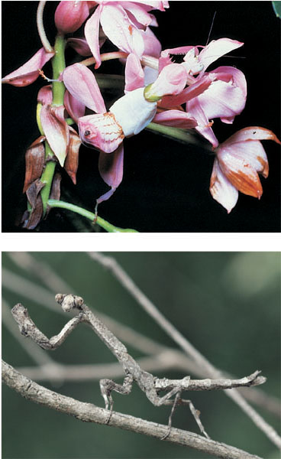
Variation in body color = Camouflage as an example of evolutionary adaptation
(a) A flower mantid
in Malaysia
(b) A stick mantid
in Africa

Slide 24
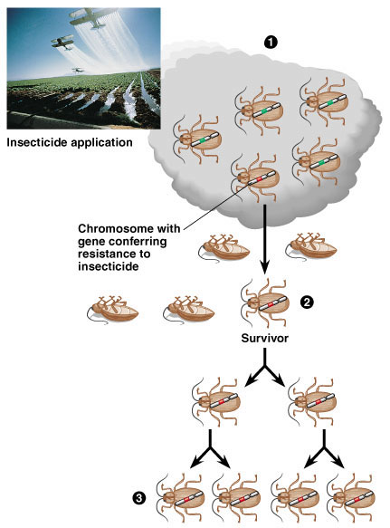
Natural selection in action
Insecticide &
drug resistance
  insecticide doesn’t
  kill all individuals
  resistant survivors reproduce
  resistance is inherited
  insecticide becomes less & less effective
Notes:
The evolution of resistance to insecticides in hundreds of insect species is a classic example of natural selection in action.
The results of application of new insecticide are typically encouraging, killing 99% of the insects.
However, the effectiveness of the insecticide becomes less effective in subsequent applications. The few survivors from the early applications of the insecticide are those insects with genes that enable them to resist the chemical attack. Only these resistant individuals reproduce, passing on their resistance to their offspring. In each generation the % of insecticide-resistant individuals increases.

Slide 25
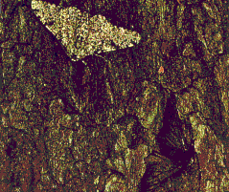
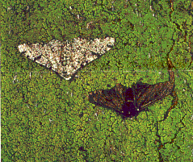
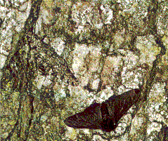
Peppered Moths
Dark vs. light variants
Year % dark % light
1848 5 95
1895 98 2
1995 19 81

Slide 26
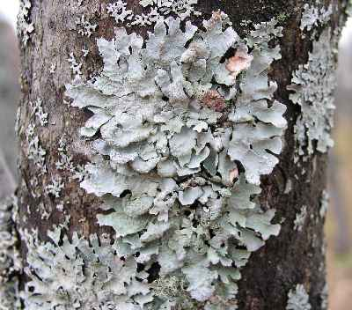
Peppered moth
What was the selection factor?
  early 1800s = pre-industrial England
    low pollution
    lichen growing on trees = light colored bark
  late 1800s = industrial England
    factories = soot coated trees
    killed lichen = dark colored bark
  mid 1900s = pollution controls
    clean air laws
    return of lichen = light colored bark
  industrial melanism

Slide 27
What Is Theoretical About Darwin’s View of Life?
In science, a theory accounts for many observations and data and attempts to explain and integrate a great variety of phenomena
Darwin’s theory of evolution by natural selection integrates diverse areas of biological study and stimulates many new research questions
Ongoing research adds to our understanding of evolution
Copyright © 2008 Pearson Education, Inc., publishing as Pearson Benjamin Cummings

Slide 28
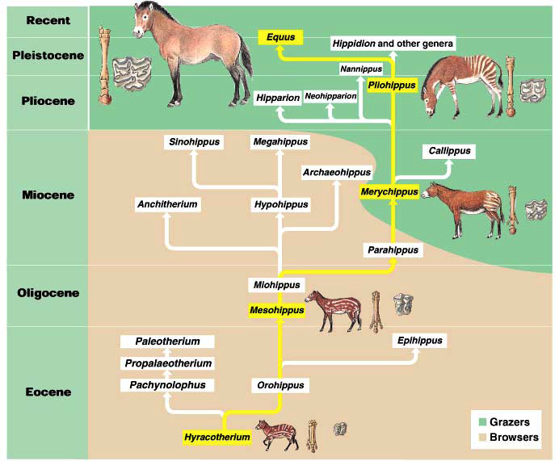
Evolution is not goal-oriented
An evolutionary trend does not mean that evolution is goal-oriented.
Surviving species
do not represent
the peak of
perfection. There
is compromise &
random chance
involved as well
Remember that for
humans as well!
Evolution is not the survival of the fittest. Rather it is the survival of the just good enough.

Slide 29
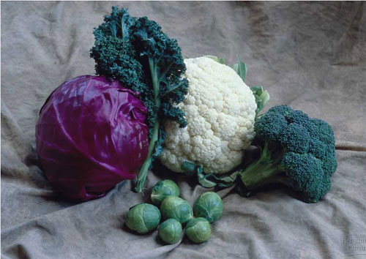
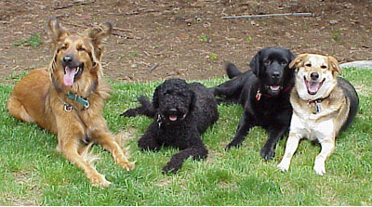
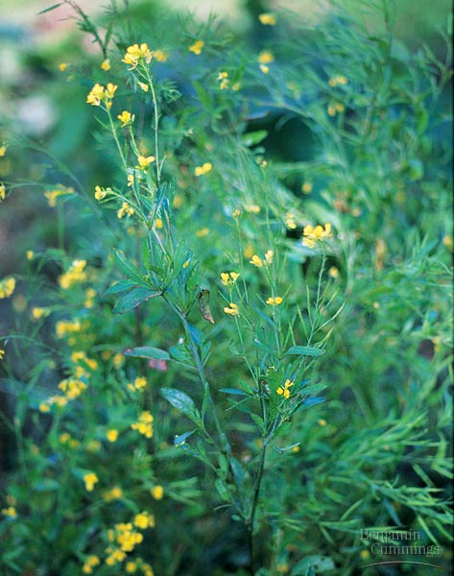
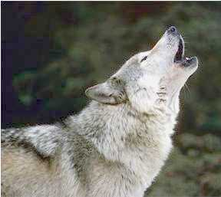
Artificial selection
Artificial breeding can use variations in populations to create vastly different “breeds” & “varieties”
“descendants” of wild mustard
“descendants” of the wolf

Slide 30
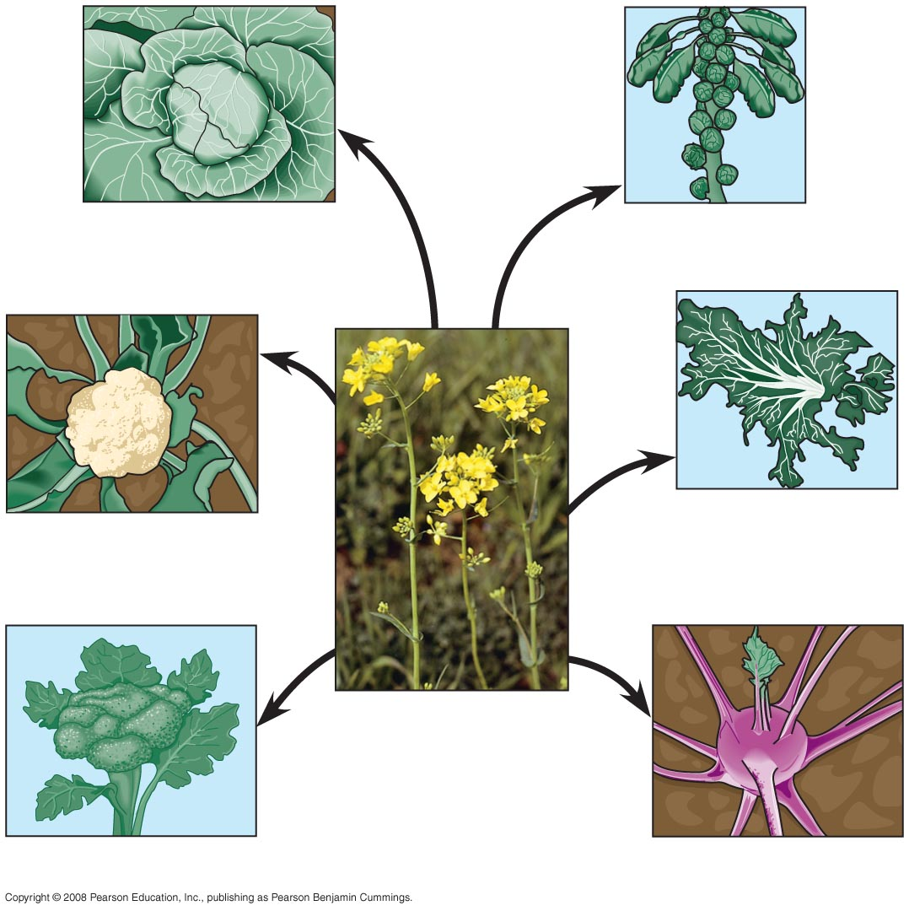
Fig. 22-9
Terminal
bud
Lateral
buds
Cabbage
Brussels sprouts
Flower
clusters
Leaves
Kale
Cauliflower
Stem
Wild mustard
Flowers
and stems
Broccoli
Kohlrabi
Notes:
Figure 22.9 Artificial selection
Darwin noted that humans have modified other species by selecting and breeding individuals with desired traits, a process called artificial selection

Slide 31
1. Increased UV irradiation causes the skin of humans to become more darkly pigmented over a period of days. The notion that the offspring of such tanned individuals should consequently inherit darkened skin from their parents is consistent with the ideas of
  Charles Darwin.
  Carolus Linnaeus.
  Alfred Wallace.
  Jean Baptiste Lamarck.
  Charles Lyell.
Notes:
Answer: d
Source: Barstow - Test Bank for Biology, Seventh Edition, Question #8

Slide 32
Acquired Characteristics
  Are passed on to offspring, regardless of the parent who possesses them.
  Are the basis for all variation in a population
  Can not be inherited
  Are the raw material for natural selection
  Are passed on to offspring only if the mother acquires them
Notes:
c

