Slide 1
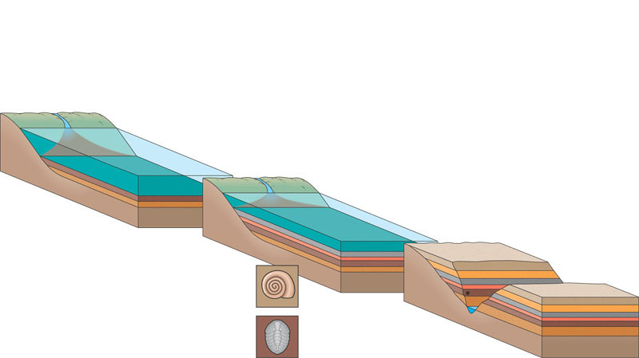
Formation of sedimentary strata containing fossils
1 Rivers carry sediment to the
ocean. Sedimentary rock layers
containing fossils form on the
ocean floor.
2 Over time, new strata are
deposited, containing fossils
from each time period.
3 As sea levels change and the seafloor
is pushed upward, sedimentary rocks are
exposed. Erosion reveals strata and fossils.
Younger stratum
with more recent
fossils
Older stratum
with older fossils
Notes:
Figure 22.3 Formation of sedimentary strata with fossils
The study of fossils helped to lay the groundwork for Darwin’s ideas
Fossils are remains or traces of organisms from the past, usually found in sedimentary rock, which appears in layers or strata
Paleontology, the study of fossils, was largely developed by French scientist Georges Cuvier
Cuvier advocated catastrophism, speculating that each boundary between strata represents a catastrophe
Geologists James Hutton and Charles Lyell perceived that changes in Earth’s surface can result from slow continuous actions still operating today
Lyell’s principle of uniformitarianism states that the mechanisms of change are constant over time
This view strongly influenced Darwin’s thinking
The fossil record provides evidence of the extinction of species, the origin of new groups, and changes within groups over time

Slide 2
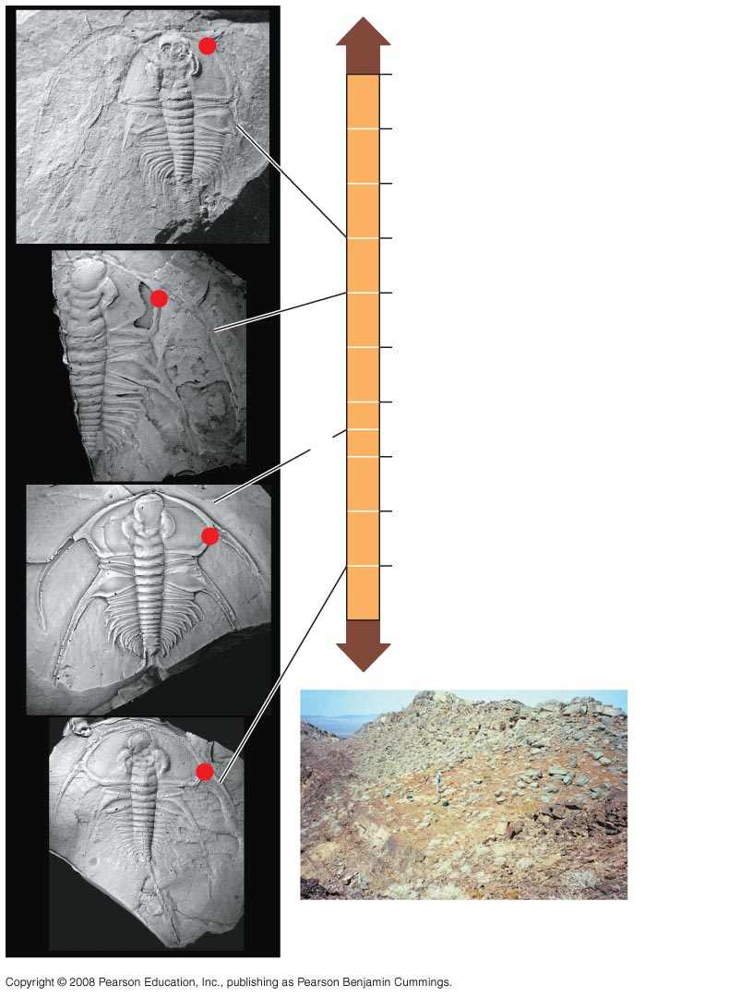
Fig. 22-15
0
2
4
4
6
4
Bristolia insolens
8
3
Bristolia bristolensis
10
12
3
Depth (meters)
Bristolia harringtoni
14
2
16
18
1
Bristolia mohavensis
3
2
1
Latham Shale dig site, San
Bernardino County, California
Notes:
Figure 22.15 Fossil evidence of evolution in a group of trilobites
The fossil record provides evidence of the extinction of species, the origin of new groups, and changes within groups over time
The Darwinian view of life predicts that evolutionary transitions should leave signs in the fossil record
Paleontologists have discovered fossils of many such transitional forms

Slide 3
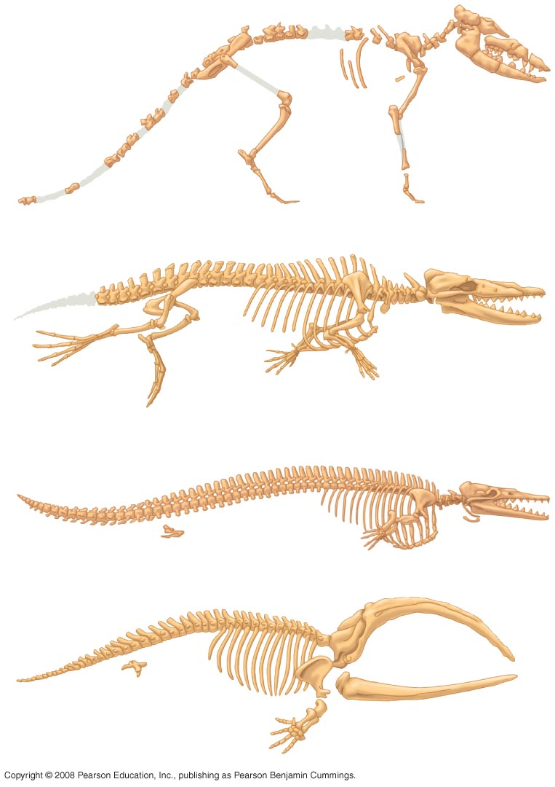
Fig. 22-16
(a) Pakicetus (terrestrial)
(b) Rhodocetus (predominantly aquatic)
Pelvis and
hind limb
(c) Dorudon (fully aquatic)
Pelvis and
hind limb
(d) Balaena
(recent whale ancestor)
Notes:
Figure 22.16 The transition to life in the sea

Slide 4
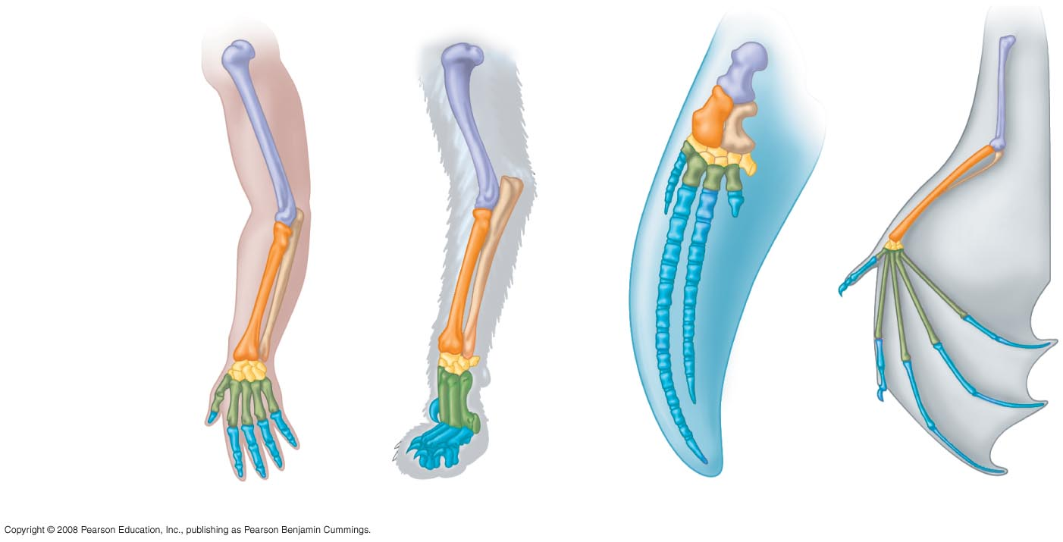
Fig. 22-17
Homologous structures are anatomical resemblances that represent variations on a structural theme present in a common ancestor
Humerus
Radius
Ulna
Carpals
Metacarpals
Phalanges
Human
Cat
Whale
Bat
Notes:
Figure 22.17 Mammalian forelimbs: homologous structures
Homology is similarity resulting from common ancestry

Slide 5

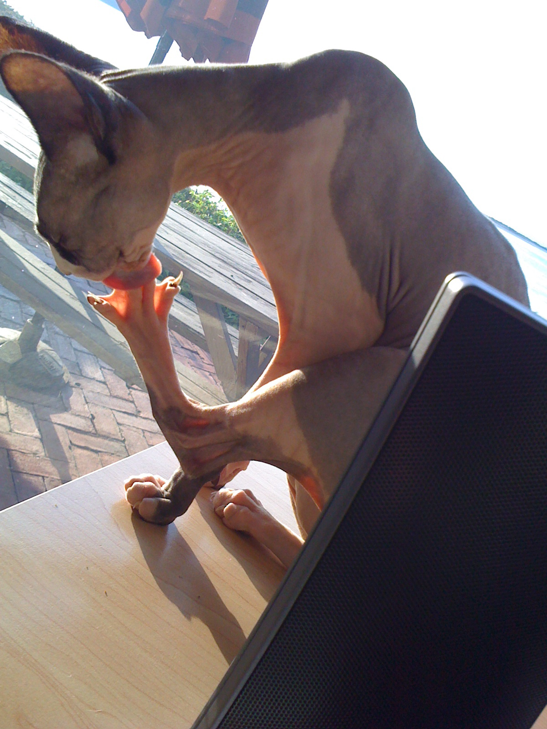



Homologous structures
Similar structure
Similar development
Different functions
Evidence of close evolutionary relationship
  recent common ancestor

Slide 6
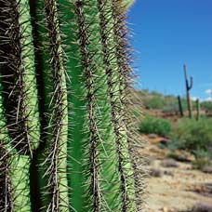
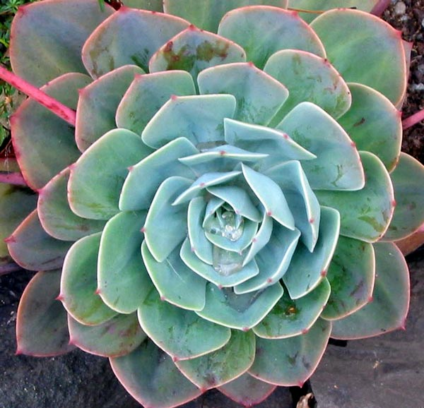
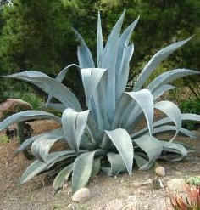
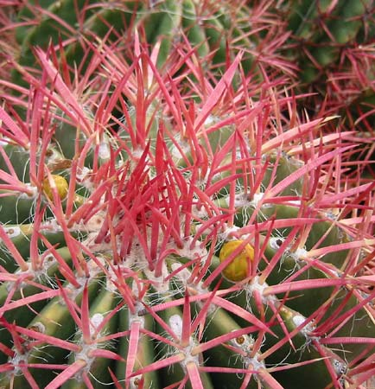
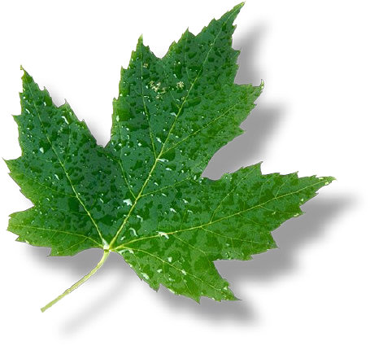
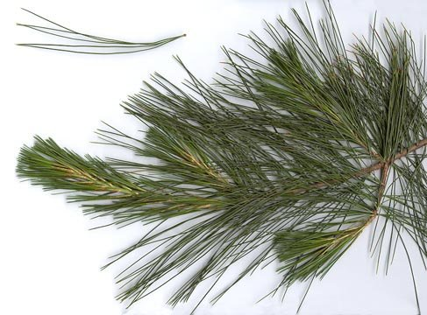

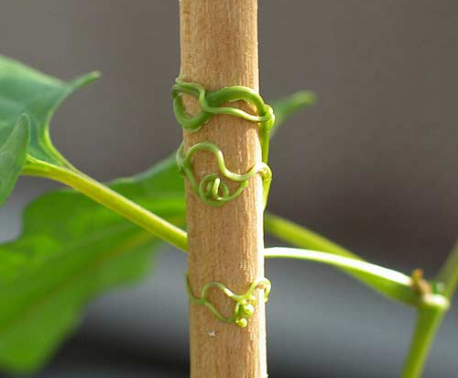


Homologous structures
spines
leaves
succulent leaves
tendrils
needles
colored leaves

Slide 7
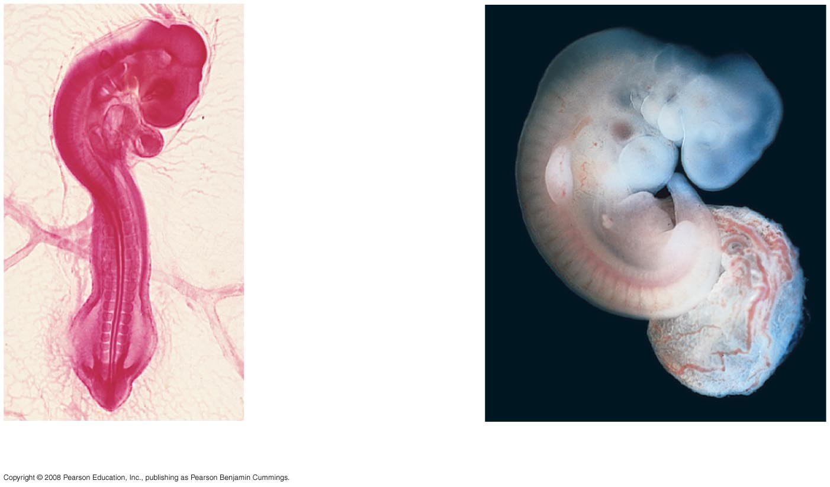
Fig. 22-18
Pharyngeal
pouches
Post-anal
tail
Chick embryo (LM)
Human embryo
Notes:
Figure 22.18 Anatomical similarities in vertebrate embryos
Comparative embryology reveals anatomical homologies not visible in adult organisms

Slide 8
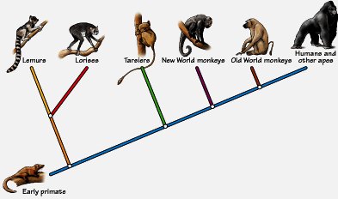
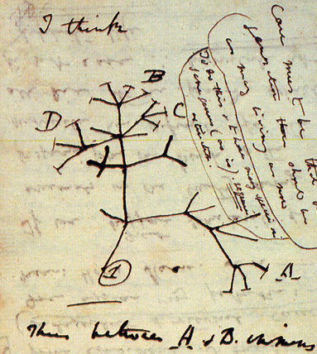
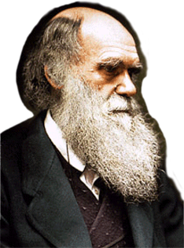
Building “family” trees
Closely related species (branches) share same line of descent until their divergence from a common ancestor

Slide 9
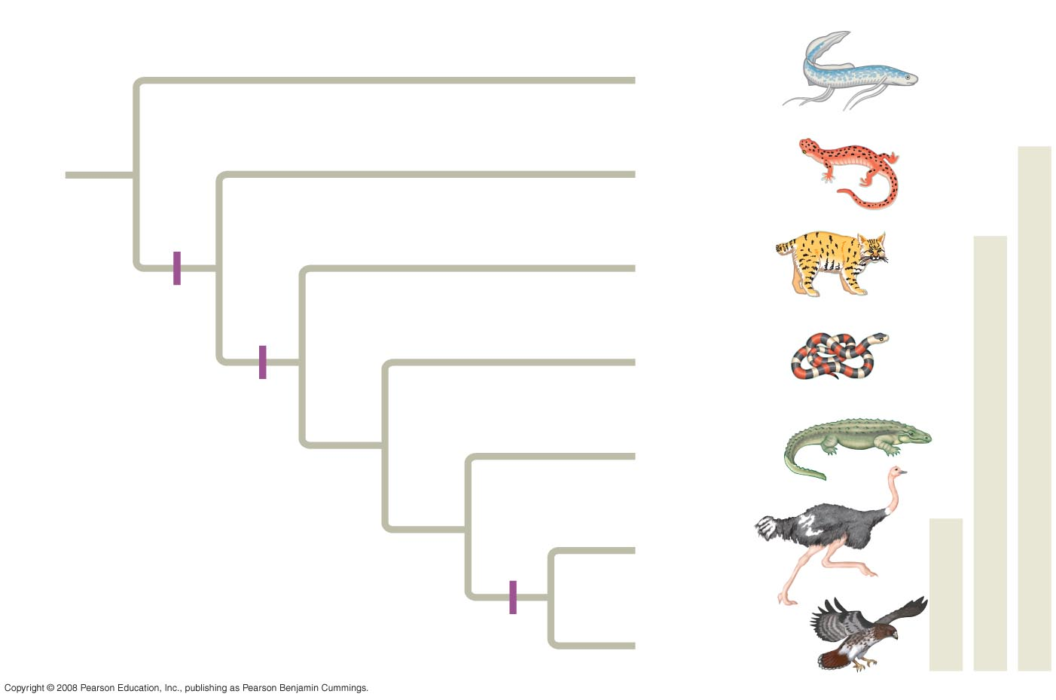
Fig. 22-19
Branch point
(common ancestor)
Lungfishes
1
Amphibians
Tetrapods
2
Mammals
Tetrapod limbs
Amniotes
3
Lizards
and snakes
Amnion
4
Crocodiles
Homologous
characteristic
5
Ostriches
Birds
6
Feathers
Hawks and
other birds
Notes:
Figure 22.19 Tree thinking: information provided in an evolutionary tree
The Darwinian concept of an evolutionary tree of life can explain homologies
Evolutionary trees are hypotheses about the relationships among different groups
Evolutionary trees can be made using different types of data, for example, anatomical and DNA sequence data

Slide 10
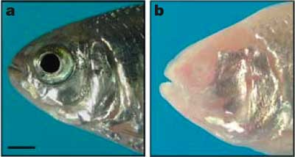
Vestigial organs
Structures that serve little or no function
  remnants of structures that were functional in ancestral species
  deleterious mutations accumulate in genes for non-critical structures without reducing fitness
    snakes & whales — remains of pelvis & leg bones of walking ancestors
    eyes on blind cave fish
    human tail bone
Notes:
Vestigial structures are remnants of features that served important functions in the organism’s ancestors
Examples of homologies at the molecular level are genes shared among organisms inherited from a common ancestor

Slide 11
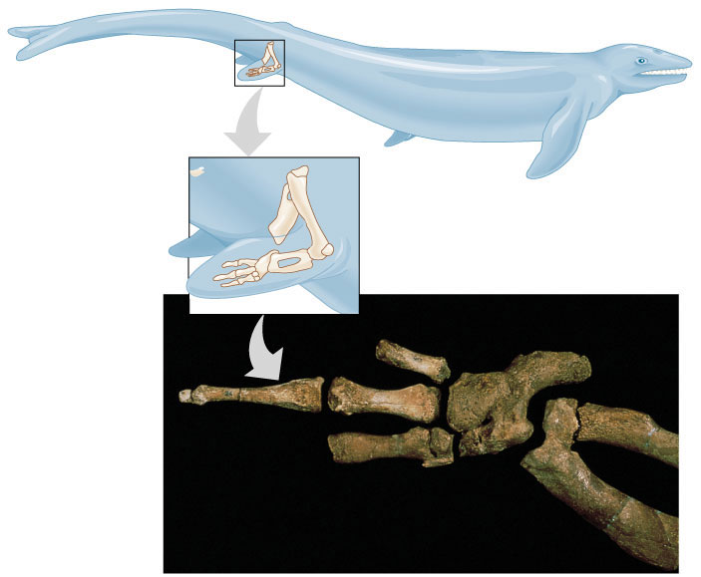
Vestigial organs
Hind leg bones on whale fossils

Slide 12
Molecular record
Comparing DNA & protein structure
  universal genetic code!
    DNA & RNA
  compare common genes
    cytochrome C (respiration)
    hemoglobin (gas exchange)
Human/kangaroo
100
Human/
cow
Dog/
cow
Closely related species have sequences that are more similar than distantly related species
  A molecular record of evolutionary relationships
75
Rabbit/
rodent
50
Horse/
donkey
Llama/
cow
Human/rodent
Nucleotide substitutions
Horse/cow
Sheep/
goat
Pig/
cow
25
Goat/cow
0
0
25
50
75
100
125
Millions of years ago

Slide 13
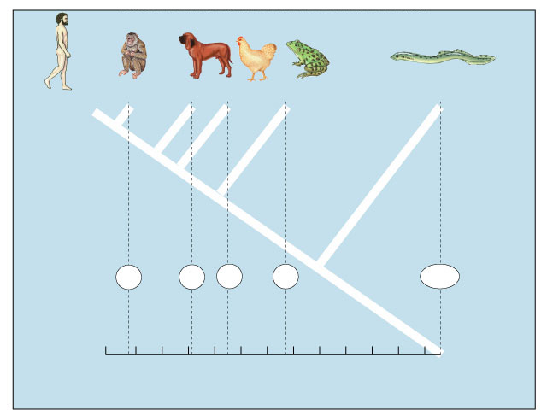
Comparative hemoglobin structure
Human
Macaque
Dog
Bird
Frog
Lamprey
Why does comparing
amino acid sequence
measure evolutionary
relationships?
8
32
45
67
125
0
10
20
30
40
50
60
70
80
90
100
110
120
Number of amino acid differences between
hemoglobin (146 aa) of vertebrate species and that of humans

