Slide 1
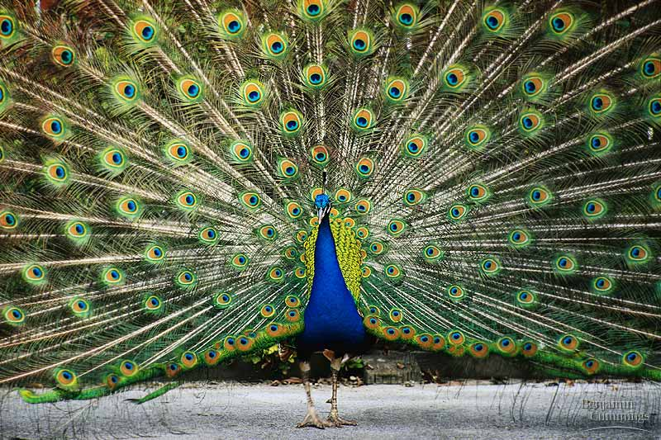
Evolutionary Forces
What changes populations?

Slide 2
Overview: The Smallest Unit of Evolution
One misconception is that organisms evolve, in the Darwinian sense, during their lifetimes
Natural selection acts on individuals, but only populations evolve
Genetic variations in populations contribute to evolution
Microevolution is a change in allele frequencies in a population over generations

Slide 3
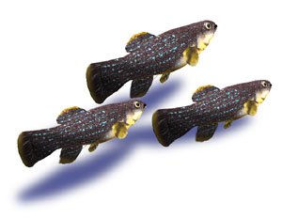
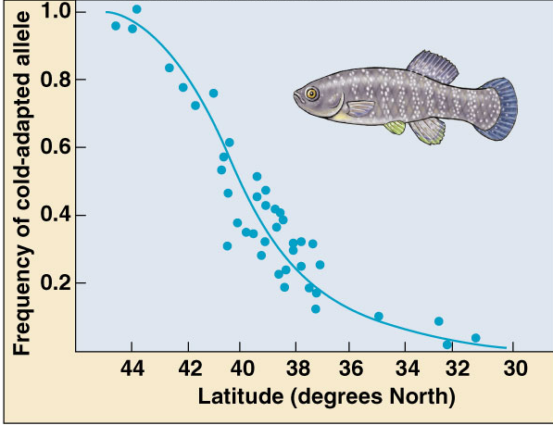
Populations evolve
Natural selection acts on individuals
  differential survival
  differential reproductive success
Populations evolve
  genetic makeup of
  population changes
  over time
  favorable traits
  (greater fitness)
  become more common
Presence of lactate dehydrogenase
Mummichog
Notes:
The Mummichog (Fundulus heteroclitus heteroclitus) is a small killifish found in the eastern United States. It is capable of tolerating highly variable salinity and temperatures, and is found in estuaries and saltmarshes as well as less salty waters.
A year-round resident of tidal creeks and wetlands, this brownish-green saltwater minnow may reach a maximum length of 5 inches. Its Indian name means "they go in great numbers." It is also known as the common killifish.
A hardy fish, the mummichog is an important food source for larger fish and is often used as bait. The mummichog also has been used as a natural method of mosquito control in marsh ponds and ditches. It has been reported that one mummichog can eat as many as 2,000 mosquito larvae ("wrigglers") a day. The mummichog also feeds on other insects, small fish, crustaceans, and plant material.
Because of the extreme hardiness of the species, it is sometimes the only species found in severely polluted and oxygen-deprived streams, such as the Hackensack River and the Arthur Kill in New Jersey during the height of the water pollution problem in the United States. In 1973 the Mummichog became the first fish in space when carried on Skylab 3 as part of the biological experiments package later space missions by the U.S., such as Bion 3, have also carried Mummichog.

Slide 4
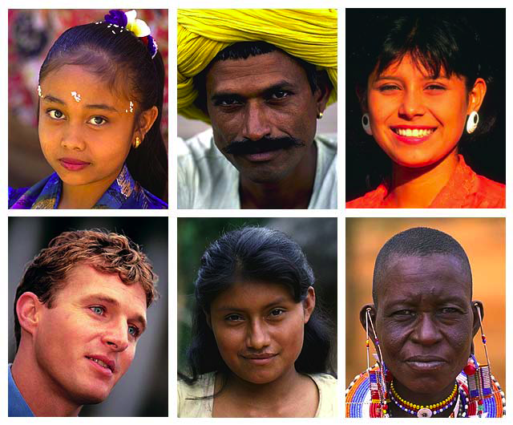
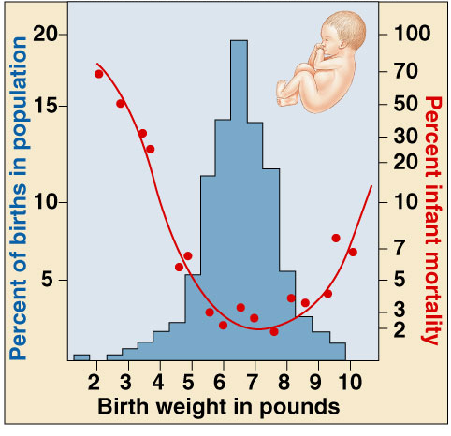
Individuals DON’T evolve…
Individuals survive or don’t survive…
Individuals are selected
Populations evolve
Individuals reproduce or don’t…
Populations evolve!

Slide 5
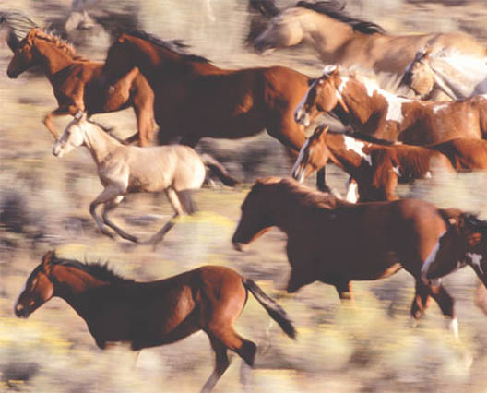
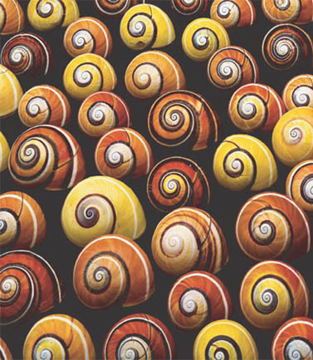
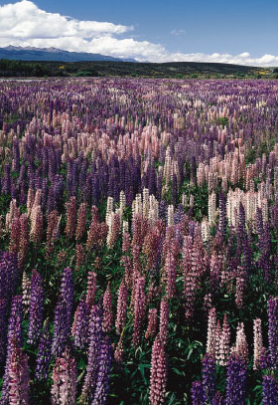
Variation & natural selection
Variation is the raw material for natural selection
  there have to be differences within population
  some individuals must be more fit than others
Notes:
Variation in individual genotype leads to variation in individual phenotype
Not all phenotypic variation is heritable
Natural selection can only act on variation with a genetic component
Two processes, mutation and sexual reproduction, produce the variation in gene pools that contributes to differences among individuals

Slide 6
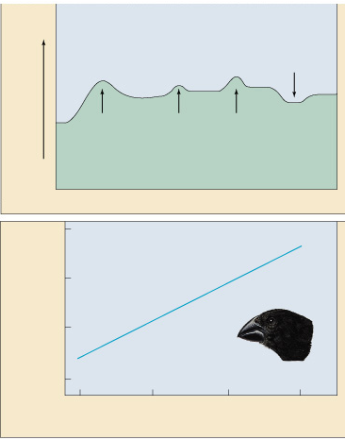
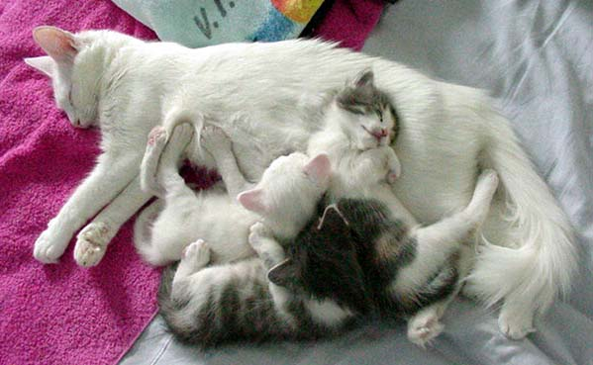
Where does Variation come from?
Mutation
  random changes to DNA
    errors in gamete production
    environmental damage
Sex
  mixing of alleles
    recombination of alleles
      new arrangements in every offspring
    new combinations of traits
  spreads variation
    offspring inherit traits from parent
Wet year
Beak depth
Dry year
Dry year
Dry year
1977
1980
1982
1984
11
10
Beak depth of
offspring (mm)
9
8
Medium ground finch
8
9
10
11
Mean beak depth of parents (mm)

Slide 7
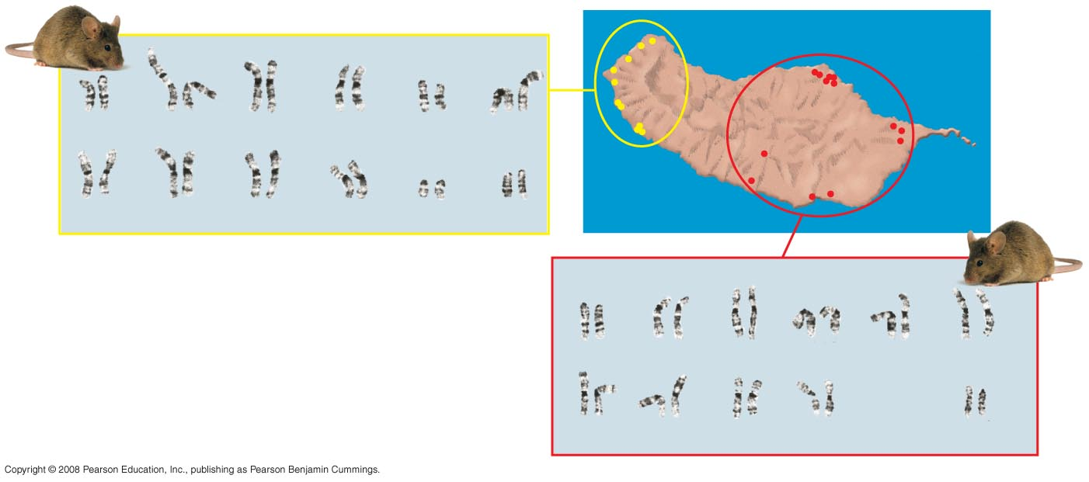
Fig. 23-3
Most species exhibit geographic variation, differences between gene pools of separate populations or population subgroups
1
2.4
3.14
5.18
6
7.15
8.11
9.12
10.16
13.17
19
XX
1
2.19
3.8
4.16
5.14
6.7
9.10
11.12
13.17
15.18
XX
Notes:
Figure 23.3 Geographic variation in isolated mouse populations on Madeira

Slide 8
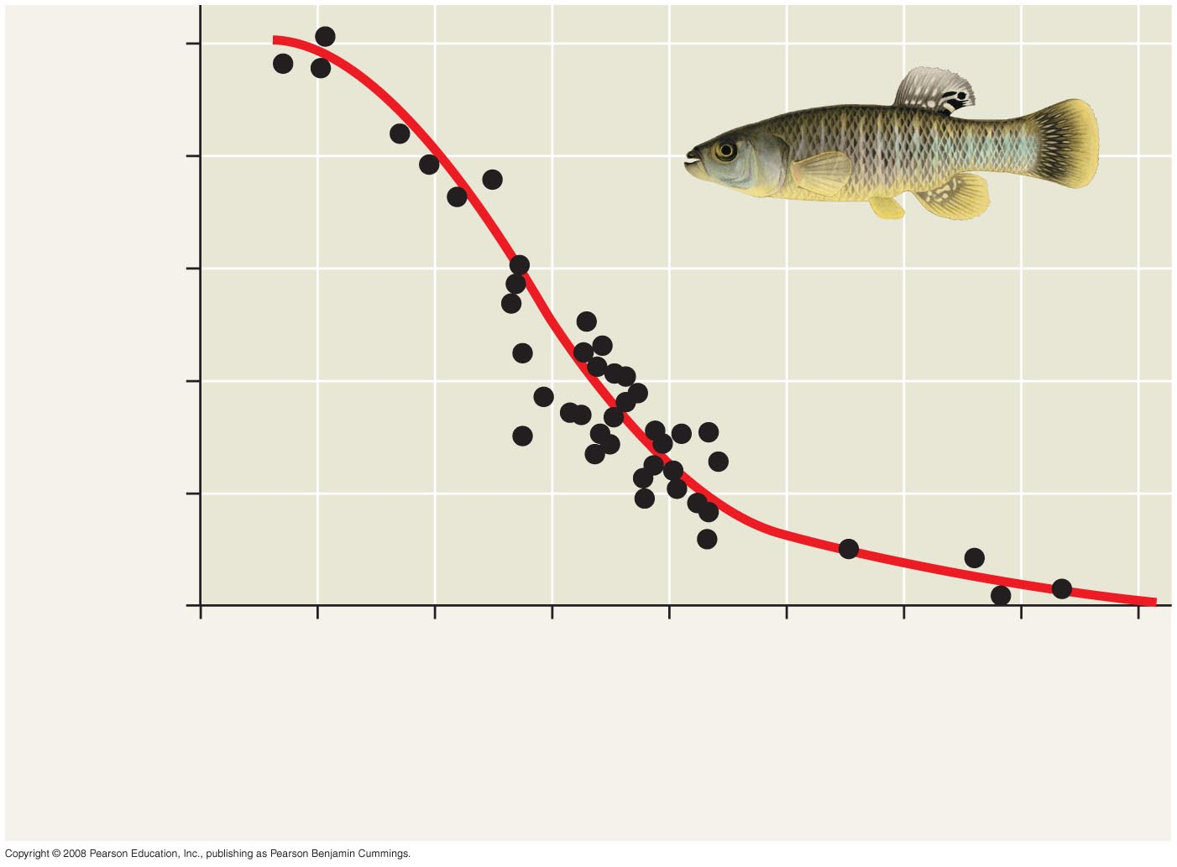
Fig. 23-4
Some examples of geographic variation occur as a cline, which is a graded change in a trait along a geographic axis
1.0
0.8
Ldh-B ^{b} allele frequency
0.6
0.4
0.2
0
46
44
42
40
38
36
34
32
30
Latitude (°N)
Maine
Cold (6°C)
Georgia
Warm (21°C)
Notes:
Figure 23.4 A cline determined by temperature

Slide 9
Brief Terminology Review
Gene – determines a trait (ex. eye color)
Allele – A variant of a gene (ex. brown eyes vs. blue eyes)
All sexually reproducing organisms have 2 alleles for any trait.
Dominant – An allele that will show a trait, regardless of the other other allele (ex. brown eyes)
Recessive – An allele that will only show a trait if both alleles are recessive (ex. blue eyes)

Slide 10
Homozygous – any individual who has 2 copies of the same allele. Can be homozygous dominant or homozygous recessive.
Heterozygous- any individual who has one copy of a dominant allele and one copy of a recessive allele. WILL SHOW THE DOMINANT TRAIT!

Slide 11
Populations & gene pools
Concepts
  a population is a localized group of interbreeding individuals
  gene pool is collection of alleles in the population
    remember difference between alleles & genes!
  allele frequency is how common is that allele in the population
    how many A vs. a in whole population
Notes:
A population is a localized group of individuals capable of interbreeding and producing fertile offspring
A gene pool consists of all the alleles for all loci in a population
A locus is fixed if all individuals in a population are homozygous for the same allele

Slide 12
Evolution of populations
Evolution = change in allele frequencies in a population
  hypothetical: what conditions would cause allele frequencies to not change?
  non-evolving population
    REMOVE all agents of evolutionary change
    very large population size (no genetic drift)
    no migration (no gene flow in or out)
    no mutation (no genetic change)
    random mating (no sexual selection)
    no natural selection (everyone is equally fit)

Slide 13
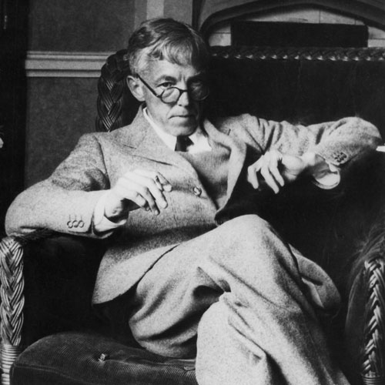
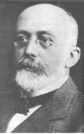
Hardy-Weinberg equilibrium
Hypothetical, non-evolving population
  preserves allele frequencies
Serves as a model (null hypothesis)
  natural populations rarely in H-W equilibrium
  useful model to measure if forces are acting on a population
G.H. Hardy
mathematician
W. Weinberg
physician
Notes:
G.H. Hardy (the English mathematician) and W. Weinberg (the German physician) independently worked out the mathematical basis of population genetics in 1908. Their formula predicts the expected genotype frequencies using the allele frequencies in a diploid Mendelian population. They were concerned with questions like "what happens to the frequencies of alleles in a population over time?" and "would you expect to see alleles disappear or become more frequent over time?”
The Hardy-Weinberg principle states that frequencies of alleles and genotypes in a population remain constant from generation to generation
In a given population where gametes contribute to the next generation randomly, allele frequencies will not change
Mendelian inheritance preserves genetic variation in a population
The Hardy-Weinberg principle describes a population that is not evolving
If a population does not meet the criteria of the Hardy-Weinberg principle, it can be concluded that the population is evolving

Slide 14
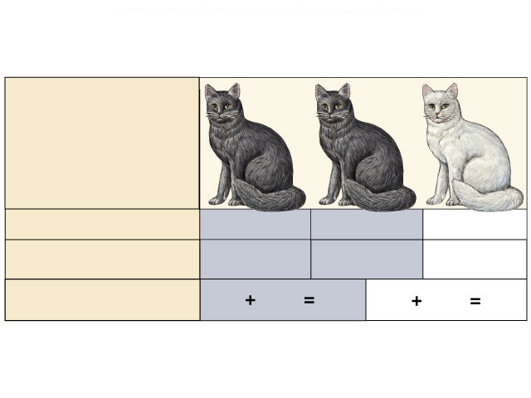
Hardy-Weinberg theorem
Counting Alleles
  assume 2 alleles = B, b
  frequency of dominant allele (B) = p
  frequency of recessive allele (b) = q
    frequencies must add to 1 (100%), so:
  p + q = 1
BB
Bb
bb
Notes:
The frequency of an allele in a population can be calculated
By convention, if there are 2 alleles at a locus, p and q are used to represent their frequencies
The frequency of all alleles in a population will add up to 1
For example, p + q = 1
The frequency of an allele in a population can be calculated
For diploid organisms, the total number of alleles at a locus is the total number of individuals x 2
The total number of dominant alleles at a locus is 2 alleles for each homozygous dominant individual plus 1 allele for each heterozygous individual; the same logic applies for recessive alleles

Slide 15
Hardy-Weinberg theorem
Counting Individuals
  frequency of homozygous dominant: p x p = p²
  frequency of homozygous recessive: q x q = q²
  frequency of heterozygotes: (p x q) + (q x p) = 2pq
    frequencies of all individuals must add to 1 (100%), so:
  p² + 2pq + q² = 1
BB
Bb
bb
Notes:
Hardy-Weinberg equilibrium describes the constant frequency of alleles in such a gene pool
If p and q represent the relative frequencies of the only two possible alleles in a population at a particular locus, then
p² + 2pq + q² = 1
where p² and q² represent the frequencies of the homozygous genotypes and 2pq represents the frequency of the heterozygous genotype

Slide 16
H-W formulas
Alleles: p + q = 1
Individuals: p² + 2pq + q² = 1
B
b
BB
Bb
bb
BB
Bb
bb

Slide 17
Using Hardy-Weinberg equation
population:
100 cats
84 black, 16 white
How many of each genotype?
q² (bb): 16/100 = .16
q (b): √.16 = 0.4
p (B): 1 - 0.4 = 0.6
p²=.36
2pq=.48
q²=.16
BB
Bb
bb
What are the genotype frequencies?
Must assume population is in H-W equilibrium!

Slide 18
Using Hardy-Weinberg equation
p²=.36
2pq=.48
q²=.16
Assuming
H-W equilibrium
BB
Bb
bb
Null hypothesis
p²=.20
p²=.74
2pq=.64
2pq=.10
q²=.16
q²=.16
BB
Bb
bb
Sampled data
How do you explain the data?
How do you explain the data?
Notes:
Sampled data 1:
Heterozygote advantage.
What’s preventing this population from being in equilibrium.
Sampled data 1:
Hybrids are in some way weaker.
Immigration in from an external population that is predomiantly homozygous B
Non-random mating... white cats tend to mate with white cats and black cats tend to mate with black cats.

Slide 19
Conditions for Hardy-Weinberg Equilibrium
The Hardy-Weinberg theorem describes a hypothetical population
In real populations, allele and genotype frequencies do change over time
Notes:
Natural populations can evolve at some loci, while being in Hardy-Weinberg equilibrium at other loci

Slide 20
The five conditions for nonevolving populations are rarely met in nature:
  No mutations
  No gene flow
  Random mating
  Extremely large population size
  No natural selection
Notes:
Natural selection can only act on rare homozygous individuals who do not follow dietary restrictions
The population is large
Migration has no effect as many other populations have similar allele frequencies

Slide 21
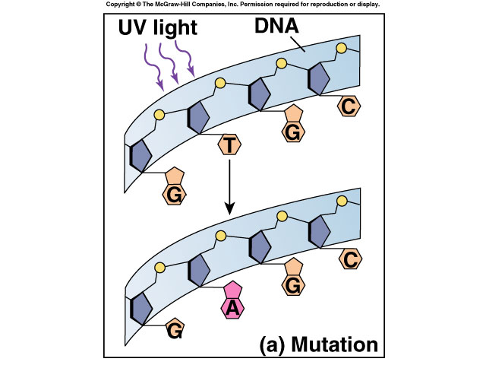
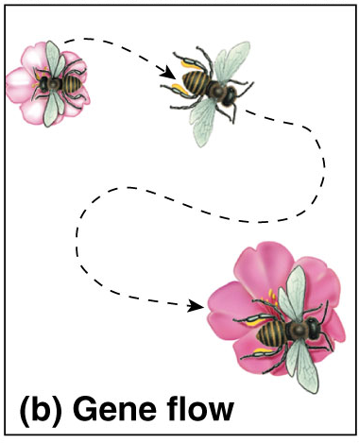
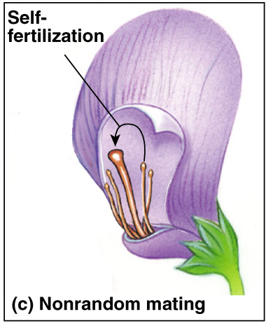
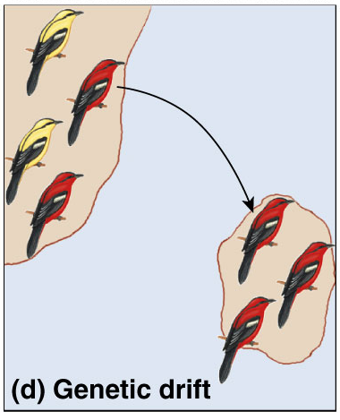
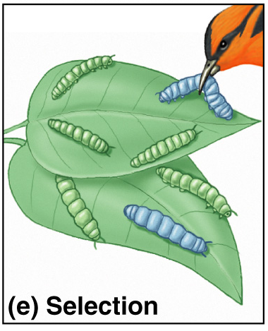
5 Agents of evolutionary change
Mutation
Gene Flow
Non-random mating
Genetic Drift
Selection

Slide 22
1. Mutation & Variation
Mutation creates variation
  new mutations are constantly appearing
Mutation changes DNA sequence
  changes amino acid sequence?
  changes protein?
    changes structure?
    changes function?
  changes in protein may
  change phenotype &
  therefore change fitness
Notes:
Every individual has hundreds of mutations
1 in 100,000 bases copied
3 billion bases in human genome
But most happen in introns, spacers, junk of various kind
Not every mutation has a visible effect.
Some effects on subtle.
May just affect rate of expression of a gene.

Slide 23
2. Gene Flow
Movement of individuals &
alleles in & out of populations
  seed & pollen distribution by
  wind & insect
  migration of animals
    causes genetic mixing
    across regions
    reduce differences
    between populations
Notes:
Gene flow consists of the movement of alleles among populations
Alleles can be transferred through the movement of fertile individuals or gametes (for example, pollen)
Gene flow tends to reduce differences between populations over time
Gene flow is more likely than mutation to alter allele frequencies directly
Gene flow can decrease the fitness of a population
In bent grass, alleles for copper tolerance are beneficial in populations near copper mines, but harmful to populations in other soils
Windblown pollen moves these alleles between populations
The movement of unfavorable alleles into a population results in a decrease in fit between organism and environment
Gene flow can increase the fitness of a population
Insecticides have been used to target mosquitoes that carry West Nile virus and malaria
Alleles have evolved in some populations that confer insecticide resistance to these mosquitoes
The flow of insecticide resistance alleles into a population can cause an increase in fitness

Slide 24
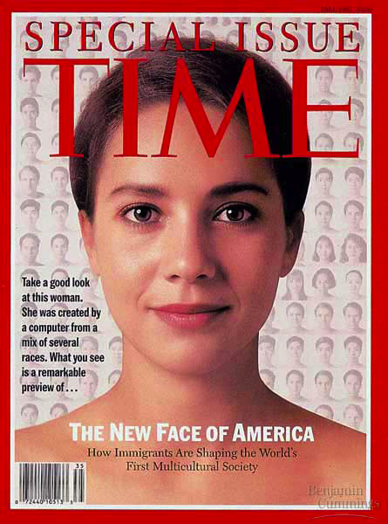
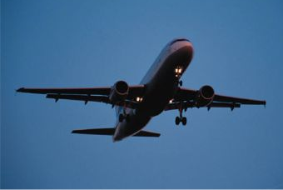
Human evolution today
Gene flow in human populations is increasing today
  transferring alleles between populations
Are we moving towards a blended world?

Slide 25
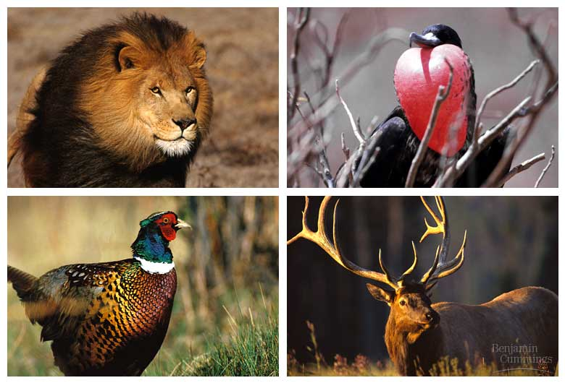
3. Non-random mating
Sexual selection
Notes:
Intrasexual selection is competition among individuals of one sex (often males) for mates of the opposite sex
Intersexual selection, often called mate choice, occurs when individuals of one sex (usually females) are choosy in selecting their mates
Male showiness due to mate choice can increase a male’s chances of attracting a female, while decreasing his chances of survival
How do female preferences evolve?
The good genes hypothesis suggests that if a trait is related to male health, both the male trait and female preference for that trait should be selected for

Slide 26
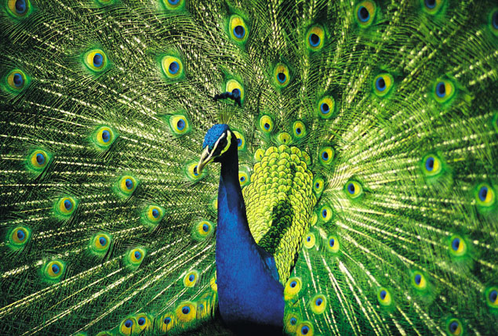
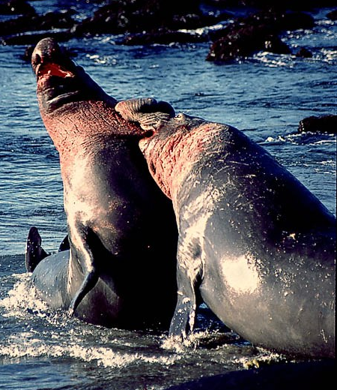
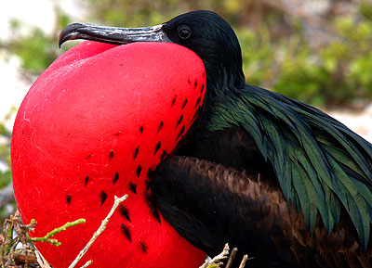
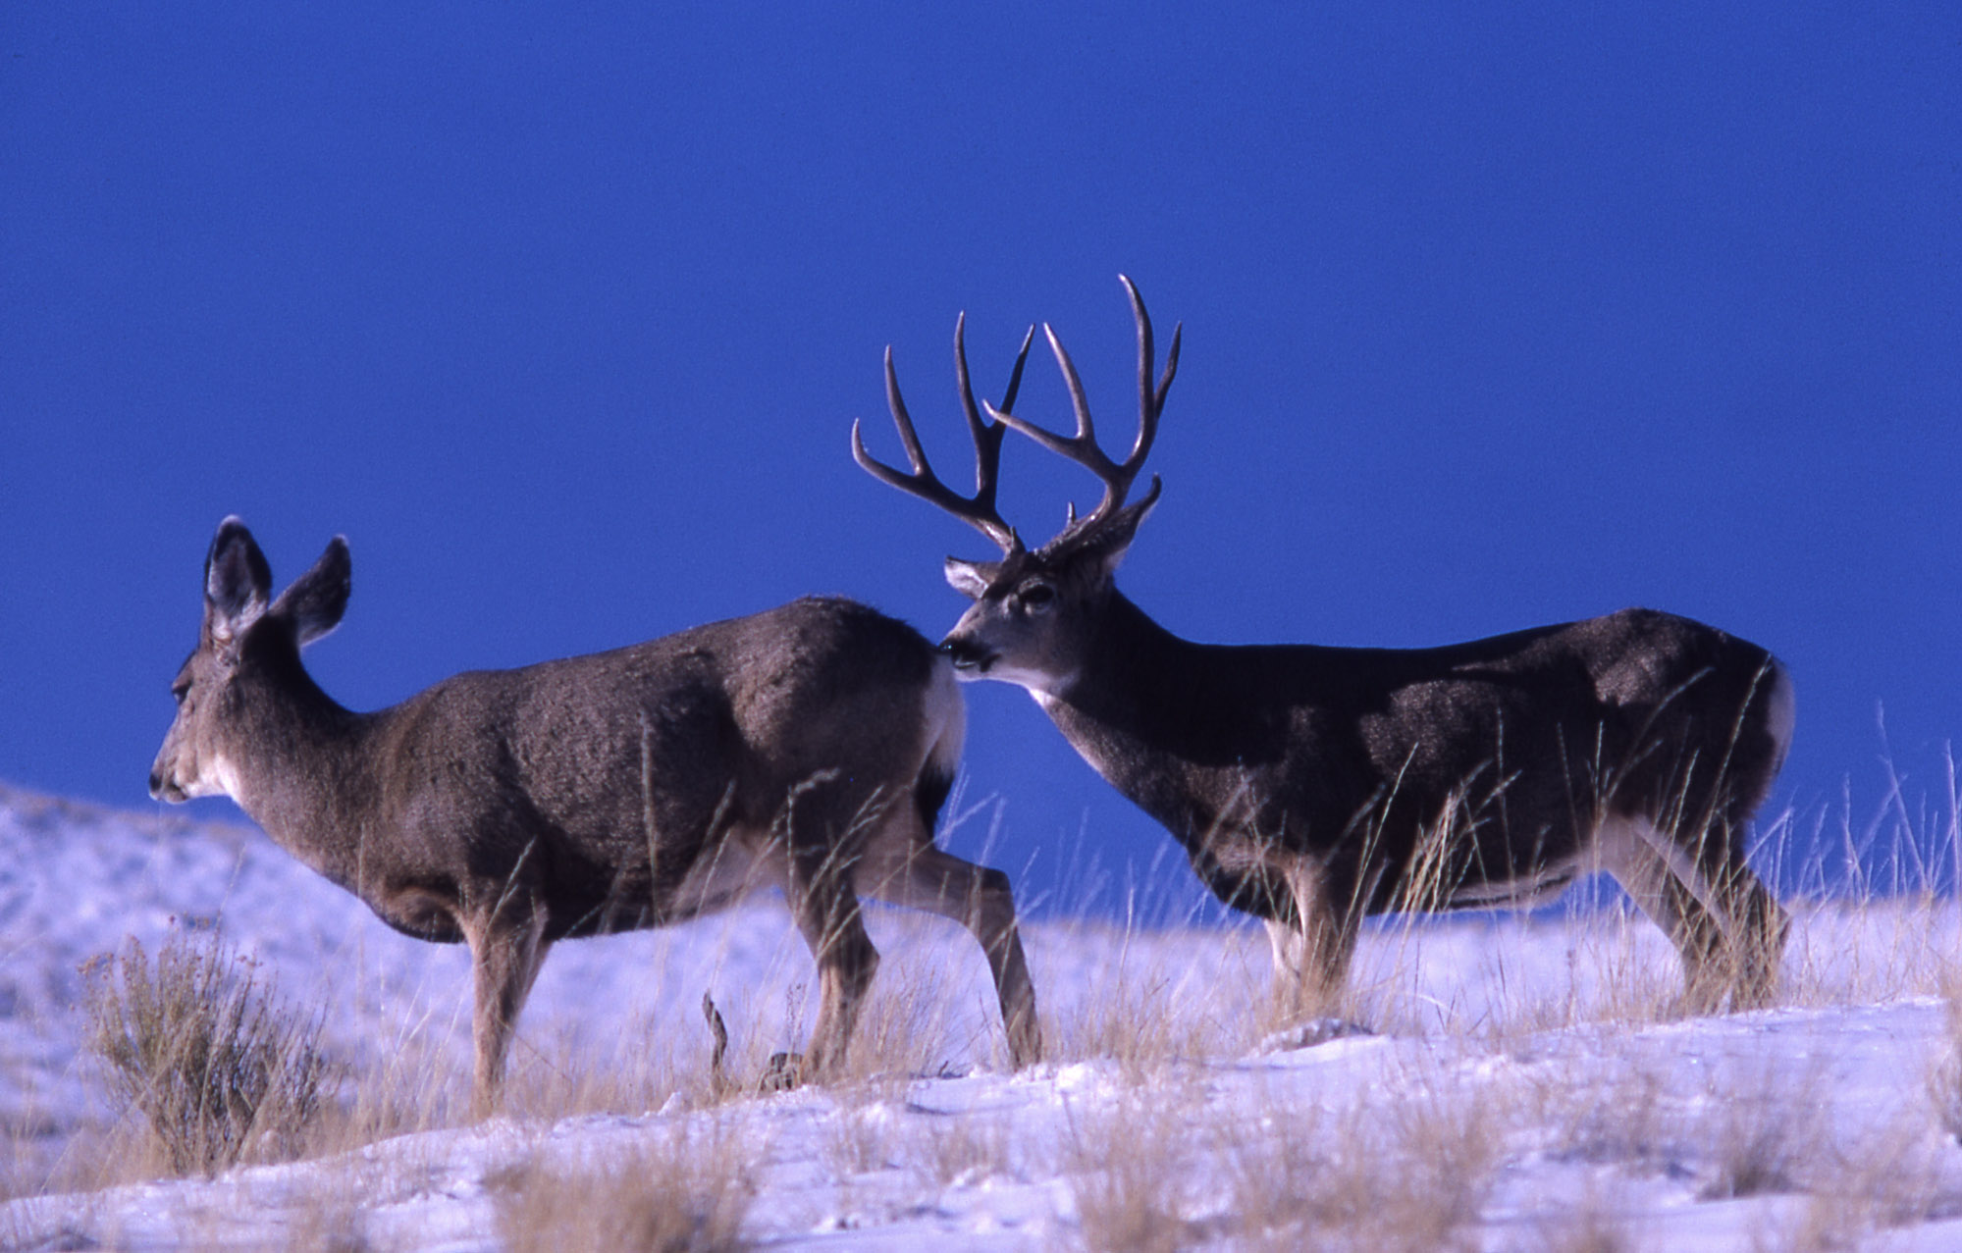
Sexual Selection
Acting on reproductive success
  attractiveness to potential mate
  fertility of gametes
  successful rearing of offspring
Survival doesn’t matter
if you don’t reproduce!
Notes:
Sexual selection is natural selection for mating success
It can result in sexual dimorphism, marked differences between the sexes in secondary sexual characteristics

Slide 27
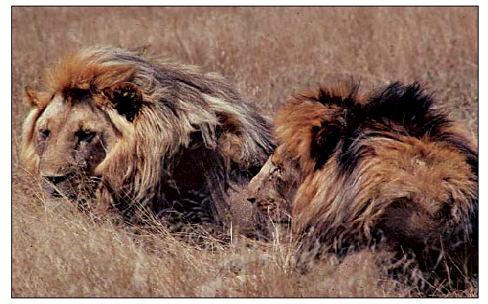
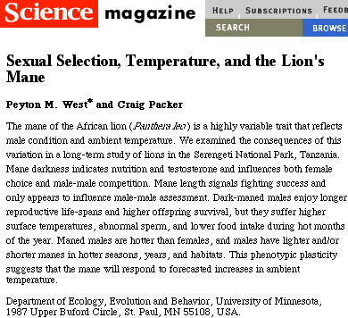
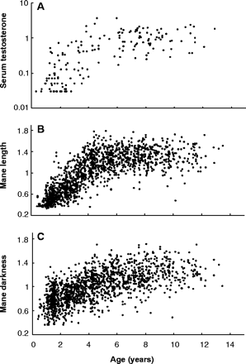
The lion’s mane…
Females are attracted to males with larger, dark manes
Correlation with higher testosterone levels
  Better health
  more muscle
  Better fertility
  longer life
But imposes a cost to male
  HOT! Is it worth it??
Notes:
Even though it’s very hot to have a large mane the benefit of attracting mates and successfully producing & rearing young since you have that large mane outweighs the costs.
Females who chose these males were more “successful” (more, healthier young) and therefore had a greater opportunity to pass on the trait of being attracted to longer darker manes to their daughters and the trait of having longer, darker manes to their sons.

Slide 28
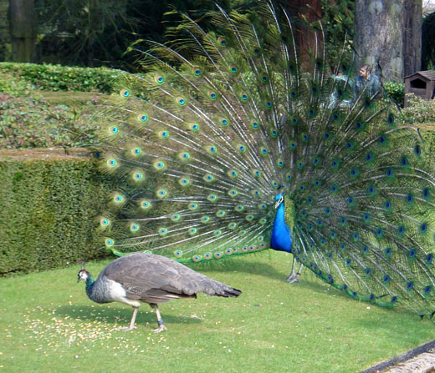
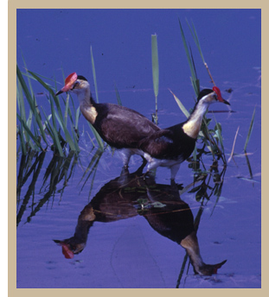
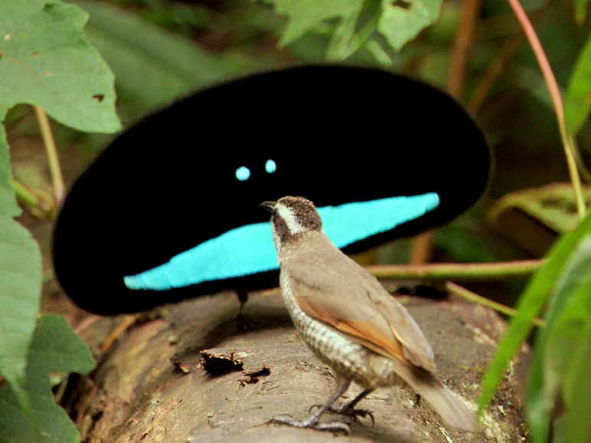
Sexual selection
Acts in all sexually
reproducing species
  the traits that get you mates
  influences both morphology & behavior
  Can seem maladaptive
Jacanas
Is there a testable
hypothesis in there?

Slide 29
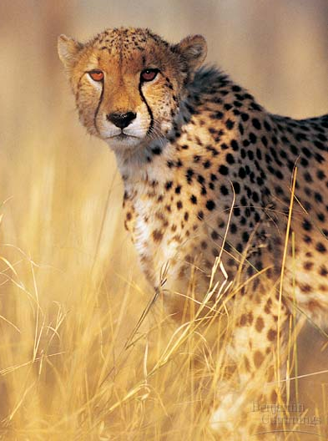
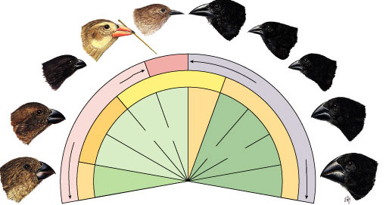
4. Genetic drift
Chance events changing frequency of traits in a population
  not adaptation to environmental conditions
  founder effect
  Bottleneck
Warbler
finch
Tree finches
Ground finches
Notes:
Animation Causes of Evolutionary Change
1 family has a lot of children & grandchildren therefore has a greater impact on the genes in the population than other families
Genghis Khan tracked through Y chromosome.
The smaller a sample, the greater the chance of deviation from a predicted result
Genetic drift describes how allele frequencies fluctuate unpredictably from one generation to the next
Genetic drift tends to reduce genetic variation through losses of alleles

