Slide 1
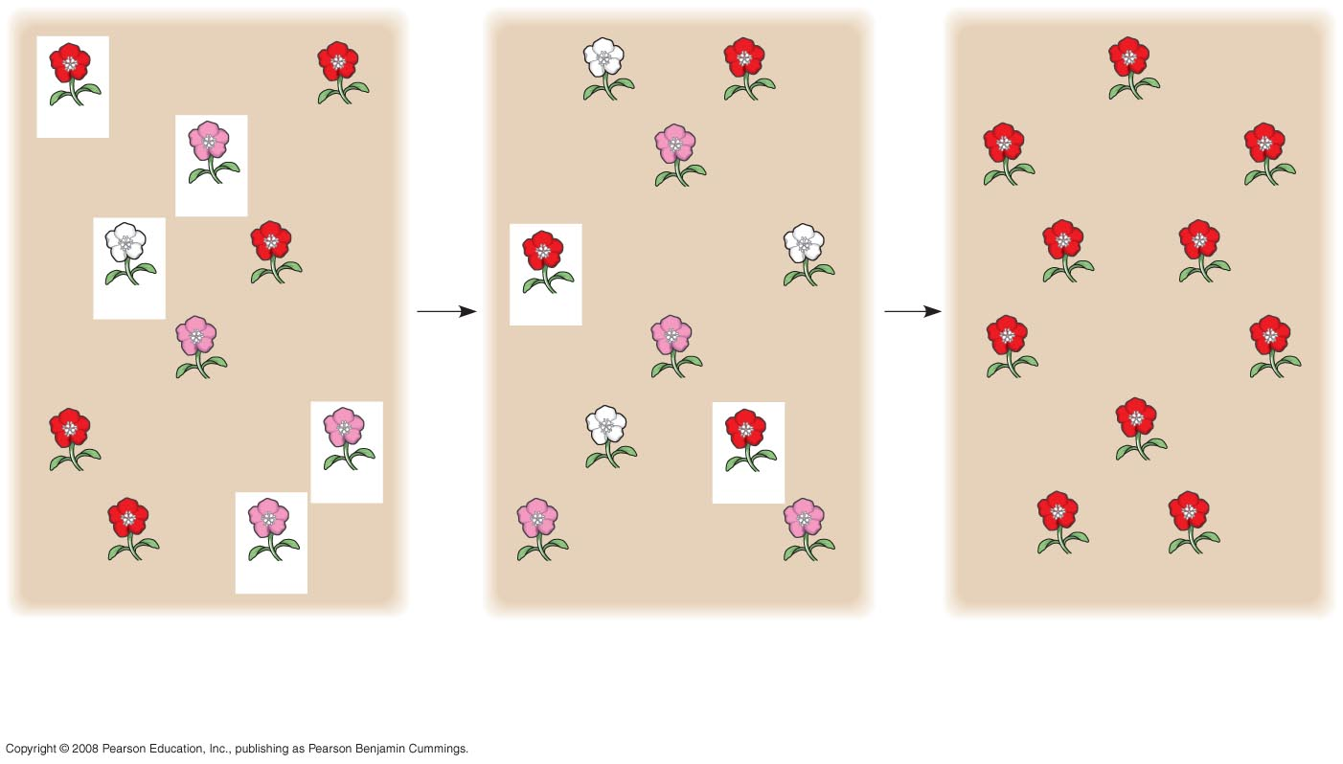
Fig. 23-8-3
C^{R} C^{R}
C^{R} C^{R}
C^{W} C^{W}
C^{R} C^{R}
C^{R} C^{R}
C^{R} C^{W}
C^{R} C^{W}
C^{R} C^{R}
C^{R} C^{R}
C^{W} C^{W}
C^{R} C^{R}
C^{R} C^{R}
C^{W} C^{W}
C^{R} C^{R}
C^{R} C^{R}
C^{R} C^{W}
C^{R} C^{W}
C^{R} C^{R}
C^{R} C^{R}
C^{R} C^{R}
C^{R} C^{W}
C^{W} C^{W}
C^{R} C^{R}
C^{R} C^{R}
C^{R} C^{R}
C^{R} C^{W}
C^{R} C^{W}
C^{R} C^{W}
C^{R} C^{R}
C^{R} C^{R}
Generation 1
Generation 2
Generation 3
p (frequency of C^{R}) = 0.7
p = 0.5
p = 1.0
q (frequency of C^{W} ) = 0.3
q = 0.5
q = 0.0
Notes:
Figure 23.8 Genetic drift

Slide 2
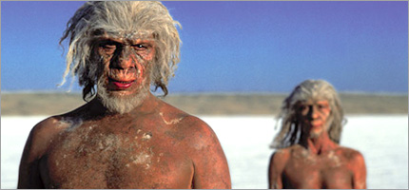
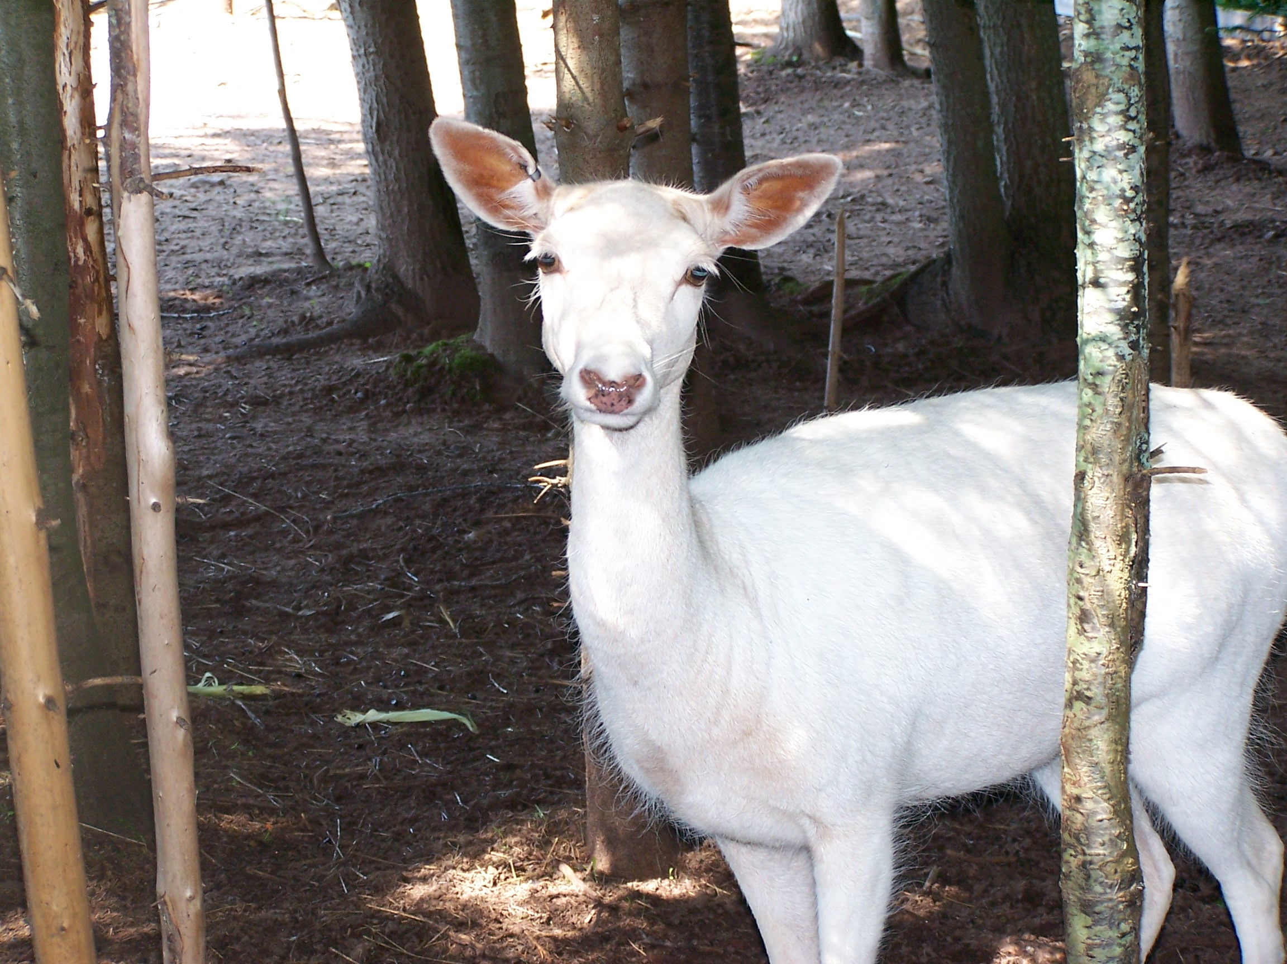
Founder effect
A new population is started by a small group of individuals
just by chance some rare traitsmay be at high frequency; others may be missing
skews the gene pool of new population
example: colonization of New World
ISLANDS!!!
albino deer Seneca Army Depot
Notes:
Small founder group, less genetic diversity than Africans
All white people around the world are descended from a small group of ancestors
100,000 years ago
(Chinese are white people!)
The founder effect occurs when a few individuals become isolated from a larger population
Allele frequencies in the small founder population can be different from those in the larger parent population

Slide 3
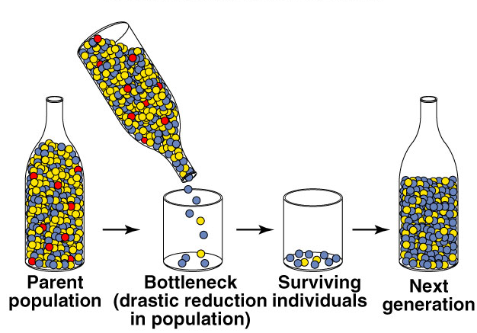
Bottleneck effect
When large population is drastically reduced by a disaster
famine, natural disaster, loss of habitat…
loss of variation by chance event
narrows the gene pool
Notes:
The bottleneck effect is a sudden reduction in population size due to a change in the environment
The resulting gene pool may no longer be reflective of the original population’s gene pool
If the population remains small, it may be further affected by genetic drift

Slide 4
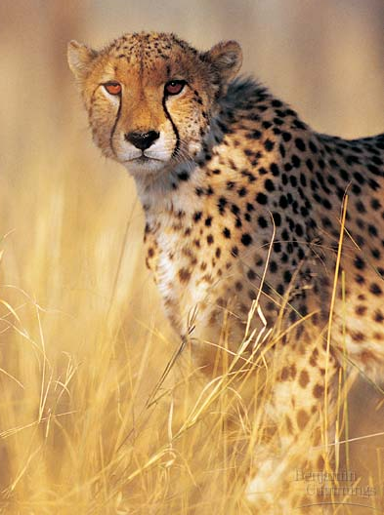
Cheetahs
All cheetahs share a small number of alleles
less than 1% diversity
as if all cheetahs are identical twins
2 bottlenecks
10,000 years ago
Ice Age
last 100 years
poaching & loss of habitat

Slide 5
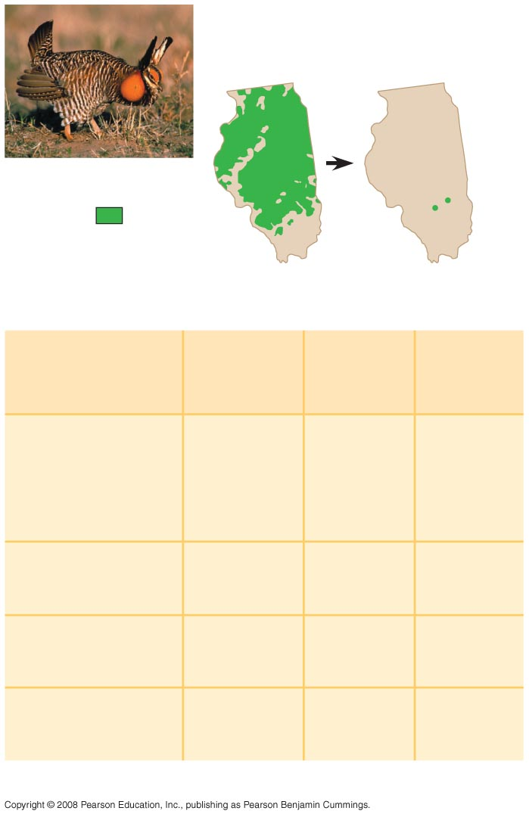
Fig. 23-10
Pre-bottleneck
(Illinois, 1820)
Post-bottleneck
(Illinois, 1993)
Range
of greater
prairie
chicken
(a)
Population
size
Number
of alleles
per locus
Percentage
of eggs
hatched
Location
Illinois
1930–1960s
1,000–25,000
5.2
3.7
93
<50
1993
<50
Kansas, 1998
(no bottleneck)
750,000
5.8
99
Nebraska, 1998
(no bottleneck)
75,000–
200,000
5.8
96
Minnesota, 1998
(no bottleneck)
4,000
5.3
85
(b)
Notes:
Figure 23.10 Bottleneck effect and reduction of genetic variation
The bottleneck effect is a sudden reduction in population size due to a change in the environment
The resulting gene pool may no longer be reflective of the original population’s gene pool
If the population remains small, it may be further affected by genetic drift
Researchers used DNA from museum specimens to compare genetic variation in the population before and after the bottleneck
The results showed a loss of alleles at several loci
Researchers introduced greater prairie chickens from population in other states and were successful in introducing new alleles and increasing the egg hatch rate to 90%

Slide 6
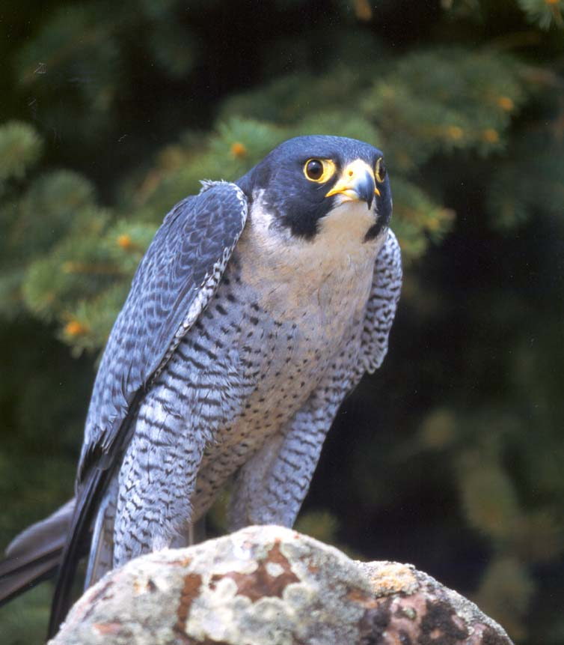
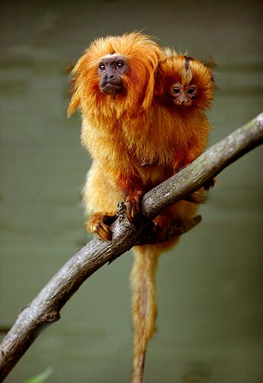
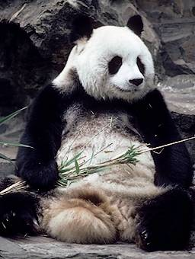
Conservation issues
Peregrine Falcon
Bottlenecking is an important concept in conservation biology of endangered species
loss of alleles from gene pool
reduces variation
reduces adaptability
Breeding programs must consciously outcross
Golden Lion Tamarin

Slide 7
Effects of Genetic Drift: A Summary
Genetic drift is significant in small populations
Genetic drift causes allele frequencies to change at random
Genetic drift can lead to a loss of genetic variation within populations
Genetic drift can cause harmful alleles to become fixed

Slide 8
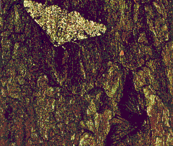
5. Natural selection
Differential survival & reproduction due to changing environmental conditions
climate change
food source availability
predators, parasites, diseases
toxins
combinations of alleles that provide “fitness” increase in the population
adaptive evolutionary change
Notes:
Natural selection brings about adaptive evolution by acting on an organism’s phenotype
Relative fitness is the contribution an individual makes to the gene pool of the next generation, relative to the contributions of other individuals
Selection favors certain genotypes by acting on the phenotypes of certain organisms
Only natural selection consistently results in adaptive evolution
Natural selection increases the frequencies of alleles that enhance survival and reproduction
Adaptive evolution occurs as the match between an organism and its environment increases
The phrases “struggle for existence” and “survival of the fittest” are misleading as they imply direct competition among individuals
Reproductive success is generally more subtle and depends on many factors
Natural selection increases the frequencies of alleles that enhance survival and reproduction
Adaptive evolution occurs as the match between an organism and its environment increases

Slide 9
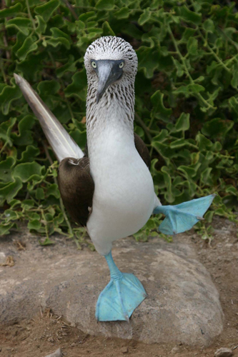
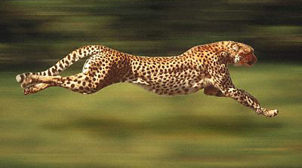
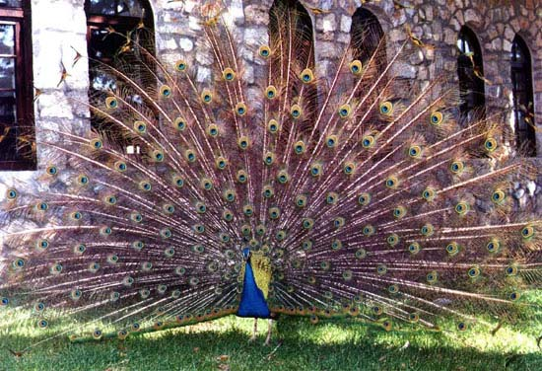
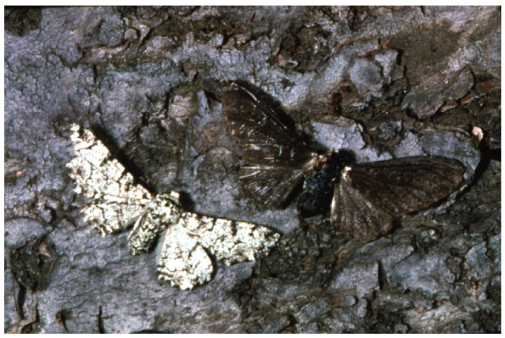
Natural Selection
Selection acts on any trait that affects survival or reproduction
predation selection
physiological selection
sexual selection
Notes:
Chance event causing allelic frequencies to fluctuate unpredictably from one generation to the next.
Differential success in reproduction results in certain alleles being passed to the next generation in greater proportions

