Slide 1
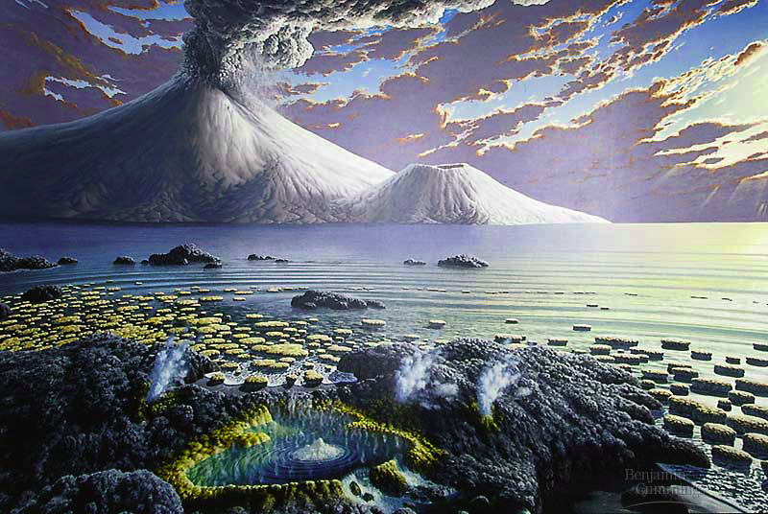
“…sparked by just the right combination of physical events & chemical processes…”
Origin of Life

Slide 2
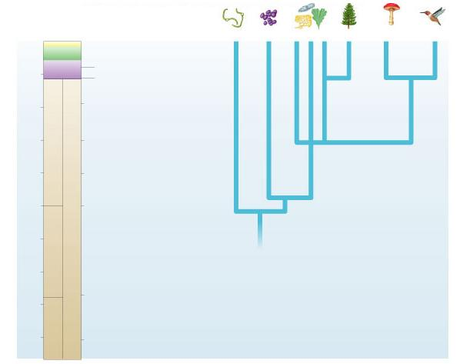
0
Bacteria
Archae-
bacteria
Protista
Plantae
Fungi
Animalia
Cenozoic
Mesozoic
Colonization of land
by animals
500
Paleozoic
Appearance of animals
and land plants
1000
First multicellular
organisms
PROTEROZOIC
Oldest definite fossils
of eukaryotes
1500
2000
Appearance of oxygen
in atmosphere
PRECAMBRIAN
Millions of years ago
2500
Oldest definite fossils
of prokaryotes
3000
The evolutionary tree of life can be documented with evidence.
The Origin of Life on Earth is another story…
ARCHEAN
3500
Molten-hot surface of
earth becomes cooler
4000
4500
Formation of earth

Slide 3
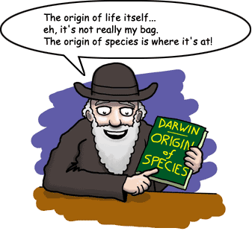
What is Life?
First we have to define LIFE…
organized as cells
respond to stimuli
regulate internal processes
homeostasis
use energy to grow
metabolism
develop
change & mature within lifetime
reproduce
heredity
DNA / RNA
adaptation & evolution

Slide 4
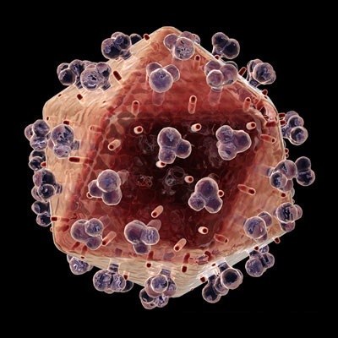
Life comes from Non-Life
Where is the line between living and non-living?
“A vehicle (organism) built by design information (DNA) for the purpose of replicating that information”
Good– but too inclusive??? (computer viruses, etc.)
Terrestrial life is cellular (sorry viruses).
No worries—
Alive or Not,
I exist!!!

Slide 5
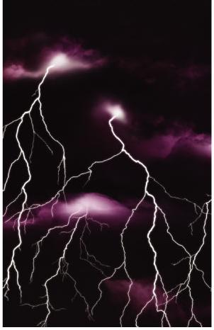
The Origin of Life is Hypothesis
Special Creation
Life was created by a supernatural or divine force.
not testable
Extraterrestrial Origin (Panspermia)
The original source of organic (carbon) materials was comets & meteorites striking early Earth.
testable
Spontaneous Abiotic Origin
Life evolved spontaneously from inorganic molecules.
testable

Slide 6
Overview: Lost Worlds
Past organisms were very different from those now alive
The fossil record shows macroevolutionary changes over large time scales including
The emergence of terrestrial vertebrates
The origin of photosynthesis
Long-term impacts of mass extinctions

Slide 7
Concept 25.1: Conditions on early Earth made the origin of life possible
Chemical and physical processes on early Earth may have produced very simple cells through a sequence of stages:
1. Abiotic synthesis of small organic molecules
2. Joining of these small molecules into macromolecules
3. Packaging of molecules into “protobionts”
4. Origin of self-replicating molecules

Slide 8
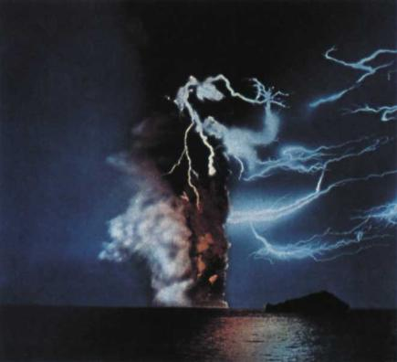
Conditions on early Earth
Reducing atmosphere
water vapor (H₂O), CO₂, N₂, NO_{x}, H₂, NH₃, CH₄, H₂S
lots of available H & its electron
no free oxygen
Energy source
lightning, UV radiation, volcanic
low O₂ = organic molecules do not breakdown as quickly
Notes:
Earth formed about 4.6 billion years ago, along with the rest of the solar system
Earth’s early atmosphere likely contained water vapor and chemicals released by volcanic eruptions (nitrogen, nitrogen oxides, carbon dioxide, methane, ammonia, hydrogen, hydrogen sulfide)
A. I. Oparin and J. B. S. Haldane hypothesized that the early atmosphere was a reducing environment
Stanley Miller and Harold Urey conducted lab experiments that showed that the abiotic synthesis of organic molecules in a reducing atmosphere is possible
However, the evidence is not yet convincing that the early atmosphere was in fact reducing
Amino acids have also been found in meteorites
Small organic molecules polymerize when they are concentrated on hot sand, clay, or rock
It is unclear whether young Earth’s atmosphere contained enough methane and ammonia to be reducing. Growing evidence suggests that the early atmosphere was made up primarily of nitrogen and carbon dioxide and was neither reducing nor oxidizing (electron–removing). Miller–Urey–type experiments using such atmospheres have not produced organic molecules. Still, it is likely that small “pockets” of the early atmosphere—perhaps near volcanic openings—were reducing.
Instead of forming in the atmosphere, the first organic compounds on Earth may have been synthesized near submerged volcanoes and deep–sea vents—weak points in Earth’s crust where hot water and minerals gush into the ocean.

Slide 9
5 Steps to go from Non-Life to Life
Formation (or presence) of Biological Molecules
Isolation of Biological Molecules from Surroundings (aka “Cells”)
Development of Metabolism.
Development of Information Molecules.
Reproduction.

Slide 10
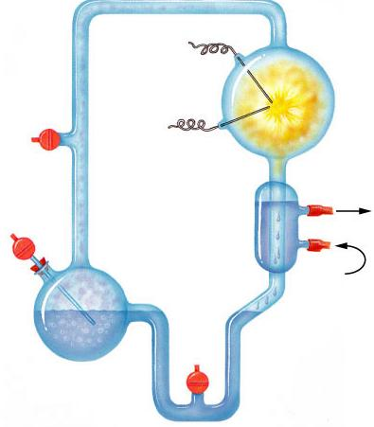
Origin of Organic Molecules
Electrodes discharge sparks
(lightning simulation)
Abiotic synthesis
1920 Oparin & Haldane propose reducing atmosphere hypothesis
1953 Miller & Urey test hypothesis
formed organic compounds
amino acids
adenine
CH₄
Water vapor
H₂
NH₃
Mixture of gases
("primitive
atmosphere")
Condenser
Water
Condensed liquid with complex, organic
molecules
Heated water
("ocean")

Slide 11
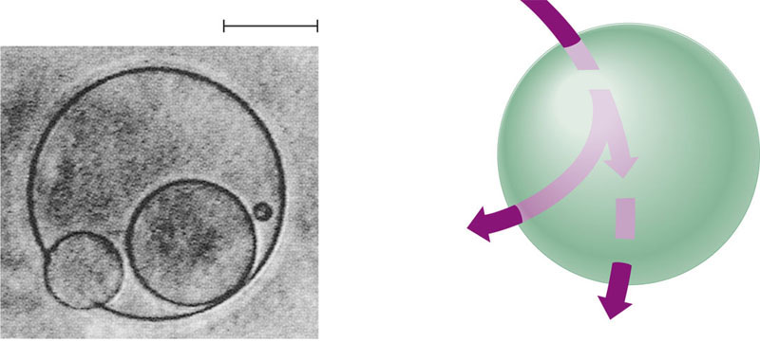
Origin of Cells (Protobionts)
Bubbles → separate inside from outside
→ metabolism & reproduction
Glucose-phosphate
20 m
Glucose-phosphate
Phosphorylase
Starch
Phosphate
Amylase
Bubbles… Tiny bubbles…
Maltose
Maltose
(a) Simple reproduction. This liposome is “giving birth” to smaller liposomes (LM).
(b) Simple metabolism. If enzymes—in this case, phosphorylase and amylase—are included in the solution from which the droplets self-assemble, some liposomes can carry out simple metabolic reactions and export the products.
Notes:
Life is defined partly by two properties: accurate replication and metabolism. Neither property can exist without the other. Self–replicating molecules and a metabolism–like source of the building blocks must have appeared together. How did that happen?
The necessary conditions for life may have been met by protobionts, aggregates of abiotically produced molecules surrounded by a membrane or membrane–like structure. Protobionts exhibit some of the properties associated with life, including simple reproduction and metabolism, as well as the maintenance of an internal chemical environment different from that of their surroundings.
Laboratory experiments demonstrate that protobionts could have formed spontaneously from abiotically produced organic compounds. For example, small membrane–bounded droplets called liposomes can form when lipids or other organic molecules are added to water.

Slide 12
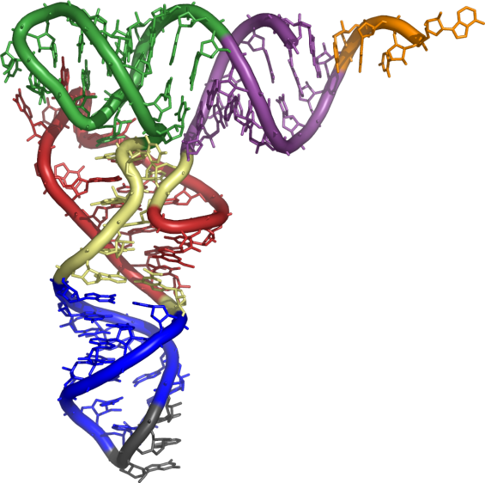
Origin of Genetics
Dawn of natural selection
RNA is likely first genetic material
multi-functional
codes information
self-replicating molecule
makes inheritance possible
natural selection & evolution
enzyme functions
ribozymes
replication
regulatory molecule
transport molecule
tRNA & mRNA
Notes:
Why RNA?
RNA molecules are important catalysts in modern cells. Modern cells use RNA catalysts, called ribozymes, to remove introns from RNA. Ribozymes also help catalyze the synthesis of new RNA, notably rRNA, tRNA, and mRNA. Thus, RNA is autocatalytic, and in the prebiotic world, before there were enzymes (proteins) or DNA, RNA molecules may have been fully capable of ribozyme-catalyzed replication.

Slide 13
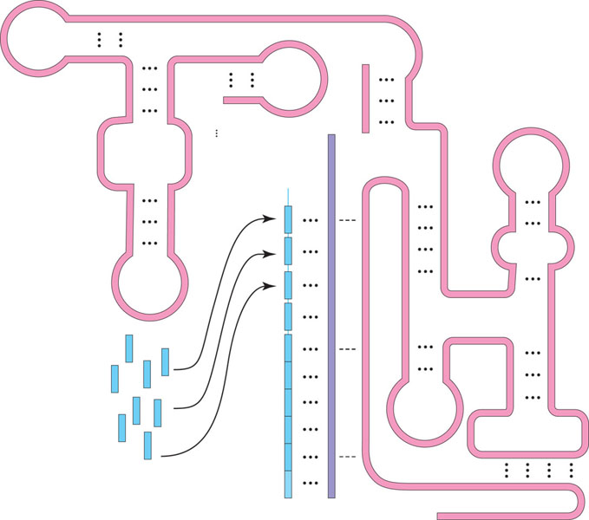
A ribozyme capable of replicating RNA
Ribozyme
(RNA molecule)
3′
Template
Nucleotides
Complementary RNA copy
5′
5′

Slide 14
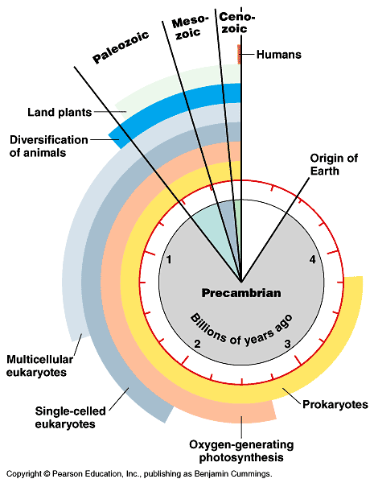
Key Events in Origin of Life
Key events in evolutionary history of life on Earth
life originated 3.5–4.0 bya
“Heterotroph Hypothesis”: cells eating other cells for ~700 million years.

Slide 15
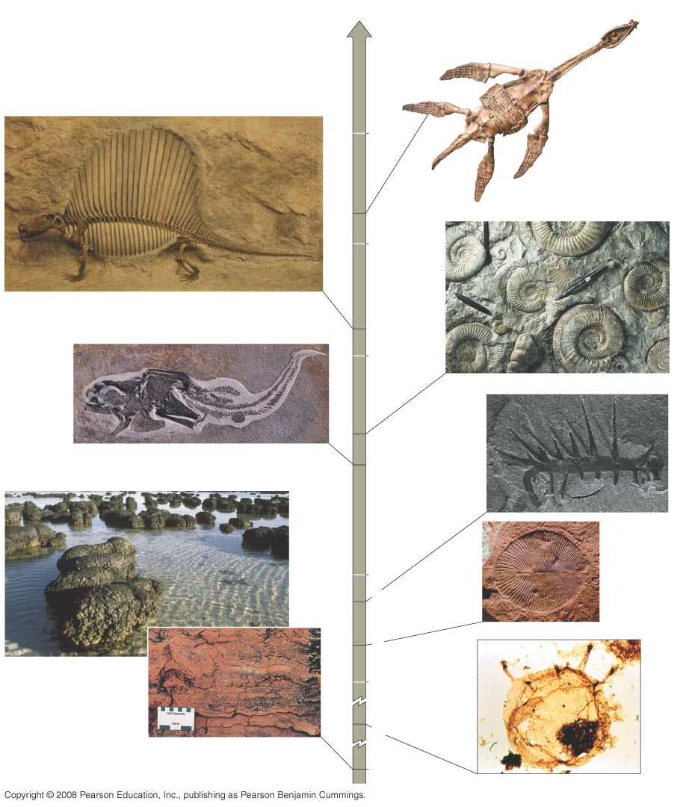
Fig. 25-4
Present
Rhomaleosaurus victor,
a plesiosaur
Dimetrodon
100 million years ago
Casts of
ammonites
175
200
270
300
4.5 cm
375
Hallucigenia
Coccosteus cuspidatus
400
1 cm
Dickinsonia
costata
500
525
2.5 cm
565
Stromatolites
600
Tappania, a
unicellular
eukaryote
Fossilized
stromatolite
3,500 1,500
Notes:
Figure 25.4 Documenting the history of life
The fossil record reveals changes in the history of life on earth
Sedimentary rocks are deposited into layers called strata and are the richest source of fossils

Slide 16
Few individuals have fossilized, and even fewer have been discovered
The fossil record is biased in favor of species that
Existed for a long time
Were abundant and widespread
Had hard parts
Animation: The Geologic Record

Slide 17
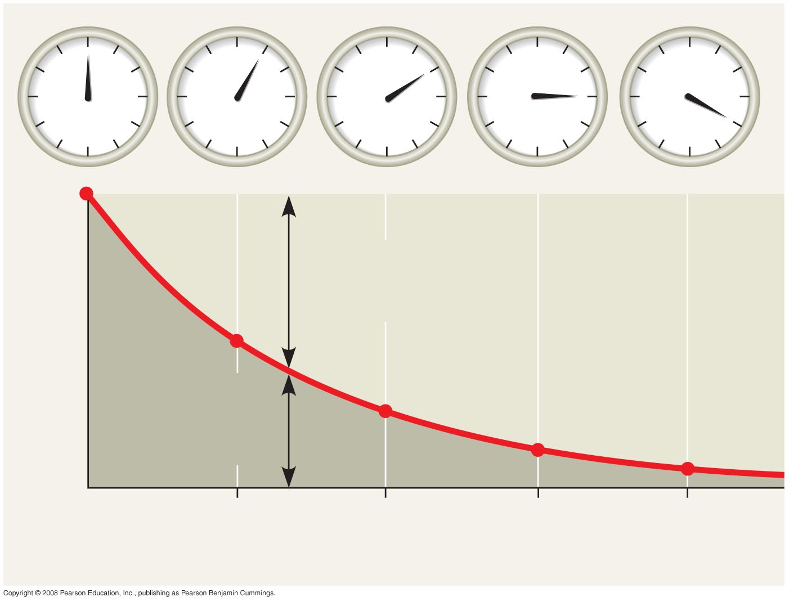
Fig. 25-5
Accumulating
“daughter”
isotope
Fraction of parent isotope remaining
¹/₂
Remaining
“parent”
isotope
¹/₄
¹/₈
¹/₁₆
1
2
3
4
Time (half-lives)
Notes:
Figure 25.5 Radiometric dating
Sedimentary strata reveal the relative ages of fossils
The absolute ages of fossils can be determined by radiometric dating
A “parent” isotope decays to a “daughter” isotope at a constant rate
Each isotope has a known half-life, the time required for half the parent isotope to decay
Radiocarbon dating can be used to date fossils up to 75,000 years old
For older fossils, some isotopes can be used to date sedimentary rock layers above and below the fossil
The magnetism of rocks can provide dating information
Reversals of the magnetic poles leave their record on rocks throughout the world

Slide 18
Concept 25.3: Key events in life’s history include the origins of single-celled and multicelled organisms and the colonization of land
The geologic record is divided into the Archaean, the Proterozoic, and the Phanerozoic eons

Slide 19
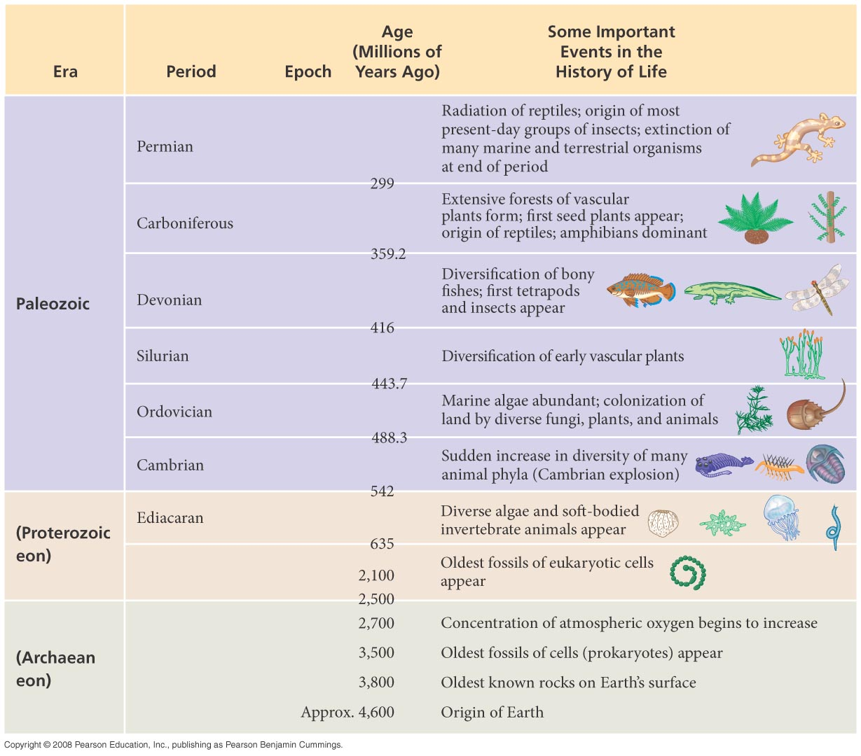
Table 25-1a
Notes:
Table 25.1

Slide 20
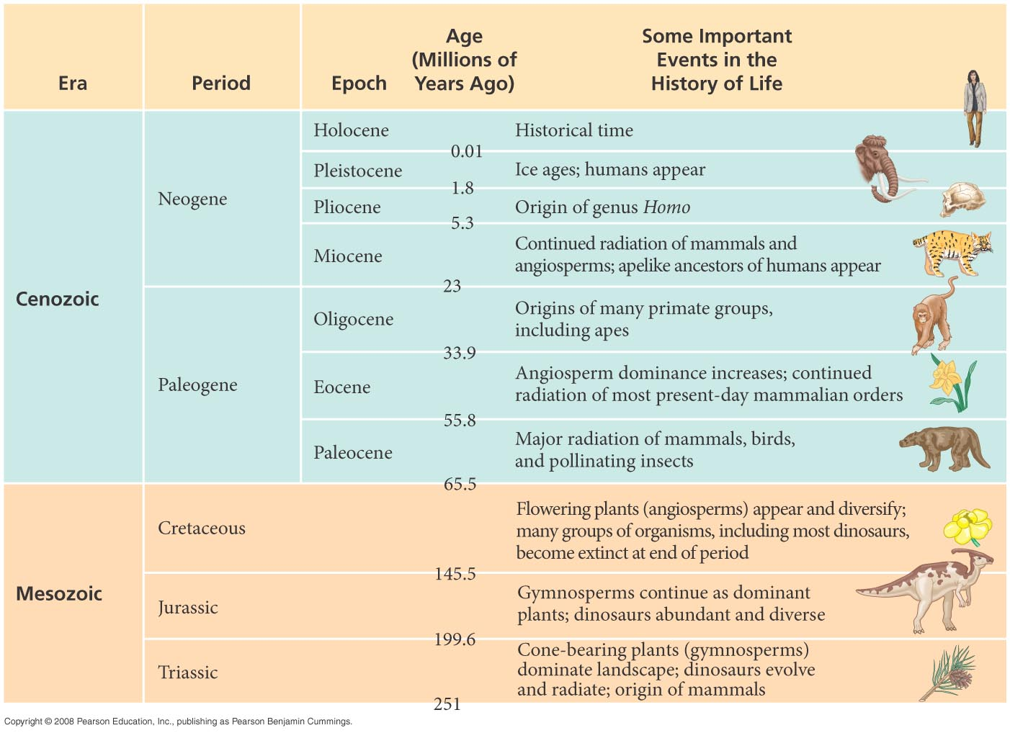
Table 25-1b
Notes:
Table 25.1

Slide 21
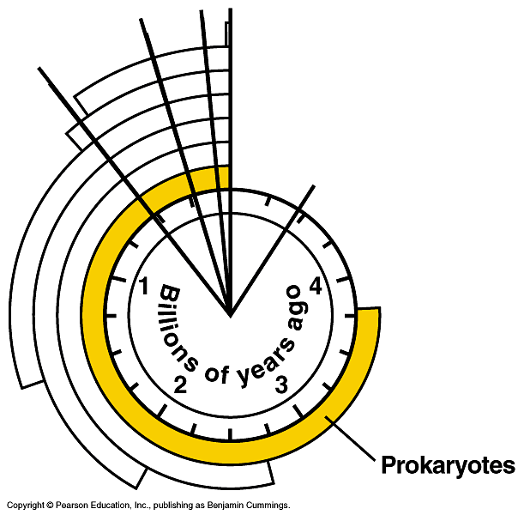
Prokaryotes
Prokaryotes dominated life on Earth from 3.5–2.0 bya
3.5 billion year old fossil of bacteria
modern bacteria
chains of one-celled cyanobacteria
Notes:
The oldest known fossils are stromatolites, rock-like structures composed of many layers of bacteria and sediment
Stromatolites date back 3.5 billion years ago
Prokaryotes were Earth’s sole inhabitants from 3.5 to about 2.1 billion years ago
Electron Transport Systems
The chemiosmotic mechanism of ATP synthesis, in which a complex set of membrane–bound proteins pass electrons to reducible electron acceptors with the generation of ATP from ADP, is common to all three domains of life—Bacteria, Archaea, and Eukarya. There is strong evidence that this electron transport mechanism actually originated in organisms that lived before the last common ancestor of all present–day life. The earliest of these electron transport systems likely evolved before there was any free oxygen in the environment and before the appearance of photosynthesis; the organisms that used it would have required a plentiful supply of energy–rich compounds such as molecular hydrogen, methane, and hydrogen sulfide. A great challenge facing scientists studying the origin of life is to determine the steps by which this electron transport mechanism originated, and how important early versions of it might have been in the emergence of the first cells.
So considerable metabolic diversity among prokaryotes living in various environments had already evolved more than 3 billion years ago. Most subsequent evolution has been more structural than metabolic.

Slide 22
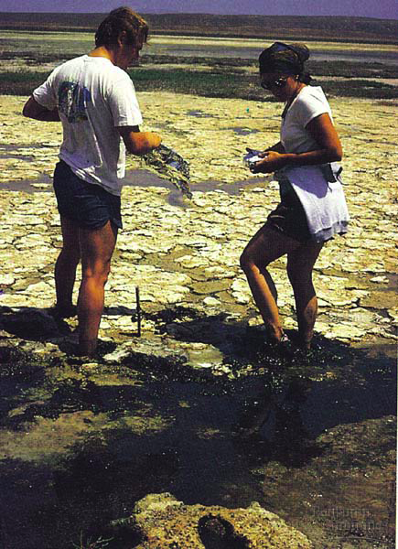
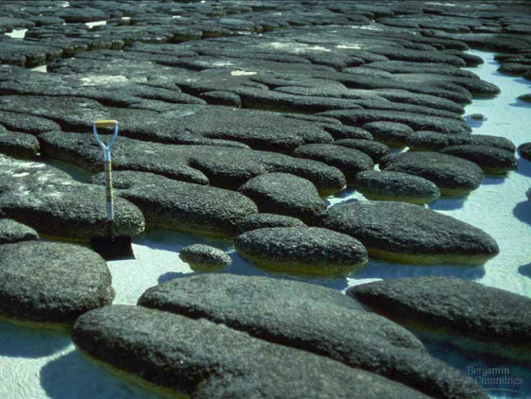
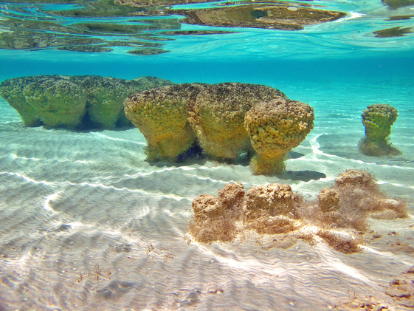
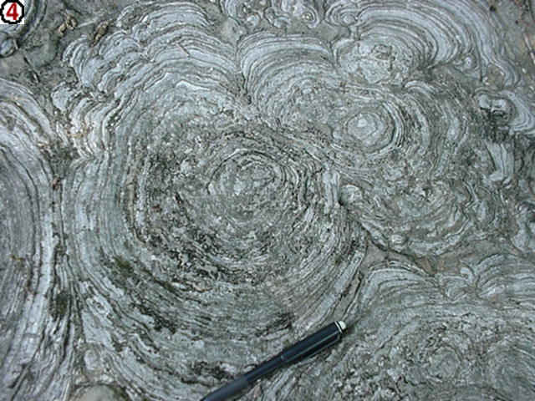
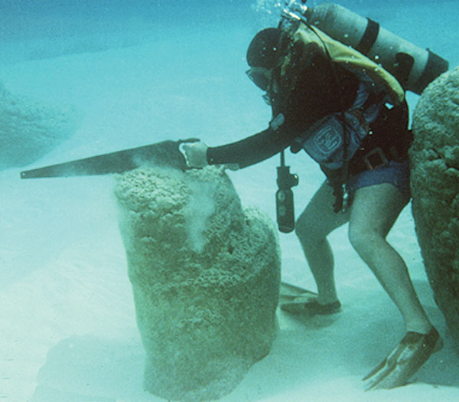
Stromatolites
Lynn Margulis
Fossilized mats of prokaryotes resemble modern microbial colonies

Slide 23
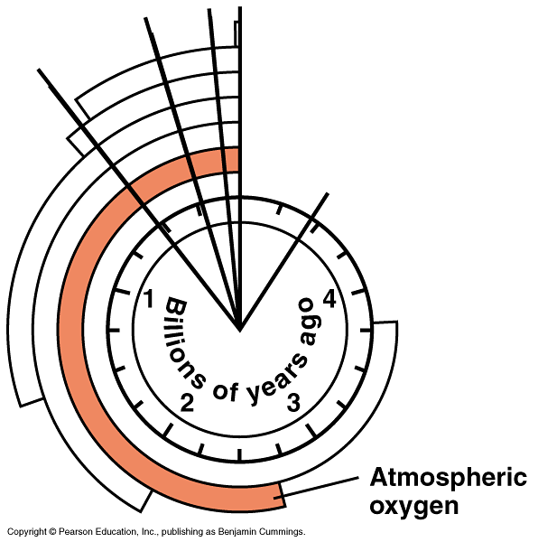
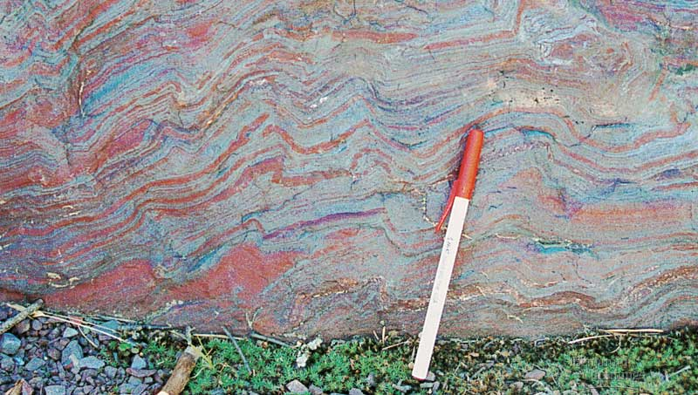
Oxygen atmosphere
Oxygen begins to accumulate 2.7 bya
reducing → oxidizing atmosphere
evidence in banded iron in rocks = rusting
makes aerobic respiration possible
photosynthetic bacteria (blue-green algae)
Notes:
Most atmospheric oxygen (O₂) is of biological origin
O₂ produced by oxygenic photosynthesis reacted with dissolved iron and precipitated out to form banded iron formations
The source of O₂ was likely bacteria similar to modern cyanobacteria
By about 2.7 billion years ago, O₂ began accumulating in the atmosphere and rusting iron-rich terrestrial rocks
This “oxygen revolution” from 2.7 to 2.2 billion years ago
Posed a challenge for life
Provided opportunity to gain energy from light
Allowed organisms to exploit new ecosystems
For the Discovery Video Early Life, go to Animation and Video Files.

Slide 24
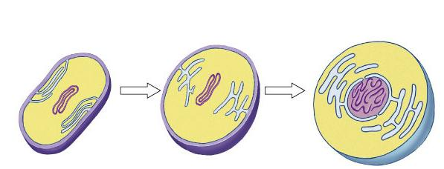
First Eukaryotes
~2 bya
Development of internal membranes
create internal micro-environments
advantage: specialization = increase efficiency
natural selection!
endoplasmic reticulum (ER)
nuclear envelope
infolding of the plasma membrane
plasma
membrane
nucleus
DNA
cell wall
plasma
membrane
Prokaryotic
cell
Prokaryotic ancestor of eukaryotic cells
Eukaryotic
cell
Notes:
The oldest fossils of eukaryotic cells date back 2.1 billion years
The hypothesis of endosymbiosis proposes that mitochondria and plastids (chloroplasts and related organelles) were formerly small prokaryotes living within larger host cells
An endosymbiont is a cell that lives within a host cell
The prokaryotic ancestors of mitochondria and plastids probably gained entry to the host cell as undigested prey or internal parasites
In the process of becoming more interdependent, the host and endosymbionts would have become a single organism
Serial endosymbiosis supposes that mitochondria evolved before plastids through a sequence of endosymbiotic events

Slide 25
Endosymbiosis
Evolution of eukaryotes
origin of mitochondria
engulfed aerobic bacteria, but did not digest them
mutually beneficial relationship
natural selection!
internal membrane system
aerobic bacterium
mitochondrion
Endosymbiosis
Ancestral
eukaryotic cell
Eukaryotic cell
with mitochondrion

