Slide 1
3.4 Monosaccharides are the simplest carbohydrates
Carbohydrates range from small sugar molecules (monomers) to large polysaccharides
Sugar monomers are monosaccharides, such as glucose and fructose
These can be hooked together to form the polysaccharides
Copyright © 2009 Pearson Education, Inc.
Notes:
Monosaccharides have molecular formulae that are multiples of CH₂O.
Monosaccharides, particularly glucose, are major nutrients for cells. Glucose is the starting compound for an important metabolic pathway called cellular respiration.
Student Misconceptions and Concerns
1. The abstract nature of chemistry can be discouraging to many students. Consider starting out this section of the lecture by examining the chemical groups on a food nutrition label. Candy bars with peanuts are particularly useful, as they contain significant amounts of all three sources of calories (carbohydrates, proteins, and lipids).
2. Consider reinforcing the three main sources of calories with food items that clearly represent each group. Bring clear examples to class as visual references. For example, a can of Coke or a bag of sugar for carbohydrates, a tub of margarine for lipids, and some beef jerky for protein (although some fat and carbohydrates might also be included).
Teaching Tips
1. If your lectures will eventually include details of glycolysis and aerobic respiration, this is a good point to introduce the basic concepts of glucose as fuel. Just introducing this conceptual formula might help: eating glucose + breathing in oxygen → water + usable energy (used to build ATP) + heat + exhaling CO₂.

Slide 2
Carbohydrates
Carbohydrates are composed of C, H, O
carbo - hydr - ate
CH₂O
Function:
energy
energy storage
raw materials
structural materials
Monomer: sugars
ex: sugars, starches, cellulose
(CH₂O)_{x}
C₆H₁₂O₆
sugar
sugar
sugar
sugar
sugar
sugar
sugar
sugar
Notes:
carb = carbon
hydr = hydrogen
ate = oxygen compound

Slide 3
Sugars
Most names for sugars end in -ose
Classified by number of carbons
6C = hexose (glucose)
5C = pentose (ribose)
3C = triose (glyceraldehyde)
H
O
C
Glucose
CH₂OH
CH₂OH
Ribose
H
C
OH
O
O
H
H
H
H
C
OH
H
6
H
5
HO
3
OH
H
HO
H
H
HO
OH
OH
H
Glyceraldehyde
H
OH

Slide 4
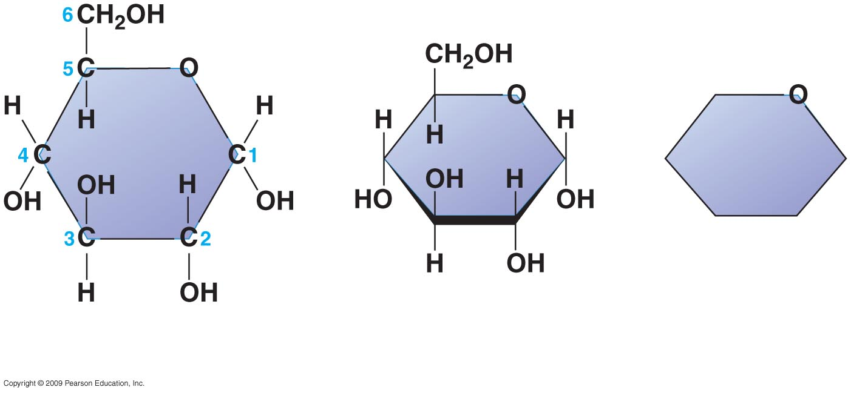
Structural
formula
Abbreviated
structure
Simplified
structure
Notes:
Figure 3.4C Three representations of the ring form of glucose.

Slide 5
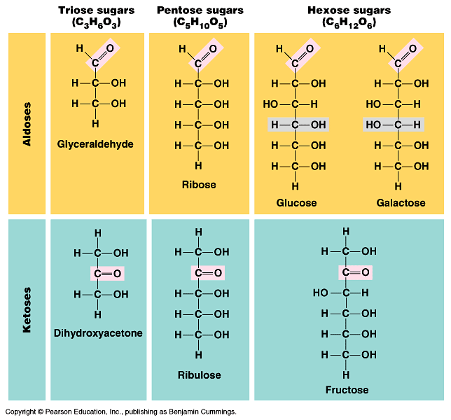
Functional groups determine function
carbonyl
aldehyde
carbonyl
ketone

Slide 6
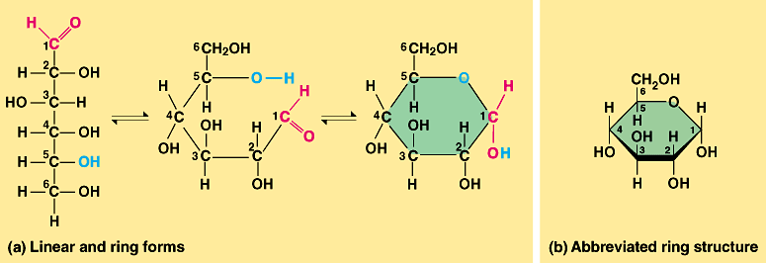
Sugar structure
5C & 6C sugars form rings in solution
Carbons are numbered

Slide 7
Numbered carbons
C
6'
C
O
5'
C
C
4'
1'
energy stored in C-C bonds
C
C
3'
2'

Slide 8
Simple & complex sugars
CH₂OH
H
O
H
H
Monosaccharides
simple 1 monomer sugars
glucose
Disaccharides
2 monomers
sucrose
Polysaccharides
large polymers
starch
OH
H
HO
OH
H
OH
Glucose

Slide 9
Building sugars
Dehydration synthesis
monosaccharides
disaccharide
H₂O
|
glucose
|
glucose
|
maltose
glycosidic linkage
Notes:
Maltose
Disaccharide video
Polysaccharide video

Slide 10
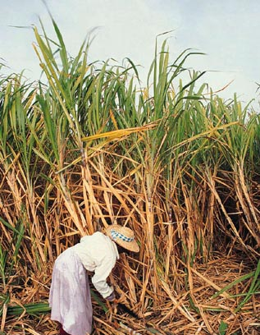
Building sugars
Dehydration synthesis
monosaccharides
disaccharide
H₂O
|
glucose
|
fructose
|
sucrose
(table sugar)
Notes:
sucrose = table sugar

Slide 11
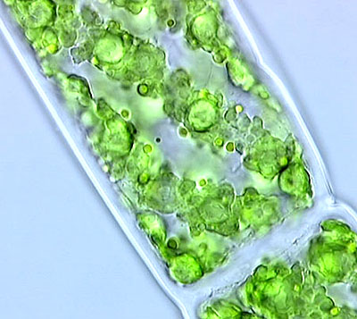
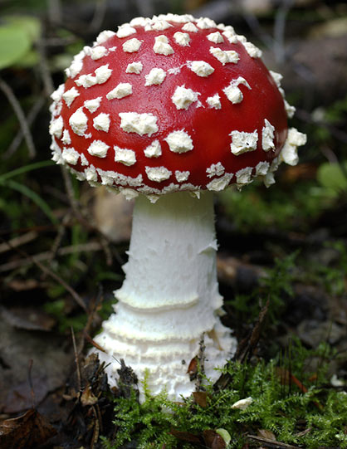
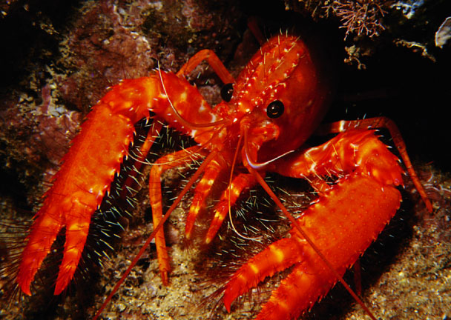
Polysaccharides
Polymers of sugars
costs little energy to build
easily reversible = release energy
Function:
energy storage
starch (plants)
glycogen (animals)
in liver & muscles
structure
cellulose (plants)
chitin (arthropods & fungi)
Notes:
Polysaccharides are polymers of hundreds to thousands of monosaccharides
Starch is a storage polysaccharide composed of glucose monomers and found in plants
Glycogen is a storage polysaccharide composed of glucose, which is hydrolyzed by animals when glucose is needed
Cellulose is a polymer of glucose that forms plant cell walls
Chitin is a polysaccharide used by insects and crustaceans to build an exoskeleton
Most mammals, including humans, do not have enzymes necessary to digest cellulose. Thus the energy in the glucose monomers is not available. Cows have solved this problem by harboring prokaryotes (bacteria) in their rumen that hydrolyze the cellulose of grass and hay to glucose monomers. The glucose can be used for energy as well as building blocks for other nutrients that nourish the cow. Likewise, termites cannot digest cellulose in wood, but the bacteria in their guts can, and so provide a meal for themselves as well as the termites
The text notes that cellulose is the most abundant organic molecule on Earth. Ask your students why this is true.

Slide 12
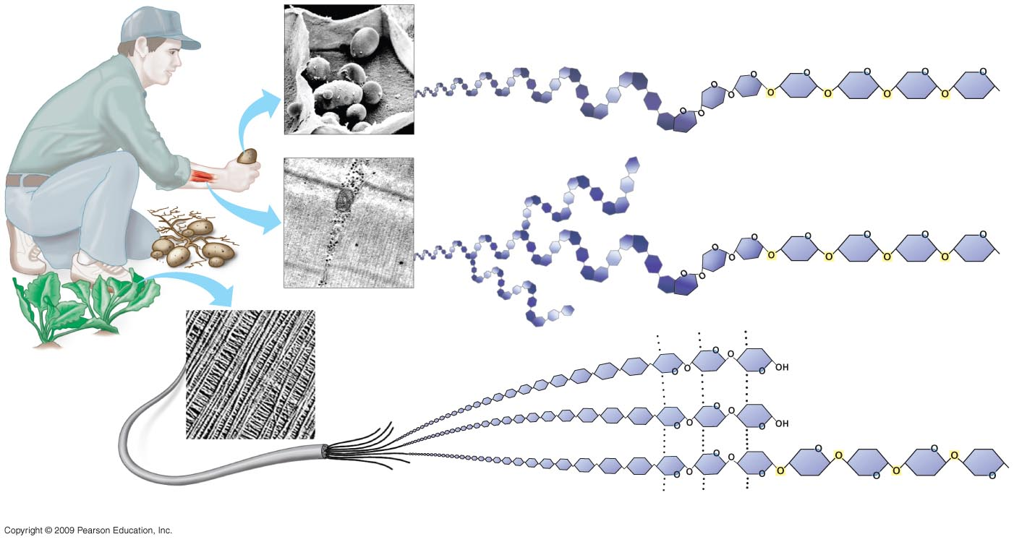
Starch granules in
potato tuber cells
STARCH
Glucose
monomer
Glycogen
granules
in muscle
tissue
GLYCOGEN
CELLULOSE
Cellulose fibrils in
a plant cell wall
Hydrogen bonds
Cellulose
molecules
Notes:
Figure 3.7 Polysaccharides

Slide 13
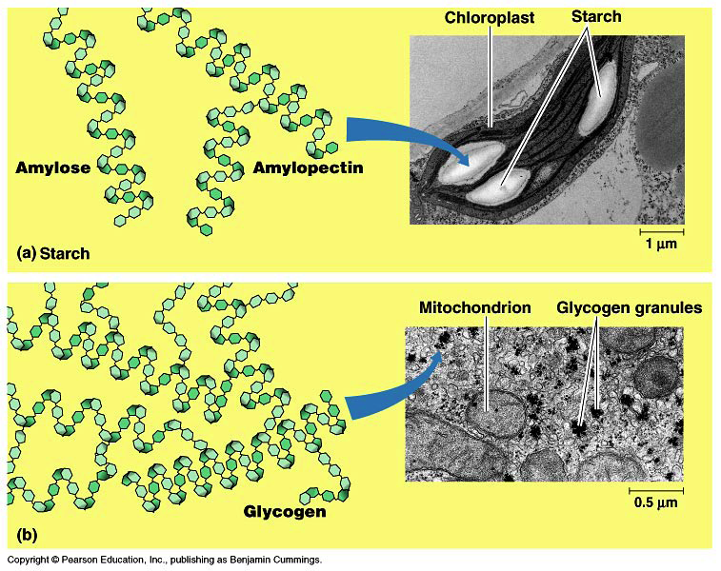
Linear vs. branched polysaccharides
slow release
starch
(plant)
energy storage
glycogen
(animal)
fast release
Notes:
Can you see the difference between starch & glycogen?
Which is easier to digest?
Glycogen = many branches = many ends
Enzyme can digest at multiple ends. Animals use glycogen for energy storage == want rapid release.
Form follows function.
APBio/TOPICS/Biochemistry/MoviesAP/05_07Polysaccharides_A.swf

Slide 14
Polysaccharide diversity
Molecular structure determines function
in starch
in cellulose
isomers of glucose
structure determines function…

Slide 15
Digesting starch vs. cellulose
starch easy to digest
enzyme
cellulose hard to digest
enzyme
Notes:
Starch = all the glycosidic linkage are on same side = molecule lies flat
Cellulose = cross linking between OH (H bonds) = rigid structure

Slide 16
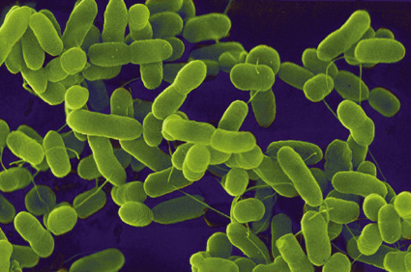
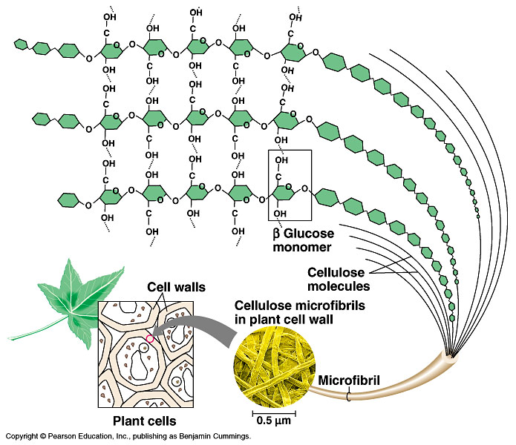
Cellulose
Most abundant organic compound on Earth
herbivores have evolved a mechanism to digest cellulose
most carnivores have not
that’s why they eat meat to get their energy & nutrients
cellulose = undigestible roughage
Notes:
Cross-linking between polysaccharide chains:
= rigid & hard to digest
The digestion of cellulose governs the life strategy of herbivores.
Either you do it really well and you’re a cow or an elephant (spend a long time digesting a lot of food with a little help from some microbes & have to walk around slowly for a long time carrying a lot of food in your stomach)
Or you do it inefficiently and have to supplement your diet with simple sugars, like fruit and nectar, and you’re a gorilla.

Slide 17
Chitin, a different structural polysaccharide
CH₂OH
H
O
OH
H
OH
H
OH
H
H
NH
C
O
CH₃
(a) The structure of the
chitin monomer.
(b) Chitin forms the exo- skeleton of arthropods. This cicada is molting, shedding its old exoskeleton and emerging
in adult form. It is also found in Fungal Cell Walls.
(c) Chitin is used to make a
strong and flexible surgical
thread that decomposes after
the wound or incision heals.

Slide 18
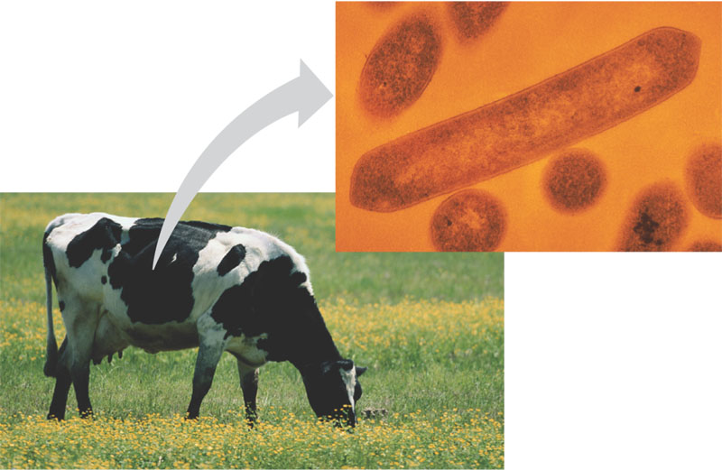
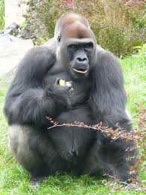
Cow
can digest cellulose well; no need to eat other sugars
Gorilla
can’t digest cellulose well; must add another sugar source, like fruit to diet
Notes:
The digestion of cellulose governs the life strategy of herbivores.
Either you do it really well and you’re a cow or an elephant (spend a long time digesting a lot of food with a little help from some microbes & have to walk around slowly for a long time carrying a lot of food in your stomach)
Or you do it inefficiently and have to supplement your diet with simple sugars, like fruit and nectar, and you’re a gorilla.
APBioTOPICS/20Biochemistry/MoviesAP/Macromolecule-Lifewire.swf

Slide 19
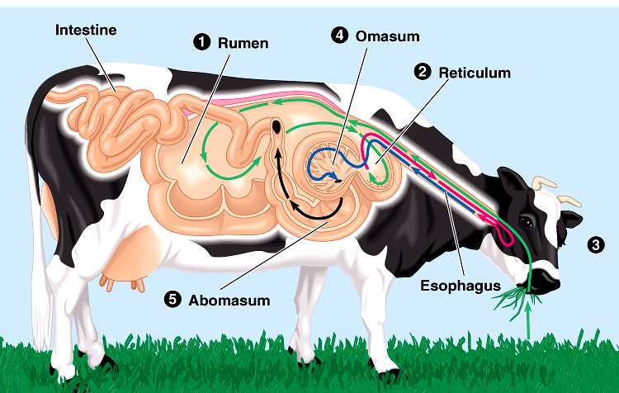
Helpful bacteria
How can herbivores digest cellulose so well?
BACTERIA live in their digestive systems & help digest cellulose-rich (grass) meals
Ruminants

