Slide 1
5.14 Enzymes speed up the cell’s chemical reactions by lowering energy barriers
Although there is a lot of potential energy in biological molecules, such as carbohydrates and others, it is not released spontaneously
Energy must be available to break bonds and form new ones
This energy is called energy of activation (E_{A})
Copyright © 2009 Pearson Education, Inc.
Notes:
Heat could be used to initiate a reaction. However, heat would kill the cell and would not be specific for a particular reaction.
For the BLAST Animation Enzymes: Activation Energy, go to Animation and Video Files.
Student Misconceptions and Concerns
1. For students not previously familiar with activation energy, analogies can make all the difference. Activation energy can be thought of as a small input that is needed to trigger a large output. This is like (a) an irritated person who needs only a bit more frustration to explode in anger, (b) small waves that lift debris over a dam, or (c) lighting a match around lighter fluid. In each situation, the output is much greater than the input.
Teaching Tips
1. The information in DNA is used to direct the production of RNA, which in turn directs the production of proteins. However, in Chapter 3, four different types of biological molecules were noted as significant components of life. Students who think this through might wonder, and you could point out that DNA does not directly control the production of carbohydrates and lipids. So how does DNA exert its influence over the synthesis of these two chemical groups? The answer is largely by way of enzymes, proteins with the ability to promote the production of carbohydrates and lipids.

Slide 2
5.14 Enzymes speed up the cell’s chemical reactions by lowering energy barriers
The cell uses catalysis to drive (speed up) biological reactions
Catalysis is accomplished by enzymes, which are proteins that function as biological catalysts
Enzymes speed up the rate of the reaction by lowering the E_{A} , and they are not used up in the process
Each enzyme has a particular target molecule called the substrate
Animation: How Enzymes Work
Copyright © 2009 Pearson Education, Inc.
Notes:
Most enzymes are proteins, but RNA enzymes, also called ribozymes, also catalyze reactions.
Student Misconceptions and Concerns
1. For students not previously familiar with activation energy, analogies can make all the difference. Activation energy can be thought of as a small input that is needed to trigger a large output. This is like (a) an irritated person who needs only a bit more frustration to explode in anger, (b) small waves that lift debris over a dam, or (c) lighting a match around lighter fluid. In each situation, the output is much greater than the input.
Teaching Tips
1. The information in DNA is used to direct the production of RNA, which in turn directs the production of proteins. However, in Chapter 3, four different types of biological molecules were noted as significant components of life. Students who think this through might wonder, and you could point out that DNA does not directly control the production of carbohydrates and lipids. So how does DNA exert its influence over the synthesis of these two chemical groups? The answer is largely by way of enzymes, proteins with the ability to promote the production of carbohydrates and lipids.

Slide 3
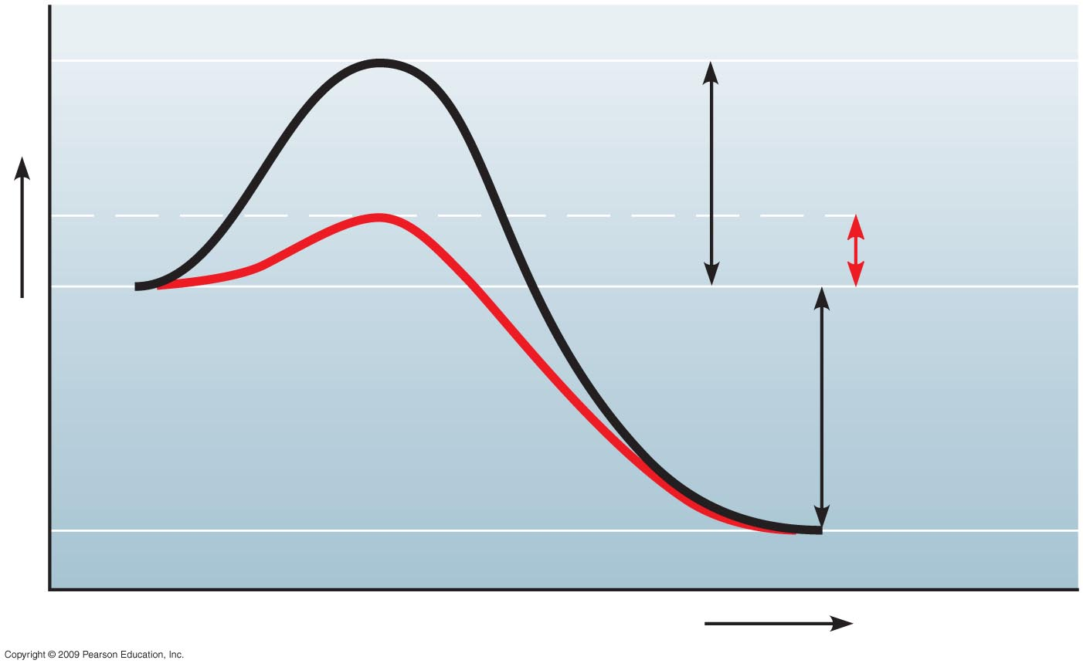
Reaction
without
enzyme
E_{A} without
enzyme
E_{A} with
enzyme
Reactants
Energy
Net
change
in energy
(the same)
Reaction with
enzyme
Products
Progress of the reaction
Notes:
Figure 5.14 The effect of an enzyme is to lower E_{A}.

Slide 4
5.15 A specific enzyme catalyzes each cellular reaction
Enzymes have unique three-dimensional shapes
The shape is critical to their role as biological catalysts
As a result of its shape, the enzyme has an active site where the enzyme interacts with the enzyme’s substrate
Consequently, the substrate’s chemistry is altered to form the product of the enzyme reaction
Copyright © 2009 Pearson Education, Inc.
Notes:
Student Misconceptions and Concerns
1. The specific interactions of enzymes and substrates can be illustrated with simple physical models. Many students new to these concepts will benefit from several forms of explanation, including diagrams such as those in the textbook, physical models, and the opportunity to manipulate or create their own examples. Just like pitching a tent, new concepts are best constructed with many lines of support.
Teaching Tips
1. The information in DNA is used to direct the production of RNA, which in turn directs the production of proteins. However, in Chapter 3, four different types of biological molecules were noted as significant components of life. Students who think this through might wonder, and you could point out that DNA does not directly control the production of carbohydrates and lipids. So how does DNA exert its influence over the synthesis of these two chemical groups? The answer is largely by way of enzymes, proteins with the ability to promote the production of carbohydrates and lipids.
2. The text notes that the relationship between an enzyme and its substrate is like a handshake, with each hand generally conforming to the shape of the other. This induced fit is also like the change in shape of a glove when a hand is inserted. The glove’s general shape matches the hand, but the final “fit” requires some additional adjustments.

Slide 5
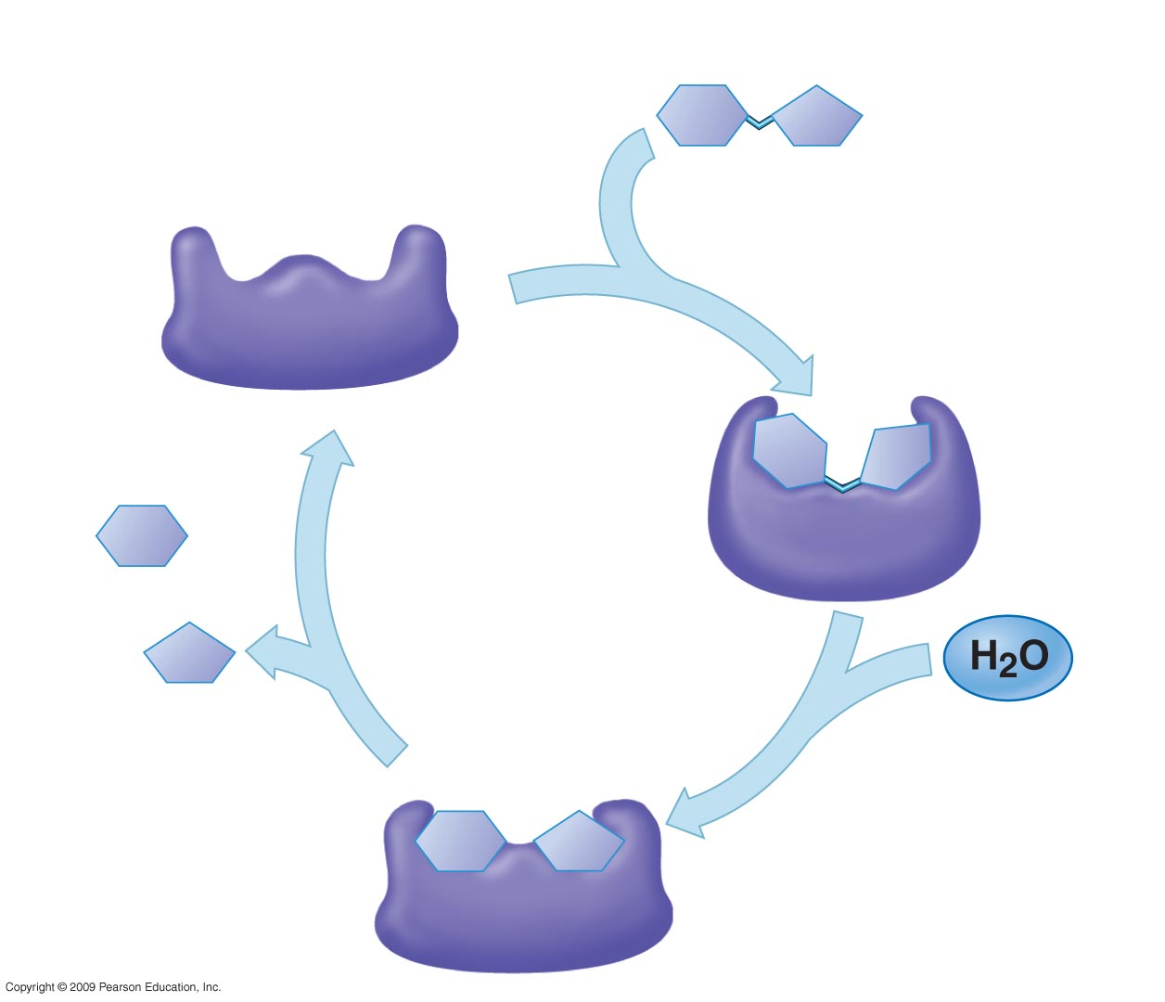
1
Enzyme available
with empty active
site
Active site
Substrate
(sucrose)
2
Substrate binds
to enzyme with
induced fit
Enzyme
(sucrase)
Glucose
Fructose
4
Products are
released
3
Substrate is
converted to
products
Notes:
Figure 5.15 The catalytic cycle of an enzyme.

Slide 6
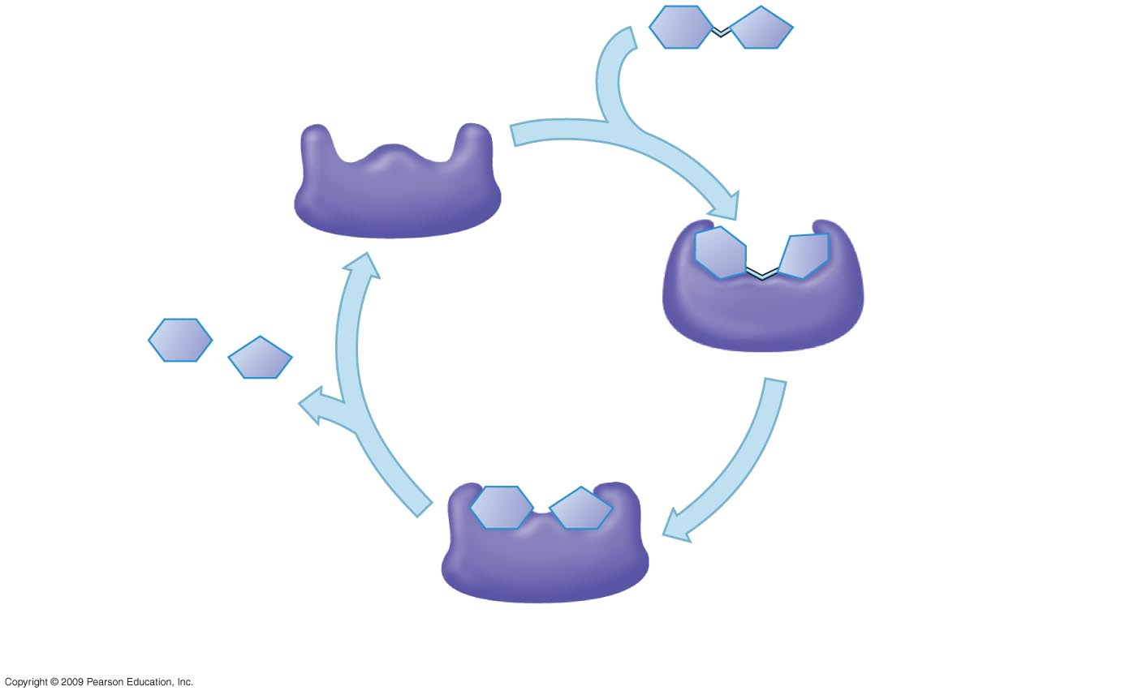
c.
b.
a.
d.
f.
e.

Slide 7
5.15 A specific enzyme catalyzes each cellular reaction
For optimum activity, enzymes require certain environmental conditions
Temperature is very important, and optimally, human enzymes function best at 37ºC, or body temperature
High temperature will denature human enzymes
Enzymes also require a pH around neutrality for best results
Copyright © 2009 Pearson Education, Inc.
Notes:
Certain chemicals also alter enzyme function and have been used to kill bacteria.
For the BLAST Animation Enzymes: Types and Specificity, go to Animation and Video Files.
Student Misconceptions and Concerns
1. The specific interactions of enzymes and substrates can be illustrated with simple physical models. Many students new to these concepts will benefit from several forms of explanation, including diagrams such as those in the textbook, physical models, and the opportunity to manipulate or create their own examples. Just like pitching a tent, new concepts are best constructed with many lines of support.
Teaching Tips
1. The information in DNA is used to direct the production of RNA, which in turn directs the production of proteins. However, in Chapter 3, four different types of biological molecules were noted as significant components of life. Students who think this through might wonder, and you could point out that DNA does not directly control the production of carbohydrates and lipids. So how does DNA exert its influence over the synthesis of these two chemical groups? The answer is largely by way of enzymes, proteins with the ability to promote the production of carbohydrates and lipids.
2. The text notes that the relationship between an enzyme and its substrate is like a handshake, with each hand generally conforming to the shape of the other. This induced fit is also like the change in shape of a glove when a hand is inserted. The glove’s general shape matches the hand, but the final “fit” requires some additional adjustments.

Slide 8
5.15 A specific enzyme catalyzes each cellular reaction
Some enzymes require nonprotein helpers
Cofactors are inorganic, such as zinc, iron, or copper
Coenzymes are organic molecules and are often vitamins
Copyright © 2009 Pearson Education, Inc.
Notes:
We need vitamins in our food or as supplements because of their role in metabolism driven by enzymes.
Student Misconceptions and Concerns
1. The specific interactions of enzymes and substrates can be illustrated with simple physical models. Many students new to these concepts will benefit from several forms of explanation, including diagrams such as those in the textbook, physical models, and the opportunity to manipulate or create their own examples. Just like pitching a tent, new concepts are best constructed with many lines of support.
Teaching Tips
1. The information in DNA is used to direct the production of RNA, which in turn directs the production of proteins. However, in Chapter 3, four different types of biological molecules were noted as significant components of life. Students who think this through might wonder, and you could point out that DNA does not directly control the production of carbohydrates and lipids. So how does DNA exert its influence over the synthesis of these two chemical groups? The answer is largely by way of enzymes, proteins with the ability to promote the production of carbohydrates and lipids.
2. The text notes that the relationship between an enzyme and its substrate is like a handshake, with each hand generally conforming to the shape of the other. This induced fit is also like the change in shape of a glove when a hand is inserted. The glove’s general shape matches the hand, but the final “fit” requires some additional adjustments.

Slide 9
5.16 Enzyme inhibitors block enzyme action and can regulate enzyme activity in a cell
Inhibitors are chemicals that inhibit an enzyme’s activity
One group inhibits because they compete for the enzyme’s active site and thus block substrates from entering the active site
These are called competitive inhibitors
Copyright © 2009 Pearson Education, Inc.
Notes:
Penicillin, an antibiotic, is an example of a competitive inhibitor because it blocks the active site of an enzyme that some bacteria use to make their cell wall.
For the BLAST Animation Enzyme Regulation: Chemical Modification, go to Animation and Video Files.
For the BLAST Animation Enzyme Regulation: Competitive Inhibition, go to Animation and Video Files.
Student Misconceptions and Concerns
1. The specific interactions of enzymes and substrates can be illustrated with simple physical models. Many students new to these concepts will benefit from several forms of explanation, including diagrams such as those in the textbook, physical models, and the opportunity to manipulate or create their own examples. Just like pitching a tent, new concepts are best constructed with many lines of support.
Teaching Tips
1. The information in DNA is used to direct the production of RNA, which in turn directs the production of proteins. However, in Chapter 3, four different types of biological molecules were noted as significant components of life. Students who think this through might wonder, and you could point out that DNA does not directly control the production of carbohydrates and lipids. So how does DNA exert its influence over the synthesis of these two chemical groups? The answer is largely by way of enzymes, proteins with the ability to promote the production of carbohydrates and lipids.
2. Enzyme inhibitors that block the active site are like (a) a person sitting in your assigned theater seat or (b) a car parked in your parking space. Analogies for inhibitors that change the shape of the active site are more difficult to imagine. Consider challenging your students to think of such analogies. (Perhaps someone adjusting the driver seat of the car differently from your preferences and then leaving it that way when you try to use the car.)
3. Feedback inhibition relies upon the negative feedback of the accumulation of a product. Ask students in class to suggest other products of reactions that inhibit the process that made them when the product reaches high enough levels. (Gas station pumps routinely shut off when a high level of gasoline is detected. Furnaces typically turn off when enough heat has been produced.)
4. Challenge your class to identify advantages of specific enzyme inhibitors for pest control. These advantages include (a) the ability to target chemical reactions of only certain types of pest organisms and (b) the ability to target chemical reactions that are found in insects but not in humans.

Slide 10
5.16 Enzyme inhibitors block enzyme action and can regulate enzyme activity in a cell
Other inhibitors do not act directly with the active site
These bind somewhere else and change the shape of the enzyme so that the substrate will no longer fit the active site
These are called noncompetitive inhibitors
Copyright © 2009 Pearson Education, Inc.
Notes:
Student Misconceptions and Concerns
1. The specific interactions of enzymes and substrates can be illustrated with simple physical models. Many students new to these concepts will benefit from several forms of explanation, including diagrams such as those in the textbook, physical models, and the opportunity to manipulate or create their own examples. Just like pitching a tent, new concepts are best constructed with many lines of support.
Teaching Tips
1. The information in DNA is used to direct the production of RNA, which in turn directs the production of proteins. However, in Chapter 3, four different types of biological molecules were noted as significant components of life. Students who think this through might wonder, and you could point out that DNA does not directly control the production of carbohydrates and lipids. So how does DNA exert its influence over the synthesis of these two chemical groups? The answer is largely by way of enzymes, proteins with the ability to promote the production of carbohydrates and lipids.
2. Enzyme inhibitors that block the active site are like (a) a person sitting in your assigned theater seat or (b) a car parked in your parking space. Analogies for inhibitors that change the shape of the active site are more difficult to imagine. Consider challenging your students to think of such analogies. (Perhaps someone adjusting the driver seat of the car differently from your preferences and then leaving it that way when you try to use the car.)
3. Feedback inhibition relies upon the negative feedback of the accumulation of a product. Ask students in class to suggest other products of reactions that inhibit the process that made them when the product reaches high enough levels. (Gas station pumps routinely shut off when a high level of gasoline is detected. Furnaces typically turn off when enough heat has been produced.)
4. Challenge your class to identify advantages of specific enzyme inhibitors for pest control. These advantages include (a) the ability to target chemical reactions of only certain types of pest organisms and (b) the ability to target chemical reactions that are found in insects but not in humans.

Slide 11
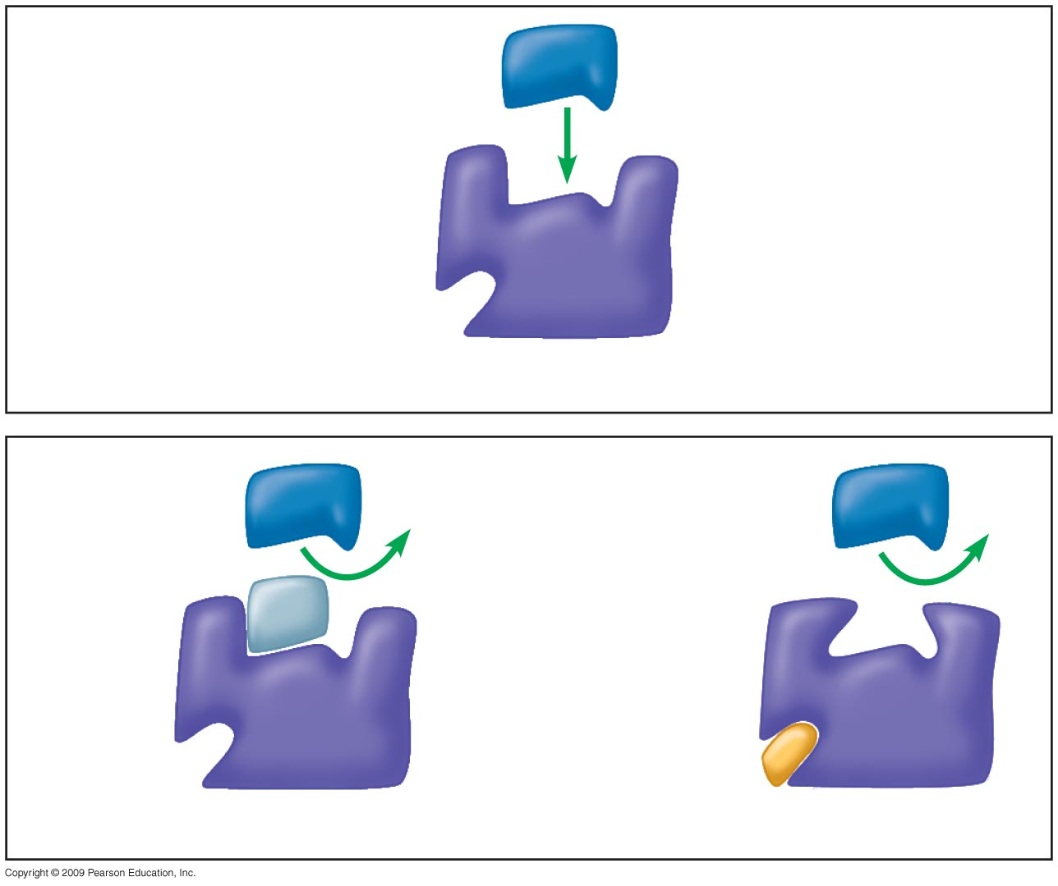
Substrate
Active site
Enzyme
Normal binding of substrate
Competitive
inhibitor
Noncompetitive
inhibitor
Enzyme inhibition
Notes:
Figure 5.16 How inhibitors interfere with substrate binding.

Slide 12
5.16 Enzyme inhibitors block enzyme action and can regulate enzyme activity in a cell
Enzyme inhibitors are important in regulating cell metabolism
Often the product of a metabolic pathway can serve as an inhibitor of one enzyme in the pathway, a mechanism called feedback inhibition
The more product formed, the greater the inhibition, and in this way, regulation of the pathway is accomplished
Copyright © 2009 Pearson Education, Inc.
Notes:
Student Misconceptions and Concerns
1. The specific interactions of enzymes and substrates can be illustrated with simple physical models. Many students new to these concepts will benefit from several forms of explanation, including diagrams such as those in the textbook, physical models, and the opportunity to manipulate or create their own examples. Just like pitching a tent, new concepts are best constructed with many lines of support.
Teaching Tips
1. The information in DNA is used to direct the production of RNA, which in turn directs the production of proteins. However, in Chapter 3, four different types of biological molecules were noted as significant components of life. Students who think this through might wonder, and you could point out that DNA does not directly control the production of carbohydrates and lipids. So how does DNA exert its influence over the synthesis of these two chemical groups? The answer is largely by way of enzymes, proteins with the ability to promote the production of carbohydrates and lipids.
2. Enzyme inhibitors that block the active site are like (a) a person sitting in your assigned theater seat or (b) a car parked in your parking space. Analogies for inhibitors that change the shape of the active site are more difficult to imagine. Consider challenging your students to think of such analogies. (Perhaps someone adjusting the driver seat of the car differently from your preferences and then leaving it that way when you try to use the car.)
3. Feedback inhibition relies upon the negative feedback of the accumulation of a product. Ask students in class to suggest other products of reactions that inhibit the process that made them when the product reaches high enough levels. (Gas station pumps routinely shut off when a high level of gasoline is detected. Furnaces typically turn off when enough heat has been produced.)
4. Challenge your class to identify advantages of specific enzyme inhibitors for pest control. These advantages include (a) the ability to target chemical reactions of only certain types of pest organisms and (b) the ability to target chemical reactions that are found in insects but not in humans.

