Slide 1
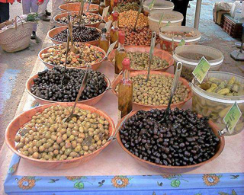
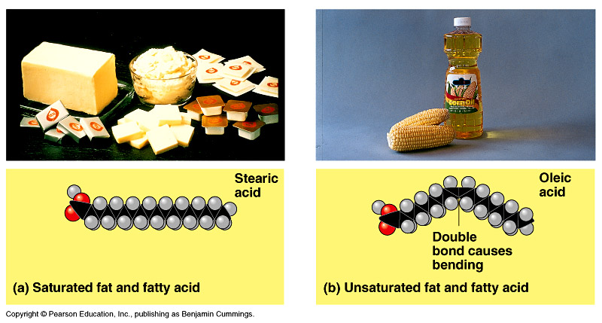
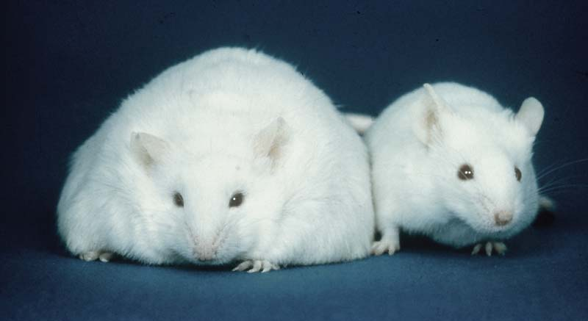
Lipids
long term energy storage
concentrated energy

Slide 2
3.8 Fats are lipids that are mostly energy-storage molecules
Lipids are water insoluble (hydrophobic, or water fearing) compounds that are important in energy storage
  They contain twice as much energy as a polysaccharide
Fats are lipids made from glycerol and fatty acids
Copyright © 2009 Pearson Education, Inc.
Notes:
Lipids are generally not big enough to be macromolecules. They are grouped together because they mix poorly, if at all, with water.
Student Misconceptions and Concerns
1. Students may struggle with the concept that a pound of fat contains more than twice the calories of a pound of sugar. It might seem that a pound of food would potentially add on a pound of weight. Other students may have never understood the concept of calories in the diet, simply following general guidelines of avoiding fatty foods. Furthermore, fiber and water have no caloric value but add to the weight of food. Consider class discussions that explore student misconceptions about calories, body weight, and healthy diets.
2. Students might struggle to extrapolate the properties of lipids to their roles in an organism. Ducks float because their feathers repel water instead of attracting it. Hair on our heads remains flexible because of oils produced in our scalp. Examples such as these help connect the abstract properties of lipids to concrete examples in our world.
Teaching Tips
1. The text in Module 3.8 notes the common observation that vinegar and oil do not mix in this type of salad dressing. A simple demonstration can help make this point. In front of the class, mix together colored water and a yellow oil (corn or canola oil work well). Shake up the mixture and then watch as the two separate. (You may have a mixture already made ahead of time that remains separated; however, the dye may bleed between the oil and the water.) Placing the mixture on an overhead projector or other well-illuminated imaging device makes for a dramatic display of hydrophobic activity!
2. The text notes that a gram of fat stores more than twice the energy of a gram of polysaccharide, such as starch. You might elaborate with a simple calculation to demonstrate how a person’s body weight would vary if the energy stored in body fat were stored in carbohydrates instead. If a 100-kg man carried 25% body fat, he would have 25 kg of fat in his body. Fat stores about 2.25 times more energy per gram than carbohydrate. What would be the weight of the man if he stored the energy in the fat in the form of carbohydrate? (2.25 × 25 = 56.25 kg of carbohydrate + 75 kg = 131.25 kg, an increase of 31.25%)
3. Margarine in stores commonly comes in liquid squeeze containers, in tubs, and in sticks. These forms reflect increasing amounts of hydrogenation, gradually increasing the stiffness from a liquid, to a firmer spread, to a firm stick of margarine. As noted in the text, recent studies have suggested that unsaturated oils become increasingly unhealthy as they are hydrogenated. Public attention to hydrogenation and the health risks of the resulting trans fats are causing changes in the use of products containing trans fats.

Slide 3
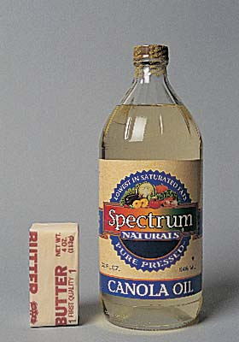
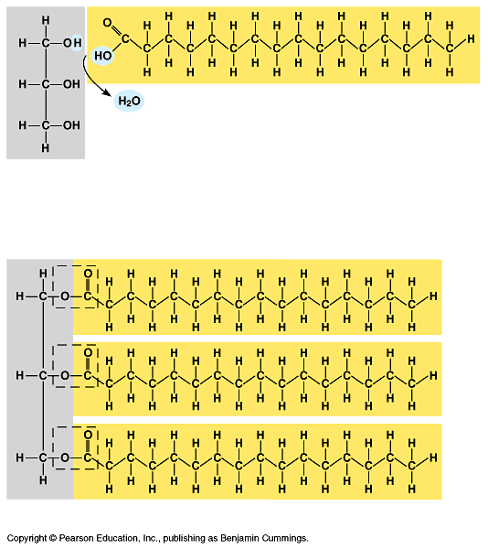
Lipids
Lipids are composed of C, H, O
  long hydrocarbon chains (H-C)
“Family groups”
  fats
  phospholipids
  steroids
Do not form polymers
  big molecules made of smaller subunits
  not a continuing chain
Notes:
Made of same elements as carbohydrates but very different structure/ proportions & therefore very different biological properties

Slide 4
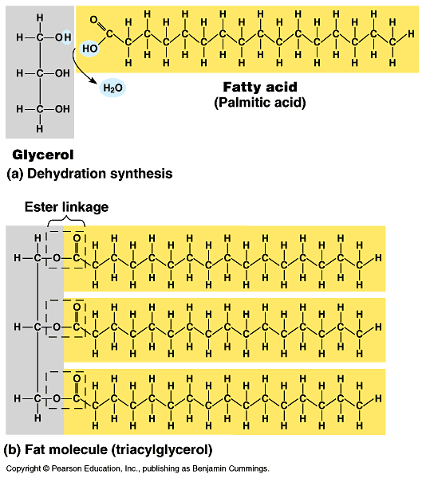
Fats
Structure:
  glycerol (3C alcohol) + fatty acid
    fatty acid =
    long HC “tail” with carboxyl (COOH) group “head”
enzyme
H₂O
dehydration synthesis
Notes:
Look at structure… What makes them hydrophobic?
Note functional group = carboxyl

Slide 5
3.8 Fats are lipids that are mostly energy-storage molecules
Fatty acids link to glycerol by a dehydration reaction
  A fat contains one glycerol linked to three fatty acids
  Fats are often called triglycerides because of their structure
Copyright © 2009 Pearson Education, Inc.
Notes:
Video: fats
Student Misconceptions and Concerns
1. Students may struggle with the concept that a pound of fat contains more than twice the calories of a pound of sugar. It might seem that a pound of food would potentially add on a pound of weight. Other students may have never understood the concept of calories in the diet, simply following general guidelines of avoiding fatty foods. Furthermore, fiber and water have no caloric value but add to the weight of food. Consider class discussions that explore student misconceptions about calories, body weight, and healthy diets.
2. Students might struggle to extrapolate the properties of lipids to their roles in an organism. Ducks float because their feathers repel water instead of attracting it. Hair on our heads remains flexible because of oils produced in our scalp. Examples such as these help connect the abstract properties of lipids to concrete examples in our world.
Teaching Tips
1. The text in Module 3.8 notes the common observation that vinegar and oil do not mix in this type of salad dressing. A simple demonstration can help make this point. In front of the class, mix together colored water and a yellow oil (corn or canola oil work well). Shake up the mixture and then watch as the two separate. (You may have a mixture already made ahead of time that remains separated; however, the dye may bleed between the oil and the water.) Placing the mixture on an overhead projector or other well-illuminated imaging device makes for a dramatic display of hydrophobic activity!
2. The text notes that a gram of fat stores more than twice the energy of a gram of polysaccharide, such as starch. You might elaborate with a simple calculation to demonstrate how a person’s body weight would vary if the energy stored in body fat were stored in carbohydrates instead. If a 100-kg man carried 25% body fat, he would have 25 kg of fat in his body. Fat stores about 2.25 times more energy per gram than carbohydrate. What would be the weight of the man if he stored the energy in the fat in the form of carbohydrate? (2.25 × 25 = 56.25 kg of carbohydrate + 75 kg = 131.25 kg, an increase of 31.25%)
3. Margarine in stores commonly comes in liquid squeeze containers, in tubs, and in sticks. These forms reflect increasing amounts of hydrogenation, gradually increasing the stiffness from a liquid, to a firmer spread, to a firm stick of margarine. As noted in the text, recent studies have suggested that unsaturated oils become increasingly unhealthy as they are hydrogenated. Public attention to hydrogenation and the health risks of the resulting trans fats are causing changes in the use of products containing trans fats.

Slide 6
Building Fats
Triacylglycerol
  3 fatty acids linked to glycerol
  ester linkage = between OH & COOH
hydroxyl
carboxyl
Notes:
BIG FAT molecule!!

Slide 7
Dehydration synthesis
H₂O
dehydration synthesis
enzyme
H₂O
enzyme
H₂O
enzyme
H₂O
Notes:
Pulling the water out to free up the bond

Slide 8
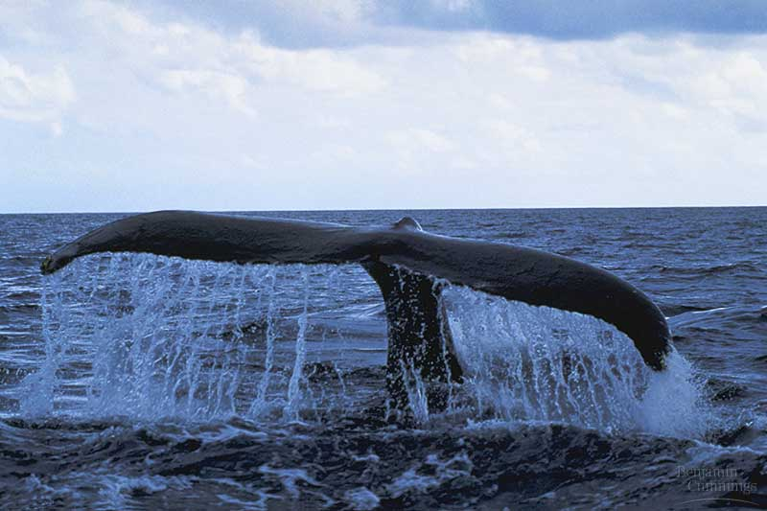
Fats store energy
Long HC chain
  polar or non-polar?
  hydrophilic or hydrophobic?
Function:
  energy storage
    concentrated
      all H-C!
    2x carbohydrates
  cushion organs
  insulates body
    think whale blubber!
Notes:
What happens when you add oil to water
Why is there a lot of energy stored in fats?
• big molecule
• lots of bonds of stored energy
So why are we attracted to eating fat?
Think about our ancestors on the Serengeti Plain & during the Ice Age. Was eating fat an advantage?

Slide 9
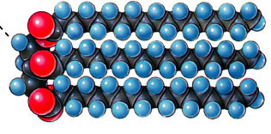
Saturated fats
All C bonded to H
No C=C double bonds
  long, straight chain
  most animal fats
  solid at room temp.
    contributes to
    cardiovascular disease
    (atherosclerosis)
    = plaque deposits
Notes:
Mostly animal fats

Slide 10
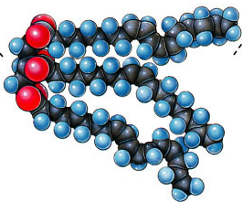
Unsaturated fats
C=C double bonds in
the fatty acids
  plant & fish fats
  vegetable oils
  liquid at room temperature
    the kinks made by double
    bonded C prevent the
    molecules from packing
    tightly together
mono-unsaturated?
poly-unsaturated?
Notes:
Mostly plant lipids
Think about “natural” peanut butter:
Lots of unsaturated fats
Oil separates out
Companies want to make their product easier to use:
Stop the oil from separating
Keep oil solid at room temp.
Hydrogenate it = chemically alter to saturate it
Affect nutrition?

Slide 11
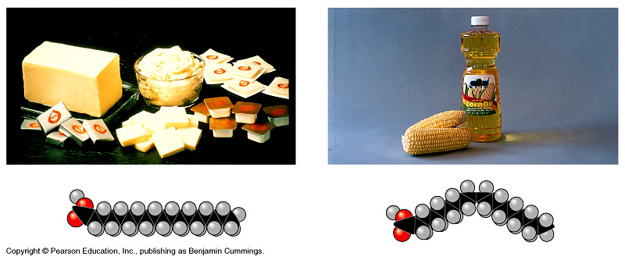
Saturated vs. unsaturated
saturated
unsaturated
✓
Notes:
Most animal fat is saturated fat. Saturated fats, such as butter and lard, will pack tightly together and will be solid at room temperature.
Plant and fish fats are usually unsaturated fats. They are usually liquid at room temperature. Olive oil and cod liver oil are examples.
Peanut butter, margarine, and many other products are hydrogenated to prevent lipids from separating out in liquid (oil) form.

Slide 12
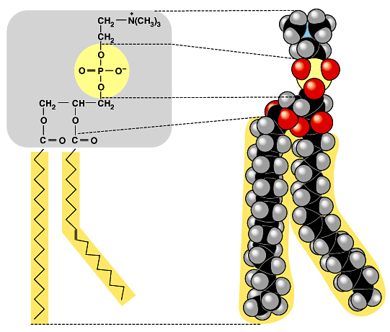
Phospholipids
Structure:
  glycerol + 2 fatty acids + PO₄
    PO₄ = negatively charged

Slide 13
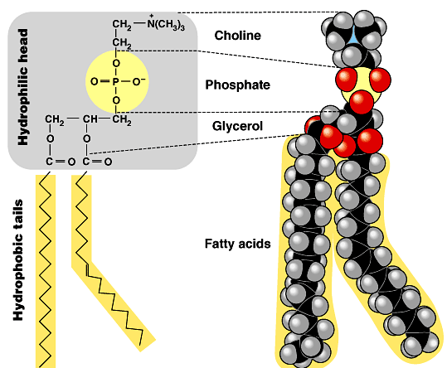
Phospholipids
Hydrophobic or hydrophilic?
  fatty acid tails =
  PO₄ head =
  split “personality”
hydrophobic
hydrophillic
“attracted to water”
interaction with H₂O is complex & very important!
“repelled by water”

Slide 14
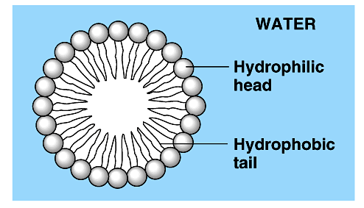
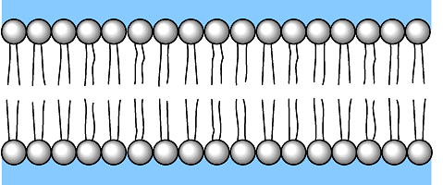
Phospholipids in water
Hydrophilic heads “attracted” to H₂O
Hydrophobic tails “hide” from H₂O
  can self-assemble into “bubbles”
    bubble = “micelle”
    can also form a phospholipid bilayer
    early evolutionary stage of cell?
water
bilayer
water

Slide 15
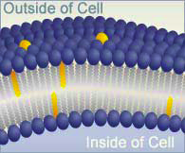
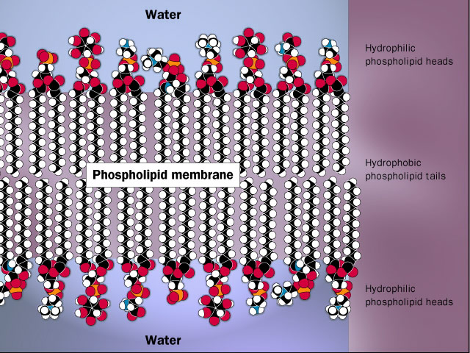
Why is this important?
Phospholipids create a barrier in water
  define outside vs. inside
  they make cell membranes!
Tell them
about soap!

Slide 16
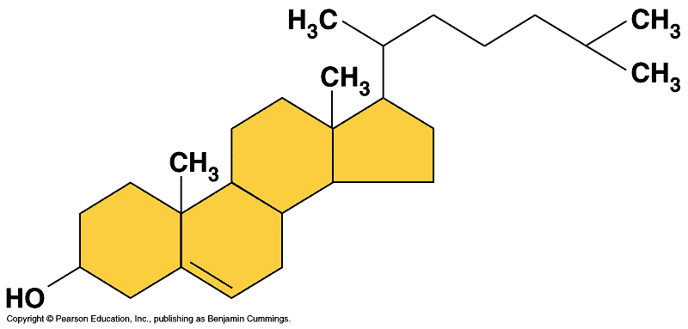
Steroids
Structure:
  4 fused C rings + ??
    different steroids created by attaching different functional groups to rings
    different structure creates different function
  examples: cholesterol, sex hormones
cholesterol

Slide 17
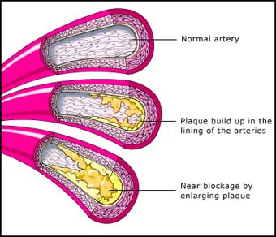
Cholesterol
Important cell component
  animal cell membranes
  precursor of all other steroids
    including vertebrate sex hormones
  high levels in blood may contribute to cardiovascular disease
Notes:
Unfortunately, a high level of cholesterol in the blood can lead to atherosclerosis. This is a heart disease that results when deposits form in the arteries that supply the heart muscle with oxygen. The deposits block blood flow, and a heart attack results. Both saturated fats and trans fats promote higher levels of cholesterol.

Slide 18
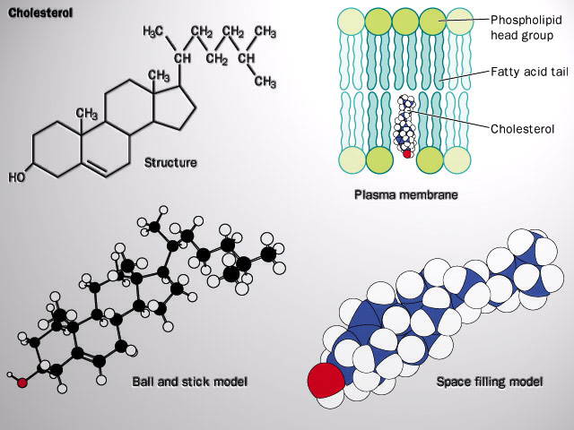
Cholesterol
Important component of cell membrane
helps keep
cell membranes
fluid & flexible

Slide 19

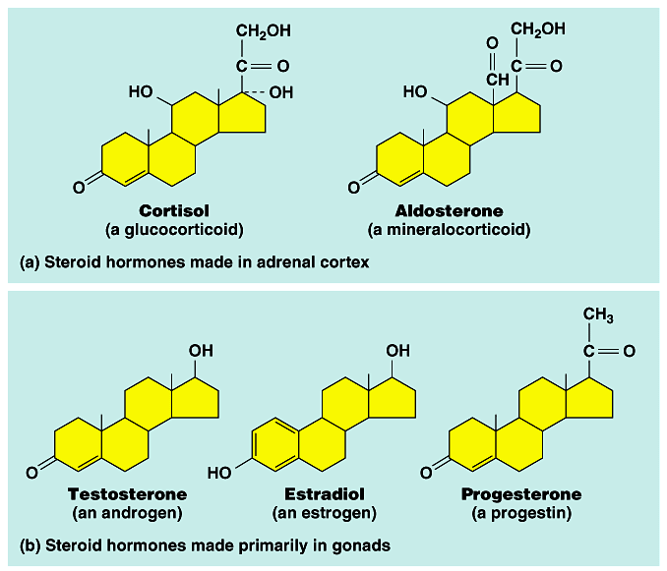
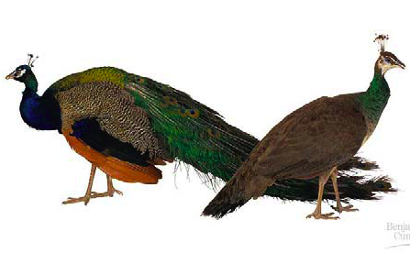
From Cholesterol → Sex Hormones
What a big difference a few atoms can make!
Notes:
Same C skeleton, different functional groups
Aldosterone is a hormone that increases the reabsorption of sodium and water and the release (secretion) of potassium in the kidneys.
Cortisol, also known as hydrocortisone, is a steroid hormone or glucocorticoid produced by the adrenal gland.^{[1]} It is released in response to stress, and to a low level of blood glucocorticoids. Its primary functions are to increase blood sugar through gluconeogenesis, suppress the immune system, and aid in fat, protein and carbohydrate metabolism.

Slide 20
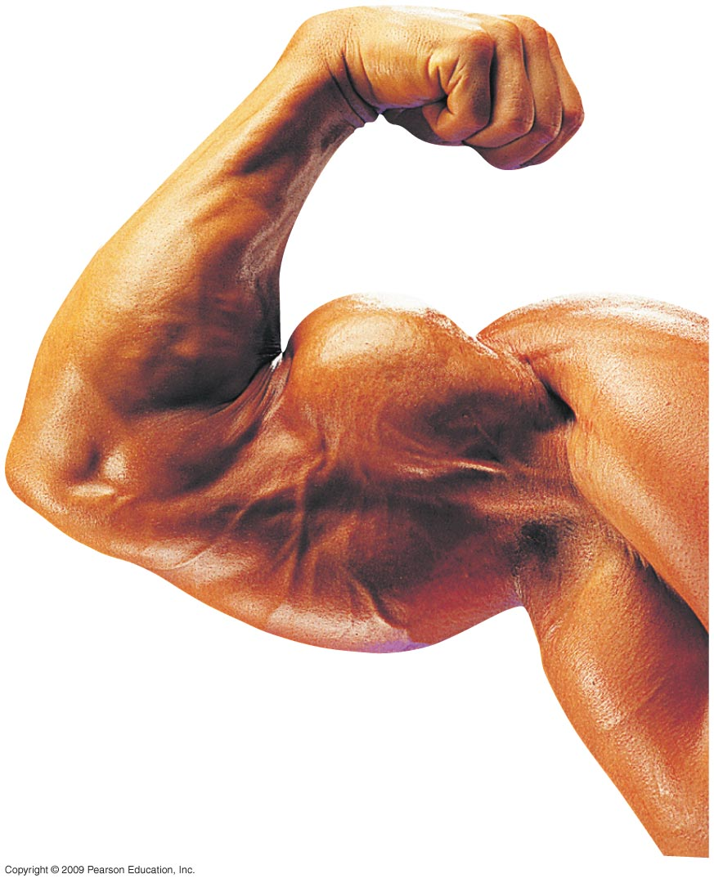
3.10 CONNECTION: Anabolic steroids pose health risks
Anabolic steroids are synthetic variants of testosterone that can cause a buildup of muscle and bone mass
  They can be sold as prescription drugs and used to treat certain diseases
  They may also be abused with serious consequences, such as liver damage that can lead to cancer
Copyright © 2009 Pearson Education, Inc.
Notes:
There are several important adverse consequences to steroid use to gain an athletic edge. Sports organizations and the public have come out against their use as a means to enhance performance. Athletic governing bodies prohibit their use.
The consequences of steroid abuse will likely be of great interest to your students. However, the reasons for the damaging consequences might not be immediately clear. As time permits, consider noting the diverse homeostatic mechanisms that normally regulate the traits affected by steroid abuse.

